Slide 1
Predicting Good and Bad Movies using Storyline
By Yash Gondkar

Slide 2
Motivation
I am an ardent moviegoer
I love watching sci-fi, fantasy, thriller, horror, mystery, and sometimes romantic movies
However not all genres are equally appealing to me and there isn’t any one genre whose all movies appeal to me
I am also a workaholic and spending 2-3 hours of my schedule to watch a boring movie is very painful for me
Not to mention many movies flop these days as we have got accustomed to high quality content that we get on OTT, thanks to COVID

Slide 3
Motivation
It seems this problem has not been tried many times as I was not able to find a good dataset
Tried Kaggle, MovieLens, HydraMovies, and IMDB
Some came close by offering attributes like tag_line, full_summary and plot_keywords, however, none contained detailed storylines
Also, many of them had missing data for fields like budget and revenue, which I will be using for making an automated guess on whether the movie is good or bad

Slide 4
Data Collection
Because of the problems in the aforementioned datasets, I would be creating a scraping script to get storyline, budget and box-office collection
Wikipedia is a good place to start scraping as it has high quality detailed storylines and budget & box-office data are rarely missing
For the list of movies I would be using data collected from TMDB
As an initial automated guess, the script will tag a movie to be good if it has become a ‘hit’
A movie is called a ‘hit’ if it has more than 25% profit margin

Slide 5
Implementation Details
I would be using Python for the scraper and the model
Libraries that I would be using –
Pytorch/Keras for building the model
BeautifulSoup 4 for scraping the data from web pages
I would use a 60/20/20 percentage split for training, validation and test data
I will be using a transformer-based architecture for my model
Will use ADAM optimizer
Also I would use GPU based computations for efficiency- either my laptop’s RTX 2060 MaxQ or the universities GPU based compute clusters

Slide 6
Why Transformer-based Architecture?
A plain neural network checking just checking the presence/absence of words can’t capture the meaning
“Jhon beat Chris in chess” is not the same as “Chris beat Jhon in chess”
Therefore, I need a model that can make sense out of sequential data
Transformers are the state of the art in NLP and are the core building blocks for ChatGPT (GPT for Generative Pre-trained Transformer)
They make sense of sequential data by using something called “Self-Attention”
They were revolutionary because they overcame the vanishing/exploding gradient problems with RNNs (previous SOTA), and their internal operations could also be parallelized

Slide 7
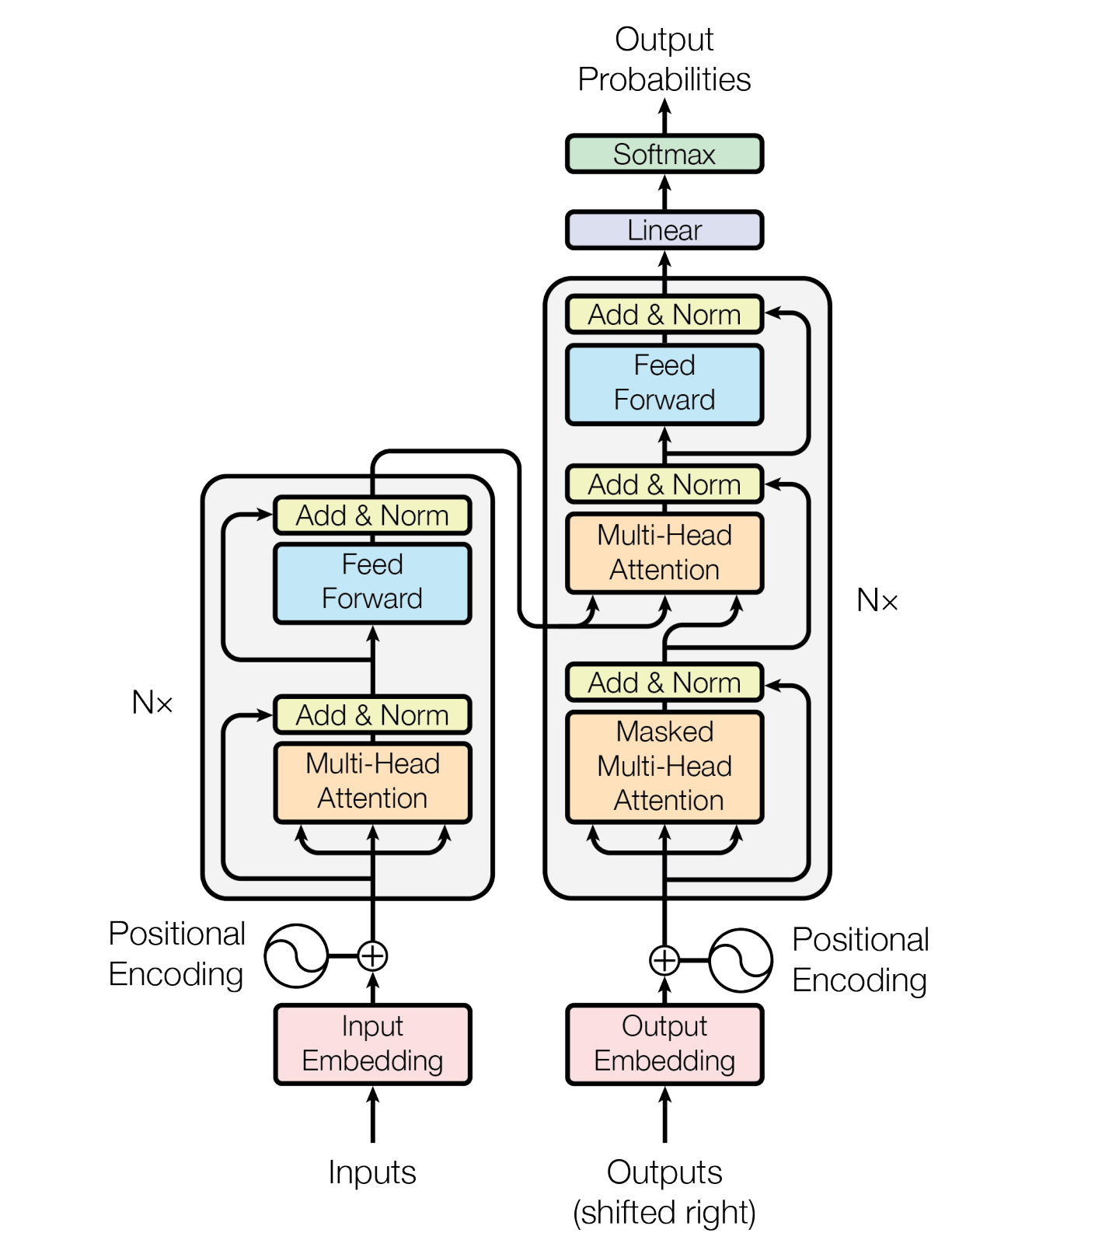
The Transformer - model architecture

Slide 8
Next Steps (Optional)
Train the model on more features like cast, release date, region, writer, director, production house, etc.
Improve the model by feeding video data instead of textual plot
Initially the video data will be either the movie trailer or a footage composed of small parts taken from the movie
Depending on the time and resources I can take it next level by using the entire movie videos
I can also create variants of the model for other tasks-
Box-office collection predictions
Genre prediction
Will the move be offensive for some audiences?
Expected rating

