Slide 1


STRATEGY | SOFTWARE | MANAGED SERVICES
AEROSPACE AND DEFENSE
Nunc congue tristique nibh in vulputate. Sed semper neque in arcu varius egestas
SUSTAINABLE, RESILIENT, COST-EFFECTIVE
END-TO-END DIGITAL TRANSFORMATION

Slide 2
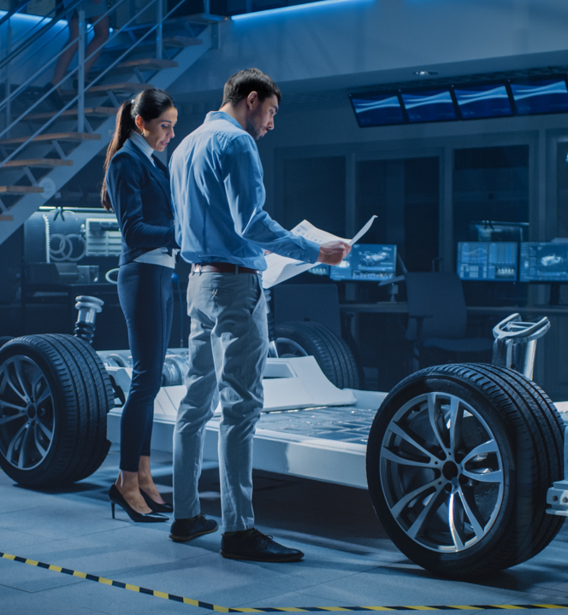
STRATEGY | SOFTWARE | MANAGED SERVICES
AUTOMOTIVE
Nunc congue tristique nibh in vulputate. Sed semper neque in arcu varius egestas
SUSTAINABLE, RESILIENT, COST-EFFECTIVE
END-TO-END DIGITAL TRANSFORMATION

Slide 3

STRATEGY | SOFTWARE | MANAGED SERVICES
CHEMICALS
Nunc congue tristique nibh in vulputate. Sed semper neque in arcu varius egestas
SUSTAINABLE, RESILIENT, COST-EFFECTIVE
END-TO-END DIGITAL TRANSFORMATION

Slide 4

STRATEGY | SOFTWARE | MANAGED SERVICES
CONSUMER PACKAGED GOODS
Nunc congue tristique nibh in vulputate. Sed semper neque in arcu varius egestas
SUSTAINABLE, RESILIENT, COST-EFFECTIVE
END-TO-END DIGITAL TRANSFORMATION

Slide 5

STRATEGY | SOFTWARE | MANAGED SERVICES
ENERGY & UTILITIES
Nunc congue tristique nibh in vulputate. Sed semper neque in arcu varius egestas
SUSTAINABLE, RESILIENT, COST-EFFECTIVE
END-TO-END DIGITAL TRANSFORMATION

Slide 6

STRATEGY | SOFTWARE | MANAGED SERVICES
FINANCIAL SERVICES
Nunc congue tristique nibh in vulputate. Sed semper neque in arcu varius egestas
SUSTAINABLE, RESILIENT, COST-EFFECTIVE
END-TO-END DIGITAL TRANSFORMATION

Slide 7

STRATEGY | SOFTWARE | MANAGED SERVICES
GOVERNMENT & NONPROFIT
Nunc congue tristique nibh in vulputate. Sed semper neque in arcu varius egestas
SUSTAINABLE, RESILIENT, COST-EFFECTIVE
END-TO-END DIGITAL TRANSFORMATION

Slide 8

STRATEGY | SOFTWARE | MANAGED SERVICES
INDUSTRIAL MANUFACTURING
Nunc congue tristique nibh in vulputate. Sed semper neque in arcu varius egestas
SUSTAINABLE, RESILIENT, COST-EFFECTIVE
END-TO-END DIGITAL TRANSFORMATION

Slide 9

STRATEGY | SOFTWARE | MANAGED SERVICES
LIFE SCIENCES
Nunc congue tristique nibh in vulputate. Sed semper neque in arcu varius egestas
SUSTAINABLE, RESILIENT, COST-EFFECTIVE
END-TO-END DIGITAL TRANSFORMATION

Slide 10

STRATEGY | SOFTWARE | MANAGED SERVICES
OIL & GAS
Nunc congue tristique nibh in vulputate. Sed semper neque in arcu varius egestas
SUSTAINABLE, RESILIENT, COST-EFFECTIVE
END-TO-END DIGITAL TRANSFORMATION

Slide 11

STRATEGY | SOFTWARE | MANAGED SERVICES
PRIVATE EQUITY
Nunc congue tristique nibh in vulputate. Sed semper neque in arcu varius egestas
SUSTAINABLE, RESILIENT, COST-EFFECTIVE
END-TO-END DIGITAL TRANSFORMATION

Slide 12

STRATEGY | SOFTWARE | MANAGED SERVICES
RETAIL
Nunc congue tristique nibh in vulputate. Sed semper neque in arcu varius egestas
SUSTAINABLE, RESILIENT, COST-EFFECTIVE
END-TO-END DIGITAL TRANSFORMATION

Slide 13

STRATEGY | SOFTWARE | MANAGED SERVICES
TELE-COMMUNICATIONS, MEDIA & TECHNOLOGY
Nunc congue tristique nibh in vulputate. Sed semper neque in arcu varius egestas
SUSTAINABLE, RESILIENT, COST-EFFECTIVE
END-TO-END DIGITAL TRANSFORMATION

Slide 14

STRATEGY | SOFTWARE | MANAGED SERVICES
TRAVEL & HOSPITALITY
Nunc congue tristique nibh in vulputate. Sed semper neque in arcu varius egestas
SUSTAINABLE, RESILIENT, COST-EFFECTIVE
END-TO-END DIGITAL TRANSFORMATION

