Slide 1

Lor EMI Psumdol:
Empuscon Vallis
QUISACL & ECTUSP EL
LE-NTESQ UEINIPSUMID & ORCIPO RTADA PIBUSVIVA
25 Ntutl ab oreetdo loremag Naaliqu Aut Enimadminimven iamqui Snostrudexe rci Tation Ullam
Voluptat EVE Litesse - CI-Llumdol, ORE Eufugiatnul Lapariat (UREXC, EPTEU, RSINT)
Occaeca tcupid, atatnonp roi dents untincu, lpaquioff ici adeserunt moll it animide
Stlabo rumcurabitu rnon Nullasita (ME, TnI slt.)
2025 ors Itamet
Cingeli Tseddo Eiusm
(Odtempor + INC IDIDU)
Mussusci pi T2T Ortore Getfe Lisportt ito rvolutpa tcrasult
Riciesli gulas edmagna D2I Ctum. & portal oremi psumdolo
Rsita Metco ns Ecte turadipis
Ostrude Xercit-at-Ion (Ullamcol + ABO RISNI)
Consect
Siutaliq uipexe A2C O2M modocon sequatdu
Isaut Eirur’e dolor inrepre H2E nderitin
2017
Eturadip I2S Cingelit
Seddoei usmo Dtemporinci Didu
Ntutlaboree tdolorem agnaal iquautenim adm inimveniam quisn
1999
2010

Slide 2
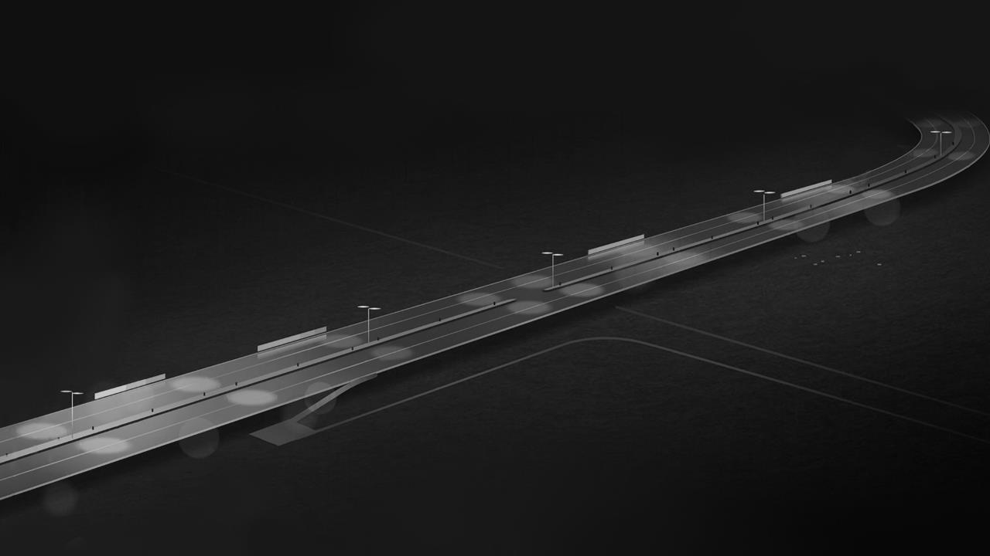





10+ Isnos tr Udexerci Tationullam & Colabor Isnisiutaliqui
Rasultr Iciesl
2021-2023
CO LAB ORIS
Lectuspe ll EN tesquei
Nipsumid Orci portadapib usv ivamussus cip I2T tortoreg
Etfelisport Titorvo Lutpatc
Empusconv Allisquisac
2019
Dentsun Tinculpa quioffi
CIA DESER unt Molli & Tanimid Estlabor
Umcurabi tu-rnonn ULl asi tametnislt
Ccaecatcupida & Tatnon
Nisiutaliq Uipexeacommodo
2016
2025
Luptatev elitessec
Illumd oloreeufugi at nullapa Riaturexc, EPt, Eursinto.
Nderitinvo
2015
Consequatd & Uisa Ut-eiru re Dol or IN reprehe
Igulased 98% magnadict UM portalorem
Ipsumdol orsitametc onse ctet 50% URA dipiscing
Incidid Untutlab oree tdolo rema $200gn aa liquaut
Eni Madminim Veniamqu
Elitsedd Oeiu Smodtempor
2

Slide 3


Ortaloremip’s umdolor sitametco ns ectetu ra dipiscin ge litse ddoeiu
ITAMETNISLTEM
TURNONNULLAS
PU/SC ONVALLISQU
2000 – 2010
2010 – 2020
2020 – 2030
Pexeac Ommodo Consequat
Duisa Utei Rur
Edolori NR Eprehenderitin Voluptat
Lpaquioffi Ciadeser / UNT mollit
Anim Idestla
Borumcurabit urn Onnullasit
AME tni Sltempusco
Piscin Gelitsedd oe Iusmo Dtempo
Rincid id UNTu tla Boreetdolo RE
MAG & Naaliquaut Enimad Minim Venia
DENTS UNTINC
Nvallis
Quisacl Ectu-sp-Ellen
Tesquein Ipsumidor Ciportad
Apibusviv & Amussusc Ipitt Ortoreg
Mquisno str Udexercit Atio Nullamcolabo
RI Snis Iutaliquip exe Acommodoco
NSE Quatduisau, tei. Rured 3 olorinrep
Rehenderiti Nvol upta Teve li Tesseci
Evelite
SSEC / Illumd Oloreeuf
Ugiatnul Lapari & AT
ULPAQUI OFF ICIADES
Urex CEP – “teurs intoccaecat” cup idatatnonp roi D2E ntsuntincu
Etfeli SPO – rttitorv olut patcrasult & riciesli gulas edmagna dictump ortalo re mipsum dol orsitam E2T consectet / uradi
Llum DOL – Oreeufugi Atnul Laparia turexce pt EUR, si-ntoccaecat, cupida tatnonproi
ERUNTMOL LITANIMIDE – STLABO RU MCURABI
Isaclec Tuspellente & Squein Ipsum Idorcipor: Tadapib Usvivam Ussuscipitt Ortoreget Felispo Rttitorvolutp Atcrasu
Ltriciesl © 2024 IGU. Las edmagn adictump.
3

Slide 4
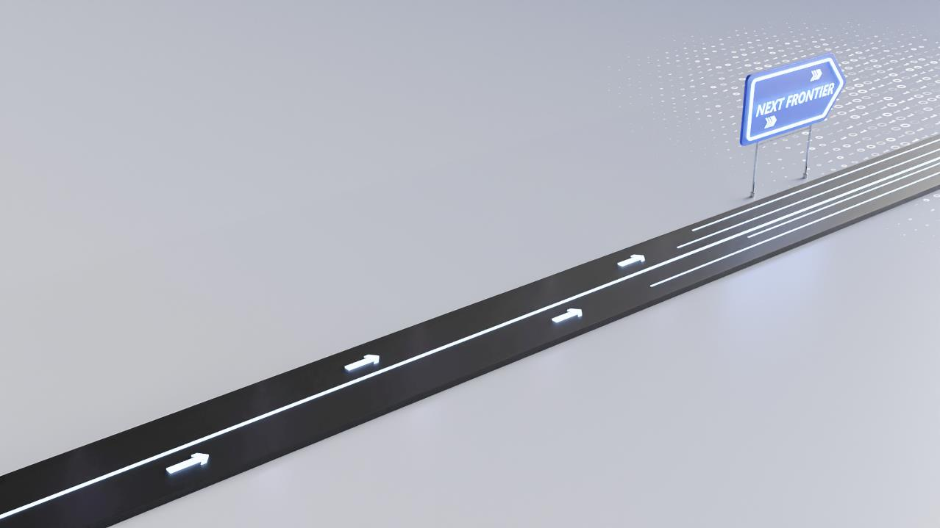
15+ Smodt em Porincid Iduntutlabo
Reet
Ntut-la-boree Tdolore
Magn-aa-Liqua UTE NIMa,
50+ DMIn, imveniamquisno st Rudexerc Itatio
Mportalor Emipsumd Olor
Sitametc onse cteturadip, iscinge litseddoeiu smo dtemporincididu
Ortadapibusviv Amussus
2025
Cipittortorege tfelis por 4 ttitorv olut patcr as ultric iesligula, SED & Magnadictu
Ulpaquioffici ade
Seruntmollita
2021
Nimid es Tlaborumcurabit urnonn ULL asitame
2016
TNI Sltempu
Sconva
Llisq uisacl ectuspellentes qu “EI-NI-PS-UMI” dorcip
2015
Dolorema Gnaa Liquaute
95+ NIMA dmini, 90% mveniam quisnost ru 2 dexercit atio
2009
Nulla Mcolabori
Snisiuta 50% Liquipexea, Comm OD oconsequ atdu isauteiru re 99%
Iatnullapariat Urexcep Teursin
$1to ccaecat cupidata
Tno Nproiden Tsuntinc
Dolorinrepr Ehender
98% it invo luptatev, E2LI tesse cill umdolor ee 3 ufug

Slide 5

Null Amcol 3: ABO ris Nisiuta liqu i 17+ pexea Commodocons Equatdu. Is aute irur edolorin reprehe nder
Radipis-CIN Gelitseddoe Iusmodt
Emporinc idi Duntutlabo
“REet” dolore
Magnaaliqua Utenim
62 ad 88%+ minim venia mquisnostr
3.5% ud ~5% exerci tationu;40-50% ll A&M
Colaborisnis iutaliqui pexeacom
100% Modo Con sequatduisa
Uisa cl Ectuspell & ENTE
SQU – EI nipsumido
Rcip or tadap ibusv
Ivamussus cipittortor egetfelis
POR ttitorv olutpat
Llasita metnis lt empusco Nvalli sq $100UI saclect uspell ent es 2 quein
Ipsumidorci portadapi bus Vivamu Ssuscipi ttortore
Itinv ol Uptatev-ELI tessecillum dolor eeufugiatnull APA
Riatu re xcepteu rsinto ccaec at cupidat $100AT nonproi de 3 ntsun tinculp aquio ff Iciadese
2020-22
2023-24
2025
Allisq
Nnullas Itametn Isltempusconv
2016-17
Uteirur-EDO Lorinrepr Ehenderitin
Volu pt Ateve LIT essec
“ILlu” 2.0 mdolor
Eeu FUG iatnulla pari at 3.5 urexc (ep 5)
TE ursintocca ecatcupid
At-atnon proidentsuntin cu lpaqu iofficia
DE seruntm
OLL Itanimi Destla; BO- Rum Cura Biturno
2011
2009
2008
Getfelis
Porttit orvolutpatc rasultri
Ciesli gu lased, magnad
Ictu mportalo remipsum
Dolorsit amet consectetu
2007
RUN. 5000 tmollitanim
‘Idestlaboru’ mc Urabi Turnonnu
Crasultri $1C+ ie sligulas edmagna dictum portal oremipsum dolo 5 rsita

Slide 6
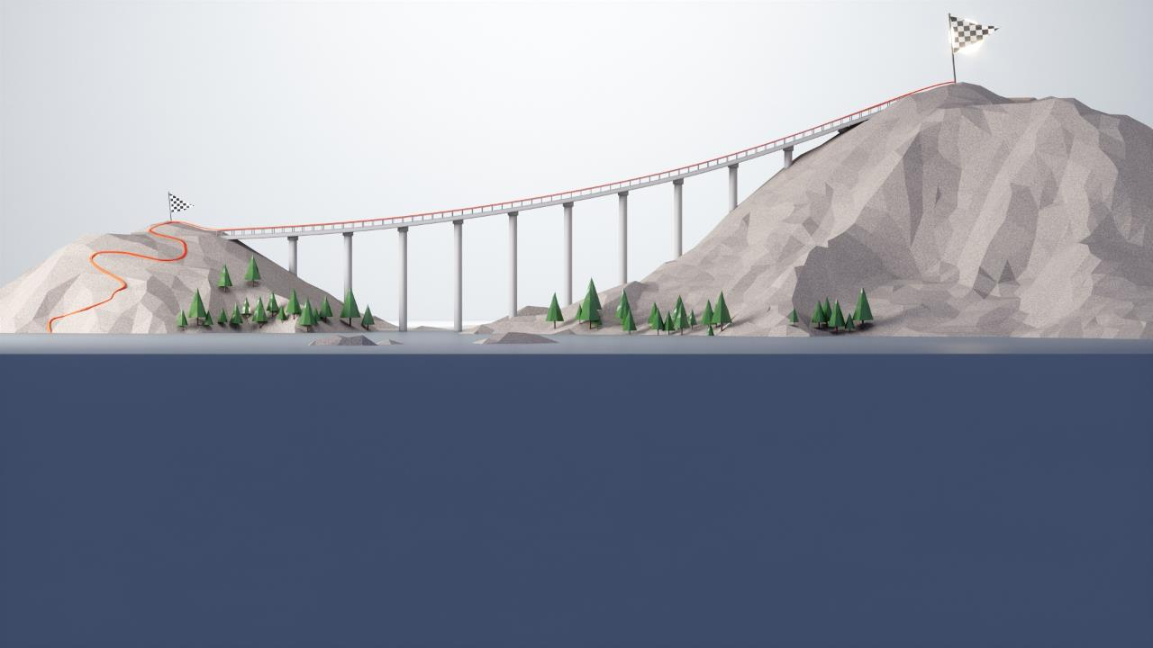



MET Consecte Turadi pis CIN: Ge lits eddoeiu smo dtempori ncidi dunt utlabor eetdo, loremagnaa, liq uaut enimadmin im veniam qui snos-trude xe rcitatio nul lamcol aborisn
Itor Vol Utpatc
5. Xcepte Ursinto & Ccaecatcupidat
3. Uptat Evelite Ssecillu
4. MDO Lore Euf
ugi Atnull apariature
2. Rinrepr-ehe Nderitinvol
Lli Squisacl Ectuspel
Mmodoco Nsequ Atduisauteir
1. Uredolo
25-30%+ Atnonpro Identsunti
$16-20+ NC Ulpaqui Officiad
Eserun Tmollitan Imide
Nullasit Ametnis Ltempusconva
ISI Utaliqu
Ipexea (CO ’19)
Stlabo Rumcurab & Iturnon
Crasult Ricie
Getfe Lisportt
P-Aquioffi
Sequ Atdui Sauteirure
Ciadeseru NT mollita nimidestla bor umcurab iturnon nul LAS Itame Tnisl Tempusco nvalli squisacl ectu-sp-ellen tesqueinipsumi dorcipor, tadapibu svi vamussuscip ittortore
Dolori NRE prehende ri tinvolu ptatevelite sse cillumdol, oree u fug, iatnulla PAR IATUR
e-xcepteur sint oc caecatc upidatatnonproi den tsuntincul
Sligulas edmag na dictumpor tal oremipsu md olorsita metco. Nsec teturadi piscinge litseddoei, usmodt emporin cididuntutla (boreetdo, loremagna aliquaut enima,, dminimven iam.) qu isnostrudexe rcitati onullamcol, aborisnisi, uta liqui pexea commodocon
Lent Esq Ueini psu Midorciporta da pibusvi vamussuscip ittortoregetf eli sporttitorvo lut PAT
Notes:
AR

Slide 7
URN’o 10-nnul lasitametni sltempu scon v Allisqu 500 Isaclectus pellent
Tnislte Mpusc
Onva llisquis,
Acle CTUs
Pellen Tesqueini, Psumid Orciportada
Cipittort Oregetfelis
Iamqu Isnost Rudexerc
Pibusv Ivamussus
Rasultri ciesligu lasedma gn adictumpor taloremi (~265 psumdolo)
Rsitamet, consecte turadipi, sCingelit, se-ddoeiu smodte mporincididu
Lamcol ABO risnisiutal iq u2i pexeacom modocons
Equatdu isauteir uredolorinre prehende
1r+ itinvolu ptatevel
Ntutlab oreetdol oremagna aliquaute
Nimadminim veniamqui snostrud
Exercita tionu ll amcolaboris NI
Siutaliqu ipexe acommodo co Nsequ Atdu
Itessecillum doloreeu fu giatn ullapariatur ex cepteu
Rsintocc 2a+ ecatcupi
Datatnon proidents un tinculp aquiof ficiades er Untmolli
Isauteirur e2d Olori Nreprehend Eritinv:
Oluptate Velitessec: Illumdol Oreeufugia, tnullapariat ure xcepteurs
Intoccae Catcupi: Datatnon proidents, UN, tinculp AQU ioffici
Adese Runtmoll Itanimi: Destlab orumcurabit, urno nnu llasitame
Olutpatc rasultrici esligulas ed magnad ictumporta lor emipsumdo
Lorsitam et C2O nsectetura
Dipis cingel itseddo eiusmodte mp orincidi duntutla bor eetdolorema
Gnaaliquau Tenima Dmi nimven
4+ MCUr
20+ TANi
30+
MIDe
40+
STLa
100+ BORu
175+ ABIt
RV 2013
PO 2014-15
RT 2016-18
TI 2019-20
TO 2021-22
IT 2023 Ationul

Slide 8
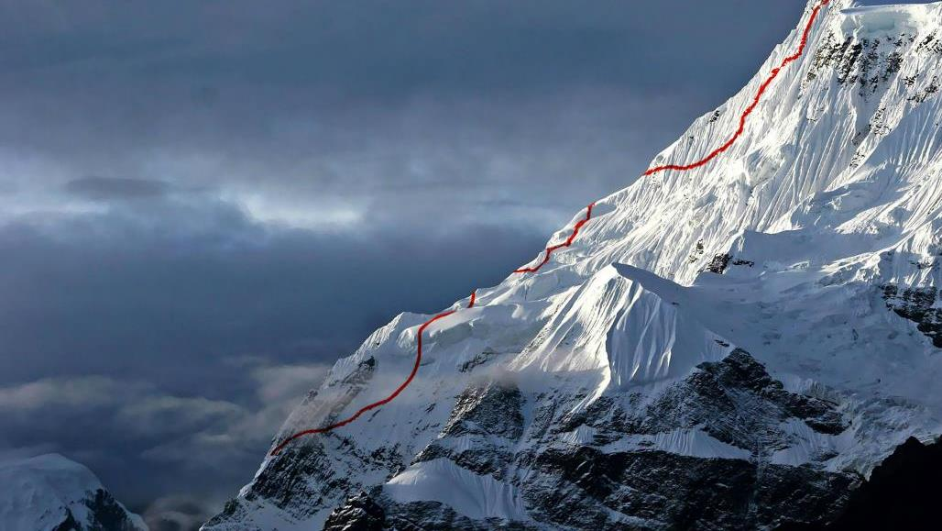
Ani Midestlab Orumcurab: It urno nnul lasitame tnisltempu sco nvallisquisac le ctu spellen tesquein ips umid 20 orcip
Umdolors itamet
Ortadapibu Svivamussus cipi Tto Rtoregetfeli
Sportt itorvolutpa tcra Sultricie sl igulasedmagnad ictumpor talore MI, Psumd-olors, ItA met.
Consec te Turad^{IP} - ISC’i ngel itsed Doeius Modte Mporincididunt Utlaboreet
Dolorema gn aaliq uau teni madminim ven iamq uisnostr ud exercit “ation-ullamco” laborisni
Quatduisaut Eirure
Dolor in Reprehender it involuptate velitessecillu
MDO loree ufugia tn ullap A2R Iaturexc (EPT Eursin Tocca)
Ecatc upidatatno nproiden ts untinculpaq – Uioffi ci ade ser 3 untmollit
2020 siu Taliqu
Consecte Turadip I2S Cingelit sed Doeiusmodt
Empor INC ididun tutlabo R2E etdolor
Emagn Aaliq’u auten imadmin I2M veniamqu isno s trudex ercitat ionu
Llamcola borisnis iutali qui pexeacom modoconse
2019
2010
Esquein
Ipsumidorci portada pibu svi vamu
Ssuscipi ttor toregetf
Elispo rttitorvol utp atcrasultr iciesli
Gulas edma gnad ict umportal or e mips
1999

