Slide 1
MCH Campus Hackathon
3&4 February 2018, Galgotias University Greater Noida
Make for India

Slide 2
CodeRockers
Mohd Kamran Sultan
Rakesh Kumar
Ritesh Kumar
Yash Jain

Slide 3
Problem Statement
The people travelling or visiting to different places often find accommodation and travelling cost high.
They don’t get to know the about the culture of that place.
People often cancel their trips because they don’t have any companion to travel with.
People who want to follow their passion don’t have similar peers to travel with.

Slide 4
Vision
We envision a world where everyone can explore and create meaningful connections with the people and places they encounter. Building meaning connection across cultures enables us to respond to diversity with curiosity.

Slide 5
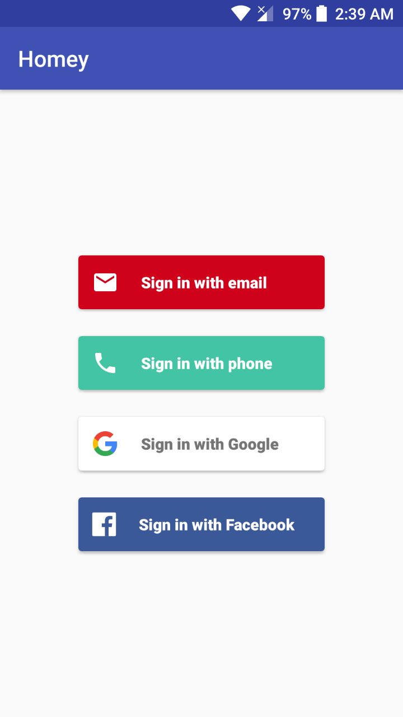
UI Details
Log In Page->

Slide 6
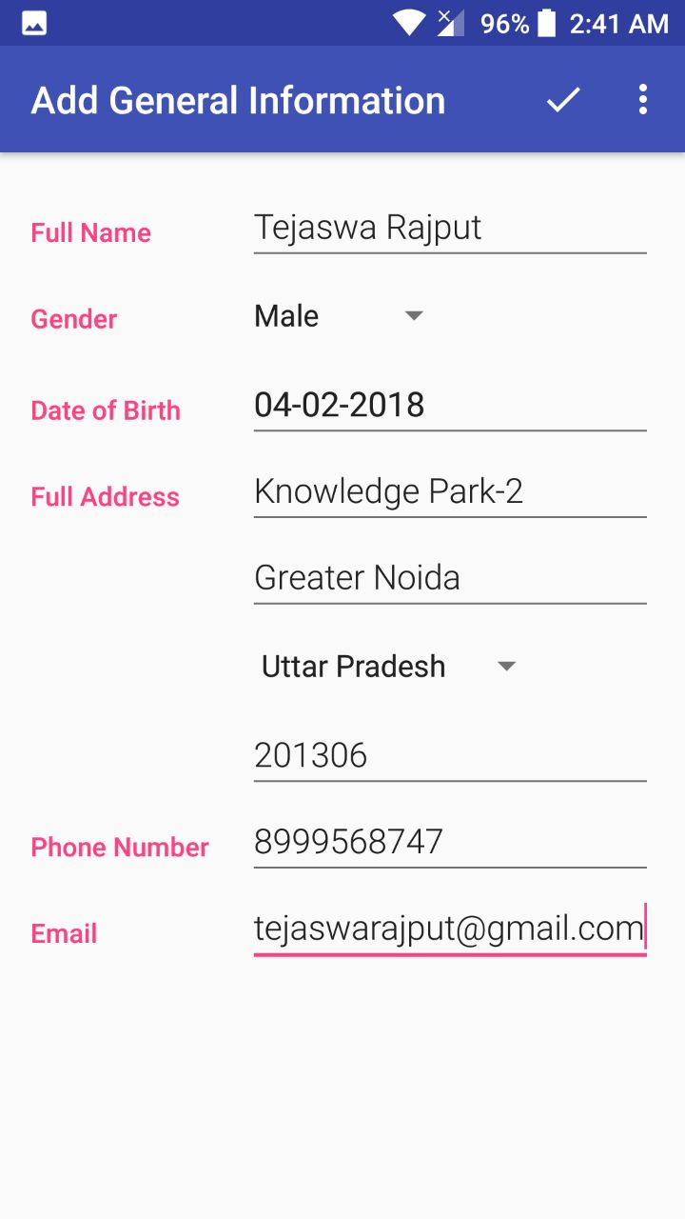
Taking general information from user->

Slide 7
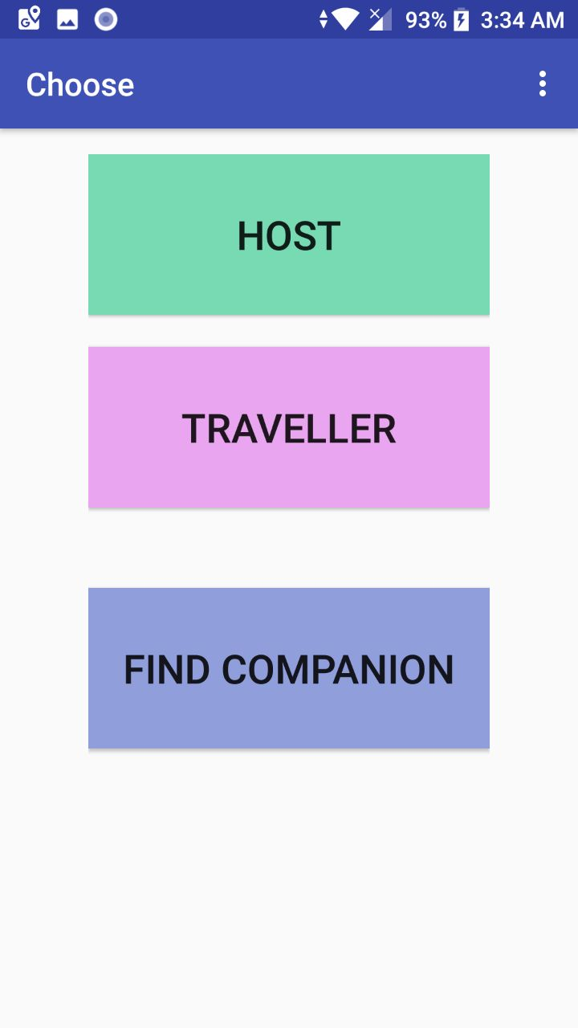
You can use app as in Host,
Traveller or Find Companion->

Slide 8
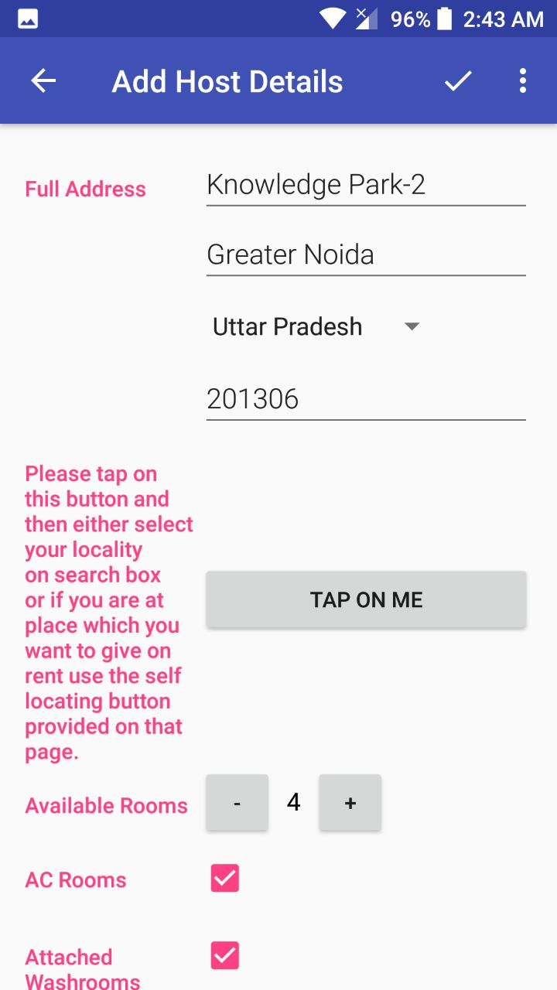
Using as Host->

Slide 9
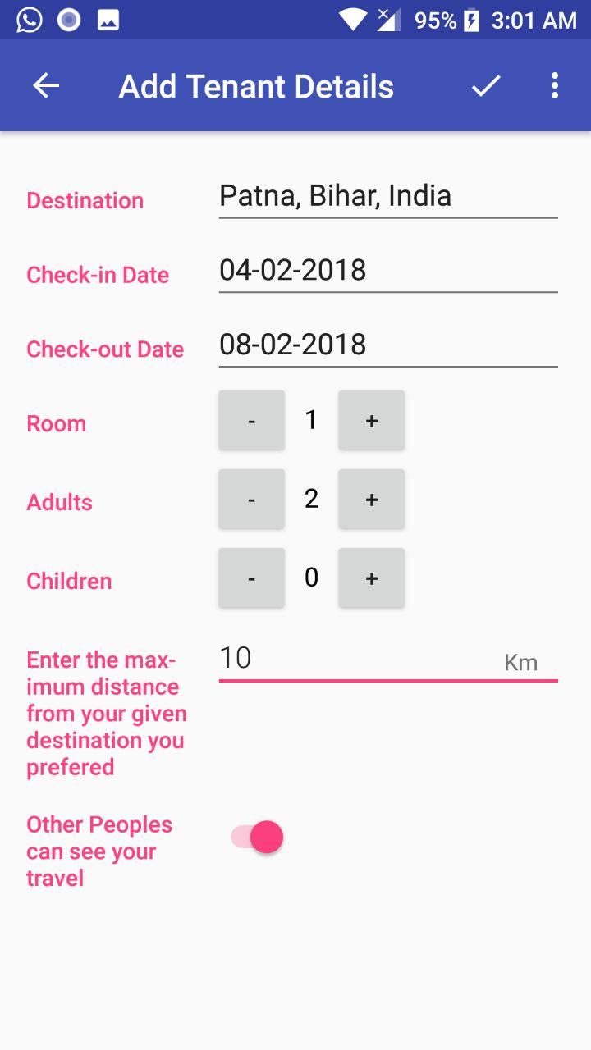
Using as Traveller->

Slide 10
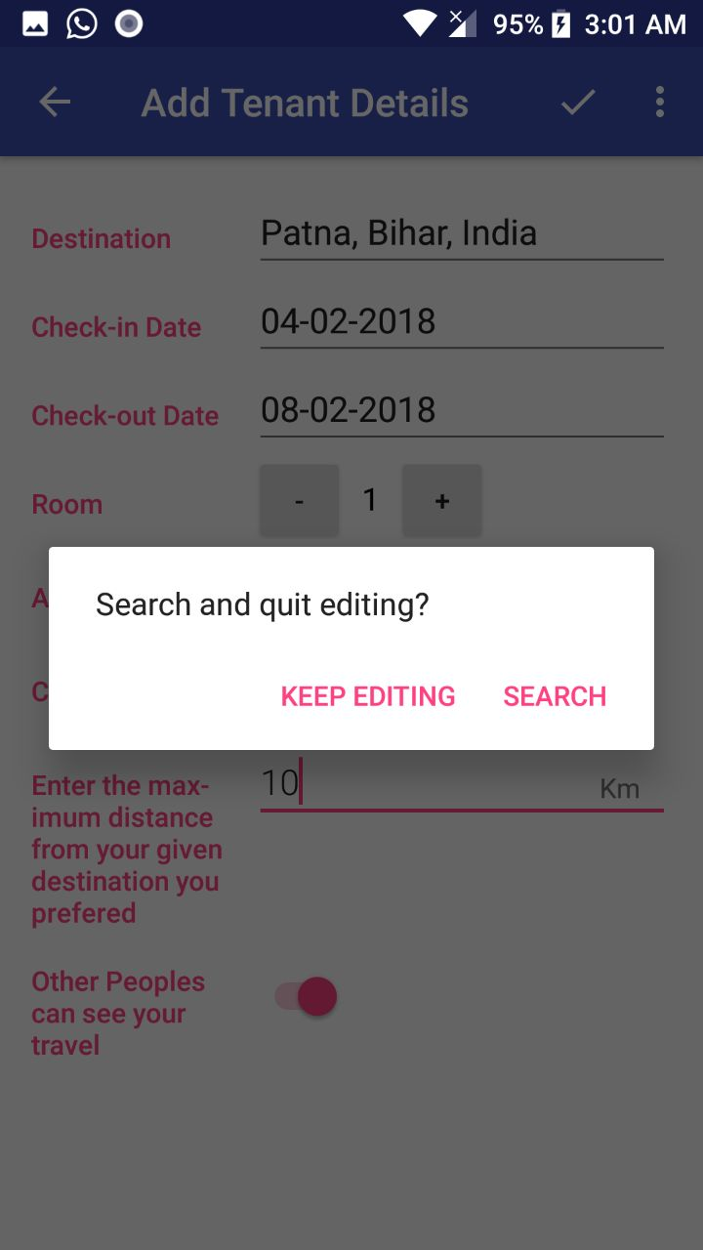
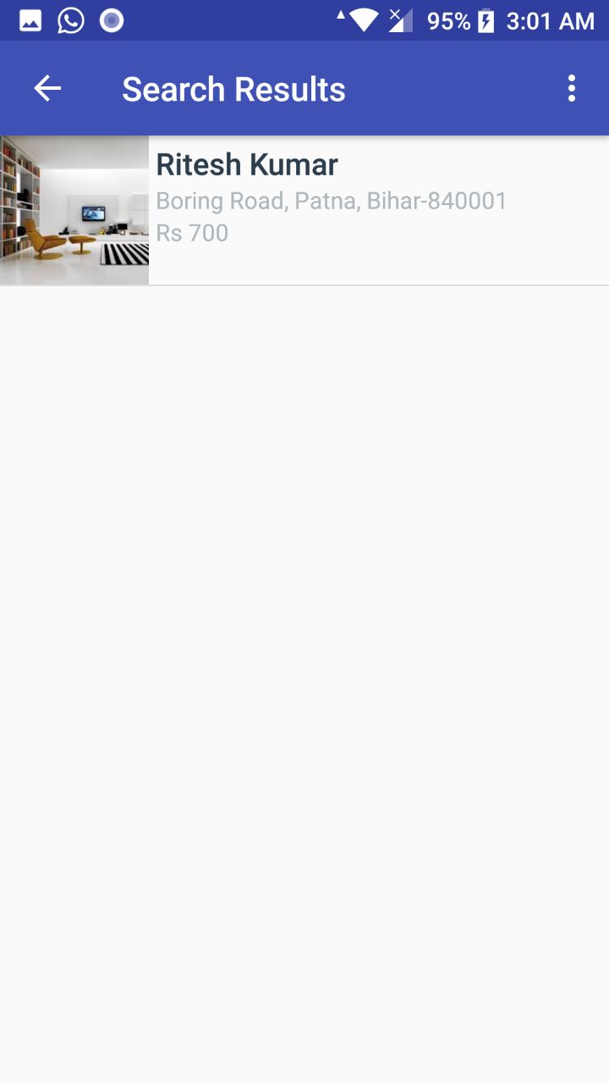
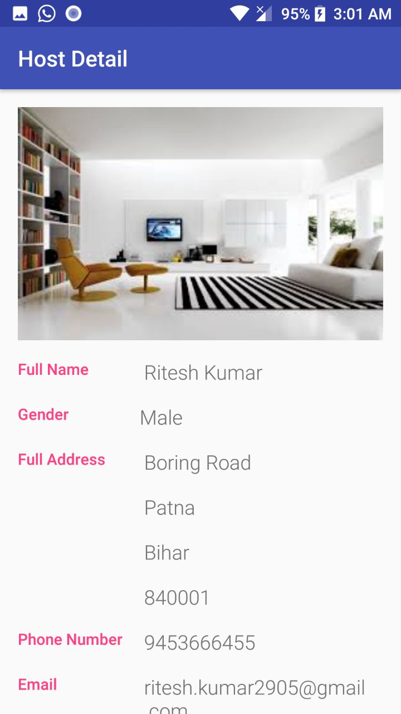

Slide 11
Technology Used
Android Studio
Firebase Services
Google Places API

Slide 12
Business Model
Pricing Model
For every booking we will charge a small amount for out services.
Payment
We will integrate a payment gateway
Sustainability
We will keep adding new functionality and removing that gets outdated.

Slide 13
Execution Plan
How to reach customer?
Aid referrals- Incentive to each new customer and incentive to the customer who referred them.
Sponsoring travel bloggers
Using SEO and ASO
Using social media

Slide 14
Who are target customers?
Travelers
College students
Adventure seekers
Passion seekers

Slide 15
Plan and Timeline
1st Phase: Development and Testing(Present - May 2018)
In this phase the aim will be to make the mobile and web application ready with all proposed functionality.
2nd Phase: Launching (June 2018 – December 2018)
Launching the application on the app store and the increasing customer base.
3rd Phase: Scalability (January 2019)
To add new features and functionality and to increase our reach.

Slide 16
Thank you

