Slide 1
Problem Statement:
DEVELOPMENT & IMPLEMENTATION OF AN INTEGRATED WEB-BASED OFFICE DOCUMENT MANAGEMENT SYSTEM

Slide 2
Common Problems:
The Physical storage and movement of files/documents has many disadvantages.
Chances of missing Files.
Files/Docs may get damages due to natural disasters or an individual’s mistakes.
Possibility of tampering of documents.
Requires peons/attendants for the physical movement of files which induces inefficiency.
Paper wastage, printing expenses .
Requirement of huge spaces for storing files/docs.

Slide 3
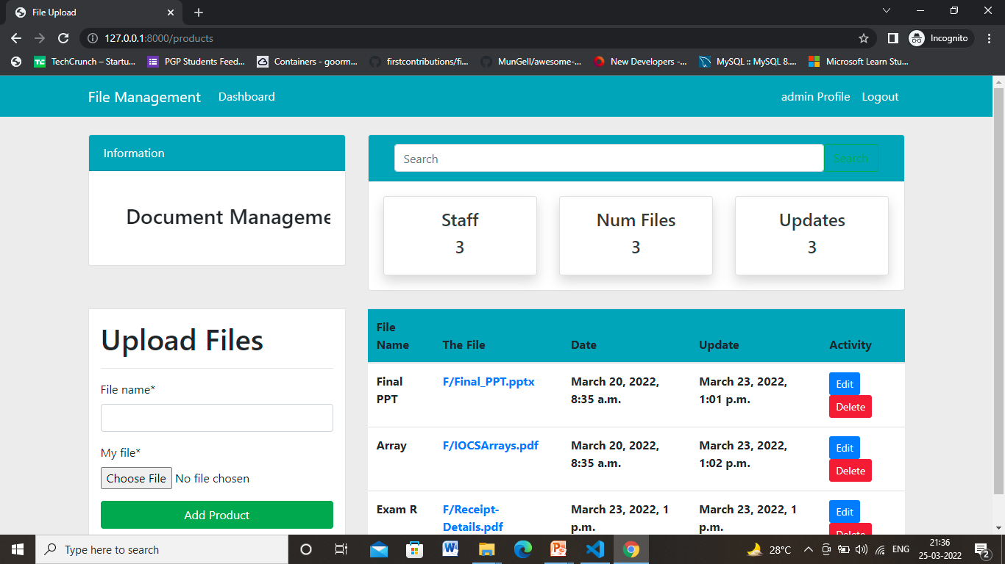

Slide 4
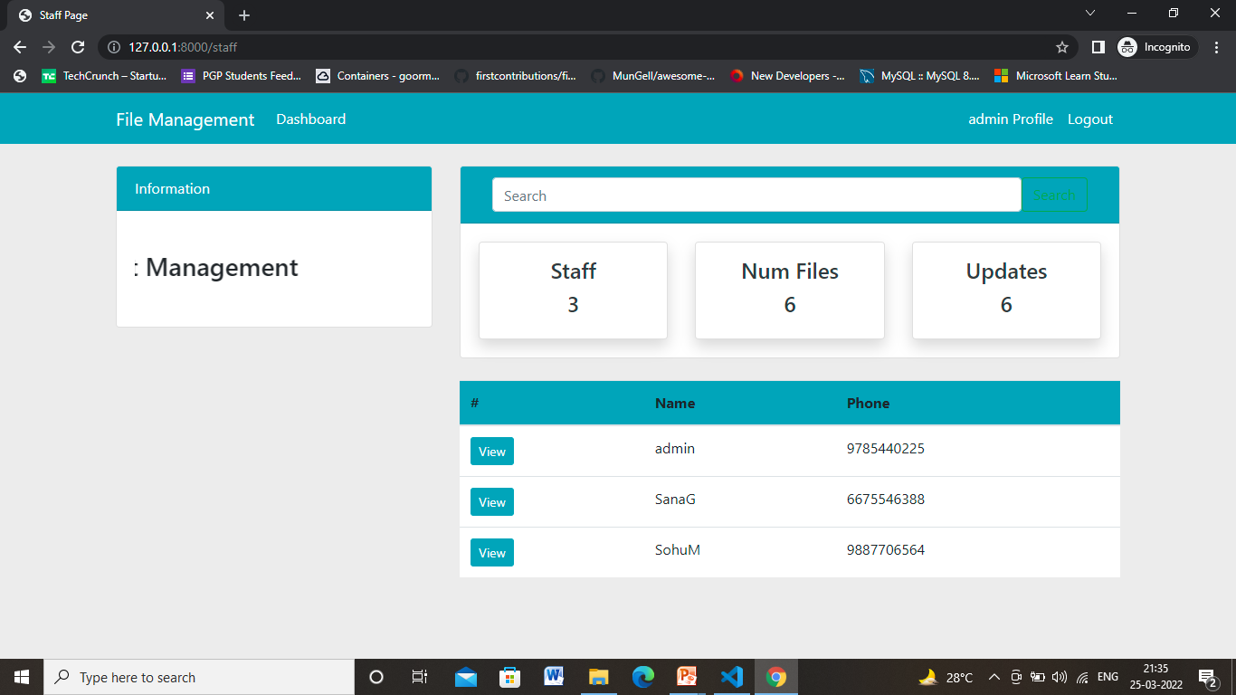

Slide 5
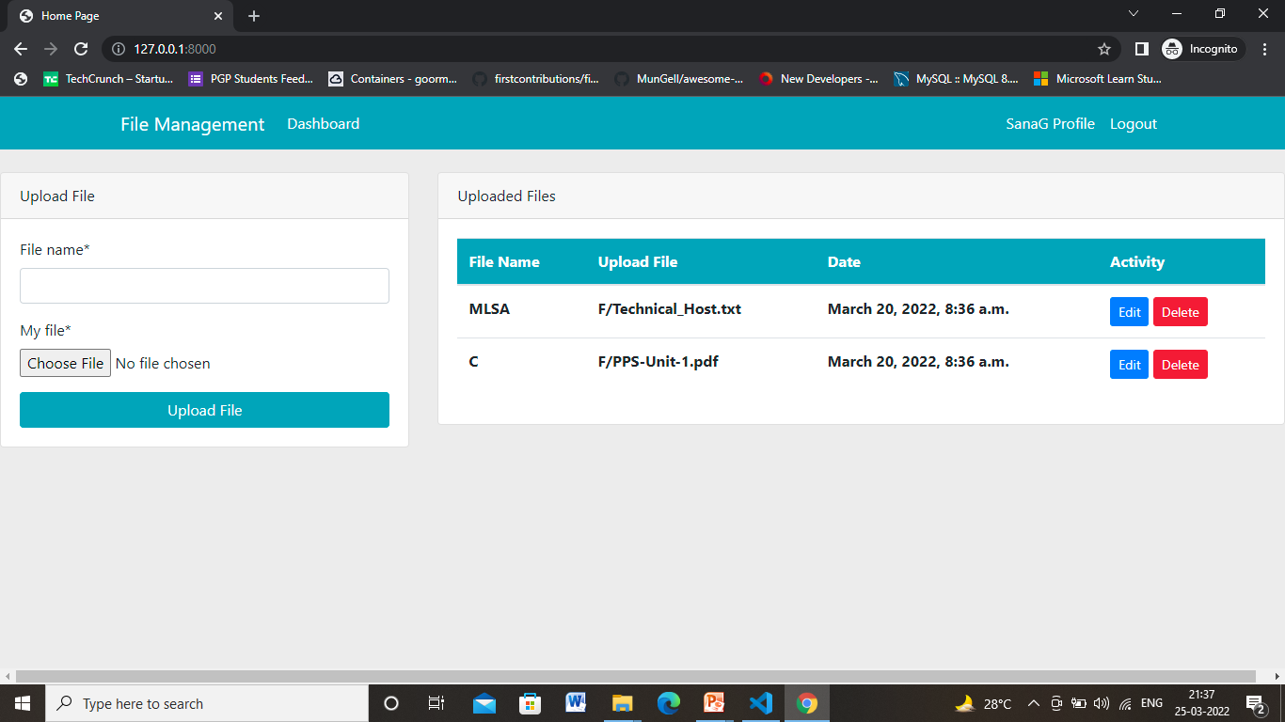

Slide 6
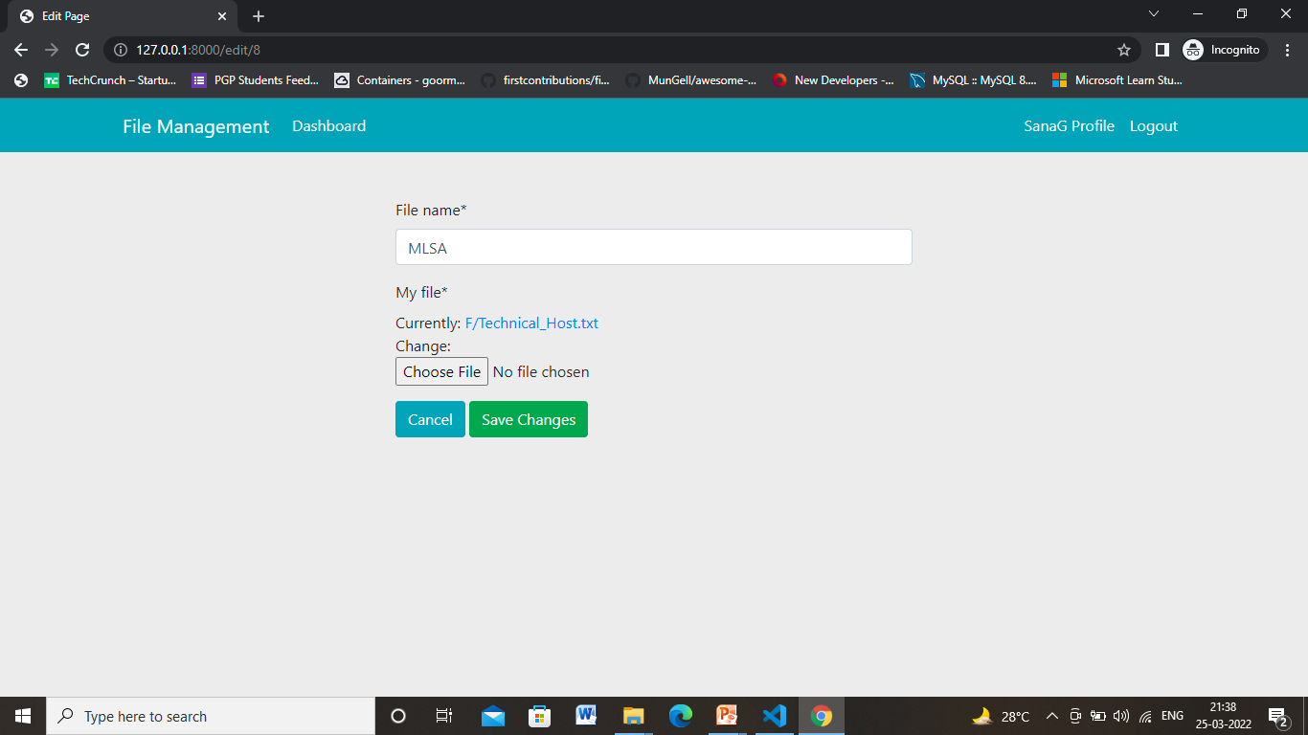
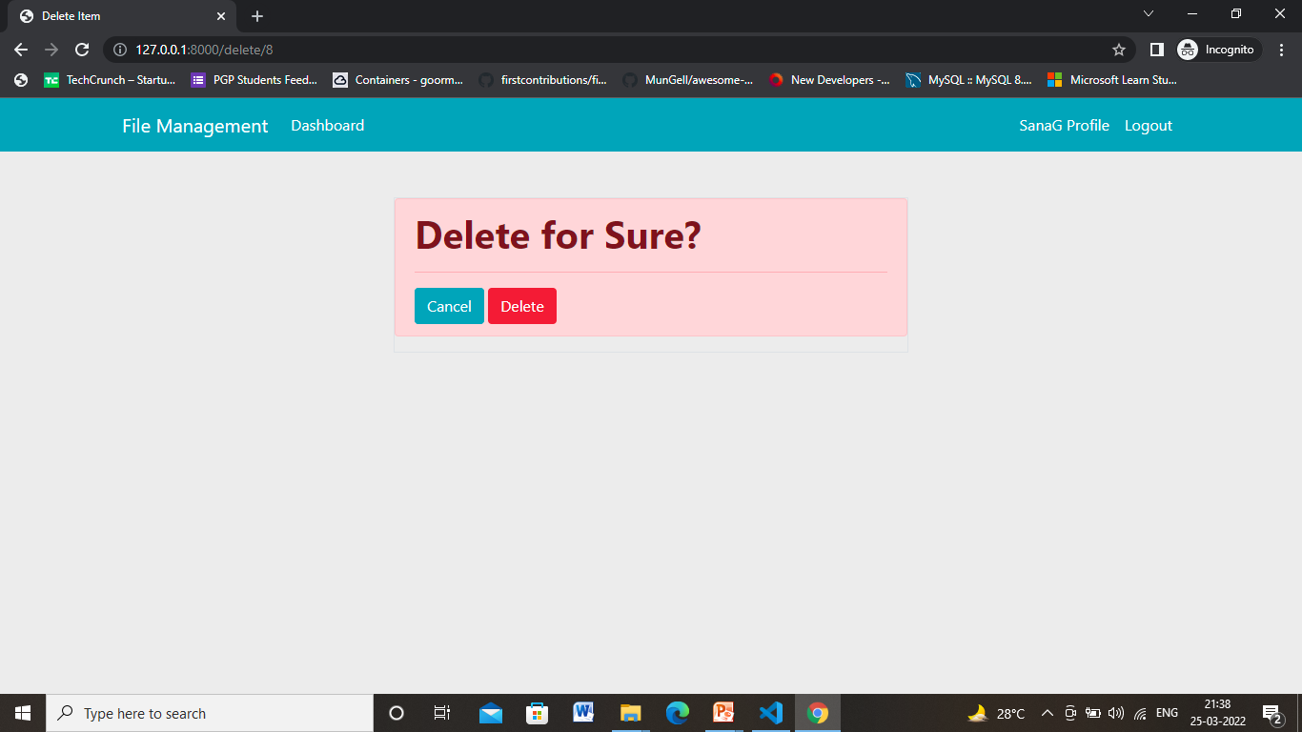

Slide 7
