Slide 1

Basic Details of the Team and Problem Statement
Ministry/Organization Name/Student Innovation:
Ministry of Social Justice and Empowerment
PS Code:
RK761 Problem Statement Title:
Web Based Integrated Document Management System Team Name:
BITCODERS Team Leader Name:
Anumalla Manikanta Institute Code (AISHE):
C-19850 Institute Name:
Hyderabad Institute of Technology and Management
Theme Name: SMART AUTOMATION

Slide 2
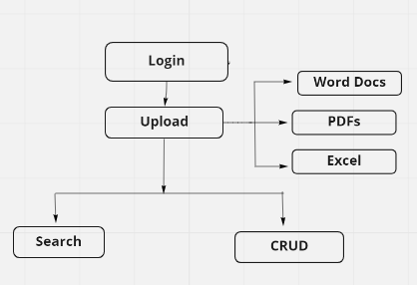
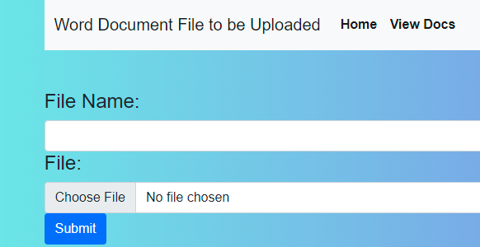
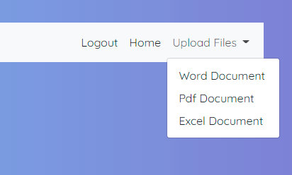
Idea/Approach Details
Describe your idea/Solution/Prototype here:
Allows the User to Upload, Update, Delete and Download Files
User can Upload different Type of Files and Use those files whenever needed.
Describe your Technology stack here:
Python / Django
Html, Css
Bootstrap
SQLite(Database)

Slide 3
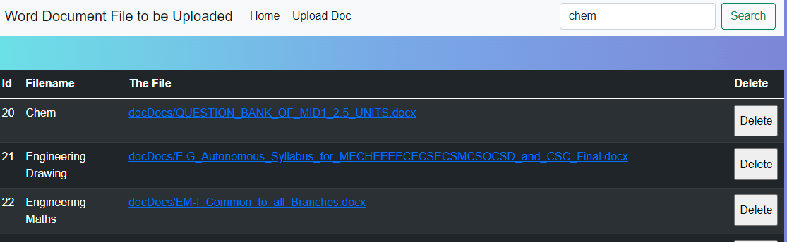
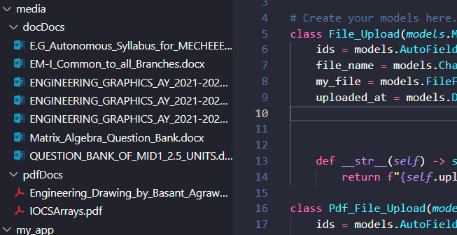
Idea/Approach Details
Describe your Use Cases here
Describe your Dependencies / Show stopper here
Security - No tampering, damaging or misplacing of documents
Powerful Search
Keep a Track of who has Uploaded / Deleted the Documents
Segregation of files

Slide 4
Team Member Details
Team Leader Name: Anumalla Manikanta
Branch (Btech/Mtech/PhD etc): Btech Stream (ECE, CSE etc): CSM Year (I,II,III,IV): I
Team Member 1 Name: Yash Kharche
Branch (Btech/Mtech/PhD etc): Stream (ECE, CSE etc): CSM Year (I,II,III,IV): I
Team Member 2 Name: Doddi Sai Prasad
Branch (Btech/Mtech/PhD etc): Stream (ECE, CSE etc): CSM Year (I,II,III,IV): I
Team Member 3 Name: CH.JAIDEV
Branch (Btech/Mtech/PhD etc): Stream (ECE, CSE etc): CSM Year (I,II,III,IV): I
Team Member 4 Name: Vyalla Anjali
Branch (Btech/Mtech/PhD etc): Stream (ECE, CSE etc): CSM Year (I,II,III,IV): I
Team Member 5 Name: N. Vamsi Krishna
Branch (Btech/Mtech/PhD etc): Stream (ECE, CSE etc): CSE Year (I,II,III,IV): I
Team Mentor 1 Name: Dr. Sugandha Singh
Category (Academic/Industry): Expertise (AI/ML/Blockchain etc): Database Domain Experience (in years): 22
Team Mentor 2 Name: Er Santosh Naik
Category (Academic/Industry): Expertise (AI/ML/Blockchain etc): AI/ML Domain Experience (in years): 5

