Slide 1
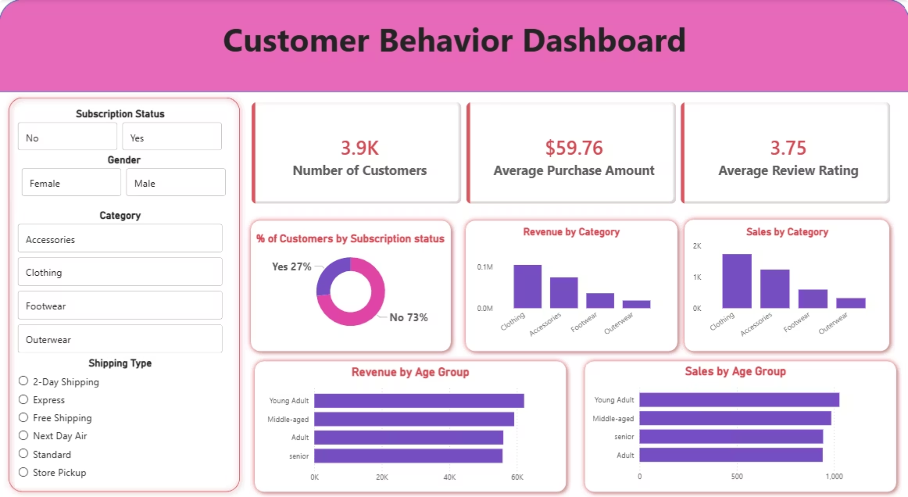
Customer Shopping Behavior Analysis
Uncovering insights from 3,900 purchases to drive strategic business decisions

Slide 2
Dataset Overview
3,900
18
37
Transactions
Features
Missing Values
Purchase records analyzed
Data points per transaction
Review ratings imputed
Customer Data
Purchase Details
Behavior Metrics
Age, gender, location
Subscription status
Previous purchases
Item, category, amount
Season, size, color
Discount applied
Review ratings
Shipping type
Frequency patterns

Slide 3
Python Data Preparation
01
02
03
Data Loading
Exploration
Cleaning
Imported dataset using pandas
Checked structure and summary statistics
Handled missing values, standardized columns
04
05
Feature Engineering
Database Integration
Created age groups and purchase frequency metrics
Loaded cleaned data into PostgreSQL

Slide 4
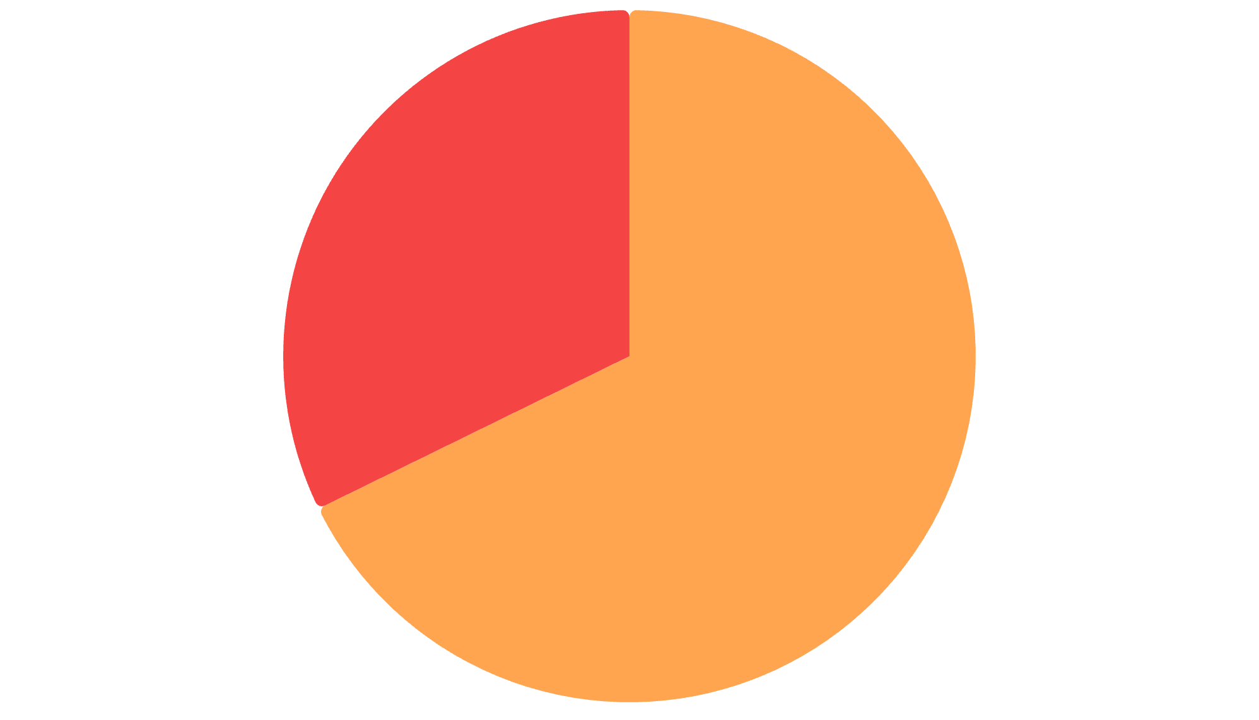
Revenue by Gender
Female
Key Finding
Male customers generate 2.1x more revenue than female customers
Understanding this gap can inform targeted marketing strategies
Male

Slide 5
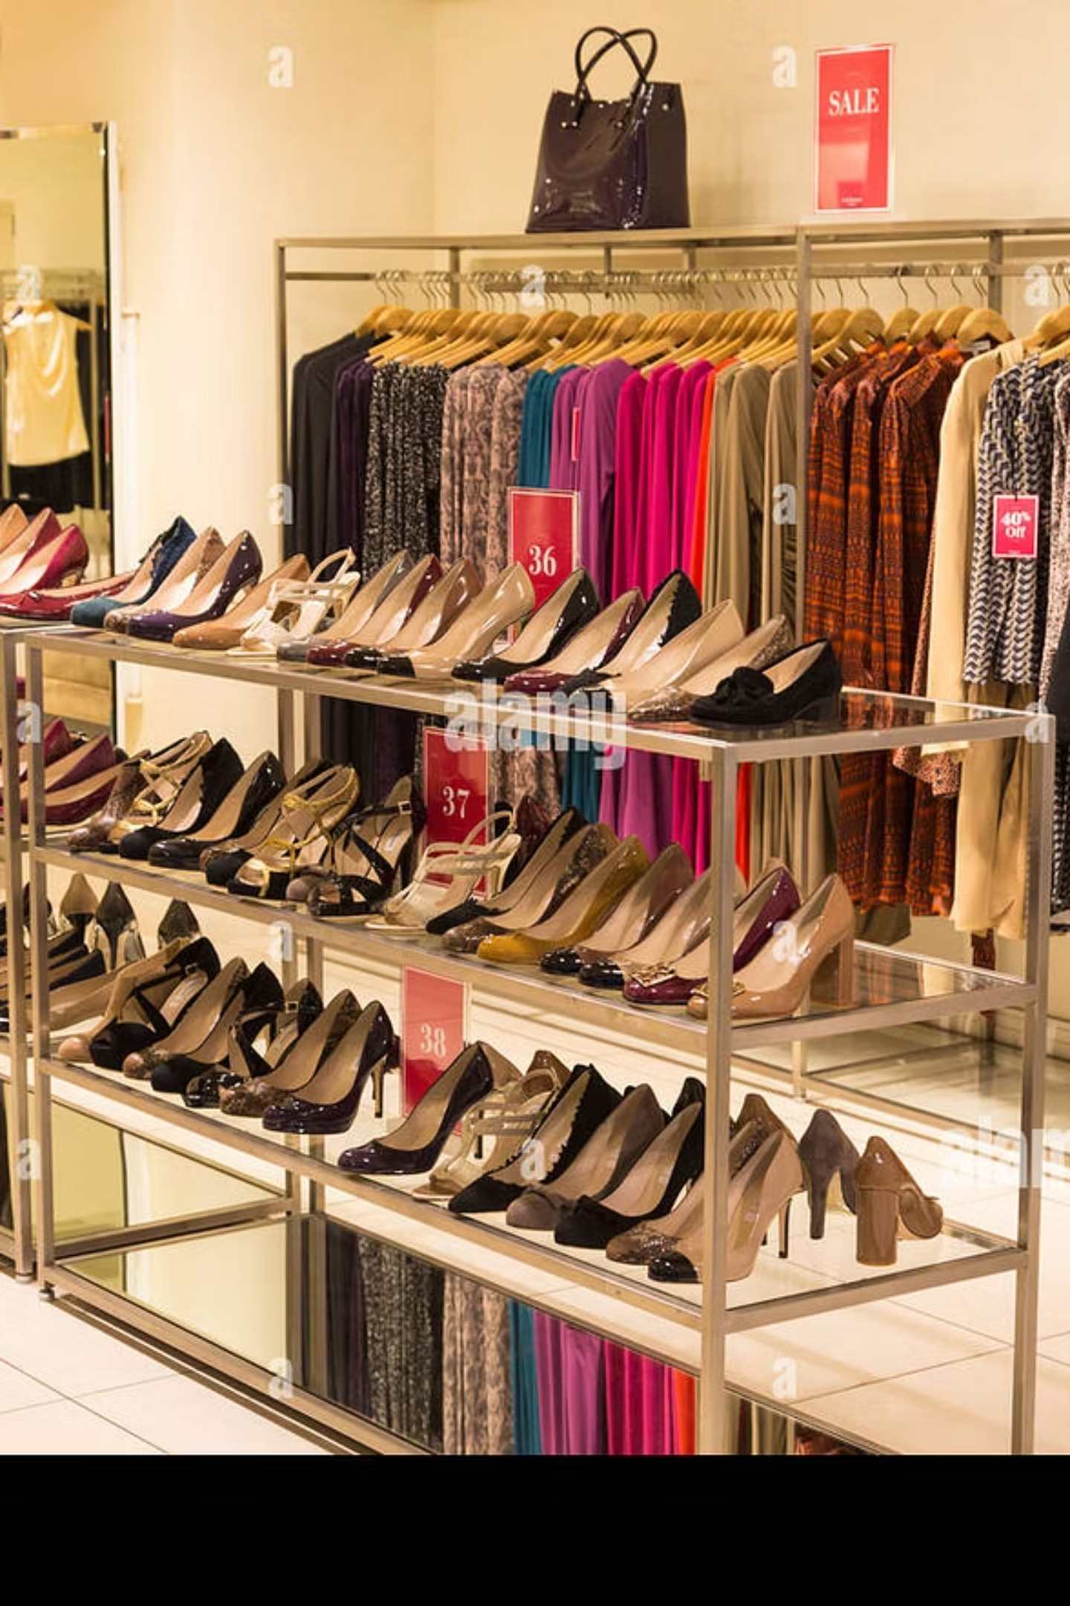
Product Performance Insights
Top Rated
Discount-Driven
Gloves, Sandals, Boots lead in customer satisfaction
Hats, Sneakers, Coats see highest discount usage
Best Sellers
Blouse, Pants, Jewelry top purchase volume

Slide 6



Customer Segmentation
79%
18%
2%
Loyal Customers
Returning
New
3,116 repeat buyers
701 customers
83 customers

Slide 7

Shipping & Subscription Analysis
Shipping Type Impact
Subscription Status
Standard: $58.46 avg
Express: $60.48 avg
2% higher spend with express
1,053 subscribers
2,847 non-subscribers
Similar avg spend ($59.49 vs $59.87)

Slide 8
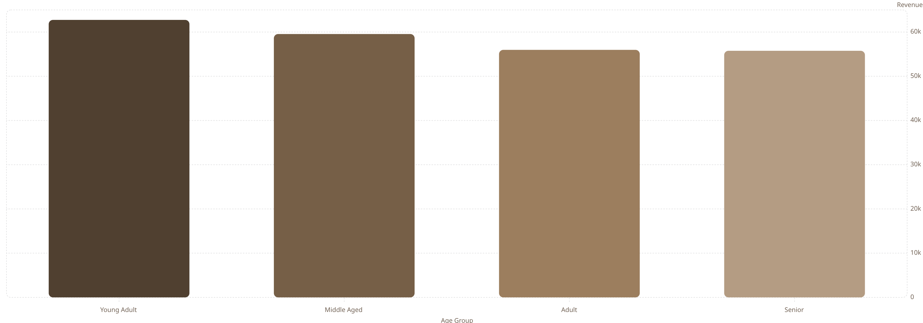
Revenue by Age Group
Young adults drive highest revenue, followed by middle-aged customers

Slide 9

Key Business Insights
High-Spending Discount Users
839 customers used discounts while spending above average
Repeat Buyers & Subscriptions
958 repeat buyers; 2,518 non-repeat customers
Top Categories
Clothing leads in both revenue and sales volume

Slide 10




Strategic Recommendations
Boost Subscriptions
Promote exclusive benefits to increase subscriber base
Customer Loyalty Programs
Reward repeat buyers to move them into loyal segment
Review Discount Policy
Balance sales boosts with margin control
Targeted Marketing
Focus on high-revenue age groups and express shipping users

