Slide 1
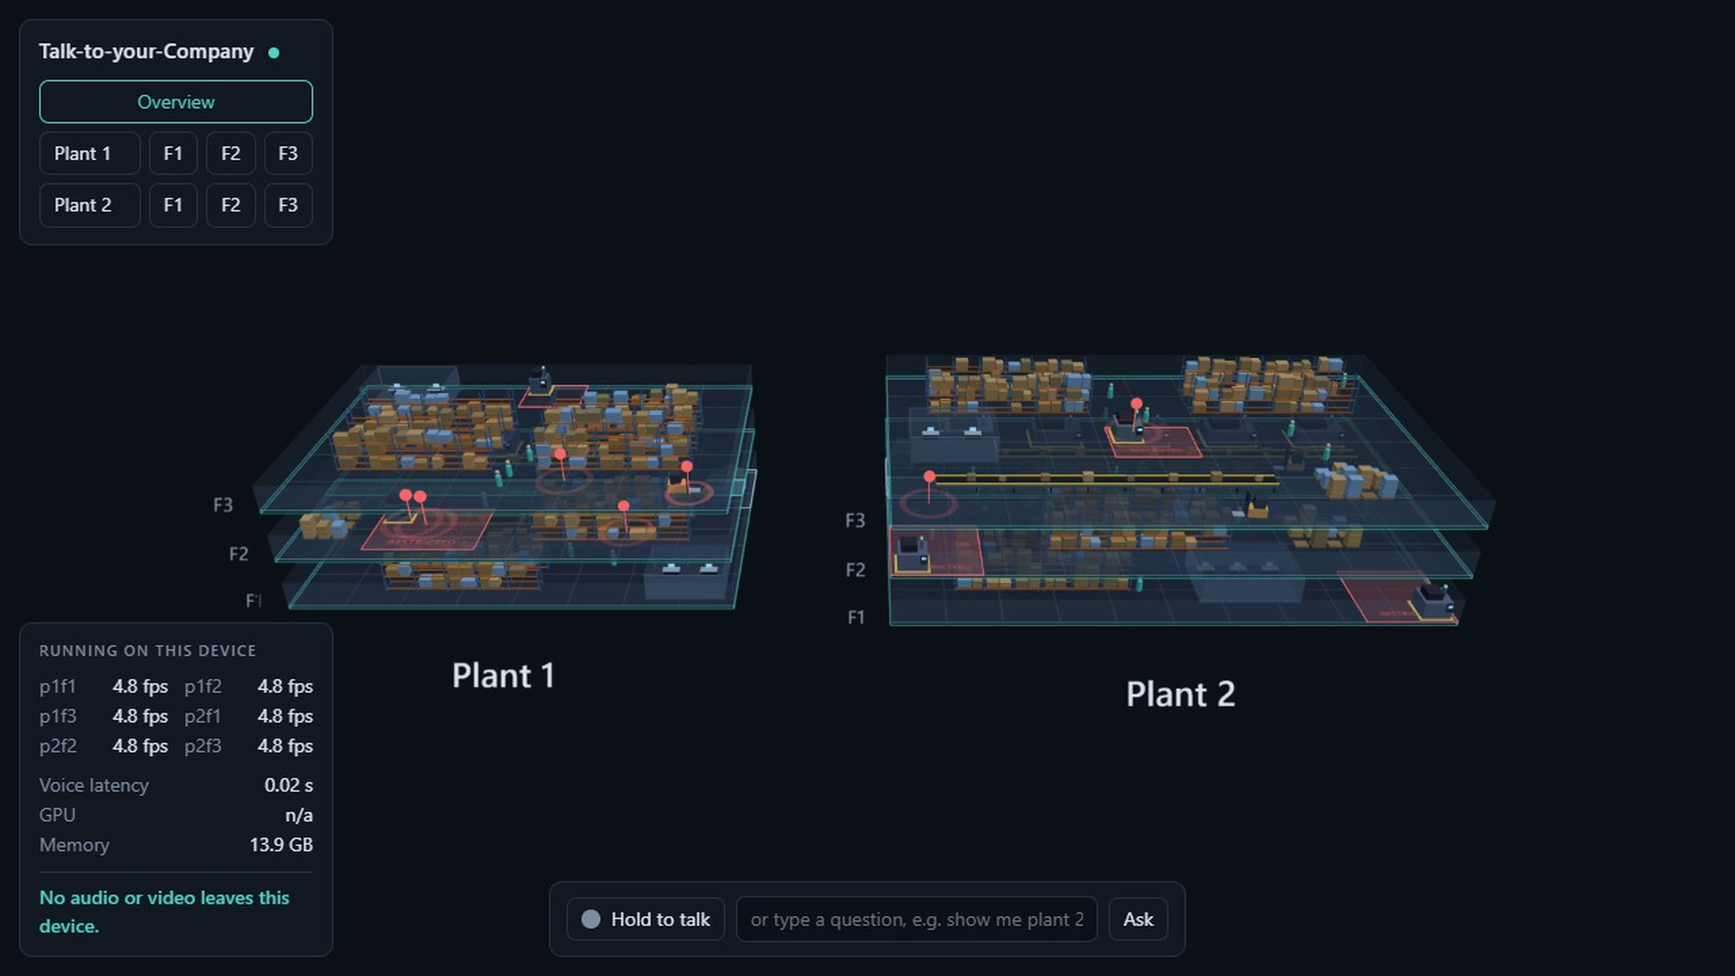
Talk-to-your-Company
A live 3D twin of your plants that you can talk to, built for one NVIDIA Jetson Thor
Yash Kavaiya · Globant Physical AI Hackathon · October 2026
Notes:
Open on the twin. One sentence: a live 3D twin of two plants that you talk to, built to run on a single Jetson Thor.

Slide 2
The problem
SECTION 1

Slide 3
Safety events go unseen because nobody can watch every camera
1
Events go unreported
Near-misses, people in restricted zones and missing helmets slip by.
THE NEED
One view of the whole site, and a way to ask it things.
2
Simple questions are slow
“What is happening on floor 3?” means walking there or calling someone.
3
Camera walls do not answer
They show video. They cannot be asked anything.
4
Cloud video is a poor fit
Sending factory video off site is slow, costly and often not allowed.
Notes:
The manager is always looking at the wrong screen. Four pains, then the need.

Slide 4
A live 3D twin of your company that you can talk to.
Ask by voice. The twin flies to the right floor, shows what the cameras see, and answers out loud.
Notes:
The whole idea in one line.

Slide 5
What it does
SECTION 2

Slide 6
Both plants and all six floors are live in one view
Every person and vehicle the cameras see is a marker on the right floor.
2 plants, 3 floors each, 6 cameras
Positions update 5 times a second
Pulsing red markers for safety events
Notes:
This is the simulated site in the screenshot: smooth, and identical in behaviour to the real pipeline.

Slide 7
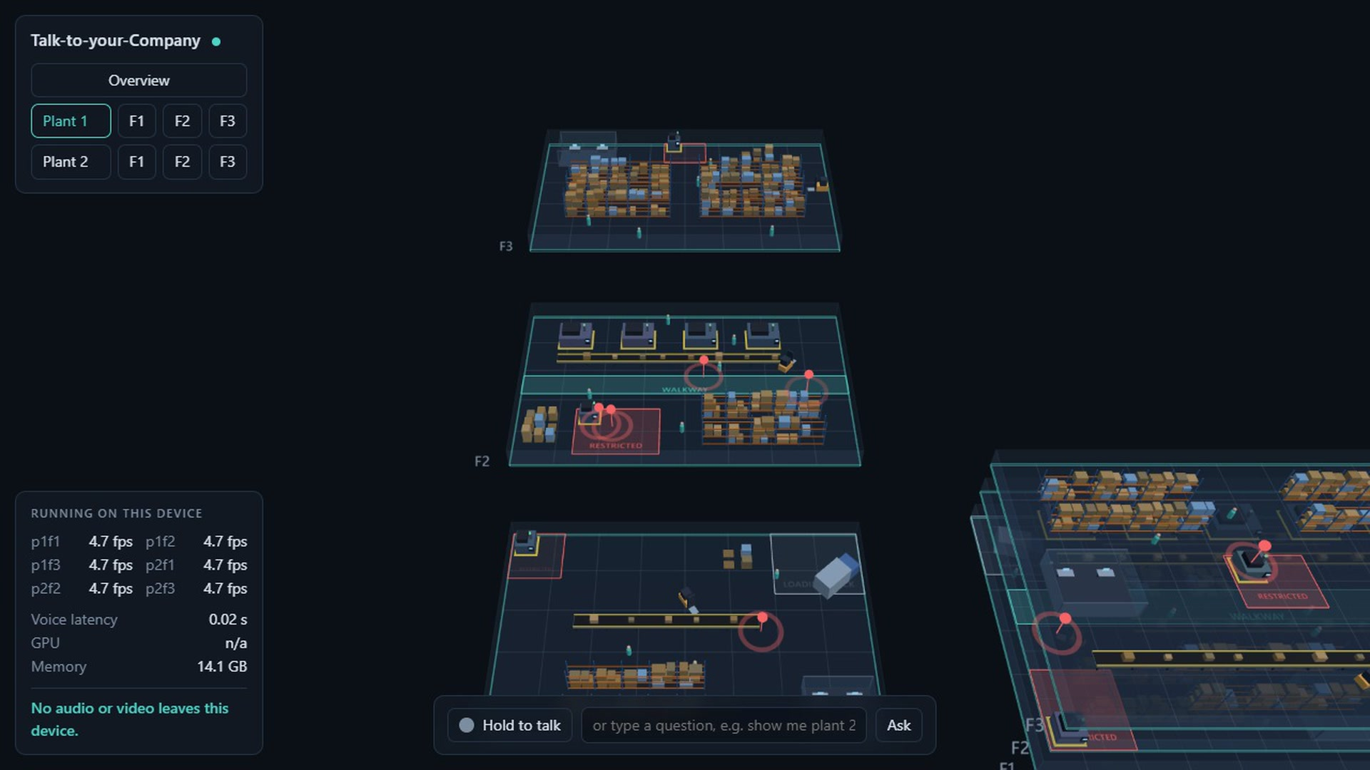
The whole site is generated from one configuration file
Select a plant and its floors spread apart to show what is inside.
Plants, floors, cameras and zones
Conveyors, racks, machines, pallets, offices
Change the file and the twin, the rules and the assistant all follow
Notes:
Nothing about the layout is in code. A new site is a new YAML file.

Slide 8
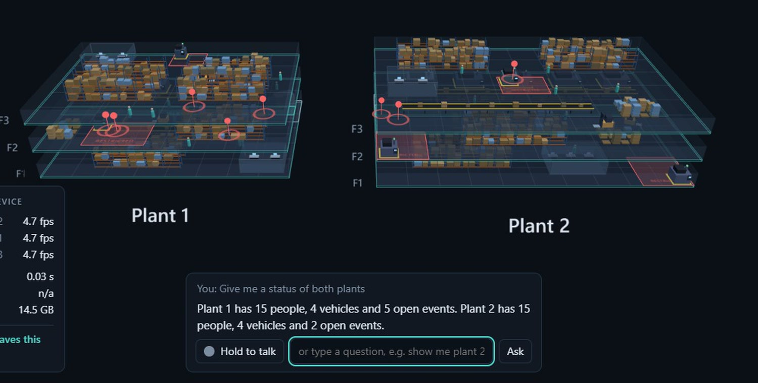
You ask in plain language, by voice or by text
The answer is spoken, shown as text, and drives the twin.
“Give me a status of both plants”
“Show me Plant 2, floor 3” moves the camera there
Out-of-scope questions get an honest “I can’t see that”
Notes:
Hold to talk, or type. The assistant must call a tool before stating any fact about the site.

Slide 9
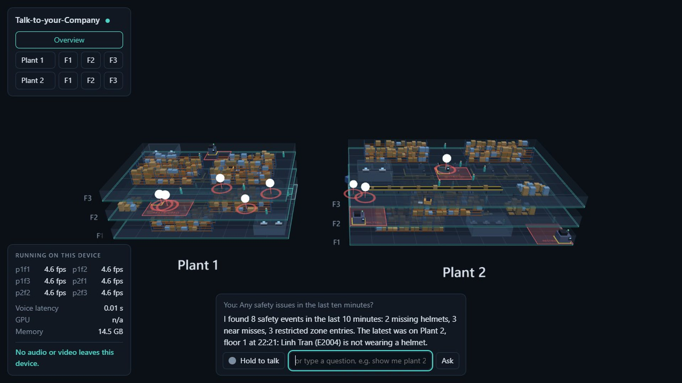
Four rules turn tracks into safety events on the right floor
Event | Raised when
Near miss | a person is within 2 m of a closing forklift
Restricted zone | a person stays inside for over 2 s
No helmet | the vision check on a person says no
Crowding | more than 4 people are within 3 m
Events are stored and can be asked about by plant, floor, type and time.
Notes:
Rules are plain functions over tracks, unit-tested. Same-person repeats are debounced for 30 seconds.

Slide 10
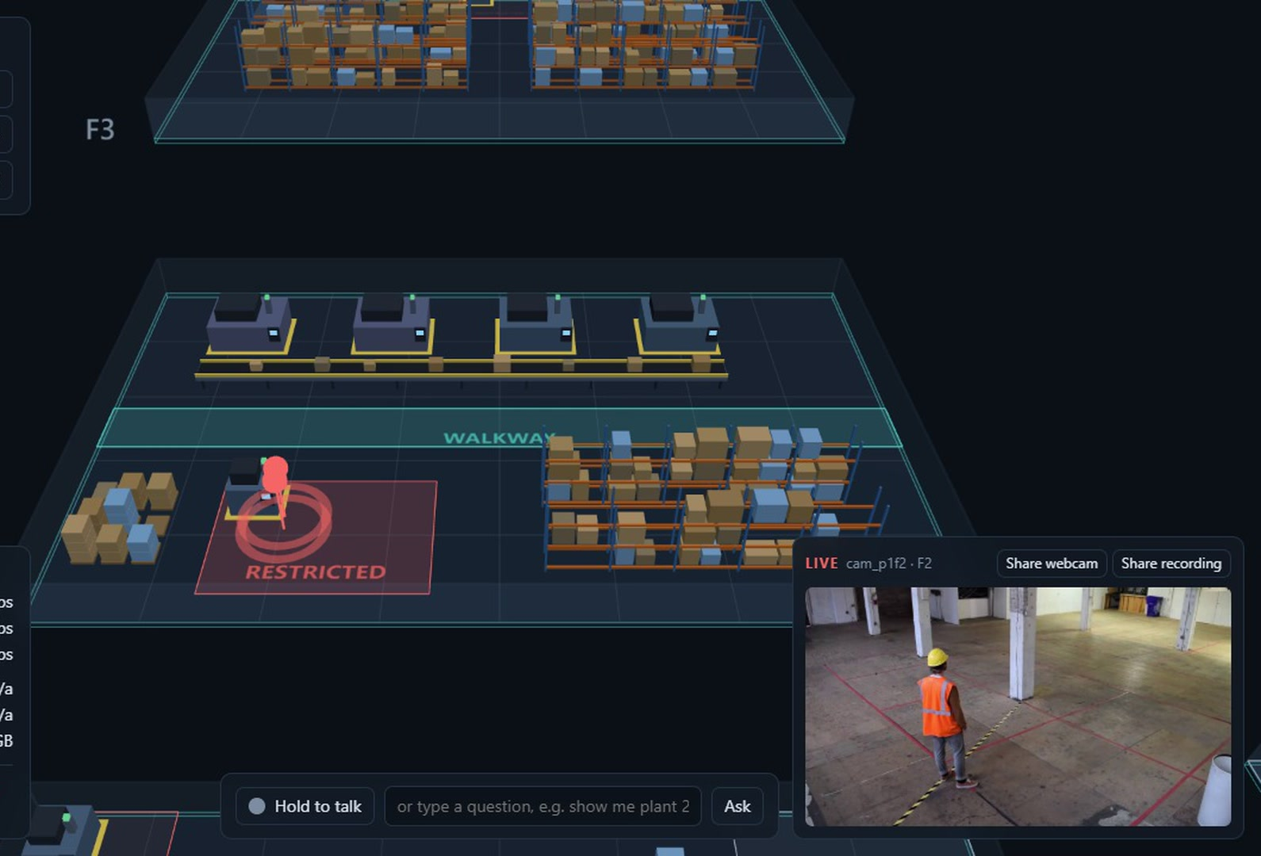
Every floor has a live camera view with detections boxed
Focus a floor and its camera appears beside the twin.
The same detection that places the marker draws the box
One stream is shown at a time, so it stays light
Nothing is published beyond the one app port
Notes:
Real video and real detection, recorded on a laptop CPU.

Slide 11
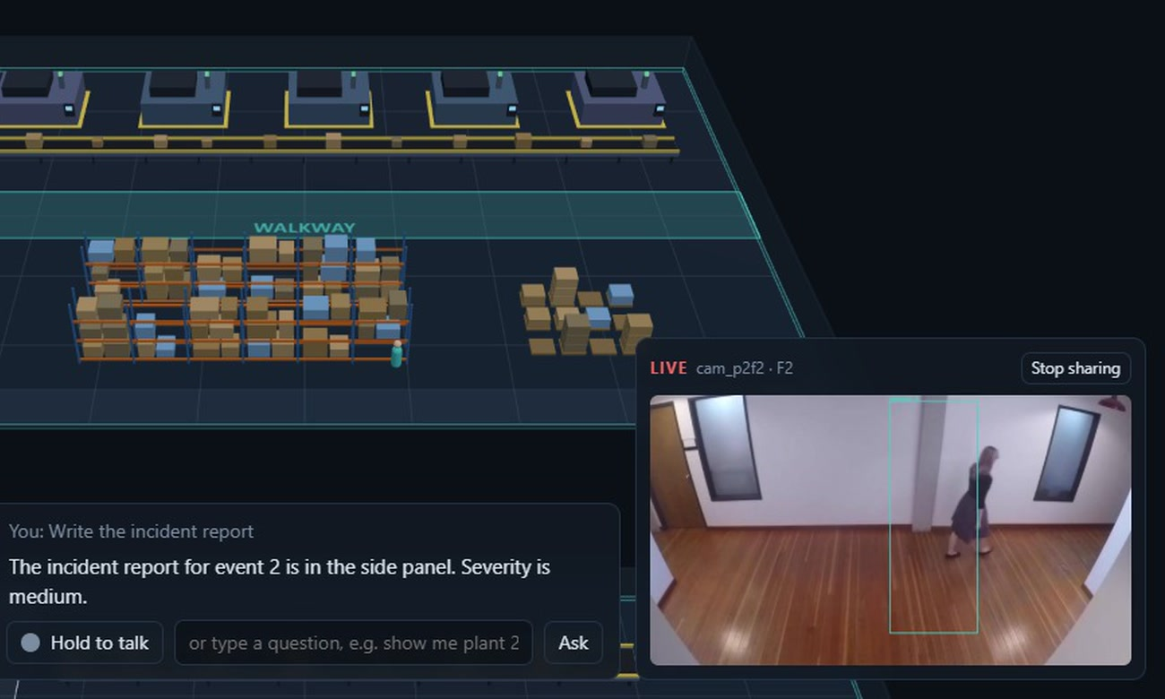
Any camera can be fed from a recording or a webcam
For a live demo, drop your own footage into a floor.
Recorded mp4 files, looped as live streams
A webcam shared from the browser, or attached to the machine
“Share recording”: pick a video file and it is analysed on the spot
Notes:
Useful with judges: let them hand you a clip.

Slide 12
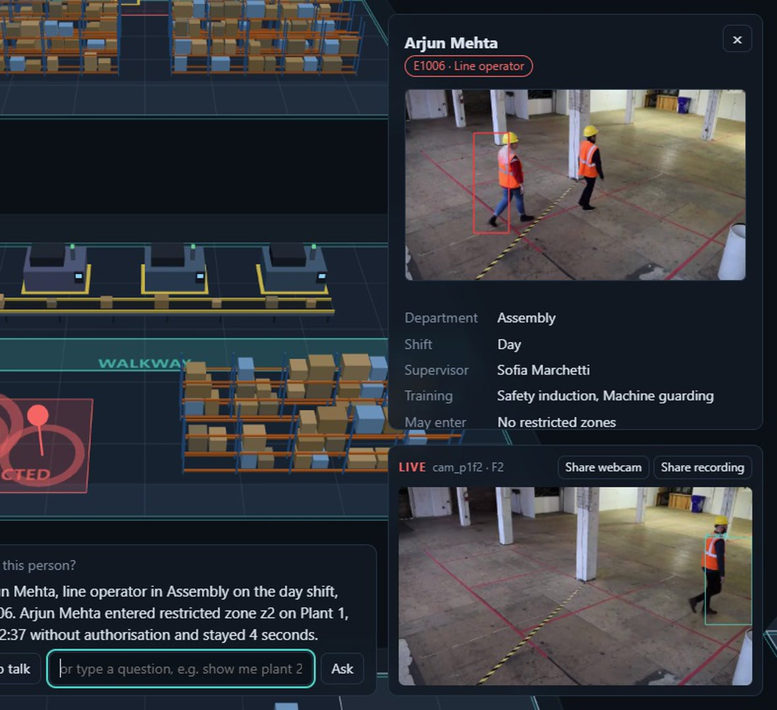
The alert names the person, and one question gives the full picture
“Who is this person?”
Name, role, shift, supervisor and training
When they entered, when the alert fired, how long they stayed
Whether they were authorised for that zone
Where they are now, and their other incidents today
Employees are fictional. Identity comes from a simulated badge feed, not from face recognition.
Notes:
Say the synthetic-data line out loud. To use real staff, the badge feed is the one piece to replace.

Slide 13
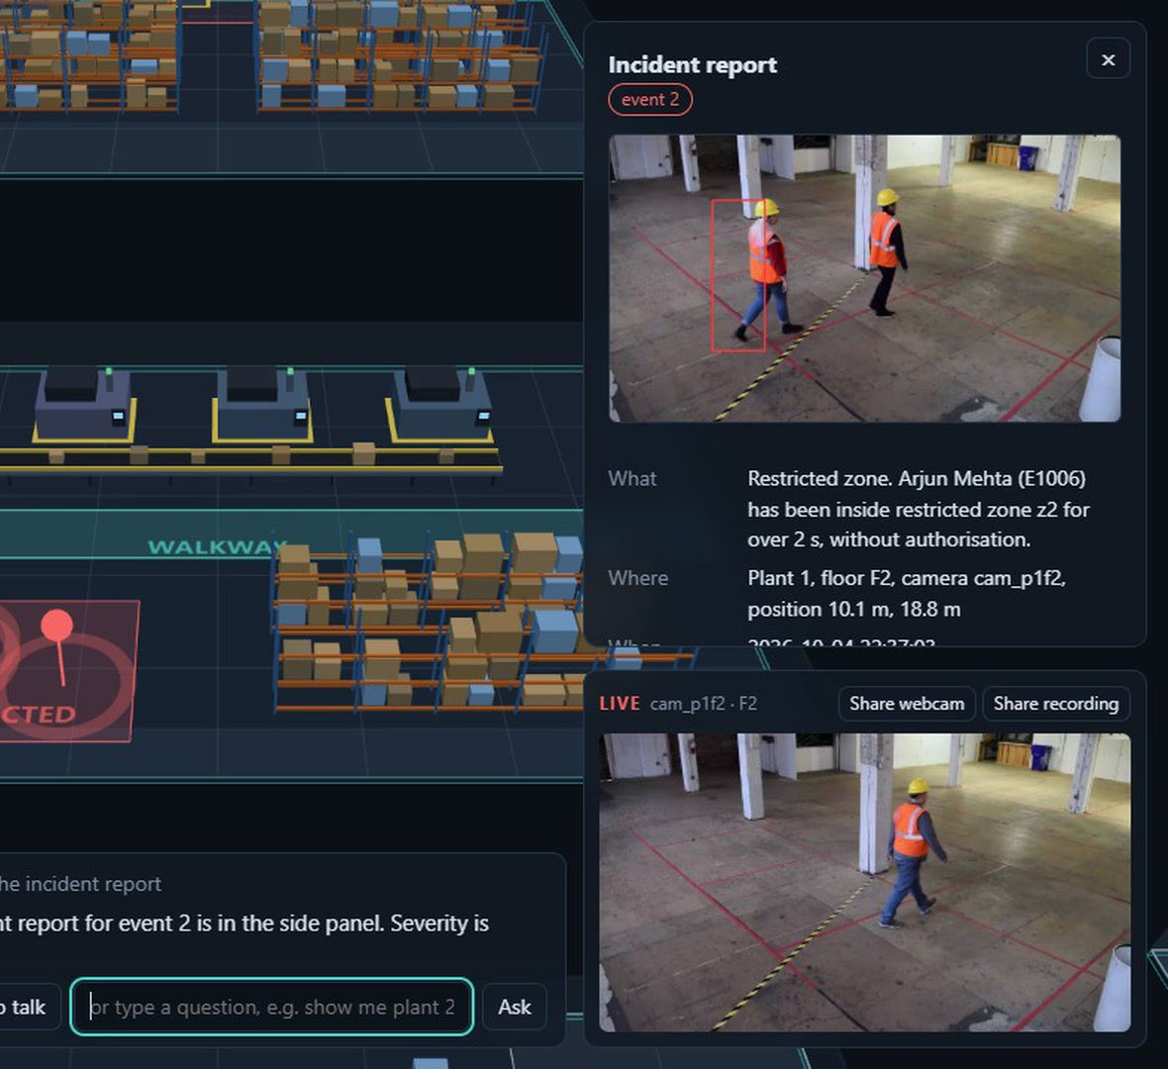
One more sentence writes the incident report
“Write the incident report.”
What, where, when, who, severity and recommended action
Filled from the stored event, so it cannot contain invented facts
The camera snapshot from the moment of the alert is attached
From alert to written report without leaving the twin.
Notes:
The report is built from the event row, not generated freely.

Slide 14
How it works
SECTION 3

Slide 15
One process on one device takes video to a spoken answer
PERCEPTION, 6 STREAMS
Cameras
Ingest
Detector
Track + map
Rules
Event store
tools read events and live state
state, events
VOICE
Microphone
Speech in
Agent + tools
Speech out
Browser twin
answer and speech
One vision-language model serves the conversation and the “look at this frame” tool
Seven tools: events, live state, look, focus, show event, identify person, write report
Notes:
Top lane is perception for six streams. Bottom lane is voice. The assistant's tools read the event store and the live state.

Slide 16
The planned model stack leaves headroom inside 15 GB
12.8 of 15 GB budgeted.
3B-class vision-language model, half precision
Whisper for speech in, Piper for speech out
YOLO exported to TensorRT, one batch for all streams
This is the plan. The figures still have to be measured on the Jetson.
Notes:
This is the budget from the plan. It has not been measured on the Jetson yet.

Slide 17
Every heavy component has a mock, so the demo cannot die
Component | Real | Mock
Perception | video, detector, tracker | simulated people, scripted scenarios
Assistant | vision-language model | keyword router calling the same tools
Speech in | Whisper | fixed question
Speech out | Piper | chime
A backend that fails to load falls back to its mock at startup, and the app says which is running
The whole app runs on a laptop without a GPU, which is how it was built and tested
Notes:
If a model fails on stage, that backend falls back to its mock at startup and the rest keeps working.

Slide 18
Architecture in detail
SECTION 4

Slide 19
One process runs three loops at once
Perception threads
Broadcast loop, 5 Hz
Agent loop, per question
One thread per stream decodes video. The latest frame of every stream goes to the detector in one batch, then to the tracker and the mapper.
Reads the latest tracks, runs the rules, attaches identity, stores events and sends state to the browser. Metrics go out once a second.
Asynchronous. Speech to text, up to three rounds of tool calls, the final answer, then speech sentence by sentence.
One FastAPI process on 0.0.0.0:8000. The browser is the only client, and that is the only port.
Python 3, FastAPI, pydantic models for every message that crosses a boundary. Plain ES modules and Three.js in the browser.
Notes:
One FastAPI process. Perception in threads, a 5 Hz broadcast loop, and an async agent loop per question.

Slide 20
Perception takes five stages from pixels to floor metres
Stage | Module | What it does
Ingest | ingest.py | GStreamer hardware decode, looping, real time, 1280x720; OpenCV fallback. Files, a webcam or frames shared from a browser.
Detect | detector.py | YOLO exported to TensorRT FP16. The latest frame of every stream goes through in one batch.
Track | tracker.py | ByteTrack-style two-stage association per stream, in pure Python. Gives each person a stable id.
Map | mapper.py | The foot point of each box goes through the camera homography to floor metres. Four clicked points calibrate a camera.
Mock | mock.py | Simulated people and vehicles. A scripted scenario every 30 s makes the real rules raise a real event.
The camera view is the same data: one JPEG of the focused floor with every track boxed, about four times a second.
Notes:
Each stage is one small module. The mock replaces all of them and still feeds the real rules.

Slide 21
Rules are pure functions with fixed thresholds
Event | Raised when | Notes
near_miss | A person and a forklift are within 2 m and closing faster than 0.5 m/s. | Severity 3.
restricted_zone | A person is inside a restricted polygon for more than 2 s. | Once per stay. Authorised people raise nothing.
no_helmet | The vision model says no about a person crop. | One unchecked person every 3 s.
crowding | More than 4 people are within a 3 m radius. | Severity 1.
Unit-tested: each rule has its own tests
Debounced: no repeat within 30 seconds for the same tracks
Backend-neutral: the same rules run on mock and real tracks
Notes:
Thresholds are constants in app/events/rules.py. Each rule has unit tests.

Slide 22
Tracks live in memory, and events live in SQLite
TRACK, IN MEMORY
EVENT, ONE ROW IN SQLITE
id, zone, cls
x, y, vx, vy
bbox, last_seen
id, ts, plant, floor, camera_id
type, severity, track_ids
x, y, snapshot_path, summary, person_id
Class is person, forklift or vehicle. Positions are floor metres. Sent to the browser five times a second.
Indexed by time. Queried by plant, floor, type and time range. The snapshot is a file beside the database. An event is open for ten minutes.
The report is filled from the event row, not generated, so it cannot contain invented facts.
Notes:
The event row is the source of truth for the report and for every question about history.

Slide 23
One WebSocket carries eleven message types
Server to browser | Carries
site | the whole site, on connect
state | every track per floor, 5 times a second
event | one event row, when a rule fires
ui | focus, highlight or open a panel
transcript | what was heard or typed
answer | one sentence per message
audio | that sentence, spoken
metrics | fps, latency, GPU, memory, once a second
Browser to server | Carries
audio_query | 16 kHz mono WAV
text_query | a typed question
select_event | a marker click
PLAIN HTTP
/api/health
/api/camera/{plant}/{floor}
Health reports which backends are real and which are mocks.
Notes:
Every message is a pydantic model in app/protocol.py; the field type tells them apart.

Slide 24
The assistant must call a tool before it states a fact
1
2
3
4
5
6
Question, spoken or typed
Model sees the tool schemas
Tool runs, twin reacts
Up to three rounds
Final answer, two sentences
Spoken, sentence by sentence
JSON tool calls
Short memory
Honest
The model answers with a tool name and arguments. The app parses them, so any model can be used.
The last six turns, the current view and the last event id, so “that” and “there” resolve.
“I can’t see that” when the tools return nothing. No guessing.
Notes:
Tool calling is JSON-constrained and parsed by the app, so it does not depend on a model's chat template.

Slide 25
Seven tools connect the model to the site
Tool | Returns | Effect on the twin
query_events | Events by plant, floor, type and time. | Highlights their markers.
live_state | People, vehicles and open events now. | None.
look | The vision model’s answer on the live frame. | Focuses that floor.
focus_view | Nothing. | Flies the camera there.
show_event | Nothing. | Opens the event panel.
identify_person | Employee, visit timing, other incidents. | Opens the person panel.
write_report | What, where, when, who, severity, action. | Opens the report panel.
On a laptop a keyword router calls the same seven tools, so the interface never changes.
Notes:
On a laptop a keyword router calls the same seven tools, so the interface never changes.

Slide 26
Voice: the target is 2.5 seconds to the first spoken word
1
2
3
4
5
6
Hold to talk
16 kHz WAV over the socket
Whisper transcribes
Agent answers
Piper speaks each sentence
Queued playback
2.5 s
3.8 s
5 s
target, from release to first audio
measured on a laptop CPU, mock assistant
hard limit. Jetson: not measured yet
Notes:
3.8 s was measured on a laptop CPU with the mock assistant. Nothing has been measured on the Jetson.

Slide 27
Identity comes from a badge feed, never from a face
Synthetic directory
Simulated badge feed
One class to replace
Fictional employees: role, shift, supervisor, authorised zones.
Gives each tracked person on a floor one of its employees.
A real access-control system plugs in at BadgeFeed.
Authorised means silent
Visit timing
Prompt rule
A person allowed in a zone raises no event.
Entered, alert raised, left, time in the zone.
The model may not name anyone from appearance.
With real footage the badge goes to whoever the tracker sees: it shows the flow, it does not know who is in the video.
Notes:
Say it plainly: fictional people, a simulated badge feed, no face recognition.

Slide 28
The frontend is plain ES modules and Three.js
Module | Role
twin.js, fixtures.js | Plants, floors, equipment and zones built from the site message.
tracks.js | Instanced markers, positions interpolated between state messages.
events.js | Pulsing event markers, click picking, the side panel.
camera.js | Camera view of the focused floor; share a webcam or a recording.
voice.js, wave.js | Push-to-talk, queued playback of the answer, the waveform.
hud.js | Per-stream fps, voice latency, GPU, memory, the privacy line.
scene.js, ws.js | Renderer and camera tweens; the one WebSocket.
No bundler and no framework. Three.js is vendored, so the page loads with no network.
Notes:
No bundler and no framework. Three.js is vendored, so the page loads with no network.

Slide 29
Three scripts take a bare Jetson to a running demo
setup_jetson.sh
preflight.sh
run.sh
Once, with the network. Installs packages one at a time, downloads the models, exports the detector to TensorRT, fetches the videos.
Every start. Checks CUDA, the hardware decoder, disk in /cache, port 8000, the Python modules, every model and every video.
Every start. All four backends real, data in /cache, offline flags set, then the app on port 8000.
No sudo, apt or Docker; torch, torchvision and numpy are never touched
8 CPU cores, 15 GB of memory, one GPU shared with other teams
Written and reviewed. Not yet run on the device.
Notes:
These scripts are written and reviewed. They have not run on the device yet.

Slide 30
Built spec first, and tested without a GPU
How the work is organised
How it is checked
spec.md says what: user stories with acceptance criteria
plan.md says how: modules, protocol, models, memory budget
tasks.md says in what order: one task at a time, each with a “done when”
77 automated tests, mock mode only, no GPU needed
A tool-calling test set of 15 questions; the real model must get 13
The golden path: seven steps, three clean runs on the Jetson
Notes:
Scope is frozen in the spec; the plan and the tasks follow it.

Slide 31
Known risks, and what is already in place for each
Risk | Mitigation
The shared GPU slows everything. | Detector held at 10 fps, models pre-warmed, a backup video recorded.
A dependency replaces torch. | Every install is dry-run checked first; setup stops if a version changes.
A small model is weak at tool calling. | JSON-constrained calls, and the keyword router as the fallback.
The microphone is blocked in the browser. | The text box does the same thing.
A model fails to load on stage. | That backend starts as its mock and the rest keeps working.
Notes:
Every row has a fallback that is already in the code or the plan.

Slide 32
Status and demo
SECTION 5

Slide 33
The software is proven on a laptop; the Jetson run is the next step
77
6
0
automated tests passing
camera streams detected together on a laptop CPU
runs on a Jetson so far
Shown working
Still to prove on the Jetson
Twin, events, conversation, report
Real detection, speech in and speech out on CPU
Webcam and shared recording
Hardware video decode and TensorRT
3B model picks tools, 13 of 15
10 fps on 6 streams, voice under 2.5 s
Notes:
Be direct about this: nothing has run on a Jetson yet. The code paths for the real models have run on CPU with small stand-in models.

Slide 34
The demo is seven steps, from overview to incident report
1
Twin loads: six streams live, metrics visible
5
Click the restricted-zone alert on Plant 1, floor 2
2
“Give me a status of both plants”
6
“Who is this person?”
3
“Show me Plant 2, floor 3”
7
“Write the incident report”
4
“Any safety issues in the last ten minutes?”
Then one unscripted question from a judge.
Notes:
Then one unscripted question from a judge.

Slide 35
Why it matters: answers at the speed of a question, with data that stays on site
Safety
Operations
Events are seen, named and written up in the moment, not at the end of a shift.
One person can ask about any floor without walking to it.
Privacy and cost
Fit
Audio and video are processed on one device, with no cloud calls at runtime.
A new site is a new configuration file, not a new project.
Notes:
The value is the time between something happening and someone knowing.

Slide 36
Ask your company a question. It shows you, and it tells you.
Talk-to-your-Company. Globant Physical AI Hackathon, on NVIDIA Jetson Thor.
Notes:
Close on the line, then go to the live demo.

