Slide 1
Mini Project (CS-IoT-2B)
Team Id : 23_CS_IOT_2B_12
Domain : IoT(Internet of Things)
Project Title : “Smart Plant Care Companion”

Slide 2






TABLE OF CONTENTS

Slide 3
01
Problem Statement
Inefficient plant watering practices

Slide 4
OUR PROBLEM STATEMENT
Inefficient and imprecise plant watering practices often lead to overwatering or underwatering, resulting in plant stress, reduced growth, and unnecessary water wastage.
Traditional methods of manual watering can lead to overwatering or underwatering, causing unnecessary stress to plants and negatively impacting their growth. Inconsistent care routines further compound the issue, making it challenging for individuals to maintain healthy, thriving gardens.
“The project's objective is to tackle these issues by developing an automated Smart Plant Watering System that not only conserves water but also optimizes plant care based on individual needs, ultimately promoting healthier and more sustainable gardening practices.”

Slide 5
02
Proposed Solution
Smart Plant Watering System

Slide 6
OUR PROPOSED SOLUTION
Automated Watering System
Precise Moisture Monitoring
Energy-Efficient Operation
Environmental Impact
Incorporate advanced soil moisture sensors to accurately measure moisture levels in real-time, ensuring plants receive the right amount of water.
Develop a user-friendly Smart Plant Watering System that serves as an automated companion for plant care.
Integrate solar panels to power the system, reducing energy consumption and environmental impact.
Contribute to water conservation efforts by reducing water wastage and promoting responsible plant care.

Slide 7
03
Project Methodology
Arduino Based Plant Watering System

Slide 8
PROJECT IMPLEMENTATION STAGES
SOFTWARE DEVELOPMENT
DATA ANALYSIS AND INSIGHTS
MICROCONTROLLER
AND SENSOR
Develop the software components, including the microcontroller firmware
Set up data analytics to collect and analyze plant growth data and develop algorithms for providing users with actionable insights.
Assemble the microcontroller and integrate soil moisture sensors for accurate data collection.
HARDWARE ASSEMBLY
TESTING AND QUALITY ASSURANCE
Conduct thorough testing of the entire system to ensure accuracy, reliability, and functionality
Assemble the physical components of the Smart Plant Watering System, including water pumps, tubing, reservoir.
z

Slide 9
Tools Used
04
Required technologies

Slide 10
TOOLS USED:
Microcontroller
Intergrated Development Environment (IDE)
It's the brain that makes decisions regarding plant watering.
Soil Moisture Sensors
An IDE is a software tool used for writing, compiling, and uploading code to the microcontroller.
These sensors measure the
moisture levels in the soil
Soldering and Solder Iron
Water Pumps
These tools are used for soldering electronic components, ensuring secure electrical connections
Water pumps are used to deliver water to the plants when the system decides it's time to water

Slide 11
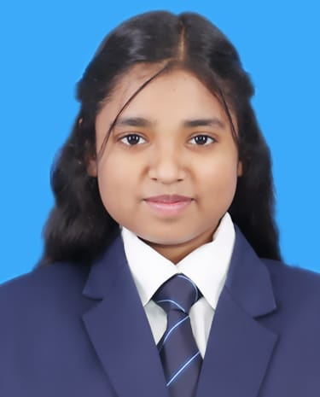

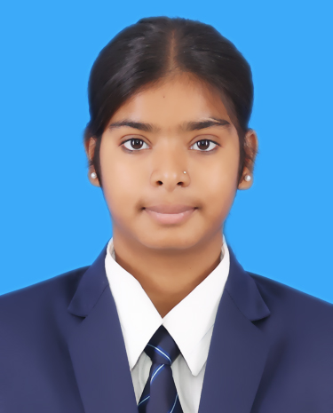


OUR TEAM
Shrasti Jaiswal (TEAM LEADER) A meticulous Software Tester with a sharp eye for detail and a dedication to ensuring the quality and reliability of software applications.
Shrasti Rajpoot (TEAM MEMBER) A seasoned Data Analyst with a passion for transforming raw data into actionable insights
Aryan Singh (TEAM MEMBER)
A skilled Software Developer known for their expertise in crafting innovative software solutions.
Sangram Singh
(TEAM MEMBER)
A skilled Hardware Assembler with a passion for bringing electronic components to life and creating functional systems
Yash Kumar
(TEAM MEMBER)
With a strong blend of leadership, organization, and communication skills, He is the driving force behind ensuring projects meet their goals and objectives.

Slide 12
Thanks!

