Slide 1
Frontend with Angular

Slide 2
Install Node.js
Node.js is a JavaScript runtime environment used to run JavaScript outside the browser.
It is required for:
Angular development
React development
Package management
Running backend JavaScript applications
Node.js includes npm (Node Package Manager) which installs project dependencies.

Slide 3
Download Node.js
Download Node.js
Open the official website https://nodejs.org
Download the LTS Version (Recommended)
Install Node.js
Run the downloaded installer:
node-vxx.x.x-x64.msi
Verify Installation
Open Command Prompt or PowerShell
Check Node.js version:
node -v
Example output:
v20.10.0
Check npm version:
npm -v
Example output:
10.2.4

Slide 4
Install Angular CLI (For Angular Development)
Angular requires **Angular CLI.
Install globally:
npm install -g @angular/cli
Verify installation:
ng version
Example output:
Angular CLI: 17.x Node: 20.x npm: 10.x
Node.js Development Tools (Recommended)
Install a code editor such as:
Visual Studio Code
Features:
JavaScript debugging
Angular support
Extensions for TypeScript
Integrated terminal

Slide 5
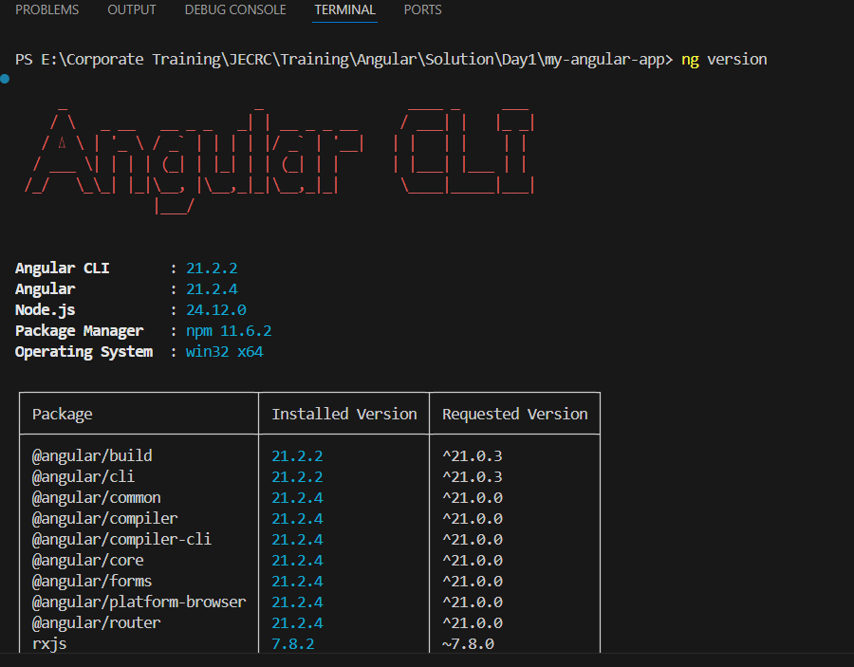
Install Angular CLI (For Angular Development)

Slide 6
Install Angular CLI (For Angular Development)
Angular requires **Angular CLI.
Install globally:
npm install -g @angular/cli
Verify installation:
ng version
Example output:
Angular CLI: 17.x Node: 20.x npm: 10.x
Create a New Angular Project
Run:
ng new my-angular-app
During setup it will ask:
Would you like to add Angular routing? (y/n) Which stylesheet format? (CSS / SCSS)
After completion, navigate to the project:
cd my-angular-app
Angular CLI will:
Create a new project folder
Install required dependencies using npm
Configure TypeScript, Webpack, and Angular settings
Generate a default Angular application

Slide 7
Install Angular CLI (For Angular Development)
package.json
This file manages project dependencies and scripts.
Example:
{ "name": "my-angular-app", "version": "0.0.0", "scripts": { "start": "ng serve", "build": "ng build" } }
Uses
Lists installed libraries
Defines project commands
Controls project versions
Benefits
Easy dependency management
Standard project configuration
Automated build processes
Project structure created:
my-angular-app/ │ ├── node_modules/ ├── src/ ├── angular.json ├── package.json ├── tsconfig.json ├── README.md └── .gitignore

Slide 8
Install Angular CLI (For Angular Development)
angular.json
This file controls the Angular project configuration.
Example settings:
build configuration assets styles scripts output directory
Uses
Project build settings
Development server configuration
Asset management
Benefits
Centralized configuration
Customizable build process
node_modules
This folder contains all installed packages.
Examples:
node_modules/ @angular rxjs typescript zone.js
Uses
Stores libraries required for Angular
Installed automatically using npm
Benefits
Keeps project dependencies isolated
Enables version control of libraries

Slide 9
Install Angular CLI (For Angular Development)
tsconfig.json
Angular uses TypeScript instead of plain JavaScript.
This file configures TypeScript compilation settings.
Example:
{ "compilerOptions": { "target": "ES2022", "module": "ESNext" } }
Uses
Controls TypeScript compilation
Defines module resolution
Enables modern JavaScript features
Benefits
Strong typing
Better IDE support
Compile-time error detection
.gitignore
This file tells Git which files to ignore.
Example:
node_modules dist .env
Uses
Prevents large unnecessary files from being committed
Benefits
Smaller repositories
Faster version control operations

Slide 10
Install Angular CLI (For Angular Development)
README.md
Documentation file for the project.
Example content:
Project Name Installation instructions Development guide
Benefits
Helps developers understand the project quickly
Improves collaboration
src Folder (Most Important)
This folder contains actual application code.
Structure:
src/ │ ├── app/ ├── assets/ ├── environments/ ├── index.html ├── main.ts ├── styles.css └── polyfills.ts

Slide 11
Install Angular CLI (For Angular Development)
Below is the structure you mentioned:
app/ │ ├── app.config.ts ├── app.ts ├── app.html ├── app.css ├── app.routes.ts ├── app.spec.ts
This is part of Angular’s standalone component architecture, promoted by Google to simplify Angular applications.
app.config.ts
Purpose
This file configures the Angular application globally.
It replaces many responsibilities previously handled by AppModule.
What it configures
Routing
Dependency Injection providers
Global services
HTTP client configuration
Benefits
Replaces complex module configuration
Centralized application setup
Cleaner architecture

Slide 12
Install Angular CLI (For Angular Development)
app.ts
This is the root component file.
Previously Angular used:
app.component.ts
Now it is simplified to:
app.ts
Key Feature
standalone: true
This means:
The component does not require NgModule.
Benefits
Less boilerplate code
Faster development
Better readability
app.html
This file is the template (UI layout) of the root component.
Example:
<h1>{{title}}</h1> <p>Welcome to Angular Application</p>
Features used in templates
Interpolation
Data binding
Angular directives
Event binding
Example:
<button (click)="sayHello()">Click</button>

Slide 13
Install Angular CLI (For Angular Development)
app.css
Contains component-level styles.
Example:
h1{ color:blue; } p{ font-size:18px; }
Benefits
Styles are scoped to the component
Avoids global CSS conflicts
app.routes.ts
This file defines application routes.
Purpose
Handles navigation between pages.
Example URLs:
localhost:4200/ localhost:4200/products
Benefits
Lazy loading
Better performance
Modular routing

Slide 14
Install Angular CLI (For Angular Development)
app.spec.ts
This file is used for unit testing.
Angular uses Jasmine and Karma for testing.
Purpose
Tests:
Component creation
Logic correctness
UI behavior
Complete Angular Startup Flow (Standalone Architecture)
main.ts ↓ app.config.ts ↓ app.ts (Root Component) ↓ app.html (Template) ↓ Browser UI

Slide 15
Introduction & Core Building Blocks in Angular
What is Angular?
Angular is a web framework that empowers developers to build fast, reliable applications that users love.
Angular is a TypeScript-based front-end framework used to build dynamic, scalable single-page applications (SPA).
Angular developed and maintained by Google.
Angular provides:
Component-based architecture
Two-way data binding
Dependency Injection
Modular application structure
Built-in routing and HTTP services
Powerful CLI
TypeScript support
High performance

Slide 16
Introduction & Core Building Blocks in Angular
What is a Framework?
A framework is a pre-built structure that provides rules, tools, and reusable code to help developers build applications faster, more securely, and in a standard way.
Area | Framework | Language
Frontend | Angular | TypeScript
Frontend | React (library) | JavaScript
Frontend | Vue | JavaScript
Backend | Spring Boot | Java
Backend | ASP.NET Core | C#
Backend | Django | Python
Mobile | Flutter | Dart

Slide 17
Introduction & Core Building Blocks in Angular
Angular CLI now always enables live reload by default, so the option is no longer needed or recognized. Correct Way to Run the App (Angular 17–21)
ng serve
ng serve --open
ng serve --open --port 4200
Old CLI (≤16) | New CLI (17–21)
--liveReload=true | ❌ Removed
--open | ✅ Supported
--port | ✅ Supported
Auto reload | ❌ Optional

Slide 18
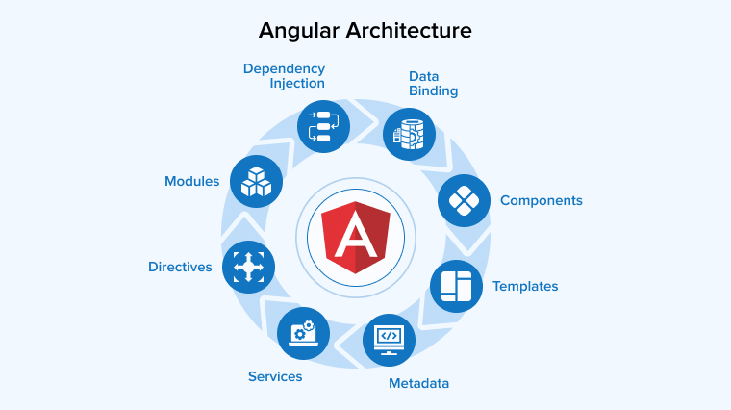
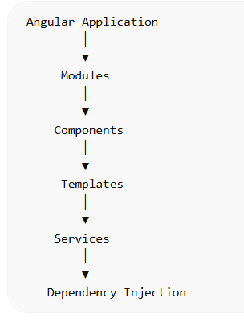
Angular Architecture
Angular applications follow a modular architecture.

Slide 19
Angular Architecture
Element | Description
Modules | Organize application features
Components | Control UI parts
Templates | Define HTML structure
Services | Business logic
Routing | Navigation between views

Slide 20
Using Angular Modules
An Angular Module is a container that groups related components, directives, pipes, and services into a single unit.
Below is the Complete Angular Startup Flow using Standalone Architecture (Angular 17+ / modern Angular). This architecture removes NgModule and uses standalone components for simpler and faster applications.
Module Type | Description
Root Module | Main entry module (AppModule)
Feature Module | Specific functionality (e.g., AuthModule)
Shared Module | Reusable components/pipes
Core Module | Singleton services
Lazy-loaded Module | Loaded on demand

Slide 21
Angular Modules
import { NgModule } from '@angular/core';
import { BrowserModule } from '@angular/platform-browser';
import { AppComponent } from './app.component';
@NgModule({
declarations: [
AppComponent
],
imports: [
BrowserModule
],
providers: [],
bootstrap: [AppComponent]
})
export class AppModule { }
Modules (NgModule)
Angular applications are organized into modules.
A module is a container that groups related components, directives, pipes, and services.
Angular uses NgModule decorator.
Root Module
Every Angular app has one root module called: AppModule
File: app.module.ts
Using Angular CLI: ng generate module app OR
ng g module app

Slide 22
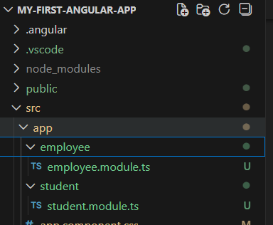

How to create a Module in Angular?
In order to create a module in angular using Angular CLI, you need to use the command.
Using Angular CLI: ng generate module app OR ng g module app.
It means the student module is created within the src => app => student folder and employee module is created within the src => app => employee folder.
Root Module
Every Angular app has one root module called: AppModule
File: app.module.ts

Slide 23
Angular Modules
import { NgModule } from '@angular/core';
import { BrowserModule } from '@angular/platform-browser';
import { AppComponent } from './app.component';
@NgModule({
declarations: [
AppComponent
],
imports: [
BrowserModule
],
providers: [],
bootstrap: [AppComponent]
})
export class AppModule { }
Modules (NgModule)
Angular applications are organized into modules.
A module is a container that groups related components, directives, pipes, and services.
Angular uses NgModule decorator.

Slide 24
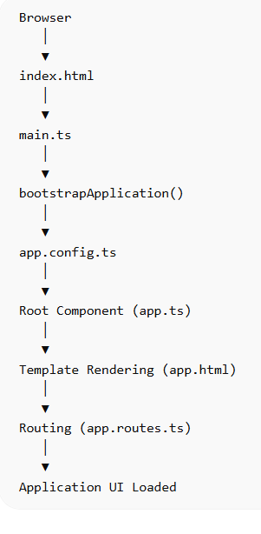
Angular Architecture
Full Angular Startup Flow Diagram

Slide 25
Angular New Startup Flow
Browser Loads index.html
This is the main HTML page loaded by the browser.
index.html
Purpose
Entry point of Angular UI
Contains root component tag
<app-root>
Angular replaces this tag with the root component UI.

Slide 26
Angular New Startup Flow
main.ts (Application Entry Point)
main.ts is the starting point of the Angular application.
main.ts
Purpose
This file:
Bootstraps Angular
Starts the root component
Loads global configuration
Key Function
bootstrapApplication()
This replaces the old Angular method:
platformBrowserDynamic().bootstrapModule(AppModule)

Slide 27

Check Your Understanding

Slide 28

Question & Answer

Slide 29
Benhar Charles Velankanni

