Slide 1
Frontend with Angular

Slide 2
What is Metadata?
Metadata provides configuration information to Angular using decorators.
Decorators are the features of Typescript and are implemented as functions.
The name of the decorator starts with @ symbol following by brackets and arguments.
That means in angular whenever you find something which is prefixed by @ symbol, then you need to consider it as a decorator.

Slide 3
Cont.,
Common Angular Decorators
Decorator | Purpose
@NgModule | Defines a module
@Component | Defines a component
@Directive | Defines a directive
@Pipe | Defines a pipe
@Injectable | Defines a service
@Input
@Output

Slide 4
Cont.,
Decorators are classified into 4 types. They are as follows:
Class Decorators: @Component and @NgModule
Property Decorators: @Input and @Output (These two decorators are used inside a class)
Method Decorators: @HostListener (This decorator is used for methods inside a class like a click, mouse hover, etc.)
Parameter Decorators: @Inject (This decorator is used inside class constructor).

Slide 5
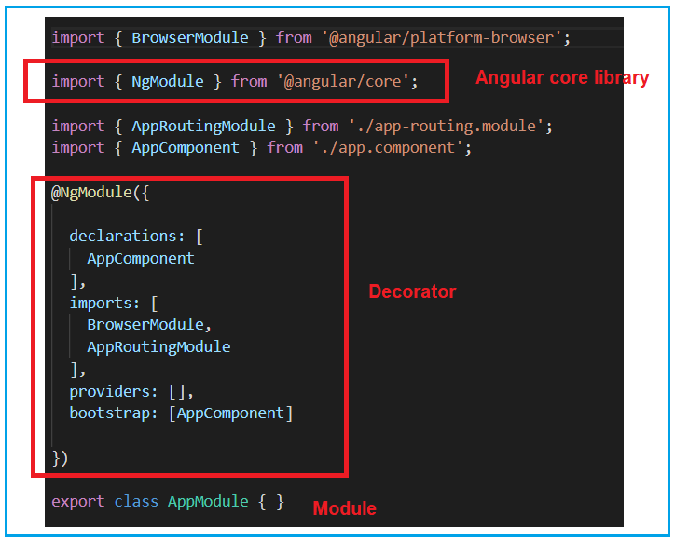
Cont.,

Slide 6
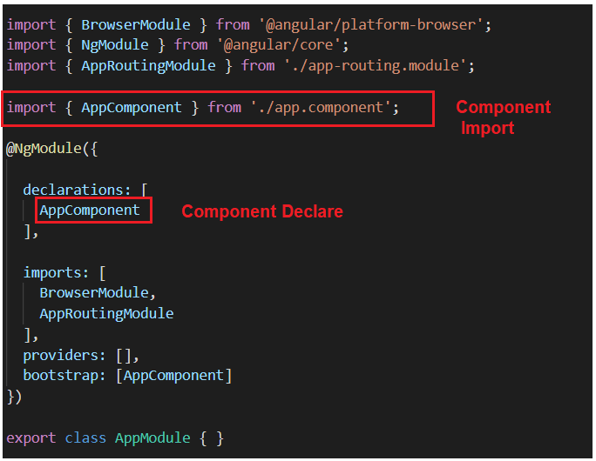
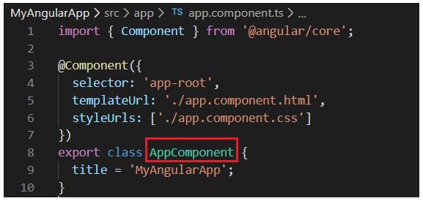
Cont.,

Slide 7
What is an Angular Component?
The Angular Component is the main building block of an Angular application.
The Component contains the data and user interaction logic that define how the View looks and behaves. A view in Angular refers to a template (HTML).
The Angular Components are plain JavaScript classes defined using the @Component Decorator. This Decorator provides the Component with a View to display and Metadata about the Component.
The Component is responsible for providing the data to the View. Angular uses data binding to get the data from the Component to the View and vice versa.
The Components consist of three main building blocks
Template
Class
MetaData

Slide 8
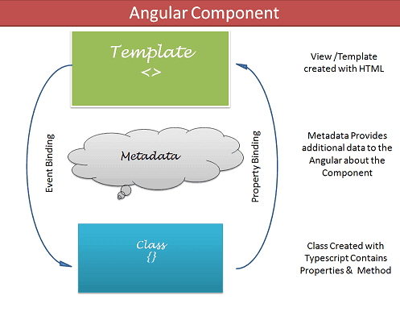
Cont.,
Component Metadata Example
@Component({
selector: 'app-login',
templateUrl: './login.component.html',
styleUrls: ['./login.component.css']
})
export class LoginComponent {}
Field | Description
selector | Custom HTML tag
templateUrl | HTML file
styleUrls | CSS files

Slide 9
Cont.,
Component Metadata Example

Slide 10
Cont.,
Component Metadata Example

Slide 11
Data Binding Deep Dive
Data Binding connects the Component (TypeScript) with the Template (HTML).
It allows data to flow between UI and application logic.
Data binding is the communication mechanism between the component's business logic (TypeScript) and the template (HTML).
Angular provides 4 types of data binding:
Type | Syntax | Direction | Direction
Interpolation One-way Data Binding | {{ }} | Component → View | TS → HTML
Property Binding | [property] | Component → View | TS → HTML
Event Binding | (event) | View → Component | HTML → TS
Two-way Binding | [(ngModel)] | Component ↔ View | TS ⇄ HTML

Slide 12
One-Way Data Binding
Angular automatically updates the view when component data changes.
app.ts
// component.ts
export class AppComponent {
title = 'My App';
user = { name: 'John', age: 30 };
getGreeting() {
return 'Hello ' + this.user.name;
}
}
app.html
<h1>{{ title }}</h1>
<p>User: {{ user.name }}, Age: {{ user.age }}</p>
<p>{{ getGreeting() }}</p>
<p>{{ 5 + 5 }}</p>

Slide 13
Property binding
The Property binding allows us to bind HTML element property to a property in the component.
Whenever the value of the component changes, the Angular updates the element property in the View.
You can set the properties such as class, href, src, textContent, etc using property binding. You can also use it to set the properties of custom components or directives (properties decorated with @Input).
app.ts
<!-- Bind to DOM properties -->
<img [src]="imageUrl">
<button [disabled]="isDisabled">Click me</button>
<div [innerHTML]="htmlContent"></div>
<!-- Bind to custom component @Input() -->
<app-child [childProperty]="parentData"></app-child>

Slide 14
Event Binding
Event binding allows us to bind events such as keystrokes, clicks, hover, touch, etc to a method in component. It is one way from view to component.
By tracking the user events in the view and responding to it, we can keep our component in sync with the view.
For Example, when the user changes input in a text box, we can update the model in the component, run some validations, etc. When the user submits the button, we can then save the model to the backend server.
<button (click)="onSave()">Save</button>

Slide 15
Two Way binding
Two-way binding means that changes made to our model in the component are propagated to the view and that any changes made in the view are immediately updated in the underlying component
Two-way binding is useful in data entry forms. Whenever a user makes changes to a form field, we would like to update our model. Similarly, when we update the model with new data, we would like to update the view as well
<input type="text" name="value" [(ngModel)]="value">

Slide 16
Directives
The Angular directive helps us to manipulate the DOM. You can change a DOM element’s appearance, behavior, or layout using the directives.
The ngFor is an Angular structural directive that repeats a portion of the HTML template once per each item from an iterable list (Collection).
The ngSwitch allows us to Add/Remove DOM elements. It is similar to the switch statement of Javascript.
The ngIf allows us to Add/Remove DOM elements.
The ngClass Directive is an Angular Attribute Directive, which allows us to add or remove CSS classes to an HTML element.
The ngStyle directive allows you to modify the style of an HTML element using the expression.

Slide 17
Custom Directive creation Using Custom Directive
In Angular, a custom directive allows you to:
Reuse behavior across multiple elements
Encapsulate DOM logic
Build enterprise-level reusable UI behavior
Type | Purpose
Attribute Directive | Change style/behavior
Structural Directive | Change DOM structure

Slide 18
Pipes
The Angular pipes are used to Transform the Data. For Example, the Date pipe formats the date according to locale rules. We can pass arguments to pipe and chain pipes. Angular also allows us to create a Custom Pipe.
Angular Pipes
Angular Custom Pipes
Date Pipe
Async Pipe
KeyValue Pipe
Using Pipes in Components & Services

Slide 19

Check Your Understanding

Slide 20

Question & Answer

Slide 21
Benhar Charles Velankanni

