Slide 1
Frontend with Angular

Slide 2
Life Cycle Hook
What is Angular life cycle hooks ?
The Angular life cycle hooks are nothing but callback functions, which angular invokes when a specific event occurs during the component’s life cycle. It forms a tree of components.
The life cycle hooks are the methods that angular invokes on directives and components as it creates, changes, and destroys them.
Using life-cycle hooks, we can fine-tune the behavior of our components during creation, update, and destruction.

Slide 3
Cont.,
Here is the complete list of life cycle hooks, which angular invokes during the component life cycle. Angular invokes them when a specific event occurs.
ngOnChanges → Input data changes
ngOnInit → Initial API call
ngDoCheck → Custom change detection
ngAfterContentInit → Content projection init
ngAfterContentChecked → Content check
ngAfterViewInit → View ready
ngAfterViewChecked → View updates
ngOnDestroy → Cleanup

Slide 4
Angular Forms
The Angular Forms module provides all the above services out of the box. It binds the form field to the Angular component class.
It tracks changes made to the form fields so that we can respond accordingly. It also provides the built-in validators to validate the inputs.
You can create your custom validator. It presents the validation errors to the user.
Finally, it encapsulates all the input fields into an object structure when the user submits the form.
Angular takes two approaches to build the forms. One is Template-driven forms approach and another one is Reactive forms or model-driven forms approach

Slide 5
Template-driven forms approach
What is Template-driven form?
In Template Driven Forms we specify behaviors/validations using directives and attributes in our template and let it work behind the scenes.
All things happen in Templates hence very little code is required in the component class. This is different from the reactive forms, where we define the logic and controls in the component class.
In Template-driven approach is the easiest way to build the Angular forms. The logic of the form is placed in the template. It allows us to create sophisticated looking forms easily without writing any JavaScript code.

Slide 6
Template-driven forms approach
The Template-driven forms
The form is set up using ngForm directive
controls are set up using the ngModel directive
ngModel also provides the two-way data binding
The Validations are configured in the template via directives
Template-driven forms are
Contains little code in the component class
Easier to set up
While they are
Difficult to add controls dynamically
Unit testing is a challenge

Slide 7
Template-driven Form Validation
Validations in Template-driven forms are provided by the Validation directives. The Angular Forms Module comes with several built-in validators.
You can also create your own custom Validator.
How to Build Custom Validator in template-driven form
Building a Validator in template-driven forms is similar to building an Angular directive. The directive must implement the Validator interface.
interface Validator {
validate(control: AbstractControl): ValidationErrors | null
registerOnValidatorChange(fn: () => void)?: void
}

Slide 8
Model-driven forms approach (Reactive Forms)
In Reactive Forms or Model-driven approach, the logic of the form is defined in the component as an object.
The Model-driven approach has more benefits as it makes the testing of the component easier.
In this approach, the representation of the form is created in the component class. where Form fields are created as properties of our component class.
This form model is then bound to the HTML elements using the special markups. This makes it easier to test.

Slide 9
Angular using RxJs
The RxJS (Reactive Extensions Library for JavaScript) is a Javascript library that allows us to work with asynchronous data streams.
The RxJs has two main players
Observable
Observers ( Subscribers)
What is a data stream?
A data stream is the data that arrives over some time. The stream of data can be anything. Like variables, user inputs, properties, caches, data structures, and even failures, etc

Slide 10
Cont.,
As said earlier the stream of data can be anything. For Example
Mouse click or Mouse hover events with x & y positions
Keyboard events like keyup, keydown, keypress, etc
Form events like value changes etc
Data that arrives after an HTTP request
User Notifications
Measurements from any sensor
Important Points regarding streams can
Emit zero, one or more values of any time.
It can also emit errors.
Must emit the complete signal when completed (finite streams).
Can be infinite, and they never complete

Slide 11
Observable in Angular
What is an Observable in Angular ?
Observable is a function that converts the ordinary data stream into an observable one. You can think of Observable as a wrapper around the ordinary data stream.
An observable stream or simple Observable emits the value from the stream asynchronously. It emits the complete signals when the stream completes or an error signal if the stream errors out.

Slide 12
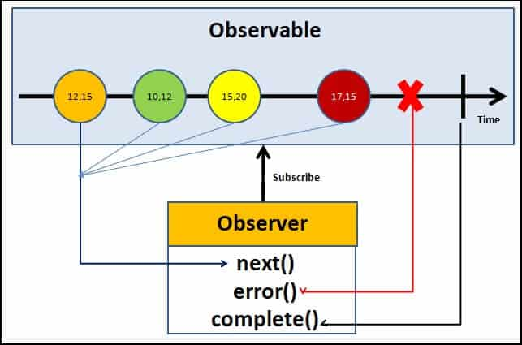
Cont.,
Observable → Data stream
Observer → Receives data
Subscription → Executes stream
Who are the observers (subscribers)?
The Observable is only useful if someone consumes the value emitted by the observable. We call them observers or subscribers.
The observers communicate with the Observable using callbacks
The observer must subscribe to the observable to receive the value from the observable. While subscribing, it optionally passes the three callbacks. next(), error() & complete()
The observable invokes the next() callback whenever the value arrives in the stream. It passes the value as the argument to the next callback. If the error occurs, then the error() callback is invoked. It invokes the complete() callback when the stream completes.

Slide 13
RxJS operators
RxJS operators are fundamental functions in Angular used to manipulate, filter, and combine asynchronous data streams (Observables) for managing tasks like HTTP requests and user events.
Operators are generally categorized by their function. Common use cases in Angular include handling forms, API calls, and reactive state management.
Category | Operators | Use Case in Angular
Transformation | map, switchMap, mergeMap, concatMap, exhaustMap, scan | Transforming API responses to specific data models, canceling outdated search requests, processing tasks sequentially or concurrently.

Slide 14
Cont.,
Category | Operators | Use Case in Angular
Filtering | filter, debounceTime, distinctUntilChanged, take, skip | Optimizing user input (e.g., search bars) to prevent excessive API calls, selecting values that meet a condition, limiting emissions.
Combination | combineLatest, forkJoin, merge, concat, zip | Waiting for multiple parallel HTTP requests to complete (forkJoin), combining the latest values from multiple form inputs or data sources (combineLatest).

Slide 15
Cont.,
Category | Operators | Use Case in Angular
Error Handling | catchError, retry | Gracefully handling failed API requests, logging errors, or providing fallback data to keep the application stable.
Creation | of, from, fromEvent, interval | Creating Observables from static values (of), arrays or Promises (from), or DOM events like clicks and keystrokes (fromEvent).

Slide 16

Check Your Understanding

Slide 17

Question & Answer

