Slide 1
Frontend with Angular

Slide 2
Angular Services
What is an Angular Service?
Service is a piece of reusable code with a focused purpose. A code that you will use in many components across your application
Our components need to access the data. You can write data access code in each component, but that is very inefficient and breaks the rule of single responsibility. The Component must focus on presenting data to the user. The task of getting data from the back-end server must be delegated to some other class. We call such a class a Service class. Because it provides the service of providing data to every component that needs it.

Slide 3
What Angular Services are used for
Features that are independent of components such a logging services
Share logic or data across components
Encapsulate external interactions like data access
Advantageous of Angular Service
Services are easier to test.
They are easier to Debug.
We can reuse the service at many places.
How to create a Service in Angular
An Angular service is simply a Javascript function. All we need to do is to create a class and add methods & properties. We can then create an instance of this class in our component and call its methods.

Slide 4
What is Angular Dependency Injection
What is Dependency
In short, the AppComponent has a dependency on ProductService.
Dependency Injection (DI) is a technique in which a class receives its dependencies from external sources rather than creating them itself.
Let us look at the ProductService, which we created in our project.
Our ProductService returns the hard-coded products when getProduct method invoked.

Slide 5
Benefits of Dependency Injection
loosely coupled
Our Component is now loosely coupled to the ProductService.
Easier to Test
AppComponent is now easier to Test. Our AppComponent is not dependent on a particular implementation of ProductService anymore. It will work with any implementation of ProductService that is passed on to it. You can just create a mockProductService Class and pass it while testing.
Reusing the Component
Reusing of the component is becomes easier. Our Component will now work with any ProductService as long as the interface is honored.

Slide 6
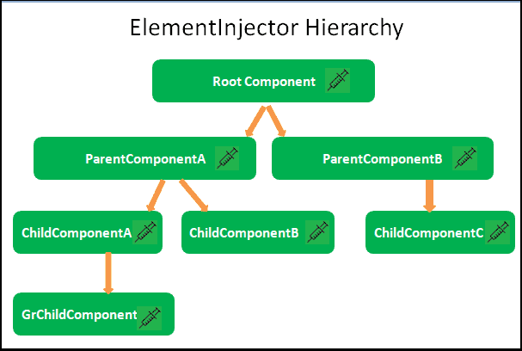
Hierarchical Dependency Injection
The Angular creates a hierarchical dependency injection system. It creates a hierarchical tree of Injectors. Each Injector gets their own copy of Angular Providers.
Angular creates the Element Injector tree for the services to be provided at the element level like Components & Directives.
When a component requests a dependency, Angular searches up the injector tree until it finds the provider

Slide 7
Angular Singleton Service
A singleton service is a service for which only one instance exists in an app.
How to Create a Singleton Service in Angular
There are two ways in which you can create a Singleton Service
Using the root option of the providedIn property. This works irrespective of your service is in an eager module or lazy loaded module. Using the providedIn is the preferred way as it makes the service tree shakeable.
Single instance shared across entire application Perfect for:
Application configuration
Global state management
Caching
Authentication
Logging
@Injectable({ providedIn: 'root' }) export class AppService { ... }

Slide 8
Angular Multi-instance Service
A Multi-Instance Service means:
Every component gets a new separate instance
Data is NOT shared between components
Useful for isolated state
SINGLETON vs MULTI-INSTANCE
Feature | Singleton | Multi-instance
Instance Count | 1 | Many
Scope | App-wide | Component-level
Data Sharing | Yes | No

Slide 9
Sharing data using services
Services act as a bridge between components
✔ Share data
✔ Communicate between components
✔ Maintain state
TYPES OF DATA SHARING
Method | Use Case
Simple Variable | Basic sharing
BehaviorSubject | Real-time updates
Observable Streams | API / async

Slide 10
Frontend with Angular

Slide 11
Angular Routing
What is Angular Routing?
.
Routing allows you to move from one part of the application to another part or one View to another View.
In Angular, Routing is handled by the Angular Router Module.

Slide 12
Components of Angular Router
Router
An Angular Router is a service (Angular Router API) that enables navigation from one component to the next component as users perform application tasks like clicking on menus links, and buttons, or clicking on the back/forward button on the browser.
Route
Route tells the Angular Router which view to display when a user clicks a link or pastes a URL into the browser address bar.
Routes
Routes is an array of Route objects our application supportsProgramming
RouterOutlet
The outerOutlet is a directive (<router-outlet>) that serves as a placeholder, where the Router should display the view.

Slide 13
Components of Angular Router
RouterLink
The RouterLink is a directive that binds the HTML element to a Route.
RouterLinkActive
RouterLinkActive is a directive for adding or removing classes from an HTML element that is bound to a RouterLink.
ActivatedRoute
The ActivatedRoute is an object that represents the currently activated route associated with the loaded Component.Networking
RouterState
The current state of the router includes a tree of the currently activated routes together with convenience methods for traversing the route tree.
RouteLink Parameters array
The Parameters or arguments to the Route. It is an array that you can bind to RouterLink directive or pass it as an argument to the Router.navigate method.

Slide 14
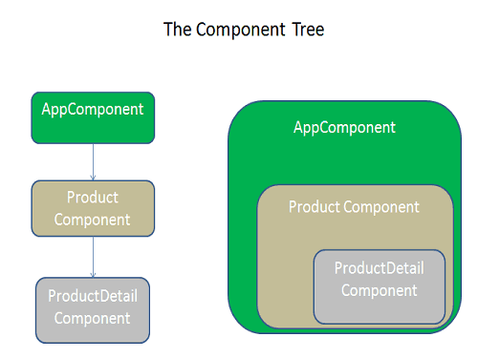
Child Routes / Nested Routes
The Angular applications are based on the idea of Components. The Components follows a Tree structure, where we have a root component at the top. We can then add child components forming loosely coupled components resembling a Tree
The Routes in Angular also follows the component tree structure and allows us to define the nested or child routes.
Example
In the above example, the ProductComponent displays the list of Products. The ProductDetailsComponent is the child of the ProductComponent displays the details of the selected Product.
So Our routes would be /Product and /Product/Details/:Id

Slide 15
Angular Route Guards
We use the Angular Guards to control whether users can navigate to or away from the current route.
Allowing the user to navigate all application parts is not a good idea. We must restrict the user until the user performs specific actions like logging in etc. Angular provides the Route Guards for this purpose.
Uses of Angular Route Guards
To Confirm the navigational operation
Asking whether to save before moving away from a view
Allow access to certain parts of the application to specific users.
Validating the route parameters before navigating to the route
Fetching some data before you display the component.

Slide 16
Types of Route Guards
The Angular Router supports six different guards, which you can use to protect the route.
CanActivate
CanDeactivate
Resolve
CanLoad
CanActivateChild
CanMatch

Slide 17
CanActivate
The Angular CanActivate guard decides if a route can be activated ( or the component gets rendered). We use this guard when we want to check on some condition, before activating the component or showing it to the user. This allows us to cancel the navigation.
Use cases
Checking if a user has logged in
Checking if a user has permission

Slide 18
CanDeactivate
This Angular Guard decides if the user can leave the component (navigate away from the current route).
This route is useful when the user might have some pending changes, which is not yet saved.
The CanDeactivate route allows us to ask for user confirmation before leaving the component. You might ask the user if it’s OK to discard pending changes rather than save them.

Slide 19
Resolve
This guard delays the activation of the route until some tasks are complete.
You can use the guard to pre-fetch the data from the backend API before activating the route.

Slide 20
CanLoad
The CanLoad Guard prevents the loading of the Lazy Loaded Module.
We generally use this guard when we do not want to unauthorized users to be able even to see the source code of the module.
This guard works similarly to CanActivate guard with one difference.
The CanActivate guard prevents a particular route from being accessed.
The CanLoad prevents the entire lazy-loaded module from being downloaded, protecting all the routes within that module.

Slide 21
CanActivateChild
CanActivateChild guard determines whether a child route can be activated. This guard is very similar to CanActivateGuard.
We apply this guard to the parent route. The Angular invokes this guard whenever the user tries to navigate to any of its child routes.
This allows us to check some conditions and decide whether to proceed with the navigation or cancel it.

Slide 22
Angular HttpClient
The HttpClient is a separate model in Angular and is available under the @angular/common/http package. The following steps show you how to use the HttpClient in an Angular app.
What is Observable?
The Angular HTTPClient makes use of observable. Hence it is important to understand the basics of it.
Observable help us to manage async data. You can think of Observables as an array of items, which arrive asynchronously over time.

Slide 23
Angular HTTP GET
The HttpClient.get sends the HTTP Get Request to the API endpoint and parses the returned result to the desired type. By default, the body of the response is parsed as JSON. If you want any other type, then you need to specify explicitly using the observe & responseType options.
Syntax
getTasks(): Observable<Task[]> {
return this.http.get<Task[]>(this.api);
}

Slide 24
Angular HttpClient HTTP Post
The HttpClient.post() sends the HTTP POST request to the endpoint. Similar to the get(), we need to subscribe to the post() method to send the request. The post method parsed the body of the response as JSON and returns it. This is the default behavior. If you want any other type, then you need to specify explicitly using the observe & responseType options.
The syntax of the HTTP Post is similar to the HTTP Get.
this.service.addTask(this.task).subscribe({ next: (res) => { this.router.navigate(['/']); // go back to list } });

Slide 25
Angular HttpClient HTTP PUT
The HttpClient.put() sends the HTTP PUT request to the endpoint. The syntax and usage are very similar to the HTTP POST method.
The syntax of the HTTP Put
updateTask(task: Task): Observable<Task> {
return this.http.put<Task>(`${this.api}/${task.id}`, task);
}

Slide 26
Angular HttpClient HTTP PATCH
The HttpClient.patch() sends the HTTP PATCH request to the endpoint. The syntax and usage are very similar to the HTTP POST method.
The syntax of the HTTP Patch
updateTaskStatus(id: number, completed: boolean): Observable<Task> {
return this.http.patch<Task>(`${this.api}/${id}`, {
completed: completed
});
}

Slide 27
Angular HttpClient HTTP DELETE
The HttpClient.delete() sends the HTTP DELETE request to the endpoint. The syntax and usage are very similar to the HTTP GET method.
The syntax of the HTTP Delete
delete(id: number) { this.service.deleteTask(id).subscribe(() => { this.tasks = this.tasks.filter(t => t.id !== id); }); }

Slide 28
Angular Interceptors (Auth, Logging)
What is an Interceptor?
An Interceptor in Angular is a powerful middleware mechanism that intercepts HTTP requests and responses at the application level. It allows you to inspect, transform, or handle HTTP requests and responses globally before they reach their intended destination.
Think of interceptors as gatekeepers or middleware that sit between your application and the backend API, allowing you to:
Add authentication tokens to requests:
Log all HTTP activity
Handle errors globally
Modify request/response data
Cache responses
Show loading indicators
Retry failed requests

Slide 29
Angular Interceptors (Auth, Logging)
Component → HTTP Request → INTERCEPTOR → Backend API
↓
Modify/Inspect
↓
Component ← HTTP Response ← INTERCEPTOR ← Backend API
↓
Modify/Handle

Slide 30
Angular CLI Commands
bash
# Create new project
ng new project-name
# Serve application
ng serve
ng serve --open # Opens in browser
ng serve --port 4201 # Custom port
# Build application
ng build
ng build --prod # Production build
# Run tests
ng test
ng e2e # End-to-end tests

Slide 31
Angular CLI Component Generation
bash
# Basic component
ng generate component component-name
# or shorthand
ng g c component-name
# With specific options
ng g c components/user-profile --skip-tests --flat
ng g c features/dashboard --standalone # Standalone component

Slide 32
Angular CLI Module Generation
bash
ng g m modules/user --routing # With routing module
ng g m shared --flat # Flat structure

Slide 33
Angular CLI Service Generation
bash
ng g s services/user-data
ng g s services/auth --flat # Without folder
ng g s services/api --skip-tests

Slide 34
Angular CLI Other Generators
bash
ng g directive directives/highlight
ng g pipe pipes/date-format
ng g guard guards/auth
ng g interface models/user
ng g enum enums/status
ng g class models/product

Slide 35
Differences from NgModules
Standalone Components | NgModules
No module file needed | Requires module declaration
Direct imports in component | Imports in module
Simpler setup for small apps | Better for large enterprise apps
Lighter bundle size | More boilerplate
Lazy loading by default | Explicit lazy loading configuration

Slide 36
State Management
What is State Management?
State management is the practice of handling data flow and application state in a predictable way. It helps:
Maintain consistency across components
Debug application state changes
Handle complex data flows
Improve performance with change detection

Slide 37
NgRx Flow Diagram
Component → Dispatch Action → Reducer → Update Store → Component Selects State → UI Update
When to Use NgRx
Large applications with complex state
Multiple data sources that need synchronization
Team development requiring predictable patterns
Heavy user interactions with undo/redo requirements
Performance-critical apps needing optimized change detection

Slide 38

Check Your Understanding

Slide 39

Question & Answer

Slide 40
Benhar Charles Velankanni

