Slide 1
Day-5

Slide 2
Collection
A collection is a group of objects and these groups of objects are handled by our programmers.
Some of them are ArrayList, HashTable, Stack and Queue.

Slide 3
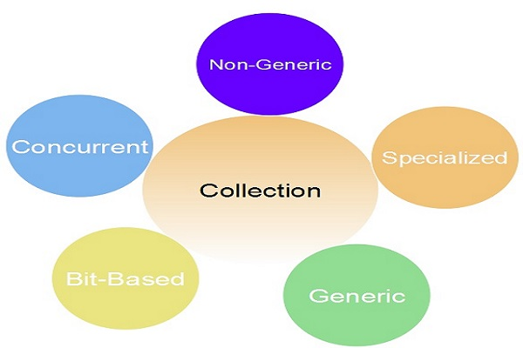
Collection
The .NET Framework supports the following five types of collections in C#:

Slide 4
System.Collections Namespace
The System.Collections namespace contains interfaces and classes.
The non-generic collection implements several fundamental data structures, including a dynamic array, stack and queue.
They also include dictionaries, in which we can store key/value pairs.

Slide 5
system.Collections.Specialized Namespace
The specialized collections operate on a specific type of data or operate in a unique way.
Like specialized collections for strings.
There are also specialized collections that use a single link list.

Slide 6
system.Collections.Generic Namespace
Generic collections provide us a generic implementation of several standard data structures, such as list, linked list, stack, queue and dictionary.
These collections are generic, they are type-safe.
This means that only items are type-compatible with the type of collection can be stored in a generic collection.

Slide 7
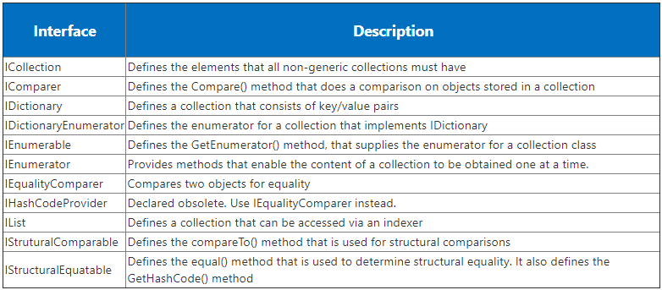
Non-Generic Interfaces

Slide 8
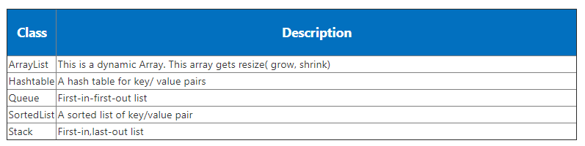
Non-Generic Classes

Slide 9
What Are Generics?
New Feature in c# 2.0.
The term generics mean parameterized types.
Parameterized types are important because they enable you to create classes, interfaces, methods, and delegates in which the type of data operated on is specified as a parameter.

Slide 10
Contd.,
Using generics, it is possible to create a single class that automatically works with different types of data.
A class, interface, method, or delegate that operates on a parameterized type is called generic, as in generic class or generic method.
In other words, generics allow you to write a class or method that can work with any data type.

Slide 11
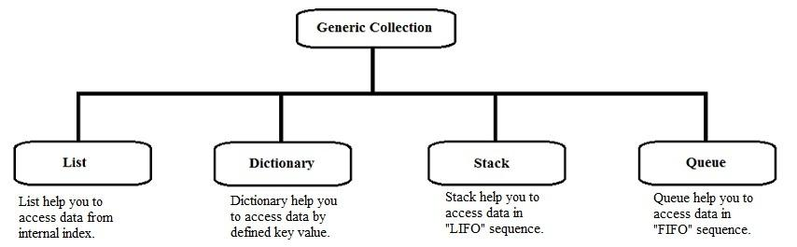
Contd.,

Slide 12
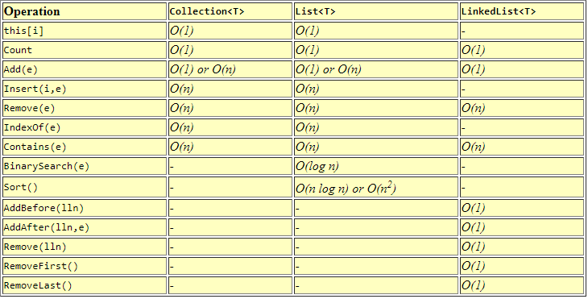

Slide 13
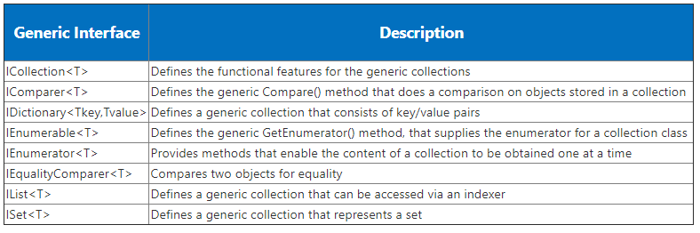
Generic Interface

Slide 14
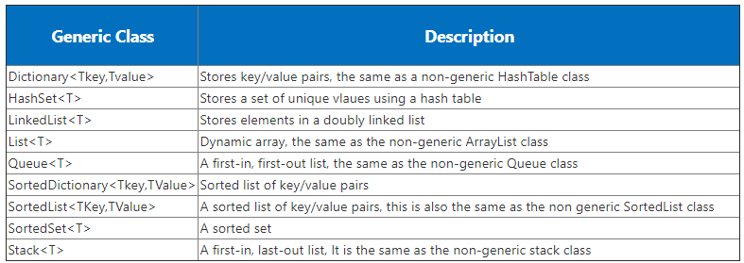
Generic Classes

Slide 15
The collection api
Adding and inserting items to a collection
Removing items from a collection
Finding, sorting, searching items
Replacing items
Copy and clone collections and items
Capacity and Count properties to find the capacity of the collection and number of items in the collection

Slide 16
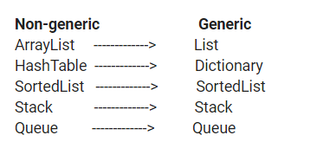
Contd.,

Slide 17
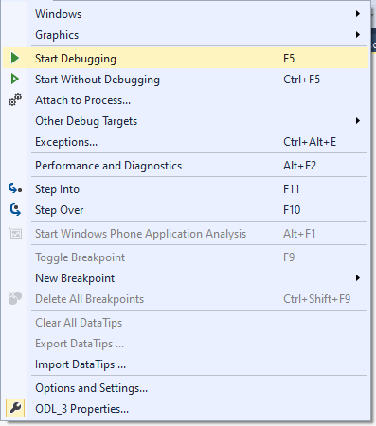
Debugging using Window

Slide 18
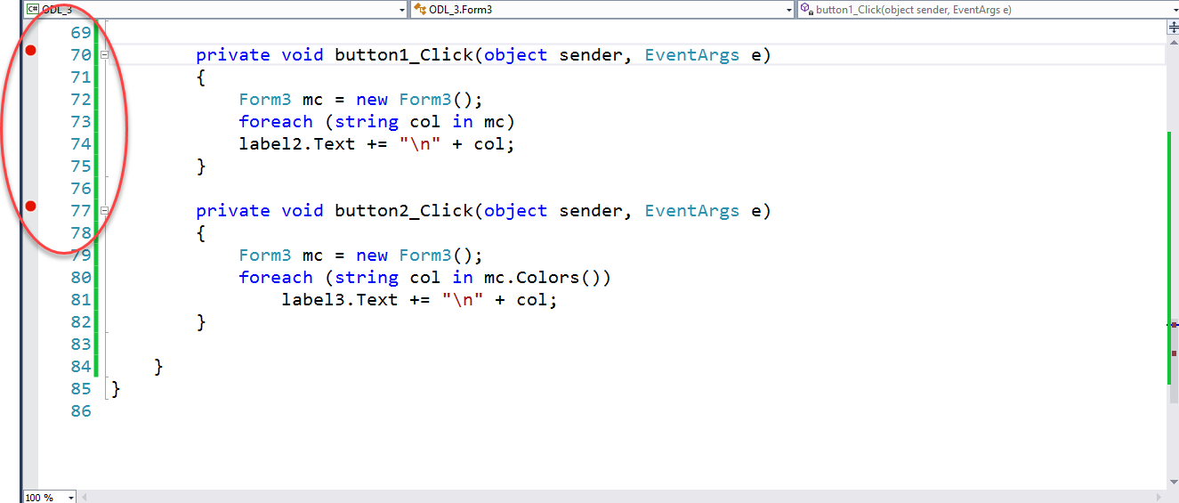
Breakpoints using Window

Slide 19
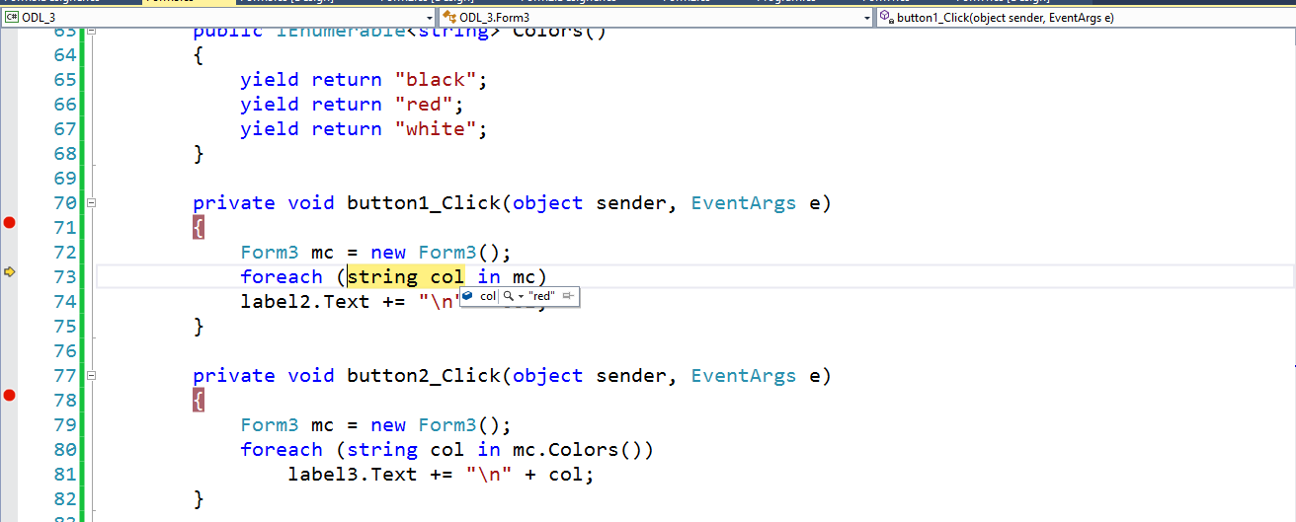
Data Viewing using Window

Slide 20
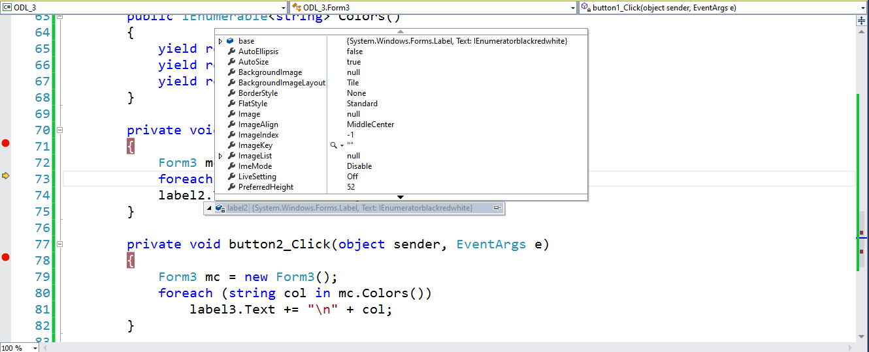
Variables Window

