Slide 1
Javascript
Course Level – Intermediate

Slide 2
About the Course Creators
Course Name | Java Script
Course Author Name : | Benhar Charles Velankanni
About the Author : | Senior Technical Trainer L&D

Slide 3
What is Javascript?
How to validate the user data using Javascript?
What are the types of Javascript?
Do You Know?

Slide 4
Pre-Test
S.No | Question | Answer Options
1 | Which of the following tag is used to write internal Javascript? | a)<style> b) <script> c) <javascript> d) <js>
2 | Which of the following is / are the types of Javascript? | a)Inline Javascript. b) Internal Javascript. c) External Javascript. d) All the above

Slide 5
Pre-Test
S.No | Question | Answer Options
3 | Which of the following is / are valid events in Javascript? | a) onclick b) onblur c) onfocus d) All the above
4 | What is the correct syntax for referring to an external script called "abc.js"? | a) <script src=”abc.js”/> b) <script href=”abc.js”/> c) <script ref=”abc.js”/> d) <script link=”abc.js”/>

Slide 6
Javascript - Overview

Slide 7
6WH JS?
What if JS is not available? | Site loses interactivity; use HTML/CSS and server-side fallbacks.
What is the alternative to JS? | HTML5, CSS, and server-side languages like PHP, Python, or Ruby.
When to use JS? | For dynamic content, form validation, interactivity, and real-time updates.
Best scenario to use JS? | SPAs, dashboards, live chat, modals, and dynamic forms.
How to implement JS? | Inline, internal (<script> tag), or external (.js file).

Slide 8
JavaScript (js) is a light-weight object-oriented programming language which is used by several websites for scripting the webpages.
It is an interpreted, full-fledged programming language that enables dynamic interactivity on websites when applied to an HTML document.
It was introduced in the year 1995 for adding programs to the webpages in the Netscape Navigator browser. Since then, it has been adopted by all other graphical web browsers.
With JavaScript, users can build modern web applications to interact directly without reloading the page every time.
The traditional website uses js to provide several forms of interactivity and simplicity.
What is JS?

Slide 9
All popular web browsers support JavaScript as they provide built-in execution environments.
JavaScript follows the syntax and structure of the C programming language. Thus, it is a structured programming language.
JavaScript is a weakly typed language, where certain types are implicitly cast (depending on the operation).
JavaScript is an object-oriented programming language that uses prototypes rather than using classes for inheritance.
Features of JS.

Slide 10
It is a light-weighted and interpreted language.
It is a case-sensitive language.
JavaScript is supportable in several operating systems including, Windows, macOS, etc.
It provides good control to the users over the web browsers.
Features of JS.

Slide 11
It is a light-weighted and interpreted language.
It is a case-sensitive language.
JavaScript is supportable in several operating systems including, Windows, macOS, etc.
It provides good control to the users over the web browsers.
Features of JS.

Slide 12
You can implement JavaScript in three main ways:
Inline:
<button onclick="alert('Hello!')">Click Me</button>
Internal (within <script> tag):
<script>
document.getElementById("myBtn").onclick = function() {
alert("Button clicked!");
};
</script>
Implement JavaScript
External (best practice):​
<!-- HTML -->​
<script src="script.js"></script>​
// script.js​
document.getElementById("myBtn").addEventListener("click", function() {​
alert("Button clicked!");​
});​

Slide 13
Javascript - Basics

Slide 14
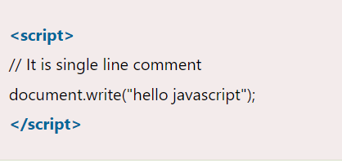
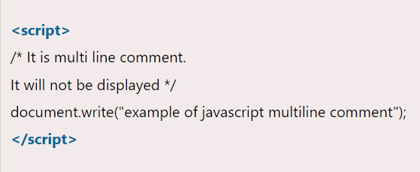
There are two types of comments in JavaScript.
Single-line Comment
Multi-line Comment
JS Comments

Slide 15
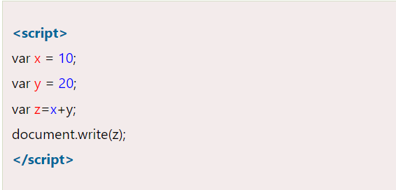
A JavaScript variable is simply a name of storage location.
There are two types of variables in JavaScript : local variable and global variable.
Variables in JavaScript

Slide 16
JS Variables
Concept | Explanation | Example
What is a variable? | A container for storing data values. | let age = 25;
How to declare? | Use var, let, or const. | const city = "Delhi";
var | Old way to declare variables; function-scoped. | var score = 100;
let | Modern way; block-scoped and can be updated. | let name = "Alice"; name = "Bob";
const | Block-scoped; cannot be updated or re-declared. | const pi = 3.14;
Naming rules | Must start with a letter, _, or $; no spaces; case-sensitive. | let $price = 99; let _userName = "John";

Slide 17
var – Function‑scoped (older way)
Scope: Function‑scoped (visible throughout the entire function in which it is declared, or globally if declared outside any function).
Redeclaration: Allowed – you can declare the same variable multiple times within the same scope without error.
Hoisting: Variables declared with var are hoisted to the top of their scope. They are initialized with undefined until the actual declaration is reached.
Reassignment: Allowed.
Global object property: When declared globally, var adds a property to the global object (window in browsers).
Use: Generally avoid in modern JavaScript because its function‑scoping and hoisting behavior can lead to bugs.

Slide 18
let – Block‑scoped (preferred)
Scope: Block‑scoped (visible only within the nearest enclosing block { ... }).
Redeclaration: Not allowed within the same scope – trying to redeclare a let variable in the same block throws a SyntaxError.
Hoisting: let declarations are hoisted but not initialized. Accessing them before the declaration results in a ReferenceError (Temporal Dead Zone).
Reassignment: Allowed.
Global object property: Global let variables do not become properties of the global object.
Use: Preferred over var when you need to reassign the variable.

Slide 19
const – Block‑scoped, constant reference
Scope: Block‑scoped (same as let).
Redeclaration: Not allowed within the same scope.
Hoisting: Hoisted but uninitialized (Temporal Dead Zone applies).
Reassignment: Cannot be reassigned – the binding is constant. However, if the value is an object or array, its properties or elements can still be modified.
Initialization: Must be initialized at the time of declaration.
Global object property: Does not become a property of the global object.
Use: Use by default for values that should not be reassigned (immutable binding).

Slide 20
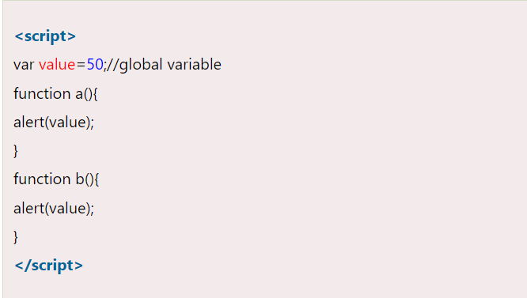
A JavaScript global variable is declared outside the function or declared with window object. It can be accessed from any function.
JS Global Variables

Slide 21
JS Global Variables
Concept | Explanation | Example
Global Scope | Variables declared outside functions are in the global scope. | var name = "Alice";
Access Anywhere | Global variables can be accessed and modified from any function or block. | console.log(name);
var vs let/const | var creates a property on the window object in browsers; let and const do not. | window.name // "Alice"

Slide 22
Global Scope
Definition: Variables declared outside any function or block ({ ... }) are in the global scope. They can be accessed from anywhere in the code – inside functions, blocks, or other scripts.
Creation: var, let, or const declared at the top level (not inside any function/block) become global.
In browsers, global var variables and function declarations become properties of the window object. Global let and const do not attach to window.
Risks: Overusing global variables can lead to naming collisions and make code harder to maintain. It’s best to keep the global scope as clean as possible.

Slide 23
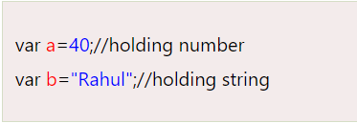
JavaScript provides different data types to hold different types of values. There are two types of data types in JavaScript.
Primitive data type
Non-primitive (reference) data type
JavaScript is a dynamic type language, means you don't need to specify type of the variable because it is dynamically used by JavaScript engine. You need to use var here to specify the data type. It can hold any type of values such as numbers, strings etc.
JS Data Types

Slide 24
JS Data Types
Data Type | Description | Example
String | Text enclosed in quotes | "Hello, world"
Number | Numeric values (integers or decimals) | 42, 3.14
Boolean | Logical value: true or false | true, false
Undefined | A variable declared but not assigned a value | let x;
Null | Represents an intentional absence of value | let x = null;
Object | Collection of key-value pairs | { name: "John", age: 30 }
Array | Ordered list of values | [1, 2, 3, 4]
Symbol | Unique and immutable primitive value | Symbol("id")
BigInt | For very large integers | 123456789012345678901234567890n

Slide 25
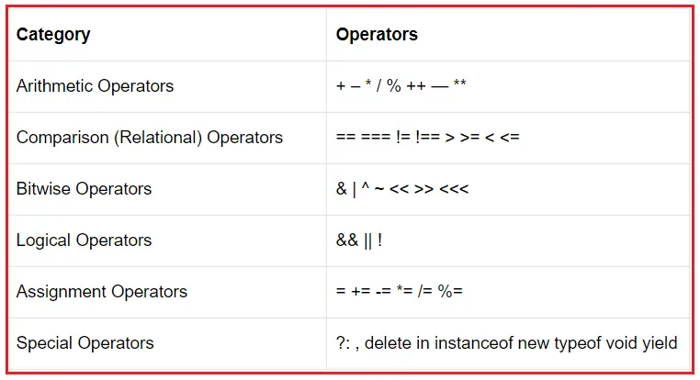
JS Operators

Slide 26
JS Operators
Operator Type | Description | Example | Result
Arithmetic | Perform basic math operations | 5 + 2, 10 * 3 | 7, 30
Assignment | Assign values to variables | x = 10, x += 5 | x = 15
Comparison | Compare two values | 5 == '5', 5 === '5' | true, false
Logical | Combine or invert boolean values | true && false, !true | false, false
String | Concatenate strings | "Hello" + " World" | "Hello World"
Type | Check or convert data types | typeof 123, typeof "abc" | "number", "string"
Ternary | Short form of if-else | age > 18 ? "Adult" : "Kid" | "Adult" or "Kid"
Bitwise | Operate on binary representations | 5 & 1, `5 | 1`
Notes:
==: compares the value of the variables
===: compares the type and value of the variables
For example, 5 === "5" will return a false result. Even though the value of both variables is the same, their type is not; one of them is a String ("5"), and the other one is an Integer (5).
On the other hand, 5 == "5" will return a true result. Both variables have the same value; therefore, the result will be true.

Slide 27

Check Your Understanding
What is Javascript?
How to use Javascript to validate user data?
What are the types of Javascript?

Slide 28

Question & Answer

Slide 29
Benhar Charles Velankanni

