Slide 1
Javascript
Course Level – Intermediate

Slide 2
About the Course Creators
Course Name | Java Script
Course Author Name : | Benhar Charles Velankanni
About the Author : | Senior Technical Trainer L&D

Slide 3
Javascript - Basics

Slide 4
The JavaScript if-else statement is used to execute the code whether condition is true or false. There are three forms of if statement in JavaScript.
If Statement
If else statement
if else if statement
JS if-else

Slide 5
JS if-else
Structure | Description | Example
if | Runs code if condition is true | if (x > 10) { console.log("Big"); }
else | Runs code if condition is false | else { console.log("Small"); }
else if | Checks another condition if the first is false | else if (x === 10) { ... }

Slide 6
The JavaScript switch statement is used to execute one code from multiple expressions.
It is just like else if statement that we have learned in previous page.
But it is convenient than if..else..if because it can be used with numbers, characters etc.
JS switch

Slide 7
JS Loops
Loop Type | Description | Example
for | Loops a block a specific number of times | for (let i = 0; i < 5; i++) { ... }
while | Loops while a condition is true | while (i < 5) { ... }
do...while | Runs once, then repeats while condition is true | do { ... } while (i < 5);
for...of | Loops through values of an iterable (like arrays) | for (let item of arr) { ... }
for...in | Loops through keys of an object | for (let key in obj) { ... }

Slide 8
JavaScript functions are used to perform operations. We can call JavaScript function many times to reuse the code.
There are mainly two advantages of JavaScript functions.
Code reusability: We can call a function several times so it save coding.
Less coding: It makes our program compact. We don’t need to write many lines of code each time to perform a common task.
JS Functions

Slide 9
JS Functions
Concept | Description | Example
Function Declaration | Defines a named function | function greet() { ... }
Function Call | Executes the function | greet();
Parameters | Inputs passed to a function | function greet(name) { ... }
Return Value | Output sent back from a function | return name + "!"
Anonymous Function | Function without a name | const sayHi = function() { ... };
Arrow Function | Shorter syntax for functions | const add = (a, b) => a + b;

Slide 10
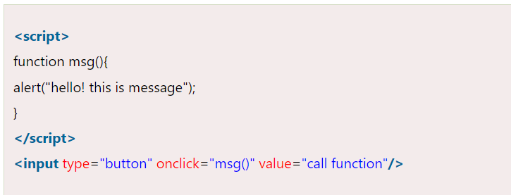
JS Function Example

Slide 11
Javascript - Objects

Slide 12
A javaScript object is an entity having state and behavior (properties and method). For example: car, pen, bike, chair, glass, keyboard, monitor etc.
JavaScript is an object-based language. Everything is an object in JavaScript.
JavaScript is template based not class based. Here, we don't create class to get the object. But, we directly create objects.
JS Objects

Slide 13
JS Objects
Concept | Description | Example
Object | A container for properties and methods | let person = { name: "John", age: 30 };
Property | A key-value pair inside an object | name: "John"
Method | A function inside an object | greet: function() { ... }
Access Property | Use dot . or bracket [] notation | person.name or person["name"]
Add Property | Add new key-value pair | person.city = "Delhi";
Delete Property | Remove a property | delete person.age;

Slide 14
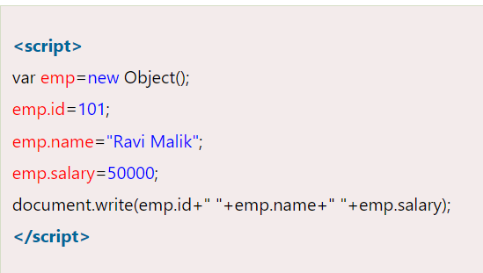
Creating Objects in JS

Slide 15
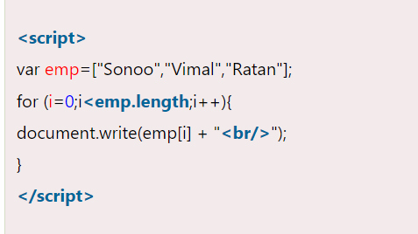
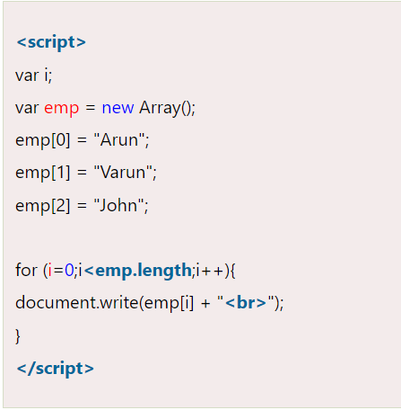
JavaScript array is an object that represents a collection of similar type of elements.
JS Array

Slide 16
JS Array
Concept | Explanation | Example
Create an Array | Use square brackets [] or the Array constructor. | let fruits = ["apple", "banana", "cherry"];
Access Elements | Use index numbers (starting from 0). | fruits[1] // "banana"
Change Elements | Assign a new value to an index. | fruits[0] = "mango";
Array Length | Use .length to get the number of elements. | fruits.length // 3

Slide 17
JS Array
Loop Through | Use for, forEach, or for...of to iterate. | fruits.forEach(f => console.log(f));
Add Elements | Use .push() to add at the end, .unshift() to add at the beginning. | fruits.push("orange");
Remove Elements | Use .pop() to remove from end, .shift() to remove from beginning. | fruits.pop();
Check Type | Use Array.isArray() to check if a variable is an array. | Array.isArray(fruits) // true

Slide 18
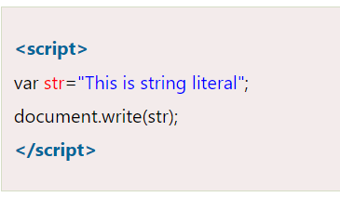
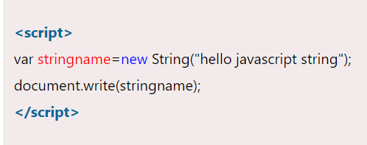
The JavaScript string is an object that represents a sequence of characters.
JS String

Slide 19
JS String
Concept | Explanation | Example
Create a String | Use single ('), double ("), or backticks (`) for template literals. | let name = "Alice";
Concatenation | Combine strings using + or template literals. | "Hello, " + name or `Hello, ${name}`
Length | Use .length to get the number of characters. | name.length // 5
Access Characters | Use bracket notation with index (starts at 0). | name[0] // "A"
Escape Characters | Use \ to escape quotes or special characters. | "He said, \"Hi!\""
Multiline Strings | Use backticks (template literals). | `Line 1\nLine 2`

Slide 20
JS String
Method | Description | Example
toUpperCase() | Converts to uppercase | "hello".toUpperCase() → "HELLO"
toLowerCase() | Converts to lowercase | "HELLO".toLowerCase() → "hello"
includes() | Checks if string contains a substring | "apple".includes("pp") → true
indexOf() | Returns index of first match | "banana".indexOf("a") → 1
slice(start, end) | Extracts part of a string | "hello".slice(1, 4) → "ell"
replace() | Replaces part of a string | "Hi Bob".replace("Bob", "Alice")
trim() | Removes whitespace from both ends | " hello ".trim() → "hello"
split() | Splits string into an array | "a,b,c".split(",") → ["a", "b", "c"]

Slide 21

Check Your Understanding
What is Javascript?
How to use Javascript to validate user data?
What are the types of Javascript?

Slide 22

Question & Answer

Slide 23
https://www.w3schools.com/js/
https://www.javascripttutorial.net/
https://www.tutorialspoint.com/javascript/index.htm
Reference Materials

Slide 24
Benhar Charles Velankanni

