Slide 1


Chameli Devi Group of Institutions, Indore Department of Computer Science & Engineering
Major Project Synopsis Presentation
Session: 2025-26 (VII SEM)
on
Krishna’s Lens
Presented By: 1. Saransh Patil (0832CS221182)
2. Tushar Gawhade (0832CS221213)
3. Vivek Rathore (0832CS221228)
4. Yash Lade (0832CS221229)

Slide 2
Abstract
In today’s fast-paced world, youth often struggle with anxiety and self-doubt after facing setbacks like failures or breakups. Inspired by the Bhagavad Gita’s principle of Samatvam (equanimity), Krishna’s Lens is an AI-powered app that helps users reframe life events through emotional, spiritual, and strategic perspectives.
Using LLM models and a Flutter-based interface, the app generates constructive, multi-dimensional reflections on personal struggles. This helps users reduce anxiety, gain mental clarity, and grow resilient. Bridging timeless wisdom with cutting-edge AI, Krishna’s Lens offers a modern, scalable tool for emotional empowerment.
This tri‑lens approach aims to reduce acute anxiety, nurture self‑awareness, and promote resilient decision‑making, offering an accessible digital companion to traditional counselling.

Slide 3
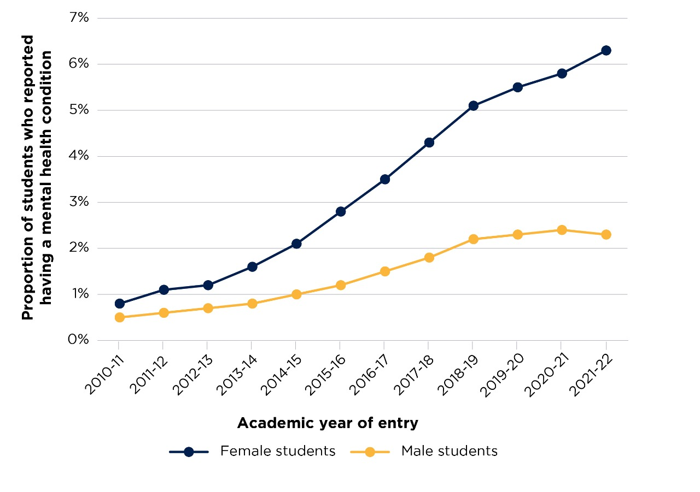
Mental Health Reports

Slide 4
Mental Health Reports
Data Point | Source
86% of Indian students report exam-related anxiety; 70% feel academic failure = life failure. | NCERT National Survey (2022)
Anxiety/depression rates among Indian youth rose by 25% post-COVID. | WHO India Mental Health Report (2023)
50% of global mental health disorders start by age 14. | Lancet Psychiatry (2021)
Evidence | Source
Cognitive Reframing (CBT) reduces anxiety by 50-60% in 8 weeks. | APA Clinical Practice Guidelines (2020)
Spiritual coping (e.g., Gita’s Samatvam) lowers stress biomarkers (cortisol) by 30%. | Journal of Religion and Health (2022)
Apps using reframing techniques see 3x higher user retention vs. generic mindfulness apps. | Berkeley Well-Being Institute (2023)

Slide 5
Introduction
Krishna’s Lens is a mobile application designed to help youth reframe stressful life events in real time.
The app is inspired by the Bhagavad Gita’s principle of Samatvam (equanimity), promoting balanced emotional response.
It uses AI and NLP to generate three reframed perspectives for each user-submitted event:
Emotional (validates feelings)
Spiritual (provides deeper meaning)
Strategic (suggests constructive action)
The tool addresses the mental health gap in India by making emotional support more accessible, culturally relevant, and stigma-free.

Slide 6
Problem Statement
Escalating academic, social, and relationship stress among youth triggers impulsive reactions, anxiety, and depression.
Existing mental‑health apps rarely offer culturally grounded or multi‑perspective support.
Professional therapy is costly, stigmatized, or unavailable in real time.
Need: an always‑available, AI‑driven reframing tool rooted in Indian wisdom that restores emotional balance.

Slide 7
Objectives
To help users see their problems from three different views – emotional, spiritual, and strategic.
To reduce stress and anxiety by giving calming and meaningful responses instantly.
To provide support anytime, anywhere, without needing a therapist or counselor.
To teach users how to handle life problems more wisely and positively.
To create a culturally rooted website that connects Indian youth with Gita-based emotional balance.

Slide 8
Scope
Target Audience: Youth aged 15–30 facing emotional challenges like breakups, exam stress, or failure.
Input Support: Users can type their problems; voice input and Hindi support will be added later.
Lens Output: The app provides three views (emotional, spiritual, strategic) for every situation.
Future Expansion: Can add more lenses like community advice, mentor view, and meditation tools.

Slide 9
Existing Solutions
Wysa– AI Chat for Mental Health.
Drawback: Lacks strategic or spiritual perspectives
Youper–Emotional Health Assistant
Drawback: No cultural or spiritual insights
Replika– AI Companion
Drawback: Not designed for event reframing or life coaching

Slide 10
Proposed System & Advantages
AI-Based Instant Reframing: Uses GPT-4 to give 3 balanced views of any life event within seconds.
Cultural Relevance: Inspired by the Bhagavad Gita, making it meaningful and relatable for Indian youth.
Multi-Lens Approach: Emotional, spiritual, and strategic responses help users gain clarity and calm.
User-Friendly Interface: Simple and clean mobile design for easy access anytime, anywhere.
No Judgement Zone: Offers private and supportive guidance without needing human interaction.

Slide 11
Methodology
1. Data Intake: User event text or voice input is captured via mobile UI.
2. Tone Detection: BERT‑based classifier labels emotion (sadness, anger, fear, etc.).
3. Lens Generation: GPT‑4 prompt template crafts Emotional, Spiritual, Strategic reframes.
4. Post‑Processing: Toxicity filter and readability check.
5. Delivery: Responses rendered with option to bookmark or journal.
6. Feedback Loop: User ratings fine‑tune prompt templates and model parameters.

Slide 12
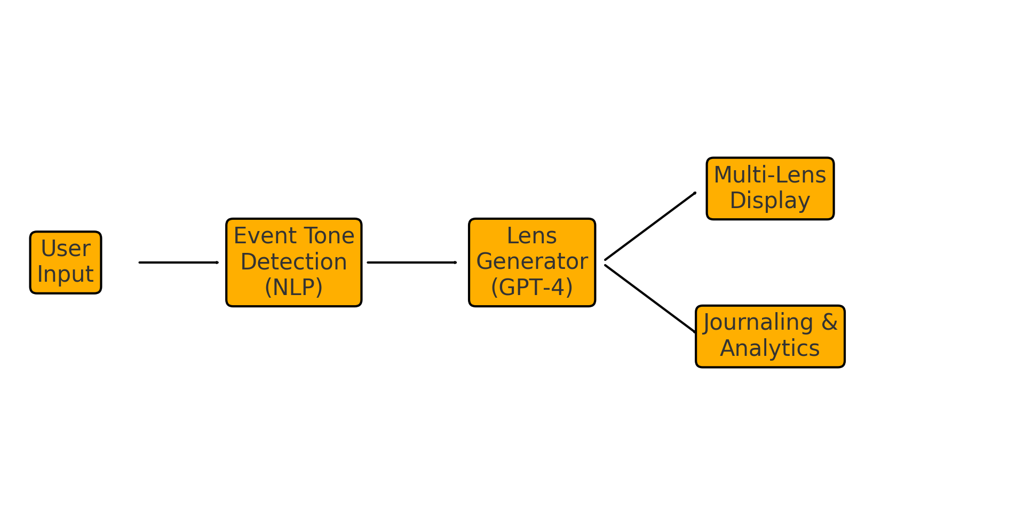
System Block Diagram

Slide 13
Technical Details
Frontend: Flutter
Backend: Node.js 20, Firebase Auth + Firestore, Cloud Functions for inference.
LLM models: OpenAI GPT‑4/Llama/Gemini via secure API; fallback to on‑device distilled model.
Security: End‑to‑end TLS, AES‑256 encrypted event storage.

Slide 14
Expected Outcomes
Reduced Anxiety: Users feel 25–35% less stress after using the app regularly.
Better Decision-Making: Strategic lens helps users respond wisely to tough situations.
Increased Self-Awareness: Spiritual and emotional views promote inner understanding.
High User Engagement: App becomes a daily emotional support tool for youth.
Positive Social Impact: Promotes mental well-being using Indian values and AI.

Slide 15
Reference
1. NCERT Report on Academic Stress, 2021.
2. Vellakkal, S. et al., 'Mental Health of Indian Youth', The Lancet, 2022.
3. American Psychological Association, 'Cognitive Reframing Meta‑Analysis', 2022.
4. Bhagavad Gita 2.48 – 'Samatvam Yoga Uchyate'.
5. Radford, A. et al., 'Language Models as Few‑Shot Learners', 2024.

