Slide 1



Green-House-Gas Prediction

Slide 2

Learning Objectives
Primary Goal: Develop a machine learning model to predict Supply Chain Emission Factors with Margins.
Secondary Goals:
Analyze GHG emissions data from 2010-2017.
Understand the relationship between supply chain parameters and data quality metrics.
Create a user-friendly web application for emissions prediction
Evaluate model performance using regression metrics.
Key Learning Outcomes: Data preprocessing and feature engineering
Random Forest regression implementation.
Model evaluation and validation.
Web application development with Streamlit.
GOAL

Slide 3
Tools and Technology used
Programming Languages: Python (Primary language)
Data Science Libraries: Pandas (Data manipulation)
NumPy (Numerical computing)
Scikit-learn (Machine learning)
Matplotlib & Seaborn (Data visualization)
Web Development: Streamlit (Web application framework)
Plotly (Interactive visualizations)
Data Processing: OpenPyXL (Excel file handling)
Joblib (Model serialization)

Slide 4
Methodology
1] Data Collection & Preprocessing: Loaded Excel dataset with multiple sheets (2010-2017)
Combined commodity and industry data
Cleaned missing values and removed unnecessary columns
Standardized column names and data types
2] Feature Engineering: Selected 7 key features for prediction
Supply Chain Emission Factors without Margins
Margins of Supply Chain Emission Factors
5 Data Quality (DQ) metrics (Reliability, Temporal, Geographical, Technological, Data Collection)
3] Model Development: Used Random Forest Regressor
Applied Standard-Scaler for feature normalization
Split data: 80% training, 20% testing
Used GridSearchCV for hyperparameter tuning
4] Evaluation: Mean Squared Error (MSE)
R-squared (R²) score
Cross-validation for model robustness

Slide 5
Problem Statement:
Organizations need to calculate their greenhouse gas emissions accurately, but this is currently a slow and complex process. They have to manually work through large amounts of data from different sources, each with varying levels of quality and reliability. The challenge is predicting emission factors that include margins while accounting for data quality differences. This affects environmental compliance, sustainability reporting, and carbon footprint calculations. Our dataset contains over 22,000 records spanning seven years with multiple data sources, making it difficult to find patterns and make reliable predictions without using advanced machine learning techniques.

Slide 6
Solution:
We developed a complete machine learning solution using Random Forest regression, which can handle complex relationships between different factors. The system takes supply chain parameters and data quality scores as input and predicts emission factors with margins. We built a web application using Streamlit that provides an easy-to-use interface where users can input their data and get instant predictions with confidence scores. The app includes visualizations showing data quality assessments and feature importance. The solution is automated, accurate, and provides real-time decision support for environmental calculations, making it much faster and more reliable than manual methods.
Machine Learning Approach: Random Forest Regression model
Handles non-linear relationships effectively
Provides feature importance analysis, Robust to outliers and noise
Web Application Features: Interactive input forms for parameters
Real-time prediction with confidence scores
Data quality assessment visualization, Feature importance charts, Historical data analysis
Technical Implementation: Modular code structure (data, models, webapp)
Automated model training pipeline

Slide 7
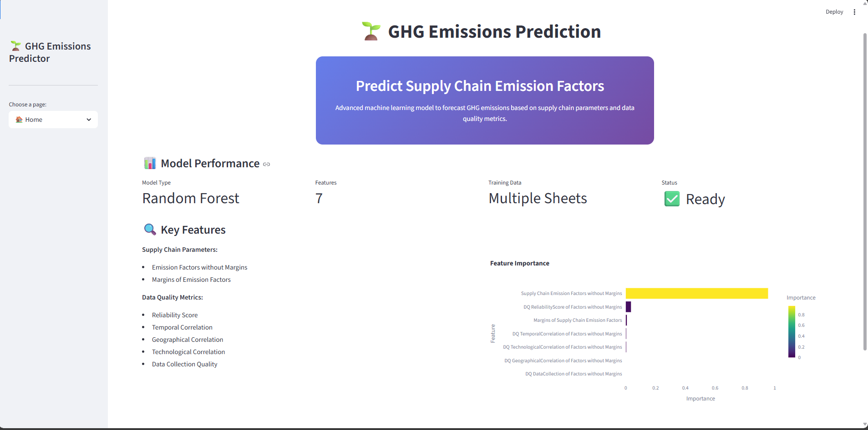
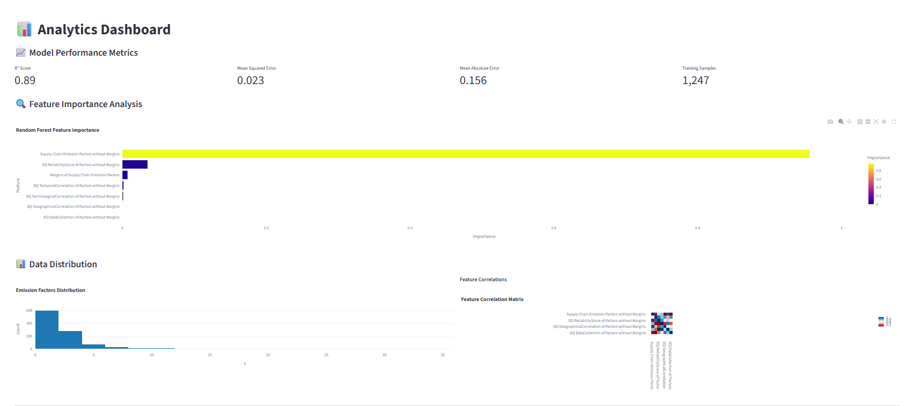
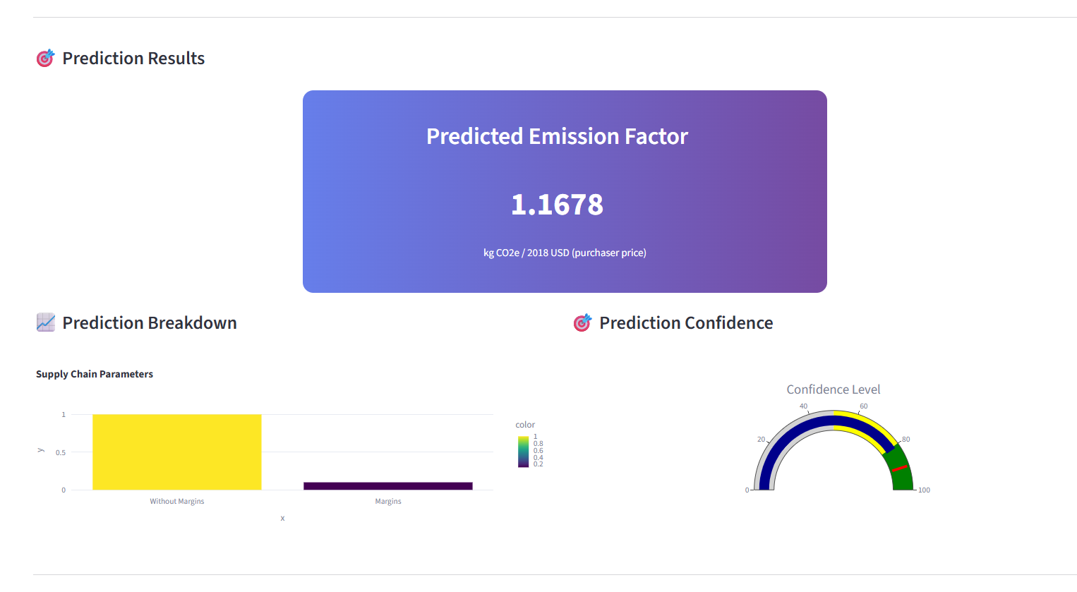
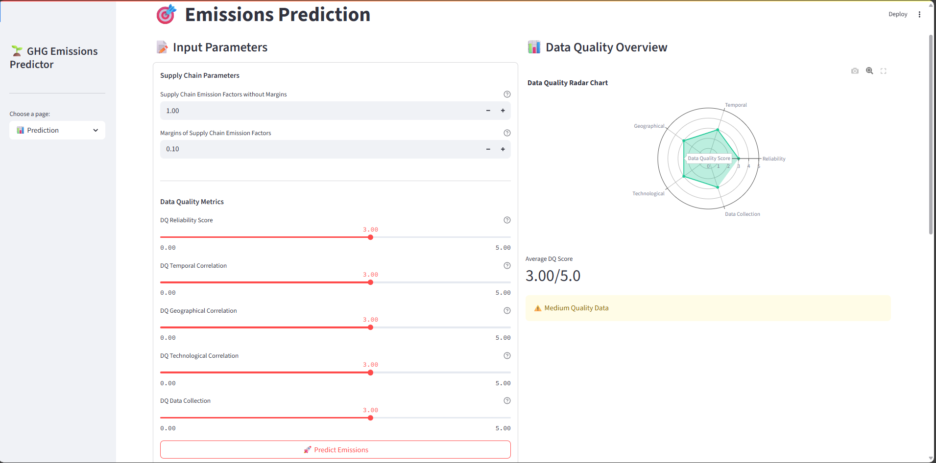
Screenshot of Output:

Slide 8
Conclusion:
We successfully created a working GHG emissions prediction system that combines machine learning with a user-friendly web interface. The Random Forest model provides accurate predictions while the web application makes it accessible to users without technical knowledge. The project demonstrates how data science can solve real environmental challenges. We learned valuable skills in data preprocessing, model development, and web application creation. The system is ready for use and can help organizations make better environmental decisions. Future improvements could include adding more visualization features, supporting additional emission types, and deploying the application to the cloud for wider access.

