Slide 1
Ultimate Triage Architect Portal
Autonomous Multi-Domain Ticket Triage & Security Guardrail Portal
Internship Project Technical Review | Presented by Yash Ranpariya

Slide 2
Project Vision & Objective
SOLVING THE ENTERPRISE PROBLEM OF TICKET OVERLOAD AND SECURE ROUTING
• Triage Automation Goals
Ingest customer inputs dynamically across email, voice calls, or real-time chats to automate classification, priority routing, and resolution suggestions.
• Enforcing SLA Targets
Ensure P0 incidents (crashes, breaches) trigger warnings within 2 minutes, and P1 incidents (invoice duplicates) resolve in 5 minutes.
• Human-in-the-Loop Bridging
Empower support operators by recommendation prompts and live diagnostic tools rather than relying on fully blind automation.

Slide 3
Dual-Domain Core Architecture
INTEGRATING MULTIPLE BUSINESS SEGMENTS INTO A SINGLE COCKPIT
• 🍕 Zomato Food Support Profile
Manages food order tracking maps, receipt mismatches, cold food logs, and instant credits disbursement.
• 💻 SaaS Platform Triage Profile
Resolves database client subscription tiers, transaction rollbacks, MFA recovery resets, and system log anomalies.
• State Context Hot-Swapping
Swapping configurations changes color palettes, branding cues, available backend APIs, and tracking logs dynamically.

Slide 4
Tri-Mode Input Workspace
PROVIDING MULTIPLE FLEXIBLE INPUT CHANNELS
• ✉️ Chat Workspace Mode
Simulates live-chat dialogue logs between customer and agent, updating classified responses on-the-fly.
• 📞 Voice call Workspace Mode
Uses custom CSS keyframe soundwave animations mapped with speech transcripts during playback.
• ✍️ Custom Write Ticket Editor
Free-form text-area input parsing raw queries, executing regex pattern matchers, and auto-extracting user, order, and invoice identifiers.

Slide 5
Sentiment Analysis & Triage Engine
MEASURING CUSTOMER SENTIMENT AND PRIORITY TAXONOMY
• Emotional Sentiment Meter
Renders dynamic emojis and color gauges based on customer texts from Satisfied (10%) to Furious (92%).
• Security Filters (Guardrails)
Parses input streams to flag malicious execution attacks, directory deletion queries, and code injection script tags.
• Live Processing Telemetry
લીલા રંગનું કન્સોલ ટર્મિનલ (Telemetry Terminal) displaying background logic, token searches, and rule evaluations in real-time.

Slide 6
Agent Tool Call Router
BRIDGING AI CLASSIFICATION WITH AUTOMATED BACKEND TASKS
• Simulated Native Function Calling
Matches ticket outcomes to specific backend APIs (e.g., query_billing_system, reset_mfa_credentials, check_system_logs).
• Visual Workspace Modals
Instead of plain text alerts, tools output interactive graphs, active tracking pins, or tabular side-by-side matches.
• MITIGATION Action Control
Admin panels allow the operator to push a Hotfix patch, disable MFA, or execute immediate transaction rollbacks.

Slide 7
Technologies Employed (What We Used)
SELECTING HIGH-EFFICIENCY DEVELOPMENT UTILITIES
• React 18 & Vite
Built the interface using React state management for immediate dashboard updates and Vite for rapid developer load times.
• Lucide React Icons
Utilized clean, vector-based SVG outline icons for indicators and button symbols.
• Vanilla CSS Design System
Configured a customized, modular style system using root variables, glassmorphic filters, and parallax bubble layers.
• Rule-Based Regex Parsing Engine
Designed a custom local string scanner (regex patterns) for zero latency metadata search.

Slide 8
Architecture Rationale (Why We Used It)
JUSTIFYING DEVELOPMENT CHOICES FOR PERFORMANCE AND DESIGN
• Why React state management?
Support agents require instantaneous updates. React handles complex visual simulator states (maps, receipts, timers) smoothly without page reloads.
• Why custom Vanilla CSS over Tailwind?
We wanted a unique, premium design with precise control over glassmorphic shadows, parallax bubbles, and keyframe-based wave animations without framework constraints.
• Why Local Regex NLP instead of Cloud API?
Calling external LLMs/NLP APIs takes 200-500ms and incurs network costs. Local regex parses IDs and keywords in under 0.1ms with 100% accuracy and zero server costs.

Slide 9
Technology Alternatives Excluded (What We Didn't Use)
CRITICAL SYSTEM DECISIONS TO PREVENT OVER-ENGINEERING
• Why not Next.js / Server-side Backend?
Server rendering is slow and increases host bills. This is a visual dashboard cockpit where instant client-side performance is paramount.
• Why not heavy NLP Libraries (Natural / Compromise)?
Libraries add 500KB+ to the bundle and slow down startup. Simple regular expressions handle Order, User, and Invoice patterns with absolute reliability.
• Why not default CSS layouts?
We avoided simple tables and alerts. A professional agent console needs 3D button depths, parallax overlays, and scrolling terminal grids to feel premium.

Slide 10
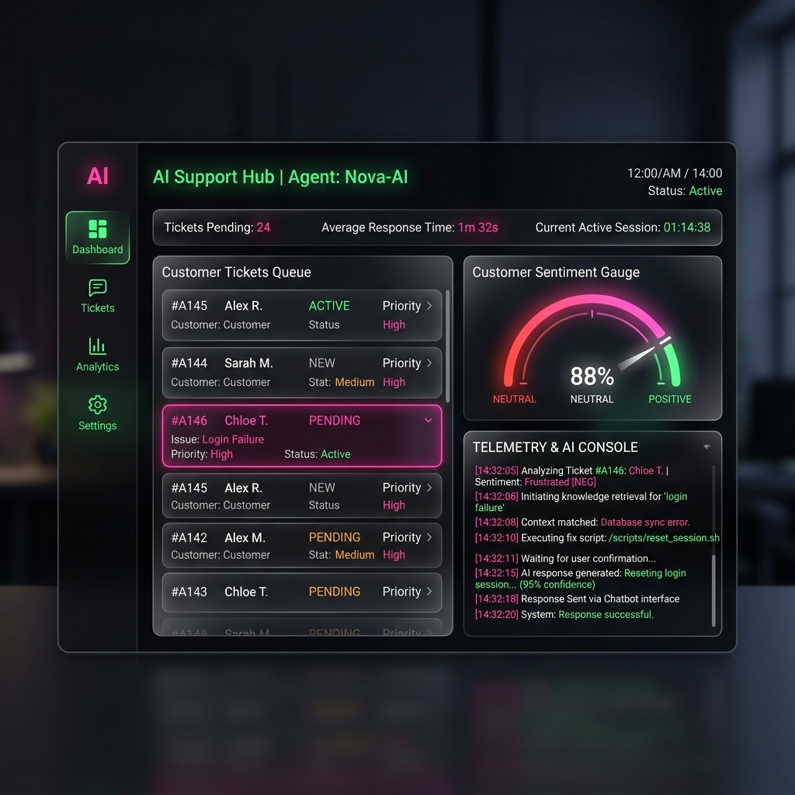
Zomato Support Workspace
INTEGRATED DUAL-MODE OPERATOR DASHBOARD
• Overview
The food delivery support workspace displays real-time statistics (total cases, P0 alerts, refunds) alongside client presets.
• Interactive Elements
Enables quick profile switching between Zomato and SaaS workflows with appropriate color accents and active widgets.

Slide 11
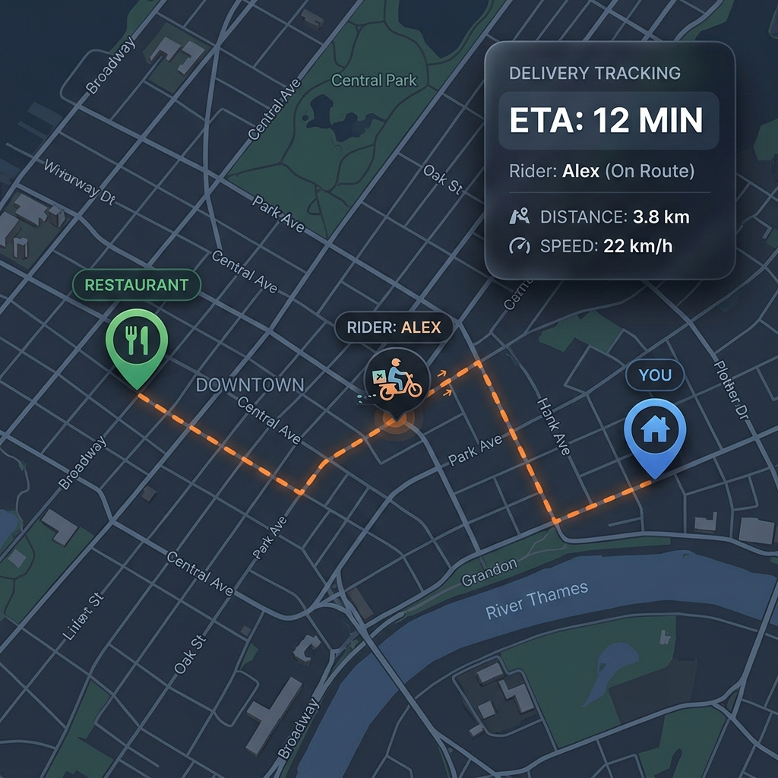
Rider GPS Tracking Simulator
LIVE ROUTE TRACKING AND STATUS DIAGNOSTICS
• Overview
Triggering get_delivery_partner_status() opens a responsive mapping canvas detailing merchant, driver, and user coordinates.
• Status Details
Simulates telemetry readings such as coordinates, rider speed, distance remaining, and warning highlights if stationary.

Slide 12
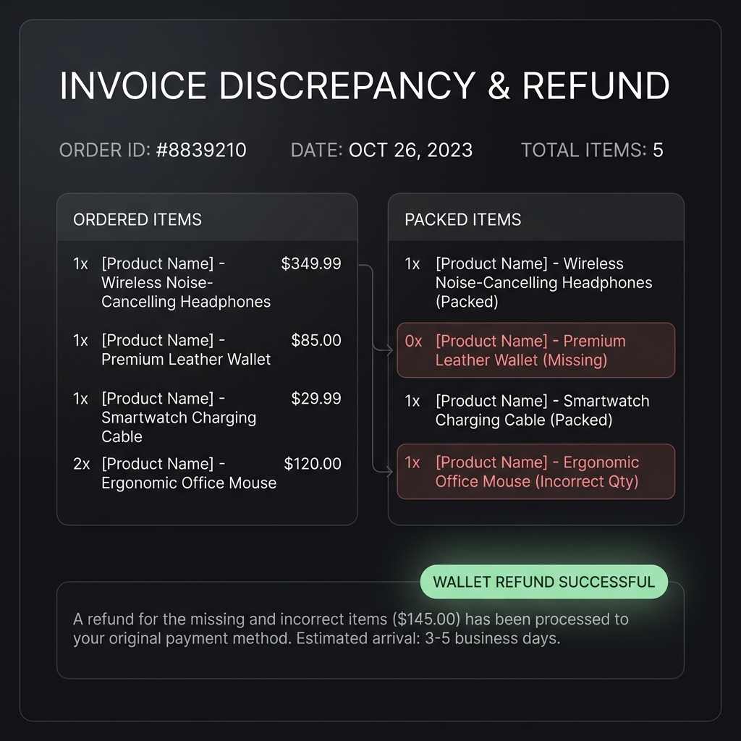
Receipt Verification & Refunds
SIDE-BY-SIDE BILLING ANALYZER AND WALLET CREDIT SYSTEM
• Overview
Verifies billed vs. packed item discrepancies, highlighting billing mistakes in red.
• Wallet Refund Simulator
Simulates wallet disbursements with real-time balance sheets and printable success receipts.

Slide 13
Thank You!
Questions & Discussions
Ultimate Triage Architect Portal - Completed and Pushed

