Slide 1


USING MACHINE LEARNING TO IDENTIFY ONLINE GAMING ADDICTION
Presented By
SARTHAK SINGH 2020UIC3544
ISHMIT KOCHHAR 2020UIC3508
RISHABH DOBHAL 2020UIC3545
PRATEEK CHAUDHARY 2020UIC3536
Dept. of Instrumentation & Control Engineering
Netaji Subhas University of Technology
Mid Term Review
ICICC22 B.Tech Project-1

Slide 2

TABLE OF CONTENT
Introduction
Literature Review
Gaps Identified
Aims/Objectives of the Project
Solution Methodology adopted/to be adopted
Dataset
Learning algorithms used
Results (if any/optional)
Future work to be done
References

Slide 3
INTRODUCTION
Both young and old people around the world enjoy playing video games as a pastime. Asia was the world's largest market for video games in 2021, with approximately 1.48 billion gamers, followed by Europe (715 million), which was the second-largest market. An estimated 3.24 billion people played video games worldwide.
Online gaming addiction has become increasingly common as a result of how well-liked online games have become among the younger generation. One of the most addictive Internet behaviors to date, according to recent studies, is online gaming.
The concern over online gaming addiction among youth has prompted the idea of employing machine learning to predict the likelihood of addiction.
A diverse and balanced dataset is crucial for developing a reliable machine learning model. It should encompass a wide range of features, including not only demographic factors like age and gender but also gaming behavior, types of games played, and social interactions within games.

Slide 4
LITERATURE REVIEW

Slide 5
GAPS IDENTIFIED
Previous research focused on classifying gaming addiction. Our innovative approach goes beyond binary classification, developing a sophisticated probabilistic model. It identifies existing addiction and estimates the likelihood of future online gaming addiction. This research leverages probabilistic modeling for a comprehensive understanding and potential early intervention.
Our unique platform fills a void, enabling users to input data and gauge their risk of online gaming addiction, providing essential insights for informed decisions

Slide 6
AIM/OBJECTIVE
The objective of this study is to analyze the data of participants and create a model for predicting the start of an addiction to online gaming. Data from people's daily lives and other related data are used to build the prediction model.
Our project involves the creation of a user-friendly web interface that empowers individuals to provide input regarding their gaming habits. This interface will then analyze the data to help users identify whether they may be addicted to online gaming or not. By offering a straightforward and accessible platform for self-assessment, we aim to raise awareness and enable individuals to make informed decisions about their gaming behavior.

Slide 7
METHODOLOGY
The goal of this study is to develop a model of predicting onset of online gaming addiction. The Prediction Model is built using data collected from various sources. We will be using a variety of machine-learning methods to develop this model.
LRR
SVM
SURVEY DATA
PREPOCESSING
FEATURE
ENGINEERING
MODEL TRAINING
MODEL EVALUATION
KNN
DT

Slide 8
DATASET
Data collection was done via Google Forms within a two-week timeframe. The questionnaire encompassed inquiries related to:
S.no | Item | Description
1. | Demographic Details | This includes Age, Gender and Country of participants.
2. | Platform Played On | Participants were asked if they played on XBOX, PS4, Mobile or PC. Mobile users were further redirected to upload screenshots of their statistics.
3. | IGDS9-SF | Nine items questionnaire to assess Internet Gaming Disorder
4. | Playtime statistics | This includes weekly playtime and average session duration.

Slide 9
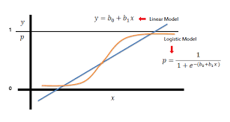
Learning Algorithms Used
The following four algorithms were used to predict online gaming addiction:
Logistic Regression: Logistic regression is a statistical model that uses a logistic function to model a binary dependent variable.
Linear Model: Calculate a linear function and then a threshold.
Logistic Model: It estimates the class probability directly.

Slide 10

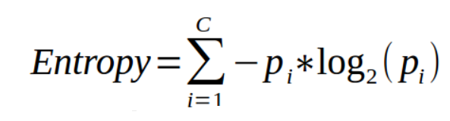
Learning Algorithms (contd.)
2) Decision Tree: Decision Trees are a type of Supervised Machine Learning (that is you explain what the input is and what the corresponding output is in the training data) where the data is continuously split according to a certain parameter.
In order to decide which feature to select in order to split the dataset, we calculate entropy of each feature . Higher the entropy, lesser the purity and higher the impurity.

Slide 11
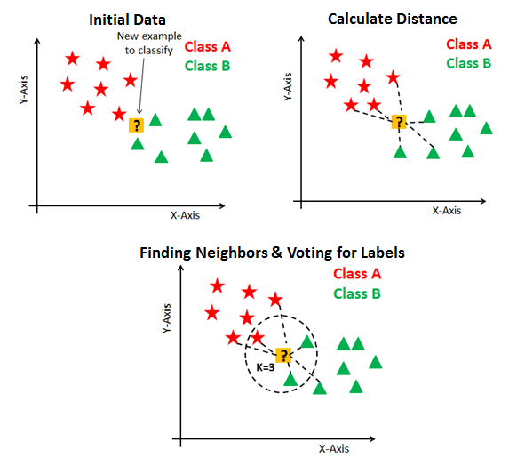
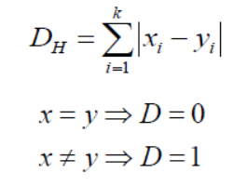
Learning Algorithms (contd.)
3) k-Nearest Neighbors: kNN tries to predict the correct class for the test data by calculating the distance between the test data and all the training points.
In KNN, algebraic distances are calculated but as soon as a categorical variable comes we calculate hamming distance. The dataset is standardized when we have a mix of numerical and categorical variables.
Hamming distance DH,:

Slide 12

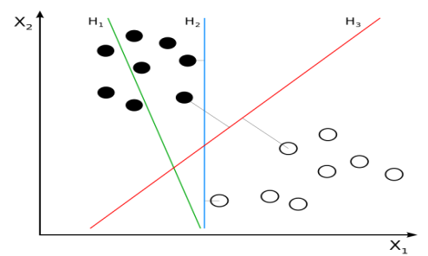
Learning Algorithms (contd.)
4)Support Vector Machine (SVM)
The training data is represented as points in space split into categories by a clear gap as broad as possible in a support vector machine. New examples are then mapped into the same space and classified according to which side of the gap they fall on. SVMs work well in high-dimensional domains and employ only a portion of training points in the decision function, making them memory-efficient.

Slide 13
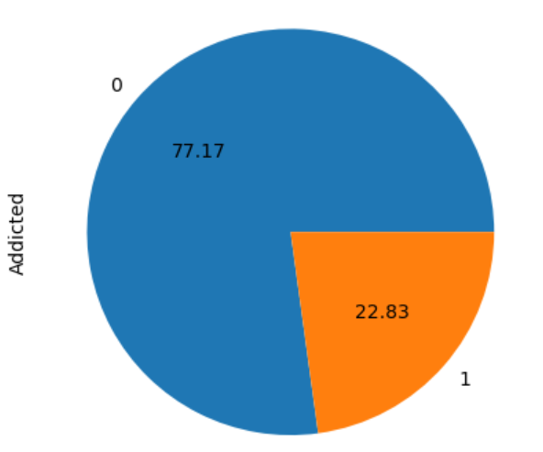
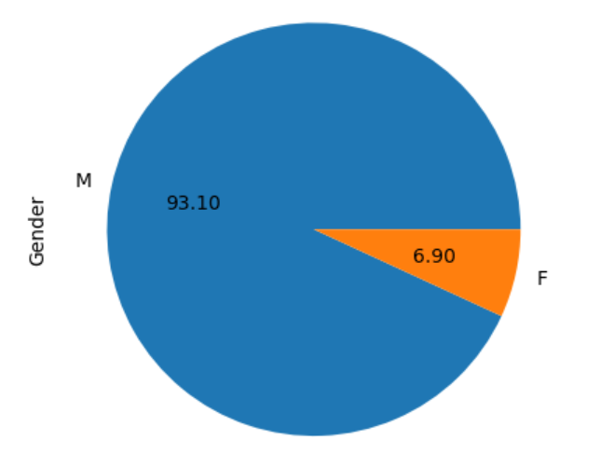
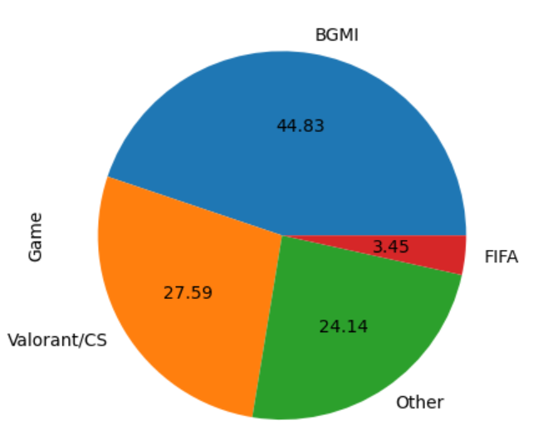
Results
Categorizing participants into addicted and non-addicted groups.
Gender variation of participants
Most played games by the participants

Slide 14
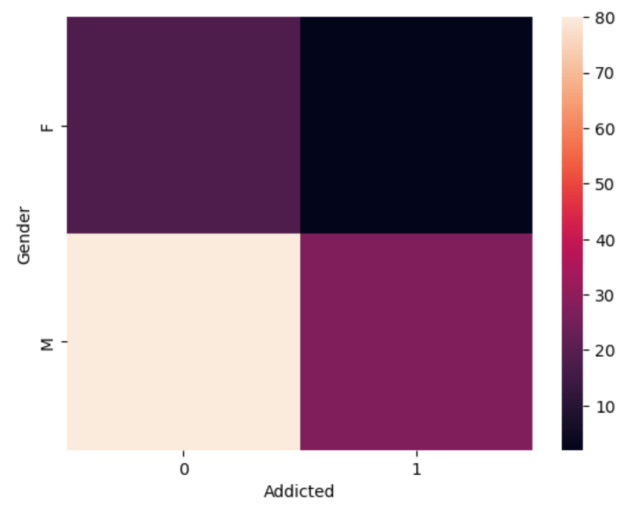
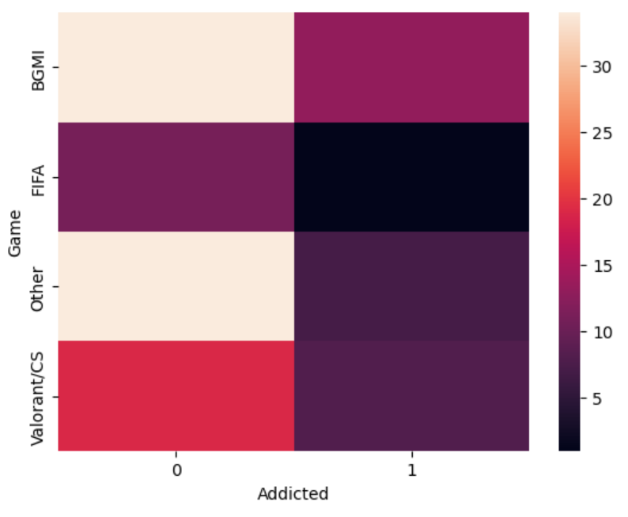
Results (contd.)
Heatmap ( addicted vs gender )
Heatmap ( addicted vs most played game )

Slide 15
Future work to be done
To develop a model capable of accurately classifying and identifying cases of online gaming addiction, providing valuable insights for early intervention and prevention.
To conduct a comparative analysis among various algorithms to assess their performance and suitability for the given problem.
Our ultimate objective is to create a user-friendly platform that allows individuals to recognize and acknowledge their online gaming addiction. This platform will serve as a supportive environment, offering valuable information and access to resources for those in need

Slide 16
References

Slide 17
Thank you
2020UIC3544 - SARTHAK SINGH
2020UIC3508 - ISHMIT KOCHHAR
2020UIC3545 - RISHABH DOBHAL
2020UIC3536 - PRATEEK CHAUDHARY
Mid Term Review
ICICC22 B.Tech Project-1

