Slide 1
Statistics for Audio
Deepfake Detection
A Data Mining Approach to Finding Codec-Robust
Acoustic Indicators of Synthetic Speech
Presented By:
[Your Name], [Affiliation]
MCCNNY 2026
Notes:
[15s] Good morning. My talk: which acoustic features identify deepfakes after codec compression?

Slide 2
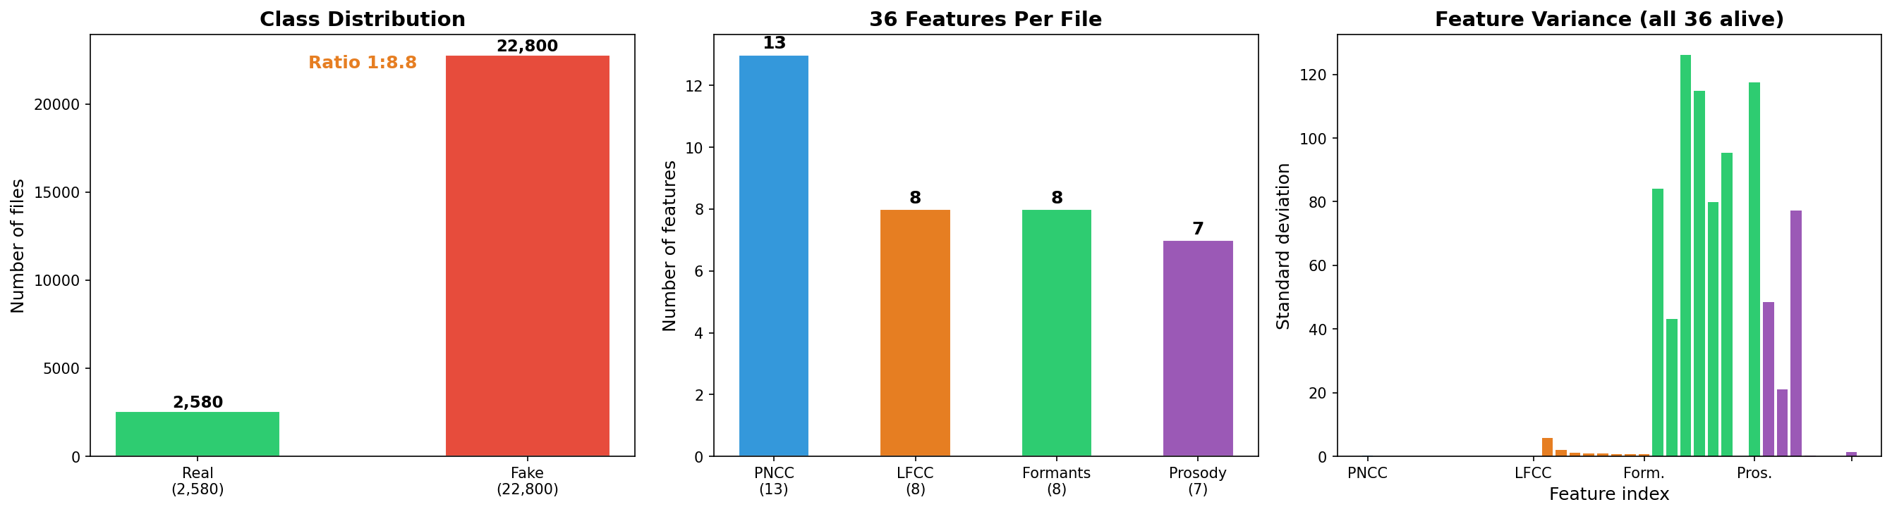
STEP 1
Understanding the Data
25,380 files: 2,580 real + 22,800 fake (ratio 1:8.8) | 36 features per file | ASVspoof 2019 LA challenge
Problem: Lab error 7% → After codecs: 50% (coin flip). Which features survive AND detect fakes?
Notes:
[30s] 25,380 files. 1:8.8 ratio. 36 features. Lab: 7%. Codecs: 50%. Which features survive?

Slide 3
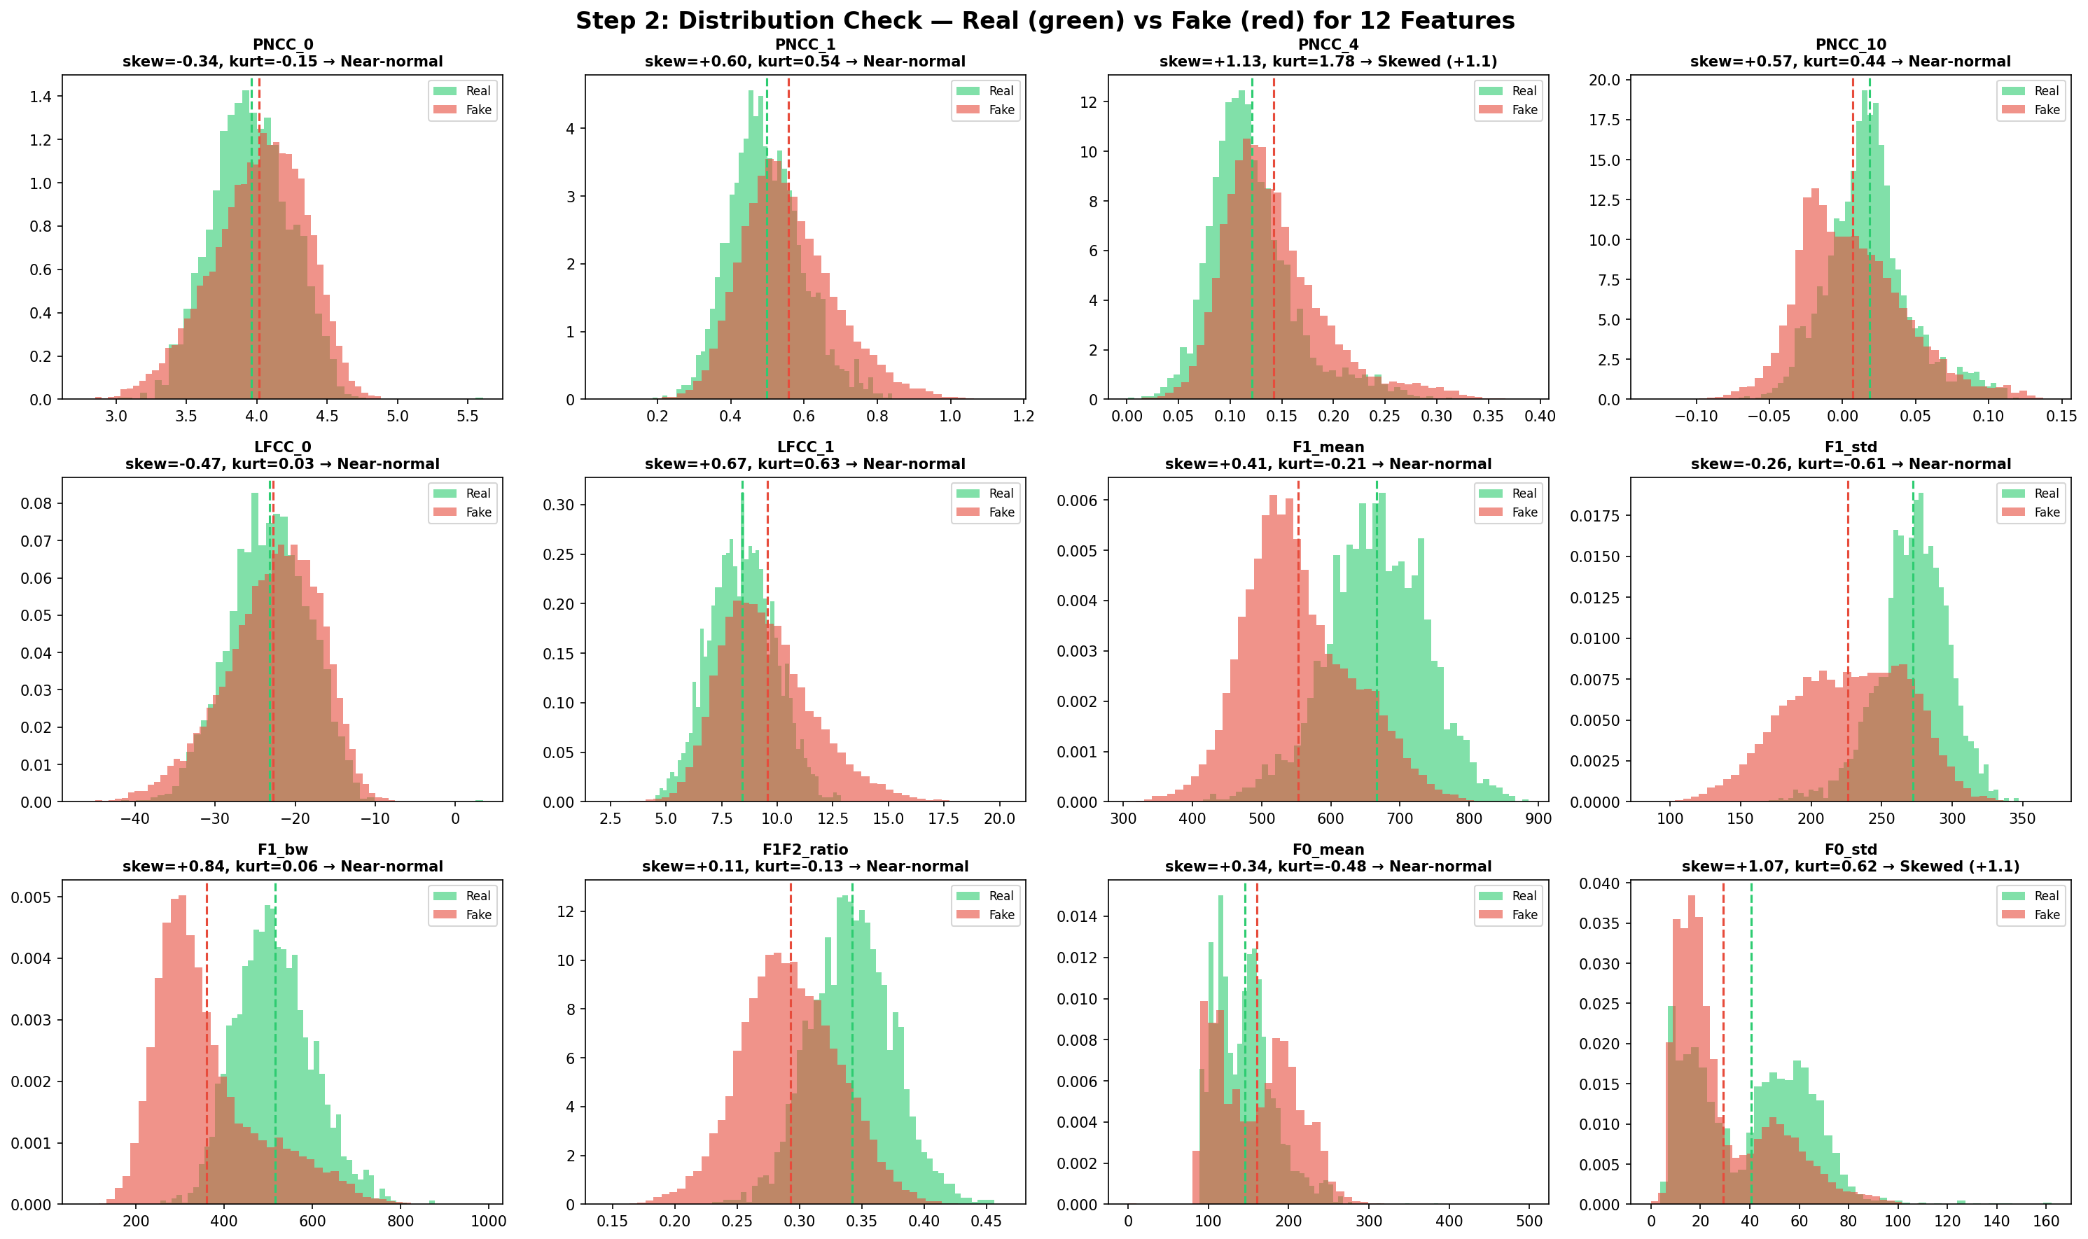
STEP 2
What Distribution Does the Data Follow?
33/36 near-normal (skew < 1). 3 skewed. → Decision: Use Mann-Whitney (non-parametric) for all tests.
Notes:
[30s] 33/36 near-normal. 3 skewed. Decision: Mann-Whitney for all — works on both normal and non-normal.

Slide 4
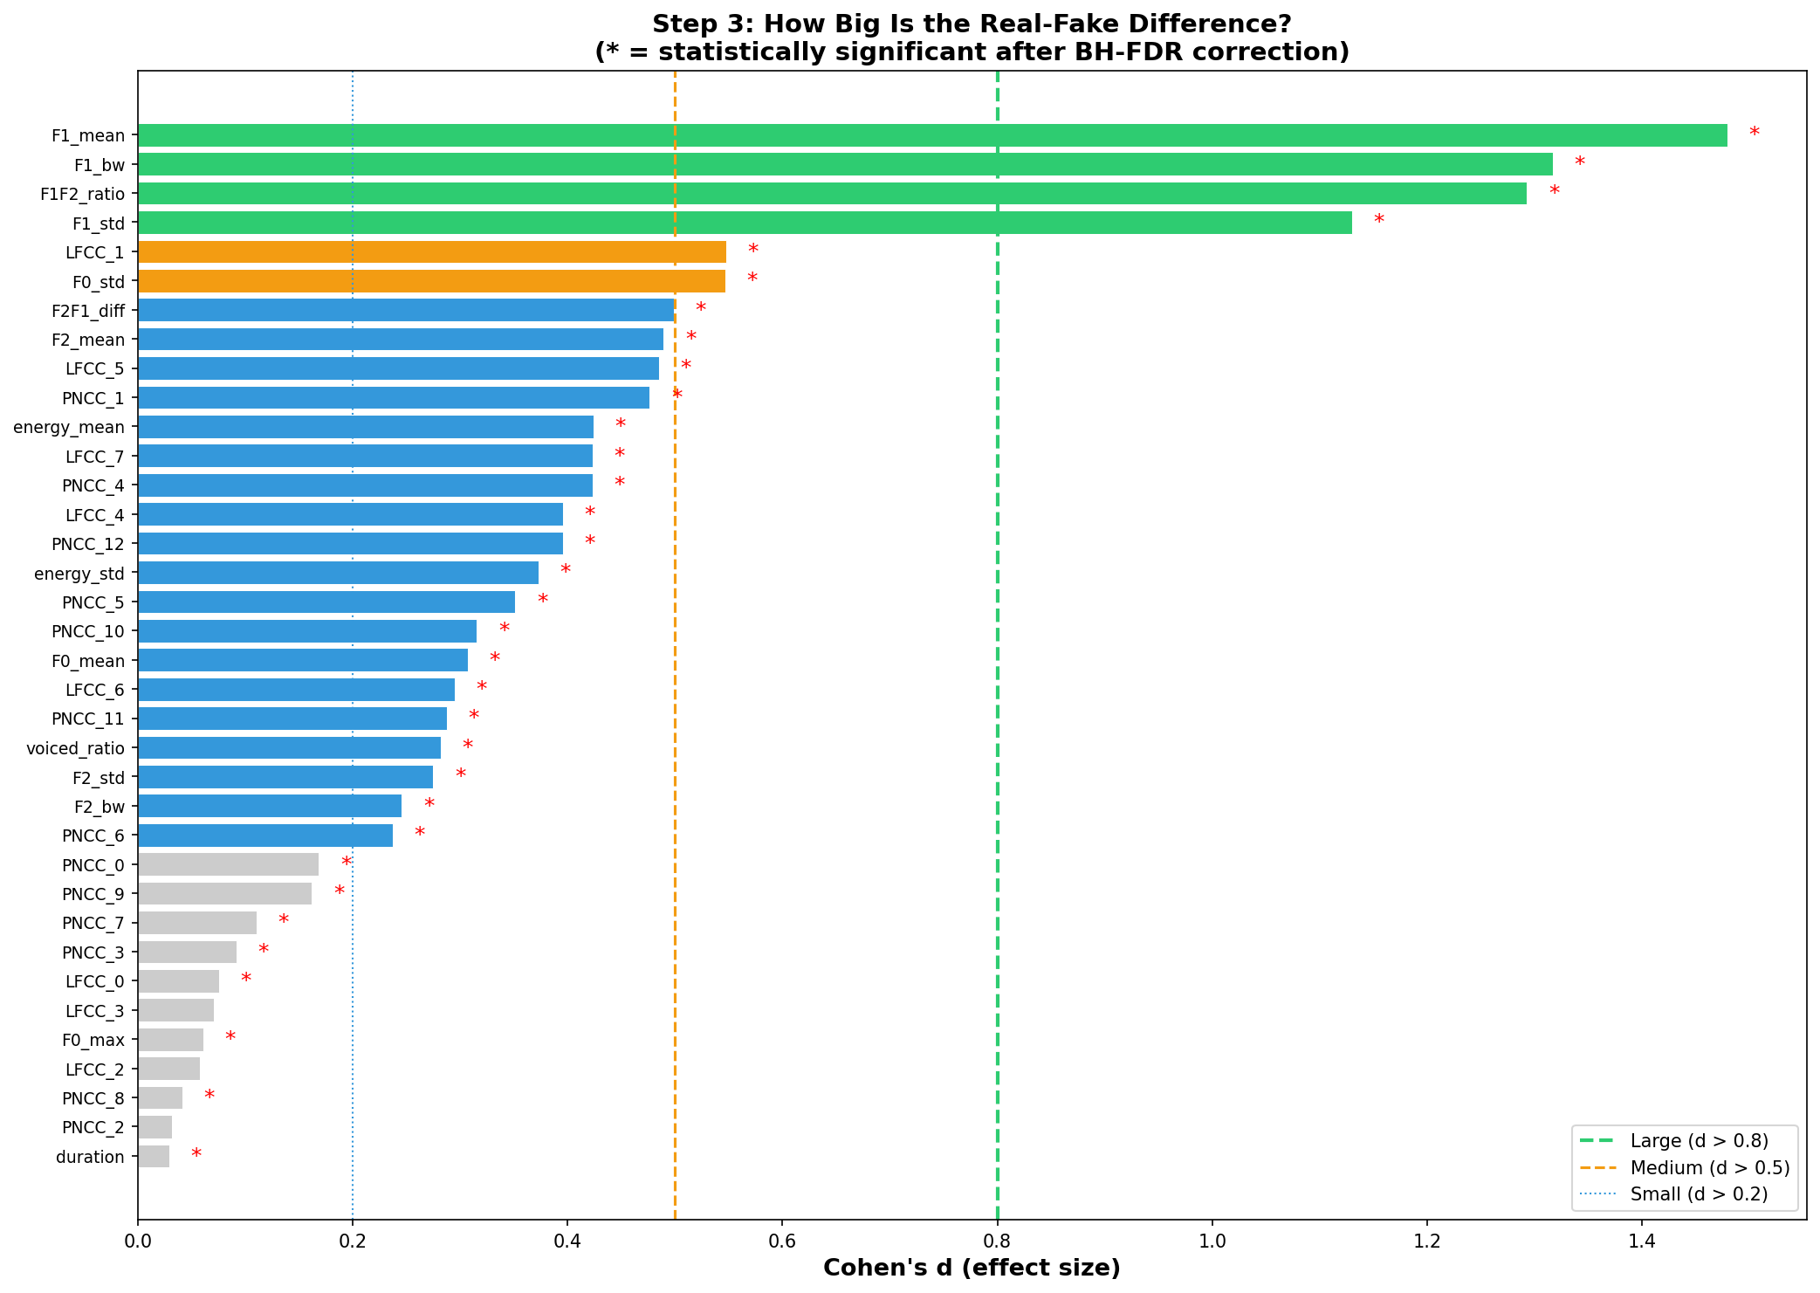
STEP 3
Is the Difference Real and Meaningful?
Mann-Whitney U Test
Cohen's d (Effect Size)
Non-parametric: no normality assumption needed
Corrected for 36 tests (Benjamini-Hochberg FDR 5%)
Result: 33/36 significant. The 4 formant winners: p ≈ 0
25,000 files → even tiny gaps are 'significant'
Effect size measures practical importance
Only 4 LARGE (d > 0.8): F1_mean, F1_bw, F1F2, F1_std
Notes:
[30s] Mann-Whitney: 33/36 significant after correction. Cohen's d: only 4 LARGE. Green bars = the winners.

Slide 5
STEP 3
The 4 Winning Features
Feature | Real (avg ± spread) | Fake (avg ± spread) | Gap | Effect size (d) | Error rate alone
F1 bandwidth | 515 ± 87 Hz | 361 ± 120 Hz | 154 Hz | 1.32 (LARGE) | 18.0%
F1 mean freq | 666 ± 71 Hz | 553 ± 77 Hz | 113 Hz | 1.48 (LARGE) | 19.5%
F1 variability | 272 ± 25 Hz | 226 ± 42 Hz | 46 Hz | 1.13 (LARGE) | 21.7%
F1/F2 ratio | 0.342 ± 0.033 | 0.292 ± 0.039 | 0.050 | 1.29 (LARGE) | 23.0%
All 4 measure the first formant (F1) — the first resonance of the vocal tract
Real speech has WIDER, HIGHER, MORE VARIABLE F1 resonances than fake speech
Kruskal-Wallis test across 6 attack types: all 4 features differ significantly (H > 10,000, p ≈ 0)
→ These features detect MANY types of fakes, not just one specific system
Notes:
[30s] Table: the 4 winners with avg ± spread. All F1 formant. Kruskal-Wallis: differ across 6 attacks.

Slide 6
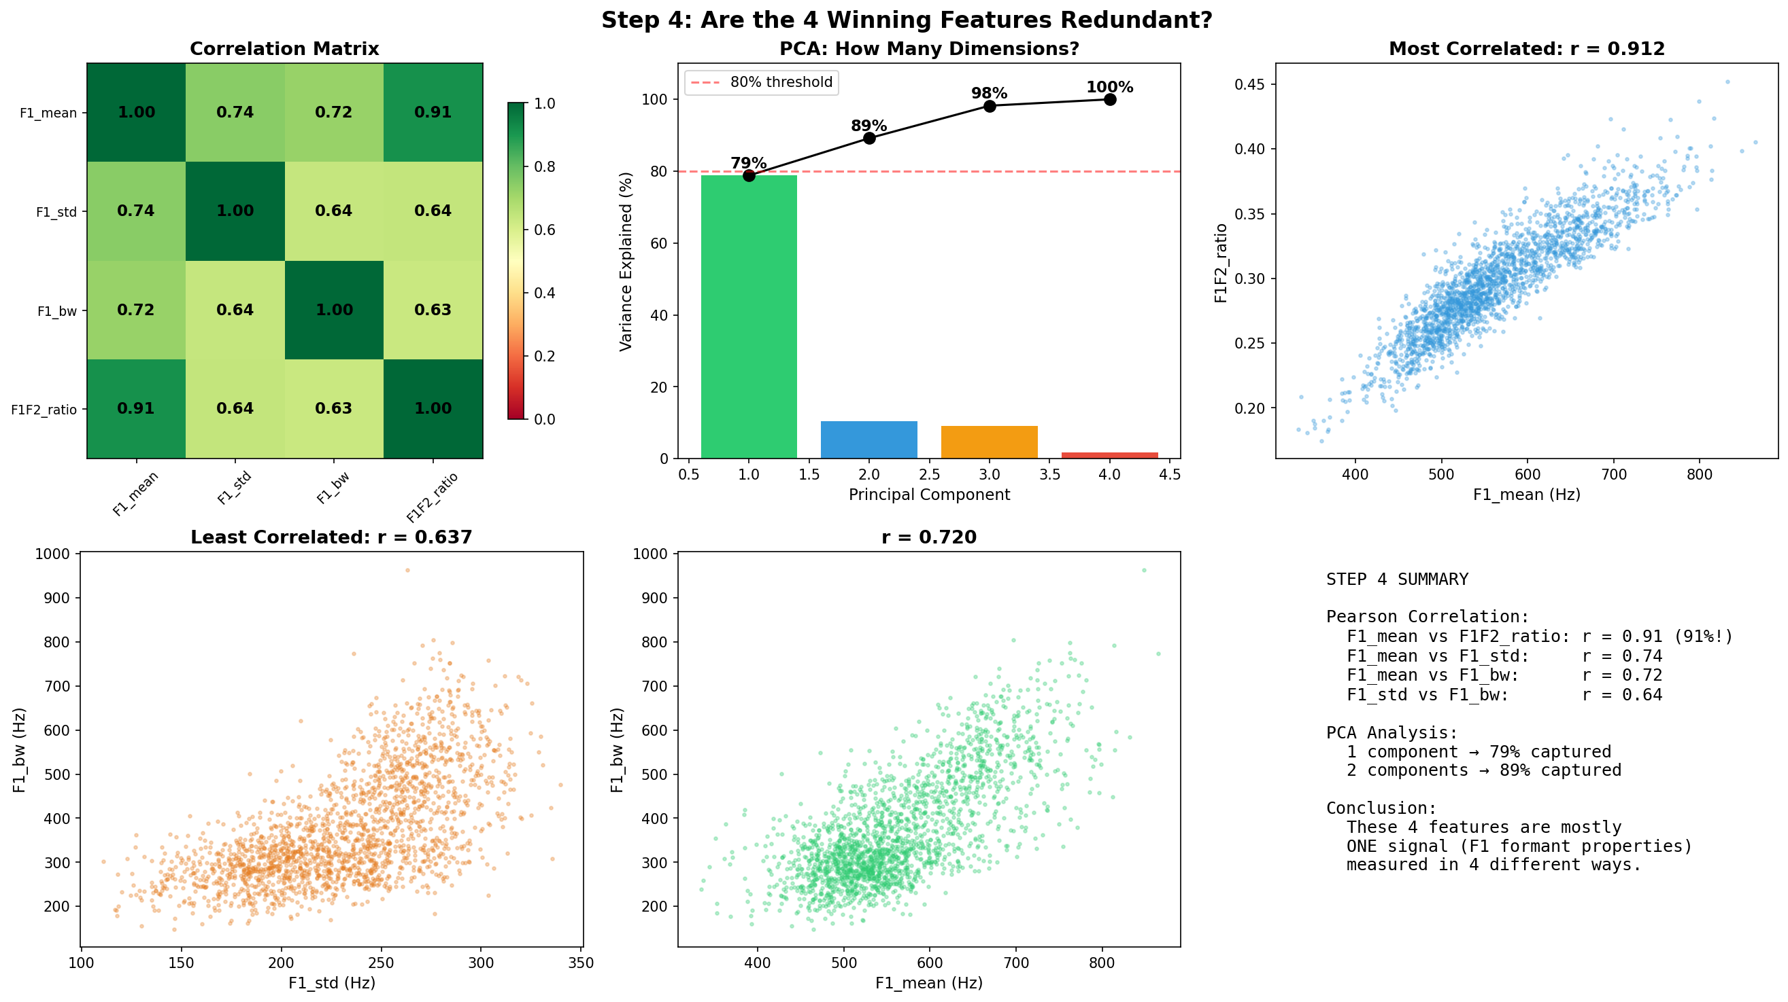
STEP 3
Are the 4 Winners Redundant?
Conclusion: ONE signal (F1 formant characteristics) measured 4 different ways. PCA 1 component = 79%.
Notes:
[30s] F1_mean vs F1F2_ratio: r = 0.91. PCA: 1 component = 79%. They're one signal.

Slide 7
STEP 4
Why Do Formants Differ Between Real and Fake?
Real Speech
Fake Speech
Your mouth and throat form a tube
This tube has resonances (formants)
The tube absorbs energy
→ wide resonances (515 Hz)
High natural variation
A neural network generates sound
It optimizes for average shape
No physical damping
→ sharp, narrow resonances (361 Hz)
Over-smoothed, less variation
Codecs MUST preserve formants — without them, you can't understand speech on the phone. That's why this difference survives compression.
Notes:
[30s] Real: physical tube, damping, wide resonances 515 Hz. Fake: neural net, no damping, narrow 361 Hz. Codecs preserve formants for intelligibility.

Slide 8
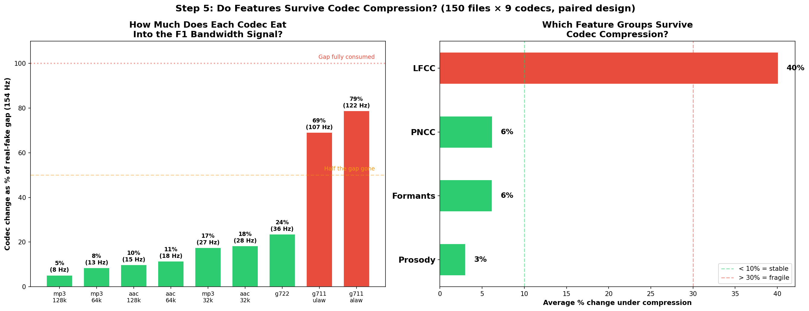
STEP 4
Paired Codec Test: Does the Signal Survive?
150 files × 9 codecs, paired design | MP3/AAC: 5-18% of gap (survives) | G.711: 69-79% (marginal)
Notes:
[30s] Paired test: same file before/after codec. MP3: 5% of 154 Hz gap. G.711: 79%. Formants survive streaming, marginal on telephone.

Slide 9
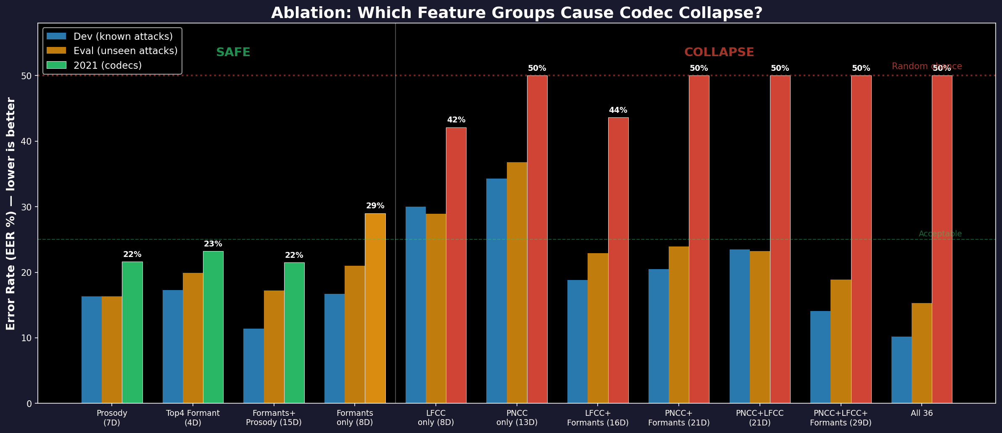
STEP 5
Ablation: Adding Bad Features Destroys Detection
Key Finding
Left (green):
Formants/Prosody alone
→ 21-29% after codecs (stable)
Right (red):
Any set with PNCC or LFCC
→ 42-55% COLLAPSED
Adding fragile features doesn't
just fail — it DESTROYS the system.
Notes:
[30s] Formants alone: 21-29%. Add PNCC/LFCC: 42-55%. PNCC+Formants = 50%. Formants alone = 29%.

Slide 10
STEP 6
Classifiers: Which Feature Set Works Best?
Feature Set | # Features | Lab Error | After Codecs | Collapse?
F1_bw alone | 1 | 18.0% | 24.3% | No
Top 4 F1 features | 4 | 17.3% | 23.2% | No
Formants + Prosody | 15 | 11.4% | 21.5% | No
All 36 features | 36 | 9.2% | 54.8% | YES!
Best in lab (9%) = worst deployed (55%). Feature selection prevents catastrophic failure.
Using SVM (RBF kernel, balanced class weights) on fixed ASVspoof challenge splits
Notes:
[30s] F1_bw alone: 18→24%. Formants+Prosody: 11→21%. All 36: 9→55% COLLAPSED. Best lab = worst deployed.

Slide 11
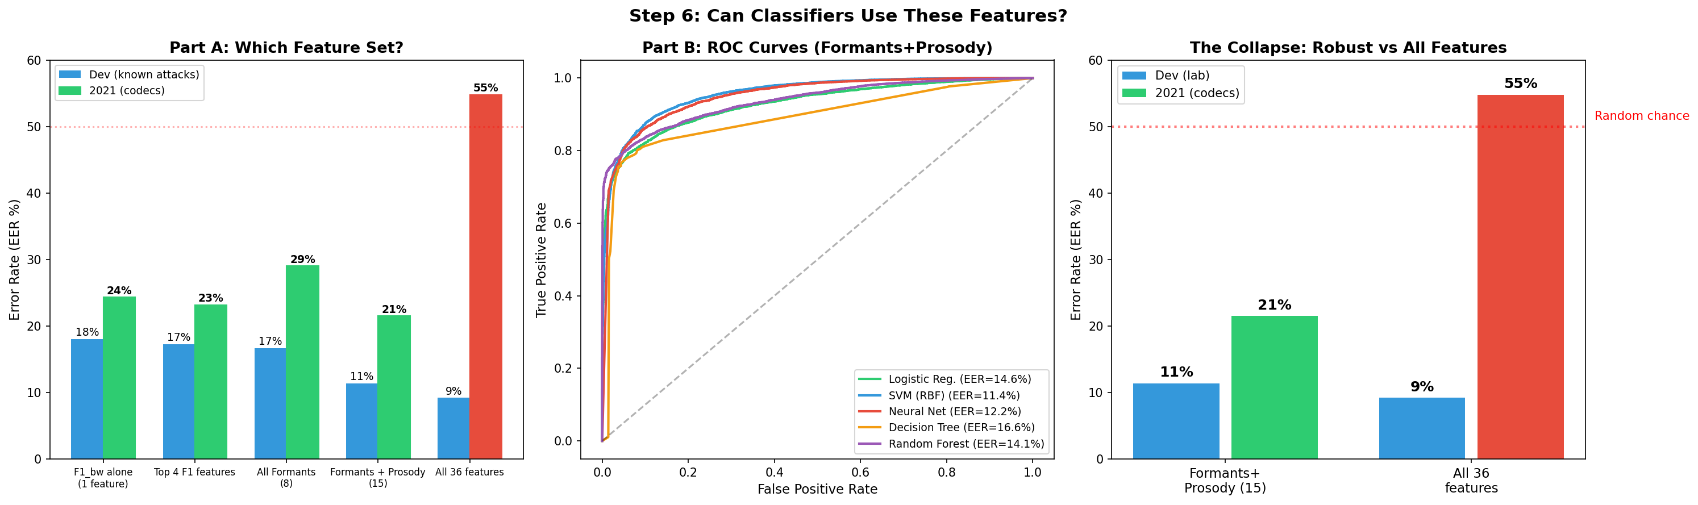
STEP 6
5 Classifiers + The Collapse
Formants+Prosody: 11% → 21% (graceful) | All 36: 9% → 55% (COLLAPSED) | Not SOTA (1.9%) but explainable
Notes:
[30s] ROC curves: SVM best (11.4%). Right chart: the collapse. 11→21% vs 9→55%. Not SOTA but explainable.

Slide 12
Conclusions
What We Found
Limitations
1. Out of 36 features, 4 detect deepfakes after compression. All measure F1 formant.
2. Confirmed by Mann-Whitney, Cohen's d, Kruskal-Wallis, paired codec test, PCA.
3. Adding fragile features DESTROYS the detector: 9% → 55%.
1. 21% error — SOTA neural systems: 1.9%
2. 4 features are 91% correlated — one signal
3. Advanced vocoders (A17-A19): error > 48%
4. G.711 telephone: 79% of signal lost
Real speech: F1 bandwidth = 515 ± 87 Hz | Fake speech: 361 ± 120 Hz
Gap: 154 Hz | Survives MP3/AAC | Physical cause: vocal tract damping
github.com/Yash-Sukhdeve/stats-audio-deepfake-detection
Mann & Whitney (1947) | Cohen (1988) | Benjamini & Hochberg (1995) | Kruskal & Wallis (1952) | Kim & Stern (2016)
Notes:
[30s] 4 of 36. All F1. 515 vs 361 Hz. Survives codecs. Adding fragile features destroys it. Thank you.

