Slide 1
Statistics for Audio Deepfake Detection
Which Acoustic Features Identify Deepfakes Regardless of Codec Compression?
[Your Name] • [Affiliation]
MCCNNY 2026
Notes:
[20s] Good morning. My talk is about using statistics to detect audio deepfakes — which acoustic features identify fake audio even after telephone compression?

Slide 2
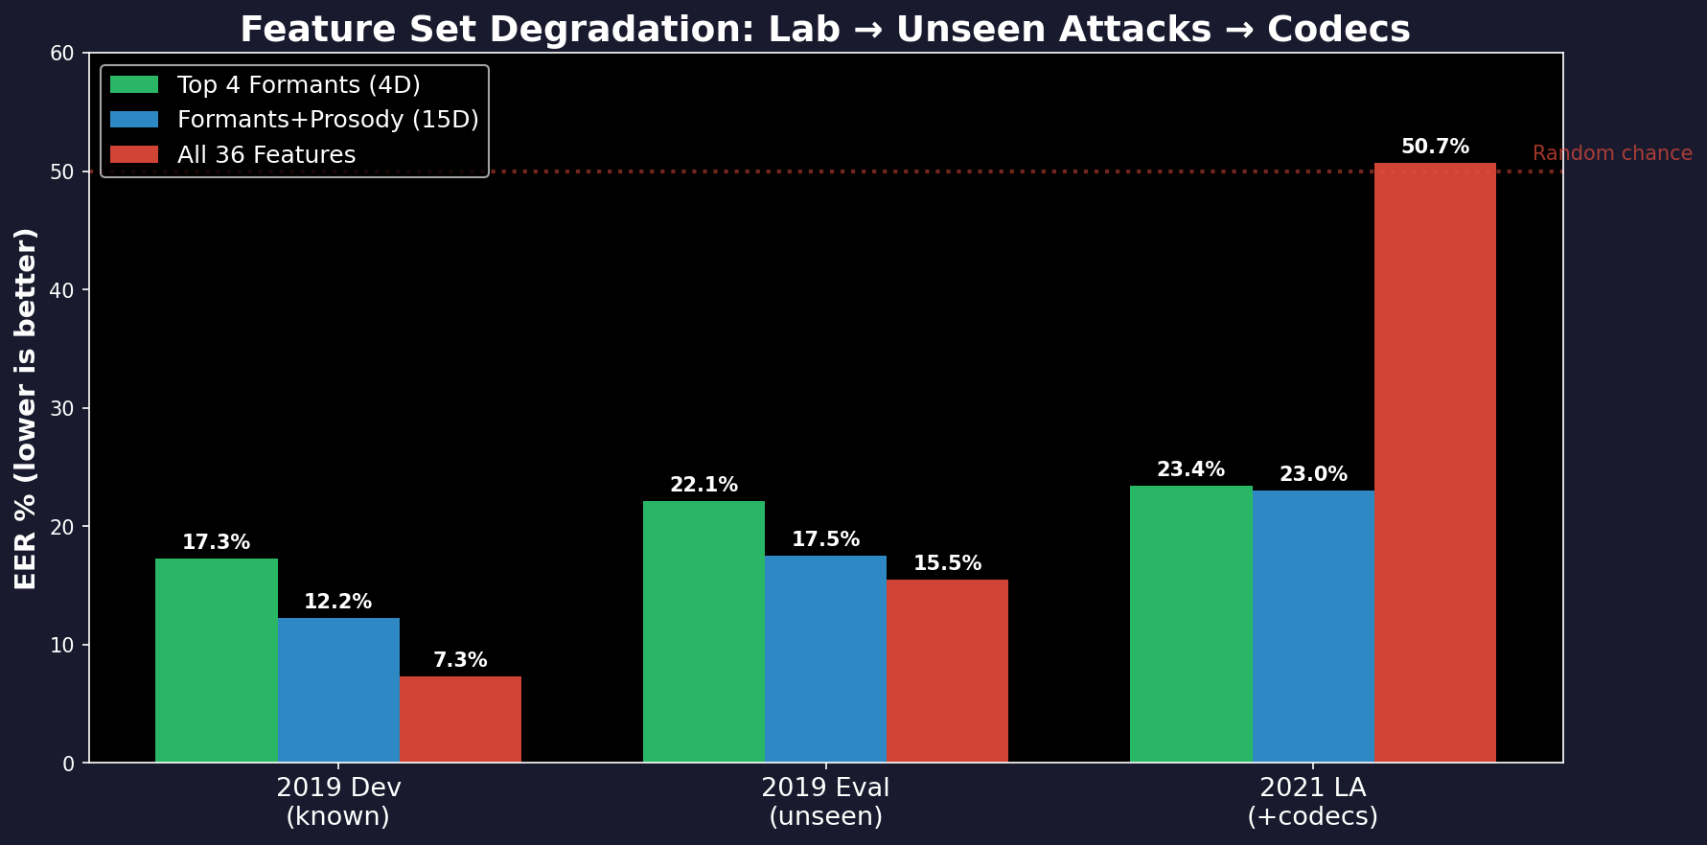
The Problem
We want to catch fake audio (deepfakes).
• Train a detector on clean recordings
• Deploy on phone calls, VoIP, social media
• Phone networks compress audio (codecs)
• Compression distorts the features
• Detector stops working
The numbers:
• In the lab: 7% error rate (good)
• After compression: 50% error rate
(same as guessing — useless)
• Which features survive?
Notes:
[45s] We train on clean audio — 25,000 files. 7% error in the lab. Deploy on phone calls with codecs. Error jumps to 50% — coin flip. Why? Features the model relied on got destroyed. Which features survive?

Slide 3
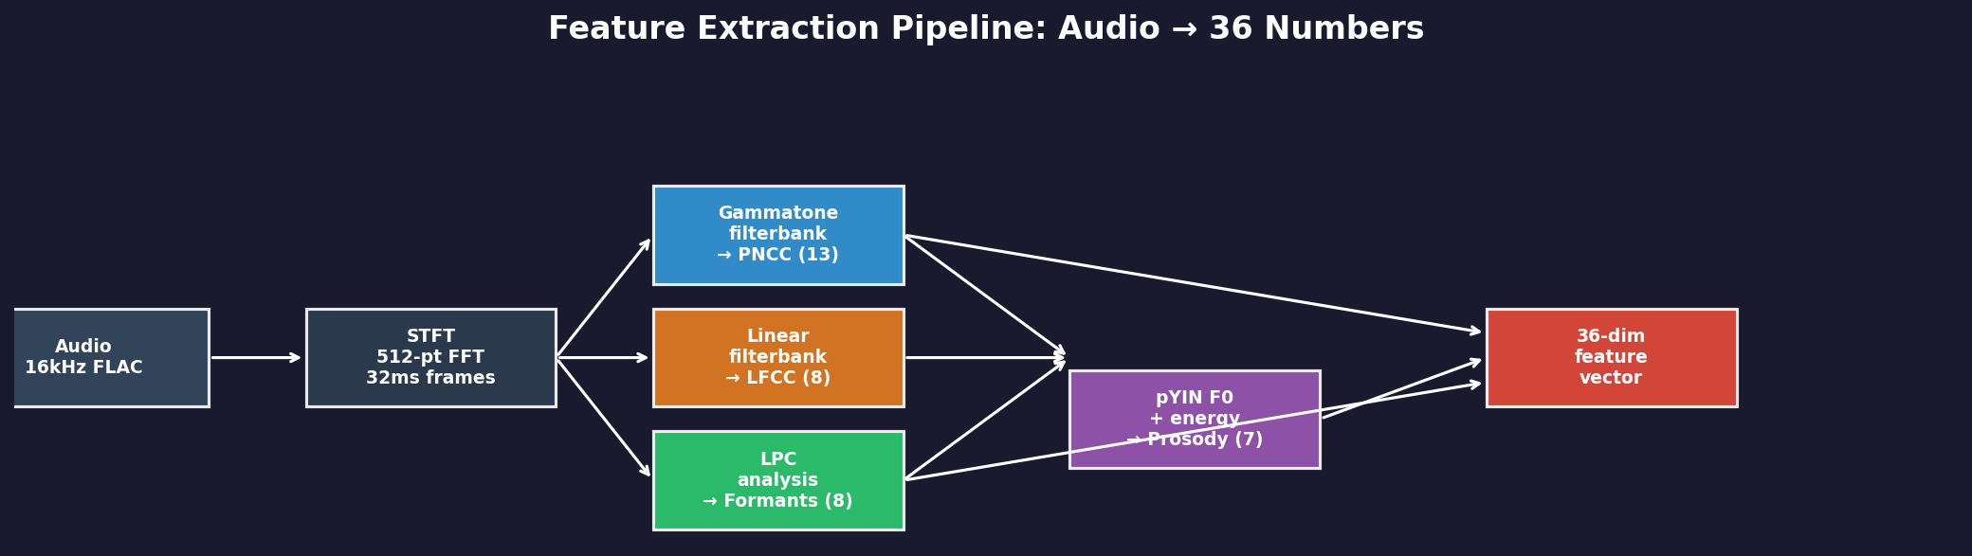
What We Measure From Each Audio File
36 numbers per file, in 4 groups:
PNCC (13 numbers)
LFCC (8 numbers)
Formants (8 numbers)
Prosody (7 numbers)
Overall sound shape
Models how the ear
hears frequencies
Fine sound detail
Equal detail at all
frequencies
Mouth shape resonances
F1 = jaw opening
F2 = tongue position
Rhythm & melody
Pitch, loudness,
speaking speed
Notes:
[40s] We extract 36 numbers from each audio file in four groups. PNCC — sound shape. LFCC — fine detail. Formants — mouth resonances. Prosody — rhythm and pitch. Which of these 36 tell real from fake, and which survive compression?

Slide 4
The 4 Features That Detect Deepfakes
Out of 36 features tested, only these 4 work reliably:
Feature | Real (avg ± spread) | Fake (avg ± spread) | Gap | How big? | Error rate (alone)
F1 bandwidth | 515 ± 87 Hz | 361 ± 120 Hz | 154 Hz | Large | 18.0%
F1 mean freq | 666 ± 71 Hz | 553 ± 77 Hz | 113 Hz | Large | 19.5%
F1 variability | 272 ± 25 Hz | 226 ± 42 Hz | 46 Hz | Large | 21.7%
F1/F2 ratio | 0.342 ± 0.033 | 0.292 ± 0.039 | 0.050 | Large | 23.0%
How to read: Real speech F1 bandwidth averages 515 Hz (spread ±87 Hz). Fake averages 361 Hz. Gap = 154 Hz. Using just this one feature, error rate is 18%.
What about the other 32?
Are these 4 really different?
• PNCC (13 features): can't tell real from
fake at all — error rate near 50%
• LFCC (8 features): moderate detection but
codecs destroy them (change by 39%)
• Other formants (F2): small gaps, weak
• Prosody: small gaps, but survives codecs
• All 4 measure the first formant (F1)
• F1_mean and F1/F2 ratio: 91% correlated
• PCA: 1 component captures 79% of info
• Using just 1 principal component: 17.1% error
Using all 4: 17.3% error (same!)
• They are ONE signal measured 4 ways
Notes:
[1.5 min] These are the 4 features that detect deepfakes. Each row shows the average value for real and fake files, plus or minus the spread. The gap column is the difference. F1 bandwidth has a 154 Hz gap — real speech has wider resonances. All 4 are F1 formant features. They're actually one signal measured 4 ways — PCA shows 1 component does the same job as all 4.

Slide 5
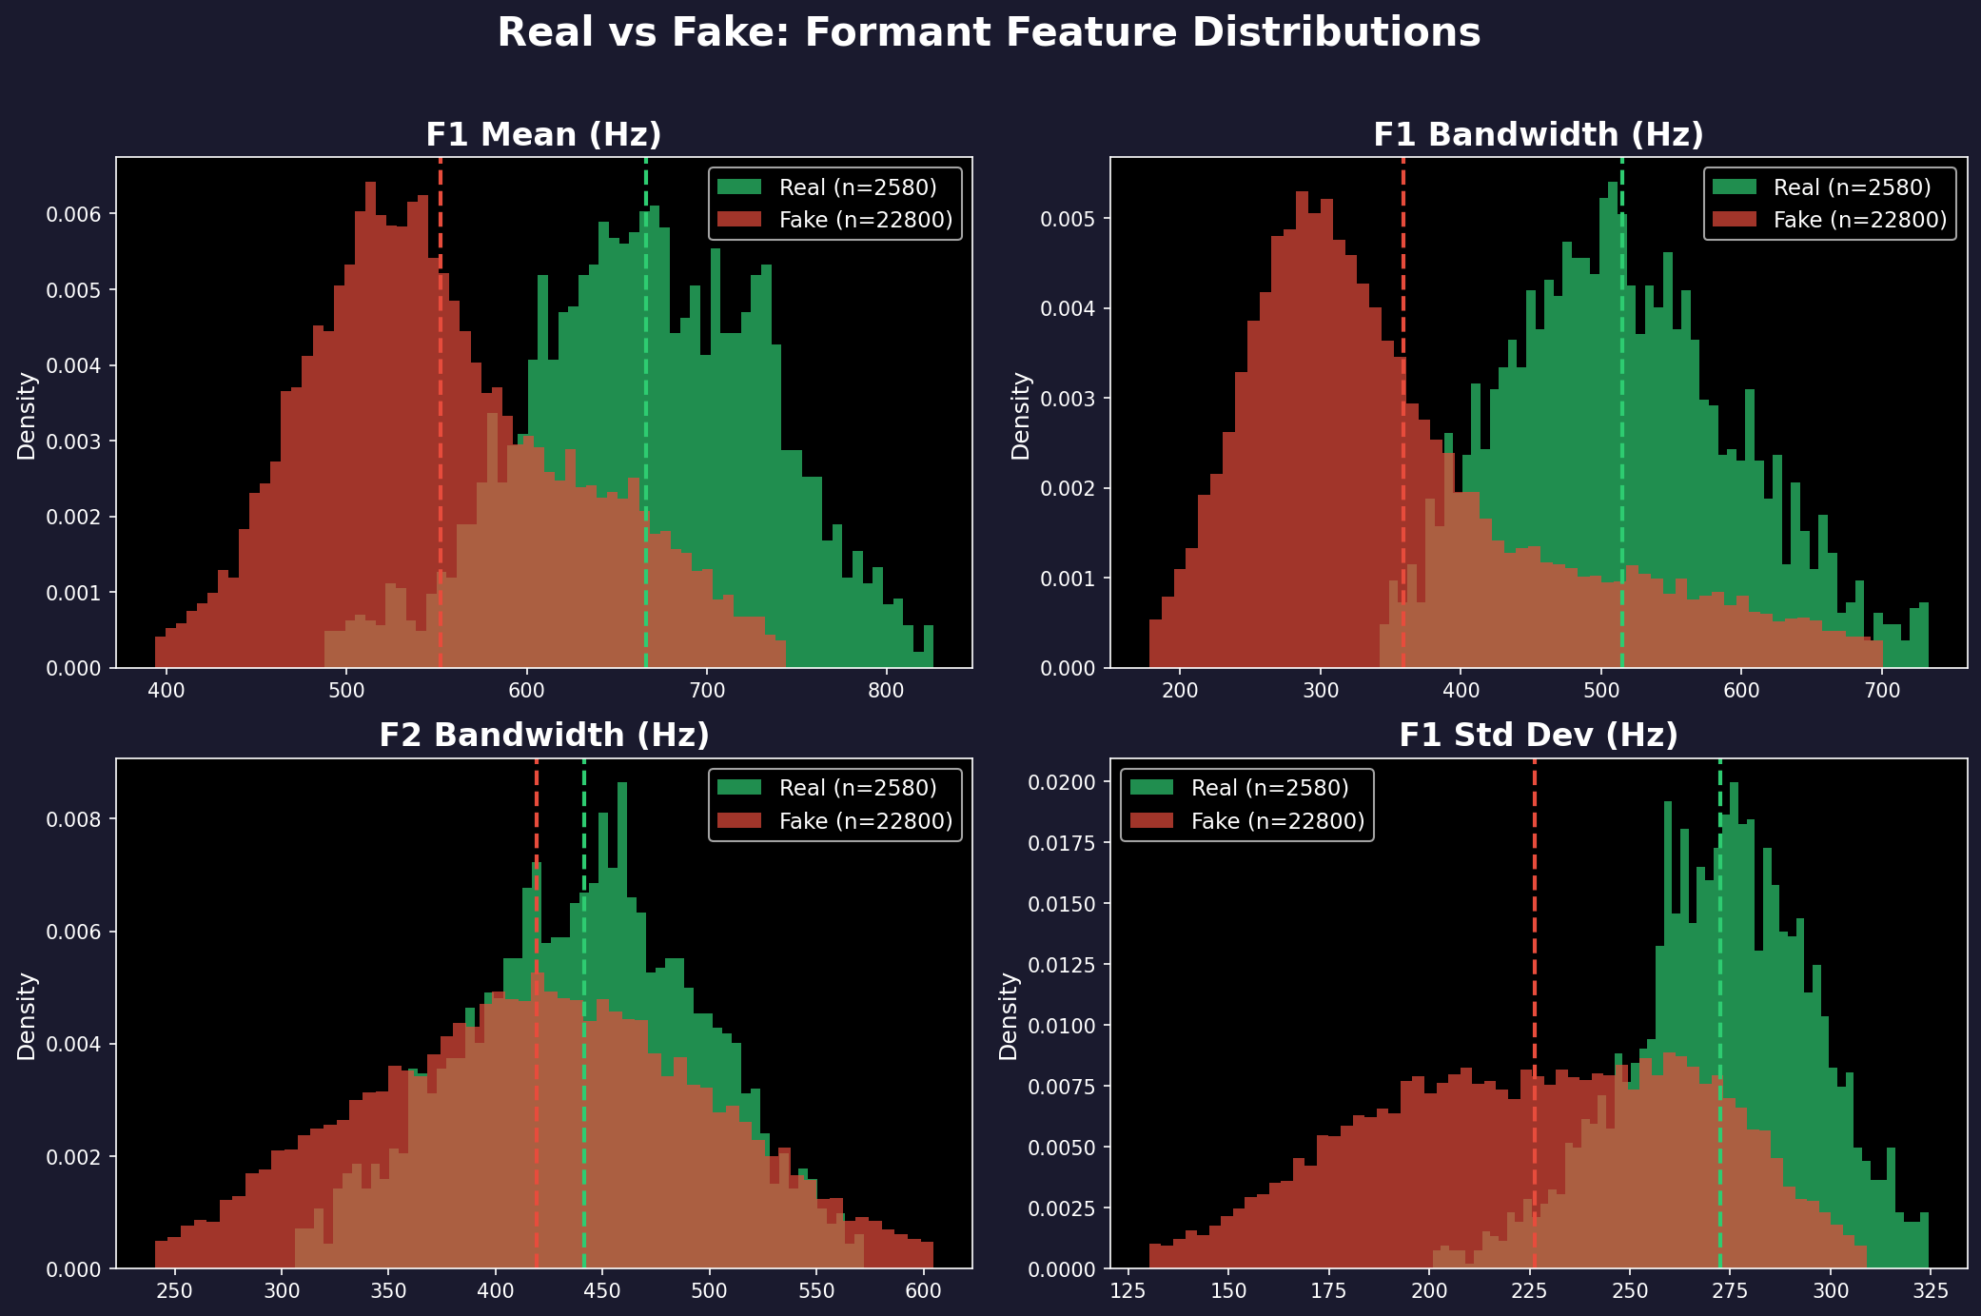
You Can See the Difference
Green = Real speech (wider, higher values) | Red = Fake speech (narrower, lower) | Dashed lines = averages
Notes:
[30s] Here's what the difference looks like. Green is real, red is fake. Look at F1 bandwidth — top right. Clear separation. The green peak is shifted right — real speech has wider resonances.

Slide 6
Why This Difference Exists
Real Speech
Fake Speech
• Your mouth and throat form a tube
• This tube has resonances (formants)
• The tube absorbs energy → wide resonances
• F1 bandwidth ≈ 515 Hz
• Lots of natural variation
• A neural network generates the sound
• It optimizes for average spectral shape
• No physical damping → sharp resonances
• F1 bandwidth ≈ 361 Hz (154 Hz narrower)
• Less variation (over-smoothed)
Why This Survives Compression
• Codecs MUST preserve formants — without them, you can't understand speech on the phone
• Phone codecs (G.729) explicitly encode formant frequencies in their compression
• Even MP3 and AAC keep the resonance structure intact below 4000 Hz
• Codecs change formant values by only ~6% on average — the 154 Hz gap easily survives
Notes:
[40s] Why do formants differ? Real speech comes from a physical tube with damping — wide resonances. Fake speech from a neural network that optimizes reconstruction loss — sharp, narrow resonances. Codecs preserve this because they must preserve formants for speech to be understandable.

Slide 7
Do Features Survive Compression?
Same file compressed through 9 codecs — how much does each feature value change?
Feature Group | # Features | Avg Change | Worst Change | Verdict
Prosody | 7 | 3% | 8% | VERY STABLE
Formants | 8 | 6% | 18% | STABLE
PNCC | 13 | 6% | 22% | MODERATE
LFCC | 8 | 39% | 120% | FRAGILE
Measured on 150 files, each compressed through 9 codecs (G.711, G.722, MP3, AAC). Change = average |original − compressed| / average |original| × 100
What this means
Why the detector collapsed
• Formants change by only 6%
The 154 Hz real-vs-fake gap is much
larger than codec noise
• LFCC changes by 39% (worst: 120%!)
Codec MORE THAN DOUBLES the value
→ completely unreliable
• The all-36-feature model learned to
rely on LFCC features
• Codecs destroyed those LFCC features
• Without them, the model had nothing left
• Result: 50% error (random guessing)
Notes:
[40s] Do they survive compression? We compressed 150 files through 9 codecs. Formants: 6% change — stable. LFCC: 39% average, worst case 120% — destroyed. This is why the all-36 model collapsed: it relied on LFCC that codecs wrecked.

Slide 8
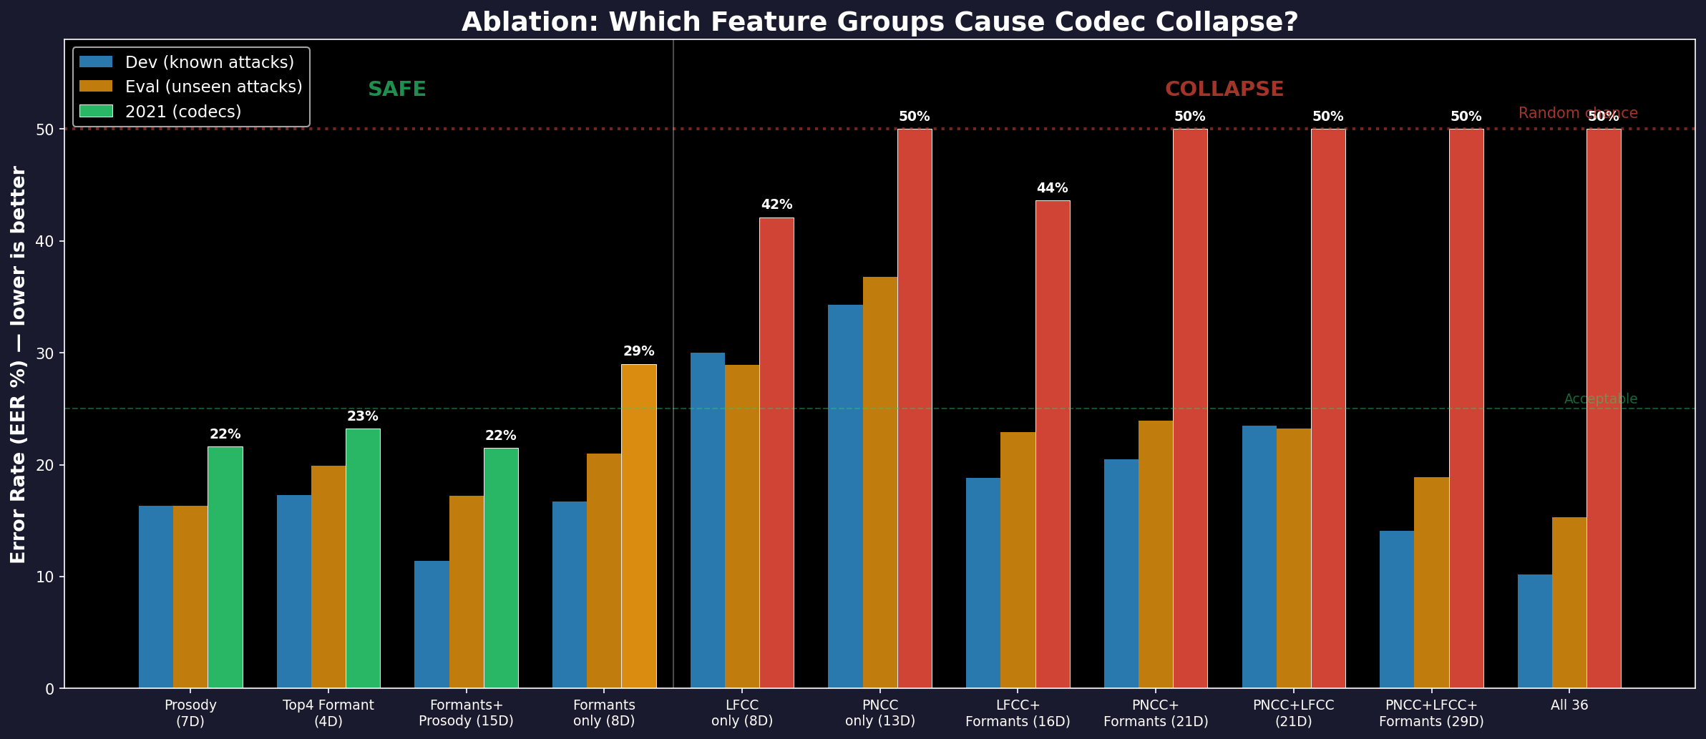
Adding Bad Features Destroys the Detector
The Pattern
LEFT (green bars):
Formants and Prosody alone
→ 21–23% error on codecs
→ Stable
RIGHT (red bars):
Any set with PNCC or LFCC
→ 42–50% error on codecs
→ COLLAPSED
The lesson:
Adding fragile features
doesn't just fail to help —
it DESTROYS the detector.
Notes:
[45s] This is the ablation. Left side — just formants and prosody — stable at 21-23%. Right side — anything with PNCC or LFCC — collapsed to 42-50%. Adding PNCC to formants made it WORSE — 50% instead of 29%. Fragile features don't just fail, they poison the model.

Slide 9
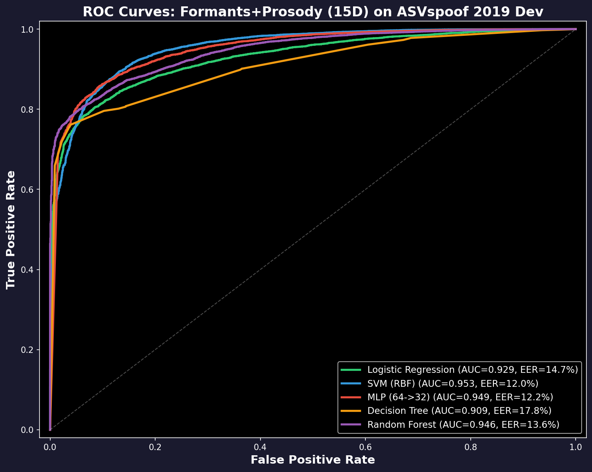
Detection Results: Simple Classifiers
Using the 4 winning features + prosody (15 total)
Model | Lab | Unseen attacks | After codecs
Logistic Reg. | 14.6% | 17.2% | 24.5%
SVM | 11.4% | 17.2% | 21.5%
Neural Net | 10.6% | 17.3% | 22.3%
Decision Tree | 16.6% | 21.8% | 22.9%
Random Forest | 14.2% | 18.5% | 21.2%
• Error rate = % of wrong predictions
• Best in lab: 10.6%
• After codecs: 21-25% (degrades, doesn't collapse)
• All-36 features: 50% after codecs (collapsed!)
• These aren't state-of-art (best systems: 1.9%)
but they're explainable — you know WHY
Notes:
[40s] Five classifiers on the winning features plus prosody. SVM: 11% error in the lab, 21% after codecs. All degrade gracefully, none collapse. Compare to all-36: 7% in the lab, 50% after codecs. These aren't state-of-art — best neural systems get 2% — but you can explain every prediction.

Slide 10
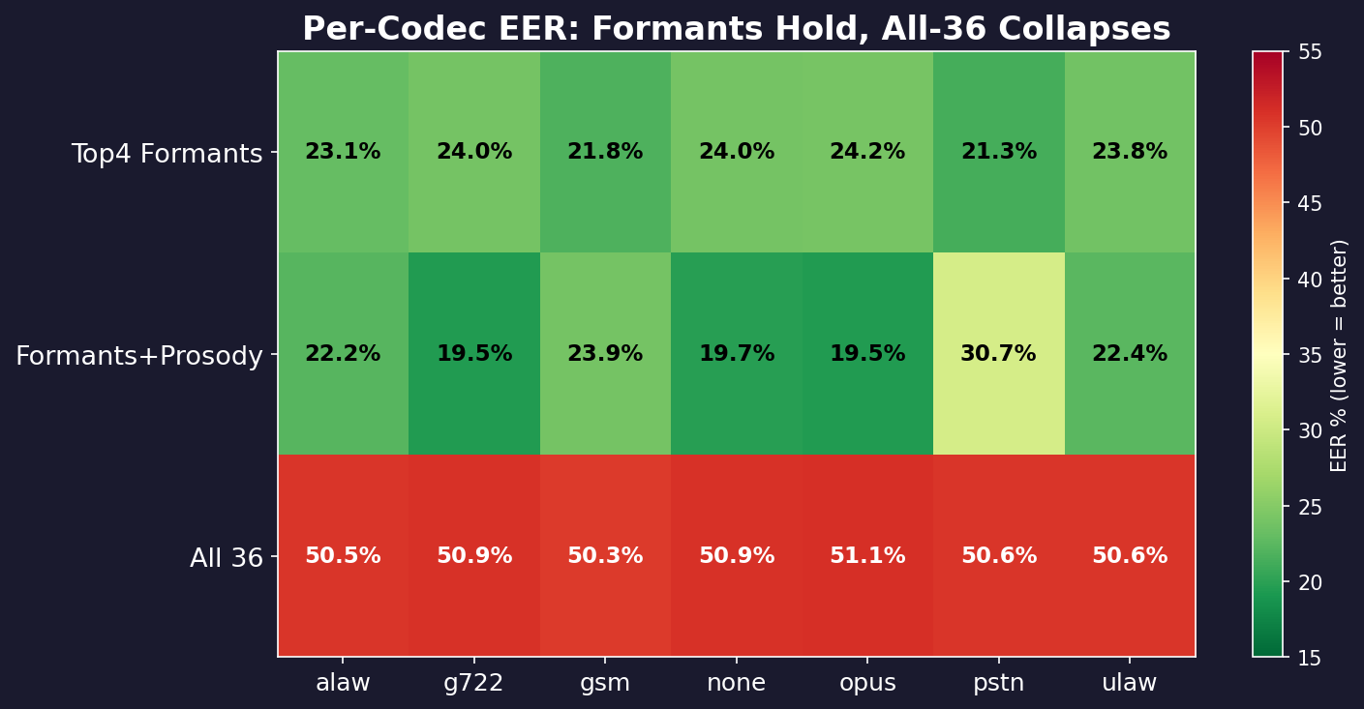
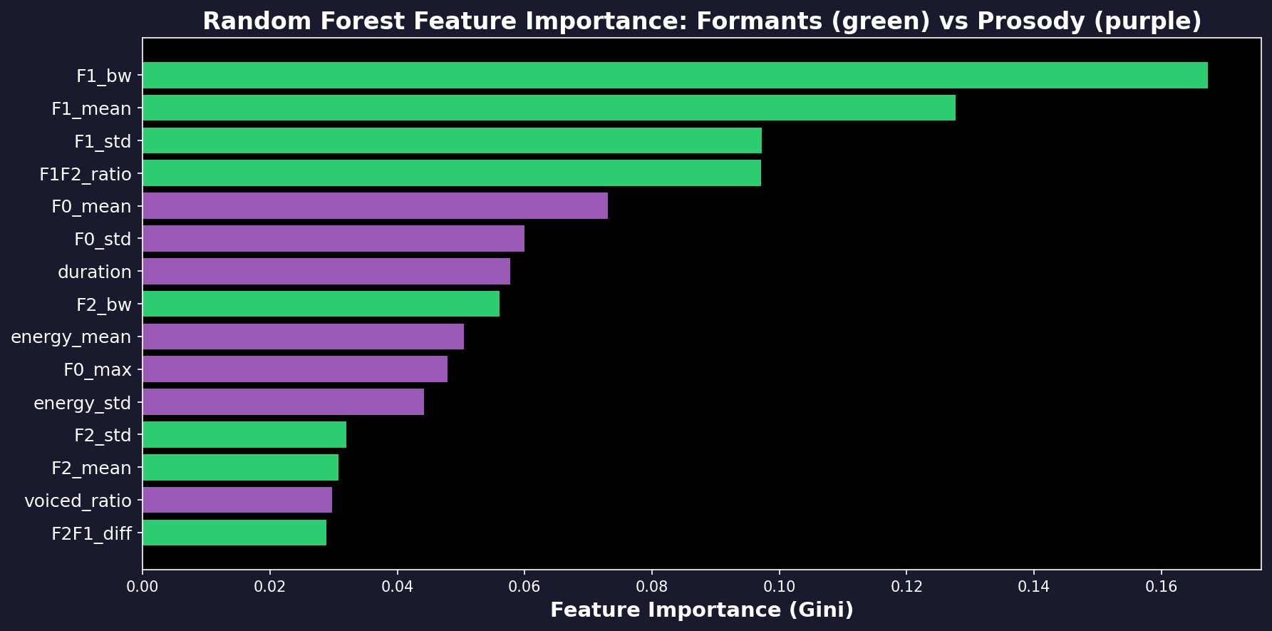
Works on Every Codec & What Matters Most
Every Codec Tested
• Formants: 19–24% error across ALL codecs
• Only 5% variation between codecs
• All-36: 50% on EVERY codec (broken)
• Green = good, Red = bad
Most Important Features
• F1 bandwidth: 26% of model decisions
(the single best feature)
• F1 mean: 15%
• F1/F2 ratio: 12%
Notes:
[30s] Top: error per codec. Formant row is green — 19 to 24% everywhere. All-36 row is red — 50% everywhere. Bottom: F1 bandwidth is 26% of the Random Forest's decisions.

Slide 11
Conclusions
What We Found
Limitations & Next Steps
1. Out of 36 features, only 4 detect deepfakes
reliably after compression. All 4 measure
the first formant (mouth resonance F1).
2. Real speech: F1 bandwidth = 515 ± 87 Hz
Fake speech: F1 bandwidth = 361 ± 120 Hz
A 154 Hz gap that survives all codecs.
3. Adding fragile features (PNCC, LFCC) to
the model DESTROYS it — error goes from
21% to 50%. Feature selection matters.
1. 21–23% error is not state-of-the-art
(best neural systems: 1.9%)
2. Advanced voice cloners (A17–A19) now
make realistic formants — error >48%
3. The 4 features are one signal measured
4 ways (91% correlated, PCA confirms)
4. Next: combine with neural models for
accuracy AND explainability
One-Sentence Summary
Real speech has wider formant resonances than synthetic speech because physical vocal tracts have damping that voice synthesizers don’t model — and this difference survives audio compression.
github.com/Yash-Sukhdeve/stats-audio-deepfake-detection
Notes:
[35s] Out of 36 features, only 4 detect deepfakes after compression. All measure F1 formant. Real: 515 Hz. Fake: 361 Hz. A 154 Hz gap that survives every codec. Adding fragile features like PNCC or LFCC destroys the detector — from 21% to 50%. Feature selection prevents this. Thank you.

