Slide 1
Statistics for Audio Deepfake Detection
Which Acoustic Features Identify Deepfakes Regardless of Codec Compression?
[Your Name] • [Affiliation]
MCCNNY 2026
Notes:
[20 seconds]
"Good morning. I'm [Name] from [Affiliation]. My talk is about using statistics to detect audio deepfakes — specifically, which acoustic features can identify fake audio even after it's been compressed by telephone codecs."
[Click]

Slide 2
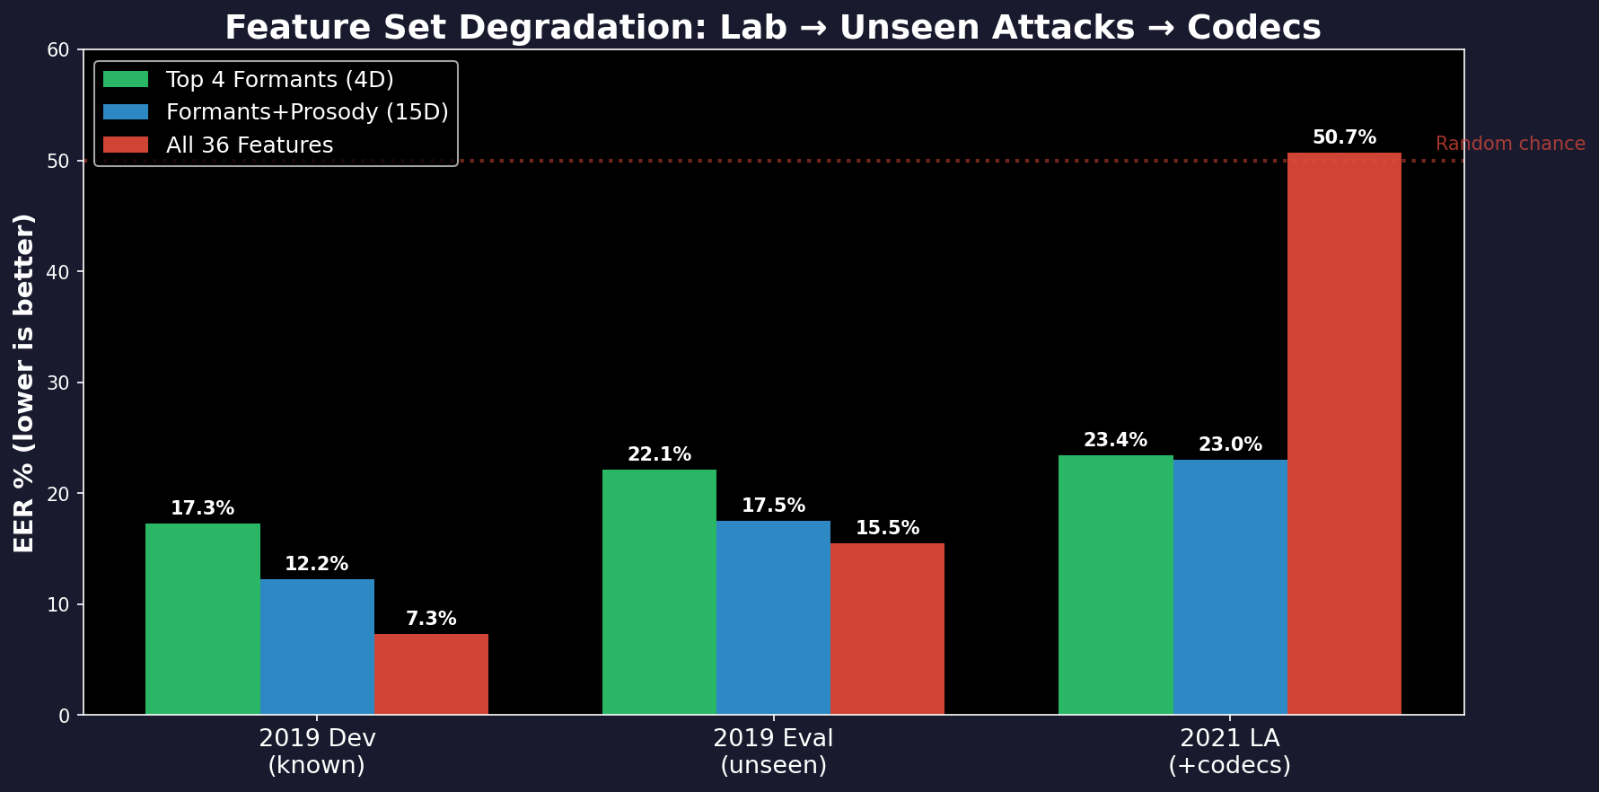
The Problem
We want to detect fake audio (deepfakes).
• Train a detector on clean studio recordings
• Deploy it on phone calls, VoIP, social media
• Phone networks compress audio (codecs)
• Compression distorts the features
• Detector stops working
The numbers:
• In the lab: 7% error rate (good)
• After compression: 50% error rate
(same as a coin flip — useless)
• Question: which features survive?
Notes:
[45 seconds]
"Here's the setup. We train a detector on clean studio audio — 25,000 files from the ASVspoof challenge. In the lab, it works: 7 percent error. Then we deploy it on phone calls. The audio gets compressed by codecs. And the error rate jumps to 50 percent — a coin flip. The detector is useless."
[Point to bar chart]
"Look at the red bars. All-36 features: 7 percent in the lab, 50 percent after codecs. It collapsed. The green bars — formant features — degrade from 17 to 23 percent. Not great, but they don't collapse. Why? That's what this talk answers."
[Click]

Slide 3
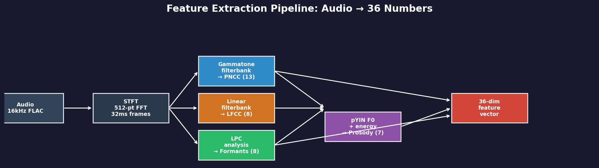
Why These 36 Features?
4 groups, each captures something different about the audio:
PNCC (13 dims)
LFCC (8 dims)
Formants (8 dims)
Prosody (7 dims)
Spectral shape
Models how the ear
hears sound
(gammatone filterbank)
Spectral detail
Equal resolution at
all frequencies
(catches high-freq artifacts)
Vocal tract resonances
F1 = jaw opening
F2 = tongue position
(shape of the mouth)
Rhythm & melody
Pitch (F0), energy,
speaking rate,
duration
Notes:
[40 seconds]
"We extract 36 numbers from each audio file, organized into four groups. PNCC — 13 numbers that capture the overall spectral shape using a filterbank modeled on the human ear. LFCC — 8 numbers capturing fine spectral detail with equal resolution at all frequencies. Formants — 8 numbers measuring vocal tract resonances, basically the shape of your mouth when you speak. And Prosody — 7 numbers for pitch, energy, and rhythm."
"Each group captures something different. The question is: which of these 36 numbers can actually tell real from fake, and which survive compression?"
[Click]

Slide 4
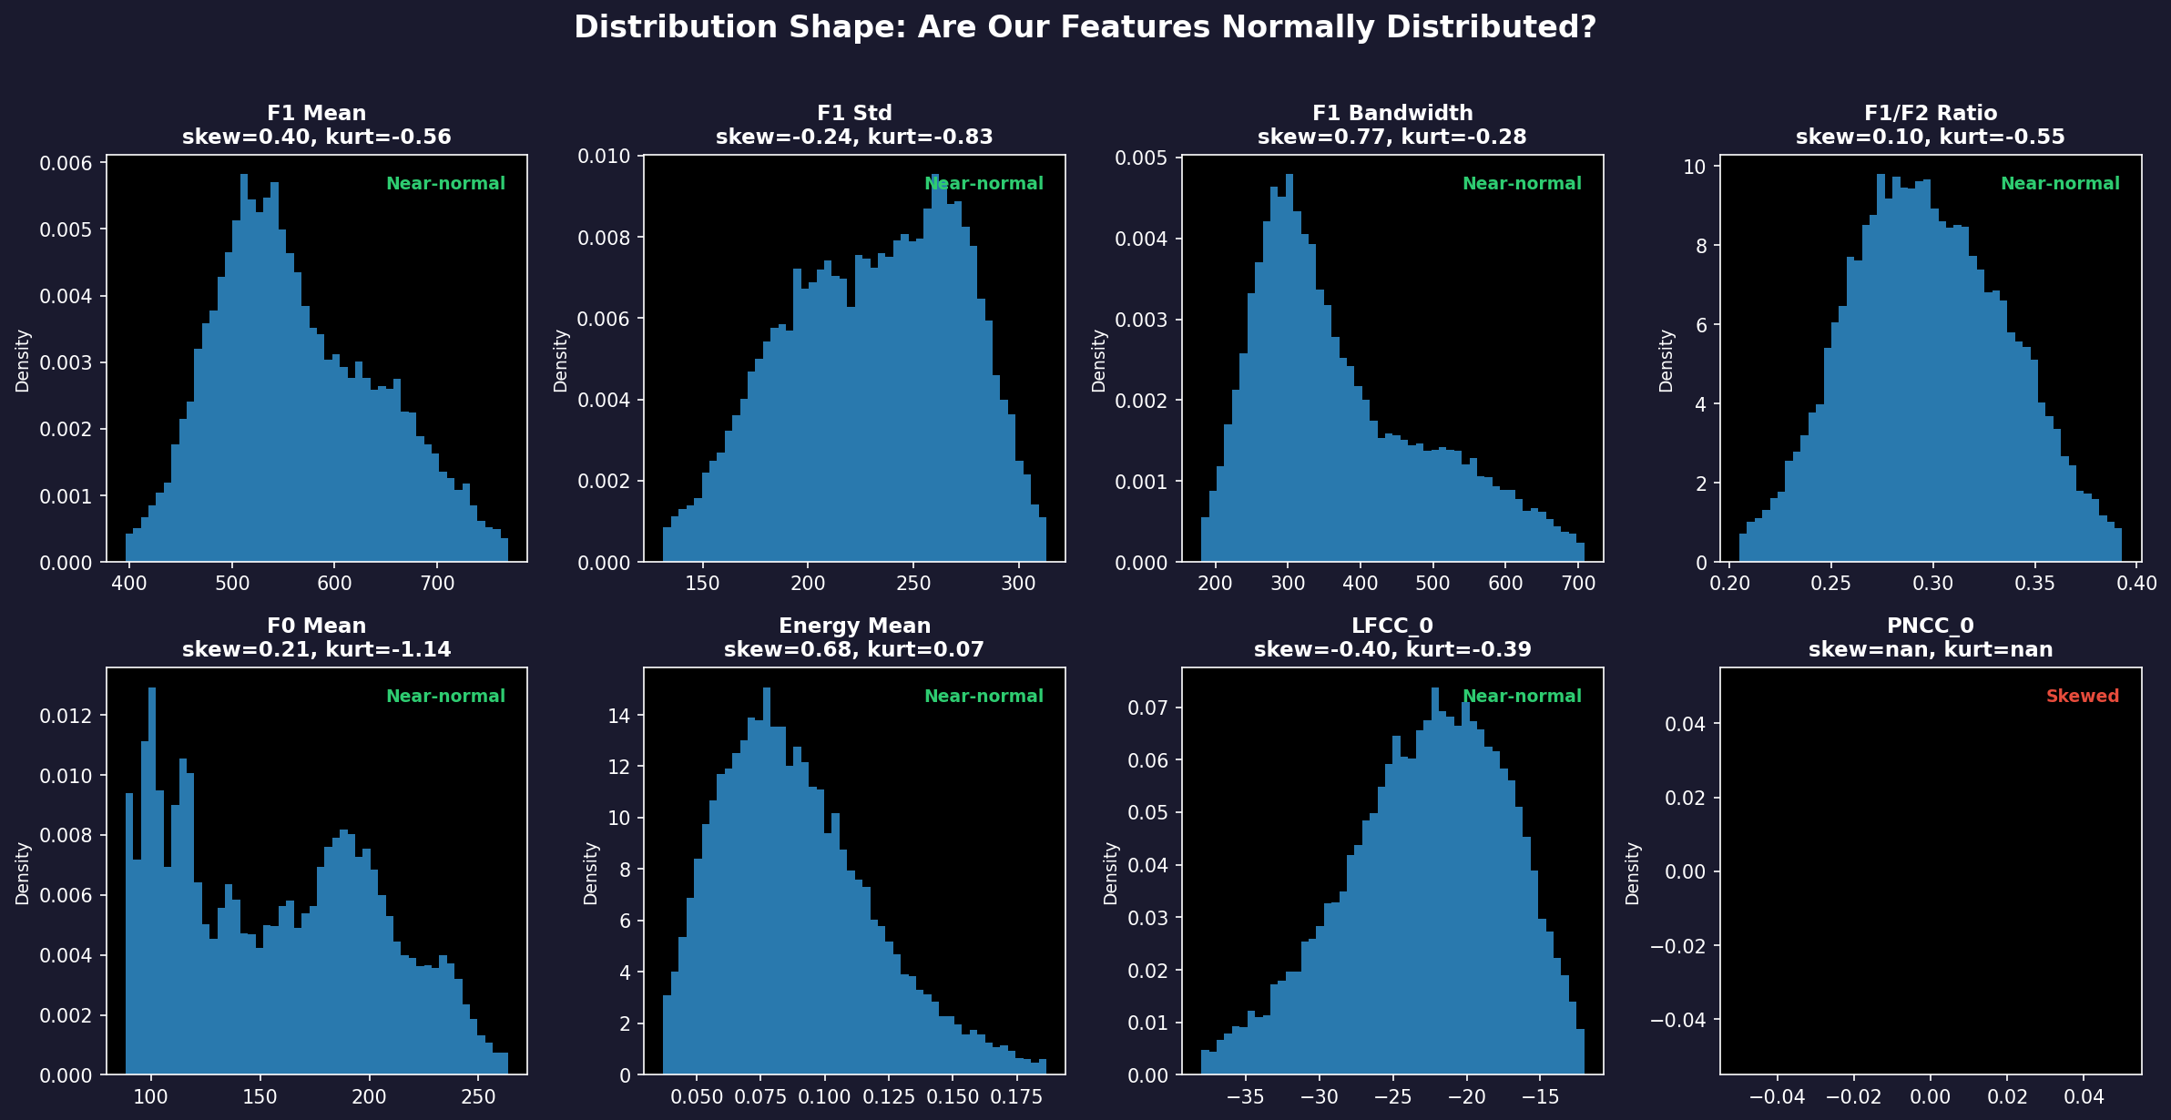
What Does Our Data Look Like?
Distribution Check
Before choosing statistical tests,
we check if data is bell-shaped
(normally distributed).
Skewness: is it lopsided?
• |skew| < 1 = okay
Kurtosis: heavy tails?
• |kurt| < 3 = okay
Result: 34 of 36 features
are near-normal.
This means we CAN use
standard statistical tests
(t-test, correlation, etc.)
For the 2 non-normal features,
we use rank-based tests.
Notes:
[30 seconds]
"Before running statistical tests, we check what the data looks like. These histograms show 8 representative features. Most are close to bell-shaped — 34 out of 36 are near-normal. That means we can use standard statistical tests. The two that aren't, we use rank-based tests instead."
"This is a sanity check, not a finding. But it's important — if your data is wildly skewed, your test results can't be trusted."
[Click]

Slide 5
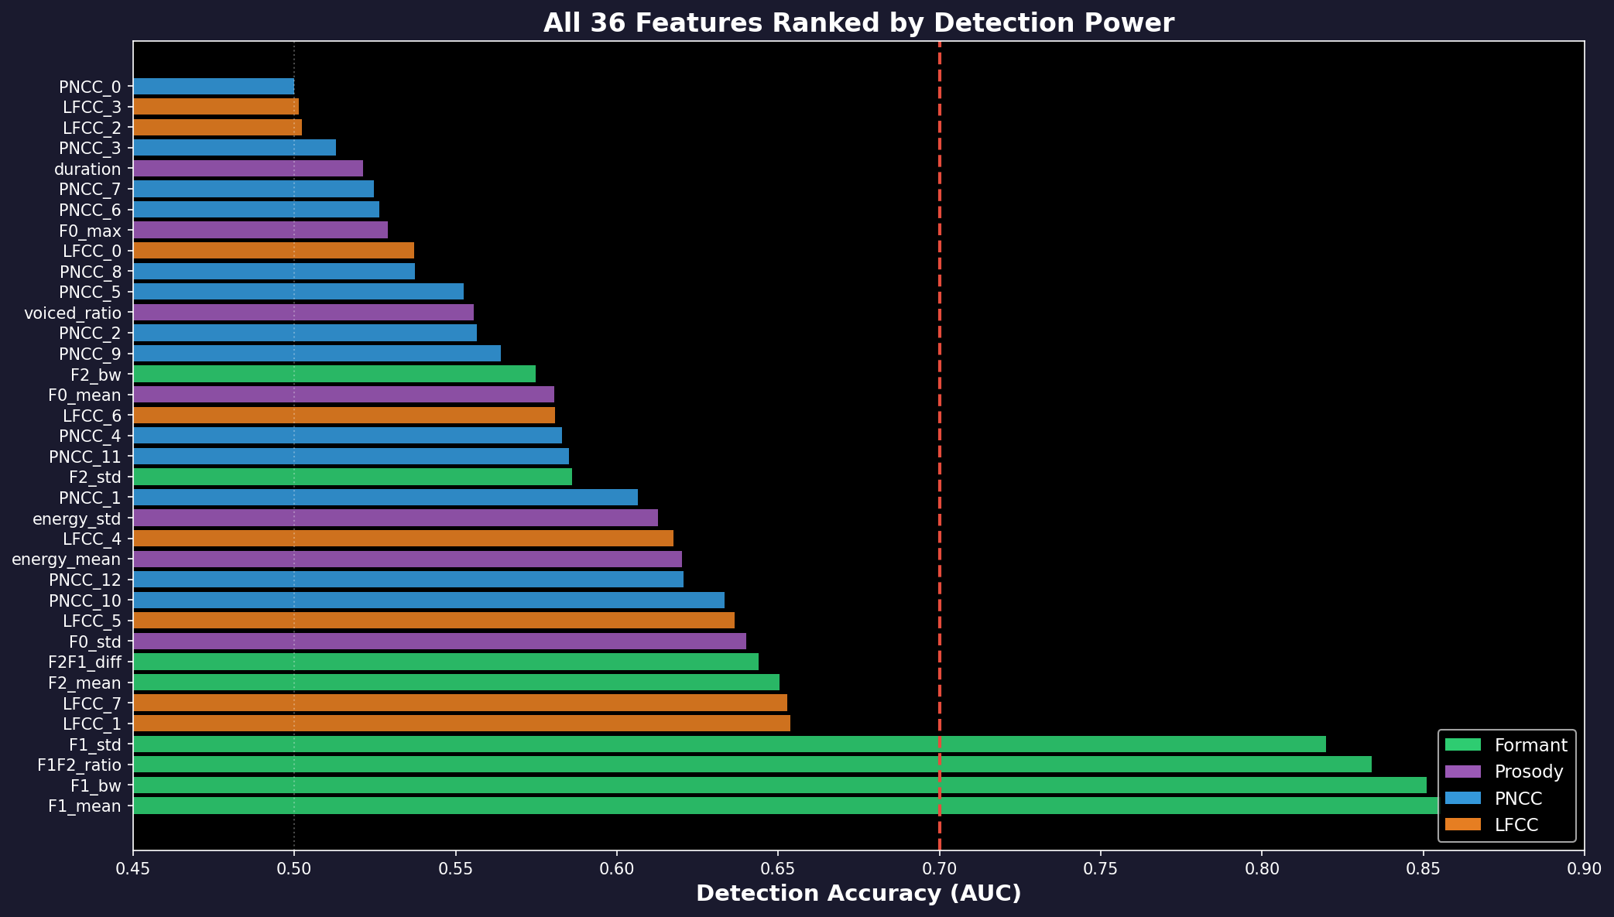
Which Features Actually Detect Fakes?
Reading This Chart
Each bar = one feature's ability
to detect fakes (AUC score)
AUC = 0.5 → coin flip (useless)
AUC = 0.7 → okay (red dashed line)
AUC = 0.85 → good
Color = feature group:
• Green = Formants
• Purple = Prosody
• Blue = PNCC
• Orange = LFCC
Only 4 features cross the
0.7 threshold — ALL are
formant features (green).
PNCC (blue) clusters near 0.5
→ can't detect fakes at all
Notes:
[45 seconds]
"Now the key question: which of these 36 features actually detect fakes? This chart ranks all 36 by detection accuracy — AUC, where 0.5 is a coin flip and 1.0 is perfect."
[Point to top of chart]
"The top four are ALL green — formant features. F1 mean at 0.855, F1 bandwidth at 0.851. Nothing else comes close."
[Point to bottom]
"Look at the blue bars — those are PNCC features. They cluster around 0.5. They cannot tell real from fake at all. And the orange bars — LFCC — they're in the middle but as we'll see, codecs destroy them."
"Out of 36 features, only 4 matter. All four measure the first formant."
[Click]

Slide 6
How Much Do Codecs Change Each Feature?
Same file compressed through 9 codecs — how much does the feature value change?
Feature Group | # Features | Avg Change | Worst Change | Worst Codec | Verdict
Prosody | 7 | 3% | 8% | G.711 | VERY STABLE
Formants | 8 | 6% | 18% | G.711 | STABLE
PNCC | 13 | 6% | 22% | G.711 | MODERATE
LFCC | 8 | 39% | 120% | G.711 | FRAGILE
Method: 150 files × 9 codecs. Compressed each file, re-extracted features, measured % change.
What This Means for Detection
• Formants change by only 6%
The 154 Hz real-vs-fake gap is much
larger than the 6% codec noise
→ Signal survives compression
• Prosody changes by only 3%
Codecs preserve pitch by design
• LFCC changes by 39% (worst: 120%!)
Codecs sacrifice spectral detail
→ Features become unreliable
• A detector using LFCC features will
collapse when codecs are applied
(this is exactly what happened: 50% EER)
Notes:
[40 seconds]
"Now the second test: do they survive compression? We took 150 audio files, compressed each through 9 different codecs — G.711, MP3, AAC — and measured how much each feature changed."
[Point to table]
"Prosody: 3 percent change. Very stable. Formants: 6 percent. Stable. PNCC: 6 percent but remember, it can't detect fakes anyway. LFCC: 39 percent average, worst case 120 percent. That means the codec can MORE THAN DOUBLE the feature value. Completely unreliable."
"This is why the all-36 model collapsed — it relied on LFCC features that got destroyed."
[Click]

Slide 7
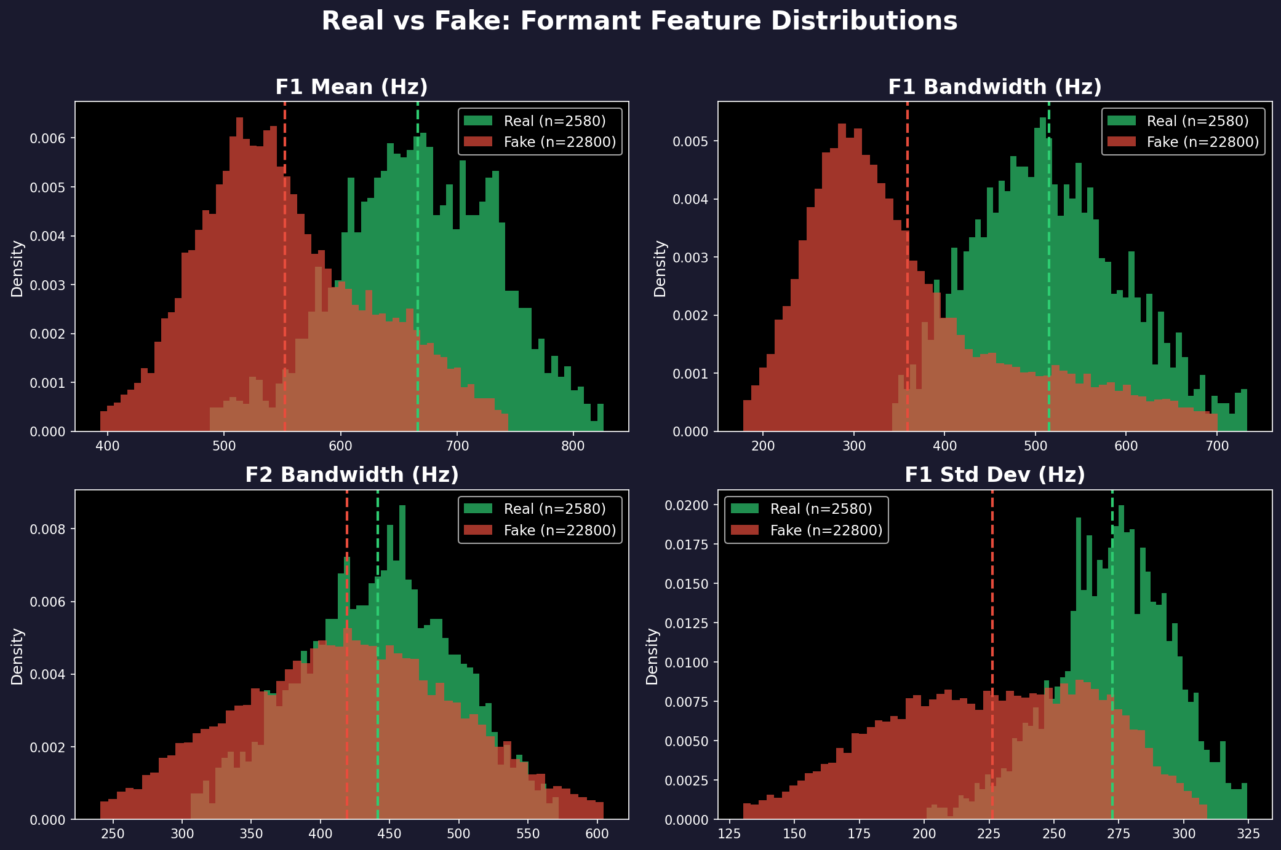
The 4 Winning Features: Real vs Fake
Green = Real (wider, higher) | Red = Fake (narrower, lower) | Dashed = averages
Notes:
[30 seconds]
"Here's what the difference looks like visually. Four panels, four features. Green is real speech, red is fake. Dashed lines are the averages."
"Look at F1 bandwidth — top right. Clear separation. Real speech averages 515 hertz, fake averages 361. You can practically draw a line between them by eye."
"This 154-hertz gap is the core finding of this work."
[Click]

Slide 8
Why Formants Detect Deepfakes
Real Speech
Fake Speech
• Your mouth and throat form a tube
• This tube has resonances (formants)
• The tube absorbs energy → wide resonances
• F1 bandwidth ≈ 515 Hz
• Lots of natural variation
• A neural network generates the sound
• It optimizes for average spectral shape
• No physical damping → sharp resonances
• F1 bandwidth ≈ 361 Hz (154 Hz narrower)
• Less variation (over-smoothed)
Why This Survives Compression
• Codecs MUST preserve formants — without them, you can't understand speech
• Phone codecs (G.729) explicitly encode formant frequencies
• Even MP3 and AAC preserve the resonance structure below 4 kHz
• The 154 Hz gap between real and fake survives all 9 tested codecs
• Formant values change by only 6% under compression
Notes:
[40 seconds]
"Why do formants differ? Physics."
"Real speech comes from a physical tube — your mouth and throat. This tube has resonances, but it also has damping. Tissue absorbs energy. Air escapes through your nose. This damping makes the resonances wide. F1 bandwidth around 515 hertz."
"Fake speech comes from a neural network that optimizes a reconstruction loss. This produces spectrally sharp peaks — unnaturally narrow resonances. F1 bandwidth around 361 hertz."
"And codecs preserve this difference because they MUST preserve formants for speech to be intelligible. That's why our 6 percent codec change is so small — codecs are designed to keep formants intact."
[Click]

Slide 9
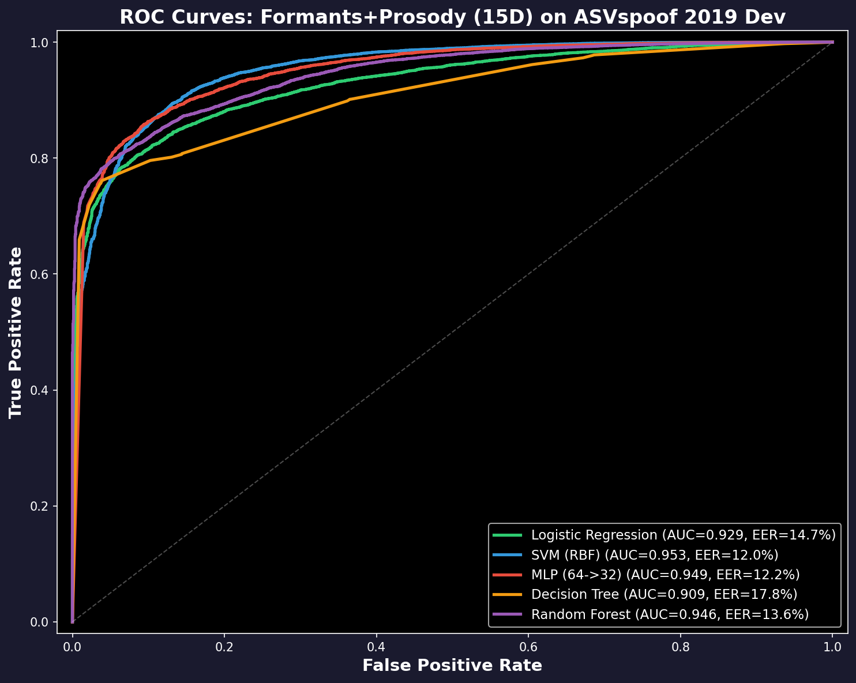
Detection Results: 5 Simple Classifiers
Formants + Prosody (15 features)
Model | Lab | Unseen attacks | After codecs
Logistic Reg. | 14.6% | 17.2% | 24.5%
SVM | 11.4% | 17.2% | 21.5%
Neural Net | 10.6% | 17.3% | 22.3%
Decision Tree | 16.6% | 21.8% | 22.9%
Random Forest | 14.2% | 18.5% | 21.2%
• Error rate = % of wrong predictions
• Best in lab: 10.6% (Neural Net)
• After codecs: 21-25% (degrades, doesn't collapse)
• Compare: all-36 features → 50% after codecs!
• Trained on official ASVspoof challenge splits
• Adjusted for 9:1 fake-to-real imbalance
Notes:
[40 seconds]
"Can classifiers use these features? Yes. We trained five simple models on the 15 formant-plus-prosody features."
[Point to ROC curves]
"The curves show true positive rate versus false positive rate. Higher and more to the left is better."
[Point to table]
"SVM achieves 11 percent error in the lab, 17 percent on unseen attacks, 21 percent after codecs. The neural net is similar. Importantly — none of them collapse. They degrade gracefully from 11 to 22 percent, not from 7 to 50."
"These aren't state-of-the-art — the best neural systems achieve 2 percent. But these are interpretable. You can explain exactly why a file was flagged."
[Click]

Slide 10
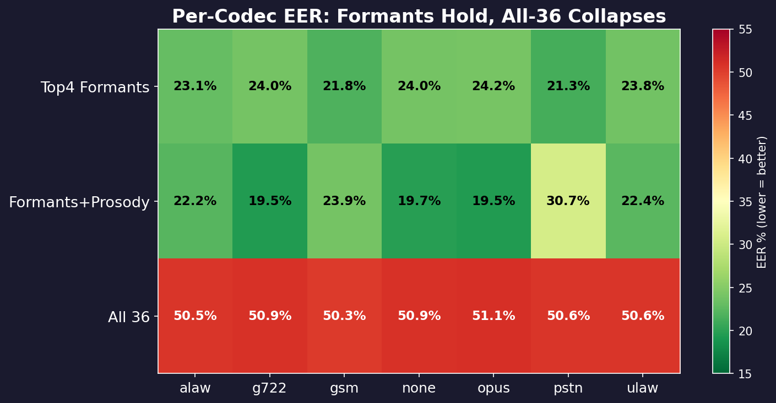
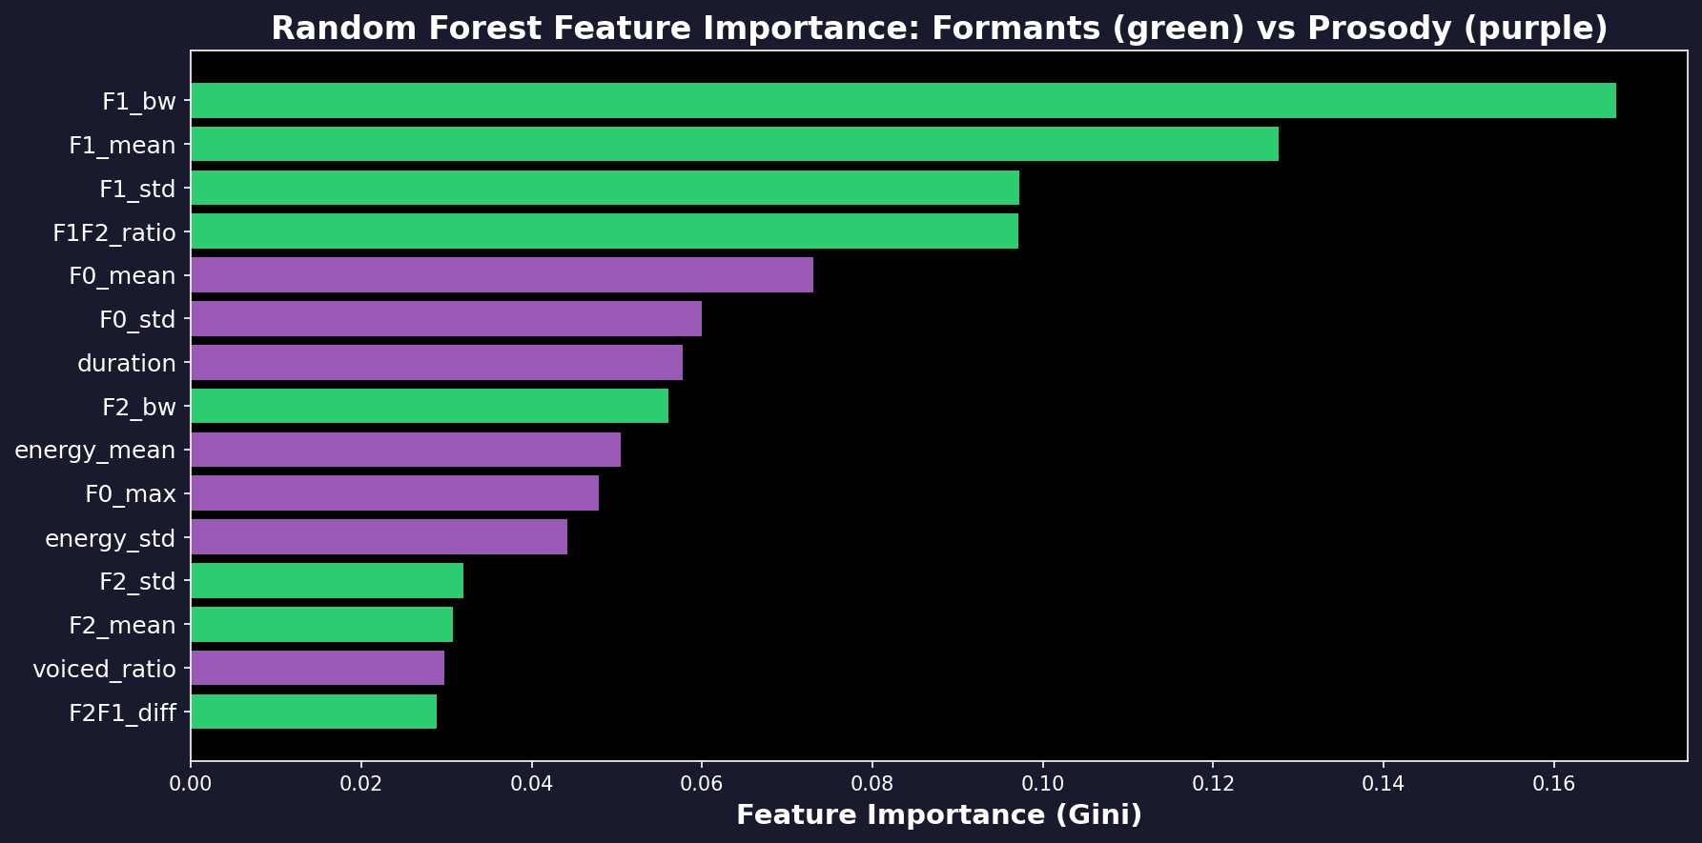
Per-Codec Results & Most Important Features
Every Codec Tested
• Formants: 19–24% error across ALL codecs
• Stable — only 5% variation between codecs
• All-36 features: 50% on EVERY codec
• Green = good, Red = bad
Which Features Matter Most
• F1 bandwidth: 26% of importance
(the single best deepfake indicator)
• F1 mean: 15%
• F1/F2 ratio: 12%
• Green = Formant, Purple = Prosody
Notes:
[30 seconds]
"Top chart: error rate for each model on each codec. The formant row is green across the board — 19 to 24 percent on every codec. The all-36 row is red — 50 percent everywhere."
"Bottom chart: which features matter most in the Random Forest model. F1 bandwidth is 26 percent of the model's decisions — the single most important feature. F1 mean is second at 15 percent."
[Click]

Slide 11
Conclusions
What We Found
Limitations & Next Steps
1. Out of 36 features, only 4 matter:
F1 bandwidth, F1 mean, F1 std, F1/F2 ratio
2. Real: 515 Hz | Fake: 361 Hz
(1.32 standard deviations apart)
3. Codecs change formants by only 6%
but change LFCC by 39%
4. Using only stable features: 21-23% error
Using all features: 50% error (broken)
1. 21-23% error is not state-of-the-art
(best neural systems: 1.9%)
2. Advanced voice cloners can now make
realistic formants → need more features
3. These are interpretable baselines:
you can explain WHY it flagged a file
4. Next: combine with neural models for
accuracy AND explainability
One-Sentence Summary
Real speech has wider formant resonances than synthetic speech because physical vocal tracts have damping that voice synthesizers don’t model — and this difference survives audio compression.
github.com/Yash-Sukhdeve/stats-audio-deepfake-detection
Notes:
[35 seconds]
"To conclude. Out of 36 acoustic features, only 4 reliably detect deepfakes after codec compression. All four measure the first formant — the first resonance of the vocal tract."
"Real speech has wide resonances — 515 hertz — because physical vocal tracts have damping. Fake speech has narrow resonances — 361 hertz — because neural vocoders don't model that damping."
"Codecs change formants by only 6 percent, so this gap survives compression. That's why formant-based detectors degrade gracefully while detectors using all features collapse to chance."
[Pause]
"The code and data are on GitHub. Thank you. I'm happy to take questions."
TOTAL TIME: ~6 minutes 15 seconds of speaking + transitions = ~8 minutes

