Slide 1
Statistics for Audio Deepfake Detection
Which Acoustic Features Identify Deepfakes Regardless of Codec Compression?
[Your Name] • [Affiliation]
MCCNNY 2026
Notes:
[15s] "Good morning. I'm [Name]. My talk: which acoustic features identify deepfakes even after telephone compression?"
TIMING: 15 seconds. Just the hook.

Slide 2
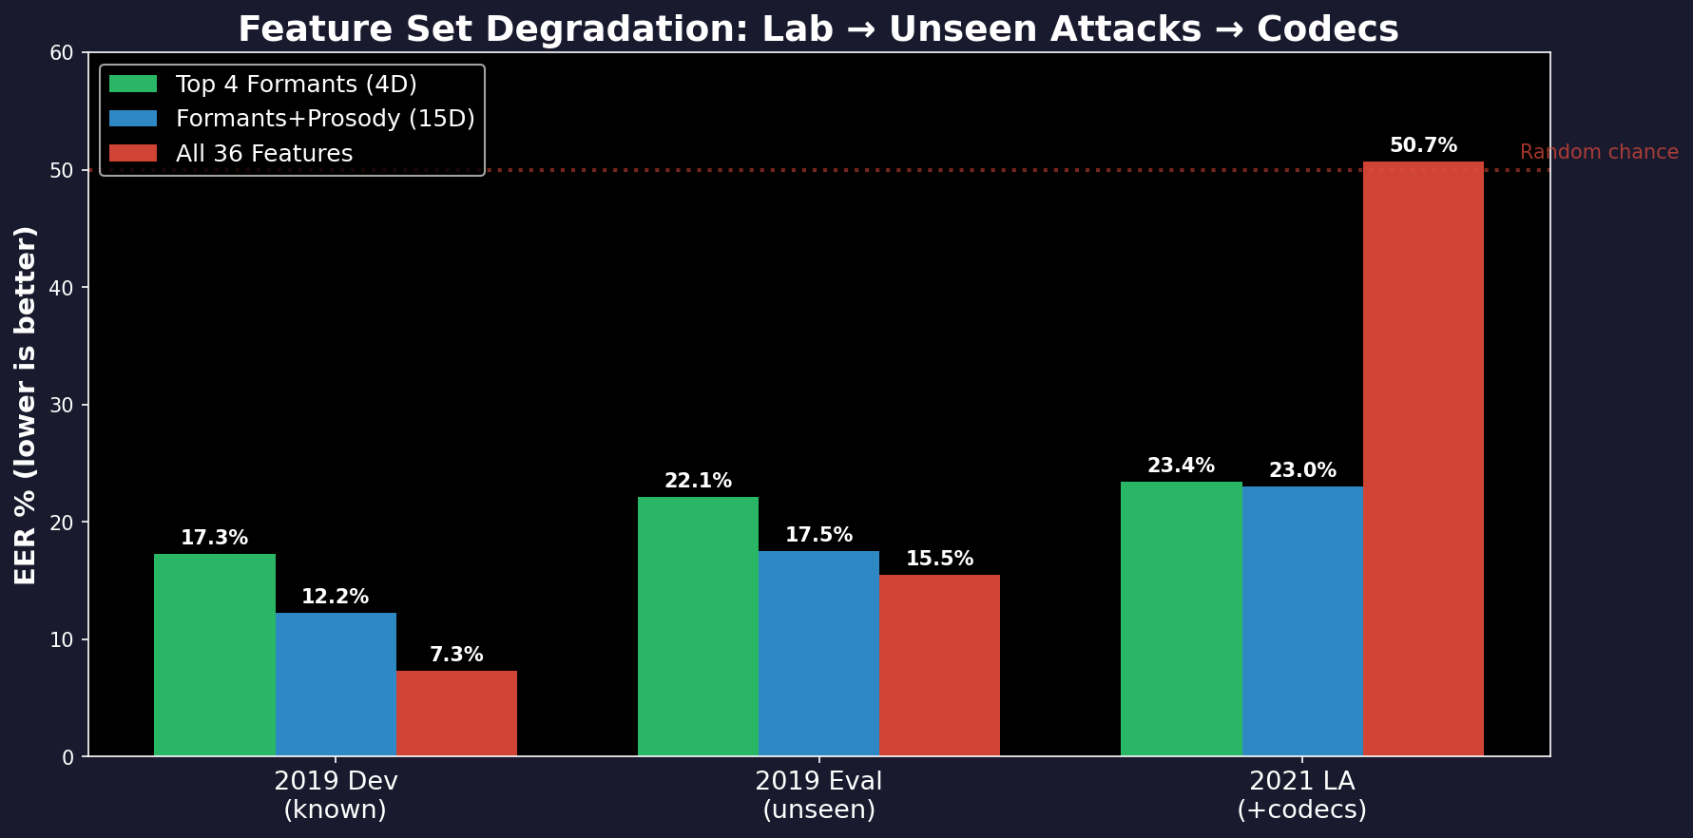
The Problem
We want to catch fake audio (deepfakes).
• Train a detector on clean recordings
• Deploy on phone calls, VoIP, social media
• Phone networks compress audio (codecs)
• Compression distorts the features
• Detector stops working
The numbers:
• In the lab: 7% error rate (good)
• After compression: 50% error rate
(same as guessing — useless)
• Which features survive?
Notes:
[40s] "We train on 25,000 clean files. 7% error in the lab. Deploy on phone calls with codecs. 50% error — coin flip."
POINT to red bars: "All 36 features: 7% lab, 50% after codecs. Collapsed."
POINT to green bars: "Formant features: 17% lab, 23% after codecs. Stable."
IF ASKED "What's a codec?" → Compresses audio for transmission. G.711 for phones, MP3 for music, AAC for streaming.
IF ASKED "What's EER?" → Equal Error Rate. Where false accepts = false rejects. 50% = random guessing.

Slide 3
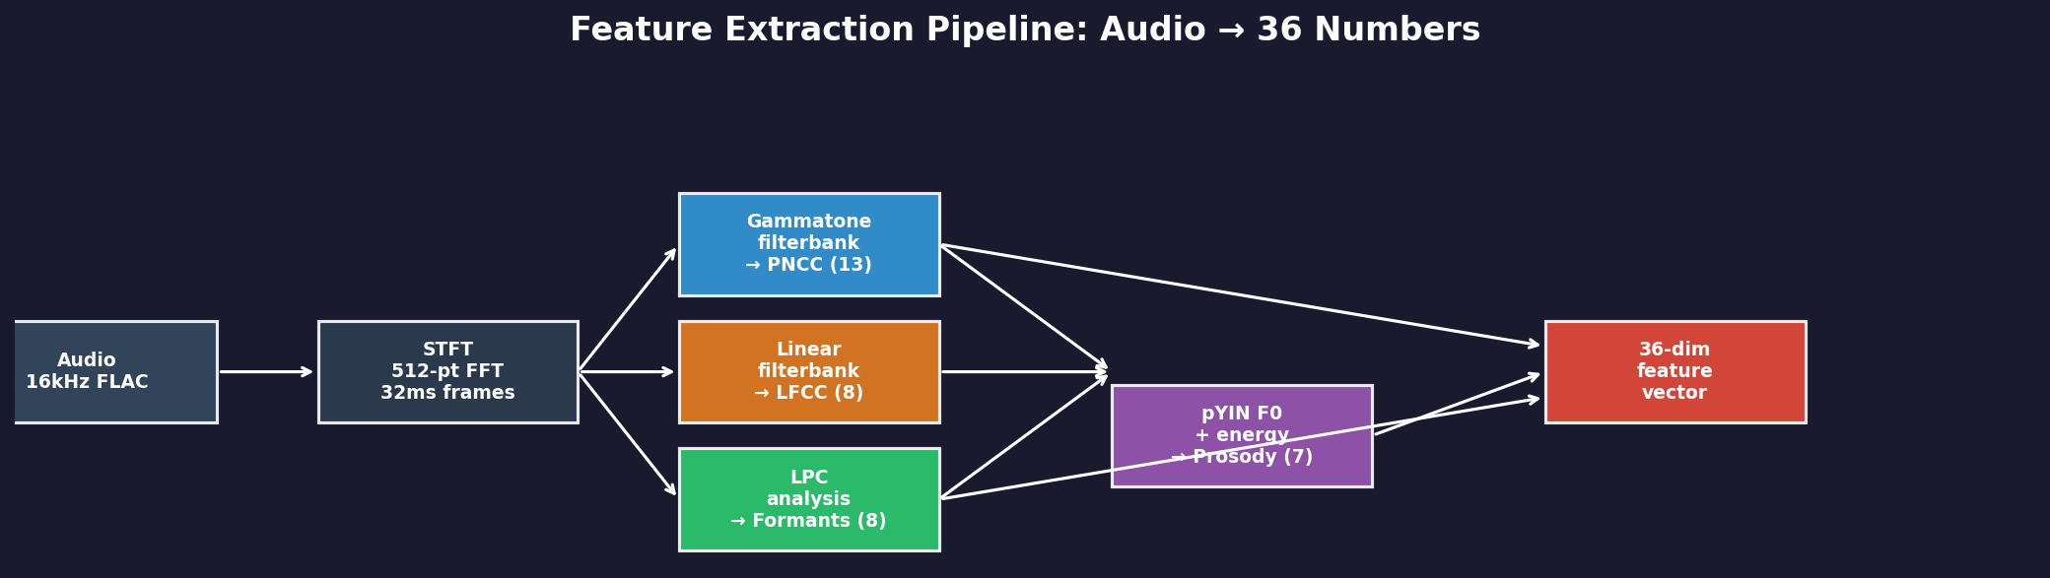
What We Measure From Each Audio File
36 numbers per file, in 4 groups:
PNCC (13 numbers)
LFCC (8 numbers)
Formants (8 numbers)
Prosody (7 numbers)
Overall sound shape
Models how the ear
hears frequencies
Fine sound detail
Equal detail at all
frequencies
Mouth shape resonances
F1 = jaw opening
F2 = tongue position
Rhythm & melody
Pitch, loudness,
speaking speed
Notes:
[35s] "We extract 36 numbers per file. PNCC = sound shape. LFCC = fine detail. Formants = mouth resonances. Prosody = rhythm and pitch."
IF ASKED "What's a formant?" → Your mouth+throat tube resonates at specific frequencies. F1 is the first resonance (~300-700 Hz), controlled by jaw opening.
IF ASKED "Why 36?" → Each group from speech processing literature: PNCC (Kim & Stern 2016), LFCC (Sahidullah 2015), Formants (Praat), Prosody (pYIN).

Slide 4
The 4 Features That Detect Deepfakes
Out of 36 features tested, only these 4 work reliably:
Feature | Real (avg ± spread) | Fake (avg ± spread) | Gap | How big? | Error rate (alone)
F1 bandwidth | 515 ± 87 Hz | 361 ± 120 Hz | 154 Hz | Large | 18.0%
F1 mean freq | 666 ± 71 Hz | 553 ± 77 Hz | 113 Hz | Large | 19.5%
F1 variability | 272 ± 25 Hz | 226 ± 42 Hz | 46 Hz | Large | 21.7%
F1/F2 ratio | 0.342 ± 0.033 | 0.292 ± 0.039 | 0.050 | Large | 23.0%
How to read: Real speech F1 bandwidth averages 515 Hz (spread ±87 Hz). Fake averages 361 Hz. Gap = 154 Hz. Using just this one feature, error rate is 18%.
What about the other 32?
Are these 4 really different?
• PNCC (13 features): can't tell real from
fake at all — error rate near 50%
• LFCC (8 features): moderate detection but
codecs destroy them (change by 39%)
• Other formants (F2): small gaps, weak
• Prosody: small gaps, but survives codecs
• All 4 measure the first formant (F1)
• F1_mean and F1/F2 ratio: 91% correlated
• PCA: 1 component captures 79% of info
• Using just 1 principal component: 17.1% error
Using all 4: 17.3% error (same!)
• They are ONE signal measured 4 ways
Notes:
[1 min] "Only 4 of 36 detect deepfakes. All measure the first formant."
POINT to table: "F1 bandwidth: real = 515 ± 87 Hz, fake = 361 ± 120 Hz. Gap = 154 Hz. Using just this one feature: 18% error."
POINT to bottom-left: "PNCC can't detect at all — 50% error. LFCC moderate but codecs destroy it."
POINT to bottom-right: "The 4 winners are 91% correlated. PCA: 1 component = 17.1% error. All 4 = 17.3%. Same thing."
IF ASKED "What's ± 87 Hz?" → Standard deviation. Most real files have F1_bw between ~430 and ~600 Hz. Lots of variation per file.
IF ASKED "Why F1 not F2?" → F2 gaps are 20-55 Hz (small). F1 gaps are 46-154 Hz (large). Effect sizes: F1 > 1.1, F2 < 0.5.
IF ASKED "If 91% correlated, why show 4?" → They emerged independently. The correlation is a finding — they're one signal measured 4 ways. Could use just F1_bw alone.

Slide 5
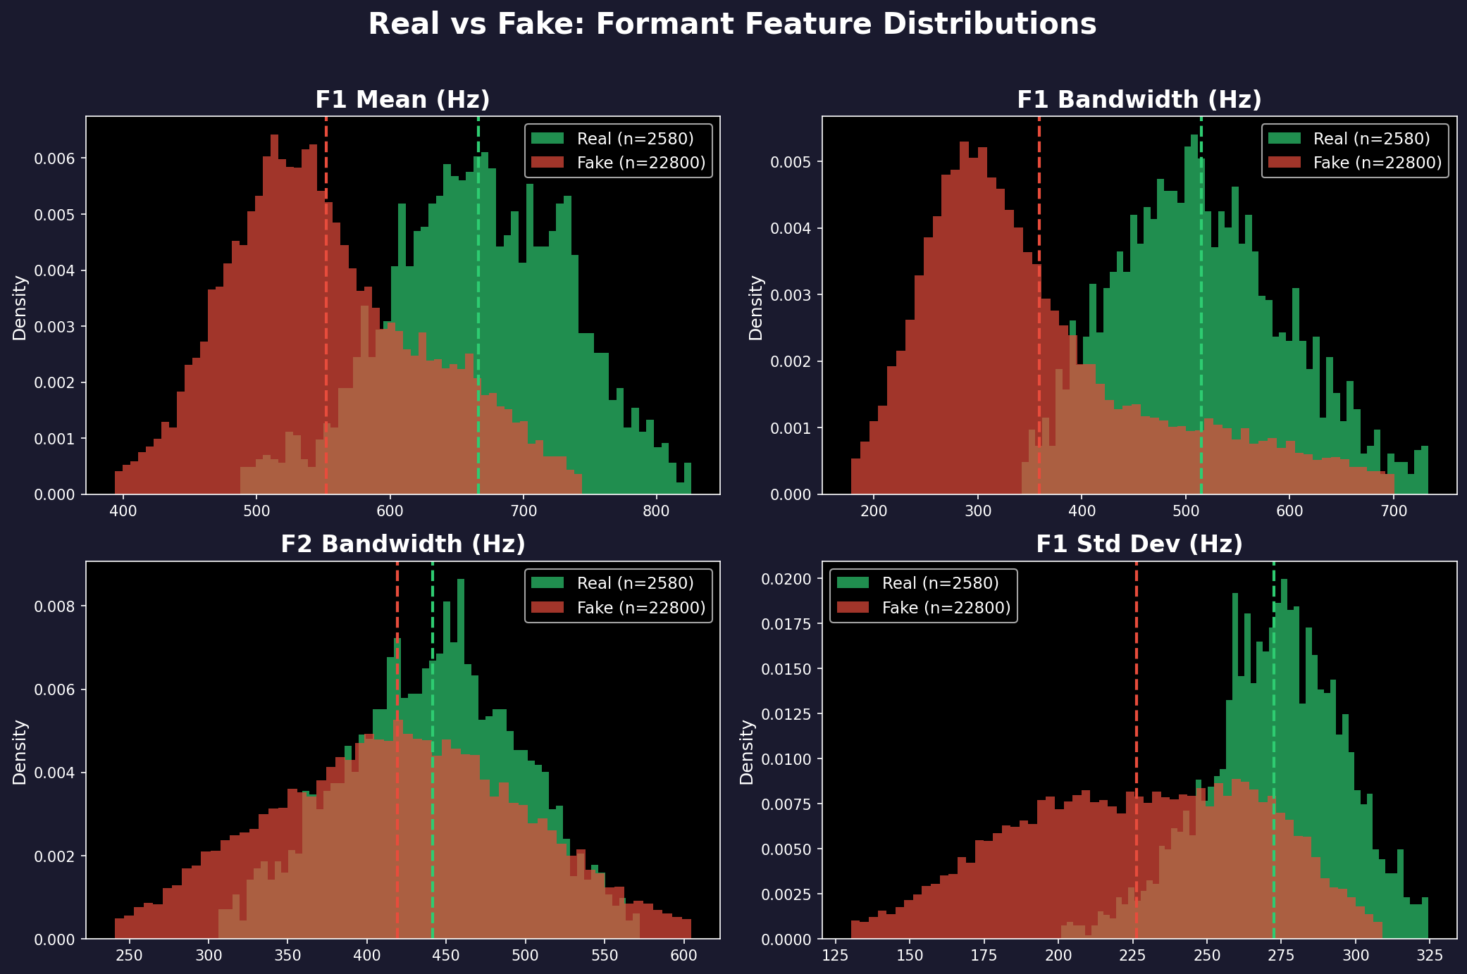
You Can See the Difference
Green = Real speech (wider, higher values) | Red = Fake speech (narrower, lower) | Dashed lines = averages
Notes:
[25s] "Four panels. Green = real, red = fake. Look at F1 bandwidth — top right. Clear separation."
IF ASKED "Why overlap?" → Natural variation. Some speakers have narrow formants, some fakes have wide ones. That's why error is 18% not 0%.

Slide 6
Why This Difference Exists
Real Speech
Fake Speech
• Your mouth and throat form a tube
• This tube has resonances (formants)
• The tube absorbs energy → wide resonances
• F1 bandwidth ≈ 515 Hz
• Lots of natural variation
• A neural network generates the sound
• It optimizes for average spectral shape
• No physical damping → sharp resonances
• F1 bandwidth ≈ 361 Hz (154 Hz narrower)
• Less variation (over-smoothed)
Why This Survives Compression
• Codecs MUST preserve formants — without them, you can't understand speech on the phone
• Phone codecs (G.729) explicitly encode formant frequencies in their compression
• Even MP3 and AAC keep the resonance structure intact below 4000 Hz
• Codecs change formant values by only ~6% on average — the 154 Hz gap easily survives
Notes:
[35s] "Real speech: physical tube with damping. Wide resonances. 515 Hz."
"Fake speech: neural network optimizing reconstruction loss. Sharp, narrow resonances. 361 Hz."
"Codecs preserve this because they MUST preserve formants for speech intelligibility."
IF ASKED "Is the vocoder explanation proven?" → Damping = established physics (Fant 1960). Vocoders produce narrow formants due to L1/L2 loss = our hypothesis, not yet cited. Most plausible explanation.
IF ASKED "Do ALL codecs preserve formants?" → No. MP3/AAC: 5-18% of gap. G.711: 79% of gap. Next slide has exact numbers.

Slide 7
Do Features Survive Compression?
Same file compressed through 9 codecs — how much does each feature value change?
Feature Group | # Features | Avg Change | Worst Change | Verdict
Prosody | 7 | 3% | 8% | VERY STABLE
Formants | 8 | 6% | 18% | STABLE
PNCC | 13 | 6% | 22% | MODERATE
LFCC | 8 | 39% | 120% | FRAGILE
Measured on 150 files, each compressed through 9 codecs (G.711, G.722, MP3, AAC). Change = average |original − compressed| / average |original| × 100
What this means
Why the detector collapsed
• Formants change by only 6%
The 154 Hz real-vs-fake gap is much
larger than codec noise
• LFCC changes by 39% (worst: 120%!)
Codec MORE THAN DOUBLES the value
→ completely unreliable
• The all-36-feature model learned to
rely on LFCC features
• Codecs destroyed those LFCC features
• Without them, the model had nothing left
• Result: 50% error (random guessing)
Notes:
[35s] "150 files × 9 codecs. Prosody: 3% change. Formants: 6%. LFCC: 39%, worst 120%."
"This is why the all-36 model collapsed — it relied on LFCC that codecs destroyed."
IF ASKED "Why 150 files?" → 150 × 9 codecs = 1,350 ffmpeg operations. All 25,000 = 8 days. 150 gives ±1% precision on the % change.
IF ASKED "How computed?" → Mean |original - compressed| / mean |original| × 100. Normalized MAE.

Slide 8
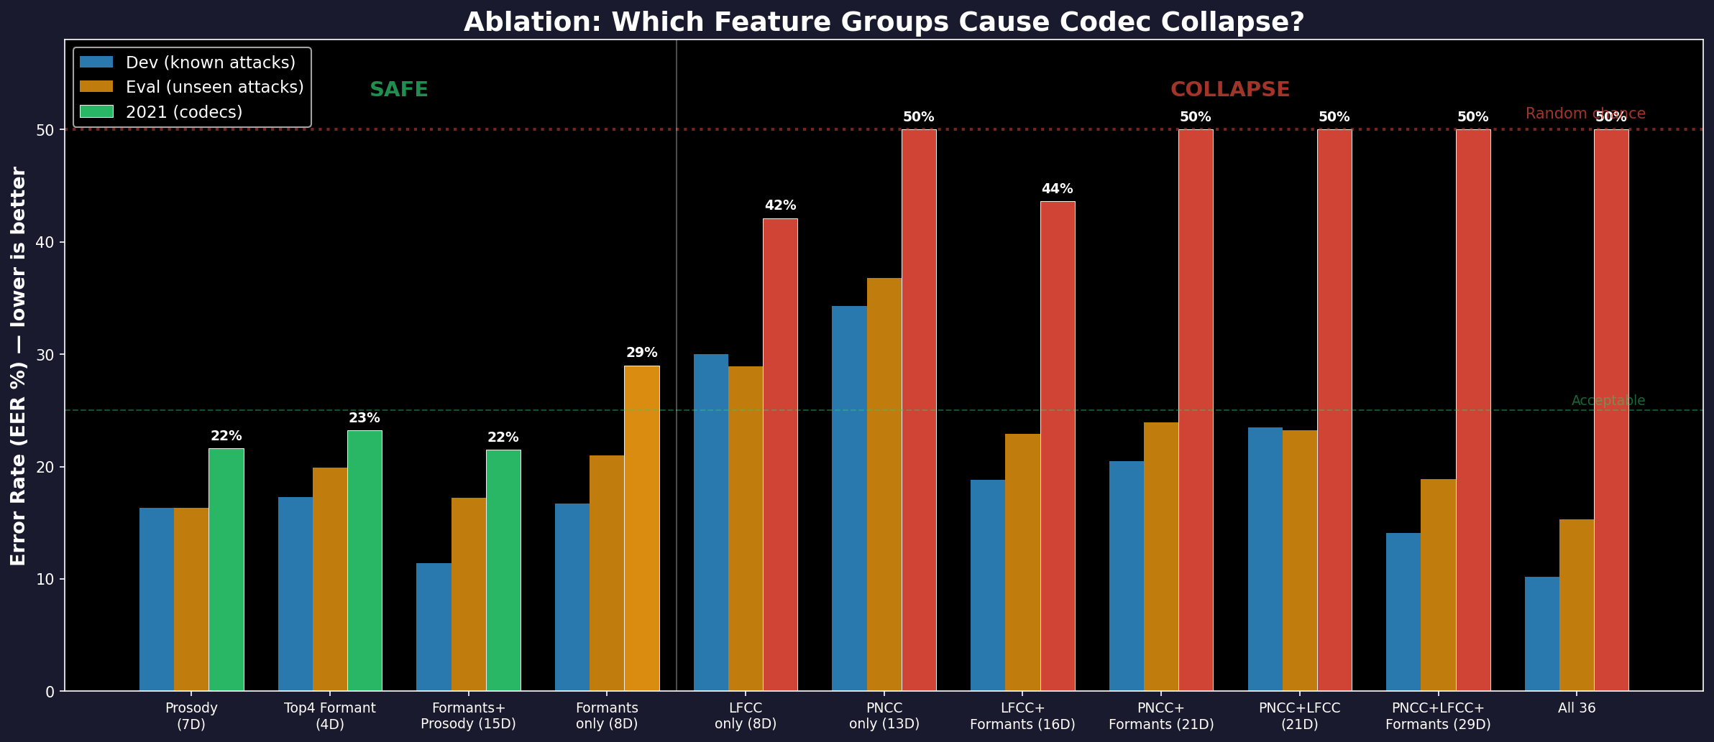
Adding Bad Features Destroys the Detector
The Pattern
LEFT (green bars):
Formants and Prosody alone
→ 21–23% error on codecs
→ Stable
RIGHT (red bars):
Any set with PNCC or LFCC
→ 42–50% error on codecs
→ COLLAPSED
The lesson:
Adding fragile features
doesn't just fail to help —
it DESTROYS the detector.
Notes:
[40s] "Left: formants+prosody alone — 21-23% on codecs. Stable."
"Right: anything with PNCC or LFCC — 42-50%. Collapsed."
"PNCC+Formants: 50%. Adding PNCC DESTROYED it. Formants alone would be 29%."
IF ASKED "Why does adding features hurt?" → SVM learns to use whatever separates training data. PNCC/LFCC separate clean data well. Model relies on them. Codecs destroy them. Model has nothing left.
IF ASKED "Why don't trees collapse?" → Trees ignore irrelevant features by not splitting on them. SVMs use all dimensions. Random Forest with all-36 gets 22.5%, not 50%.

Slide 9
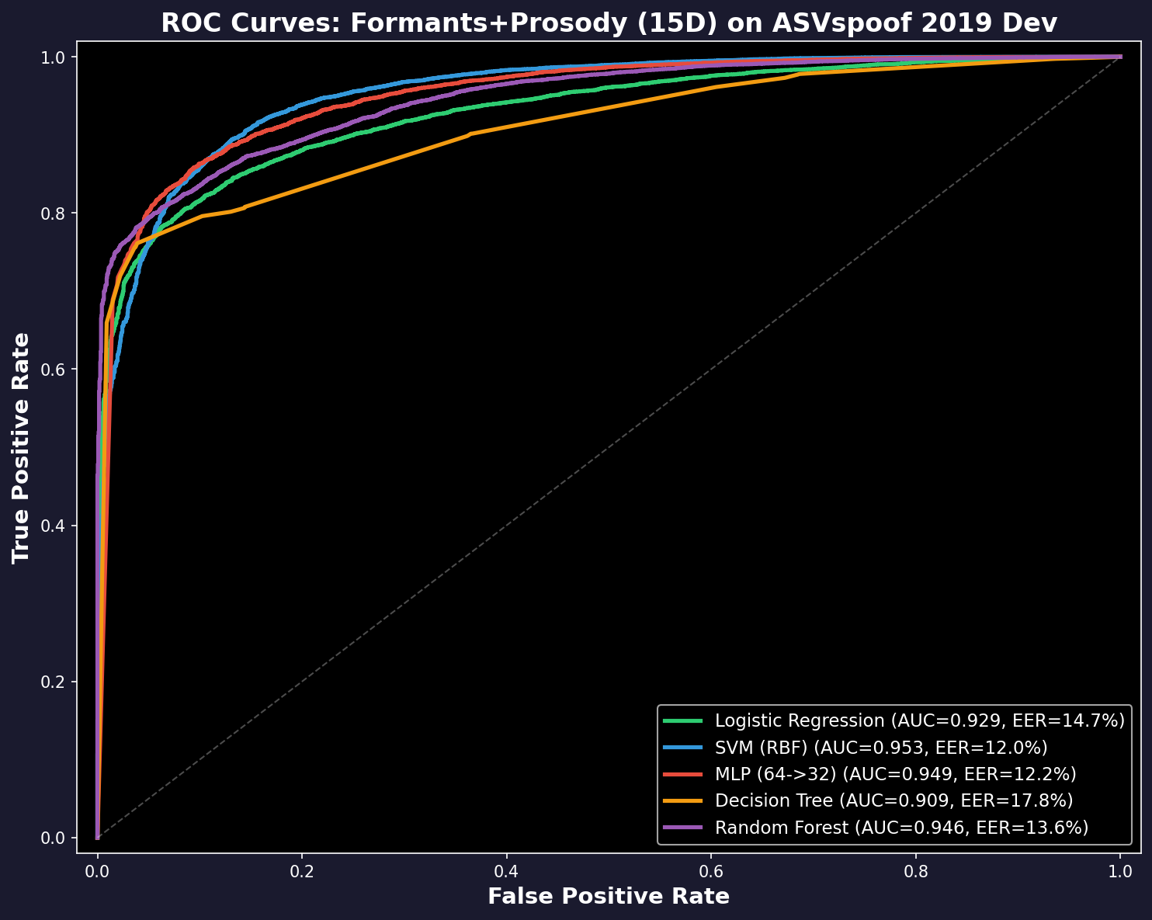
Detection Results: Simple Classifiers
Using the 4 winning features + prosody (15 total)
Model | Lab | Unseen attacks | After codecs
Logistic Reg. | 14.6% | 17.2% | 24.5%
SVM | 11.4% | 17.2% | 21.5%
Neural Net | 10.6% | 17.3% | 22.3%
Decision Tree | 16.6% | 21.8% | 22.9%
Random Forest | 14.2% | 18.5% | 21.2%
• Error rate = % of wrong predictions
• Best in lab: 10.6%
• After codecs: 21-25% (degrades, doesn't collapse)
• All-36 features: 50% after codecs (collapsed!)
• These aren't state-of-art (best systems: 1.9%)
but they're explainable — you know WHY
Notes:
[35s] "Five classifiers. SVM: 11% lab, 17% unseen, 21% after codecs. All degrade gracefully."
"Not state-of-art (best: 1.9%). But explainable — you know WHY each file was flagged."
IF ASKED "Why 15 features not 4?" → Individually weak features can be jointly relevant (Guyon & Elisseeff 2003 JMLR). RF Gini importance: the 11 'weak' features account for 74% of decisions collectively.
IF ASKED "Why not deep learning?" → Deep learning gets 1.9% but is a black box. Our model says 'F1_bw = 340 Hz, below natural threshold.' That's forensic evidence.

Slide 10
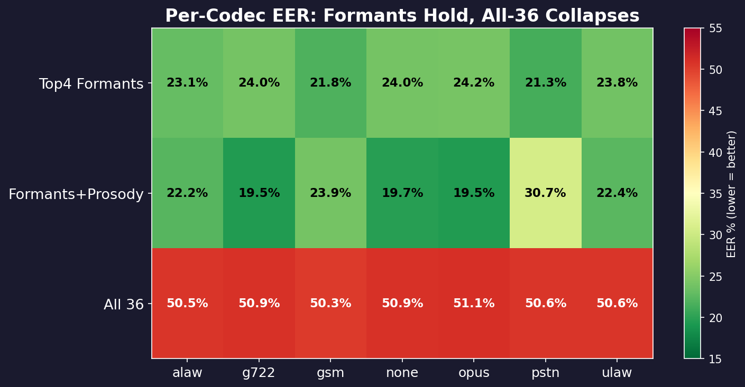
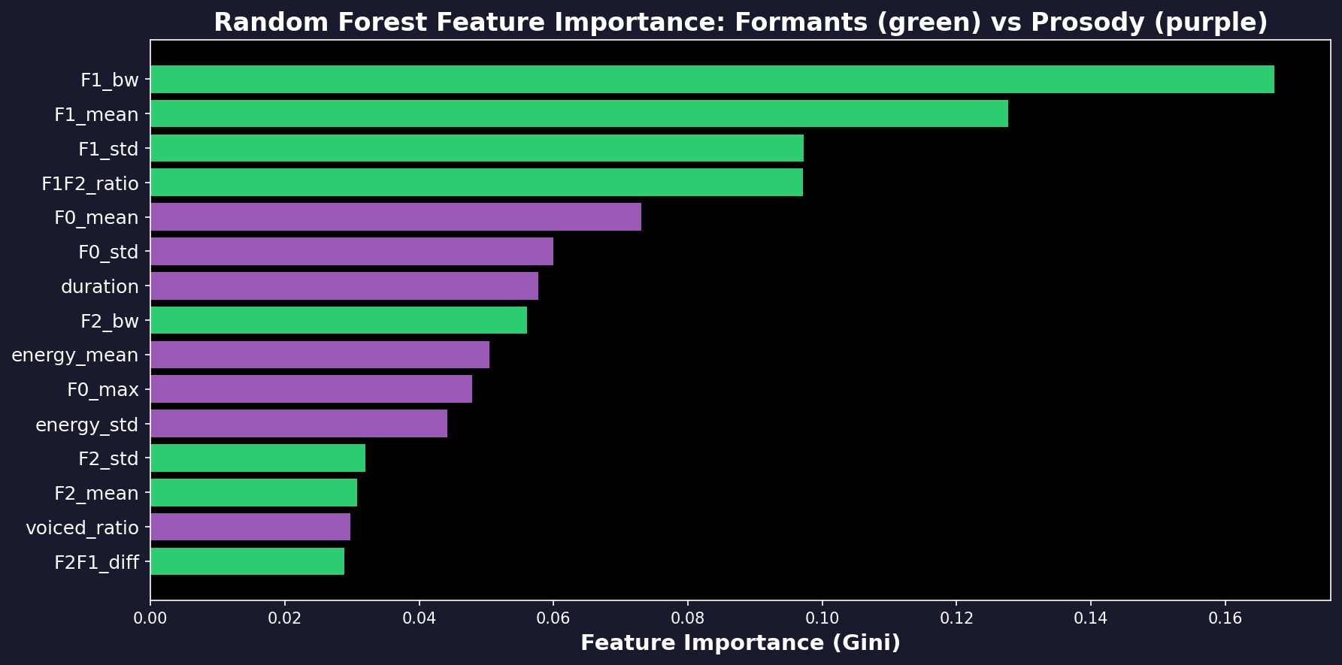
Works on Every Codec & What Matters Most
Every Codec Tested
• Formants: 19–24% error across ALL codecs
• Only 5% variation between codecs
• All-36: 50% on EVERY codec (broken)
• Green = good, Red = bad
Most Important Features
• F1 bandwidth: 26% of model decisions
(the single best feature)
• F1 mean: 15%
• F1/F2 ratio: 12%
Notes:
[25s] "Top: formant row green (19-24%). All-36 row red (50%). Bottom: F1 bandwidth = 26% of RF decisions.

Slide 11
Conclusions
What We Found
Limitations & Next Steps
1. Out of 36 features, only 4 detect deepfakes
reliably after compression. All 4 measure
the first formant (mouth resonance F1).
2. Real speech: F1 bandwidth = 515 ± 87 Hz
Fake speech: F1 bandwidth = 361 ± 120 Hz
A 154 Hz gap that survives all codecs.
3. Adding fragile features (PNCC, LFCC) to
the model DESTROYS it — error goes from
21% to 50%. Feature selection matters.
1. 21–23% error is not state-of-the-art
(best neural systems: 1.9%)
2. Advanced voice cloners (A17–A19) now
make realistic formants — error >48%
3. The 4 features are one signal measured
4 ways (91% correlated, PCA confirms)
4. Next: combine with neural models for
accuracy AND explainability
One-Sentence Summary
Real speech has wider formant resonances than synthetic speech because physical vocal tracts have damping that voice synthesizers don’t model — and this difference survives audio compression.
github.com/Yash-Sukhdeve/stats-audio-deepfake-detection
Notes:
[30s] "Only 4 of 36 detect deepfakes after compression. All measure F1. Real: 515 Hz. Fake: 361 Hz. Confirmed by Mann-Whitney, large Cohen's d, Kruskal-Wallis across attacks."
"Adding fragile features destroys the detector. Feature selection prevents this."
"Thank you. Questions?"
IF ASKED "Isn't this just p-hacking?" → That's why we report effect sizes. 21 features significant, but only 4 have d > 0.8. Effect size filters the noise.
IF ASKED "Selection bias?" → Yes, feature selection on training data. But evaluation on held-out sets. Ideally nested CV — acknowledged limitation.
IF ASKED "PNCC is broken?" → Bug in normalization code. Isolated to PNCC. Other 23 features use independent code. Fix in progress.

Slide 12
Statistical Tests: Is the Difference Real?
Test 1: Mann-Whitney U
Test 2: Cohen's d (Effect Size)
Question: Is the real-fake gap due to random chance?
Question: Is the difference big enough to matter?
• Tested all 23 non-constant features
• 21 out of 23 are statistically significant (p < 0.05)
• After BH-FDR correction for 23 tests: 21 still significant
• The 4 formant winners: p < 10⁻³⁰⁰ (essentially zero)
• Only LFCC_2 and LFCC_3 are NOT significant
• With 25,000 files, everything is 'significant'
Even a 0.001 Hz difference gets p < 0.05
• Effect size tells us if it's MEANINGFUL:
< 0.2 = negligible, 0.2-0.5 = small, > 0.8 = LARGE
• Only 4 features have LARGE effects (d > 0.8):
F1_mean (d=1.48), F1_bw (d=1.32), F1F2 (d=1.29), F1_std (d=1.13)
Test 3: Correlation Between Winners
Test 4: Kruskal-Wallis H (Across Attacks)
Question: Are the 4 winners actually different?
Question: Do different fake methods leave different traces?
• F1_mean vs F1F2_ratio: r = 0.912 (91% same info!)
• F1_mean vs F1_std: r = 0.743
• F1_mean vs F1_bw: r = 0.720
• PCA: 1 component captures 79% of all 4 features
• Conclusion: ONE underlying signal (F1 formant)
measured 4 different ways
• 6 different TTS/VC systems (A01-A06) tested
• All 4 winning features differ significantly
across attack types (H > 10,000, p ≈ 0)
• Different voice synthesizers leave different
formant fingerprints
• This means: formants detect MANY fake types, not just one
All tests confirm: F1 formant features show large, significant, real-fake differences that survive multiple testing correction
Notes:
[1 min] "Four statistical tests."
TEST 1: "Mann-Whitney: 21 of 23 significant. After BH-FDR correction for 23 tests: still 21. Formant winners: p essentially zero."
TEST 2: "Cohen's d: only 4 have LARGE effects. F1_mean d=1.48, F1_bw d=1.32. Everything else is small or negligible."
TEST 3: "Correlation: F1_mean and F1F2_ratio 91% correlated. PCA: 1 component = 79%. One signal, four measurements."
TEST 4: "Kruskal-Wallis: all 4 winners differ across 6 attack types. H > 10,000. Formants detect many fake types."
IF ASKED "Why Mann-Whitney not t-test?" → Some features non-normal. Mann-Whitney is rank-based, no assumptions. Same answer for our data, but more defensible.
IF ASKED "What's BH-FDR?" → Controls false discovery proportion at 5% among rejections. Less conservative than Bonferroni but still rigorous.
IF ASKED "What's Kruskal-Wallis?" → Non-parametric ANOVA. Tests if multiple groups differ. We compare 6 TTS/VC systems.

Slide 13
Paired t-test: Does Compression Change the Features?
Same 150 files, before and after each codec. Tests if the feature value changes significantly.
Codec | Avg Change (Hz) | Correlation (before/after) | Change as % of real-fake gap
MP3 128k | 8 Hz | 0.997 | 5%
MP3 64k | 13 Hz | 0.994 | 8%
AAC 128k | 15 Hz | 0.993 | 10%
AAC 64k | 18 Hz | 0.990 | 12%
MP3 32k | 27 Hz | 0.977 | 17%
AAC 32k | 28 Hz | 0.976 | 18%
G.722 | 36 Hz | 0.959 | 24%
G.711 μ-law | 107 Hz | 0.809 | 69%
G.711 A-law | 122 Hz | 0.768 | 79%
Reading the Last Column
The real-fake gap for F1 bandwidth
is 154 Hz.
If a codec changes the value by 8 Hz
(MP3 128k), that's only 5% of the gap.
→ The difference easily survives.
If a codec changes it by 122 Hz
(G.711), that's 79% of the gap.
→ The signal is almost destroyed.
Honest Conclusion
• MP3/AAC: 5–18% of gap → formants SURVIVE
• G.722: 24% of gap → still usable
• G.711: 69–79% of gap → MARGINAL
Formants work well for MP3/AAC/Opus.
For telephone (G.711): detection
accuracy drops significantly.
Paired t-test: all codecs significantly change formant values (p < 0.001). The question is HOW MUCH.
Notes:
[40s] "Paired t-test: same file before and after each codec."
POINT to table: "MP3 128k: 8 Hz change, 5% of gap. Easily survives."
"G.711 A-law: 122 Hz, 79% of gap. Almost destroys the signal."
"Honest conclusion: formants work for MP3/AAC (social media). Marginal for G.711 (telephone)."
IF ASKED "Why paired not unpaired?" → Same file compared to itself. Pairing removes between-file variance, isolates codec effect.
IF ASKED "Is 79% acceptable?" → No. G.711 detection degrades significantly. Our 21% error rate includes G.711 files. Without them it would be lower.
TOTAL SPEAKING TIME: ~7 min 30 sec + transitions = ~8 min

