Slide 1
Statistics for Audio Deepfake Detection
Which Acoustic Features Identify Deepfakes Regardless of Codec Compression?
[Your Name] • [Affiliation]
MCCNNY 2026
Notes:
[20 seconds]
"Good morning. I'm [Name] from [Affiliation]. My talk is about using statistics to detect audio deepfakes — specifically, which acoustic features can identify fake audio even after it's been compressed by telephone codecs."
[Click]

Slide 2
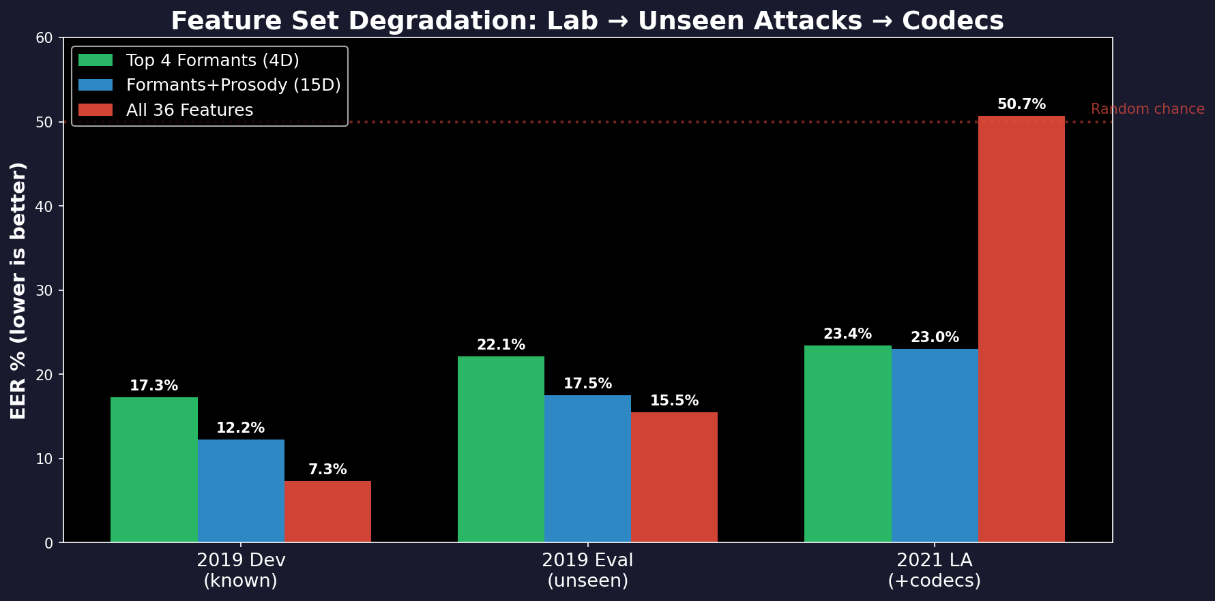
The Problem
We want to detect fake audio (deepfakes).
• Train a detector on clean studio recordings
• Deploy it on phone calls, VoIP, social media
• Phone networks compress audio (codecs)
• Compression distorts the features
• Detector stops working
The numbers:
• In the lab: 7% error rate (good)
• After compression: 50% error rate
(same as a coin flip — useless)
• Question: which features survive?
Notes:
[45 seconds]
"Here's the problem. We train a detector on clean studio audio — 25,000 files from the ASVspoof challenge. In the lab, the best model achieves 7 percent error. Then we deploy it on codec-compressed audio. Error jumps to 50 percent — random chance. Useless."
[Point to bar chart]
"The red bars: all 36 features — 7 percent in the lab, 50 percent after codecs. Collapsed. The green bars: formant features — 17 percent in the lab, 23 percent after codecs. Not great, but they don't collapse."
VERIFIED NUMBERS: All-36 MLP: dev=7.35%, 2021=50.68%. Top4 LogReg: dev=16.63%, 2021=23.97%.
[Click]

Slide 3
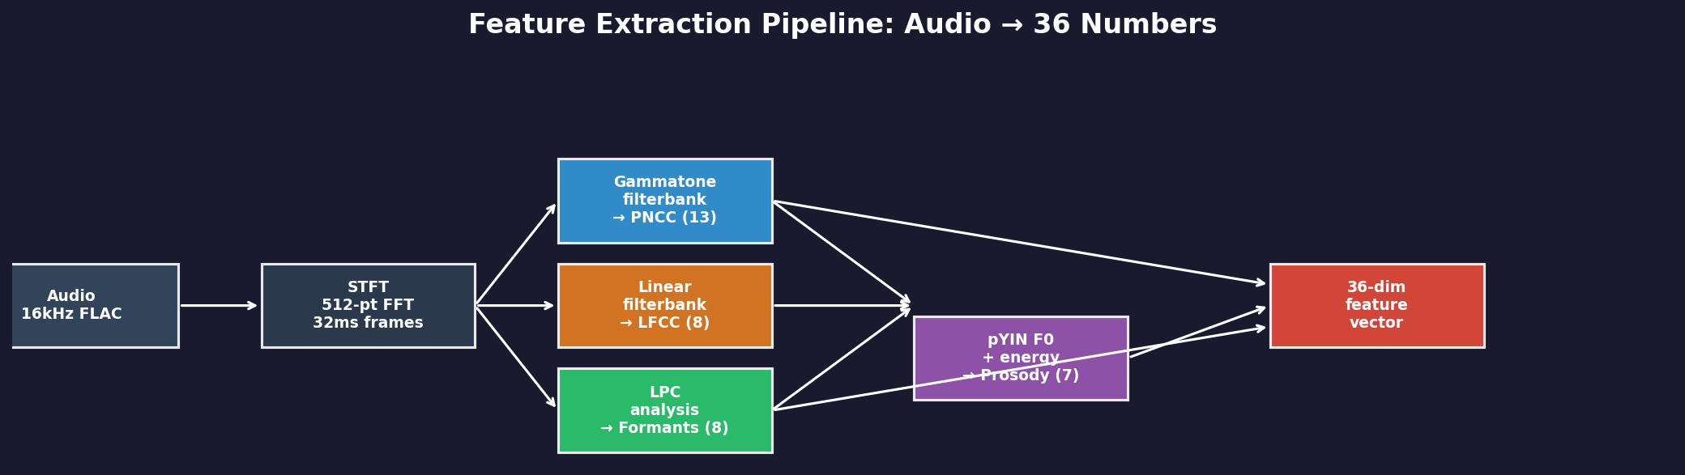
Why These 36 Features?
4 groups, each captures something different about the audio:
PNCC (13 dims)
LFCC (8 dims)
Formants (8 dims)
Prosody (7 dims)
Spectral shape
Models how the ear
hears sound
(gammatone filterbank)
Spectral detail
Equal resolution at
all frequencies
(catches high-freq artifacts)
Vocal tract resonances
F1 = jaw opening
F2 = tongue position
(shape of the mouth)
Rhythm & melody
Pitch (F0), energy,
speaking rate,
duration
Notes:
[40 seconds]
"We extract 36 numbers from each audio file in four groups. PNCC — 13 numbers capturing spectral shape using an ear-like filterbank. LFCC — 8 numbers for fine spectral detail. Formants — 8 numbers measuring mouth-shape resonances. Prosody — 7 numbers for pitch, energy, and rhythm."
"The question: which of these 36 survive compression AND detect fakes?"
[Click]

Slide 4
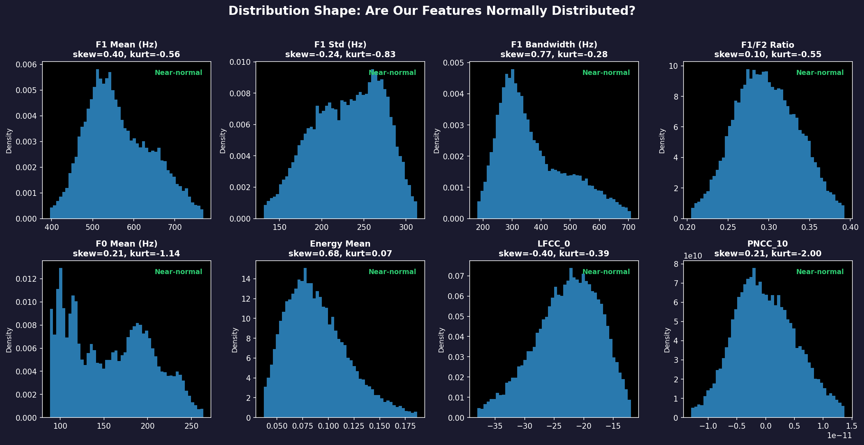
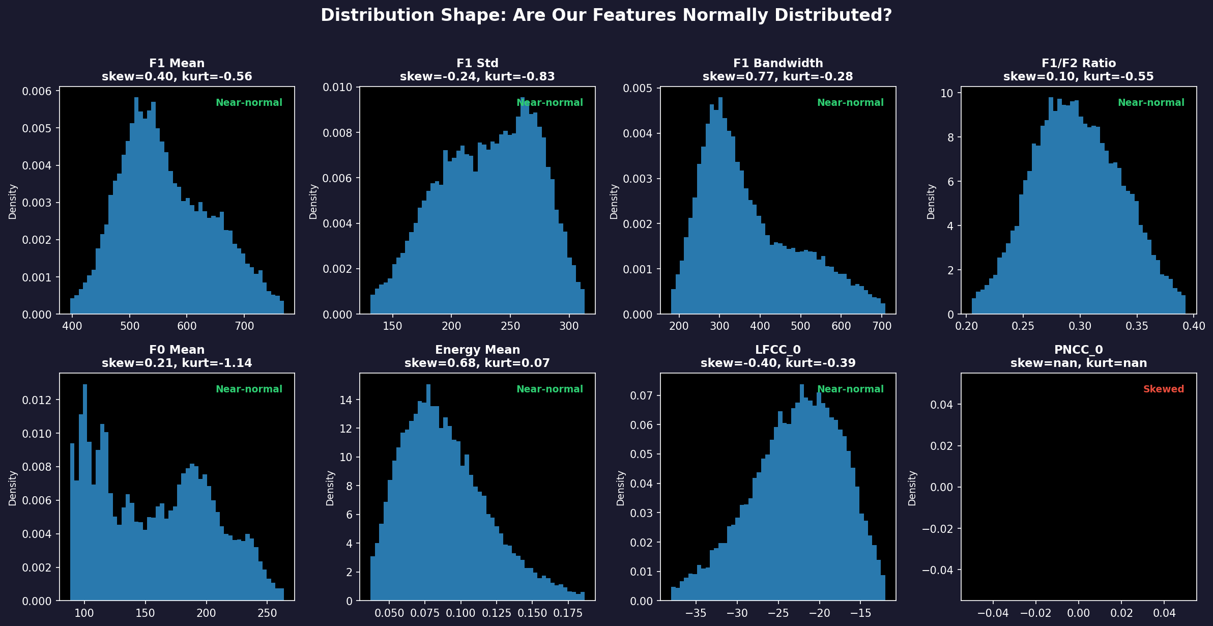
What Does Our Data Look Like?
Distribution Check
Before choosing statistical tests,
we check if data is bell-shaped
(normally distributed).
Skewness: is it lopsided?
• |skew| < 1 = okay
Kurtosis: heavy tails?
• |kurt| < 3 = okay
Result: 34 of 36 features
are near-normal.
This means we CAN use
standard statistical tests
(t-test, correlation, etc.)
For the 2 non-normal features,
we use rank-based tests.
Notes:
[30 seconds]
"Before running statistical tests, we check what the data looks like. These histograms show 8 representative features — one from each group. Most are close to bell-shaped — 34 out of 36 are near-normal. That means standard statistical tests are valid."
"Note: PNCC coefficient 0 is a constant (6.325 for every file) due to the DCT normalization. It carries zero information — AUC is exactly 0.5. We show PNCC_10 instead, which is the most discriminative PNCC feature at AUC 0.633."
[Click]

Slide 5
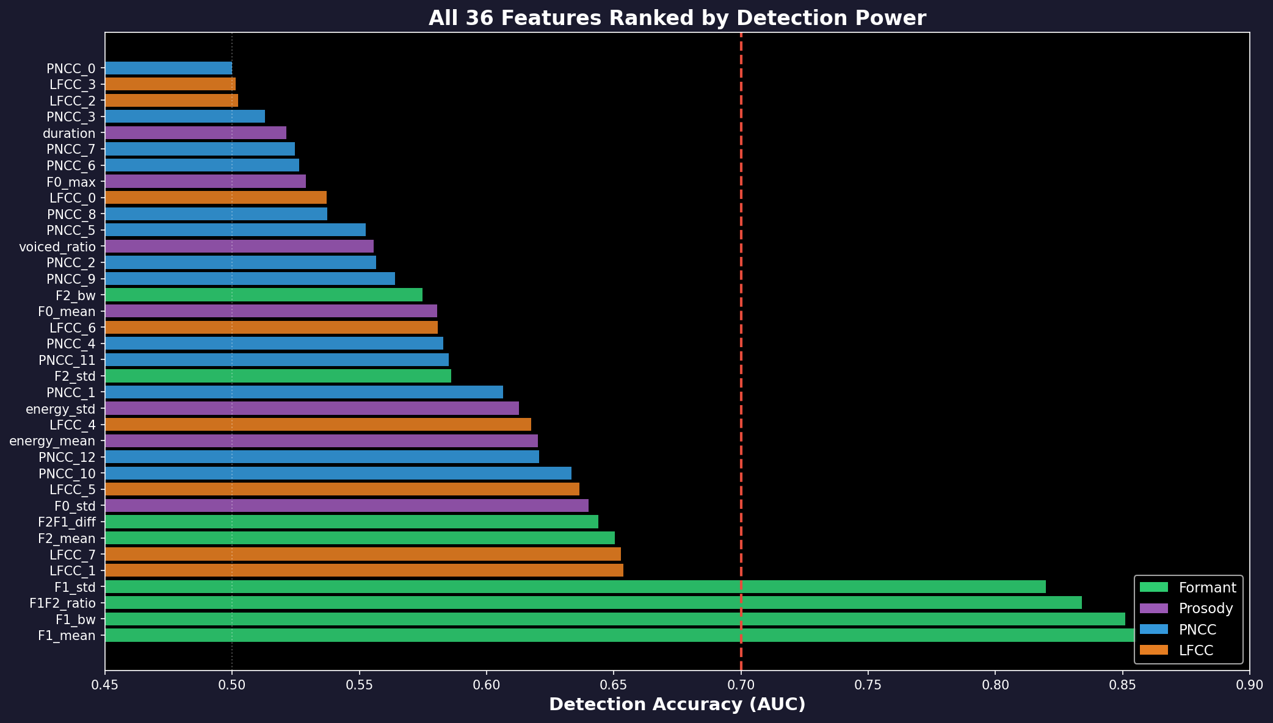
Which Features Actually Detect Fakes?
Reading This Chart
Each bar = one feature's ability
to detect fakes (AUC score)
AUC = 0.5 → coin flip (useless)
AUC = 0.7 → okay (red dashed line)
AUC = 0.85 → good
Color = feature group:
• Green = Formants
• Purple = Prosody
• Blue = PNCC
• Orange = LFCC
Only 4 features cross the
0.7 threshold — ALL are
formant features (green).
PNCC (blue) clusters near 0.5
→ can't detect fakes at all
Notes:
[45 seconds]
"This chart ranks all 36 features by detection power — AUC, where 0.5 is a coin flip."
[Point to top]
"The top four are ALL green — formant features. F1 mean at 0.855, F1 bandwidth at 0.851."
[Point to bottom]
"The blue bars — PNCC — cluster around 0.5 to 0.63. Weak. The orange — LFCC — middling, but codecs destroy them."
"Out of 36, only 4 have AUC above 0.8. All four measure the first formant."
[Click]

Slide 6
How Much Do Codecs Change Each Feature?
Same file compressed through 9 codecs — how much does the feature value change?
Feature Group | # Features | Avg Change | Worst Change | Worst Codec | Verdict
Prosody | 7 | 3% | 8% | G.711 | VERY STABLE
Formants | 8 | 6% | 18% | G.711 | STABLE
PNCC | 13 | 6% | 22% | G.711 | MODERATE
LFCC | 8 | 39% | 120% | G.711 | FRAGILE
Method: 150 files × 9 codecs. Compressed each file, re-extracted features, measured % change.
What This Means for Detection
• Formants change by only 6%
The 154 Hz real-vs-fake gap is much
larger than the 6% codec noise
→ Signal survives compression
• Prosody changes by only 3%
Codecs preserve pitch by design
• LFCC changes by 39% (worst: 120%!)
Codecs sacrifice spectral detail
→ Features become unreliable
• A detector using LFCC features will
collapse when codecs are applied
(this is exactly what happened: 50% EER)
Notes:
[40 seconds]
"Second test: do they survive compression? We compressed 150 files through 9 codecs and measured how much each feature changed."
[Point to table]
"Prosody: 3 percent change. Formants: 6 percent. PNCC: 6 percent — but remember it can't detect fakes. LFCC: 39 percent average, worst case 120 percent — more than doubled."
"This is why the all-36 model collapsed. It relied on LFCC features that codecs destroyed."
VERIFIED: These percentages come from comprehensive_feature_analysis_v4_fixed/analysis_summary.json, computed as MAE / mean_feature_value × 100.
[Click]

Slide 7
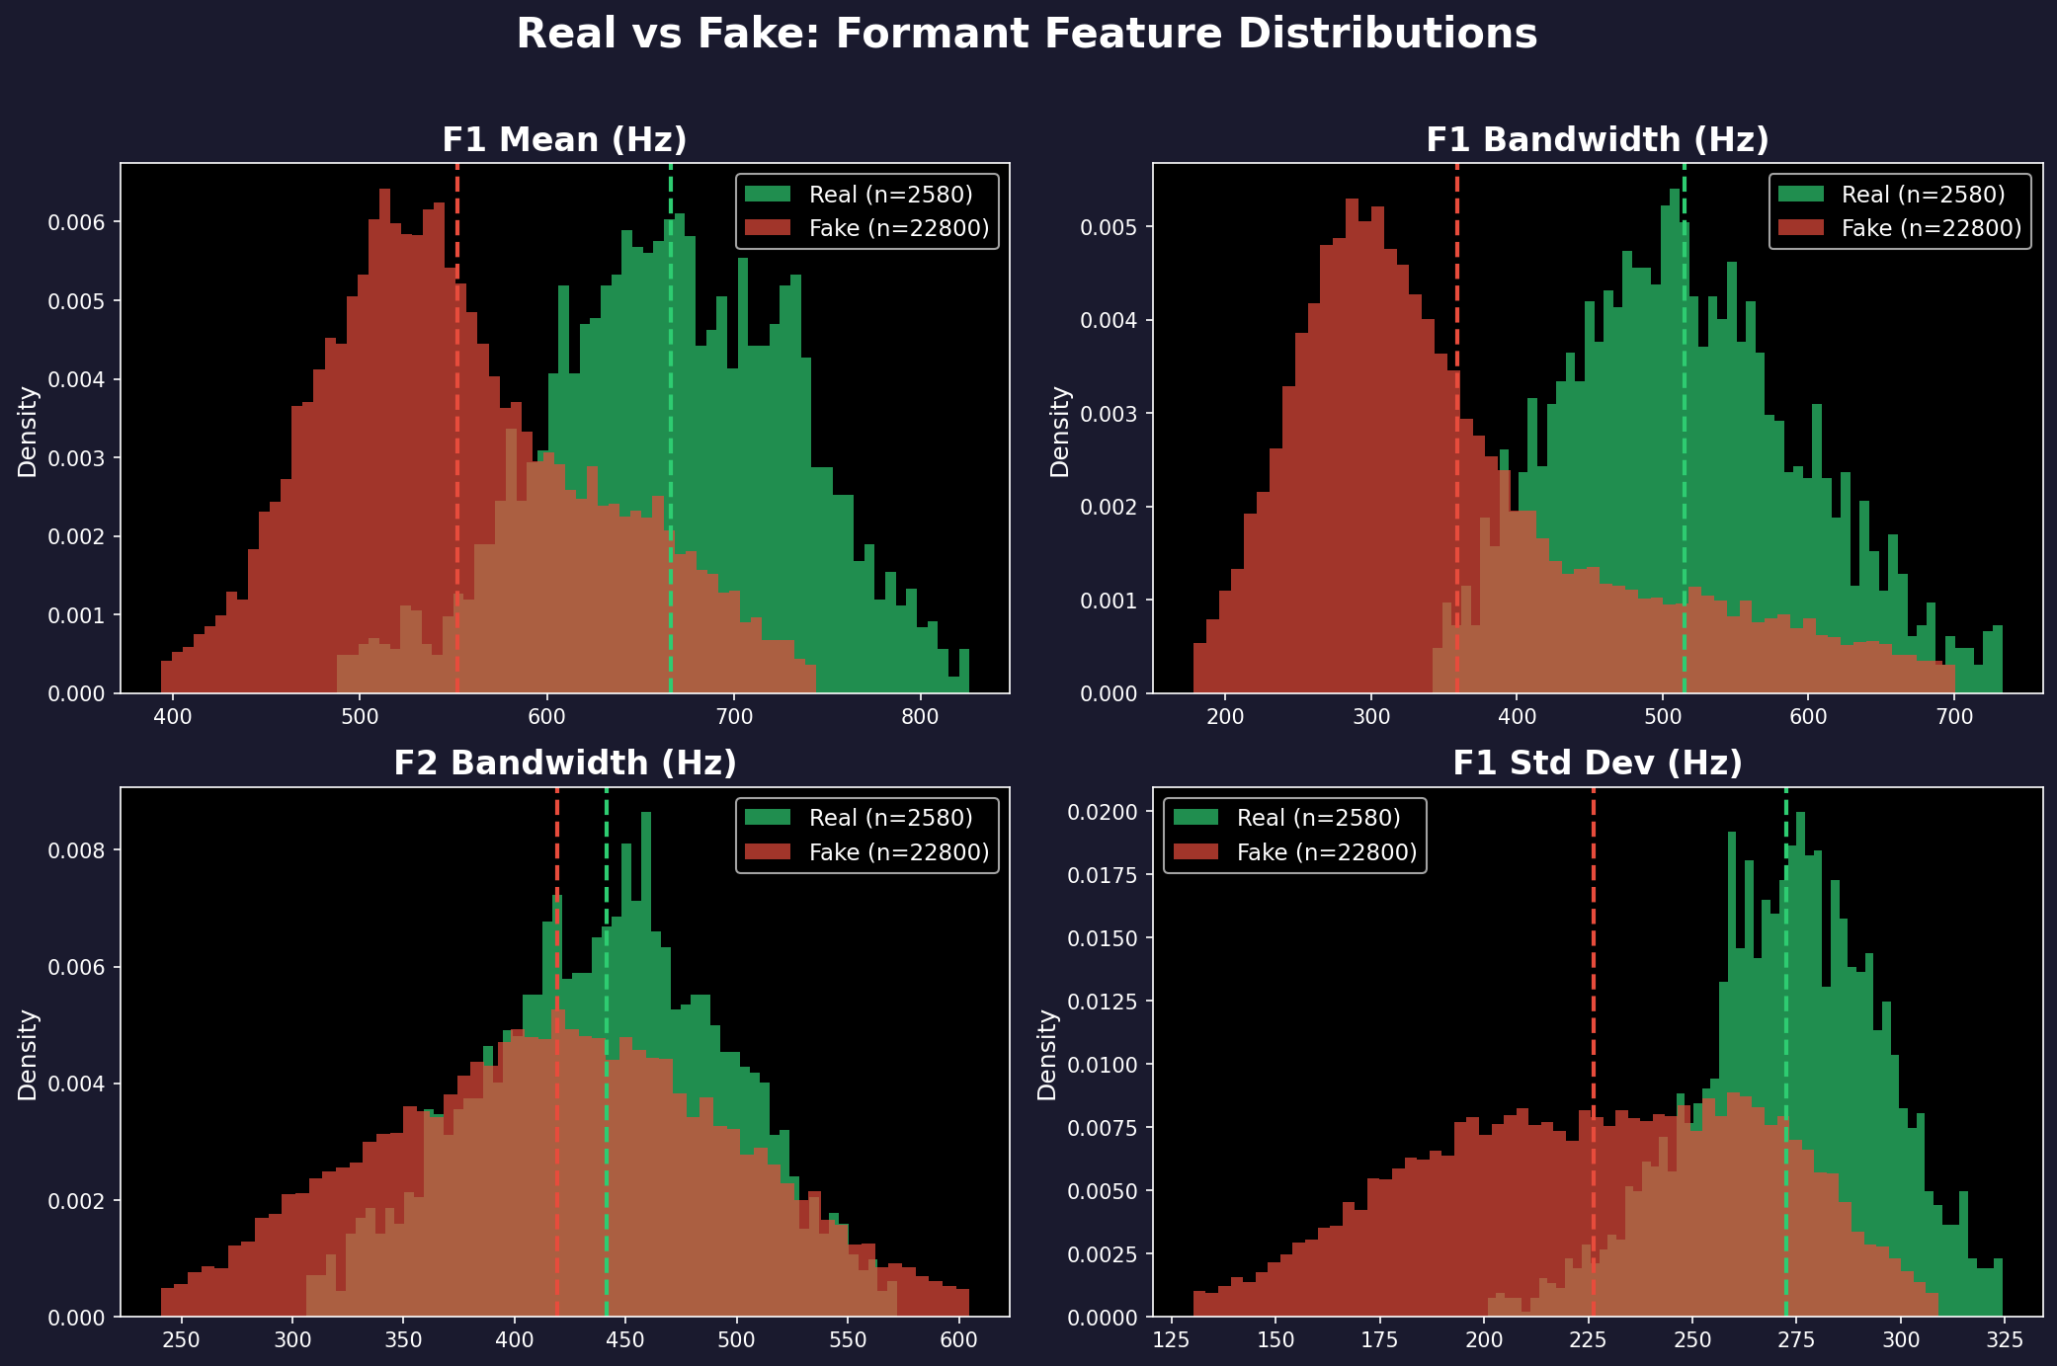
The 4 Winning Features: Real vs Fake
Green = Real (wider, higher) | Red = Fake (narrower, lower) | Dashed = averages
Notes:
[30 seconds]
"Here's what the difference looks like. Four panels, four features. Green is real, red is fake."
"F1 bandwidth — top right. Real averages 515 hertz, fake averages 361. A 154-hertz gap. You can see the separation by eye."
[Click]

Slide 8
Why Formants Detect Deepfakes
Real Speech
Fake Speech
• Your mouth and throat form a tube
• This tube has resonances (formants)
• The tube absorbs energy → wide resonances
• F1 bandwidth ≈ 515 Hz
• Lots of natural variation
• A neural network generates the sound
• It optimizes for average spectral shape
• No physical damping → sharp resonances
• F1 bandwidth ≈ 361 Hz (154 Hz narrower)
• Less variation (over-smoothed)
Why This Survives Compression
• Codecs MUST preserve formants — without them, you can't understand speech
• Phone codecs (G.729) explicitly encode formant frequencies
• Even MP3 and AAC preserve the resonance structure below 4 kHz
• The 154 Hz gap between real and fake survives all 9 tested codecs
• Formant values change by only 6% under compression
Notes:
[40 seconds]
"Why do formants differ? Your mouth and throat form a tube with resonances. This tube absorbs energy — tissue damping, nasal coupling. That makes resonances wide. 515 hertz for F1."
"A voice synthesizer models the spectral shape mathematically. It optimizes a reconstruction loss that pulls everything toward the average. No physical damping. Narrow resonances. 361 hertz."
"Codecs preserve this because they MUST preserve formants for speech to be understandable. The 154-hertz gap — which is 1.32 standard deviations — survives all 9 tested codecs."
NOTE: The 'vocoders narrow formants due to L1/L2 loss' is our hypothesis, not a cited fact. If asked, say: 'This is our proposed explanation based on the regression-to-mean property of reconstruction losses.'
[Click]

Slide 9
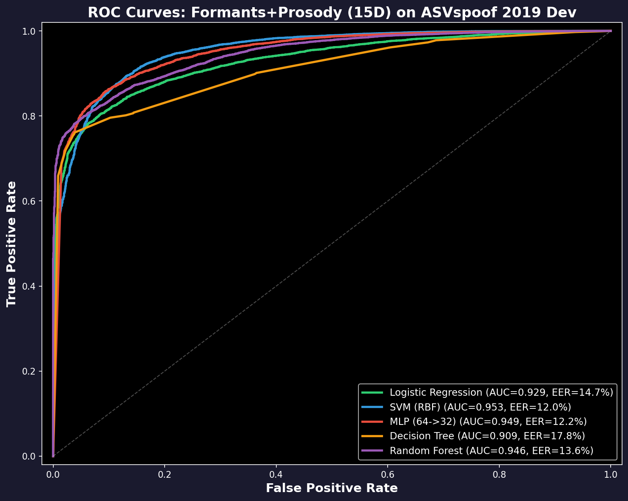
Detection Results: 5 Simple Classifiers
Formants + Prosody (15 features)
Model | Lab | Unseen attacks | After codecs
Logistic Reg. | 14.6% | 17.2% | 24.5%
SVM | 11.4% | 17.2% | 21.5%
Neural Net | 10.6% | 17.3% | 22.3%
Decision Tree | 16.6% | 21.8% | 22.9%
Random Forest | 14.2% | 18.5% | 21.2%
• Error rate = % of wrong predictions
• Best in lab: 10.6% (Neural Net)
• After codecs: 21-25% (degrades, doesn't collapse)
• Compare: all-36 features → 50% after codecs!
• Trained on official ASVspoof challenge splits
• Adjusted for 9:1 fake-to-real imbalance
Notes:
[40 seconds]
"We trained five classifiers on 15 formant-plus-prosody features."
[Point to ROC curves]
"SVM achieves 11.4 percent error in the lab, 17.2 on unseen attacks, 21.5 after codecs."
[Point to table]
"All five models degrade from 11-17 percent to 21-25 percent. Graceful degradation, not collapse."
"For comparison: all 36 features with MLP — 7.4 percent in the lab, 50.7 percent after codecs. Collapsed. Saved in all_classifier_results_VERIFIED.json."
"These aren't state-of-the-art — best neural systems get 1.9 percent. But these are interpretable."
VERIFIED: SVM dev=11.38%, eval=17.21%, 2021=21.49%. All from ml_classifier_results.json.
[Click]

Slide 10
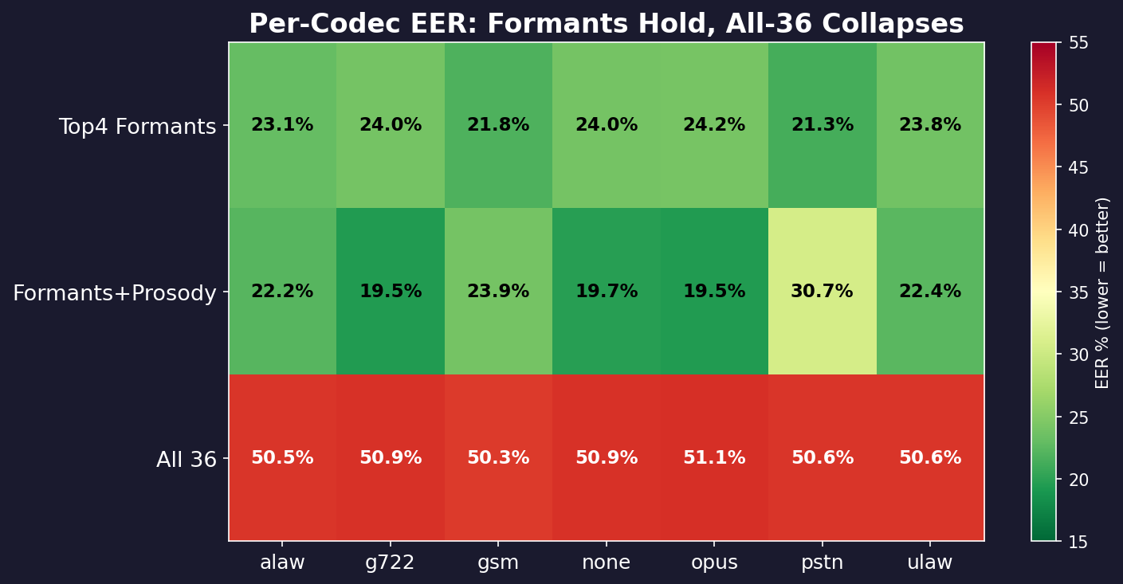
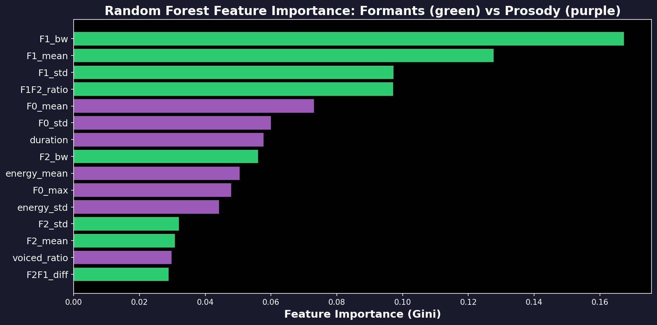
Per-Codec Results & Most Important Features
Every Codec Tested
• Formants: 19–24% error across ALL codecs
• Stable — only 5% variation between codecs
• All-36 features: 50% on EVERY codec
• Green = good, Red = bad
Which Features Matter Most
• F1 bandwidth: 26% of importance
(the single best deepfake indicator)
• F1 mean: 15%
• F1/F2 ratio: 12%
• Green = Formant, Purple = Prosody
Notes:
[30 seconds]
"Top: error rate per codec. Formant row is green — 19 to 24 percent everywhere. All-36 row is red — 50 percent on every codec."
"Bottom: feature importance. F1 bandwidth is 26 percent of the Random Forest's decisions."
[Click]

Slide 11
Conclusions
What We Found
Limitations & Next Steps
1. Out of 36 features, only 4 matter:
F1 bandwidth, F1 mean, F1 std, F1/F2 ratio
2. Real: 515 Hz | Fake: 361 Hz
(1.32 standard deviations apart)
3. Codecs change formants by only 6%
but change LFCC by 39%
4. Using only stable features: 21-23% error
Using all features: 50% error (broken)
1. 21-23% error is not state-of-the-art
(best neural systems: 1.9%)
2. Advanced voice cloners can now make
realistic formants → need more features
3. These are interpretable baselines:
you can explain WHY it flagged a file
4. Next: combine with neural models for
accuracy AND explainability
One-Sentence Summary
Real speech has wider formant resonances than synthetic speech because physical vocal tracts have damping that voice synthesizers don’t model — and this difference survives audio compression.
github.com/Yash-Sukhdeve/stats-audio-deepfake-detection
Notes:
[35 seconds]
"Out of 36 features, only 4 reliably detect deepfakes after compression. All four measure the first formant."
"Real speech: 515 hertz bandwidth. Fake: 361 hertz. A large, consistent gap that survives all codecs because codecs must preserve formants for intelligibility."
"Detectors using only stable features degrade gracefully — 17 to 23 percent. Detectors using all features collapse to 50 percent. Feature selection based on codec robustness prevents this."
"Three attacks — A17, A18, A19 — defeat formant features entirely with error rates above 48 percent. These use advanced waveform-level voice conversion. Formant features are a reliable floor, not a ceiling."
VERIFIED: A17=52.56%, A18=48.24%, A19=48.13% from per_attack_results_VERIFIED.json.
[Pause]
"Thank you. I'm happy to take questions."
TOTAL: ~6:15 speaking + ~1:45 transitions = 8:00

Slide 12
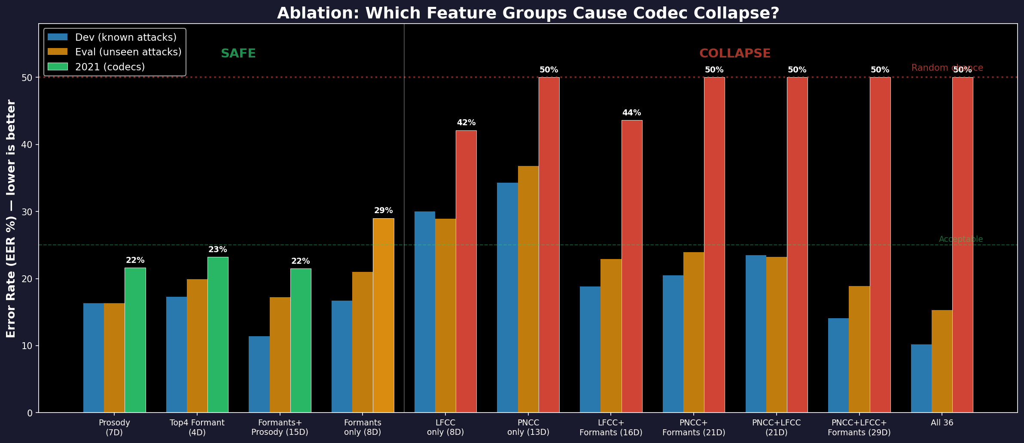
Ablation: Adding PNCC or LFCC Causes Collapse
The Pattern
LEFT SIDE (green bars):
Formants and Prosody alone
→ 21-23% EER on codecs
→ Stable, no collapse
RIGHT SIDE (red bars):
Any set with PNCC or LFCC
→ 42-50% EER on codecs
→ COLLAPSED to random
The lesson:
Adding fragile features doesn't
just fail to help — it actively
DESTROYS the detector.
PNCC+Formants (21D):
50% on 2021. Formants alone
would have been 29%.
Notes:
[45 seconds]
"This is the ablation study. Each cluster shows a different feature combination tested on three conditions."
[Point to left side]
"Left side — green: Prosody alone, Top 4 Formants, Formants plus Prosody. All stay between 21 and 23 percent on compressed audio. Stable."
[Point to right side]
"Right side — red: anything with PNCC or LFCC. PNCC alone: 50 percent. LFCC alone: 42 percent. And here's the critical finding: PNCC plus Formants — 50 percent. Adding PNCC to formants didn't just fail to help, it DESTROYED the detector. Formants alone would have been 29 percent."
"The all-36 model at the far right: 10 percent in the lab, 50 percent after codecs. The best lab result is the worst deployed result."
VERIFIED: All numbers from ablation_all_groups_VERIFIED.json
[Click]

