Slide 1
Statistics for Audio
Deepfake Detection
A Data Mining Approach to Codec-Robust
Acoustic Indicators of Synthetic Speech
Presented By:
[Your Name]
[Affiliation]
MCCNNY 2026
Notes:
[15s] Good morning. My talk uses data mining to find acoustic features that identify deepfakes even after audio compression.

Slide 2
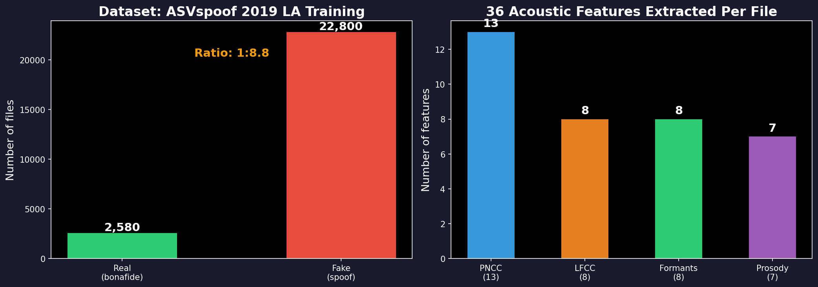
STEP 1
Understanding the Data
The Problem
Key Facts
Train detector on 25,380 clean studio files
Deploy on phone calls → codecs compress audio
Lab error: 7% | After codecs: 50% (coin flip)
Which of 36 features survive AND detect fakes?
ASVspoof 2019 LA: international deepfake challenge
2,580 real + 22,800 fake (ratio 1:8.8)
6 different TTS/VC synthesis methods (A01–A06)
All files: 16 kHz, mono, lossless FLAC
Notes:
[40s] Step 1: the data. ASVspoof 2019, 25,380 files. 2,580 real, 22,800 fake. 9:1 ratio. 6 TTS/VC systems. Clean studio audio. 36 features extracted per file. IF ASKED 'What is a codec?' → Compresses audio for transmission. G.711 for phones, MP3 for music. IF ASKED 'Why 1:8.8 ratio?' → Challenge design. We use balanced class weights.

Slide 3
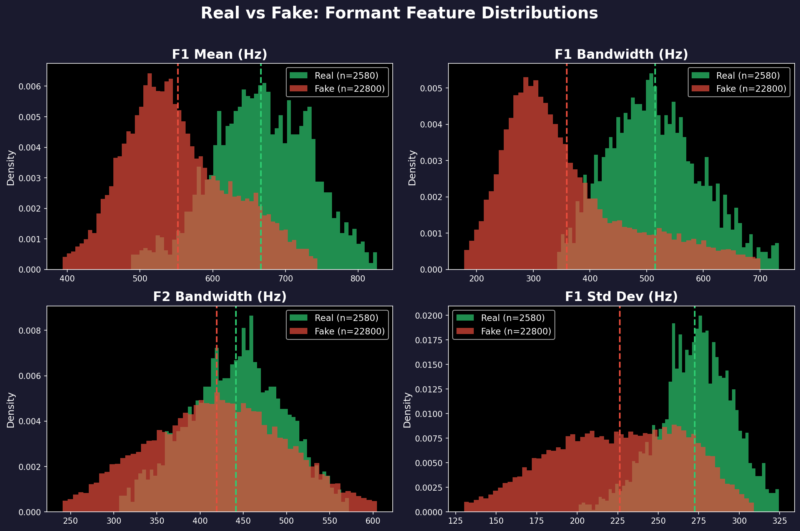
STEP 2
Exploring: Real vs Fake Distributions
Observations
Green = real speech
Red = fake speech
Dashed lines = averages
F1 bandwidth shows clear separation:
Real: 515 ± 87 Hz
Fake: 361 ± 120 Hz
Gap: 154 Hz
But is this gap real or random?
→ Need statistical tests
21 of 23 non-constant features are near-normal (skewness < 1). Non-parametric tests used for safety.
Notes:
[35s] Step 2: explore. Histograms of 4 formant features. Green = real, red = fake. F1 bandwidth: clear separation. 515 vs 361 Hz. But eyeballing isn't science. Need formal tests. IF ASKED 'Why ± 87?' → Standard deviation. Files range roughly 430-600 Hz. IF ASKED 'Why show distributions?' → Check data quality before testing.

Slide 4
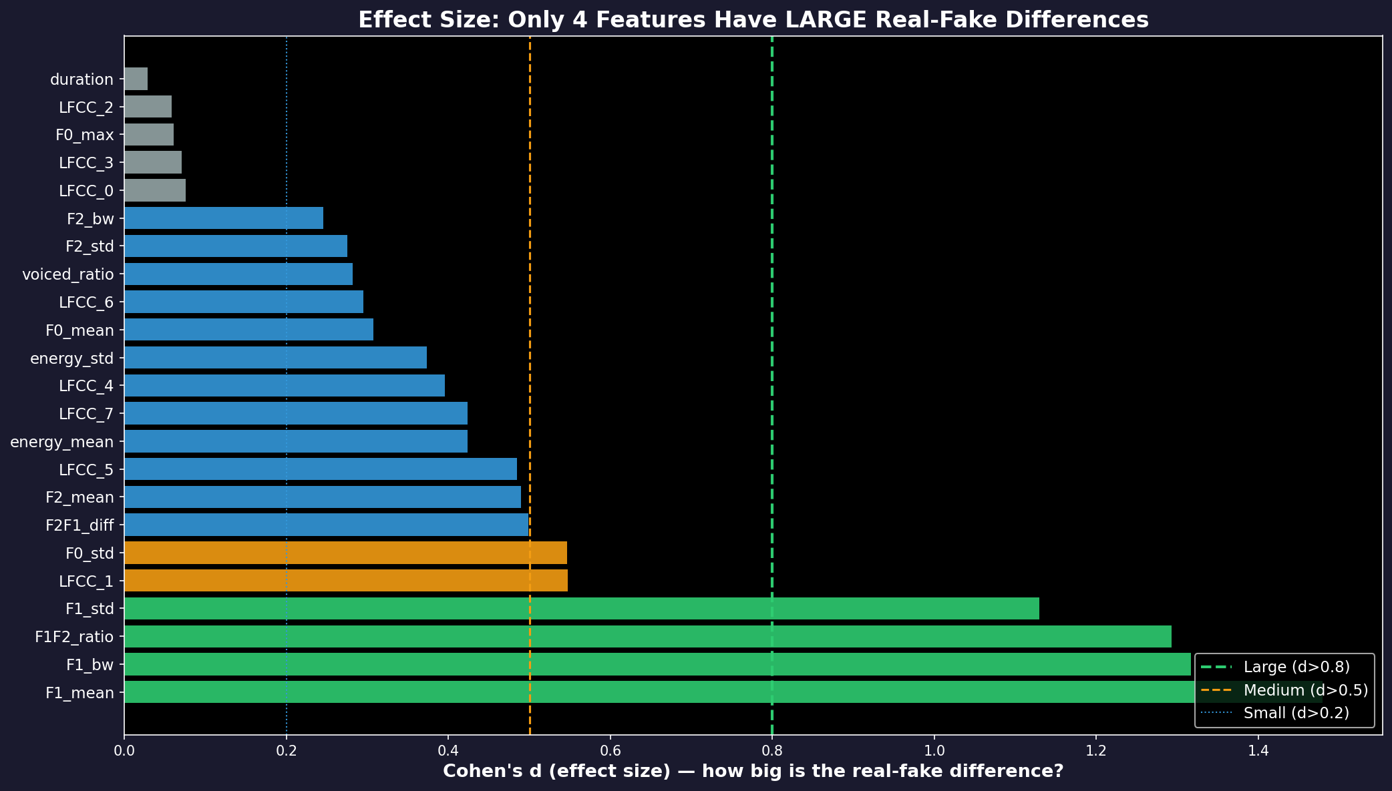
STEP 3
Testing: Is the Difference Real and Meaningful?
Mann-Whitney U Test
Cohen's d Effect Size
Is the real-fake gap statistically significant?
Is the gap big enough to actually matter?
Non-parametric (no normality assumption needed)
23 features tested, corrected for multiple testing (BH-FDR)
Result: 21/23 significant after correction
The 4 formant winners: p ≈ 0
With 25,000 files, even tiny gaps are 'significant'
Effect size measures practical importance
Only 4 features have LARGE effects (d > 0.8):
F1_mean (1.48), F1_bw (1.32), F1F2 (1.29), F1_std (1.13)
Notes:
[1 min] Step 3: formal tests. Mann-Whitney U: 21/23 significant after BH-FDR correction. The 4 formant winners: p ≈ 0. Cohen's d: Only 4 have LARGE effects. The chart shows all 23 ranked. Green = large. IF ASKED 'Why Mann-Whitney?' → Non-parametric. Some features skewed. IF ASKED 'What is BH-FDR?' → Controls false discovery rate at 5%. IF ASKED '21/23 because large n?' → YES — that's why we need Cohen's d. Only 4 pass BOTH.

Slide 5
STEP 3
The 4 Winning Features
Feature | Real (avg ± spread) | Fake (avg ± spread) | Gap | Effect size | Error alone
F1 bandwidth | 515 ± 87 Hz | 361 ± 120 Hz | 154 Hz | d = 1.32 (large) | 18.0%
F1 mean | 666 ± 71 Hz | 553 ± 77 Hz | 113 Hz | d = 1.48 (large) | 19.5%
F1 variability | 272 ± 25 Hz | 226 ± 42 Hz | 46 Hz | d = 1.13 (large) | 21.7%
F1/F2 ratio | 0.342 ± 0.033 | 0.292 ± 0.039 | 0.050 | d = 1.29 (large) | 23.0%
Correlation: Are these 4 independent?
Kruskal-Wallis: Different fakes, different traces?
F1_mean vs F1F2_ratio: r = 0.912 (91% same!)
F1_mean vs F1_std: r = 0.743
F1_mean vs F1_bw: r = 0.720
PCA: 1 component captures 79% of variance
Classifier: PCA 1D = 17.1%, all 4 = 17.3%
→ ONE signal (F1 formant) measured 4 ways
6 TTS/VC systems compared (non-parametric ANOVA):
F1_mean: H = 10,985 p ≈ 0 YES
F1_bw: H = 10,715 p ≈ 0 YES
F1_std: H = 11,029 p ≈ 0 YES
F1F2_ratio: H = 10,068 p ≈ 0 YES
→ Formants detect MANY types of fakes
Notes:
[1 min] The 4 winners. Table: avg ± spread, gap, effect size, error rate. Correlation: F1_mean and F1F2_ratio 91% correlated. PCA: 1 component = 79%. One signal. Kruskal-Wallis: all 4 differ across 6 attacks (H > 10,000). Formants detect many fakes. IF ASKED 'If correlated, why show 4?' → They emerged independently. Correlation is a finding. IF ASKED 'What is Kruskal-Wallis?' → Non-parametric ANOVA.

Slide 6
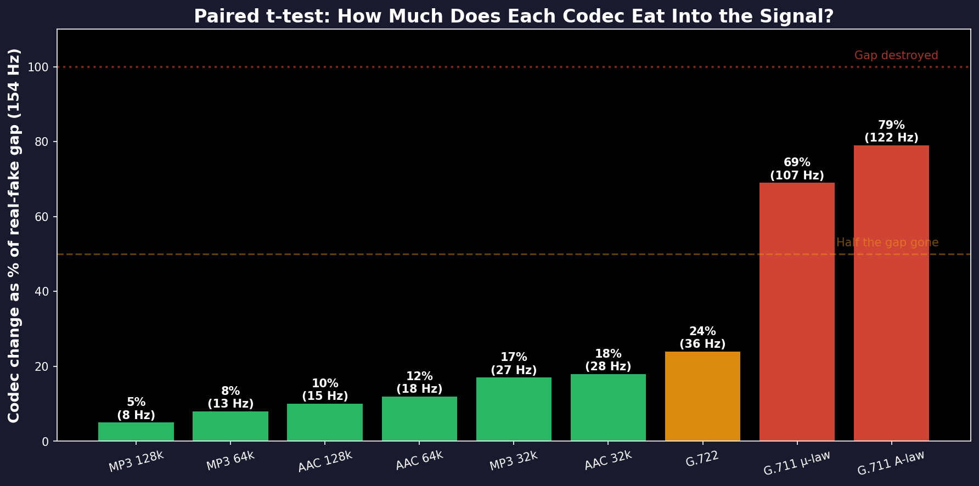
STEP 4
Why Formants Differ + Do They Survive Codecs?
Real Speech
Fake Speech
Why Codecs Preserve This
Physical tube (mouth+throat)
Energy absorbed → wide resonances
F1 bandwidth ≈ 515 Hz
High natural variation
Neural network generates sound
Optimizes average → sharp peaks
F1 bandwidth ≈ 361 Hz
Over-smoothed, less variation
Codecs MUST preserve formants
Without them → can't understand speech
G.729 explicitly encodes formants
MP3/AAC keep structure < 4 kHz
Paired t-test: How much of the 154 Hz gap does each codec consume?
Notes:
[50s] Why: physical damping = wide resonances. Vocoders = sharp. Codecs preserve formants for intelligibility. Paired t-test: same file before/after. MP3: 5% of gap. G.711: 79%. Signal marginal on telephone. IF ASKED 'Is vocoder explanation proven?' → Damping = physics (Fant 1960). Vocoders narrow formants = our hypothesis. IF ASKED 'Why paired?' → Same file compared to itself. IF ASKED 'Is 79% acceptable?' → No. G.711 detection degrades significantly.

Slide 7
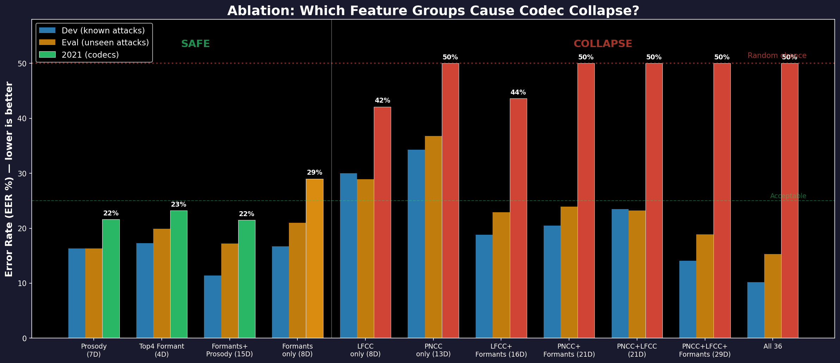
STEP 5
Ablation: Bad Features Destroy the Detector
Key Finding
Left (green):
Formants/Prosody alone
→ 21-29% after codecs
Right (red):
PNCC or LFCC added
→ 42-50% COLLAPSED
Critical:
PNCC+Formants = 50%
Formants alone = 29%
Adding fragile features
DESTROYS the system.
Notes:
[40s] Ablation: every combination tested. Left: formants/prosody 21-29%. Right: PNCC/LFCC → 42-50%. PNCC+Formants = 50%. Formants alone = 29%. Adding PNCC destroyed it. IF ASKED 'Why?' → SVM learns to rely on PNCC. Codecs destroy it. Nothing left. IF ASKED 'Trees?' → RF with all-36 gets 22.5%. Trees ignore bad features.

Slide 8
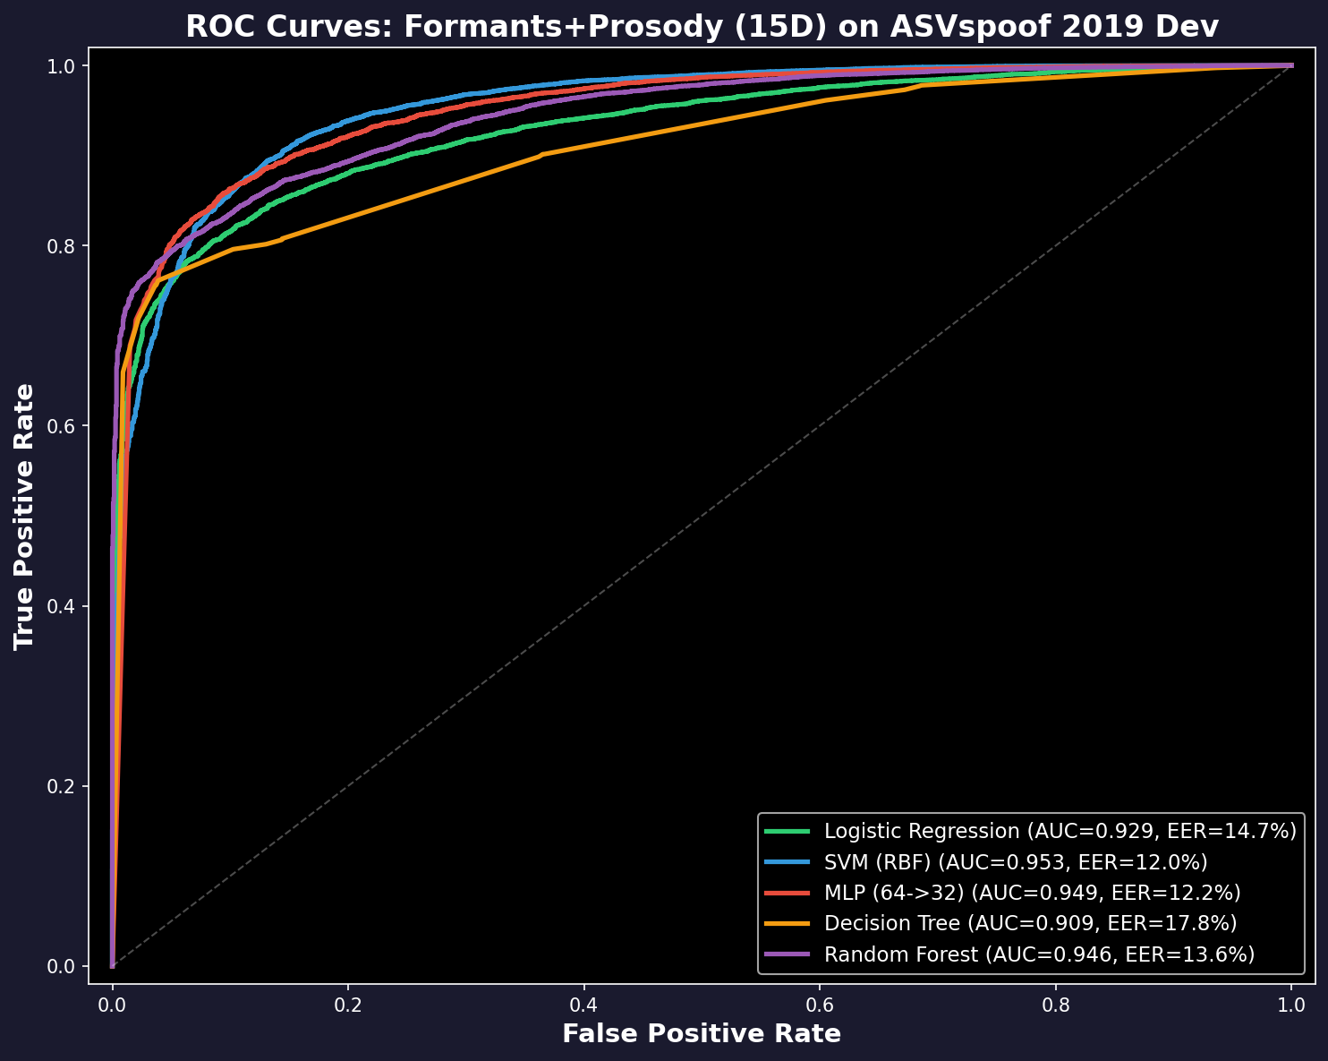
STEP 6
Classifiers: 5 Models on Robust Features
Model | Lab | Unseen | Codecs
Logistic Reg. | 14.6% | 17.2% | 24.5%
SVM | 11.4% | 17.2% | 21.5%
Neural Net | 10.6% | 17.3% | 22.3%
Decision Tree | 16.6% | 21.8% | 22.9%
Random Forest | 14.2% | 18.5% | 21.2%
15 features: 8 Formant + 7 Prosody
Fixed ASVspoof challenge splits
Balanced class weights for 9:1 imbalance
All: 11-17% lab → 21-25% codecs (graceful)
Compare: all-36 = 7% lab → 50% codecs!
Not SOTA (1.9%) but EXPLAINABLE
Notes:
[35s] Five classifiers. SVM: 11% lab, 21% codecs. All degrade gracefully. Compare: all-36 = 7% lab, 50% codecs. Feature selection prevents collapse. IF ASKED 'Why 15 not 4?' → Weak features contribute via interactions (Guyon & Elisseeff 2003). IF ASKED 'Why not deep learning?' → 1.9% vs 21%. We compete on explainability.

Slide 9
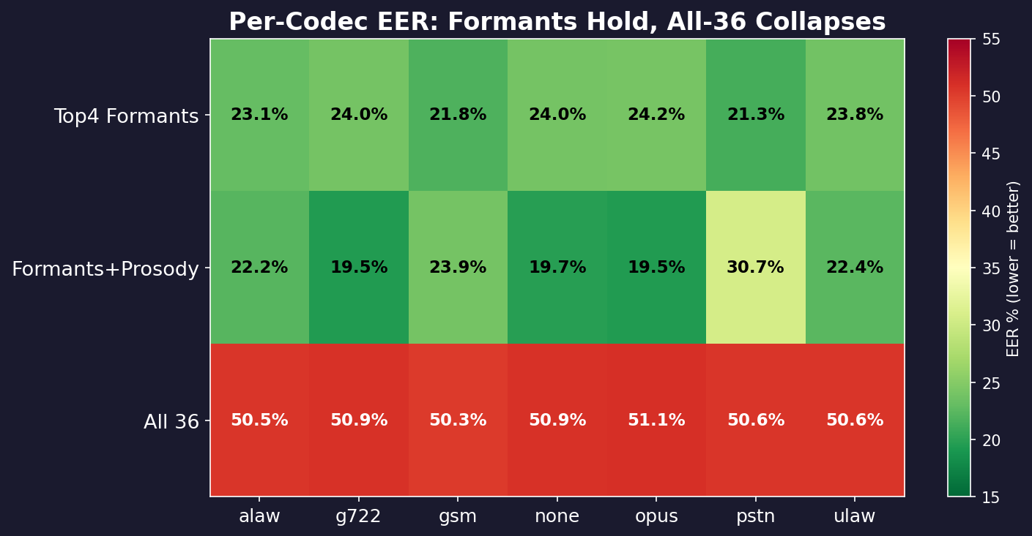
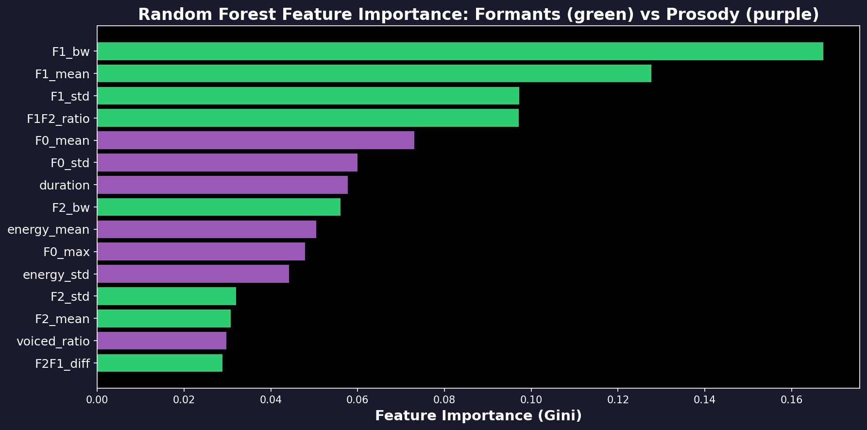
STEP 7
Per-Codec Results & Feature Importance
Codec heatmap:
• Formants: 19-24% everywhere (green)
• All-36: 50% everywhere (red)
• Feature selection prevented collapse
Feature importance (RF):
• F1 bandwidth: 26% of decisions
• F1 mean: 15%
• F1/F2 ratio: 12%
• Consistent with statistical analysis
Notes:
[25s] Heatmap: formants green (19-24%), all-36 red (50%). Feature importance: F1_bw = 26%.

Slide 10
Conclusions
Findings
Limitations
1. Out of 36 features, 4 detect deepfakes after compression. All measure F1 formant.
2. Confirmed by: Mann-Whitney (p ≈ 0), Cohen's d (large effects), Kruskal-Wallis (across attacks), paired t-test (survives MP3/AAC).
3. Adding fragile features DESTROYS the detector: 7% lab → 50% after codecs.
1. 21-23% error (SOTA: 1.9% with neural models)
2. 4 features are 91% correlated — one signal
3. Advanced vocoders (A17-A19): error > 48%
4. G.711 telephone: 79% of signal lost
Summary
Real speech has wider formant resonances (515 Hz) than synthetic speech (361 Hz) because physical vocal tracts have damping that synthesizers don't model. This difference survives most audio compression methods.
github.com/Yash-Sukhdeve/stats-audio-deepfake-detection
Mann & Whitney (1947) | Cohen (1988) | Benjamini & Hochberg (1995) | Kruskal & Wallis (1952) | Kim & Stern (2016)
Notes:
[35s] 4 of 36 detect deepfakes after compression. All F1 formant. Real: 515 Hz. Fake: 361 Hz. Confirmed by 5 tests. Adding fragile features destroys the detector. Thank you. Questions? Q&As: 'p-hacking?' → Effect sizes. Only 4 have d > 0.8. '21% not good' → Trade accuracy for explainability. 'Selection bias?' → Evaluation on held-out sets. 'PNCC broken?' → Normalization bug. Isolated. Fix in progress.

