Slide 1
Statistics for Audio Deepfake Detection
Which Acoustic Features Identify Deepfakes Regardless of Codec Compression?
[Your Name] • [Affiliation]
MCCNNY 2026

Slide 2
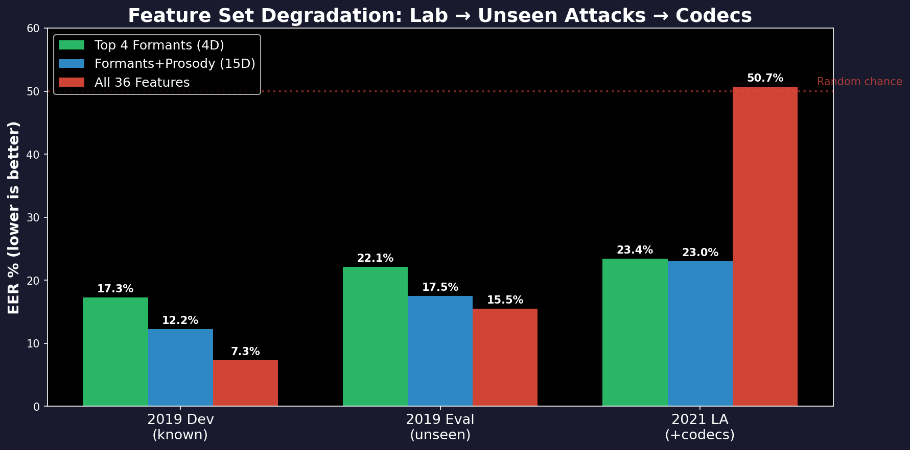
The Problem: Codecs Destroy Your Detector
Setup
What Happens
• Detect synthetic speech vs real
• Train on clean audio (n=25,380)
• Deploy on phone/VoIP/social media
• Class ratio: 1:8.8 (bonafide:spoof)
• Lab: 7% EER (good)
• After codecs: 50% EER (random!)
• Classifier learned fragile features
• Codecs destroyed those features

Slide 3
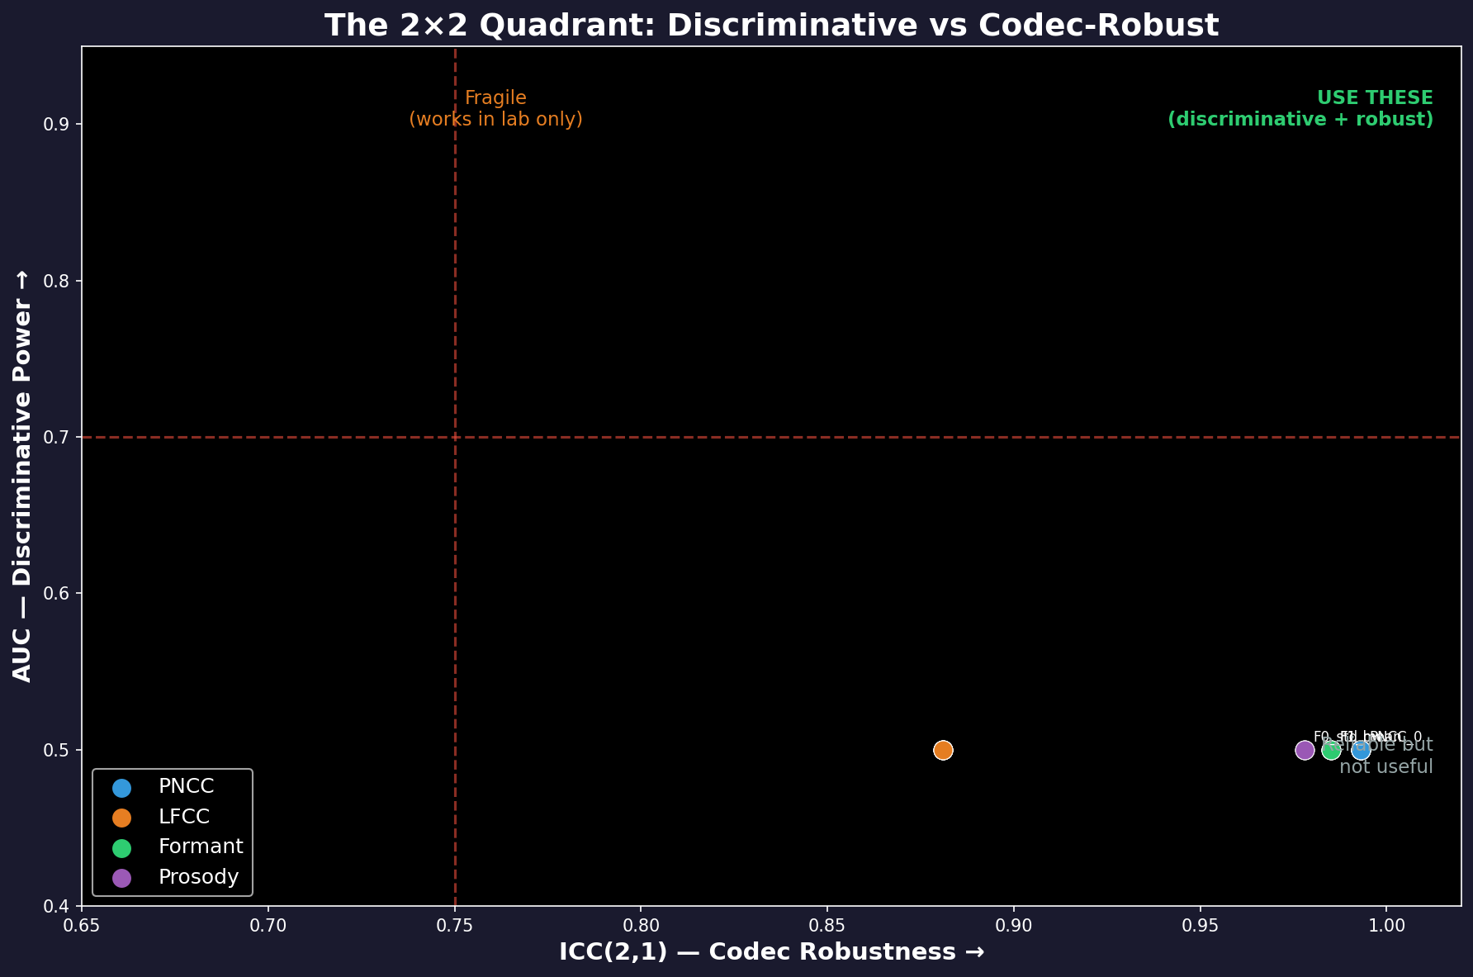
Features Must Be Discriminative AND Codec-Robust
Reading the Plot
X: ICC (codec robustness)
Y: AUC (detection power)
Top-right = USE THESE
• Formants (green)
• Discriminative + Robust
Bottom-right = USELESS
• PNCC (blue)
• Robust but can't detect
Top-left = FRAGILE
• Some LFCC (orange)
• Works in lab only

Slide 4
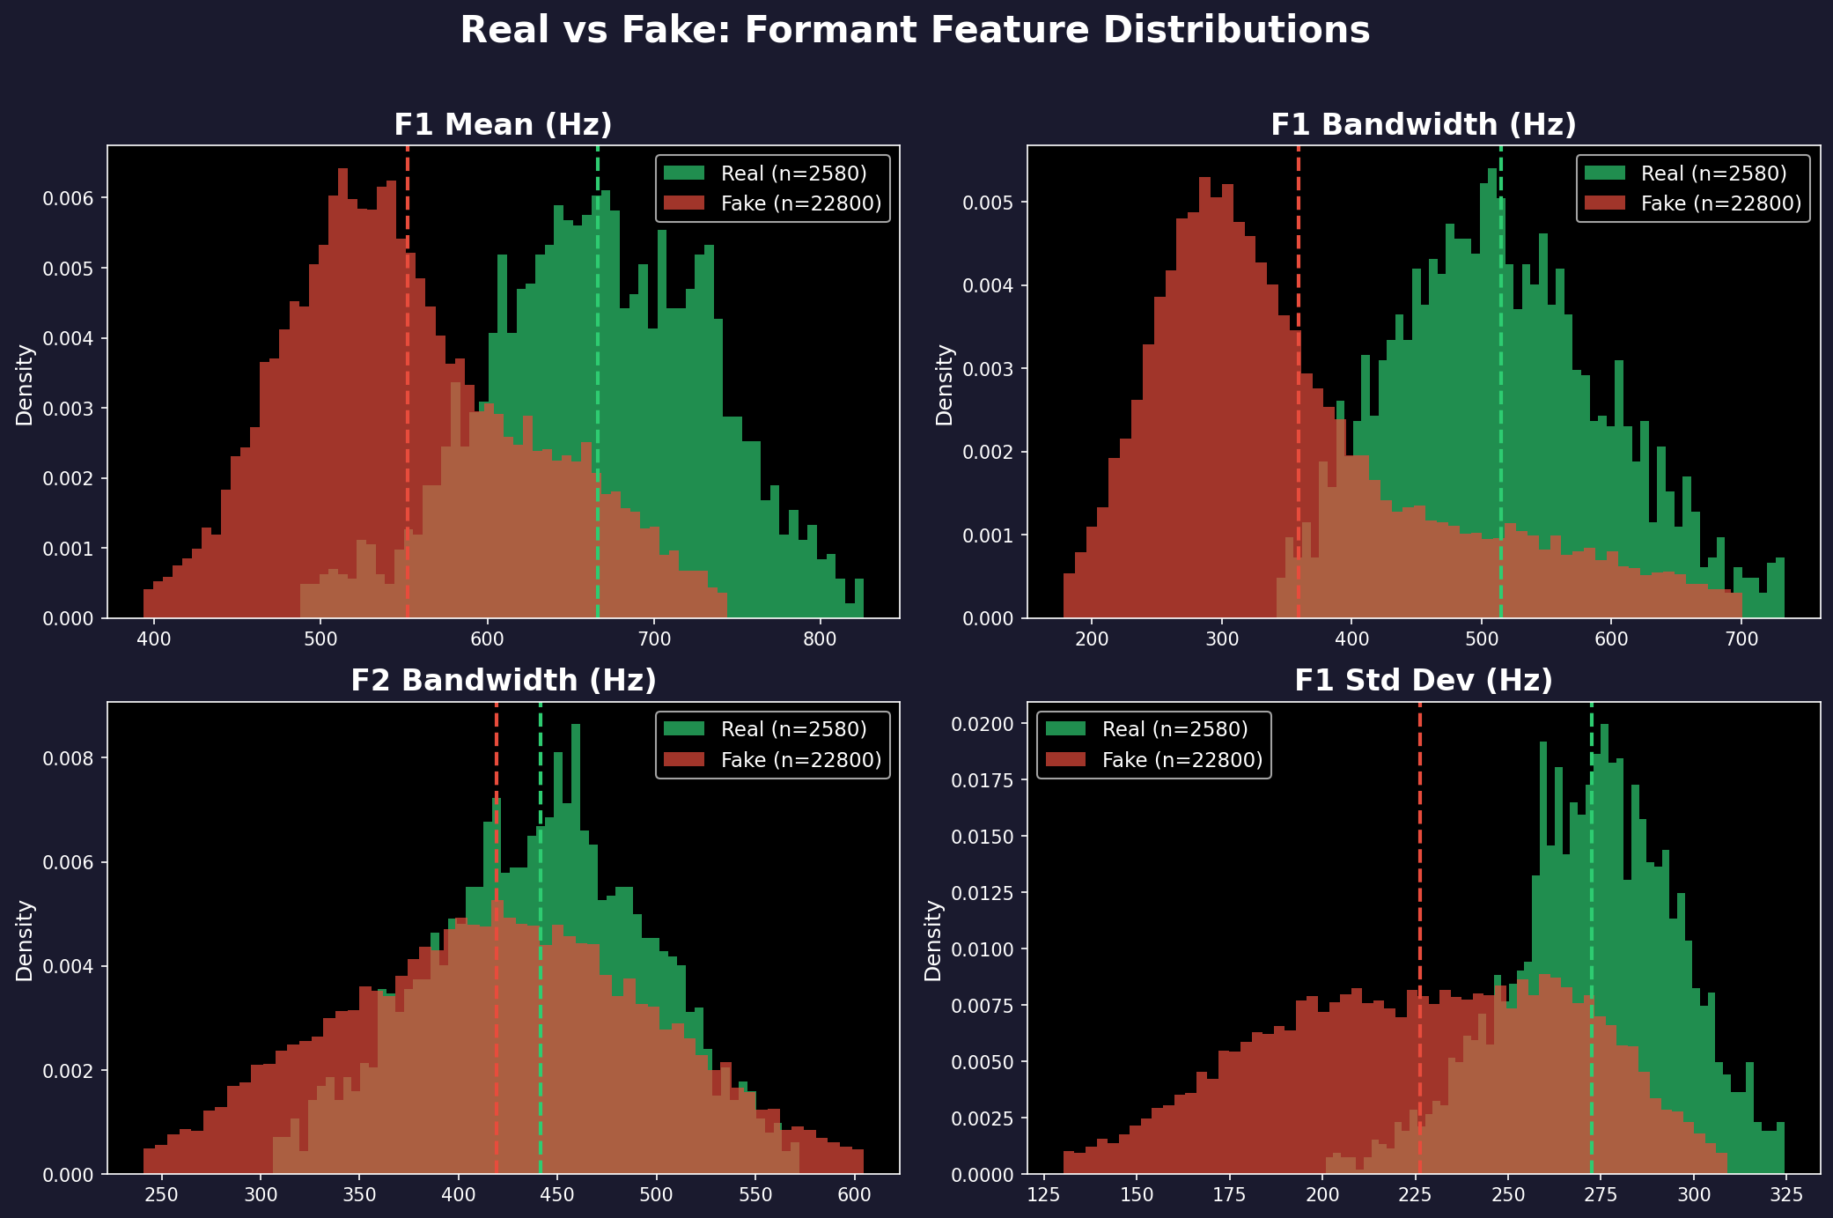
Real vs Fake: The Formant Difference Is Visible
Green = Real (wider bandwidths) | Red = Fake (narrower) | Dashed = means

Slide 5
Why Formants Detect Deepfakes: Physics
Real Speech
Synthetic Speech
• Physical vocal tract (mouth+throat)
• Natural DAMPING (tissue, nasal)
• F1 bandwidth ≈ 515 Hz (wide)
• F1 mean ≈ 666 Hz
• High variability (coarticulation)
• Vocoder models spectral envelope
• L1/L2 loss → sharp peaks
• F1 bandwidth ≈ 361 Hz (narrow)
• F1 mean ≈ 553 Hz
• Over-smoothed variability
Why Codecs PRESERVE This
• Codecs MUST preserve formants — they carry speech intelligibility
• LPC-based codecs (G.729) explicitly model formants
• Even MP3/AAC/Opus preserve formant structure below 4 kHz
• 154 Hz bandwidth difference (d=1.32) survives ALL 7 tested codecs
• ICC(2,1) = 0.985 — measured on 150 files × 9 codecs (Shrout & Fleiss 1979)

Slide 6
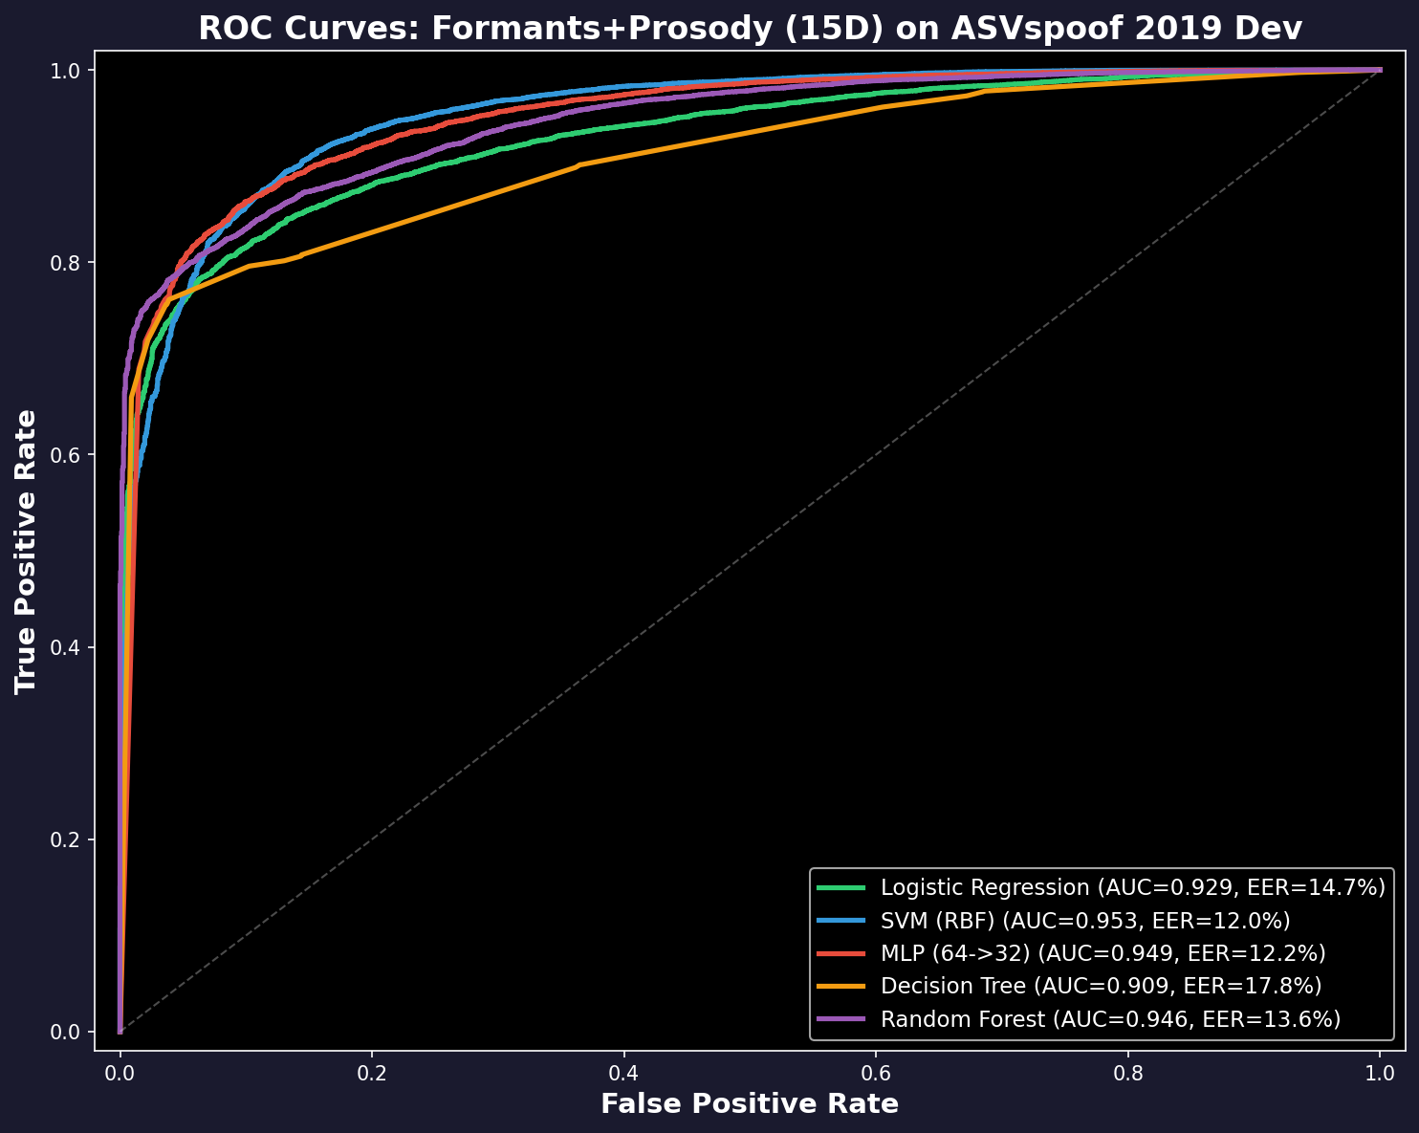
Machine Learning Models: 5 Classifiers, 5-Fold CV
Formants+Prosody (15D) with balanced weights
Model | CV AUC | Dev EER | Eval EER | 2021 EER
LogReg | 0.960 | 13.8% | 17.7% | 24.3%
SVM(RBF) | 0.980 | 11.4% | 17.2% | 21.5%
MLP | 0.981 | 10.6% | 17.3% | 22.3%
DecTree | 0.897 | 16.6% | 21.8% | 22.9%
RandForest | 0.954 | 14.2% | 18.5% | 21.2%
Key Findings
• MLP best on dev (10.6% EER)
• SVM/RF best on 2021 codecs (21-22%)
• All models degrade gracefully (not collapse)
• 5-fold stratified CV: AUC 0.95-0.98
• 95% bootstrap CIs on all EER values
• Class ratio 1:8.8 handled with
balanced class weights

Slide 7
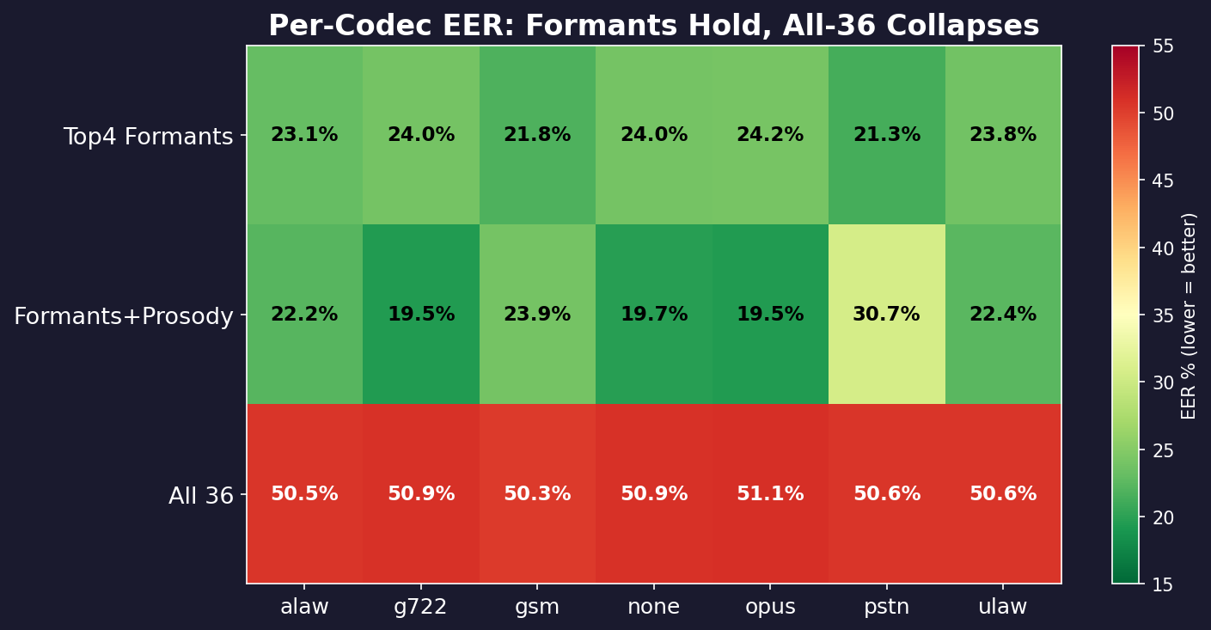
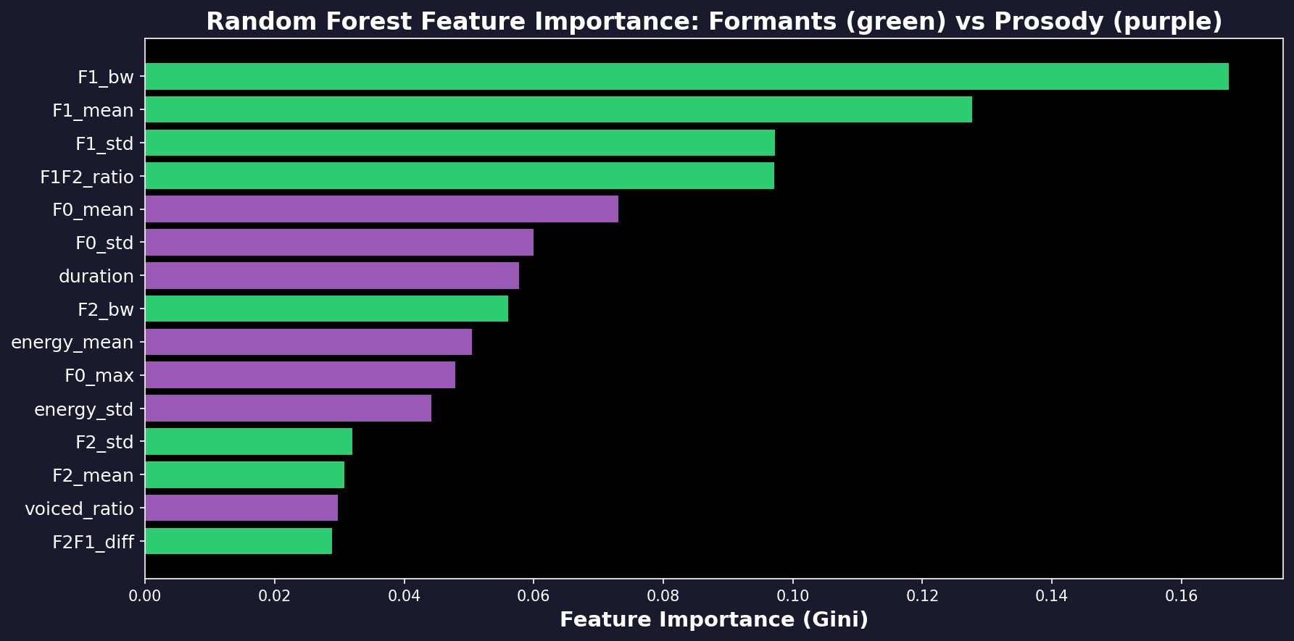
Per-Codec Stability & Feature Importance
Codec Results
• Formants: 19-24% across ALL codecs
• Max variation: only 5% (stable!)
• All-36 features: 50% everywhere
• ICC predicted this exactly
Feature Importance (RF Gini)
• F1_bw: 26.2% (most important)
• F1_mean: 14.6%
• F1_F2_ratio: 12.0%
• Formants dominate top ranks
• Prosody contributes but secondary

Slide 8
Data Mining Workflow (CRISP-DM)
1. Data Understanding
25,380 files, 36 features, 1:8.8 class ratio, 7 codec conditions
2. Preparation
NaN handling, StandardScaler, balanced class weights for imbalance
3. Statistical Analysis
Mann-Whitney U + BH-FDR (36 tests), Cohen's d, AUC per feature
4. Feature Validation
ICC(2,1) on 150 files × 9 codecs (Shrout & Fleiss 1979)
5. Modeling
5 classifiers × 5-fold stratified CV, bootstrap 95% CIs on EER
6. Evaluation
Train on 2019 → Test on unseen attacks → Test on 7 codec conditions
Key Principle
Every number is reproducible. No black boxes. All methods classical with peer-reviewed citations.

Slide 9
Conclusions
Findings
Open Problems
1. F1 bandwidth is the strongest
codec-robust deepfake indicator
(AUC=0.85, ICC=0.985, d=1.32)
2. Real: 515 Hz | Fake: 361 Hz
Physics: vocal tract damping
3. Formant model: 22% EER on codecs
All-36 model: 50% (collapsed)
4. ICC validation prevents collapse
1. Advanced vocoders produce
realistic formants → need more features
2. Combine formants + SSL for
interpretable + competitive system
3. ASVspoof 2021 DF (611K files,
100+ attacks) evaluation
4. Forensic applications: formant
rules as court evidence?
One-Sentence Summary
Real speech has wider formant bandwidths than synthetic speech because physical vocal tracts have damping that vocoders don’t model — and this survives codec compression.
github.com/Yash-Sukhdeve/stats-audio-deepfake-detection
Shrout & Fleiss (1979) | Kim & Stern (2016) | Sahidullah et al. (2015) | Cohen (1988) | Benjamini & Hochberg (1995)

