Slide 1

Urban Pluvial Flood Risk Analysis
Insights from Geospatial and Hydrological Data
Course: B-tech (Data Science)
Presented by: Yash Tiwari, Ashwani Thakur, Sourabh Suman

Slide 2

Introduction
Objective:
Analyze urban pluvial flood risk using geospatial and hydrological data.
Dataset:
500+ segments across multiple cities.
Key Focus:
Drainage density, latitude, longitude, elevation, storm drain proximity, rainfall intensity, return period.

Slide 3
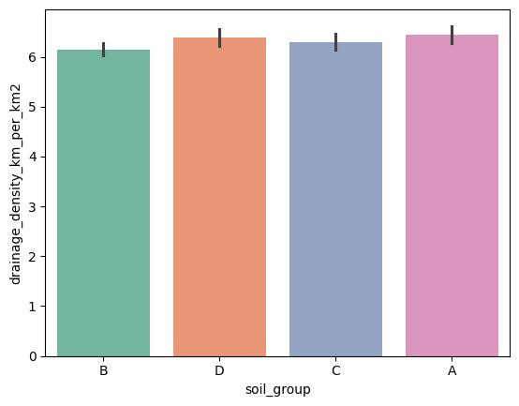
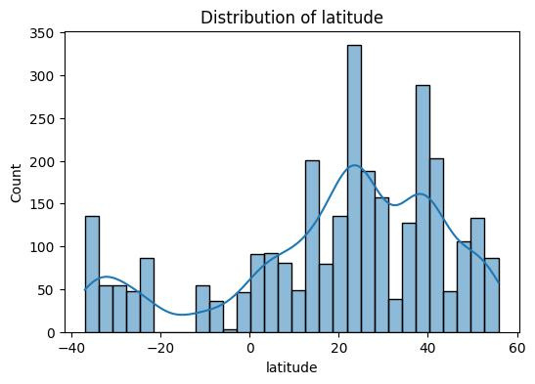
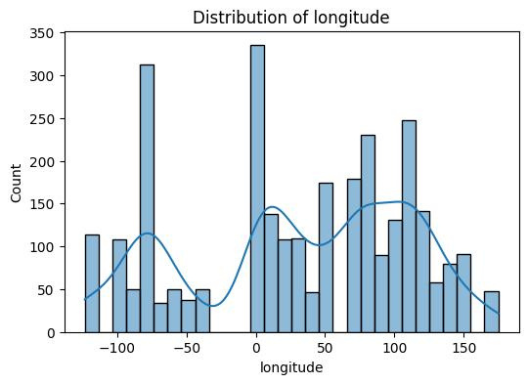
Data Distribution Overview
Drainage Density: Peaks at ~6 km/km² across soil groups.
Latitude: Concentrated 0°-40°, peak at 20°-30°.
Longitude: Peaks at 0° and 70°-100°.

Slide 4
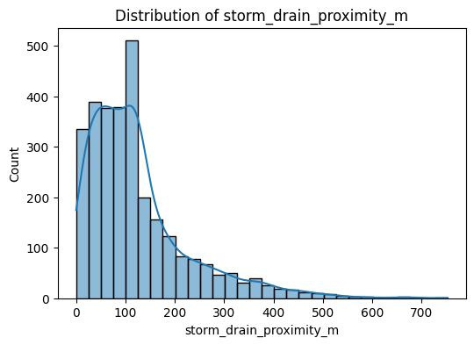
Distribution of Storm Drain Proximity
Peaks at 0-100m, majority within 0-300m.
Very few exceed 600m.

Slide 5
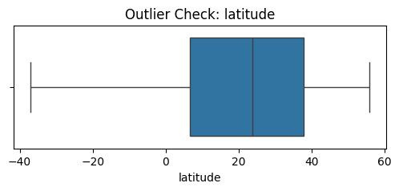
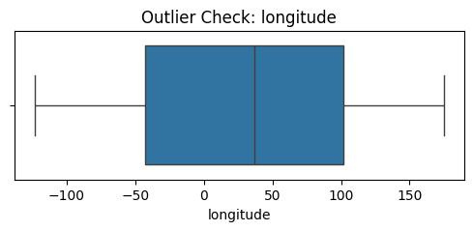
Outlier Check: Latitude and Longitude
Latitude: No significant outliers, data within interquartile range.
Longitude: No significant outliers, data well-distributed.

Slide 6
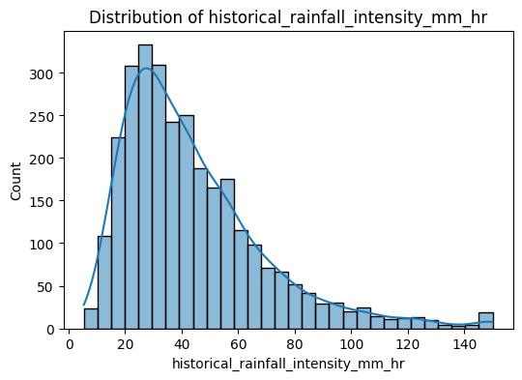
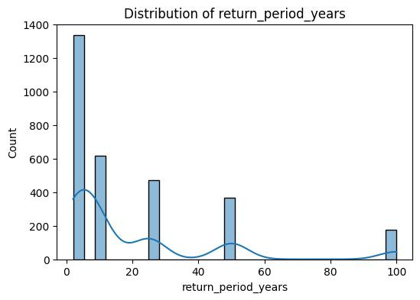
Rainfall Intensity and Return Period
Rainfall Intensity: Most 0-80mm/hr, outliers >120mm/hr.
Return Period: Majority 0-20 years, peak at 0-10 years.

Slide 7
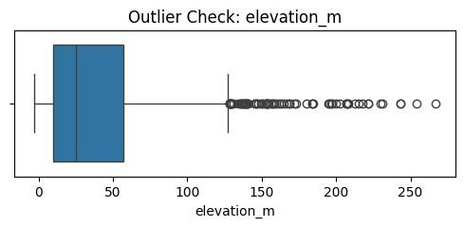
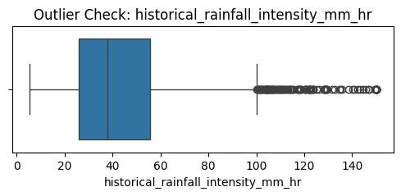
Outlier Check and Conclusion
Outliers: Elevation (>150m), Rainfall Intensity (>80mm/hr).
Conclusion: Low elevation and high rainfall intensity are key risk factors: proximity to storm drains impacts risk; outliers need further study.

Slide 8
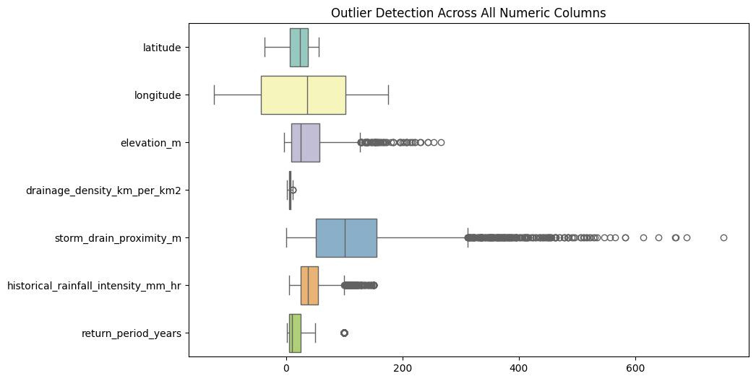
All Outliers of Numeric Rows and
Column

Slide 9
Conclusion and Recommendations
Key Findings: Low elevation and high rainfall intensity are critical risk factors; proximity to storm drains impacts risk; outliers in elevation and rainfall intensity need attention.
Recommendations: Focus mitigation on low-elevation areas, improve drainage in high-intensity zones, investigate outliers.

