Slide 1
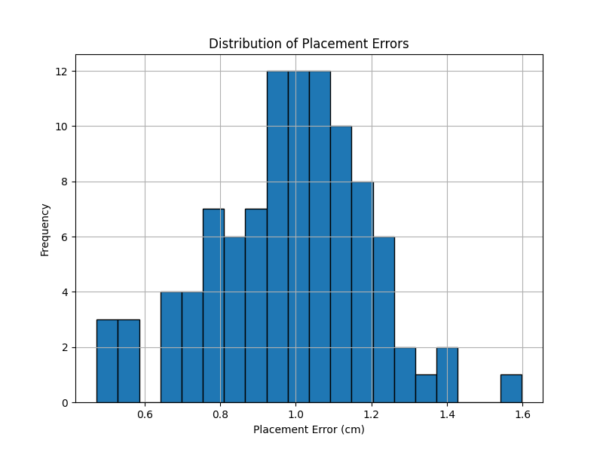
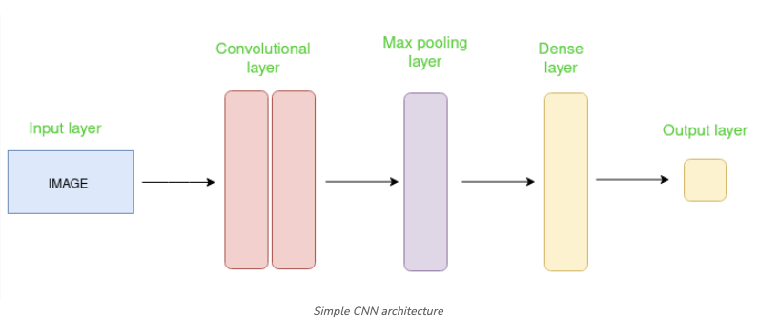
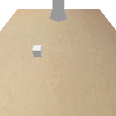
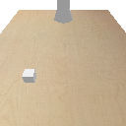
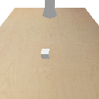
Poster Title: Robot Grasp Position Prediction Using Convolutional Neural Networks Author: Nikhil Sawane, Yashwant Gandham Course: CSCI 5922: Neural Nets and Deep Learning, Spring 2025
Introduction:
Objective: Predict 3D grasp positions directly from RGB images using deep learning.
Motivation: Classical planning struggles with uncertain, dynamic environments.
Approach: Lightweight CNN model predicts (x, y, z) placement directly from images.
Problem Setup:
Simulation Environment: PyBullet with Franka Panda robot arm.
Simplification: Static conveyor and stationary objects.
Goal: Predict (x, y, z) grasp position from input image.
Dataset:
Images: 100 simulated scenes (grasp_001.png to grasp_100.png).
Labels: Randomized dummy labels (x, y, z, score).
Input Format: 128x128 RGB images.
Output: Predicted grasp position (x, y, z).
Methodology:
CNN Architecture:
3 Convolutional Layers (ReLU + MaxPooling)
Fully Connected Layers
Loss Function: Mean Squared Error (MSE)
Training Status: Evaluation with randomly initialized model (no real training yet).
Results:
Mean Placement Error: 1.00 cm
Success Rate: 100% (error threshold = 5 cm)
Conclusion and Future Work:
Successfully implemented the full prediction pipeline from simulation to evaluation.
Future steps:
Collect ground-truth grasp labels.
Train CNN model properly.
Deploy trained model in dynamic real-world setups.
Acknowledgments:
CSCI 5922: Neural Nets and Deep Learning
Thanks to course instructors and TAs for their support.

