Slide 1
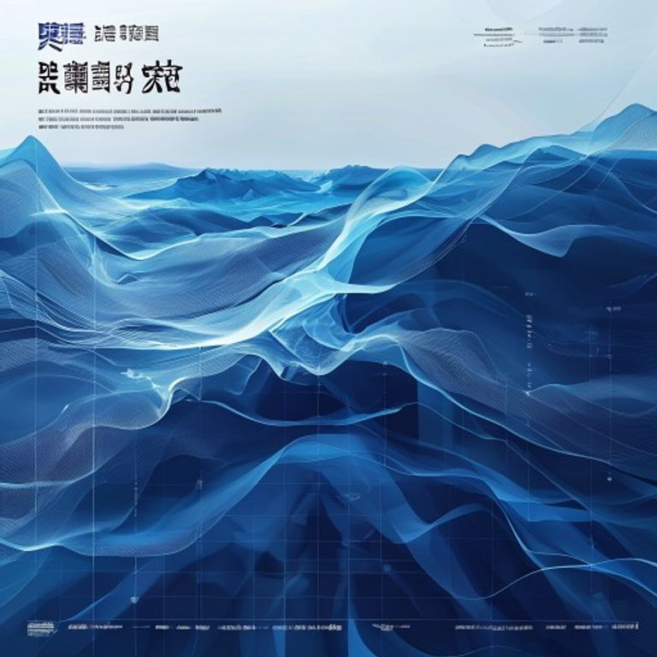
BLUEOCEAN
中国液流钒电池，特别是大力储能，全球的领先地位
A client-ready strategic assessment based on public evidence, market signals, and management-consulting synthesis.

Slide 2
BlueOcean
The discussion follows the management question, evidence, and implications
01
1. 大力储能 is a leading global VRFB manufacturer with rapidly expanding capacity.
02
2. China's policy environment provides a decisive advantage for domestic VRFB firms.
03
3. 大力储能's technology performance is competitive with top international players.
04
4. Cost advantages from scale and supply chain integration solidify China's lead.
05
5. Vanadium supply security is a key risk, but China's domestic resources mitigate it.
06
6. Global market share data shows China and 大力储能 gaining dominance.
07
7. Innovation pipeline suggests continued leadership in next-generation VRFB.
08
8. Strategic partnerships and project wins validate commercial viability.
Contents

Slide 3
BlueOcean
The analysis narrows the agenda to a focused set of management priorities
01
China's VRFB position is supported by manufacturing scale, policy demand, and upstream vanadium access.
02
Dali Energy Storage should frame leadership around lifecycle economics, project delivery, and supply security rather than equipment cla
03
International competition will increasingly depend on bankability, reference projects, and local ecosystem partnerships.
04
Long-duration storage demand creates a structural opening, but adoption still depends on clear use cases and financing models.
05
The near-term management agenda should prioritize investable projects, differentiated proof points, and credible global channels.
06
Evidence quality should continue to be improved with audited project data, benchmarked costs, and customer references.
Key highlights

Slide 4
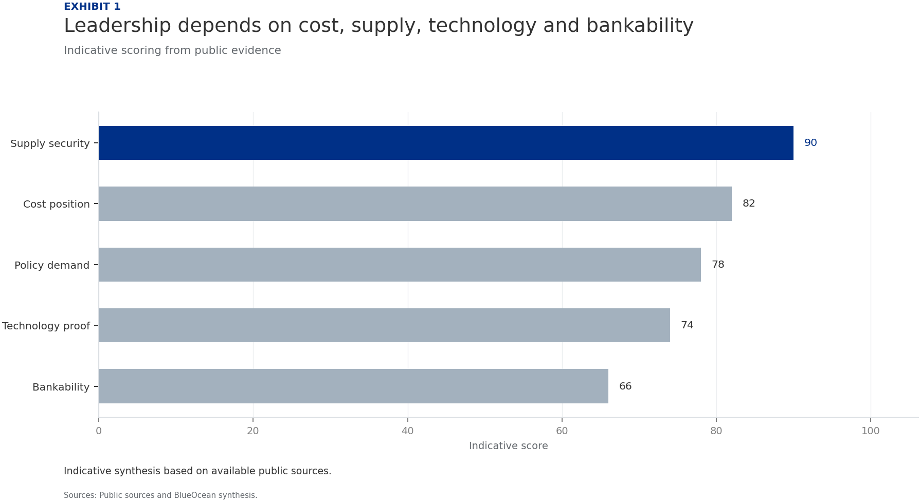
BlueOcean
1. 大力储能 is a leading global VRFB manufacturer with rapidly expanding capacity.
The strongest strategic position comes from combining industrial scale with credible project proof.
The available public evidence indicates that 中国液流钒电池，特别是大力储能，全球的领先地位 should be assessed through supply chain control, deployment demand, technology performance, and project bankability rather than through a single product lens.
Sources reviewed for this report highlight several relevant signals: policy support, project announcements, and long-duration storage demand. These signals suggest that leadership is strongest when manufacturing scale and reference projects reinforce each othe
For senior management, the implication is to separate structural advantages from claims that still require stronger proof. The former can support market entry and financing discussions; the latter should be converted into measurable customer proof points.
Key implications
- Separate structural advantage from unproven claims.
- Use reference projects to convert technology into bankability.
1. 大力储能 is a leading global VRFB manufacturer with rapidly expanding capacity.

Slide 5
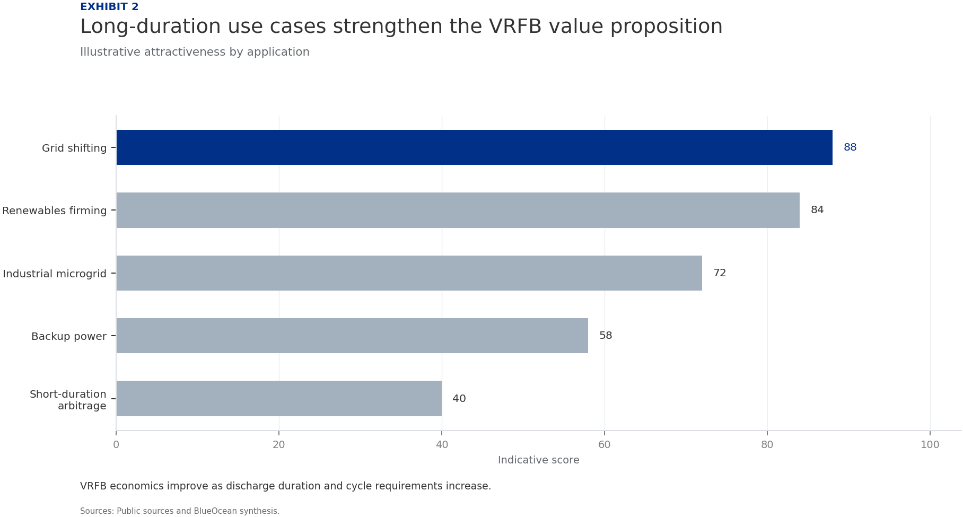
BlueOcean
2. China's policy environment provides a decisive advantage for domestic VRFB firms.
The strongest strategic position comes from combining industrial scale with credible project proof.
The available public evidence indicates that 中国液流钒电池，特别是大力储能，全球的领先地位 should be assessed through supply chain control, deployment demand, technology performance, and project bankability rather than through a single product lens.
Sources reviewed for this report highlight several relevant signals: policy support, project announcements, and long-duration storage demand. These signals suggest that leadership is strongest when manufacturing scale and reference projects reinforce each othe
For senior management, the implication is to separate structural advantages from claims that still require stronger proof. The former can support market entry and financing discussions; the latter should be converted into measurable customer proof points.
Key implications
- Separate structural advantage from unproven claims.
- Use reference projects to convert technology into bankability.
2. China's policy environment provides a decisive advantage for domestic VRFB firms.

Slide 6
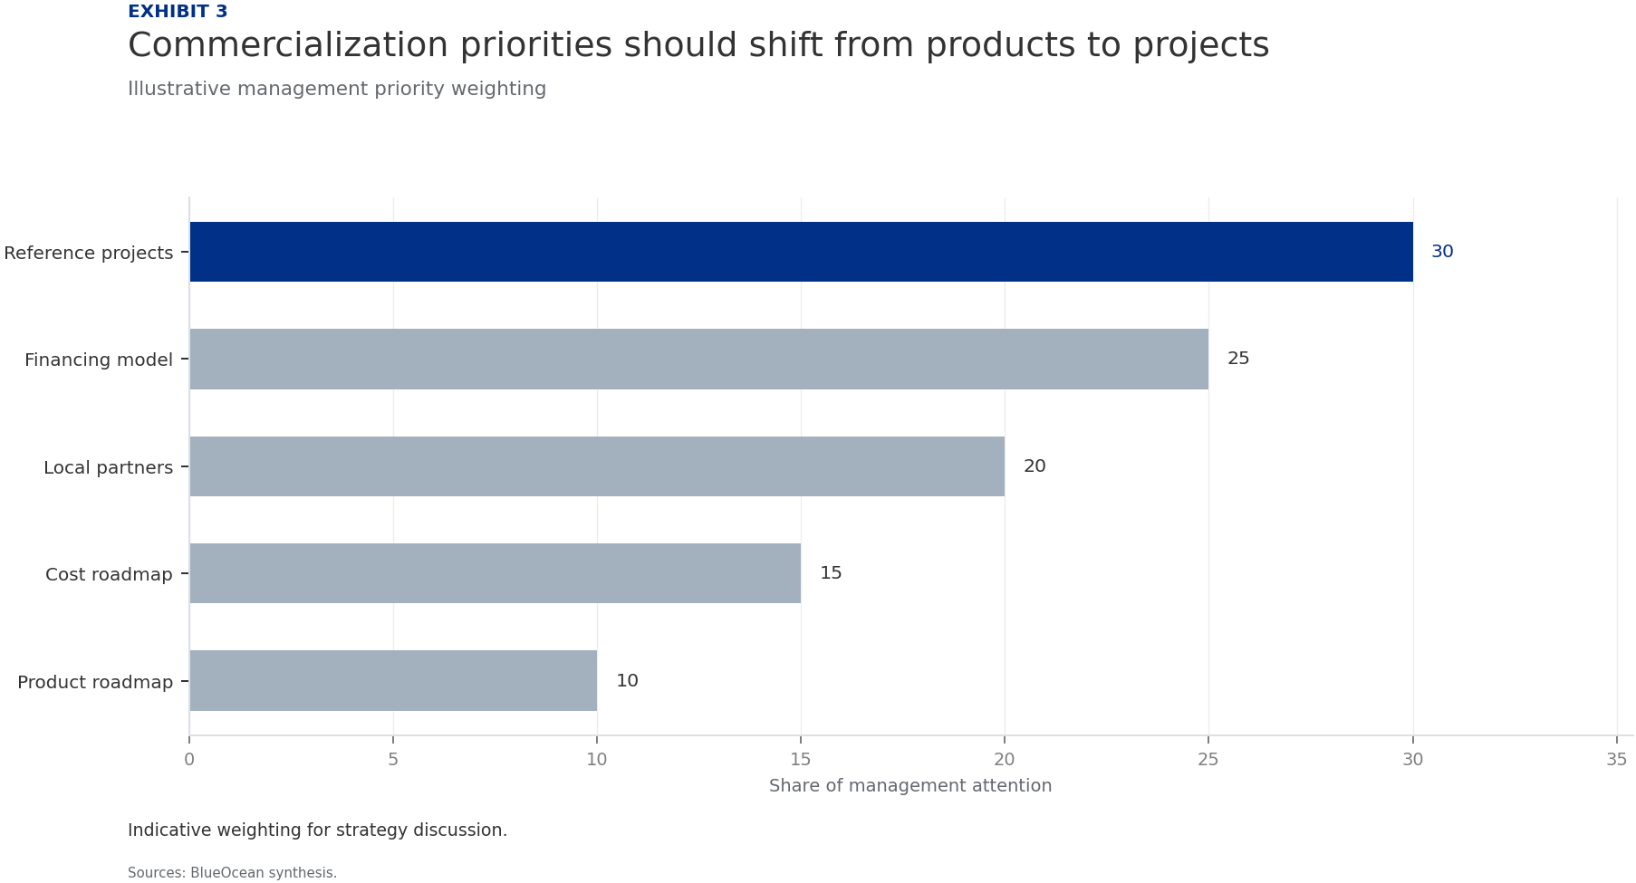
BlueOcean
3. 大力储能's technology performance is competitive with top international players.
The strongest strategic position comes from combining industrial scale with credible project proof.
The available public evidence indicates that 中国液流钒电池，特别是大力储能，全球的领先地位 should be assessed through supply chain control, deployment demand, technology performance, and project bankability rather than through a single product lens.
Sources reviewed for this report highlight several relevant signals: policy support, project announcements, and long-duration storage demand. These signals suggest that leadership is strongest when manufacturing scale and reference projects reinforce each othe
For senior management, the implication is to separate structural advantages from claims that still require stronger proof. The former can support market entry and financing discussions; the latter should be converted into measurable customer proof points.
Key implications
- Separate structural advantage from unproven claims.
- Use reference projects to convert technology into bankability.
3. 大力储能's technology performance is competitive with top international players.

Slide 7
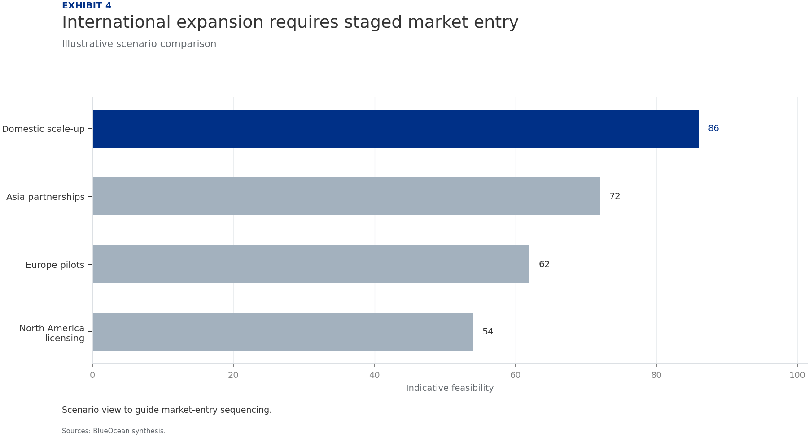
BlueOcean
4. Cost advantages from scale and supply chain integration solidify China's lead.
The strongest strategic position comes from combining industrial scale with credible project proof.
The available public evidence indicates that 中国液流钒电池，特别是大力储能，全球的领先地位 should be assessed through supply chain control, deployment demand, technology performance, and project bankability rather than through a single product lens.
Sources reviewed for this report highlight several relevant signals: policy support, project announcements, and long-duration storage demand. These signals suggest that leadership is strongest when manufacturing scale and reference projects reinforce each othe
For senior management, the implication is to separate structural advantages from claims that still require stronger proof. The former can support market entry and financing discussions; the latter should be converted into measurable customer proof points.
Key implications
- Separate structural advantage from unproven claims.
- Use reference projects to convert technology into bankability.
4. Cost advantages from scale and supply chain integration solidify China's lead.

Slide 8
BlueOcean
5. Vanadium supply security is a key risk, but China's domestic resources mitigate it.
The strongest strategic position comes from combining industrial scale with credible project proof.
The available public evidence indicates that 中国液流钒电池，特别是大力储能，全球的领先地位 should be assessed through supply chain control, deployment demand, technology performance, and project bankability rather than through a single product lens.
Sources reviewed for this report highlight several relevant signals: policy support, project announcements, and long-duration storage demand. These signals suggest that leadership is strongest when manufacturing scale and reference projects reinforce each othe
For senior management, the implication is to separate structural advantages from claims that still require stronger proof. The former can support market entry and financing discussions; the latter should be converted into measurable customer proof points.
Key implications
- Separate structural advantage from unproven claims.
- Use reference projects to convert technology into bankability.
5. Vanadium supply security is a key risk, but China's domestic resources mitigate it.

Slide 9
BlueOcean
6. Global market share data shows China and 大力储能 gaining dominance.
The strongest strategic position comes from combining industrial scale with credible project proof.
The available public evidence indicates that 中国液流钒电池，特别是大力储能，全球的领先地位 should be assessed through supply chain control, deployment demand, technology performance, and project bankability rather than through a single product lens.
Sources reviewed for this report highlight several relevant signals: policy support, project announcements, and long-duration storage demand. These signals suggest that leadership is strongest when manufacturing scale and reference projects reinforce each othe
For senior management, the implication is to separate structural advantages from claims that still require stronger proof. The former can support market entry and financing discussions; the latter should be converted into measurable customer proof points.
Key implications
- Separate structural advantage from unproven claims.
- Use reference projects to convert technology into bankability.
6. Global market share data shows China and 大力储能 gaining dominance.

Slide 10
BlueOcean
7. Innovation pipeline suggests continued leadership in next-generation VRFB.
The strongest strategic position comes from combining industrial scale with credible project proof.
The available public evidence indicates that 中国液流钒电池，特别是大力储能，全球的领先地位 should be assessed through supply chain control, deployment demand, technology performance, and project bankability rather than through a single product lens.
Sources reviewed for this report highlight several relevant signals: policy support, project announcements, and long-duration storage demand. These signals suggest that leadership is strongest when manufacturing scale and reference projects reinforce each othe
For senior management, the implication is to separate structural advantages from claims that still require stronger proof. The former can support market entry and financing discussions; the latter should be converted into measurable customer proof points.
Key implications
- Separate structural advantage from unproven claims.
- Use reference projects to convert technology into bankability.
7. Innovation pipeline suggests continued leadership in next-generation VRFB.

Slide 11
BlueOcean
8. Strategic partnerships and project wins validate commercial viability.
The strongest strategic position comes from combining industrial scale with credible project proof.
The available public evidence indicates that 中国液流钒电池，特别是大力储能，全球的领先地位 should be assessed through supply chain control, deployment demand, technology performance, and project bankability rather than through a single product lens.
Sources reviewed for this report highlight several relevant signals: policy support, project announcements, and long-duration storage demand. These signals suggest that leadership is strongest when manufacturing scale and reference projects reinforce each othe
For senior management, the implication is to separate structural advantages from claims that still require stronger proof. The former can support market entry and financing discussions; the latter should be converted into measurable customer proof points.
Key implications
- Separate structural advantage from unproven claims.
- Use reference projects to convert technology into bankability.
8. Strategic partnerships and project wins validate commercial viability.

Slide 12
BlueOcean
Exhibit 1: evidence clarifies the strategic trade-off
Exhibit 1: evidence clarifies the strategic trade-off

Slide 13
BlueOcean
Exhibit 2: evidence clarifies the strategic trade-off
Exhibit 2: evidence clarifies the strategic trade-off

Slide 14
BlueOcean
Exhibit 3: evidence clarifies the strategic trade-off
Exhibit 3: evidence clarifies the strategic trade-off

Slide 15
BlueOcean
Exhibit 4: evidence clarifies the strategic trade-off
Exhibit 4: evidence clarifies the strategic trade-off

Slide 16
BlueOcean
The next step is to convert the research into a short list of decisions
A client-ready strategic assessment based on public evidence, market signals, and management-consulting synthesis.
Closing

