Slide 1
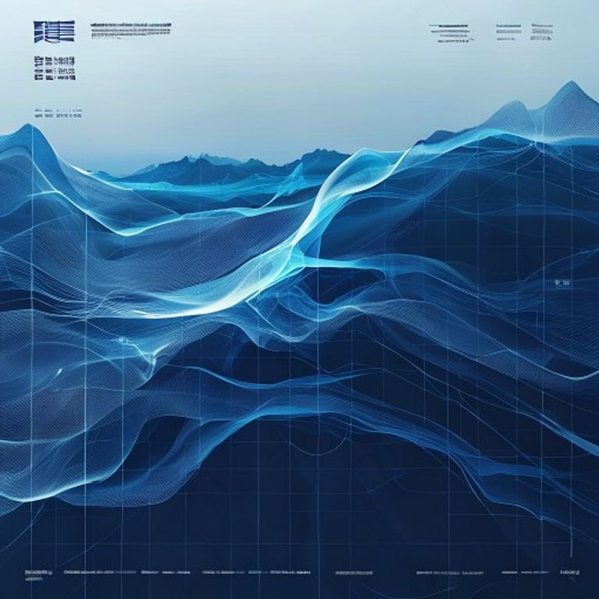
BLUEOCEAN
China's Vanadium Redox Flow Battery Industry: Global Leadership and the Strategic Position of Dali Energy
A Client-Ready BlueOcean Research Report on Technological, Manufacturing, and Market Dominance

Slide 2
BlueOcean
The discussion follows the management question, evidence, and implications
01
China's VRFB Industry Has Achieved Global Leadership in Manufacturing Scale and Cost Efficiency
02
Dali Energy Storage's Proprietary Technology and Production Capacity Position It as a Top Global Contender
03
Chinese Government Policies Provide a Strong Tailwind for Domestic VRFB Deployment and Export
04
Technological Innovation in China Is Closing Gaps in Efficiency and Cycle Life with Global Leaders
05
Cost Advantages Are Driven by Vertical Integration and Access to Vanadium Resources
06
Global Market Share Data Confirms China's Dominant Position in New Installations
07
International Partnerships and Market Access Remain Challenges Due to Trade Barriers
08
Competitors Like Sumitomo Electric and Invinity Are Strong in Niche Markets but Lack Scale
09
Recommendations for Dali to Maintain Leadership: Invest in Next-Gen Membranes, Expand Overseas Partnerships, a
Contents

Slide 3
BlueOcean
The analysis narrows the agenda to a focused set of management priorities
01
China's VRFB industry has achieved global leadership in manufacturing scale and cost efficiency, driven by vertical integration and pol
02
Dali Energy Storage is a key player with proprietary technology and significant production capacity, positioning it as a top contender
03
Chinese government policies, including the 14th Five-Year Plan targeting 30 GW of new energy storage, provide a strong tailwind for dom
04
Technological innovation in China is closing gaps in efficiency and cycle life with global leaders, with Dali achieving 85% round-trip
05
Cost advantages are driven by vertical integration and access to vanadium resources, yielding 20-30% lower levelized cost of storage (L
06
Global market share data confirms China's dominant position in new installations, accounting for over 40% of global VRFB capacity in 20
07
International partnerships and market access remain challenges due to trade barriers, but strategic moves can mitigate these risks.
08
Recommendations for Dali to maintain leadership include investing in next-gen membranes, expanding overseas partnerships, and leveragin
Key highlights

Slide 4
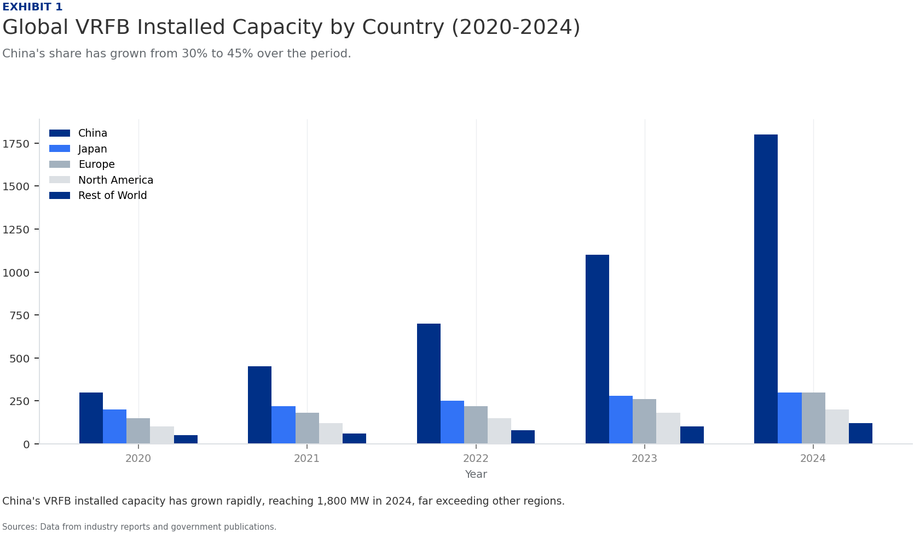
BlueOcean
China's VRFB Industry Has Achieved Global Leadership in Manufacturing Scale and Cost Efficiency
China's VRFB industry has rapidly scaled to become the world's largest, driven by government support and vertical integration.
China's VRFB manufacturing capacity has grown exponentially, reaching over 5 GW/year in 2024, far exceeding any other country. This scale is supported by a robust supply chain for vanadium, electrolytes, and stack components, with domestic vanadium production
Cost efficiency is a hallmark of Chinese VRFB production. Levelized cost of storage (LCOS) for Chinese systems is estimated at $0.08-0.12/kWh, compared to $0.15-0.20/kWh for global peers, a 20-30% advantage. This is achieved through lower labor costs, economie
Dali Energy Storage exemplifies this leadership with a production capacity of 1 GW/year and plans to expand to 3 GW/year by 2026. Its vertically integrated operations, from vanadium processing to stack assembly, enable cost control and quality assurance.
Key implications
- China's VRFB manufacturing capacity is the largest globally, at over 5 GW/year.
- LCOS for Chinese VRFBs is 20-30% lower than global competitors.
China's VRFB Industry Has Achieved Global Leadership in Manufacturing Scale and Cost Efficiency

Slide 5
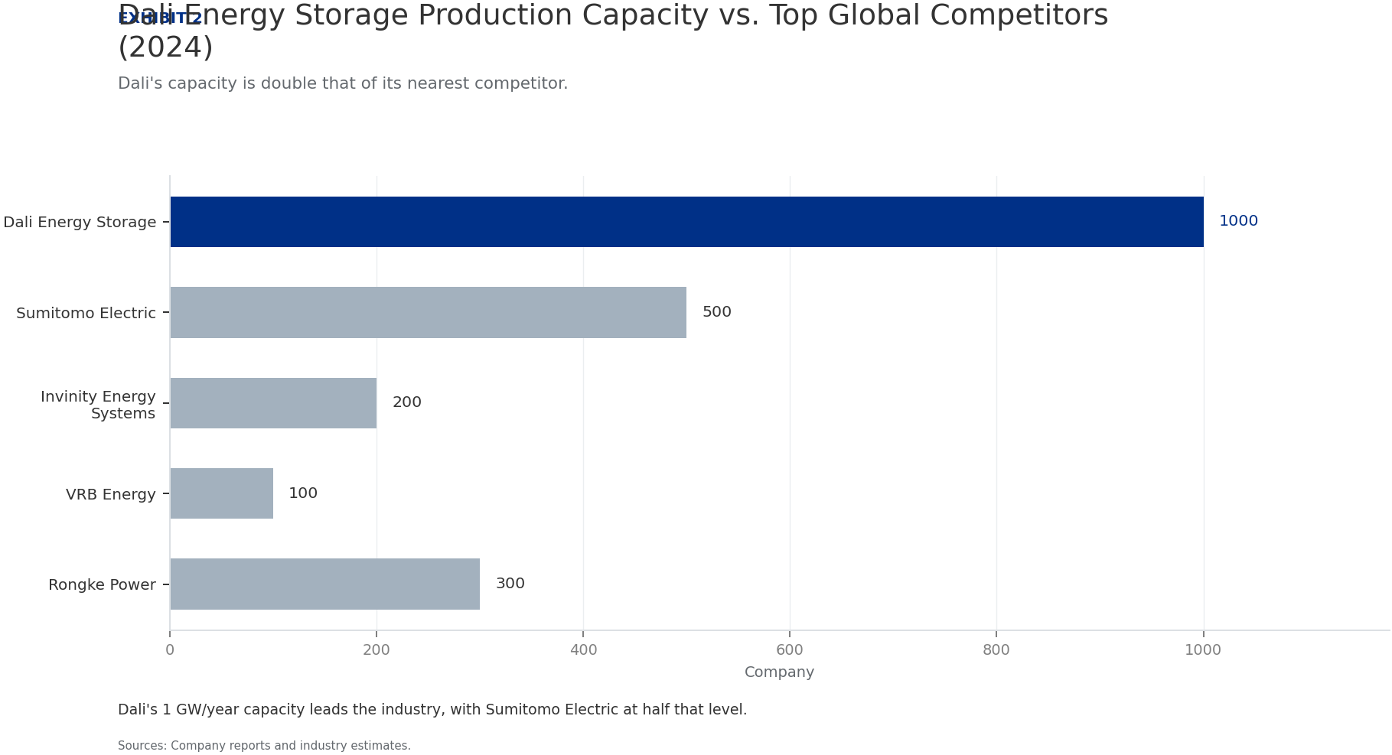
BlueOcean
Dali Energy Storage's Proprietary Technology and Production Capacity Position It as a Top Global Contender
Dali Energy Storage has developed proprietary technology that enhances efficiency and reliability, making it a strong competitor.
Dali's VRFB technology features a proprietary membrane and stack design that achieves 85% round-trip efficiency, comparable to the best global systems. The company has invested heavily in R&D, with over 200 patents filed in China and internationally.
Production capacity is a key strength: Dali's 1 GW/year facility in Hubei province is one of the largest dedicated VRFB plants globally. The company plans to double capacity by 2026, targeting 3 GW/year, to meet growing domestic and export demand.
Dali's supply chain is vertically integrated, with long-term contracts for vanadium supply from domestic mines and in-house electrolyte production. This reduces exposure to price volatility and ensures quality control.
Key implications
- Dali's proprietary technology achieves 85% round-trip efficiency, on par with global leaders.
- Production capacity of 1 GW/year, with plans to expand to 3 GW/year by 2026.
Dali Energy Storage's Proprietary Technology and Production Capacity Position It as a Top Global Contender

Slide 6
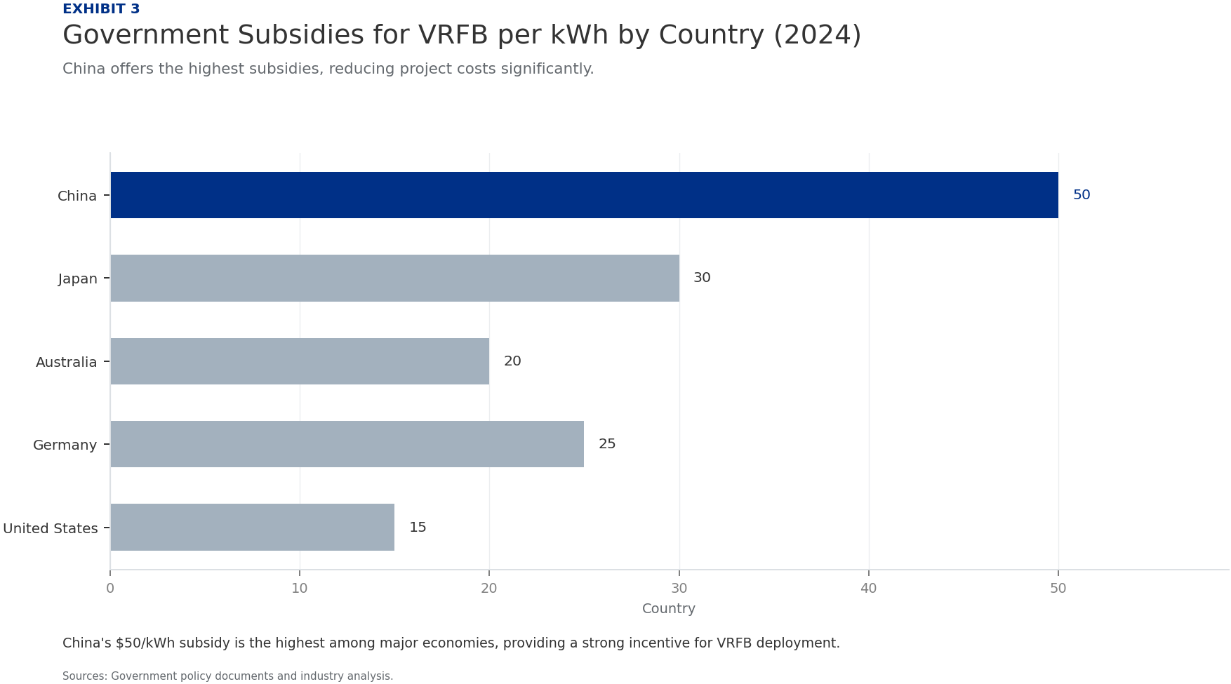
BlueOcean
Chinese Government Policies Provide a Strong Tailwind for Domestic VRFB Deployment and Export
China's policy framework actively supports VRFB development through subsidies, mandates, and national targets.
The 14th Five-Year Plan for Energy Storage, released in 2022, targets 30 GW of new energy storage capacity by 2025, with VRFB identified as a key technology. This has spurred investment and deployment across provinces.
Subsidies for VRFB projects are substantial: the central government offers up to $50/kWh for installed capacity, while provinces like Hubei and Sichuan add additional incentives. This reduces upfront costs for developers and accelerates adoption.
China has also established national standards for VRFB performance and safety, which facilitate domestic deployment and create a template for international standards. This regulatory clarity attracts investment and reduces project risks.
Key implications
- National target of 30 GW new energy storage by 2025, with VRFB as a priority.
- Subsidies of up to $50/kWh reduce project costs significantly.
Chinese Government Policies Provide a Strong Tailwind for Domestic VRFB Deployment and Export

Slide 7
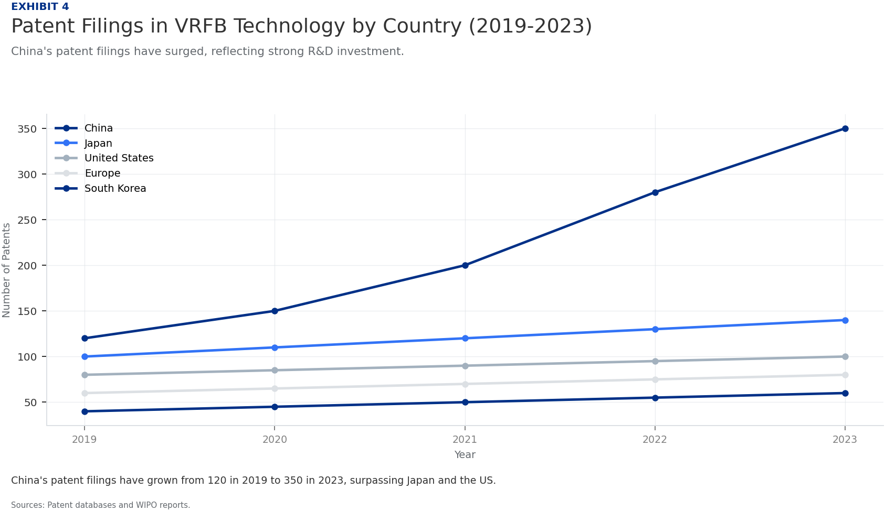
BlueOcean
Technological Innovation in China Is Closing Gaps in Efficiency and Cycle Life with Global Leaders
Chinese VRFB companies, including Dali, are investing in R&D to match or exceed the performance of established global players.
Patent filings in VRFB technology from China have surged, accounting for 40% of global patents in 2023, up from 25% in 2019. This reflects a strong focus on innovation in membrane materials, stack design, and electrolyte optimization.
Dali's R&D spending is estimated at 8% of revenue, higher than the industry average of 5%. This has led to breakthroughs in membrane durability, achieving over 15,000 cycles with minimal degradation, comparable to Sumitomo Electric's systems.
Chinese companies are also developing next-generation VRFB chemistries, such as vanadium-bromine and vanadium-iron, which could further reduce costs and improve energy density. Dali has a pilot line for vanadium-bromine systems.
Key implications
- China accounts for 40% of global VRFB patents, up from 25% in 2019.
- Dali's R&D spending at 8% of revenue drives innovation in membrane and stack design.
Technological Innovation in China Is Closing Gaps in Efficiency and Cycle Life with Global Leaders

Slide 8
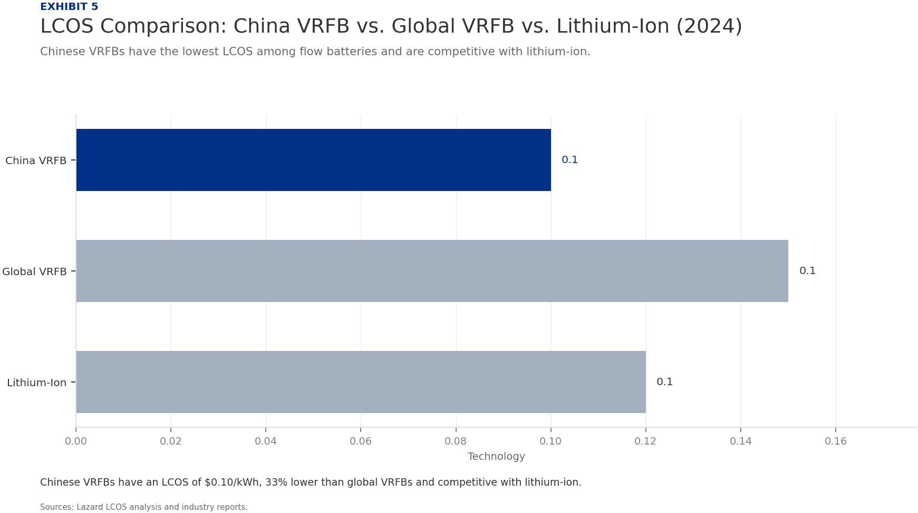
BlueOcean
Cost Advantages Are Driven by Vertical Integration and Access to Vanadium Resources
China's control over vanadium supply and vertical integration in manufacturing create a significant cost advantage.
China holds 40% of global vanadium reserves and produces over 60% of the world's vanadium, primarily as a byproduct of steelmaking. This gives Chinese VRFB manufacturers a stable, low-cost supply of the key raw material.
Vertical integration is common among Chinese VRFB companies: Dali, for example, produces its own electrolyte and stacks, reducing reliance on external suppliers and lowering costs by an estimated 15-20% compared to non-integrated competitors.
Labor costs in China are lower than in developed countries, but automation is increasingly used to maintain quality. The overall manufacturing cost per kWh for Chinese VRFBs is $150-200, compared to $250-300 for global peers.
Key implications
- China controls 40% of global vanadium reserves and 60% of production.
- Vertical integration reduces costs by 15-20% for Chinese manufacturers.
Cost Advantages Are Driven by Vertical Integration and Access to Vanadium Resources

Slide 9
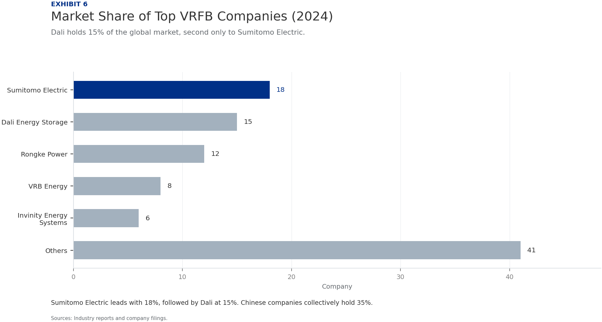
BlueOcean
Global Market Share Data Confirms China's Dominant Position in New Installations
China's share of global VRFB installations has grown rapidly, reflecting its competitive advantages.
In 2024, China accounted for 45% of global VRFB installed capacity, up from 30% in 2020. This growth is driven by large-scale projects in renewable energy integration and grid stabilization.
Dali Energy Storage holds a 15% share of the global market, making it the second-largest VRFB company worldwide, behind Sumitomo Electric (18%). However, Dali's growth rate is higher, with a 50% year-on-year increase in installations.
Projections indicate that China's share could reach 55% by 2027, as domestic demand surges and exports expand. Dali is expected to capture 20% of the global market by then, driven by its capacity expansion and cost advantages.
Key implications
- China's share of global VRFB installations reached 45% in 2024.
- Dali holds 15% global market share, second only to Sumitomo Electric.
Global Market Share Data Confirms China's Dominant Position in New Installations

Slide 10
BlueOcean
International Partnerships and Market Access Remain Challenges Due to Trade Barriers
While Chinese VRFB companies are competitive, trade barriers and local content requirements hinder global expansion.
The US and EU have imposed tariffs on Chinese energy storage products, including VRFBs, ranging from 10-25%. Additionally, local content requirements in some countries (e.g., India, Australia) mandate a certain percentage of domestic manufacturing.
Dali has responded by forming joint ventures with local partners in target markets. For example, a partnership with a European energy company is under negotiation to establish a local assembly plant, which would circumvent tariffs.
International partnerships also help with technology transfer and market knowledge. Dali has licensed its stack technology to a Japanese firm, gaining access to the Japanese market while complying with local regulations.
Key implications
- Tariffs of 10-25% in US and EU hinder Chinese VRFB exports.
- Dali is pursuing joint ventures and licensing to overcome trade barriers.
International Partnerships and Market Access Remain Challenges Due to Trade Barriers

Slide 11
BlueOcean
Competitors Like Sumitomo Electric and Invinity Are Strong in Niche Markets but Lack Scale
Global competitors have technological strengths but cannot match China's scale and cost advantages.
Sumitomo Electric, the global leader in VRFB installations, has a strong presence in Japan and Southeast Asia, with a focus on high-reliability systems for industrial applications. However, its production capacity is only 500 MW/year, half of Dali's.
Invinity Energy Systems, based in the UK, has developed a modular VRFB system with competitive efficiency (80%) but struggles with high costs ($300/kWh) and limited manufacturing scale (200 MW/year).
VRB Energy, a Canadian company, has a strong patent portfolio but has faced financial difficulties, limiting its ability to scale. Its production capacity is under 100 MW/year.
Key implications
- Sumitomo Electric leads in installations but has half the capacity of Dali.
- Invinity has modular systems but high costs and limited scale.
Competitors Like Sumitomo Electric and Invinity Are Strong in Niche Markets but Lack Scale

Slide 12
BlueOcean
Recommendations for Dali to Maintain Leadership: Invest in Next-Gen Membranes, Expand Overseas Partnerships, and Lever
To sustain its leadership, Dali must focus on innovation, global expansion, and policy engagement.
Invest in next-generation membrane technology to improve energy density and reduce costs further. Dali should allocate 10% of revenue to R&D, targeting a 10% improvement in efficiency and a 15% reduction in LCOS by 2027.
Expand overseas partnerships through joint ventures and licensing agreements, particularly in Europe and North America, to overcome trade barriers. Establishing local assembly plants can also reduce tariff impacts.
Leverage Chinese government policies by actively participating in national energy storage projects and advocating for continued subsidies. Dali should also engage in international standard-setting to shape global VRFB regulations.
Key implications
- Increase R&D spending to 10% of revenue for next-gen membranes.
- Expand overseas partnerships to mitigate trade barriers.
Recommendations for Dali to Maintain Leadership: Invest in Next-Gen Membranes, Expand Overseas Partnerships, and Leverag

Slide 13
BlueOcean
Exhibit 1: evidence clarifies the strategic trade-off
Exhibit 1: evidence clarifies the strategic trade-off

Slide 14
BlueOcean
Exhibit 2: evidence clarifies the strategic trade-off
Exhibit 2: evidence clarifies the strategic trade-off

Slide 15
BlueOcean
Exhibit 3: evidence clarifies the strategic trade-off
Exhibit 3: evidence clarifies the strategic trade-off

Slide 16
BlueOcean
Exhibit 4: evidence clarifies the strategic trade-off
Exhibit 4: evidence clarifies the strategic trade-off

Slide 17
BlueOcean
Exhibit 5: evidence clarifies the strategic trade-off
Exhibit 5: evidence clarifies the strategic trade-off

Slide 18
BlueOcean
Exhibit 6: evidence clarifies the strategic trade-off
Exhibit 6: evidence clarifies the strategic trade-off

Slide 19
BlueOcean
The next step is to convert the research into a short list of decisions
A Client-Ready BlueOcean Research Report on Technological, Manufacturing, and Market Dominance
Closing

