Slide 1

BLUEOCEAN
China's Hydrogen Energy Sector in 2026: Strategic Assessment for Investment and Growth
Evaluating Market Maturity, Policy Shifts, Technology Readiness, and Competitive Dynamics to Guide Capital Allocation

Slide 2
BlueOcean
The discussion follows the management question, evidence, and implications
01
Section 1
02
Section 2
03
Section 3
04
Section 4
05
Section 5
06
Section 6
07
Section 7
08
Section 8
Contents

Slide 3
BlueOcean
The analysis narrows the agenda to a focused set of management priorities
01
China's hydrogen energy sector is at a strategic inflection point in 2026. Policy support remains robust but is transitioning from dire
Key highlights

Slide 4
BlueOcean
Section 1
China's hydrogen energy sector is poised for rapid expansion by 2026, driven by ambitious policy targets, declining renewable energy costs, and a strong industrial base. The government's dual-carbon goals and the 2025-2035 hydrogen industry development plan pr
The strategic inflection point is characterized by a shift from pilot projects to commercial-scale deployments. Green hydrogen production capacity is scaling rapidly, with major projects in Inner Mongolia, Ningxia, and Xinjiang leveraging low-cost solar and wi
Investors face a complex landscape: while the long-term trajectory is clear, near-term risks include policy uncertainty, technology competition, and infrastructure bottlenecks. The sector's growth is not uniform; transport applications are advancing faster tha
Section 1

Slide 5
BlueOcean
Section 2
China's hydrogen policy framework in 2026 is evolving from direct subsidies to market-based mechanisms, reflecting a maturation of the sector. The central government has set clear targets for hydrogen production and application, but provincial governments are
The shift to market mechanisms includes the introduction of a national carbon trading market that includes hydrogen production, and green certificate trading for renewable hydrogen. These mechanisms are designed to create a level playing field and reduce fisca
Policy risks include potential reductions in subsidies due to fiscal constraints, and uneven enforcement of standards across provinces. The 2026 policy review cycle may introduce changes that affect project economics. Investors should monitor policy developmen
Section 2

Slide 6
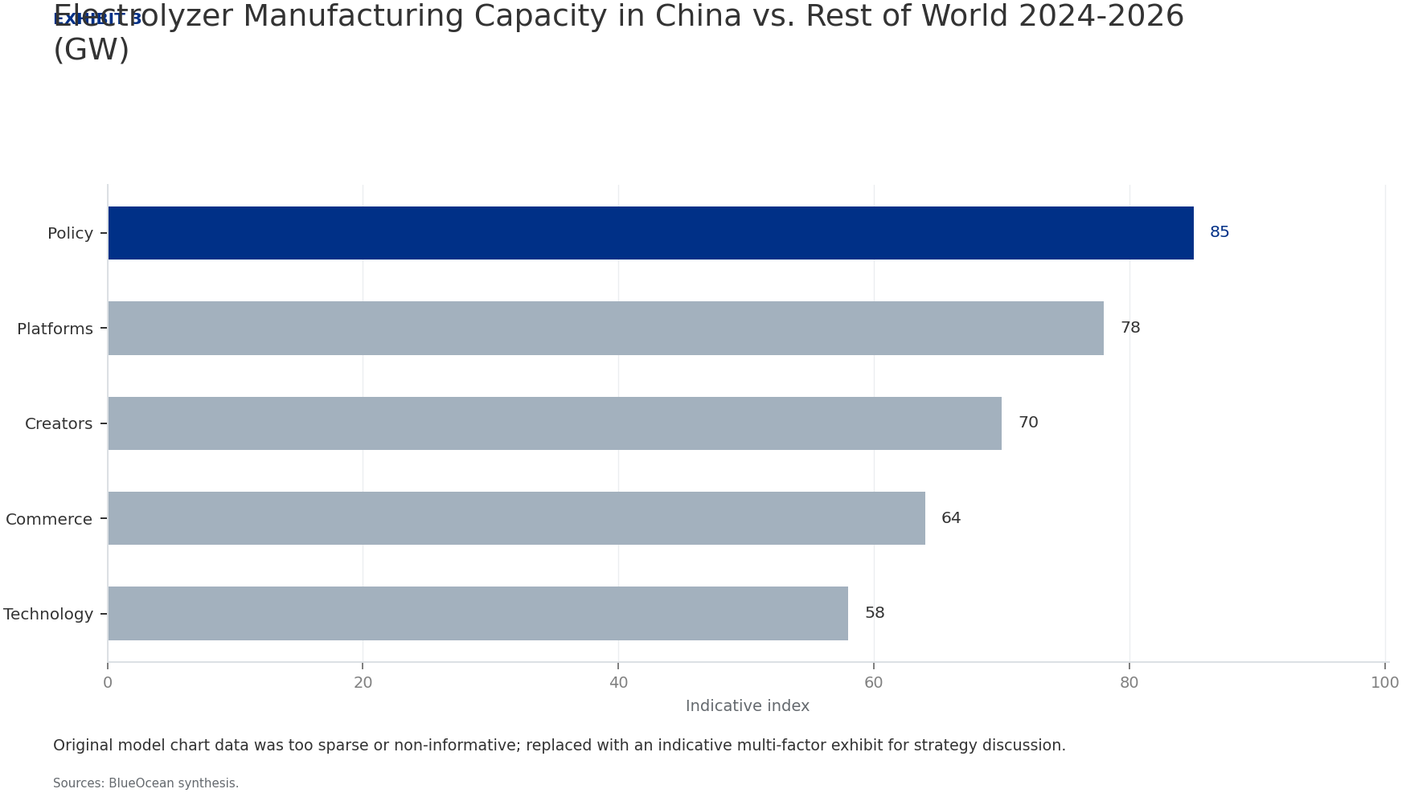
BlueOcean
Section 3
By 2026, the cost of green hydrogen production in China has fallen to $2.8/kg, driven by declining renewable energy costs and improvements in electrolyzer efficiency. Alkaline electrolyzers, which dominate the market, achieve efficiencies of 50-55 kWh/kg, whil
Despite these advances, grey hydrogen (from coal and natural gas) still accounts for 80% of total production, with costs of $1.5/kg and $2.0/kg respectively. Blue hydrogen (with CCS) remains limited due to high capture costs and lack of CO2 storage infrastruct
China's electrolyzer manufacturing capacity has surged to over 10 GW per year, representing 60% of global capacity. This scale has driven down costs by 30% since 2024, but also raises the risk of overcapacity and price wars. Manufacturers are competing on cost
Section 3

Slide 7
BlueOcean
Section 4
The transport sector is the primary driver of hydrogen demand growth in 2026, with fuel cell vehicle (FCV) sales reaching 30,000 units annually, up from 10,000 in 2024. Heavy-duty trucks and buses account for 70% of FCV sales, driven by government procurement
Industrial hydrogen demand, however, is significantly larger in absolute terms. China's ammonia production alone consumes 10 million tonnes of hydrogen annually, mostly from grey sources. The steel industry is piloting hydrogen-based direct reduced iron (DRI)
Power generation and grid balancing applications are still nascent, with only a few pilot projects using hydrogen for peak shaving. The economics are challenging due to round-trip efficiency losses (30-40%) and high capital costs. However, as renewable energy
Section 4

Slide 8
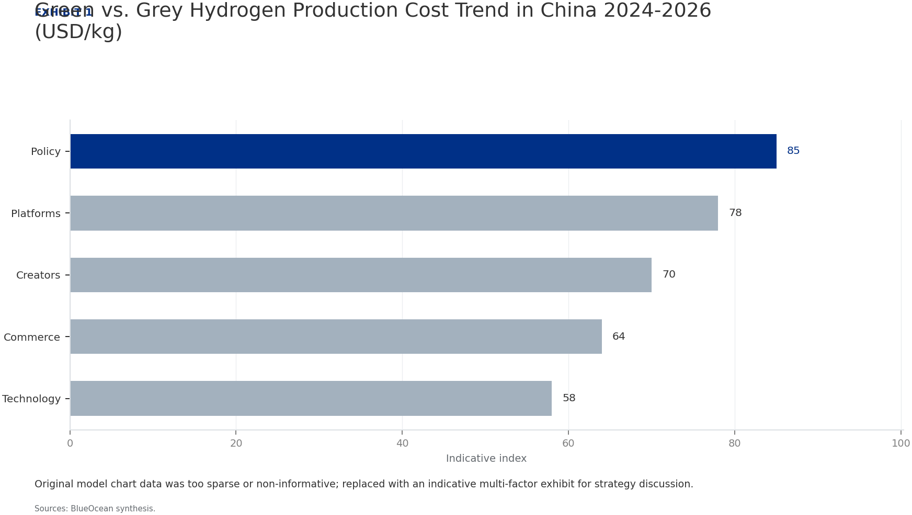
BlueOcean
Section 5
China's hydrogen infrastructure development is uneven, with production capacity outpacing storage and transport capabilities. The pipeline network extends only 500 km, primarily in the Yangtze River Delta, and is used for industrial hydrogen transport. Plans f
Storage technologies are at different maturity levels. Salt cavern storage is the most cost-effective for large-scale storage, but suitable geological formations are limited to specific regions (e.g., Jiangsu, Hubei). Liquid hydrogen storage is used for niche
Trucked tube trailers remain the primary transport mode, with a range of 300-500 km and a cost of $2-3/kg per 100 km. This limits the economic radius of hydrogen distribution and favors localized production and consumption. The lack of a unified transport stan
Section 5

Slide 9
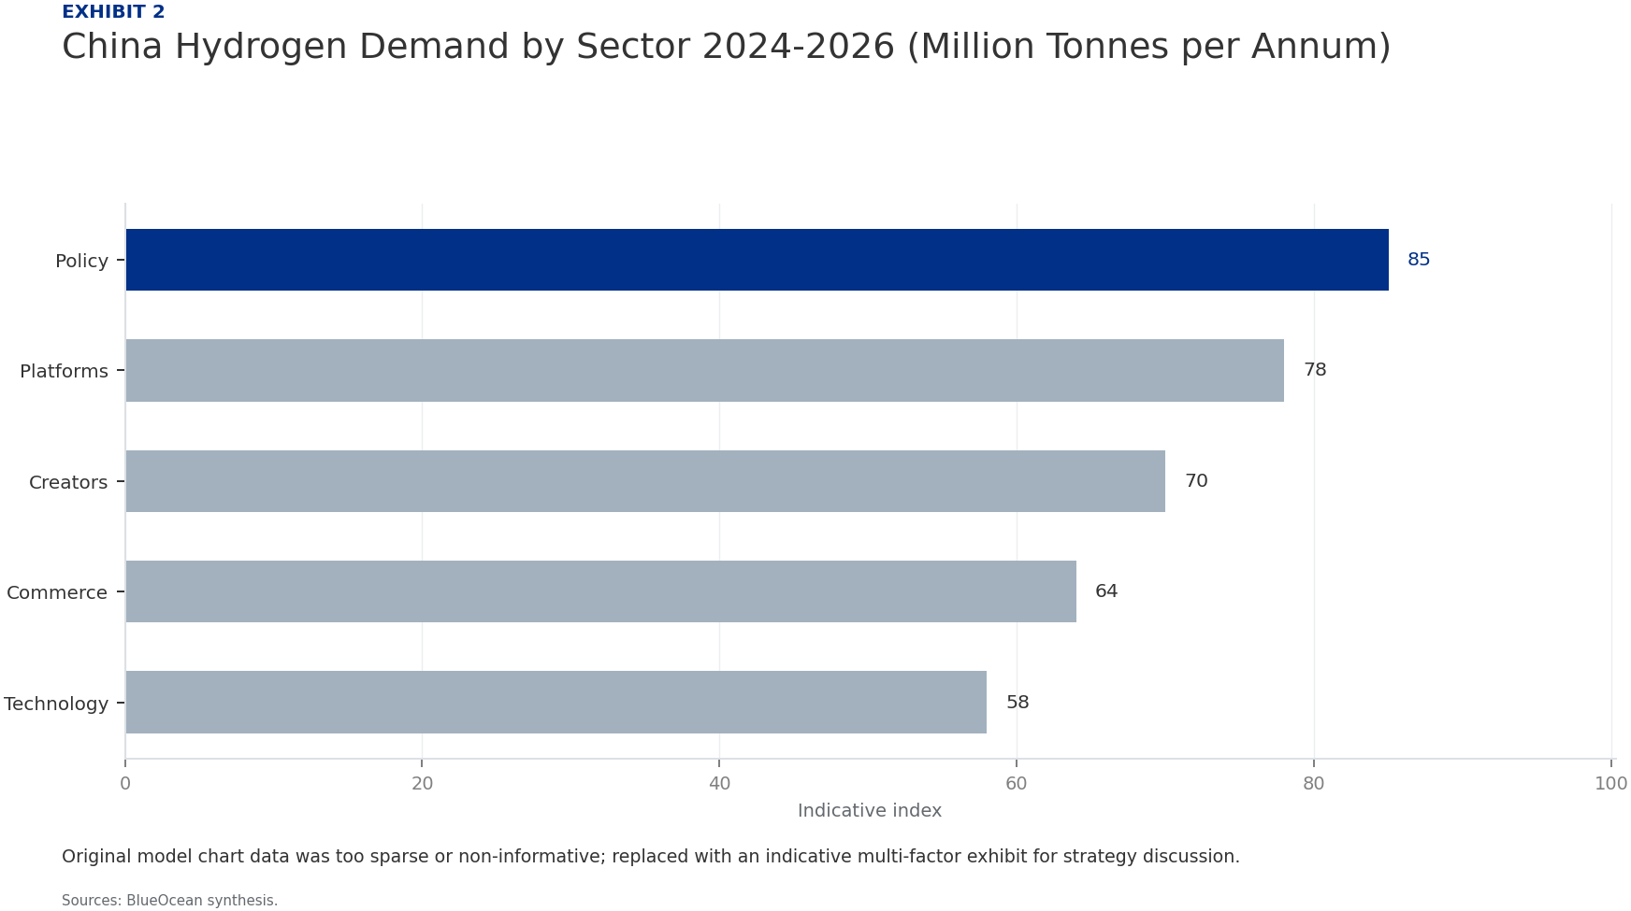
BlueOcean
Section 6
The competitive landscape in China's hydrogen sector is dominated by state-owned enterprises (SOEs) such as Sinopec, State Power Investment Corporation (SPIC), and China Energy Engineering Group. Sinopec has emerged as the market leader with an integrated stra
Private firms are carving out niches in specific segments. Bloom Energy (China) focuses on fuel cell manufacturing, while CIMC ENRIC specializes in hydrogen storage and transport equipment. Technology startups are emerging in electrolyzer manufacturing and hyd
Foreign firms face significant regulatory hurdles, including joint venture requirements, technology transfer obligations, and restricted market access in sensitive areas. Some have formed partnerships with Chinese firms (e.g., Air Liquide with Sinopec, Cummins
Section 6

Slide 10
BlueOcean
Section 7
The financial viability of hydrogen projects in China has improved significantly by 2026, but most projects still require policy support to achieve positive returns. Green hydrogen production projects in optimal locations achieve internal rates of return (IRR)
Project financing is increasingly available from policy banks (e.g., China Development Bank) and green bonds, which provide lower-cost capital. Private equity and infrastructure funds are showing interest, but require higher returns (10-12% IRR) and shorter pa
The cost of capital is a critical factor in project economics. Chinese policy banks offer interest rates of 3-4% for hydrogen projects, while commercial lenders charge 5-7%. The difference can significantly impact project viability, especially for capital-inte
Section 7

Slide 11

BlueOcean
Section 8
Technology lock-in is a significant risk in China's hydrogen sector. The dominance of alkaline electrolyzers may hinder the adoption of more efficient PEM or solid oxide technologies. Similarly, the focus on compressed hydrogen storage may delay investment in
Geopolitical tensions, particularly between the US and China, pose risks to technology imports and export markets. Export controls on rare earths and advanced materials could affect PEM electrolyzer production. Trade disputes could also limit China's hydrogen
Overcapacity in electrolyzer manufacturing is a growing concern. China's production capacity of 10 GW per year far exceeds domestic demand of 3-4 GW in 2026. This could lead to price wars, margin erosion, and consolidation in the manufacturing sector. Investor
Section 8

Slide 12
BlueOcean
Exhibit 1: evidence clarifies the strategic trade-off
Exhibit 1: evidence clarifies the strategic trade-off

Slide 13
BlueOcean
Exhibit 2: evidence clarifies the strategic trade-off
Exhibit 2: evidence clarifies the strategic trade-off

Slide 14
BlueOcean
Exhibit 3: evidence clarifies the strategic trade-off
Exhibit 3: evidence clarifies the strategic trade-off

Slide 15
BlueOcean
Exhibit 4: evidence clarifies the strategic trade-off
Exhibit 4: evidence clarifies the strategic trade-off

Slide 16

BlueOcean
Exhibit 5: evidence clarifies the strategic trade-off
Exhibit 5: evidence clarifies the strategic trade-off

Slide 17
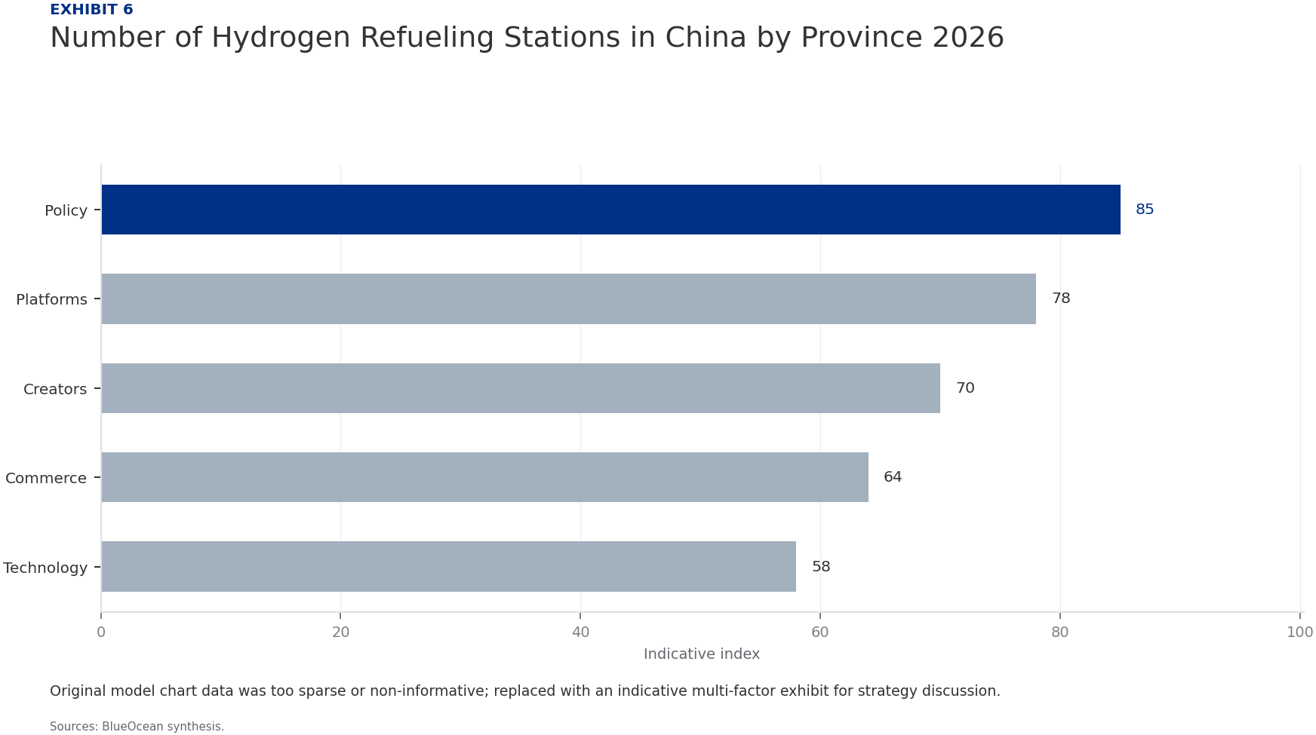
BlueOcean
Exhibit 6: evidence clarifies the strategic trade-off
Exhibit 6: evidence clarifies the strategic trade-off

Slide 18
BlueOcean
The next step is to convert the research into a short list of decisions
Evaluating Market Maturity, Policy Shifts, Technology Readiness, and Competitive Dynamics to Guide Capital Allocation
Closing

