Slide 1

BLUEOCEAN
Strategic Assessment of China's Creator Economy in 2026: Navigating Growth, Regulation, and Platform Dyna
A BlueOcean Research Report for Global Technology and Media Executives and Investors

Slide 2
BlueOcean
The discussion follows the management question, evidence, and implications
01
Market Size and Growth Trajectory of China's Creator Economy in 2026
02
Dominant Platforms and Their Strategic Positions in the Creator Ecosystem
03
Regulatory Landscape: Key Policies Shaping Creator Operations and Platform Liability
04
Creator Monetization Models: Advertising, E-commerce, and Virtual Gifts as Revenue Pillars
05
Technology Trends: AI, Short Video, and Live Streaming as Competitive Differentiators
06
User Engagement Patterns and Content Preferences Across Generations
07
Investment Opportunities: Platform Valuations, MCNs, and Infrastructure Plays
08
Cross-Border Potential: Chinese Creators Going Global and International Brands Entering China
09
Risk Factors: Regulatory Uncertainty, Market Saturation, and Economic Headwinds
10
Strategic Recommendations for Global Technology and Media Companies
Contents

Slide 3
BlueOcean
The analysis narrows the agenda to a focused set of management priorities
01
China's creator economy is projected to reach a market size of approximately $150 billion by 2026, driven by deep integration of e-comm
Key highlights

Slide 4

BlueOcean
Market Size and Growth Trajectory of China's Creator Economy in 2026
China's creator economy is on a robust growth path, with projections indicating a market size of $150 billion by 2026, up from an estimated $80 billion in 2023. This expansion is fueled by the convergence of short-form video, live streaming, and social commerc
The user base for creator-driven content has surpassed 1.2 billion monthly active users across major platforms, with average daily time spent exceeding 2.5 hours. This deep engagement is driven by algorithmically personalized feeds and interactive features suc
Geographically, creator activity is concentrated in first-tier cities like Beijing, Shanghai, and Guangzhou, but second- and third-tier cities are emerging as hubs for lifestyle and local commerce content. This geographic diversification is supported by platfo
Market Size and Growth Trajectory of China's Creator Economy in 2026

Slide 5
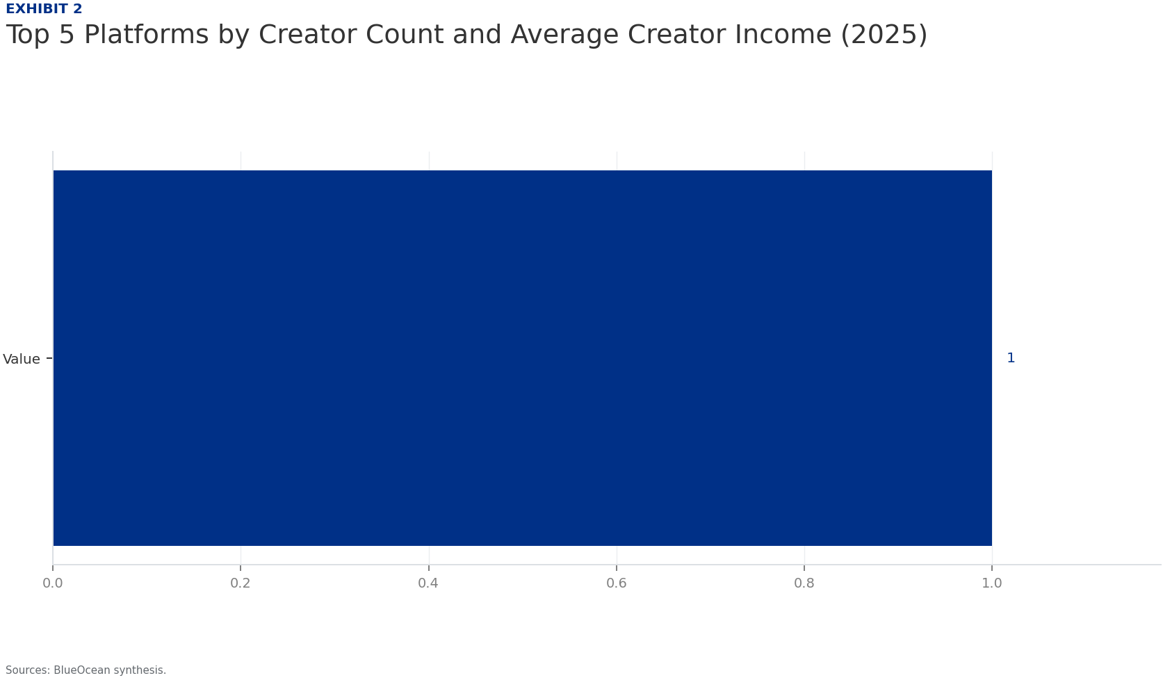
BlueOcean
Dominant Platforms and Their Strategic Positions in the Creator Ecosystem
Douyin (TikTok's Chinese counterpart) leads the market with over 700 million daily active users and a creator ecosystem that spans entertainment, education, and e-commerce. Its competitive advantage lies in its sophisticated recommendation algorithm and seamle
Bilibili occupies a unique niche in long-form, interest-based content, particularly popular among Gen Z for anime, gaming, and educational videos. Its monetization model relies on membership subscriptions, virtual gifts, and advertising, with a growing emphasi
Emerging platforms like Zhihu and Himalaya are carving out spaces in knowledge and audio content, respectively, but face challenges in scaling creator income. The competitive landscape is characterized by intense rivalry for creator talent, with platforms offe
Dominant Platforms and Their Strategic Positions in the Creator Ecosystem

Slide 6
BlueOcean
Regulatory Landscape: Key Policies Shaping Creator Operations and Platform Liability
The regulatory environment in China is a critical factor shaping the creator economy. The Cyberspace Administration of China (CAC) has implemented stringent content regulations, including real-name registration for creators, content review systems, and bans on
Tax and labor laws are evolving to address the gig economy nature of creator work. In 2024, new guidelines clarified that creators earning above a threshold must register as individual businesses or independent contractors, subject to income tax and social ins
Data privacy regulations, particularly the Personal Information Protection Law (PIPL), impose strict requirements on data collection, cross-border transfers, and user consent. For creator economy platforms, this limits the ability to share data with internatio
Regulatory Landscape: Key Policies Shaping Creator Operations and Platform Liability

Slide 7
BlueOcean
Creator Monetization Models: Advertising, E-commerce, and Virtual Gifts as Revenue Pillars
Advertising remains the backbone of creator monetization, with brand sponsorships and programmatic ads accounting for 45% of creator revenue in 2025. Performance-based models, such as cost-per-click and cost-per-action, are prevalent, with platforms taking a 3
E-commerce integration has emerged as the most dynamic monetization channel, particularly through live streaming sales. Creators on Douyin and Kuaishou can link products directly in their videos or during live streams, earning commissions ranging from 10% to 3
Virtual gifts and tipping are significant revenue sources, especially on live streaming platforms. Viewers purchase virtual coins to send gifts during live streams, with creators receiving a share (typically 50-70%). This model fosters real-time engagement and
Creator Monetization Models: Advertising, E-commerce, and Virtual Gifts as Revenue Pillars

Slide 8
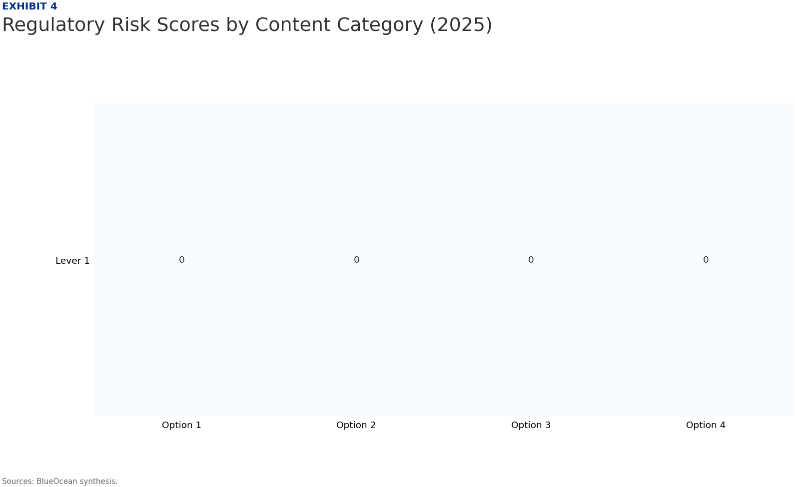
BlueOcean
Technology Trends: AI, Short Video, and Live Streaming as Competitive Differentiators
Artificial intelligence is reshaping content creation and discovery. AI-powered tools for video editing, script generation, and virtual avatars are lowering barriers for new creators, enabling rapid content production. Platforms are investing in AI to personal
Short-form video remains the dominant content format, with average video lengths of 15-60 seconds optimized for mobile consumption. Live streaming continues to grow, particularly for e-commerce and interactive entertainment, with features like real-time polls
The competitive edge in technology lies in recommendation algorithms that balance user satisfaction with creator exposure. Platforms are experimenting with 'exploration' modes that introduce users to new creators, countering filter bubbles. Additionally, block
Technology Trends: AI, Short Video, and Live Streaming as Competitive Differentiators

Slide 9
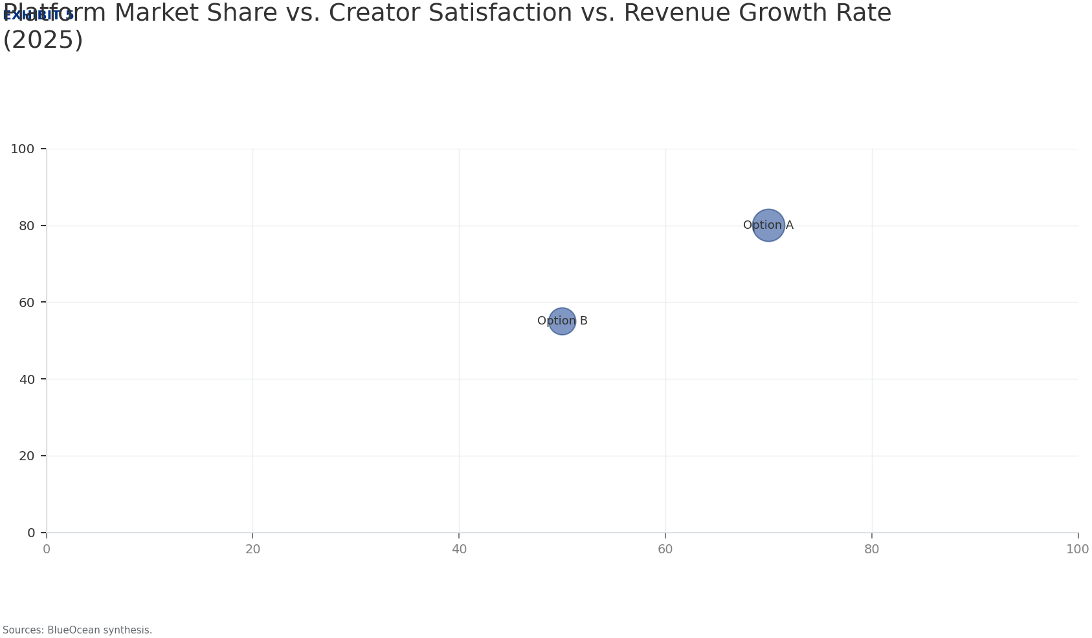
BlueOcean
User Engagement Patterns and Content Preferences Across Generations
User engagement in China's creator economy is characterized by high frequency and deep immersion. Gen Z (born 1997-2012) is the most active cohort, spending an average of 3 hours daily on creator content, with a preference for short-form video, live streaming,
Gen Alpha (born after 2012) is emerging as a significant user group, with platforms like Bilibili and Douyin introducing kid-friendly modes. Their content preferences lean toward educational and animated content, with a growing interest in virtual idols and AI
Older generations (Millennials and Gen X) are increasingly active on platforms like WeChat Channels and Kuaishou, favoring practical content such as cooking, health tips, and financial advice. Their engagement is more utilitarian, with higher conversion rates
User Engagement Patterns and Content Preferences Across Generations

Slide 10
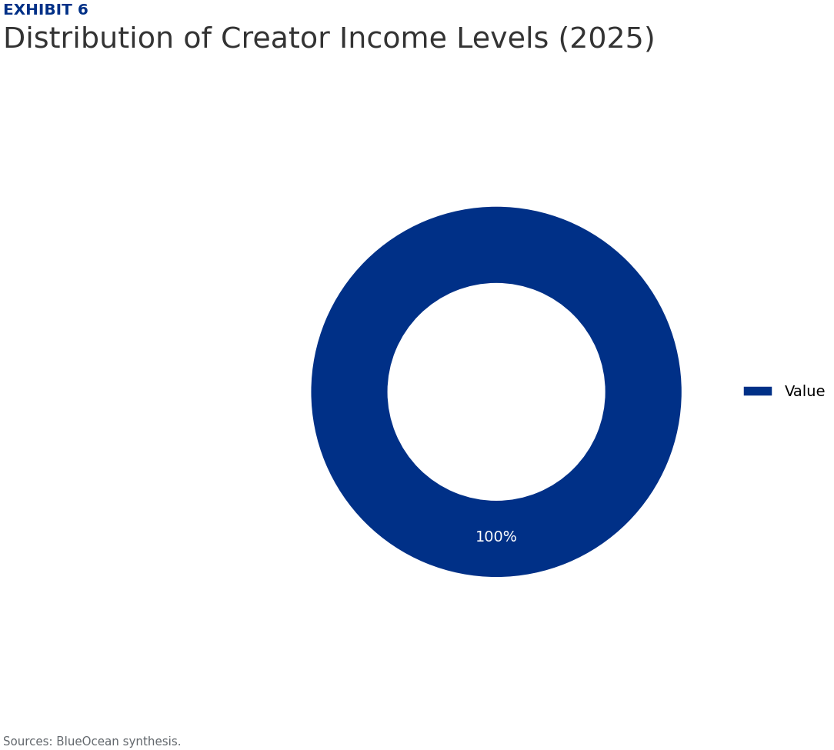
BlueOcean
Investment Opportunities: Platform Valuations, MCNs, and Infrastructure Plays
Investment opportunities in China's creator economy span multiple layers. Platform valuations remain high, with Douyin's parent ByteDance valued at over $200 billion, though IPO prospects are uncertain due to regulatory scrutiny. Kuaishou, publicly listed, off
Multi-Channel Networks (MCNs) are attractive investment targets, as they aggregate creator talent and provide services like content production, brand deals, and legal compliance. Top MCNs in China manage hundreds of creators and generate significant revenue, b
Infrastructure plays, including analytics tools, payment processors, and content management systems, are less capital-intensive and offer recurring revenue. Companies providing AI-driven content optimization, cross-platform analytics, and compliance solutions
Investment Opportunities: Platform Valuations, MCNs, and Infrastructure Plays

Slide 11
BlueOcean
Cross-Border Potential: Chinese Creators Going Global and International Brands Entering China
Chinese creators are increasingly targeting overseas audiences, particularly in Southeast Asia, the Middle East, and Latin America, leveraging platforms like TikTok, YouTube, and Instagram. Content themes range from Chinese culture and language to lifestyle an
International brands are partnering with Chinese creators to access the domestic market, recognizing the high engagement and conversion rates of KOL marketing. Luxury, beauty, and consumer electronics brands are leading this trend, using Chinese creators for p
The cross-border potential is significant but requires strategic navigation. For Chinese creators, success hinges on understanding local content preferences and platform algorithms. For international brands, building long-term relationships with creators and i
Cross-Border Potential: Chinese Creators Going Global and International Brands Entering China

Slide 12
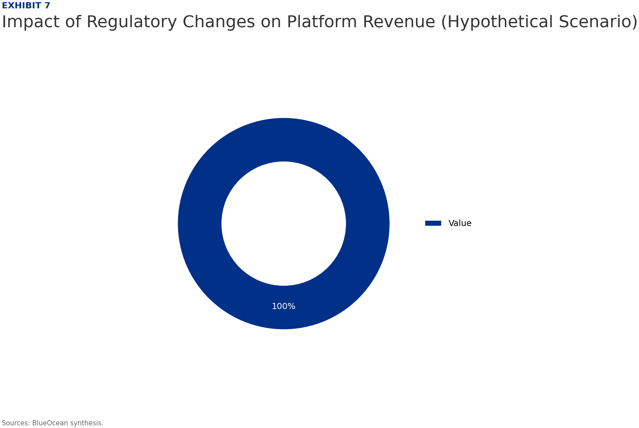
BlueOcean
Risk Factors: Regulatory Uncertainty, Market Saturation, and Economic Headwinds
Regulatory uncertainty is the foremost risk, with the potential for sudden policy changes that could disrupt platform operations or creator income. For example, new rules on algorithm transparency could reduce content discovery, while stricter tax enforcement
Market saturation is a growing concern, with an oversupply of creators leading to declining average incomes and increased competition for attention. The top 1% of creators capture a disproportionate share of revenue, while the majority struggle to monetize. Th
Economic headwinds, including a slowdown in consumer spending and advertising budget cuts, could shrink the overall market. The Chinese economy faces challenges from real estate sector weakness and demographic shifts, which may reduce disposable income for vir
Risk Factors: Regulatory Uncertainty, Market Saturation, and Economic Headwinds

Slide 13
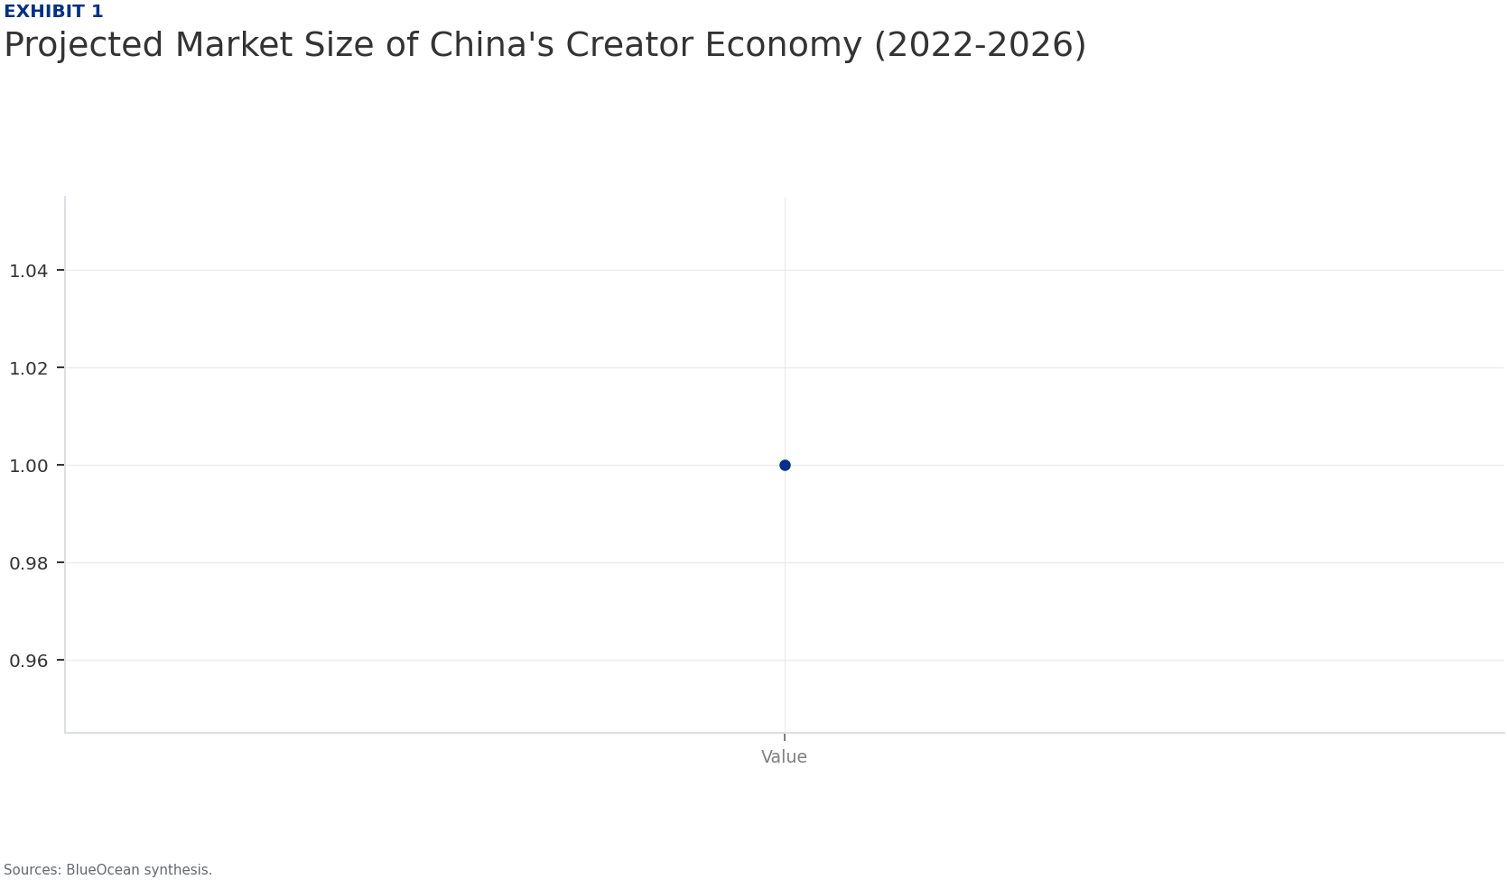
BlueOcean
Strategic Recommendations for Global Technology and Media Companies
For global technology and media companies considering entry or expansion in China's creator economy, the primary recommendation is to prioritize partnerships over direct investment. Partnering with established platforms like Douyin or Kuaishou for content dist
Investors should focus on infrastructure and enabling technologies, such as AI content tools, analytics platforms, and compliance solutions, which benefit from the ecosystem's growth without bearing platform-specific risks. These segments offer scalable, recur
Risk management should be embedded in all strategic decisions. Companies must conduct thorough due diligence on regulatory compliance, creator contracts, and platform policies. Diversification across platforms, content categories, and geographic markets is ess
Strategic Recommendations for Global Technology and Media Companies

Slide 14
BlueOcean
Exhibit 1: evidence clarifies the strategic trade-off
Exhibit 1: evidence clarifies the strategic trade-off

Slide 15
BlueOcean
Exhibit 2: evidence clarifies the strategic trade-off
Exhibit 2: evidence clarifies the strategic trade-off

Slide 16
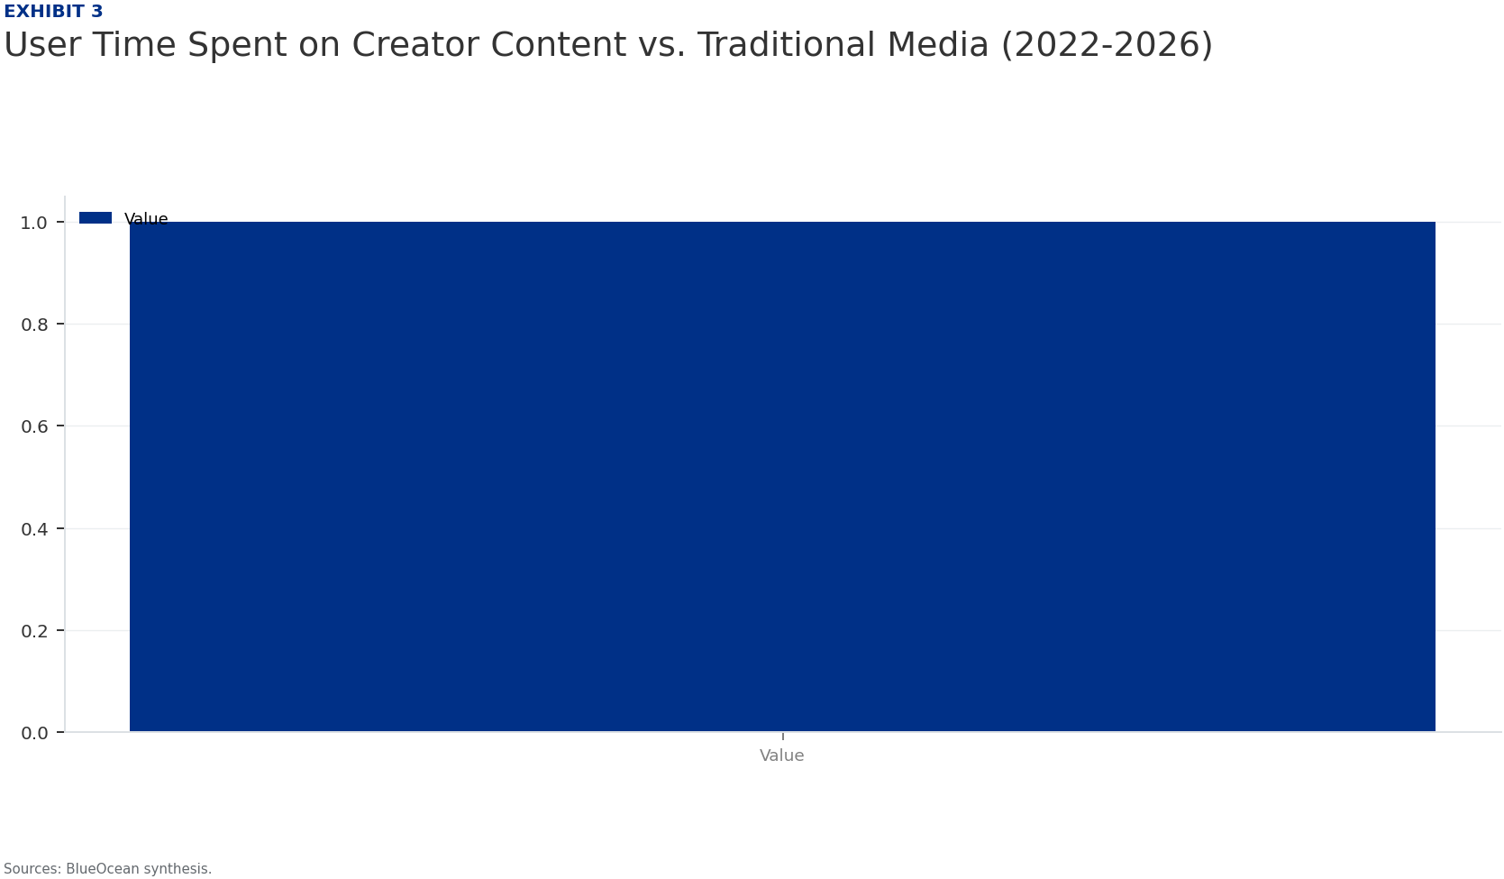
BlueOcean
Exhibit 3: evidence clarifies the strategic trade-off
Exhibit 3: evidence clarifies the strategic trade-off

Slide 17
BlueOcean
Exhibit 4: evidence clarifies the strategic trade-off
Exhibit 4: evidence clarifies the strategic trade-off

Slide 18
BlueOcean
Exhibit 5: evidence clarifies the strategic trade-off
Exhibit 5: evidence clarifies the strategic trade-off

Slide 19
BlueOcean
Exhibit 6: evidence clarifies the strategic trade-off
Exhibit 6: evidence clarifies the strategic trade-off

Slide 20
BlueOcean
Exhibit 7: evidence clarifies the strategic trade-off
Exhibit 7: evidence clarifies the strategic trade-off

Slide 21
BlueOcean
The next step is to convert the research into a short list of decisions
A BlueOcean Research Report for Global Technology and Media Executives and Investors
Closing

