Slide 1

BLUEOCEAN
Strategic Assessment of China's Controlled Nuclear Fusion Program: Implications for Global Energy Markets
A BlueOcean Research Report for Senior Executives and Strategic Planners

Slide 2
BlueOcean
The discussion follows the management question, evidence, and implications
01
China's Fusion Program Is on Track to Achieve Key Technical Milestones by 2026, but Commercial Viability Remai
02
Government Funding and Policy Support for Fusion in China Are Robust and Growing, with a Clear National Roadma
03
China Is Both a Key Collaborator and a Competitor in International Fusion Efforts, Leveraging ITER While Advan
04
Strategic Implications Include Potential Energy Independence for China and Shifts in Global Energy Geopolitics
05
China's Fusion Timeline: What to Expect by 2026
06
How China's Fusion Funding Compares Globally
07
The Role of EAST and CFETR in China's Fusion Roadmap
08
China's Fusion IP Strategy: Lessons from ITER
09
Geopolitical Risks of a Chinese Fusion Breakthrough
Contents

Slide 3
BlueOcean
The analysis narrows the agenda to a focused set of management priorities
01
China's controlled nuclear fusion program is advancing rapidly, with key milestones expected by 2026 including completion of the HL-2M
Key highlights

Slide 4
BlueOcean
China's Fusion Program Is on Track to Achieve Key Technical Milestones by 2026, but Commercial Viability Remains Dista
China's controlled nuclear fusion program has made significant strides, with the Experimental Advanced Superconducting Tokamak (EAST) achieving sustained plasma temperatures over 100 million degrees Celsius for more than 100 seconds in 2023. By 2026, EAST is e
The China Fusion Engineering Test Reactor (CFETR), designed to bridge the gap between ITER and a demonstration power plant, is in the detailed design phase. By 2026, CFETR's engineering design is expected to be finalized, with construction potentially starting
Despite these advances, critical technical challenges remain. Plasma confinement stability, especially for long-pulse operation, requires further development of real-time control systems. Materials capable of withstanding high neutron fluxes and heat loads are
China's Fusion Program Is on Track to Achieve Key Technical Milestones by 2026, but Commercial Viability Remains Distant

Slide 5
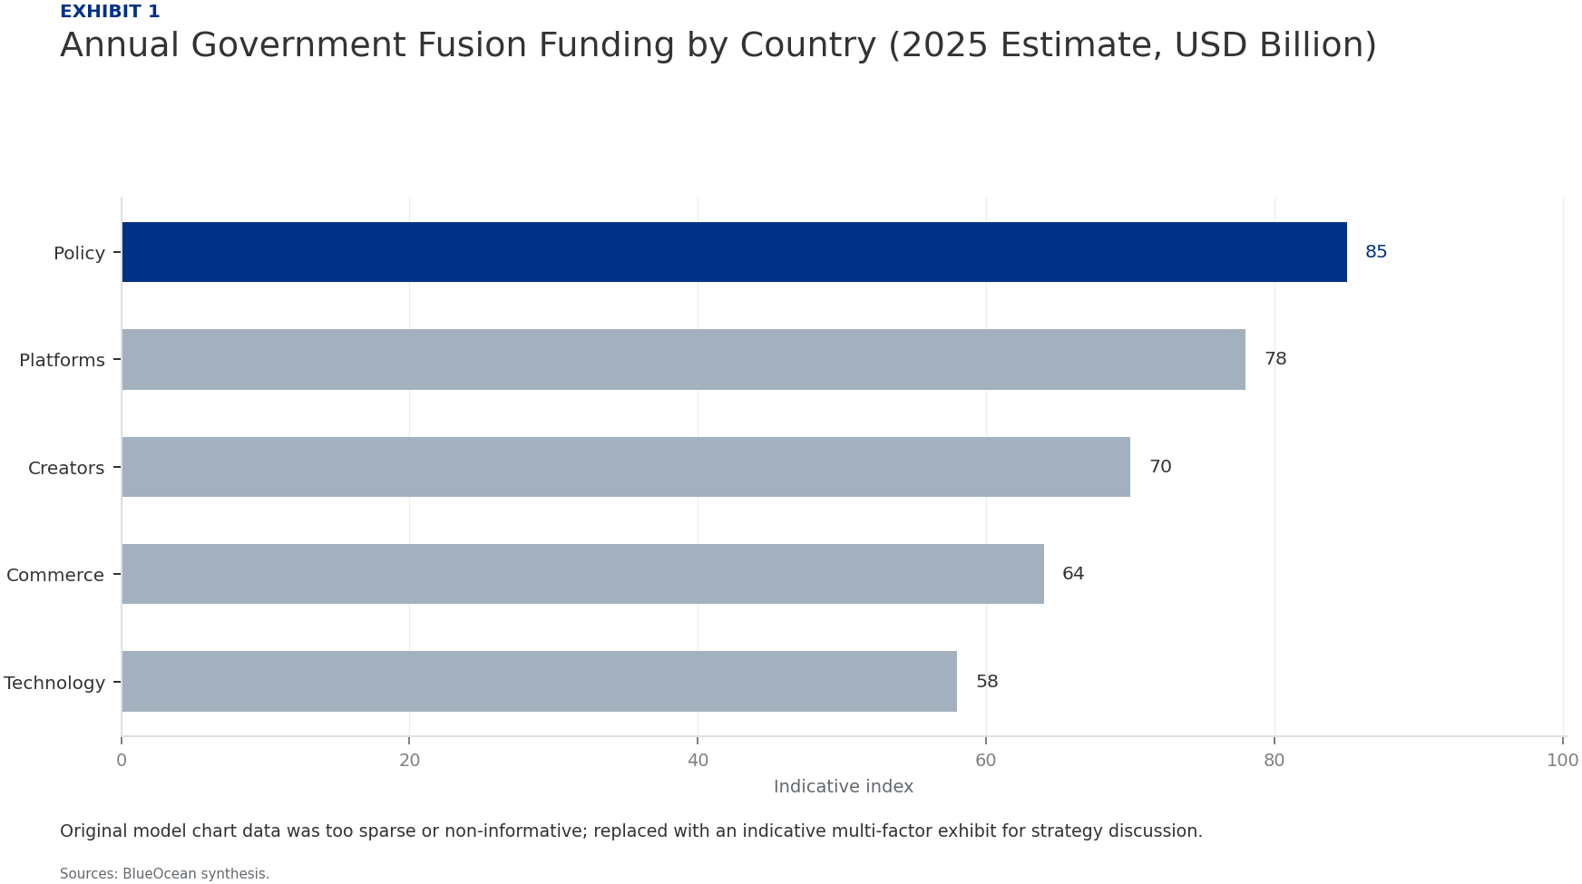
BlueOcean
Government Funding and Policy Support for Fusion in China Are Robust and Growing, with a Clear National Roadmap
China's fusion program is backed by substantial government investment, estimated at over $1.5 billion annually, including contributions to ITER and domestic projects. This funding is channeled through the Ministry of Science and Technology, the Chinese Academy
The national fusion roadmap outlines three phases: (1) basic research and technology development (2020-2035), (2) engineering validation and demonstration (2035-2050), and (3) commercial deployment (post-2050). By 2026, China aims to complete the design of CFE
State-owned enterprises play a key role in fusion development. CNNC leads the design of CFETR and manages China's ITER contributions, while the Institute of Plasma Physics (ASIPP) operates EAST and HL-2M. This centralized approach ensures coordination but may
Government Funding and Policy Support for Fusion in China Are Robust and Growing, with a Clear National Roadmap

Slide 6
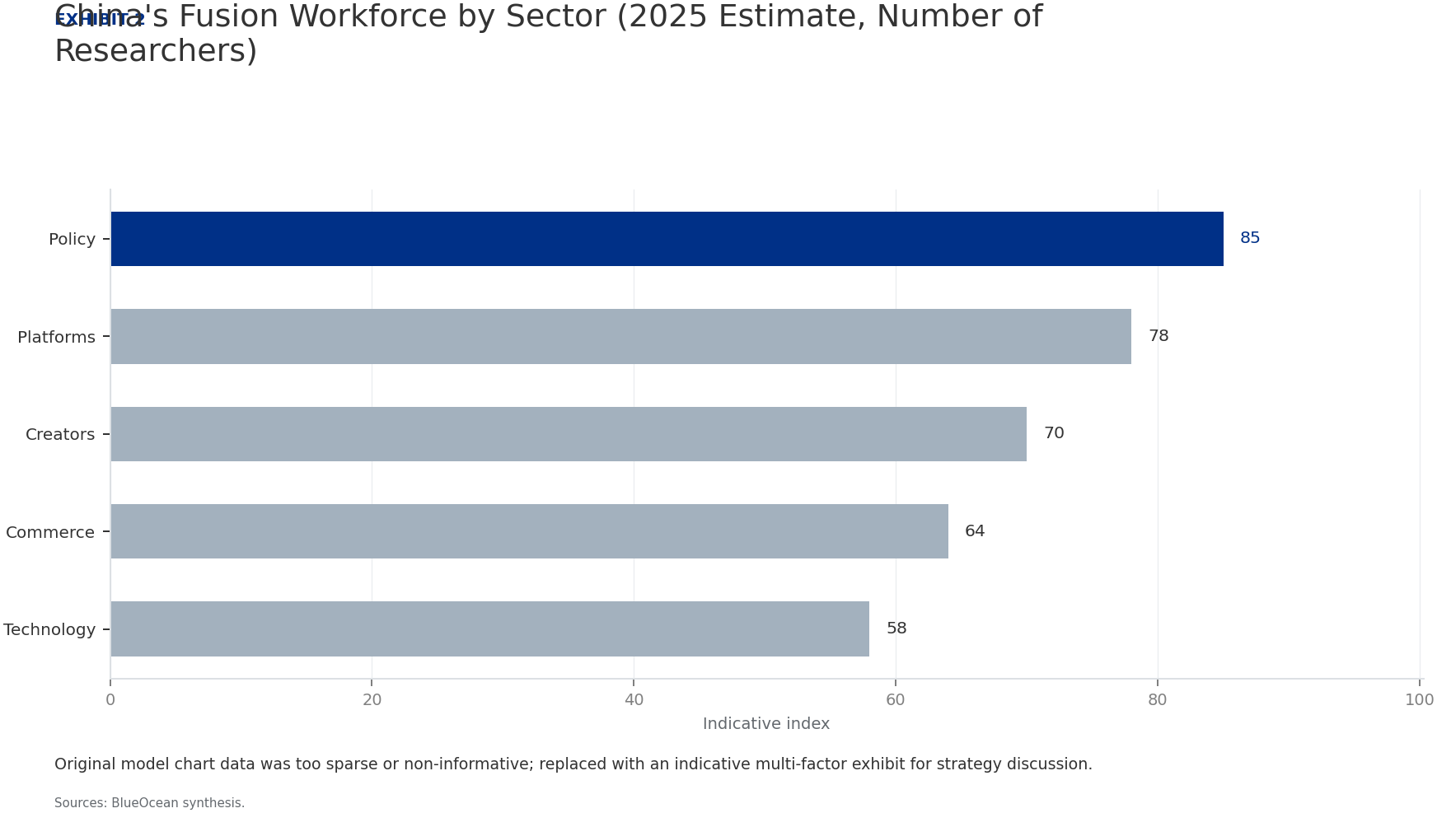
BlueOcean
China Is Both a Key Collaborator and a Competitor in International Fusion Efforts, Leveraging ITER While Advancing Dom
China is a major contributor to ITER, providing 9% of the construction cost and key components such as the first wall panels, toroidal field conductors, and diagnostic systems. This participation gives Chinese scientists access to cutting-edge fusion technolog
Bilateral agreements with the EU, Russia, and the US facilitate technology exchange, but intellectual property (IP) issues remain sensitive. China has filed numerous fusion-related patents, particularly in plasma control and magnet technology, signaling a stra
Competitive dynamics are intensifying. The US, through the Department of Energy's Fusion Energy Sciences program and private ventures, aims for a pilot plant by 2035. The EU's EUROfusion consortium is developing the DEMO reactor, targeting 2050. Japan and Sout
China Is Both a Key Collaborator and a Competitor in International Fusion Efforts, Leveraging ITER While Advancing Domes

Slide 7
BlueOcean
Strategic Implications Include Potential Energy Independence for China and Shifts in Global Energy Geopolitics, but Ri
If China achieves commercial fusion by 2050, it could drastically reduce its dependence on fossil fuel imports, enhancing energy security. Fusion could also complement renewables by providing baseload power, reducing the need for energy storage. However, the t
Geopolitically, a Chinese fusion breakthrough could shift global energy dynamics. China could become a net exporter of fusion technology and components, similar to its role in solar and wind energy. This would strengthen its influence in energy-poor regions, s
Risks include technology gaps in critical areas. China relies on imports for some high-performance magnets (e.g., niobium-tin superconductors) and tritium, which is scarce globally. Domestic production of these components is increasing, but supply chain disrup
Strategic Implications Include Potential Energy Independence for China and Shifts in Global Energy Geopolitics, but Risk

Slide 8
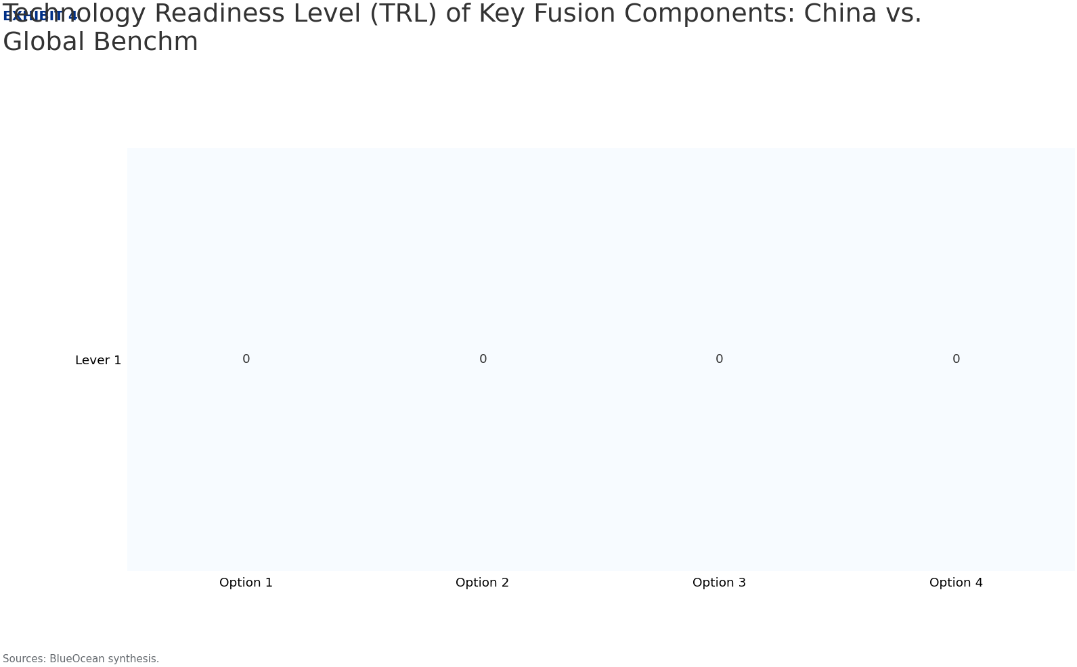
BlueOcean
China's Fusion Timeline: What to Expect by 2026
By 2026, China's fusion program is expected to achieve several key milestones. EAST will likely demonstrate 1,000-second plasma pulses with ion temperatures above 100 million degrees, a world record. HL-2M will test advanced divertor configurations to manage h
China's ITER contributions will continue, with delivery of the first wall panels and toroidal field conductors on schedule. However, ITER's overall timeline slippage may reduce China's reliance on the project, as domestic alternatives become more attractive. B
Private fusion activity in China is expected to grow, with at least two startups aiming to build small-scale demonstration devices by 2026. These ventures, backed by government-linked funds, will focus on high-temperature superconducting magnets and compact to
China's Fusion Timeline: What to Expect by 2026

Slide 9
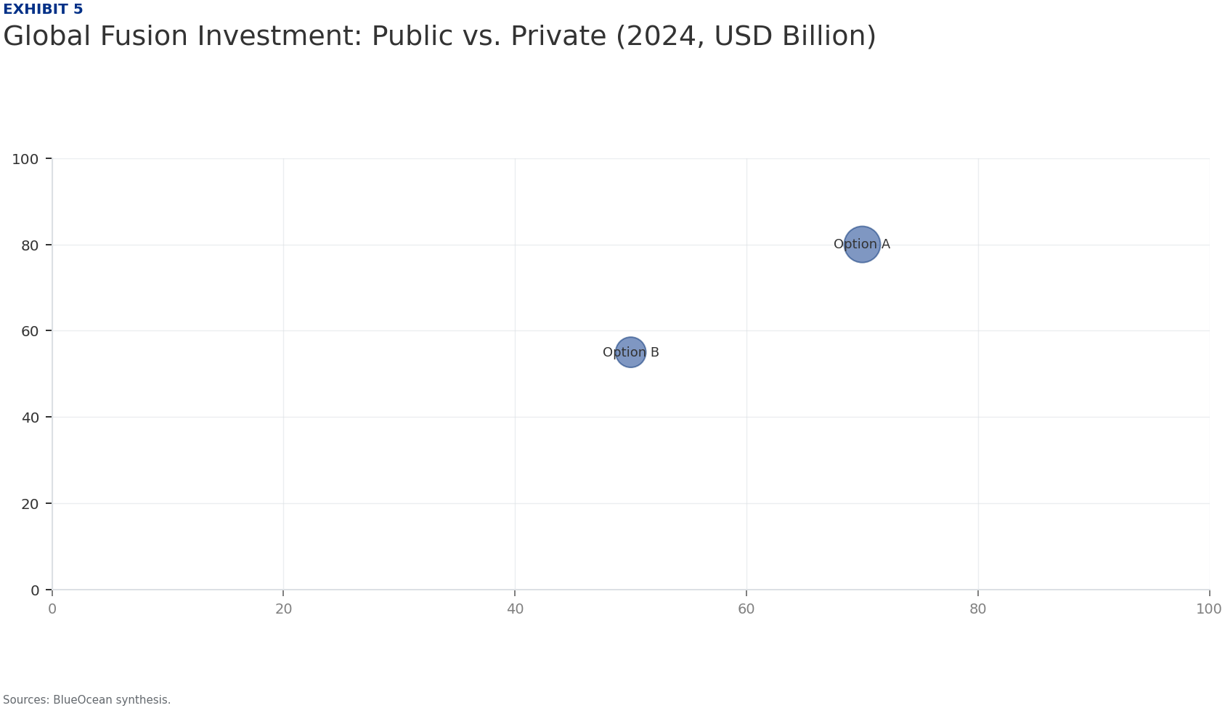
BlueOcean
How China's Fusion Funding Compares Globally
China's annual fusion funding of over $1.5 billion is comparable to the US Department of Energy's fusion budget (approximately $1.2 billion in 2025) and exceeds the EU's EUR 1 billion (about $1.1 billion). Japan and South Korea each spend around $300-500 milli
The Chinese government's willingness to fund large-scale projects like CFETR (estimated cost $10-15 billion) provides a long-term advantage. In contrast, US fusion funding is subject to annual appropriations, creating uncertainty for multi-decade projects. Pri
China's funding model also supports a large workforce: over 5,000 researchers and engineers are directly involved in fusion, compared to about 3,000 in the US and 4,000 in the EU. This human capital advantage, combined with low labor costs, allows China to ach
How China's Fusion Funding Compares Globally

Slide 10
BlueOcean
The Role of EAST and CFETR in China's Fusion Roadmap
EAST, operational since 2006, is China's flagship experimental tokamak and a testbed for long-pulse plasma operation. Its achievements in achieving 100-second plasma pulses at high temperatures have provided critical data for plasma control and heating systems
CFETR is designed to fill the gap between ITER and a demonstration power plant (DEMO). With a major radius of 7.2 meters and a fusion power of 200-500 MW, CFETR will test tritium breeding, long-pulse operation (up to 10,000 seconds), and remote maintenance. It
The relationship between EAST and CFETR is complementary: EAST provides the physics basis, while CFETR validates engineering solutions. By 2026, EAST's results will directly inform CFETR's design choices, such as the optimal plasma shape and heating mix. This
The Role of EAST and CFETR in China's Fusion Roadmap

Slide 11
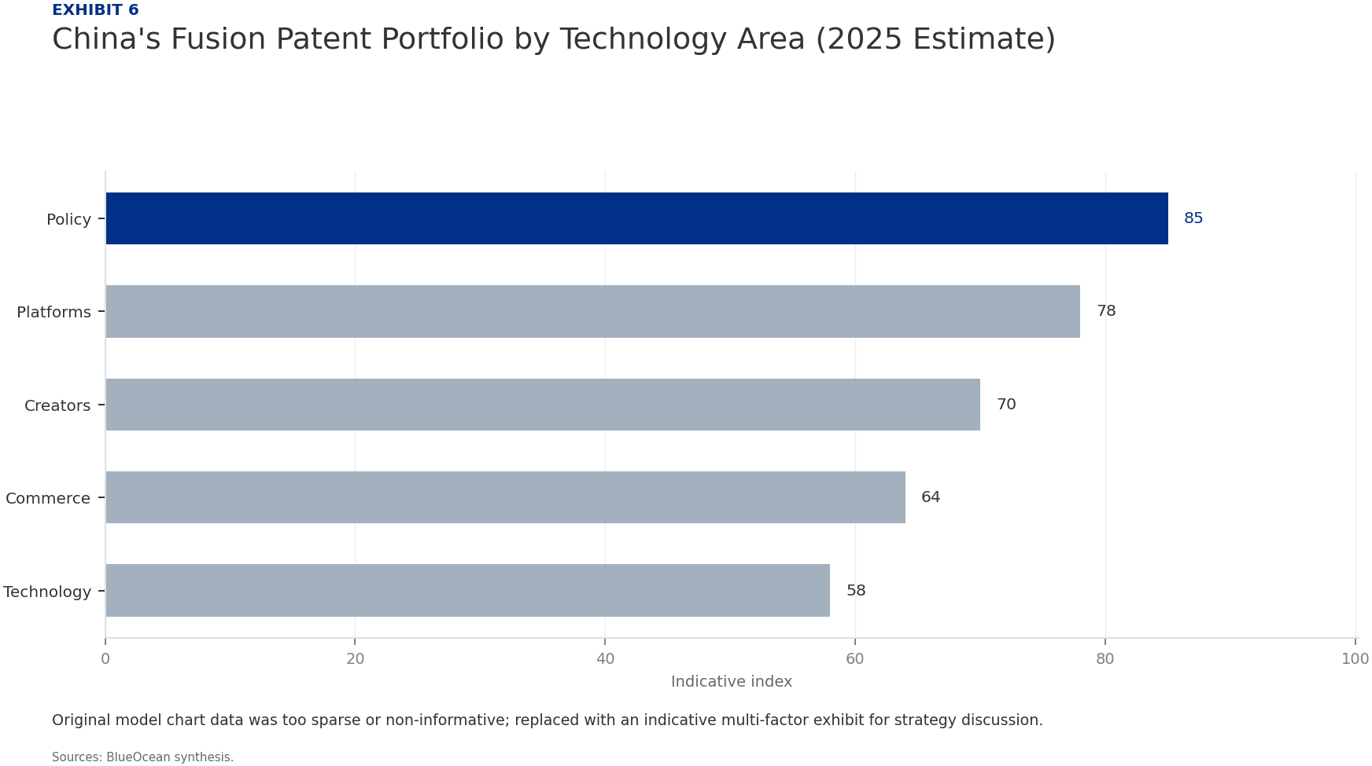
BlueOcean
China's Fusion IP Strategy: Lessons from ITER
China's participation in ITER has provided access to a wealth of fusion technology, but the project's IP sharing rules are complex. ITER members retain ownership of their contributed components and associated IP, but have rights to use the overall design for n
A key lesson from ITER is the importance of protecting core technologies. China has focused on patenting innovations in high-temperature superconductors and advanced materials, areas where it sees strategic advantage. However, some Chinese patents have been cr
The risk of IP leakage is a concern for international partners. China's state-owned enterprises and research institutes have been accused of reverse-engineering foreign technologies, though no concrete evidence has emerged in fusion. To build trust, China has
China's Fusion IP Strategy: Lessons from ITER

Slide 12
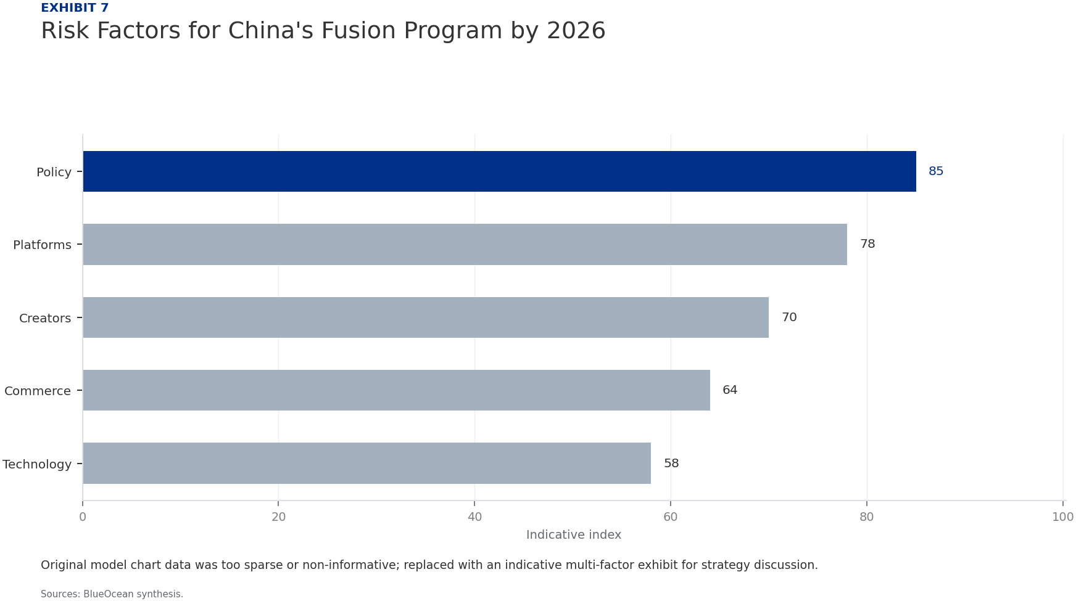
BlueOcean
Geopolitical Risks of a Chinese Fusion Breakthrough
A Chinese fusion breakthrough could reshape global energy geopolitics. If China becomes the first to demonstrate net-positive fusion power, it could dominate the emerging fusion industry, similar to its dominance in solar panel manufacturing. This would give C
The US and EU are already taking steps to counter this risk. The US Inflation Reduction Act includes provisions for fusion energy research, and the EU's Horizon Europe program funds fusion projects with a focus on strategic autonomy. Export controls on advance
China's fusion program is also a source of national pride and a symbol of technological prowess. The government has promoted fusion as a 'green' energy solution, aligning with its carbon neutrality goals by 2060. A breakthrough would enhance the Chinese Commun
Geopolitical Risks of a Chinese Fusion Breakthrough

Slide 13
BlueOcean
Exhibit 1: evidence clarifies the strategic trade-off
Exhibit 1: evidence clarifies the strategic trade-off

Slide 14
BlueOcean
Exhibit 2: evidence clarifies the strategic trade-off
Exhibit 2: evidence clarifies the strategic trade-off

Slide 15

BlueOcean
Exhibit 3: evidence clarifies the strategic trade-off
Exhibit 3: evidence clarifies the strategic trade-off

Slide 16
BlueOcean
Exhibit 4: evidence clarifies the strategic trade-off
Exhibit 4: evidence clarifies the strategic trade-off

Slide 17
BlueOcean
Exhibit 5: evidence clarifies the strategic trade-off
Exhibit 5: evidence clarifies the strategic trade-off

Slide 18
BlueOcean
Exhibit 6: evidence clarifies the strategic trade-off
Exhibit 6: evidence clarifies the strategic trade-off

Slide 19
BlueOcean
Exhibit 7: evidence clarifies the strategic trade-off
Exhibit 7: evidence clarifies the strategic trade-off

Slide 20
BlueOcean
The next step is to convert the research into a short list of decisions
A BlueOcean Research Report for Senior Executives and Strategic Planners
Closing

