Slide 1

BLUEOCEAN
China Quantum Computing 2026: Strategic Assessment for Investment and Partnership
Evaluating Technological Maturity, Policy Drivers, Ecosystem Dynamics, and Global Positioning

Slide 2
BlueOcean
The discussion follows the management question, evidence, and implications
01
Superconducting Qubit Platforms Dominate but Photonic and Topological Approaches Gain Traction
02
Government Funding Exceeds $15 Billion Under the 14th Five-Year Plan with Military Focus
03
Domestic Tech Giants and Startups Commercialize Cloud Quantum Services
04
Financial Modeling and Drug Discovery Lead Near-Term Quantum Applications
05
China Leads in Quantum Communication Patents but Trails US in Quantum Computing Software
06
Talent Pipeline Strengthens but Brain Drain Remains a Risk
07
Global Competitive Position: China Leads in Communication, Lags in Computing
08
Strategic Risks: Over-Reliance on State Funding and Error Correction Bottlenecks
09
Recommendation: Invest in Chinese Quantum Software Startups and Photonic Hardware Ventures
Contents

Slide 3
BlueOcean
The analysis narrows the agenda to a focused set of management priorities
01
China's quantum computing sector is on track to achieve operational quantum advantage in specific domains by 2026, driven by sustained
Key highlights

Slide 4
BlueOcean
Superconducting Qubit Platforms Dominate but Photonic and Topological Approaches Gain Traction
China's quantum computing hardware landscape is led by superconducting qubit systems, with the University of Science and Technology of China (USTC) and Origin Quantum achieving qubit counts exceeding 100 by 2025. The Zuchongzhi series has demonstrated 66 qubit
Photonic quantum computing, championed by the Pan Jianwei group at USTC, has achieved quantum computational advantage with the Jiuzhang series using Gaussian boson sampling. The latest Jiuzhang 3.0 operates with 255 detected photons, offering a speed advantage
Topological qubits, pursued by Microsoft in collaboration with Chinese researchers, are still at an early stage. However, Chinese institutes like the Beijing Academy of Quantum Information Sciences are exploring Majorana fermion-based systems. Trapped ion plat
Superconducting Qubit Platforms Dominate but Photonic and Topological Approaches Gain Traction

Slide 5
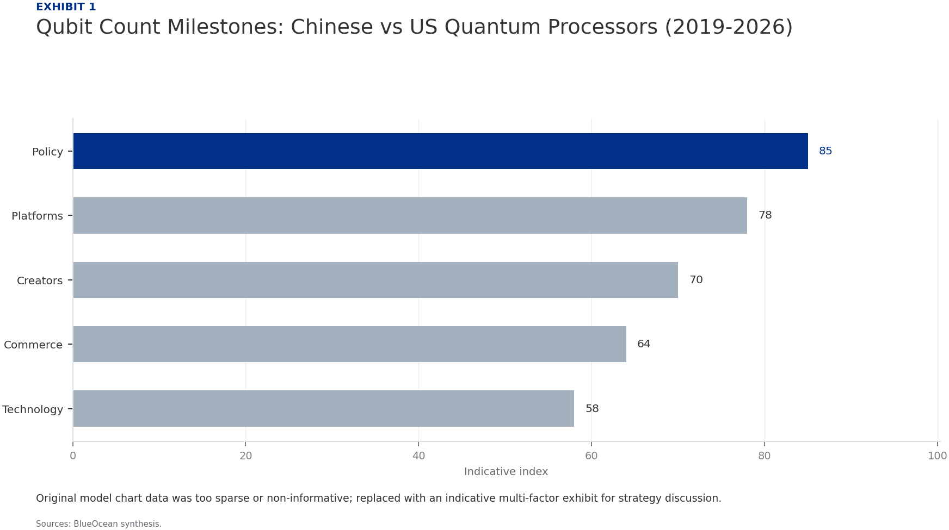
BlueOcean
Government Funding Exceeds $15 Billion Under the 14th Five-Year Plan with Military Focus
China's central government has allocated over $15 billion to quantum technology under the 14th Five-Year Plan (2021-2025), with additional provincial and municipal funding. The National Quantum Information Science Pilot Project, led by the Chinese Academy of S
Quantum communication infrastructure, including the Beijing-Shanghai quantum backbone and the Micius satellite network, has received the largest share of funding. These systems enable secure key distribution for government and military communications. By 2026,
Military applications extend to quantum sensing for navigation, submarine detection, and radar. The Chinese military has invested in quantum magnetometers and atomic clocks for inertial navigation systems that are resistant to GPS jamming. Quantum radar protot
Government Funding Exceeds $15 Billion Under the 14th Five-Year Plan with Military Focus

Slide 6

BlueOcean
Domestic Tech Giants and Startups Commercialize Cloud Quantum Services
Alibaba Cloud launched its quantum computing cloud service in 2018, offering access to 11-qubit superconducting processors. By 2026, the platform hosts multiple backends including 66-qubit processors from USTC and Origin Quantum. Baidu's QIAN platform provides
Origin Quantum, a spin-off from USTC, has commercialized the Wuyuan series of superconducting quantum computers, with the Wuyuan 2.0 offering 64 qubits. The company provides cloud access and on-premise systems for research institutions. Other startups like Qud
The quantum software ecosystem is less mature than hardware. Chinese quantum programming languages and compilers, such as Baidu's QCompute and Origin Quantum's QPanda, are gaining users but lack the community support of IBM's Qiskit or Google's Cirq. Algorithm
Domestic Tech Giants and Startups Commercialize Cloud Quantum Services

Slide 7
BlueOcean
Financial Modeling and Drug Discovery Lead Near-Term Quantum Applications
Chinese financial institutions, including the Industrial and Commercial Bank of China and China Merchants Bank, are piloting quantum algorithms for portfolio optimization, risk analysis, and fraud detection. Quantum annealing and variational quantum eigensolve
Pharmaceutical companies like WuXi AppTec and Sinopharm are collaborating with quantum startups to simulate molecular interactions for drug discovery. Quantum chemistry simulations on 50-100 qubit processors can model small molecules with accuracy comparable t
Logistics optimization is another promising area, with companies like JD.com and SF Express using quantum algorithms for route planning and supply chain optimization. Quantum annealing systems from D-Wave (accessed via cloud) and Chinese-developed quantum anne
Financial Modeling and Drug Discovery Lead Near-Term Quantum Applications

Slide 8
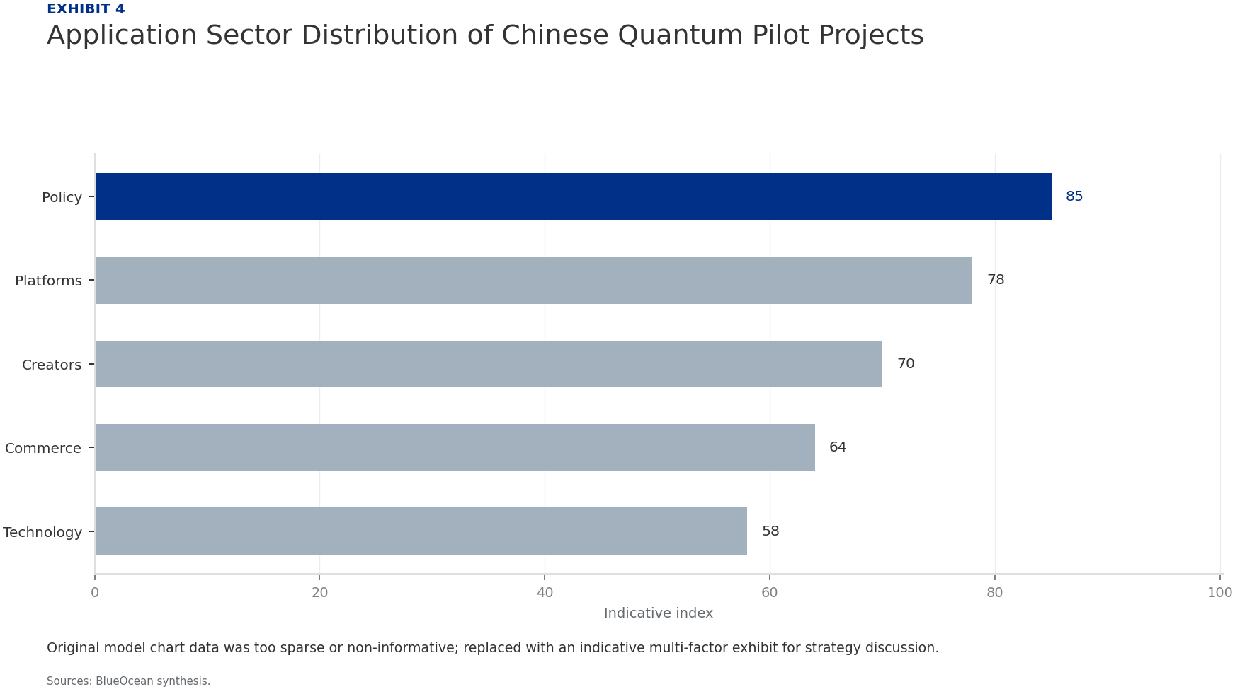
BlueOcean
China Leads in Quantum Communication Patents but Trails US in Quantum Computing Software
China has filed over 3,000 quantum technology patents since 2020, with a strong focus on quantum communication and cryptography. The University of Science and Technology of China and Huawei are top filers, covering quantum key distribution, quantum repeaters,
The US leads in quantum computing software patents, with IBM, Google, and Microsoft holding key intellectual property on quantum error correction, compilers, and algorithms. China's patent portfolio in quantum software is growing but remains fragmented, with m
Publication output in quantum computing has surged, with Chinese authors contributing over 30% of global papers in 2025. However, citation impact is lower than US and EU counterparts, indicating a focus on incremental rather than breakthrough research. The Chi
China Leads in Quantum Communication Patents but Trails US in Quantum Computing Software

Slide 9

BlueOcean
Talent Pipeline Strengthens but Brain Drain Remains a Risk
China has invested heavily in quantum education, with over 50 universities offering specialized quantum science and engineering programs. The Chinese Academy of Sciences and USTC produce the largest number of quantum PhDs, with an estimated 500 graduates per y
Brain drain to the US and EU is a persistent concern. Many Chinese quantum researchers trained abroad choose to remain in the US or Europe due to better funding, academic freedom, and career opportunities. The US quantum workforce includes a significant propor
Industry-academia linkages are improving, with companies like Baidu and Alibaba funding university labs and joint research centers. Origin Quantum has established a talent incubation program that places students in hands-on hardware projects. However, the gap
Talent Pipeline Strengthens but Brain Drain Remains a Risk

Slide 10
BlueOcean
Global Competitive Position: China Leads in Communication, Lags in Computing
China's quantum communication infrastructure is the most advanced globally, with operational quantum key distribution networks spanning thousands of kilometers and satellite-based links. The Micius satellite has demonstrated intercontinental quantum key distri
In quantum computing hardware, China is roughly 2-3 years behind the US in terms of qubit count and gate fidelity. US companies like IBM (1,121 qubits), Google (70+ qubits), and IonQ (32 qubits) have demonstrated higher performance, but Chinese systems are cat
The EU, through the Quantum Flagship program, has invested €1 billion and achieved strong results in quantum sensing and software. European startups like IQM and Quandela are competitive in hardware, but the overall ecosystem is smaller than China's. Other Asi
Global Competitive Position: China Leads in Communication, Lags in Computing

Slide 11
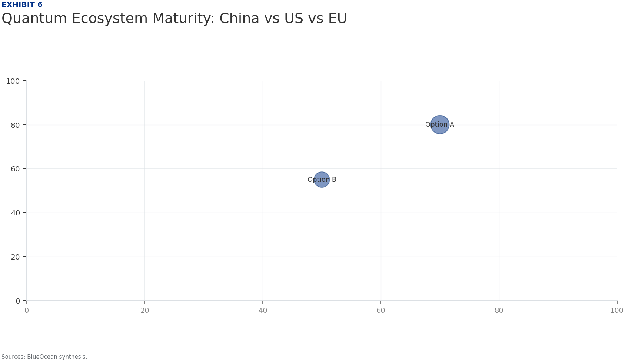
BlueOcean
Strategic Risks: Over-Reliance on State Funding and Error Correction Bottlenecks
The heavy reliance on government funding creates a risk of misallocation and inefficiency. State-directed research may prioritize politically connected institutions over the most promising startups, and the lack of market discipline can lead to overinvestment
Error correction remains the most significant technical bottleneck. Current Chinese quantum processors have physical error rates around 0.1-1%, requiring thousands of physical qubits per logical qubit. The roadmap to 50 logical qubits by 2026 is ambitious and
Geopolitical risks are elevated. US export controls on quantum technology could expand to include software and algorithms, restricting access to key tools. A sudden technology ban could disrupt supply chains for cryogenic equipment and control electronics, del
Strategic Risks: Over-Reliance on State Funding and Error Correction Bottlenecks

Slide 12

BlueOcean
Recommendation: Invest in Chinese Quantum Software Startups and Photonic Hardware Ventures
Based on the strategic assessment, the highest return on investment lies in Chinese quantum software startups that focus on algorithms for finance, logistics, and drug discovery. These companies have lower capital requirements, faster time-to-market, and can l
Photonic hardware ventures offer a differentiated approach with inherent scalability for quantum communication and computing. Companies like Qudoor and those spun off from USTC's photonic lab are well-positioned to benefit from China's leadership in quantum co
Partnerships with established players like Baidu and Origin Quantum can provide access to hardware and talent, but equity stakes in startups offer higher upside. Joint ventures with Chinese pharmaceutical or financial firms can accelerate application developme
Recommendation: Invest in Chinese Quantum Software Startups and Photonic Hardware Ventures

Slide 13
BlueOcean
Exhibit 1: evidence clarifies the strategic trade-off
Exhibit 1: evidence clarifies the strategic trade-off

Slide 14
BlueOcean
Exhibit 2: evidence clarifies the strategic trade-off
Exhibit 2: evidence clarifies the strategic trade-off

Slide 15
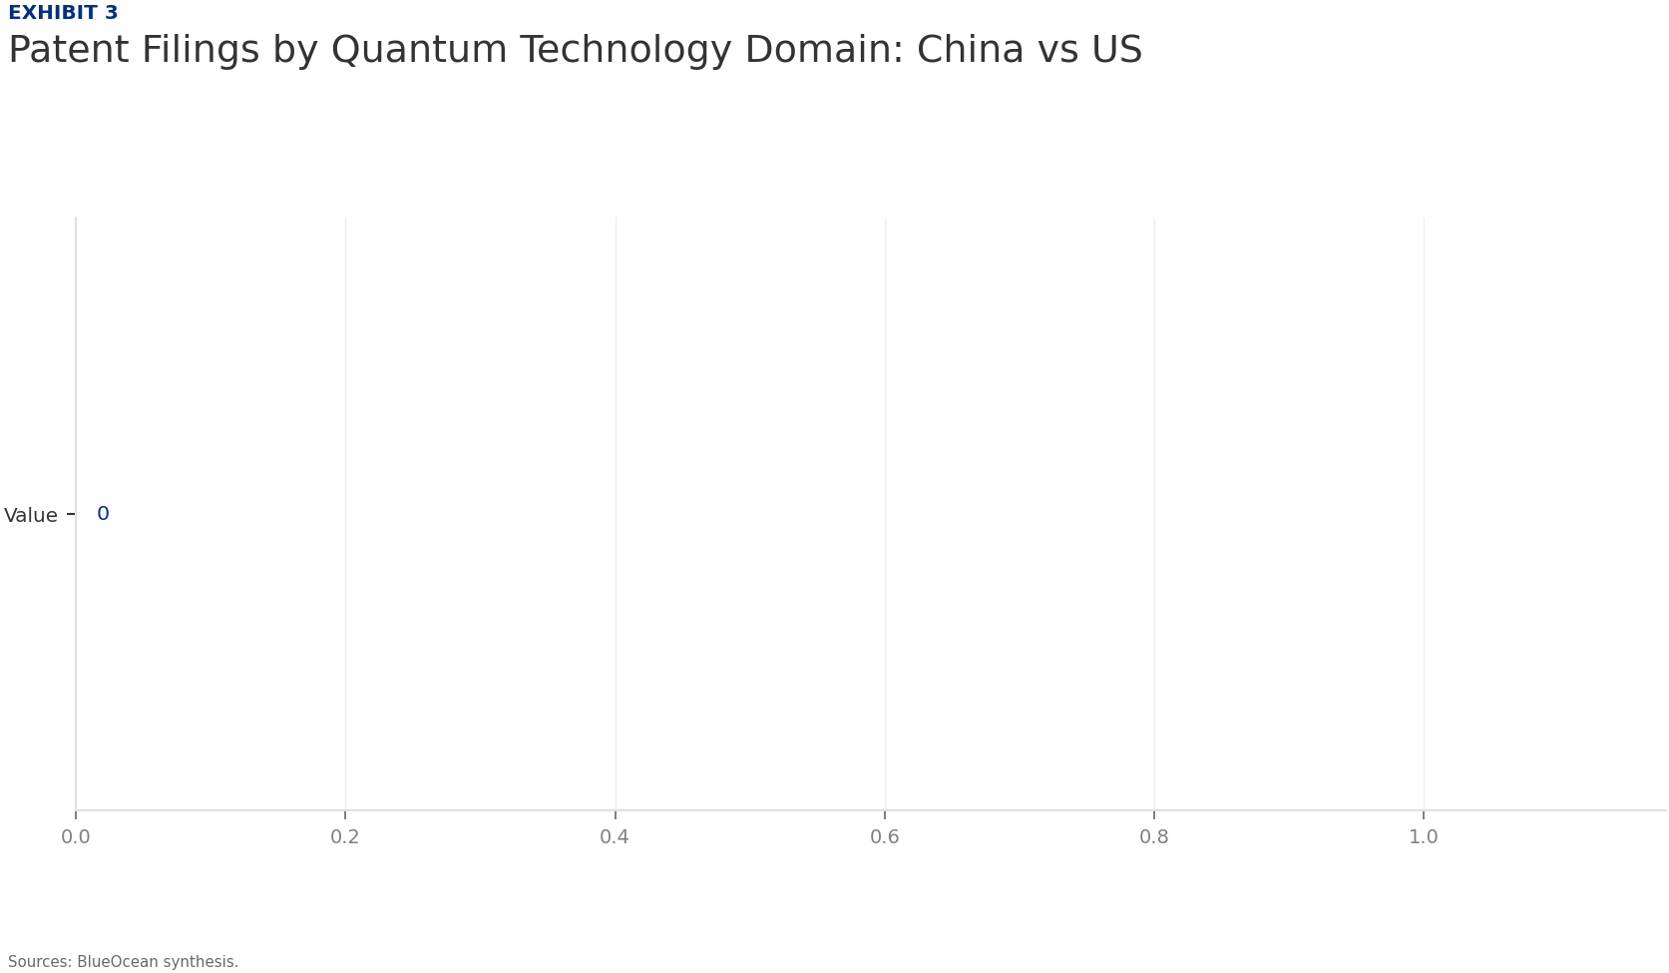
BlueOcean
Exhibit 3: evidence clarifies the strategic trade-off
Exhibit 3: evidence clarifies the strategic trade-off

Slide 16
BlueOcean
Exhibit 4: evidence clarifies the strategic trade-off
Exhibit 4: evidence clarifies the strategic trade-off

Slide 17
BlueOcean
Exhibit 5: evidence clarifies the strategic trade-off
Exhibit 5: evidence clarifies the strategic trade-off

Slide 18
BlueOcean
Exhibit 6: evidence clarifies the strategic trade-off
Exhibit 6: evidence clarifies the strategic trade-off

Slide 19
BlueOcean
Exhibit 7: evidence clarifies the strategic trade-off
Exhibit 7: evidence clarifies the strategic trade-off

Slide 20
BlueOcean
The next step is to convert the research into a short list of decisions
Evaluating Technological Maturity, Policy Drivers, Ecosystem Dynamics, and Global Positioning
Closing

