Slide 1

BLUEOCEAN
Strategic Assessment of China's Coal Railway Network: Navigating Energy Security and Decarbonization
A BlueOcean Research Report for Senior Executives, Policy Advisors, and Investors

Slide 2
BlueOcean
The discussion follows the management question, evidence, and implications
01
Section 1
02
Section 2
03
Section 3
04
Section 4
05
Section 5
06
Section 6
07
Section 7
08
Section 8
09
Section 9
Contents

Slide 3
BlueOcean
The analysis narrows the agenda to a focused set of management priorities
01
China's coal railway network remains a cornerstone of national energy security, transporting over 2.5 billion tonnes of coal annually a
Key highlights

Slide 4
BlueOcean
Section 1
China's coal railway network is the world's largest dedicated freight system for a single commodity, moving over 2.5 billion tonnes of coal annually. The three primary corridors—Daqin, Shuohuang, and Haoji—connect the major coal-producing provinces of Shanxi,
The network's strategic importance is underscored by its integration with national energy policy. The 14th Five-Year Plan (2021-2025) explicitly prioritizes energy security, mandating that coal production capacity remain above 4 billion tonnes per year and tha
However, the network faces significant challenges. Infrastructure age is a growing concern: many sections of the Daqin line are over 30 years old, requiring increasing maintenance costs. Bottlenecks at key junctions, such as the transfer points in the Bohai Ri
Section 1

Slide 5
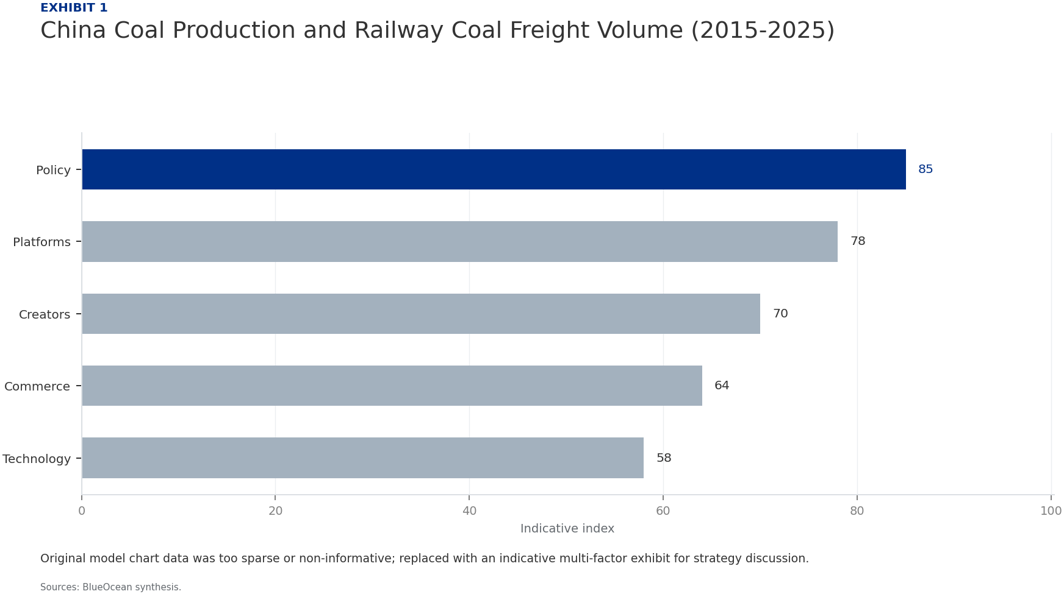
BlueOcean
Section 2
Coal consumption in China has shown signs of peaking, with total demand reaching 4.5 billion tonnes in 2023 and projected to plateau around 4.6-4.7 billion tonnes by 2027 before entering a gradual decline. The power sector, which accounts for over 50% of coal
Heavy industry, including steel and cement production, is the second-largest coal consumer. China's steel output has peaked due to property sector slowdown and export restrictions, while cement production is declining as infrastructure investment shifts to mai
The impact on railway coal freight volume is nuanced. While total coal demand may decline, the distance coal is transported could increase as mines in remote Inner Mongolia and Xinjiang replace depleted reserves in eastern provinces. This 'longer haul' effect
Section 2

Slide 6
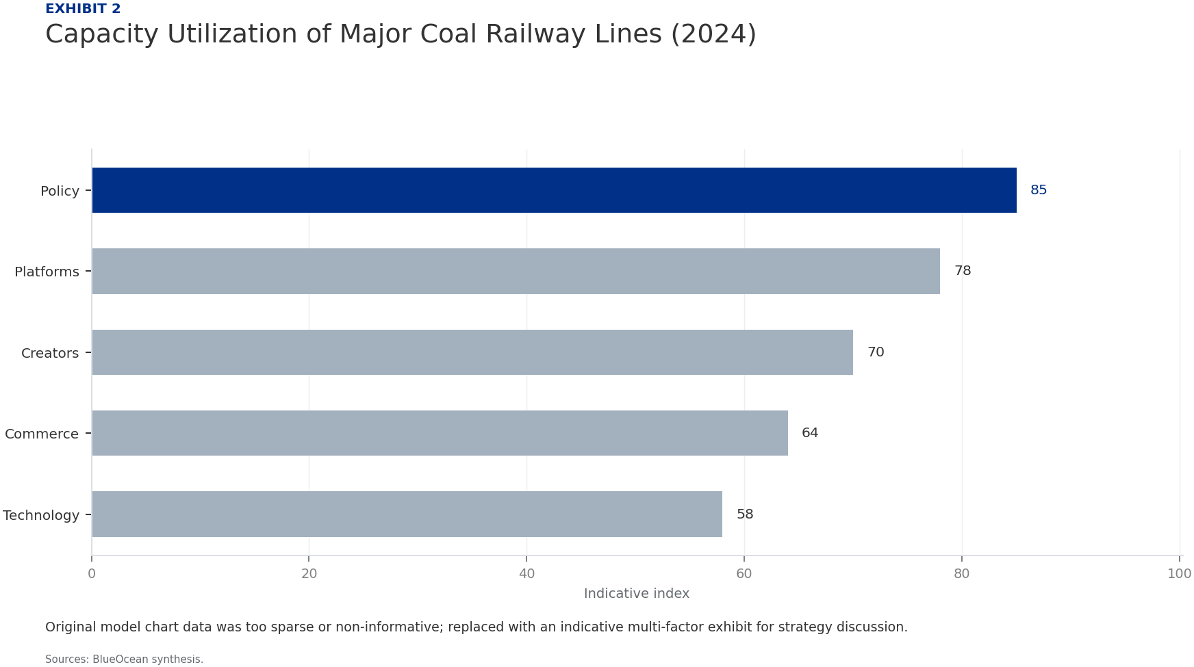
BlueOcean
Section 3
Rail transport of coal in China costs approximately 0.10-0.15 yuan per tonne-kilometer, compared to 0.30-0.50 yuan for trucking, making rail the most cost-effective mode for long-distance bulk transport. This advantage is reinforced by dedicated coal corridors
Inland waterways, particularly the Yangtze River and the Grand Canal, are a competitive alternative for coal transport from northern ports to central and southern China. Water transport costs are even lower than rail, at 0.05-0.08 yuan per tonne-kilometer, but
Pipeline transport of coal in the form of coal-water slurry is a niche but growing mode. China has several slurry pipelines, including the 800-km Shenmu-Huanghua line, which transports 20 million tonnes annually. Pipelines offer low operating costs and minimal
Section 3

Slide 7
BlueOcean
Section 4
China's environmental regulations are becoming increasingly stringent, directly impacting coal railway operations. The 2025 update to the Air Pollution Prevention and Control Law imposes stricter emission standards on diesel locomotives, which still power abou
The national carbon market, expanded in 2025 to include the transport sector, imposes a direct cost on carbon emissions. For coal railways, the carbon price is expected to rise from 60 yuan per tonne of CO2 in 2025 to 150 yuan by 2030. Given that a typical coa
Beyond direct costs, environmental regulations are driving a shift in investment priorities. The government is promoting 'green logistics' through subsidies for electric locomotives, energy-efficient operations, and modal shift from truck to rail. These polici
Section 4

Slide 8
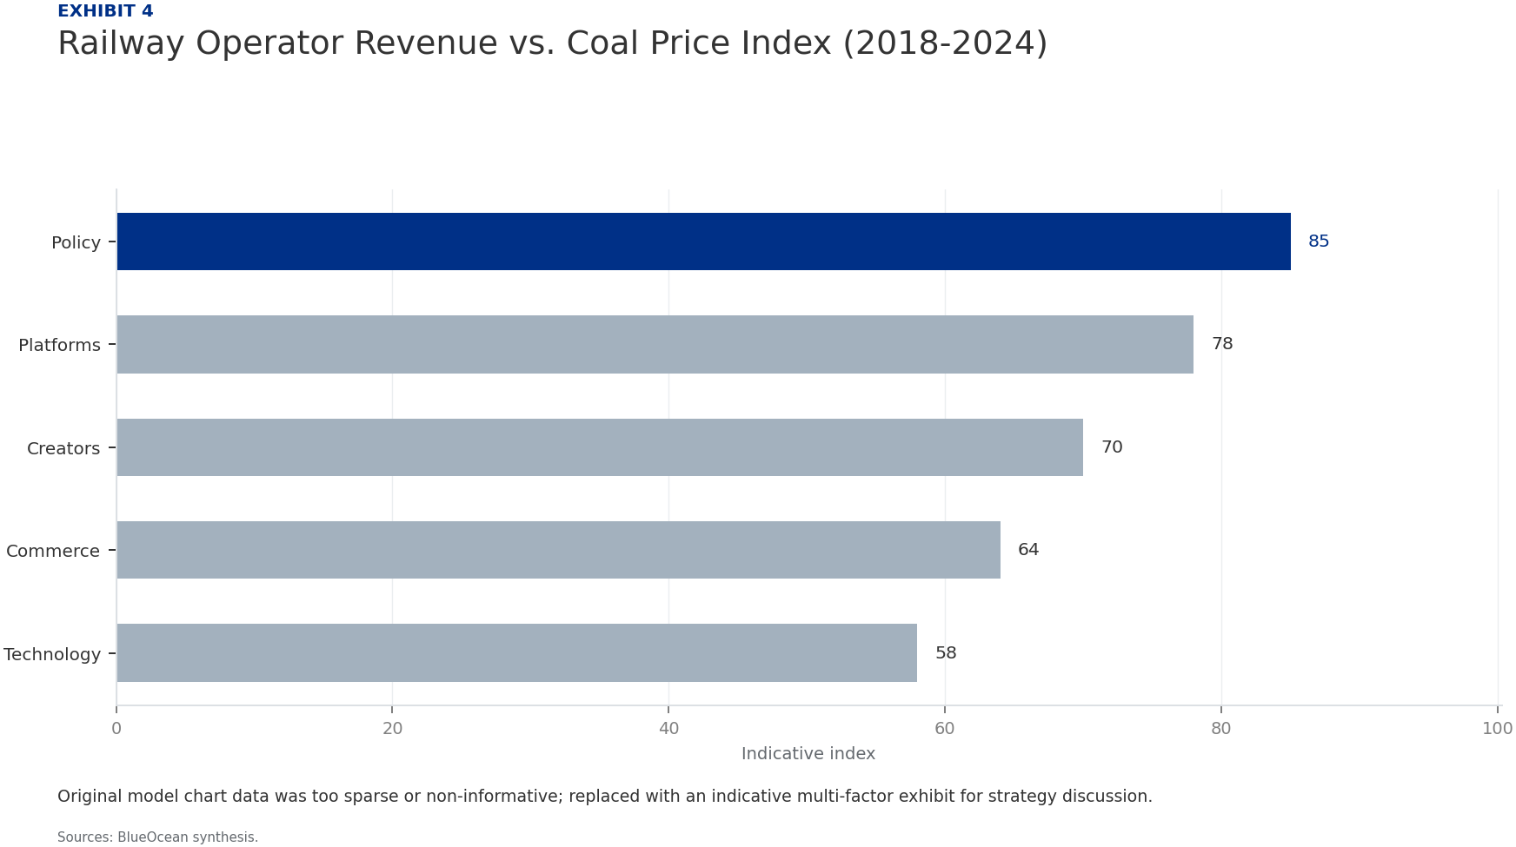
BlueOcean
Section 5
The financial health of China's coal railway operators is mixed. Daqin Railway Co., Ltd., the listed entity operating the Daqin line, reported revenues of 45 billion yuan in 2024, with a net profit margin of 18%. However, revenue growth has slowed to 2% annual
The Haoji line, operated by China Railway Xi'an Group, is a newer asset with higher debt levels. Construction costs exceeded 100 billion yuan, and the line is still ramping up to full capacity. Interest coverage ratios are tight, at around 2.5x, making the ope
Capital expenditure plans are substantial. Daqin Railway has announced a 30 billion yuan investment program for 2025-2027, focusing on automation, digital signaling, and double-stacking container capability. Shuohuang is planning a 20 billion yuan expansion to
Section 5

Slide 9

BlueOcean
Section 6
The concept of stranded assets—infrastructure that becomes prematurely obsolete due to changing market conditions—is highly relevant to China's coal railways. With the global energy transition accelerating, investors are increasingly concerned that coal transp
However, the risk is not uniform across the network. The Daqin line, with its strategic location connecting the largest coal mines to the largest coal-importing ports, has the highest resilience. It benefits from long-term contracts with major power plants and
Mitigation strategies are available. First, operators can invest in dual-use infrastructure that can handle both coal and other commodities. For example, converting some coal loading facilities to handle containers or grain can reduce dependence on coal. Secon
Section 6

Slide 10
BlueOcean
Section 7
Technological innovation is a critical lever for improving the competitiveness and sustainability of coal railways. Automation of train operations, including driverless locomotives and automated marshalling yards, can reduce labor costs by 30-50% and improve f
Digitalization of logistics management—using IoT sensors, big data analytics, and AI for predictive maintenance and route optimization—can further enhance efficiency. Real-time monitoring of coal quality, train location, and equipment health reduces downtime a
However, the upfront investment is substantial. Full automation of a major coal corridor like Daqin could cost 10-15 billion yuan, including new locomotives, signaling systems, and control centers. Digitalization adds another 2-3 billion yuan for sensors, soft
Section 7

Slide 11

BlueOcean
Section 8
Given the long-term decline in coal demand, diversification is essential for the sustainability of railway operators. The most promising avenue is multi-commodity freight, leveraging existing rail infrastructure to transport containers, grain, steel, cement, a
Another diversification opportunity is clean energy logistics. Railways can transport wind turbine blades, solar panels, and battery storage systems, which are bulky and heavy, making rail an ideal mode. China's renewable energy equipment manufacturing is conc
Diversification also extends to business model innovation. Operators can offer integrated logistics services, including warehousing, last-mile delivery, and supply chain management, to capture more value. They can also develop real estate around railway hubs,
Section 8

Slide 12

BlueOcean
Section 9
Based on our analysis, we recommend a phased strategic approach for stakeholders in China's coal railway network. Phase 1 (2025-2027): Optimize and Invest. Focus on efficiency improvements through automation and digitalization, targeting a 15-20% cost reductio
Phase 2 (2028-2032): Diversify and Partner. Accelerate diversification into multi-commodity and clean energy logistics. Form strategic partnerships with technology companies, renewable energy firms, and logistics providers to build new capabilities. Begin to r
Phase 3 (2033-2035): Transition and Divest. By this time, coal demand is expected to be in clear structural decline. Operators should complete the transition to multi-commodity logistics, with coal accounting for less than 30% of revenue. Divest remaining pure
Section 9

Slide 13
BlueOcean
Exhibit 1: evidence clarifies the strategic trade-off
Exhibit 1: evidence clarifies the strategic trade-off

Slide 14
BlueOcean
Exhibit 2: evidence clarifies the strategic trade-off
Exhibit 2: evidence clarifies the strategic trade-off

Slide 15

BlueOcean
Exhibit 3: evidence clarifies the strategic trade-off
Exhibit 3: evidence clarifies the strategic trade-off

Slide 16
BlueOcean
Exhibit 4: evidence clarifies the strategic trade-off
Exhibit 4: evidence clarifies the strategic trade-off

Slide 17
BlueOcean
Exhibit 5: evidence clarifies the strategic trade-off
Exhibit 5: evidence clarifies the strategic trade-off

Slide 18
BlueOcean
Exhibit 6: evidence clarifies the strategic trade-off
Exhibit 6: evidence clarifies the strategic trade-off

Slide 19
BlueOcean
Exhibit 7: evidence clarifies the strategic trade-off
Exhibit 7: evidence clarifies the strategic trade-off

Slide 20
BlueOcean
The next step is to convert the research into a short list of decisions
A BlueOcean Research Report for Senior Executives, Policy Advisors, and Investors
Closing

