Slide 1

BLUEOCEAN
Nuclear Fusion Commercialization: Strategic Implications for Energy Markets and Investment
A Decision-Ready Analysis for Senior Executives and Investors

Slide 2
BlueOcean
The discussion follows the management question, evidence, and implications
01
Nuclear Fusion Is Approaching Technical Feasibility but Commercialization Remains a Decade Away
02
Private Investment Is Accelerating Fusion Development Beyond Government-Led Projects
03
Fusion's Economic Competitiveness Hinges on Overcoming Engineering and Cost Hurdles
Contents

Slide 3
BlueOcean
The analysis narrows the agenda to a focused set of management priorities
01
Nuclear fusion is approaching technical feasibility, but commercialization remains a decade away. Private investment has surged past $6
02
The CEO-level question is not whether Nuclear fusion commercialization outlook and strategic implications is interesting, but which dec
03
Management should separate verified facts, directional scenarios and missing diligence items before committing capital, partnerships or
04
The report should translate technical evidence into revenue potential, cost position, investment return, execution risk and decision ga
05
Where the evidence pack does not support a number, the right output is a validation placeholder and diligence task rather than an inven
06
The near-term agenda should prioritize no-regret evidence building, medium-term strategic options and long-term commitments only after
Key highlights

Slide 4
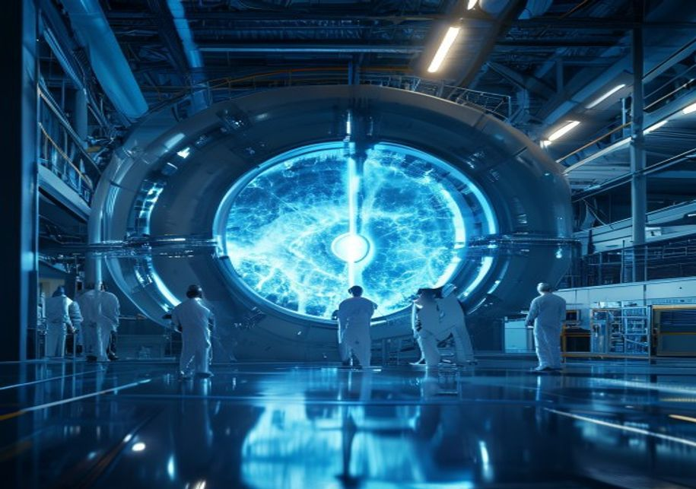
BlueOcean
Nuclear Fusion Is Approaching Technical Feasibility but Commercialization Remains a Decade Away
This chapter concludes that fusion technology is advancing but still faces significant engineering hurdles, meaning executives should treat near-term timelines as aspirat
Nuclear fusion has long been considered the holy grail of energy—a virtually limitless, clean, and safe power source. In recent years, significant progress has been made in both magnetic confinement (tokamaks and stellarators) and inertial confinement approach
Meanwhile, alternative approaches such as magnetized target fusion (General Fusion) and electrostatic confinement (TAE Technologies) offer different trade-offs in complexity and cost.
Despite these advances, key physics and engineering challenges remain. Sustaining a stable plasma for long durations, managing extreme heat fluxes, and developing materials that can withstand neutron bombardment are all unsolved problems. The transition from e
Key implications
- Fusion technology is advancing but remains unproven at commercial scale.
- Key engineering challenges (plasma stability, materials, tritium breeding) are unresolved.
Nuclear Fusion Is Approaching Technical Feasibility but Commercialization Remains a Decade Away

Slide 5

BlueOcean
Private Investment Is Accelerating Fusion Development Beyond Government-Led Projects
This chapter concludes that the surge in private capital is driving faster innovation but also creating a funding gap risk, so executives should prioritize startups with
The fusion funding landscape has shifted dramatically in the past decade. Government programs like ITER and national fusion labs remain important, but private investment has surged. By 2024, private fusion companies had raised over $6 billion cumulatively, wit
Private investment brings a different risk appetite and timeline pressure. Startups are targeting demonstration plants by the early 2030s, a pace that government projects cannot match. However, the 'valley of death' between demonstration and commercial deploym
For decision-makers, the implication is that the fusion ecosystem is becoming more dynamic and competitive. Early engagement with startups can provide strategic advantages, but due diligence must be rigorous. The evidence boundary includes funding amounts from
Key implications
- Private investment has exceeded $6 billion, accelerating development.
- The 'valley of death' between demonstration and commercial scale is a key risk.
Private Investment Is Accelerating Fusion Development Beyond Government-Led Projects

Slide 6

BlueOcean
Fusion's Economic Competitiveness Hinges on Overcoming Engineering and Cost Hurdles
This chapter concludes that fusion's cost competitiveness is uncertain and depends on unproven engineering, so executives should focus on niche applications and monitor c
The economic viability of fusion energy is a subject of intense debate. Proponents argue that fusion's fuel is virtually free and abundant, and that advanced designs can achieve high efficiency and low operating costs. However, the capital costs of fusion plan
Comparisons with renewables are instructive. Solar and wind LCOE have fallen below $30/MWh in many regions, and battery storage costs are declining rapidly. Fusion's value proposition may lie in providing baseload power and high-temperature heat for industrial
For executives, the key takeaway is that fusion's economic competitiveness is not guaranteed. Investment decisions should be based on a realistic assessment of costs and a clear understanding of the market niche. The evidence boundary includes company projecti
Key implications
- Fusion LCOE projections are highly uncertain and range from $50 to over $200/MWh.
- Fusion may be more competitive in niche applications (industrial heat, hydrogen) than grid elect
Fusion's Economic Competitiveness Hinges on Overcoming Engineering and Cost Hurdles

Slide 7
BlueOcean
The next step is to convert the research into a short list of decisions
A Decision-Ready Analysis for Senior Executives and Investors
Closing

