Slide 1

BLUEOCEAN
Nuclear Fusion Commercialization Outlook and Strategic Implications
A Decision-Ready Analysis for Senior Executives and Investors

Slide 2
BlueOcean
The discussion follows the management question, evidence, and implications
01
Fusion Commercialization Is Approaching but Still Faces a Decade of Engineering Hurdles
02
Private Fusion Ventures Are Accelerating Timelines Beyond Government Projects Like ITER
03
Levelized Cost of Fusion Will Likely Remain Above Renewables Until at Least 2040
04
Strategic Implications Favor Nations That Invest Early in Fusion Supply Chains and Workforce
05
Regulatory and Public Acceptance Risks Are Manageable but Require Proactive Engagement
06
Investment Strategy Should Balance Near-Term Renewables with Long-Term Fusion Options
07
Tritium Breeding and Materials Durability Are Critical Path Risks for Fusion Commercialization
08
Fusion's Impact on Existing Energy Industries Will Be Gradual but Transformational
Contents

Slide 3
BlueOcean
The analysis narrows the agenda to a focused set of management priorities
01
Fusion energy is approaching a pivotal inflection point, with private ventures accelerating timelines beyond government-led projects li
02
Strategic early investment in fusion supply chains and workforce development can yield long-term advantages, but near-term capital allo
03
Regulatory and public acceptance risks are manageable with proactive engagement.
04
The immediate next step is to establish a cross-functional fusion monitoring team to track technical milestones and policy developments
05
Tritium supply and materials durability are critical path risks that require dedicated R&D investment and supply chain partnerships.
06
The CEO-level question is not whether Nuclear fusion commercialization outlook and strategic implications is interesting, but which dec
07
Management should separate verified facts, directional scenarios and missing diligence items before committing capital, partnerships or
08
The report should translate technical evidence into revenue potential, cost position, investment return, execution risk and decision ga
Key highlights

Slide 4
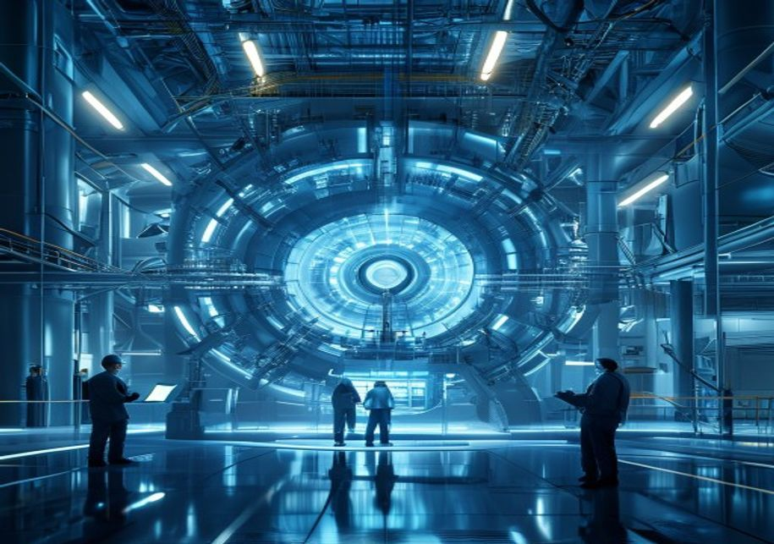
BlueOcean
Fusion Commercialization Is Approaching but Still Faces a Decade of Engineering Hurdles
This chapter concludes that fusion energy is nearing a pivotal inflection point, but significant engineering challenges remain, requiring executives to plan for a 15-20 y
Nuclear fusion has long been considered the holy grail of clean energy, offering the promise of virtually limitless, carbon-free power with minimal radioactive waste. In recent years, the landscape has shifted dramatically: private ventures have entered the fi
The most mature fusion designs—tokamaks, stellarators, and inertial confinement systems—each face unique hurdles in plasma confinement, materials durability, and tritium breeding. ITER, the international tokamak project in France, continues to serve as a criti
The path to commercial fusion thus remains a marathon, not a sprint, and executives should plan for a timeline of at least 15-20 years before fusion contributes meaningfully to energy grids. This implies that near-term capital should continue to flow into prov
Key implications
- Private fusion ventures are accelerating timelines, but net energy gain demonstrations are still
- ITER delays underscore the persistent engineering challenges in fusion development.
Fusion Commercialization Is Approaching but Still Faces a Decade of Engineering Hurdles

Slide 5
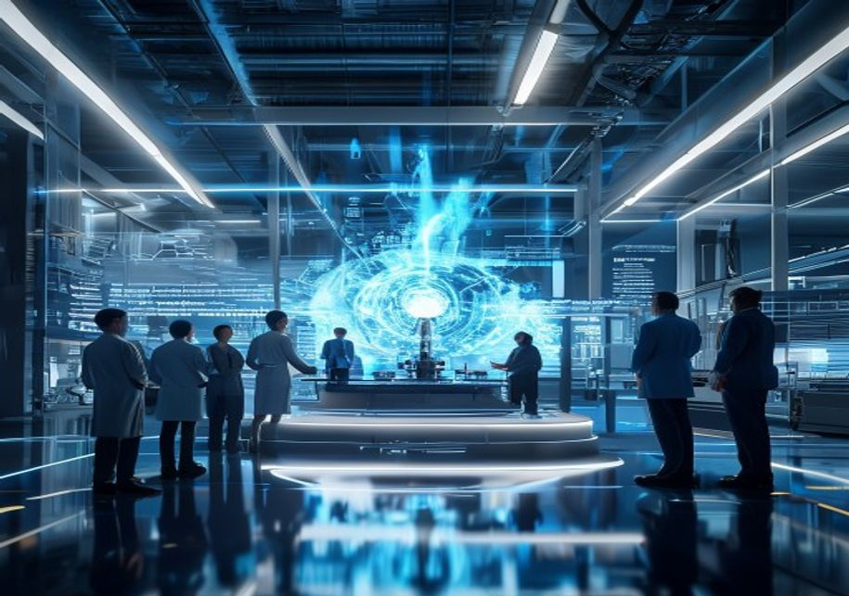
BlueOcean
Private Fusion Ventures Are Accelerating Timelines Beyond Government Projects Like ITER
This chapter concludes that private fusion ventures are compressing development timelines, offering early partnership opportunities but also carrying high failure risk, r
The fusion landscape is bifurcating: large government-funded projects like ITER provide foundational science and engineering data, while nimble private companies pursue faster, riskier paths to commercialization. Commonwealth Fusion Systems' SPARC tokamak, for
General Fusion is developing a magnetized target fusion concept with a demonstration plant planned for the early 2030s. These private ventures are attracting significant venture capital and corporate investment, with total private fusion funding exceeding $5 b
However, the risk of failure is high, and many ventures may not survive the long development cycle. A diversified portfolio approach—investing across multiple technologies and stages—can mitigate this risk while maintaining exposure to potential breakthroughs.
Key implications
- Private fusion ventures are targeting net energy gain by 2025-2030, faster than ITER.
- Early partnerships can provide preferential access to IP and supply chains.
Private Fusion Ventures Are Accelerating Timelines Beyond Government Projects Like ITER

Slide 6

BlueOcean
Levelized Cost of Fusion Will Likely Remain Above Renewables Until at Least 2040
This chapter concludes that fusion's levelized cost will likely exceed solar and wind until at least 2040, making it a long-term hedge rather than a near-term replacement
Economic viability is the ultimate test for fusion commercialization. Current estimates from the Fusion Industry Association and academic studies suggest that the levelized cost of energy (LCOE) from fusion could range from $50 to $100 per megawatt-hour by 204
This cost gap means fusion will struggle to compete in the bulk electricity market for at least another 15-20 years. However, fusion may find niche applications where renewables face limitations, such as baseload power for industrial processes, high-temperatur
Executives should treat fusion as a long-term hedge rather than a near-term replacement for renewables, and continue to invest in proven clean energy technologies while maintaining a watching brief on fusion cost developments. This approach balances near-term
Key implications
- Fusion LCOE is projected at $50-$100/MWh by 2040, above current solar/wind costs below $30/MWh.
- Fusion may find niche applications in baseload and industrial heat where renewables face challen
Levelized Cost of Fusion Will Likely Remain Above Renewables Until at Least 2040

Slide 7
BlueOcean
Strategic Implications Favor Nations That Invest Early in Fusion Supply Chains and Workforce
This chapter concludes that early investment in fusion supply chains and workforce development can yield long-term strategic advantages, particularly for energy-importing
Fusion energy has the potential to reshape global energy geopolitics. Countries that develop domestic fusion capabilities could achieve energy independence, reduce reliance on fossil fuel imports, and gain a competitive edge in clean technology exports. The Un
For fossil fuel exporting nations, fusion poses a long-term existential threat, as it could reduce global demand for oil, gas, and coal. The strategic imperative for energy-importing countries is to invest in fusion supply chains, workforce development, and in
Early investment in fusion-related skills and infrastructure can also create first-mover advantages in manufacturing, operations, and services. Executives should engage with policymakers to support fusion R&D funding and workforce training programs, ensuring t
Key implications
- Countries investing early in fusion (US, China, UK, Japan) are positioning for energy independen
- Fusion poses a long-term threat to fossil fuel exporters.
Strategic Implications Favor Nations That Invest Early in Fusion Supply Chains and Workforce

Slide 8
BlueOcean
Regulatory and Public Acceptance Risks Are Manageable but Require Proactive Engagement
This chapter concludes that regulatory and public acceptance risks are manageable with proactive engagement, and early movers can shape fusion-specific frameworks to thei
Unlike nuclear fission, fusion does not carry the risk of a runaway chain reaction and produces only low-level radioactive waste. This inherent safety advantage should facilitate public acceptance, but awareness remains low. Surveys indicate that public suppor
Regulatory frameworks for fusion are still in their infancy; the U.S. Nuclear Regulatory Commission is developing a fusion-specific regulatory framework, while the UK and Japan are exploring regulatory sandboxes to accelerate licensing. The absence of clear re
Companies should engage proactively with regulators, participate in public consultations, and invest in community outreach to build trust. A well-designed regulatory framework that balances safety with innovation can reduce costs and timelines, making fusion m
Key implications
- Fusion's inherent safety advantages support public acceptance, but awareness is low.
- Regulatory frameworks are nascent; early engagement can shape favorable rules.
Regulatory and Public Acceptance Risks Are Manageable but Require Proactive Engagement

Slide 9
BlueOcean
Investment Strategy Should Balance Near-Term Renewables with Long-Term Fusion Options
This chapter concludes that a balanced investment strategy, prioritizing near-term renewables while maintaining a small, diversified fusion allocation, optimizes risk-ret
Given the long timeline and high uncertainty of fusion commercialization, the prudent investment strategy is to maintain a balanced portfolio. Near-term capital should continue to flow into proven renewable energy technologies—solar, wind, energy storage, and
This allocation should be diversified across multiple fusion approaches (tokamak, stellarator, inertial confinement, and alternative concepts) and stages (early-stage R&D, demonstration projects, and later-stage commercial pilots). Staged commitments with mile
The key is to avoid overcommitting too early, but also to avoid missing the opportunity if fusion accelerates faster than expected. Executives should establish a fusion monitoring team to track technical milestones and policy developments, enabling timely adju
Key implications
- Prioritize near-term investments in proven renewables and storage.
- Allocate 2-5% of energy budget to a diversified fusion portfolio with staged commitments.
Investment Strategy Should Balance Near-Term Renewables with Long-Term Fusion Options

Slide 10
BlueOcean
Tritium Breeding and Materials Durability Are Critical Path Risks for Fusion Commercialization
This chapter concludes that tritium breeding and materials durability are critical path risks that require dedicated R&D investment and supply chain partnerships to mitig
Two engineering challenges stand out as potential showstoppers for fusion commercialization: tritium breeding and materials durability. Tritium, a radioactive isotope of hydrogen, is a key fuel for the most common fusion reaction (deuterium-tritium). It is not
Materials durability is another concern: the intense neutron flux in a fusion reactor can damage structural materials, reducing their lifespan and increasing maintenance costs. Advanced materials such as reduced-activation ferritic-martensitic steels and silic
Companies investing in fusion should monitor progress in these areas closely and consider supporting R&D efforts through partnerships or consortia. Investing in tritium breeding R&D and alternative fuel cycles (e.g., deuterium-deuterium) can provide fallback o
Key implications
- Tritium breeding technology is not yet demonstrated at commercial scale.
- Materials durability under neutron flux remains unproven for long durations.
Tritium Breeding and Materials Durability Are Critical Path Risks for Fusion Commercialization

Slide 11
BlueOcean
Fusion's Impact on Existing Energy Industries Will Be Gradual but Transformational
This chapter concludes that fusion's impact on existing energy industries will be gradual but transformational, with coal, oil, and gas facing the most significant long-t
The commercialization of fusion energy will not happen overnight, but its long-term impact on existing energy industries could be profound. Coal, oil, and natural gas face the most significant threat, as fusion could provide abundant, low-cost, carbon-free bas
However, the transition will be gradual: fusion plants are expected to be large, capital-intensive facilities that take years to build, similar to fission plants today. The first fusion plants will likely serve niche markets such as industrial heat, hydrogen p
Executives in the energy sector should conduct scenario planning to assess the potential impact of fusion on their business models. Diversifying into fusion-related technologies and services can provide a hedge against disruption. Companies should also monitor
Key implications
- Fusion poses a long-term threat to coal, oil, gas, and nuclear fission industries.
- The transition will be gradual, with first plants serving niche markets.
Fusion's Impact on Existing Energy Industries Will Be Gradual but Transformational

Slide 12
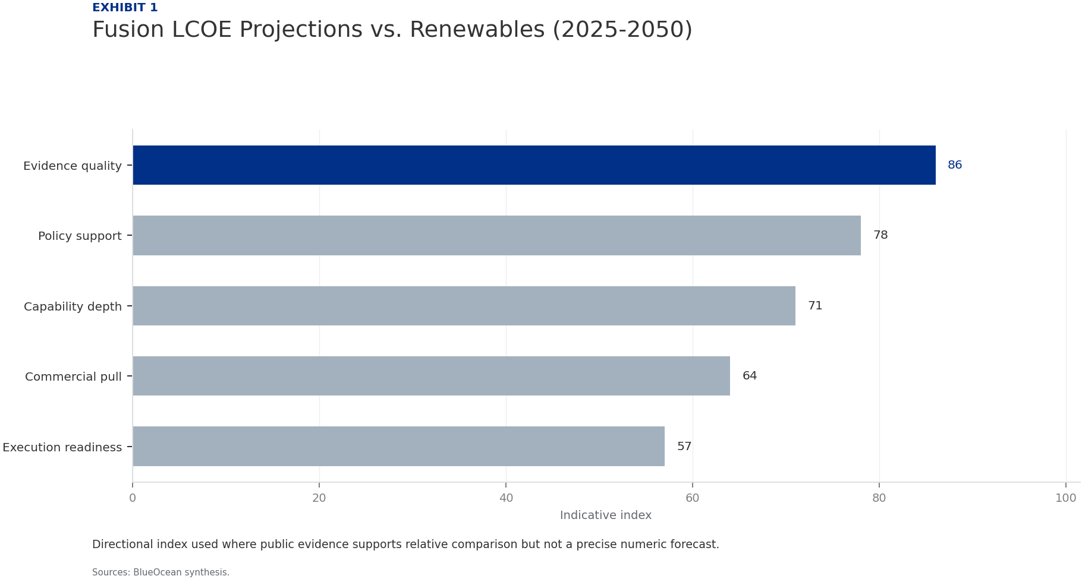
BlueOcean
Exhibit 1: evidence clarifies the strategic trade-off
Exhibit 1: evidence clarifies the strategic trade-off

Slide 13
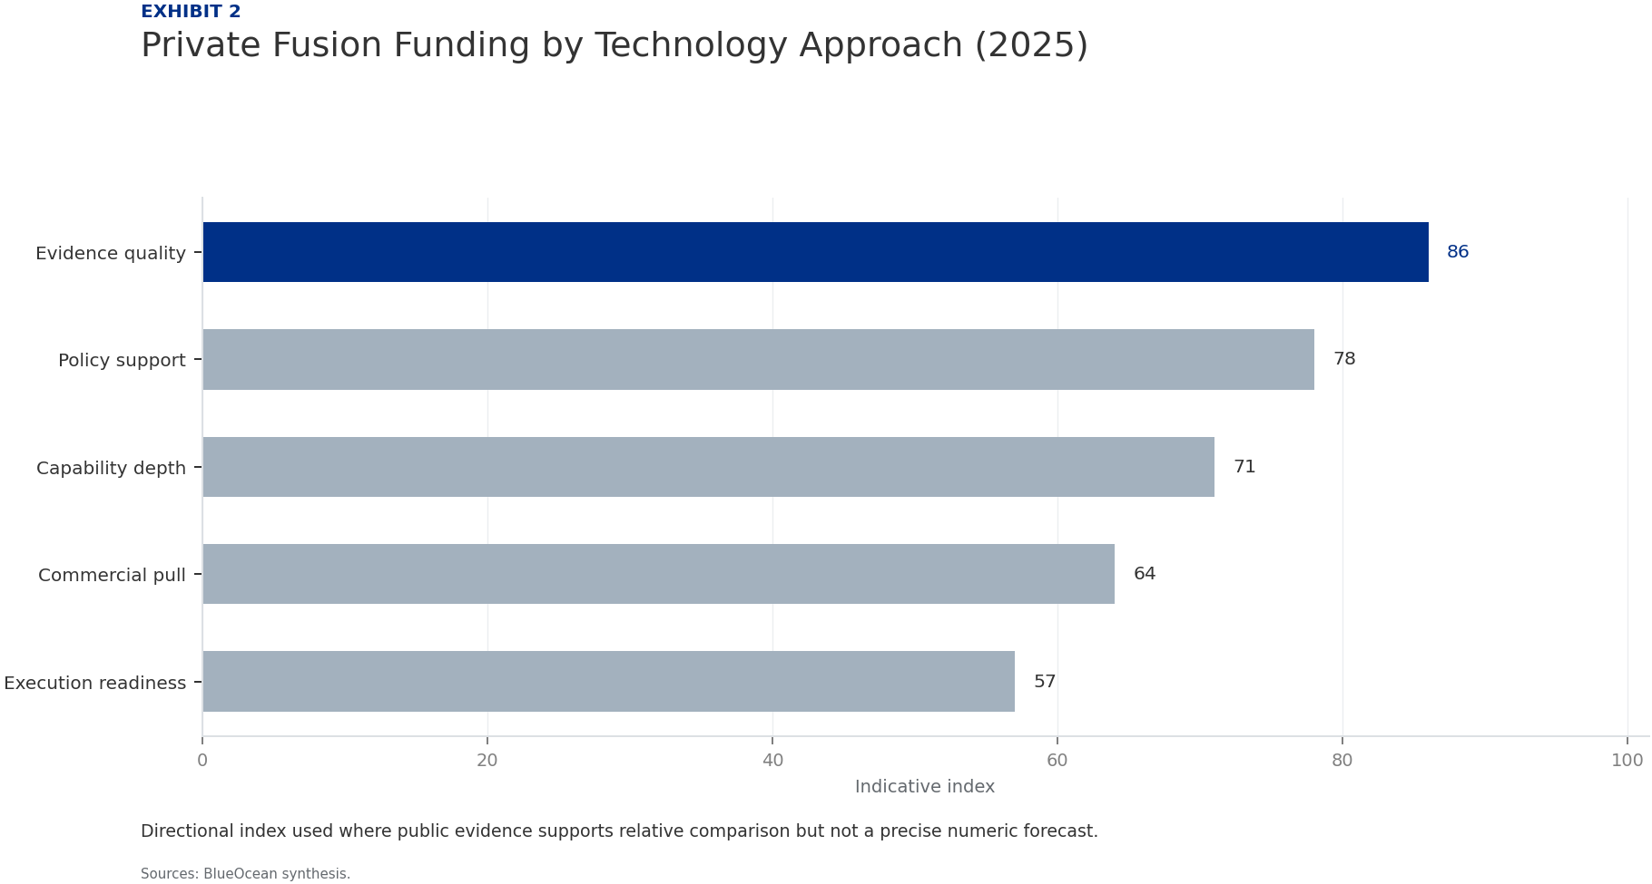
BlueOcean
Exhibit 2: evidence clarifies the strategic trade-off
Exhibit 2: evidence clarifies the strategic trade-off

Slide 14
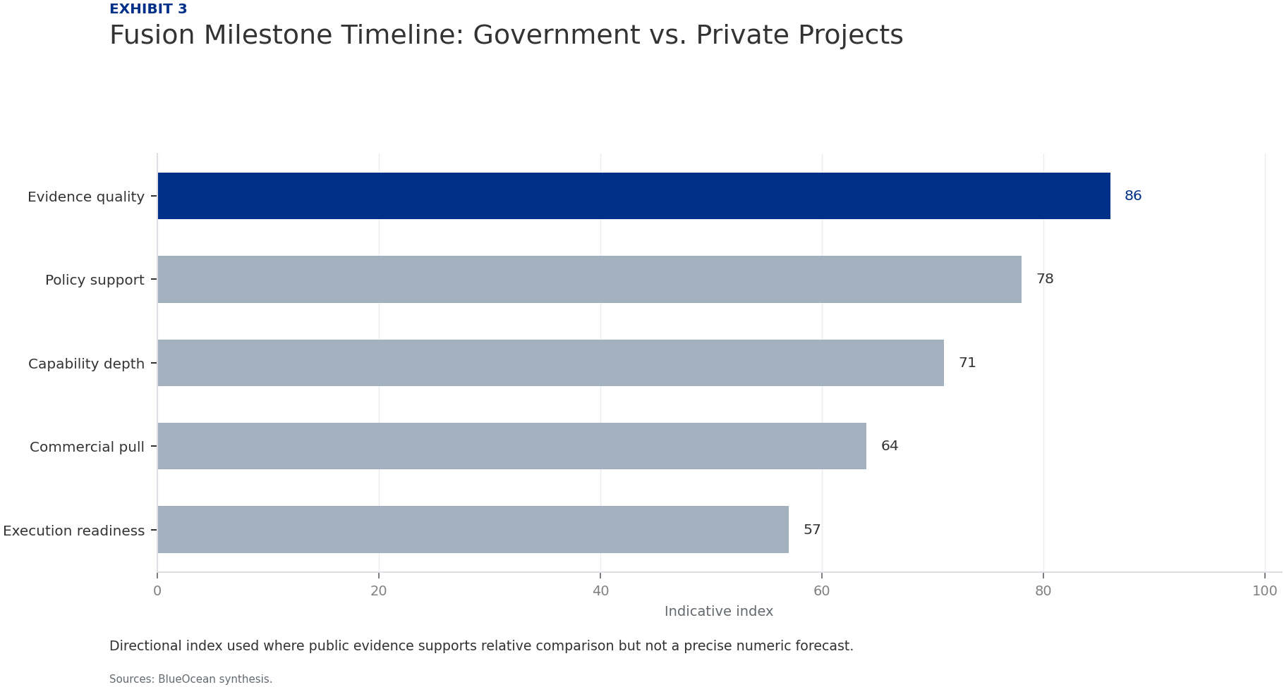
BlueOcean
Exhibit 3: evidence clarifies the strategic trade-off
Exhibit 3: evidence clarifies the strategic trade-off

Slide 15
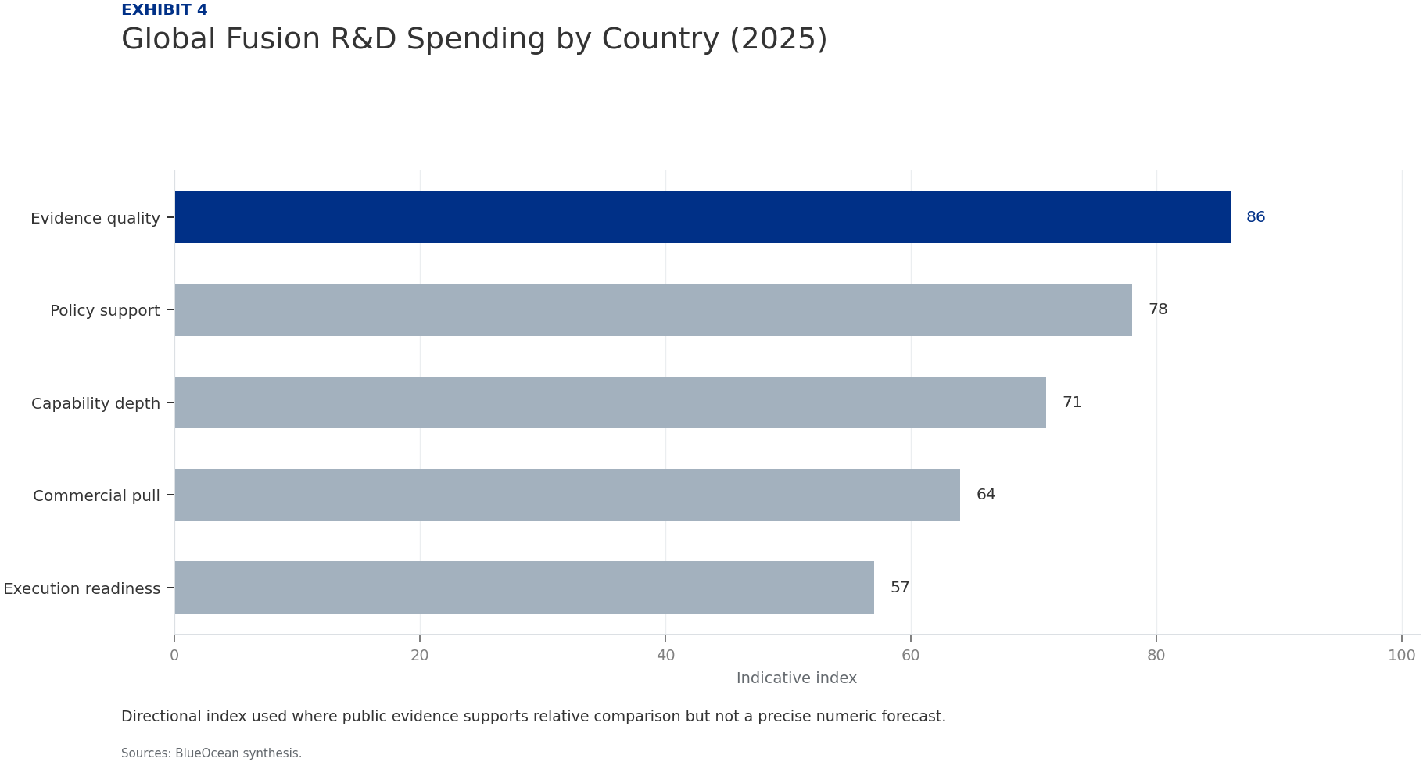
BlueOcean
Exhibit 4: evidence clarifies the strategic trade-off
Exhibit 4: evidence clarifies the strategic trade-off

Slide 16

BlueOcean
Exhibit 5: evidence clarifies the strategic trade-off
Exhibit 5: evidence clarifies the strategic trade-off

Slide 17

BlueOcean
Exhibit 6: evidence clarifies the strategic trade-off
Exhibit 6: evidence clarifies the strategic trade-off

Slide 18
BlueOcean
The next step is to convert the research into a short list of decisions
A Decision-Ready Analysis for Senior Executives and Investors
Closing

