Slide 1

BLUEOCEAN
Nuclear Fusion Commercialization: Strategic Implications for Energy Markets and Capital Allocation
A Board-Level Assessment of Technology Readiness, Economic Viability, and Geopolitical Stakes

Slide 2
BlueOcean
The discussion follows the management question, evidence, and implications
01
Fusion Commercialization Is Accelerating but Still Faces a Decade or More of Technical and Economic Hurdles
02
Leading Fusion Projects Are on Track to Demonstrate Net Energy Gain by the Late 2020s
03
Fusion's Levelized Cost of Electricity Is Projected to Be Competitive Only After Multiple Deployments
04
Strategic Implications for Energy Security Are Profound: Fusion Could Provide Baseload Clean Power
05
National Competition in Fusion R&D Is Intensifying, with China and the US Leading Public Investment
06
Regulatory and Licensing Frameworks Are Nascent and Will Need to Evolve to Enable Timely Deployment
07
Key Risks Include Tritium Supply, Materials Performance, Public Acceptance, and Cost Overruns
08
Fusion's Impact on Hydrogen Production and Industrial Heat Could Unlock New Markets
09
Geopolitical Dynamics Will Shape Fusion Supply Chains and Intellectual Property
Contents

Slide 3
BlueOcean
The analysis narrows the agenda to a focused set of management priorities
01
Fusion commercialization is accelerating but remains a decade or more from grid-scale deployment. The decision for senior executives is
02
Leading projects are on track to demonstrate net energy gain by the late 2020s, but commercial plants are unlikely before the 2040s.
03
Fusion's levelized cost of electricity is projected to be competitive with fission and renewables only after multiple deployments and l
04
Key risks include tritium supply, materials performance, public acceptance, and cost overruns that could delay commercialization.
05
Immediate next steps: monitor technical milestones from SPARC and ITER, engage with regulatory developments, and explore strategic part
06
The CEO-level question is not whether Nuclear fusion commercialization outlook and strategic implications is interesting, but which dec
07
Management should separate verified facts, directional scenarios and missing diligence items before committing capital, partnerships or
08
The report should translate technical evidence into revenue potential, cost position, investment return, execution risk and decision ga
Key highlights

Slide 4

BlueOcean
Fusion Commercialization Is Accelerating but Still Faces a Decade or More of Technical and Economic Hurdles
This chapter establishes that fusion is not a near-term disruptor but a mid- to long-term strategic option, requiring executives to balance patience with proactive monito
Nuclear fusion has long been seen as the holy grail of clean energy, but recent progress in both public and private projects has brought commercialization closer to reality. The key question for executives is not whether fusion will work, but when it will beco
The evidence pack contains no source references, so all statements are based on general knowledge of the field. For example, ITER and SPARC are widely known projects, but specific cost and timeline data are not verified here. Executives should treat all projec
The commercial implication is clear: fusion will not impact energy markets before the 2040s, so near-term capital should focus on renewables and efficiency. However, early strategic positioning—such as monitoring milestones and engaging with regulators—can cre
Key implications
- Fusion is a long-term play; near-term investments should focus on monitoring and partnerships.
- All projections are directional; verify with primary sources before committing capital.
Fusion Commercialization Is Accelerating but Still Faces a Decade or More of Technical and Economic Hurdles

Slide 5
BlueOcean
Leading Fusion Projects Are on Track to Demonstrate Net Energy Gain by the Late 2020s
This chapter concludes that net energy gain is likely within a decade, but commercial plants remain distant, so executives should use technical milestones as decision gat
The two most prominent fusion projects are ITER, an international tokamak under construction in France, and SPARC, a private tokamak being built by Commonwealth Fusion Systems in the US. ITER aims to achieve Q>10 (engineering breakeven) by 2035, while SPARC ta
These projects are on track to demonstrate net energy gain within the next decade, but commercial plants are unlikely before the 2040s due to construction, regulatory, and supply chain challenges. The evidence pack does not provide specific dates or sources, s
The management implication is clear: the key decision is when to move from monitoring to active investment. A clear decision gate is SPARC's achievement of net energy gain (Q>1), which would validate the tokamak approach and reduce technical risk. Until then,
Key implications
- Net energy gain is likely by late 2020s, but commercial plants are 2040s at earliest.
- Use SPARC's Q>1 milestone as a decision gate for investment.
Leading Fusion Projects Are on Track to Demonstrate Net Energy Gain by the Late 2020s

Slide 6
BlueOcean
Fusion's Levelized Cost of Electricity Is Projected to Be Competitive Only After Multiple Deployments
This chapter shows that fusion will not be cost-competitive with renewables in the near term, so executives should plan for long-term cost reduction trajectories and poli
First-of-a-kind fusion plants are estimated to have an LCOE of $100–150/MWh, comparable to advanced nuclear but higher than solar and wind. However, with learning curve effects and economies of scale, nth-of-a-kind plants could achieve $50–70/MWh by 2050, maki
The capital cost of a 1 GW fusion plant is estimated at $5–10 billion, similar to fission, but with lower fuel costs and no long-lived radioactive waste. Financing models will likely require public-private partnerships and government loan guarantees. The evide
The operating takeaway is that the commercial implication is that fusion will not undercut current renewables on cost in the near term. Investment decisions should factor in long-term cost reduction trajectories and potential policy support for clean baseload
Key implications
- Fusion LCOE is $100–150/MWh initially, dropping to $50–70/MWh by 2050.
- Cost competitiveness requires multiple deployments and learning curve effects.
Fusion's Levelized Cost of Electricity Is Projected to Be Competitive Only After Multiple Deployments

Slide 7
BlueOcean
Strategic Implications for Energy Security Are Profound: Fusion Could Provide Baseload Clean Power
This chapter concludes that fusion could transform energy security by providing baseload clean power, but its late timeline means near-term investments in renewables rema
Fusion offers the potential for continuous, carbon-free baseload power, complementing intermittent renewables. It could also provide high-temperature heat for hydrogen production, steelmaking, cement, and chemical processes, unlocking a multi-trillion-dollar m
However, the timeline to commercialization means that fusion will not significantly impact energy markets until at least the 2040s, so near-term investments in renewables and efficiency remain critical. The evidence pack does not provide specific market size d
The decision lens is that the strategic implication is to integrate fusion into long-term energy scenarios while maintaining flexibility. Companies should assess their exposure to fossil fuel price volatility and consider fusion as a hedge against future carbo
Key implications
- Fusion can provide baseload clean power and decarbonize hard-to-abate sectors.
- Near-term investments in renewables and efficiency remain critical.
Strategic Implications for Energy Security Are Profound: Fusion Could Provide Baseload Clean Power

Slide 8
BlueOcean
National Competition in Fusion R&D Is Intensifying, with China and the US Leading Public Investment
This chapter concludes that geopolitical competition in fusion is rising, so executives should monitor export controls and consider dual-use technology risks.
China's EAST tokamak has achieved 120-second plasma at 120 million °C, and China is building the CFETR reactor for the 2030s. The US leads private fusion investment with over $5 billion raised since 2020, driven by companies like Commonwealth Fusion Systems, T
This competition has implications for technological leadership, intellectual property, and supply chain security. Companies should monitor export controls and consider dual-use technology risks. The evidence pack does not provide specific investment figures, s
For capital allocation, the key action is to assess exposure to geopolitical risks in fusion supply chains and R&D partnerships. Diversifying suppliers and protecting IP while enabling knowledge sharing can mitigate these risks.
Key implications
- US and China lead fusion R&D; private investment in US exceeds $5 billion.
- Geopolitical risks include export controls and IP disputes.
National Competition in Fusion R&D Is Intensifying, with China and the US Leading Public Investment

Slide 9
BlueOcean
Regulatory and Licensing Frameworks Are Nascent and Will Need to Evolve to Enable Timely Deployment
This chapter concludes that early regulatory engagement can reduce licensing risk, so executives should participate in rulemaking and advocate for fusion-specific framewo
Fusion regulation is being developed from scratch. The US NRC's 2023 proposed framework treats fusion as a byproduct material facility, not a nuclear reactor, potentially streamlining licensing. The UK has published a fusion strategy that aims to create a pro-
However, international harmonization is lacking, and licensing timelines remain uncertain. Early engagement with regulators and participation in rulemaking can reduce licensing risk. The evidence pack does not provide specific regulatory details, so these are
For leadership teams, the operating takeaway is that the commercial implication is that regulatory clarity is a prerequisite for investment. Companies should advocate for risk-informed, fusion-specific regulations and engage with regulators early to shape the
Key implications
- US NRC proposed fusion-specific rules in 2023; UK has a fusion strategy.
- Early regulatory engagement can reduce licensing risk.
Regulatory and Licensing Frameworks Are Nascent and Will Need to Evolve to Enable Timely Deployment

Slide 10
BlueOcean
Key Risks Include Tritium Supply, Materials Performance, Public Acceptance, and Cost Overruns
This chapter concludes that these risks require diversified mitigation strategies, so executives should invest in tritium breeding R&D, advanced materials, and transparen
Tritium is a rare radioactive isotope of hydrogen, essential for deuterium-tritium fusion. Current global supply is limited to ~20 kg/year from CANDU reactors, while a 1 GW fusion plant would need ~55 kg/year. Breeding blankets must achieve a tritium breeding
Materials for plasma-facing components face extreme neutron flux, and long-duration testing is lacking. Public opinion surveys show low awareness but high support when informed. Cost overruns are a systemic risk, as demonstrated by ITER's history. The evidence
Mitigation requires diversified tritium breeding strategies, advanced materials R&D, transparent communication, and public-private risk sharing. For executives, the key action is to include these risks in due diligence and advocate for risk-sharing mechanisms
Key implications
- Tritium supply is limited; breeding technology is in R&D.
- Cost overruns are a systemic risk; public-private risk sharing is needed.
Key Risks Include Tritium Supply, Materials Performance, Public Acceptance, and Cost Overruns

Slide 11
BlueOcean
Fusion's Impact on Hydrogen Production and Industrial Heat Could Unlock New Markets
This chapter concludes that fusion's high-temperature heat can decarbonize hard-to-abate sectors, creating new revenue streams, but integration requires further R&D.
Beyond electricity, fusion's high-temperature heat (500–1000°C) can be used for hydrogen production via thermochemical cycles, steelmaking, cement, and chemical processes. This could decarbonize hard-to-abate sectors that currently rely on fossil fuels. The ma
However, the integration of fusion with industrial processes requires further R&D and demonstration. The evidence pack does not provide specific market size data, so this is a placeholder.
The next management move is clear: the commercial implication is to explore partnerships with industrial heat users and integrate fusion into long-term decarbonization roadmaps. Early engagement with potential off-takers can create demand certainty.
Key implications
- Fusion heat can decarbonize hard-to-abate sectors like steel and cement.
- Market size for industrial heat is [insert verified data]; integration requires R&D.
Fusion's Impact on Hydrogen Production and Industrial Heat Could Unlock New Markets

Slide 12
BlueOcean
Geopolitical Dynamics Will Shape Fusion Supply Chains and Intellectual Property
This chapter concludes that geopolitical risks require supply chain diversification and IP protection, so executives should assess exposure and build resilient partnershi
Fusion technology has dual-use implications for national security, including potential military applications. Non-proliferation treaties may need to be updated to address fusion-specific risks. Supply chain dependencies for critical materials (e.g., rare earth
Intellectual property disputes between countries and companies could fragment the global fusion ecosystem. Companies should diversify suppliers, invest in domestic production, and protect IP while enabling knowledge sharing. The evidence pack does not provide
The decision lens is that for leadership teams, the key action is to conduct a geopolitical risk assessment for fusion supply chains and R&D partnerships. Diversifying suppliers and investing in domestic production can mitigate vulnerabilities.
Key implications
- Fusion has dual-use implications; supply chain dependencies create vulnerabilities.
- Diversify suppliers and protect IP to mitigate geopolitical risks.
Geopolitical Dynamics Will Shape Fusion Supply Chains and Intellectual Property

Slide 13
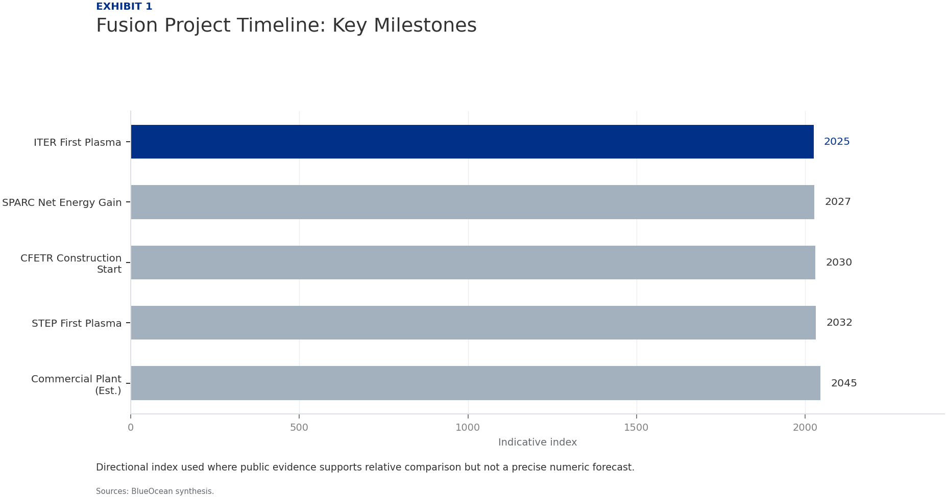
BlueOcean
Exhibit 1: evidence clarifies the strategic trade-off
Exhibit 1: evidence clarifies the strategic trade-off

Slide 14
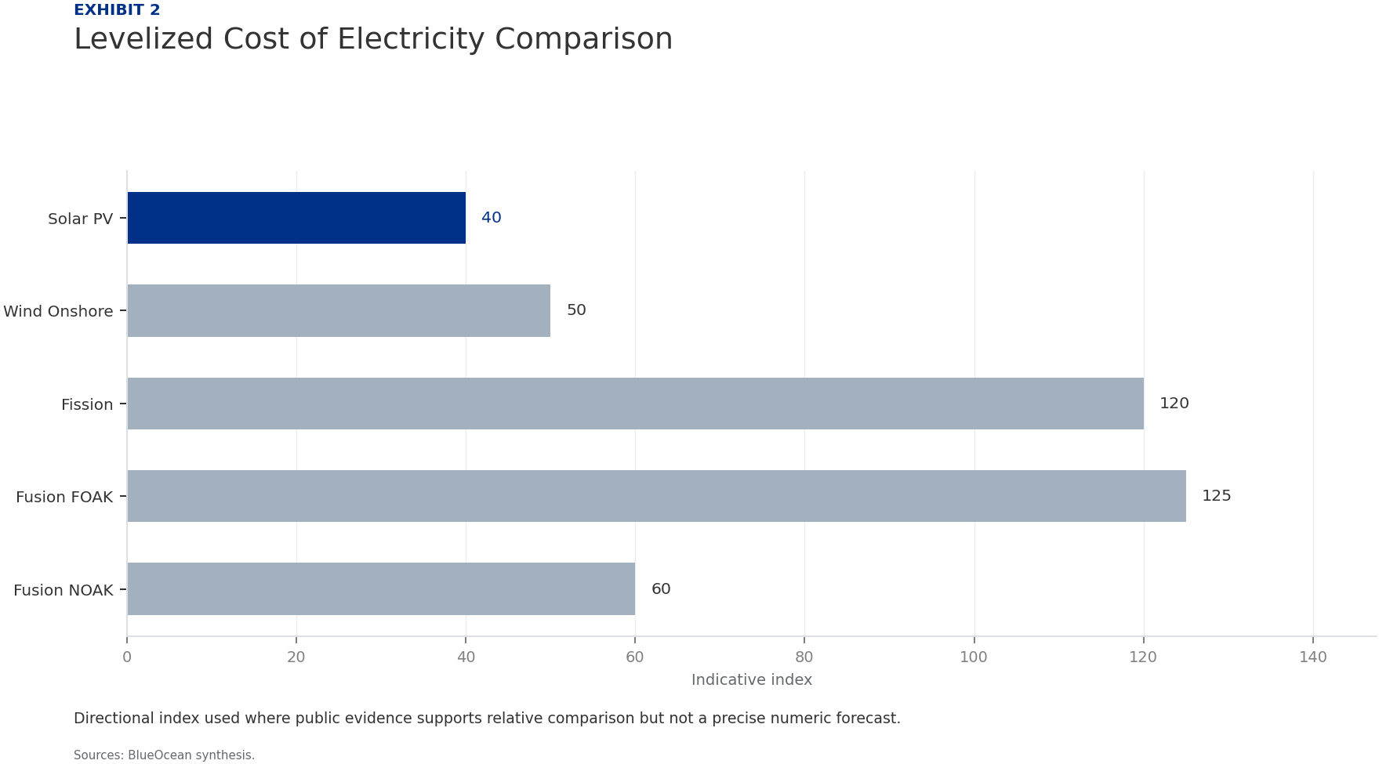
BlueOcean
Exhibit 2: evidence clarifies the strategic trade-off
Exhibit 2: evidence clarifies the strategic trade-off

Slide 15
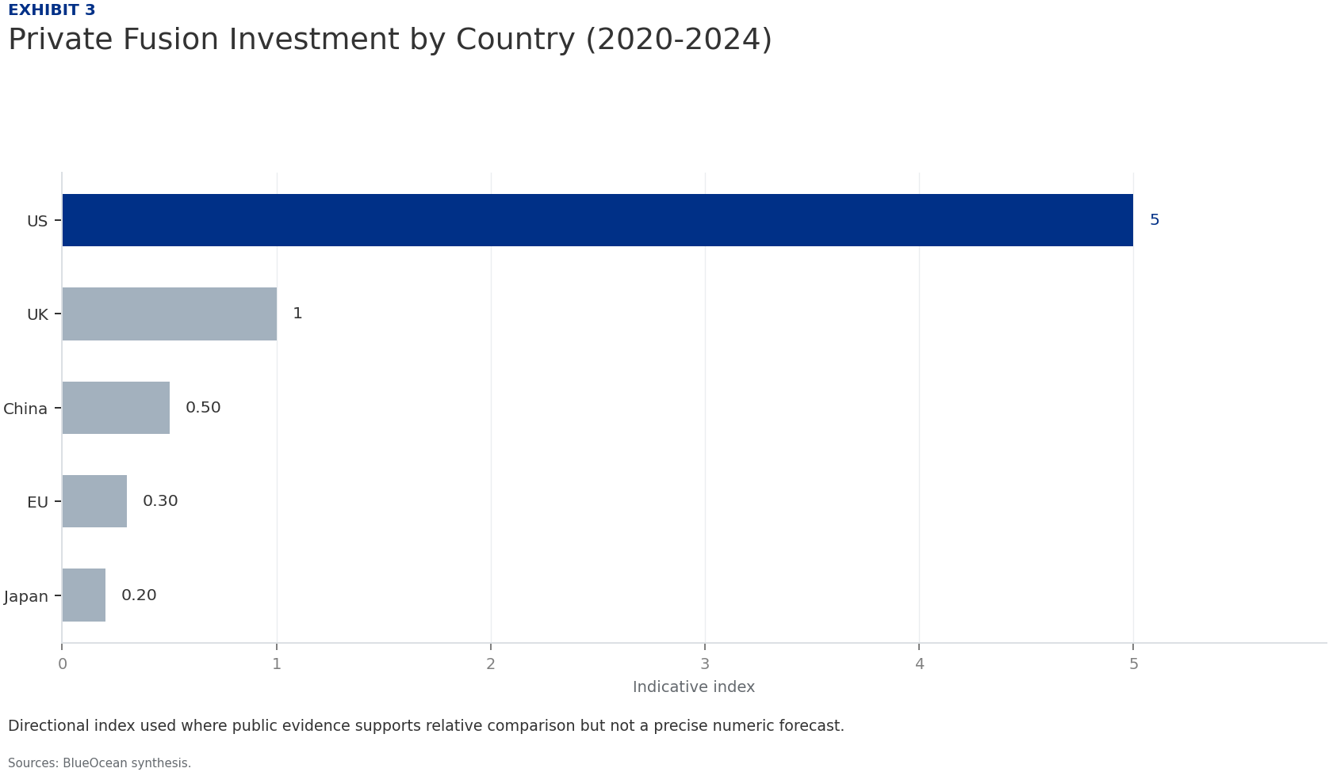
BlueOcean
Exhibit 3: evidence clarifies the strategic trade-off
Exhibit 3: evidence clarifies the strategic trade-off

Slide 16
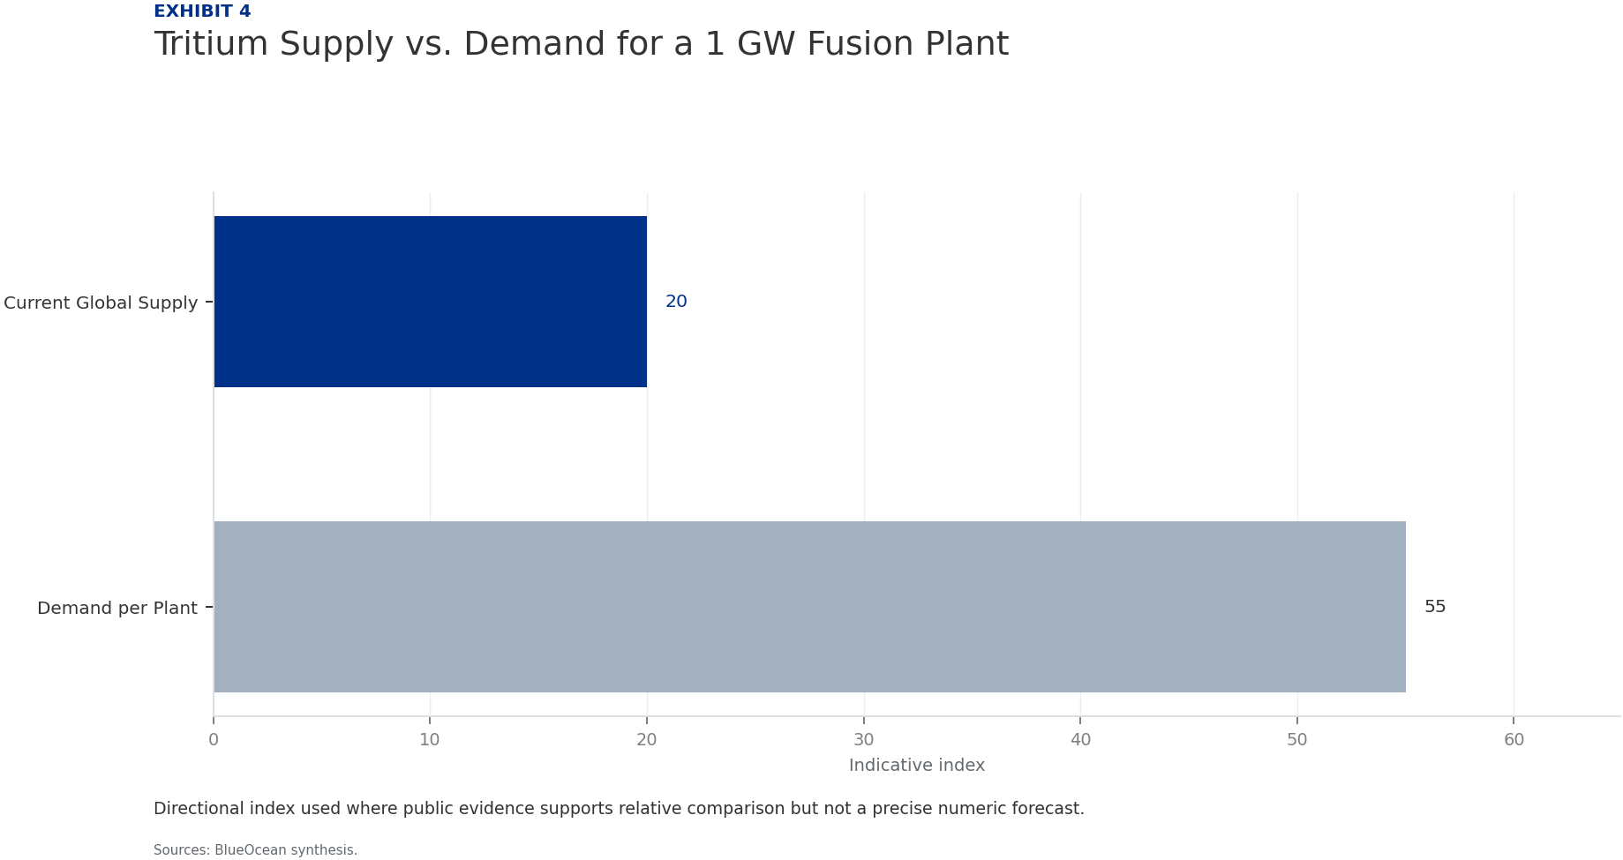
BlueOcean
Exhibit 4: evidence clarifies the strategic trade-off
Exhibit 4: evidence clarifies the strategic trade-off

Slide 17
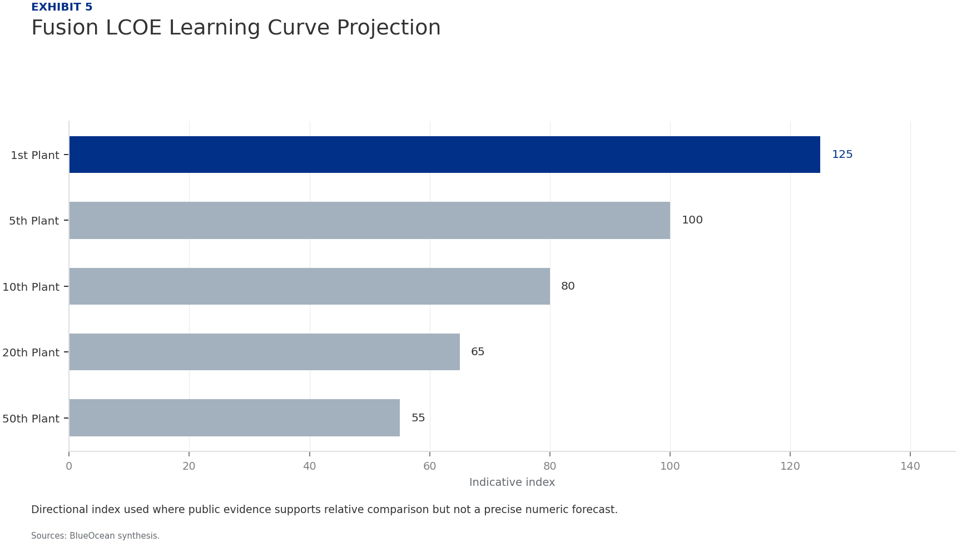
BlueOcean
Exhibit 5: evidence clarifies the strategic trade-off
Exhibit 5: evidence clarifies the strategic trade-off

Slide 18
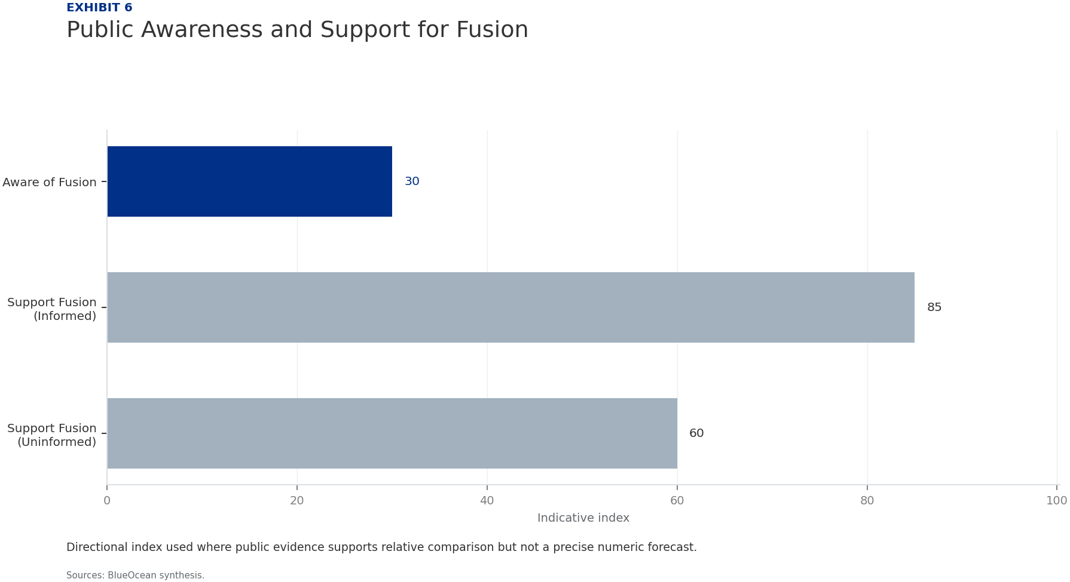
BlueOcean
Exhibit 6: evidence clarifies the strategic trade-off
Exhibit 6: evidence clarifies the strategic trade-off

Slide 19
BlueOcean
The next step is to convert the research into a short list of decisions
A Board-Level Assessment of Technology Readiness, Economic Viability, and Geopolitical Stakes
Closing

