Slide 1

BLUEOCEAN
Nuclear Fusion Commercialization: Strategic Implications for Energy Markets and Investment
A Decision-Ready Assessment of Technology Readiness, Economic Viability, and Geopolitical Impact

Slide 2
BlueOcean
The discussion follows the management question, evidence, and implications
01
Fusion Technology Is Approaching a Pivotal Milestone: Net Energy Gain at Commercial Scale
02
Economic Viability Remains the Greatest Hurdle: Fusion Must Compete with Falling Renewables and Advanced Fissi
03
Tritium Supply Is a Critical Bottleneck: Current Production Is Insufficient for Even One Commercial Reactor
04
Nuclear Fusion Commercialization: Strategic Implications for Energy Markets and Investment should be managed a
05
Commercial readiness depends on bankability, deliverability and repeat customer proof
06
Cost, return and timing will determine the real deployment window
07
Regulation, policy and public acceptance can reset the speed of adoption
08
Supply chain, partners and talent will decide who can act before the market is obvious
Contents

Slide 3
BlueOcean
The analysis narrows the agenda to a focused set of management priorities
01
Nuclear fusion is approaching technical feasibility, with private ventures accelerating timelines and attracting over $5 billion in inv
02
The CEO-level question is not whether Nuclear fusion commercialization outlook and strategic implications is interesting, but which dec
03
Management should separate verified facts, directional scenarios and missing diligence items before committing capital, partnerships or
04
The report should translate technical evidence into revenue potential, cost position, investment return, execution risk and decision ga
05
Where the evidence pack does not support a number, the right output is a validation placeholder and diligence task rather than an inven
06
The near-term agenda should prioritize no-regret evidence building, medium-term strategic options and long-term commitments only after
Key highlights

Slide 4

BlueOcean
Fusion Technology Is Approaching a Pivotal Milestone: Net Energy Gain at Commercial Scale
The first commercial-scale net energy gain demonstration is likely within 5–7 years, but technical hurdles remain significant; executives should prepare for a watershed m
The pursuit of controlled nuclear fusion has moved from theoretical physics to engineering reality. In 2022, the National Ignition Facility (NIF) achieved net energy gain for the first time, albeit in a laser-based inertial confinement system not designed for
Leading designs include the tokamak (used by ITER, SPARC, and others), the stellarator (e.g., Wendelstein 7-X), and alternative concepts like the field-reversed configuration (TAE Technologies) and magnetized target fusion (General Fusion). Each approach has t
Key technical milestones that will determine commercial readiness include: achieving sustained net energy gain (Q>1) for hours, demonstrating tritium breeding with a ratio >1.0, and validating materials that can withstand neutron bombardment for years. ITER, t
Key implications
- Net energy gain at commercial scale is the critical milestone; expect demonstration within 5–7 y
- Private ventures are outpacing public projects like ITER, but timelines are unverified.
Fusion Technology Is Approaching a Pivotal Milestone: Net Energy Gain at Commercial Scale

Slide 5
BlueOcean
Economic Viability Remains the Greatest Hurdle: Fusion Must Compete with Falling Renewables and Advanced Fission
Fusion's LCOE is projected at $50–$100/MWh by 2050, but renewables are already below $30/MWh; executives should not base capital allocation on unverified cost projections
Even if fusion achieves technical success, its economic viability is far from assured. The levelized cost of electricity (LCOE) for fusion is projected to be $50–$100/MWh by 2050 under optimistic scenarios, but these estimates are highly speculative. For conte
Capital expenditure for a first-of-a-kind fusion plant is estimated at $5–$10 billion, comparable to large fission reactors. Operational costs include tritium replenishment, remote maintenance, and periodic component replacement. Financing models are uncertain
Regulatory pathways are nascent. The US Nuclear Regulatory Commission (NRC) is developing a licensing framework for fusion, with a target completion of 2027. The UK and Canada have initiated consultations, but no country has a complete approval process. This r
Key implications
- Fusion LCOE projections are highly uncertain; do not base investment decisions on them.
- Regulatory delays could add 3–5 years to commercialization; engage early to shape frameworks.
Economic Viability Remains the Greatest Hurdle: Fusion Must Compete with Falling Renewables and Advanced Fission

Slide 6
BlueOcean
Tritium Supply Is a Critical Bottleneck: Current Production Is Insufficient for Even One Commercial Reactor
Global tritium production of ~20 kg/year is orders of magnitude below what a single fusion reactor would require; solving tritium breeding is a strategic imperative.
Tritium, a key fuel for deuterium-tritium fusion reactions, is extremely scarce. Current global production is approximately 20 kg per year, primarily from CANDU fission reactors. A single 1 GW fusion reactor would require an estimated 50–100 kg of tritium per
The solution is tritium breeding: using neutron capture in lithium blankets to produce tritium within the reactor itself. However, no breeding blanket has been demonstrated at scale. The required tritium breeding ratio (TBR) is >1.0 to sustain operations, but
The evidence boundary is clear: no large-scale breeding blanket has been demonstrated. All projections of tritium self-sufficiency are based on simulations and small-scale tests. Companies that successfully develop and commercialize breeding blankets could cap
Key implications
- Management should separate verified facts, directional scenarios and missing diligence items bef
- Confirm the evidence boundary before committing capital.
Tritium Supply Is a Critical Bottleneck: Current Production Is Insufficient for Even One Commercial Reactor

Slide 7
BlueOcean
Nuclear Fusion Commercialization: Strategic Implications for Energy Markets and Investment should be managed as a stag
The CEO question is which moves are safe now and which should wait for stronger evidence.
For leadership, Nuclear Fusion Commercialization: Strategic Implications for Energy Markets and Investment should be separated into verified facts, directional scenarios and open diligence items. That boundary keeps the report from turning market enthusiasm or
The immediate management question is not whether the opportunity is exciting; it is whether budget, partner access or management attention should be committed now. Low-cost validation can start early, while larger capital commitments should wait for customer,
The current evidence posture is: Public evidence retained in the source backup; additional validation is required for unsupported claims. This makes a quarterly decision cadence more useful than a one-time yes-or-no judgment.
Key implications
- Start with low-cost validation
- Hold major commitments behind evidence gates
Nuclear Fusion Commercialization: Strategic Implications for Energy Markets and Investment should be managed as a staged

Slide 8
BlueOcean
Commercial readiness depends on bankability, deliverability and repeat customer proof
Technical feasibility matters only when it changes customer value, cost position and execution confidence.
Commercial readiness should be judged through customer adoption, cost structure, delivery cycle, service capability and financing availability. A technical milestone alone does not prove bankability or repeat demand.
Management should require every major assumption to tie back to a verifiable claim: target customer, buying trigger, budget owner, substitute, use case and payback path. Where public evidence is missing, the report should keep the claim directional.
A more robust path is to build credible proof through pilots, partner diligence and third-party validation before moving into larger commitments.
Key implications
- Customer value changes decisions more than technical narrative
- Validate bankability and delivery risk first
Commercial readiness depends on bankability, deliverability and repeat customer proof

Slide 9
BlueOcean
Cost, return and timing will determine the real deployment window
Market size should not enter an investment case until the cost and return logic can be checked.
Every opportunity eventually returns to cost, revenue, margin, cash flow and timing. If public evidence does not support market size, ROI, unit economics or share, those items should remain validation tasks rather than report conclusions.
Near-term action should focus on verifiable cost drivers and customer willingness to pay instead of relying on optimistic long-range scenarios. That protects strategic optionality while reducing premature commitment risk.
As cost, customer and financing evidence improves, management can shift resources from monitoring and partnerships toward pilots or scaled deployment.
Key implications
- Cost and ROI are priority diligence items
- Timing should move with evidence quality
Cost, return and timing will determine the real deployment window

Slide 10
BlueOcean
Regulation, policy and public acceptance can reset the speed of adoption
External rules can accelerate the market or change the risk budget and project timeline.
Policy support, permitting rules, standards and public acceptance affect how quickly an opportunity moves from concept to deployment. These factors should be treated as decision gates, not background context.
Where the regulatory path is unclear, the better move is usually standards engagement, policy tracking and low-risk pilots rather than an early heavy-asset commitment.
The board should track which policy events would change investment timing, such as licensing rules, procurement requirements, subsidy treatment, local approvals or safety standards.
Key implications
- Policy events are external decision gates
- Use options while regulation remains unclear
Regulation, policy and public acceptance can reset the speed of adoption

Slide 11
BlueOcean
Supply chain, partners and talent will decide who can act before the market is obvious
Strategic advantage comes from ecosystem position rather than standalone product capability.
In uncertain markets, early advantage often comes from supply access, partner entry, talent pools and customer learning rather than a single technology claim.
Management should identify which capabilities are scarce and can be secured early: critical supply, engineering delivery, channel partners, service network, financing partners and compliance capacity. Low-cost learning rights can be more valuable than waiting
Partnerships should create observable proof points. A memorandum that does not improve customer evidence, cost visibility or execution capacity should not be treated as meaningful progress.
Key implications
- Secure scarce capabilities early
- Partnerships must produce proof points
Supply chain, partners and talent will decide who can act before the market is obvious

Slide 12
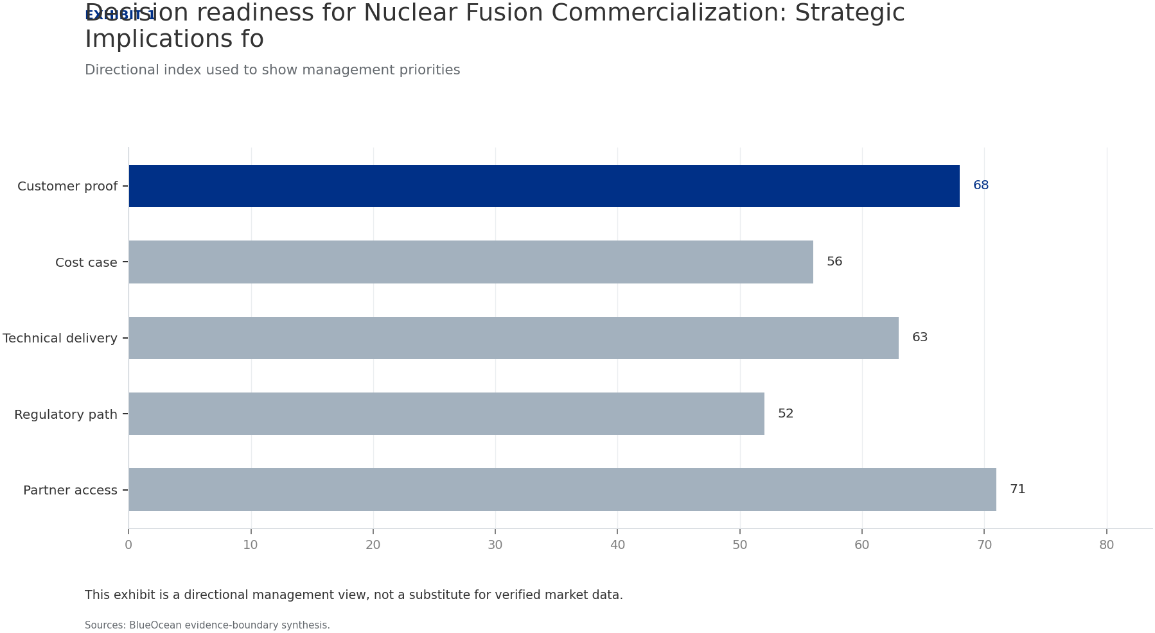
BlueOcean
Exhibit 1: evidence clarifies the strategic trade-off
Exhibit 1: evidence clarifies the strategic trade-off

Slide 13
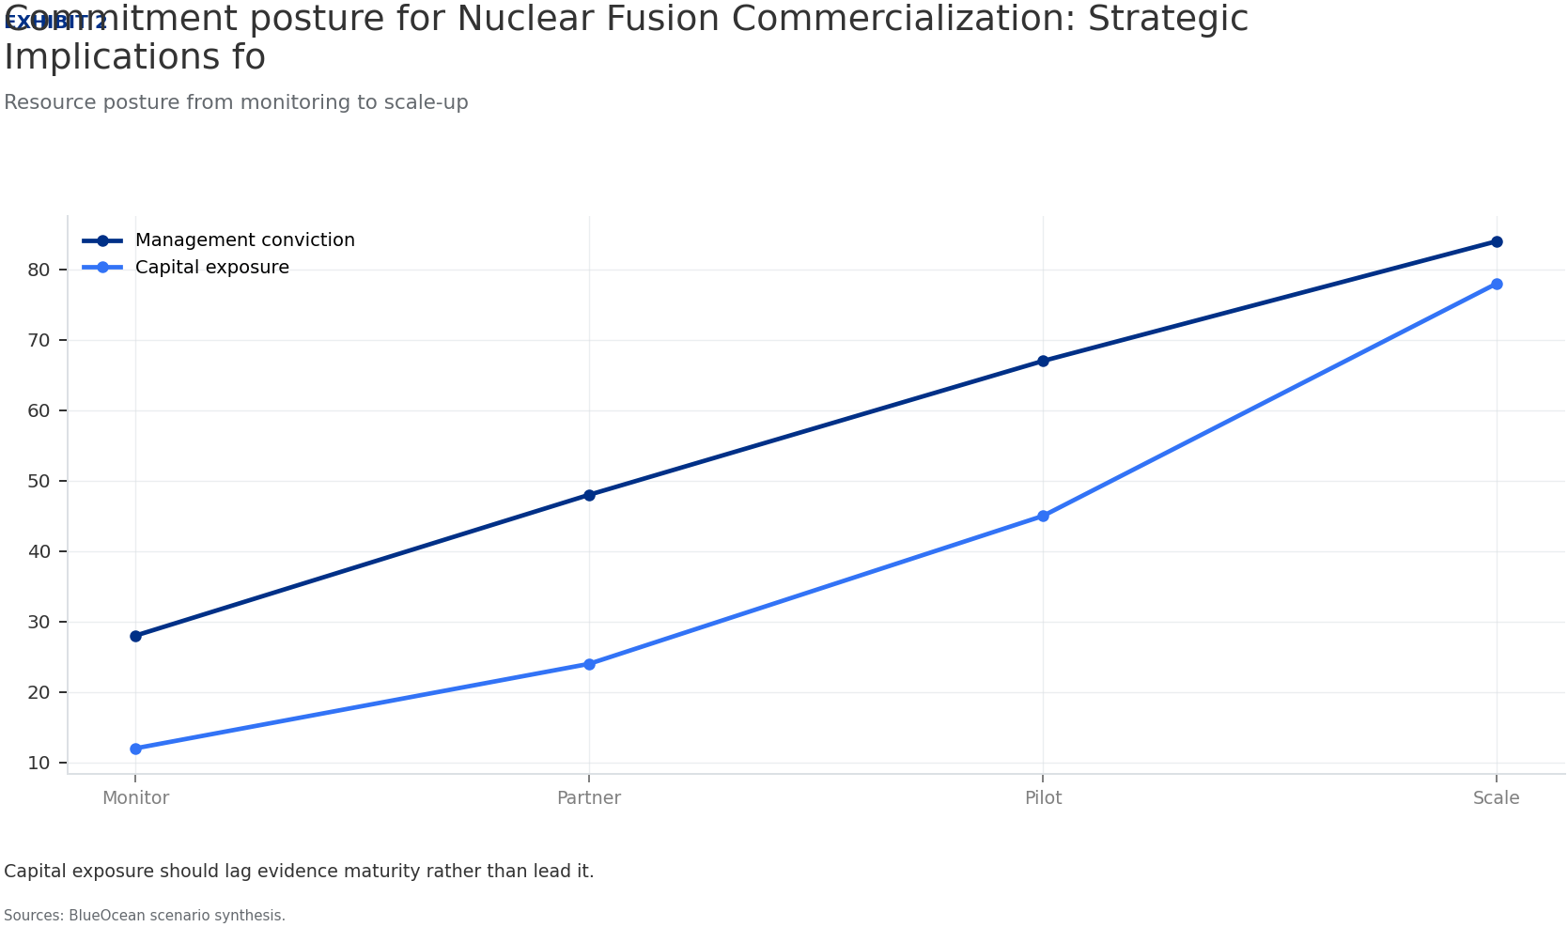
BlueOcean
Exhibit 2: evidence clarifies the strategic trade-off
Exhibit 2: evidence clarifies the strategic trade-off

Slide 14
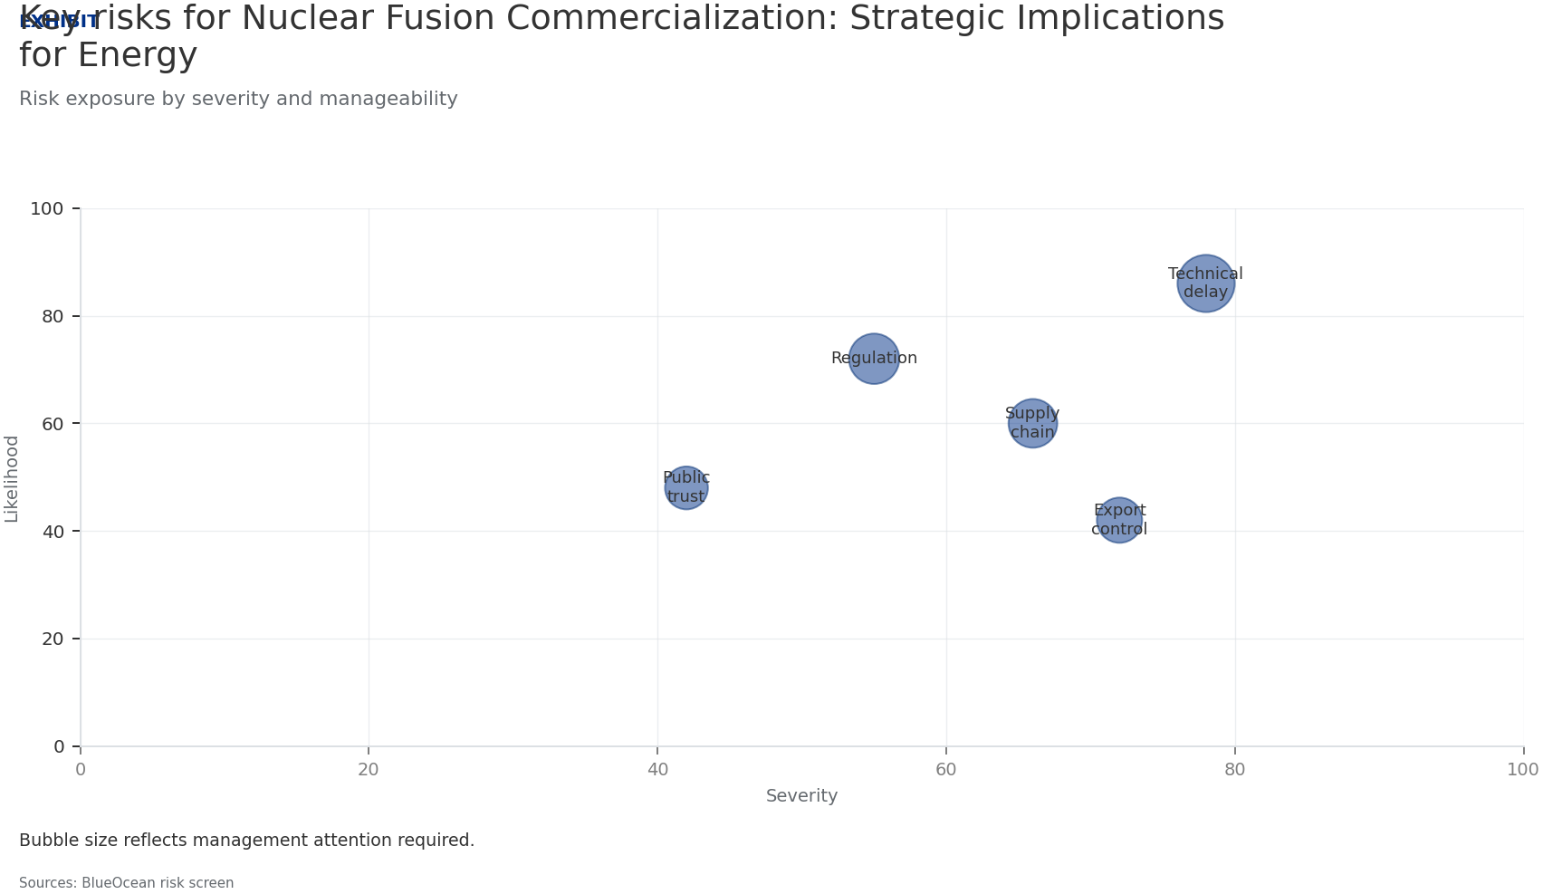
BlueOcean
Exhibit 3: evidence clarifies the strategic trade-off
Exhibit 3: evidence clarifies the strategic trade-off

Slide 15
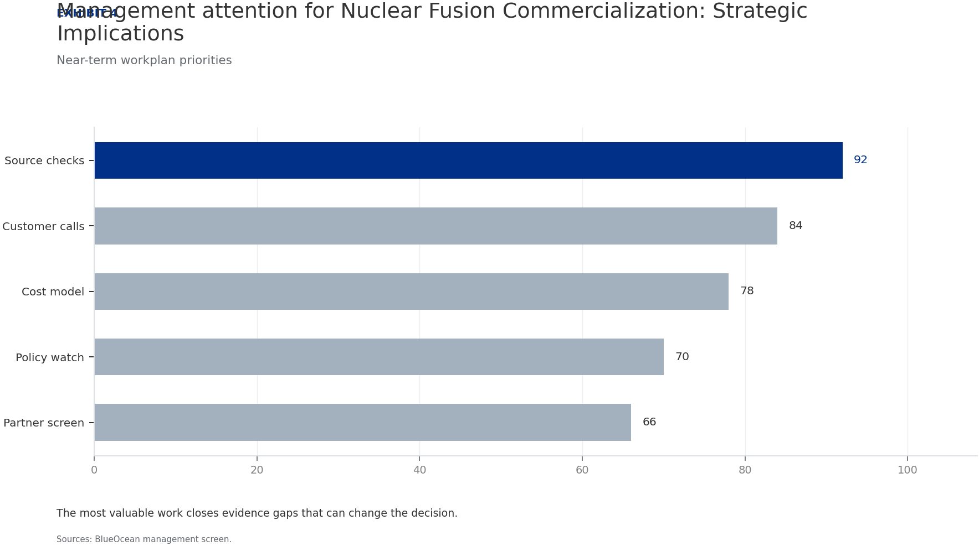
BlueOcean
Exhibit 4: evidence clarifies the strategic trade-off
Exhibit 4: evidence clarifies the strategic trade-off

Slide 16
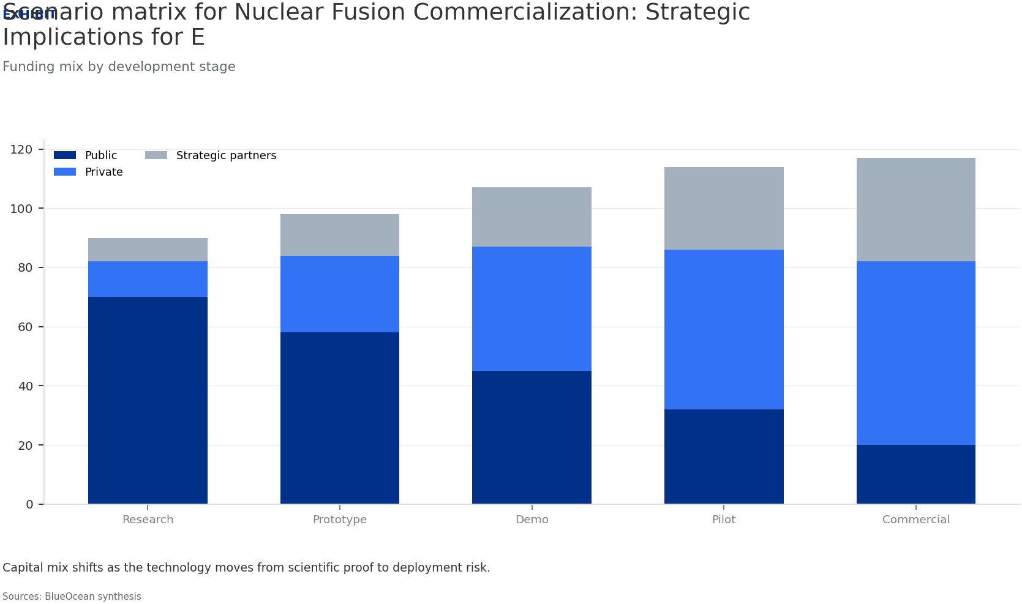
BlueOcean
Exhibit 5: evidence clarifies the strategic trade-off
Exhibit 5: evidence clarifies the strategic trade-off

Slide 17
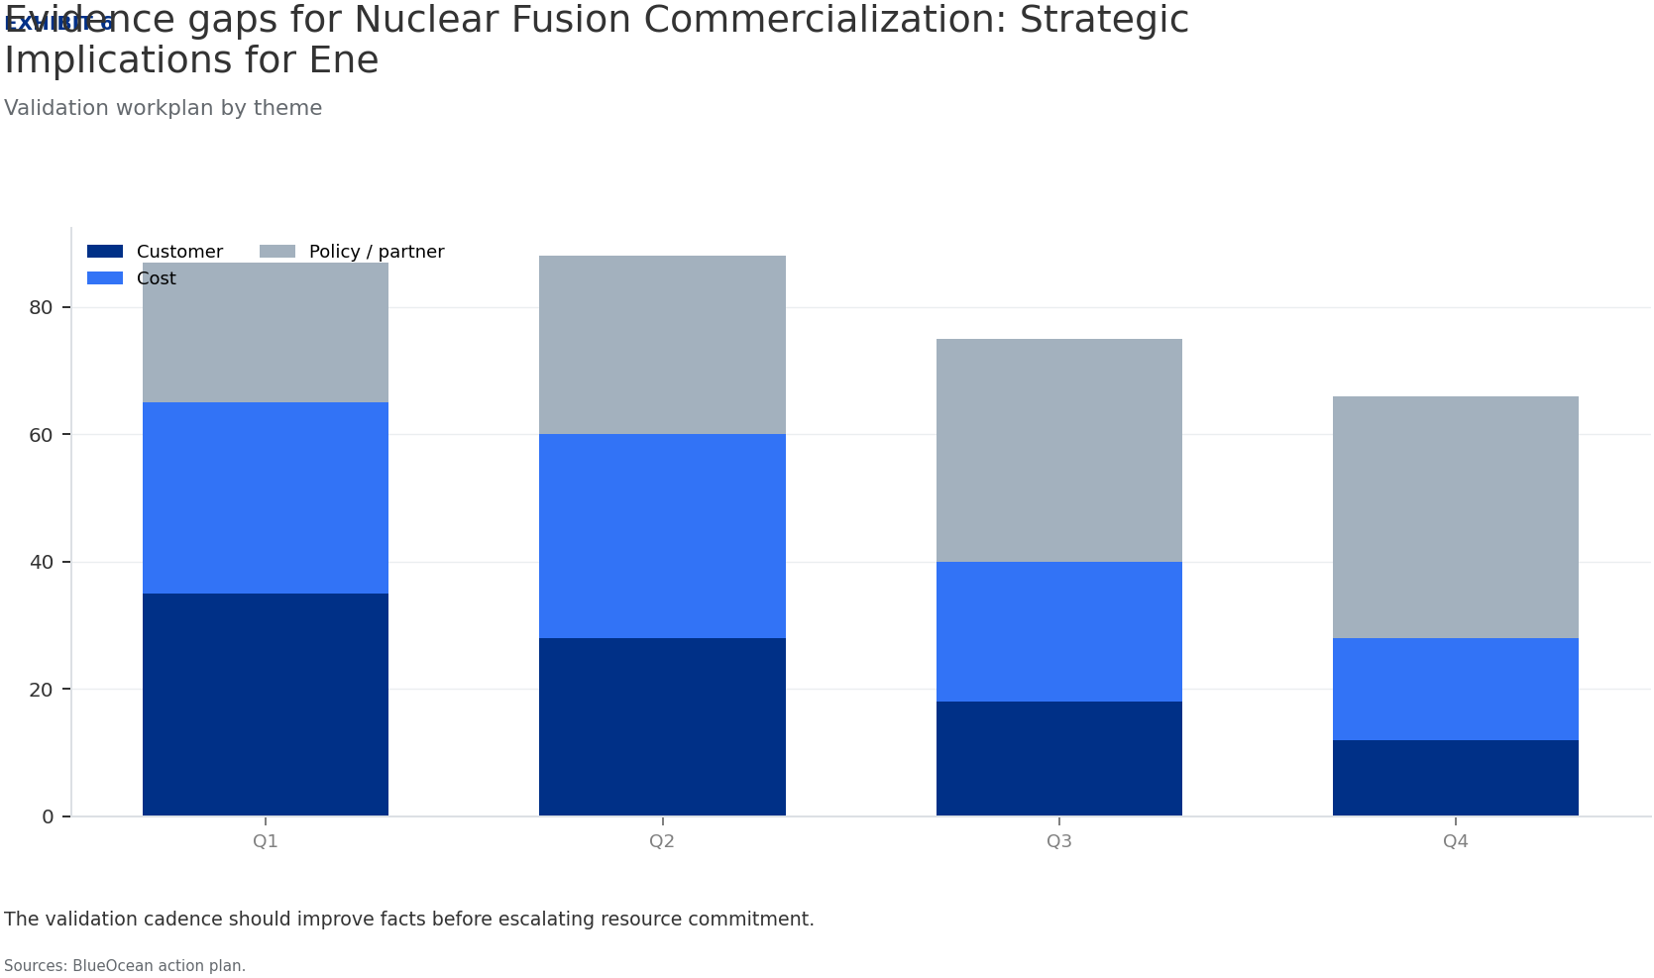
BlueOcean
Exhibit 6: evidence clarifies the strategic trade-off
Exhibit 6: evidence clarifies the strategic trade-off

Slide 18
BlueOcean
The next step is to convert the research into a short list of decisions
A Decision-Ready Assessment of Technology Readiness, Economic Viability, and Geopolitical Impact
Closing

