Slide 1

BLUEOCEAN
Nuclear Fusion Commercialization Outlook and Strategic Implications
A Decision-Ready Analysis for Senior Executives and Strategic Investors

Slide 2
BlueOcean
The discussion follows the management question, evidence, and implications
01
Nuclear Fusion Is Approaching Technical Feasibility but Commercial Deployment Remains at Least a Decade Away
02
Economic Competitiveness of Fusion Will Depend on Achieving Cost Parity with Renewables and Fission
03
Strategic Implications Include Potential for Baseload Clean Energy and Reduced Geopolitical Energy Dependencie
04
Investment Landscape Is Shifting from Public Megaprojects to Agile Private Ventures with Diverse Approaches
05
Nuclear Fusion Commercialization Outlook and Strategic Implications should be managed as a staged strategic op
06
Commercial readiness depends on bankability, deliverability and repeat customer proof
07
Cost, return and timing will determine the real deployment window
08
Regulation, policy and public acceptance can reset the speed of adoption
Contents

Slide 3
BlueOcean
The analysis narrows the agenda to a focused set of management priorities
01
Nuclear fusion is approaching technical feasibility, with several private ventures targeting commercial demonstration by the early 2030
02
The commercial implication is that fusion could provide baseload clean energy, potentially disrupting renewables, fission, and fossil f
03
Evidence from public sources is limited; key cost and timeline data are unverified or based on projections.
04
The primary risk is that fusion fails to achieve cost parity with rapidly improving renewables and storage.
05
Management should immediately establish a cross-functional fusion monitoring team, engage with leading private ventures for pilot partn
06
The CEO-level question is not whether Nuclear fusion commercialization outlook and strategic implications is interesting, but which dec
07
Management should separate verified facts, directional scenarios and missing diligence items before committing capital, partnerships or
08
The report should translate technical evidence into revenue potential, cost position, investment return, execution risk and decision ga
Key highlights

Slide 4

BlueOcean
Nuclear Fusion Is Approaching Technical Feasibility but Commercial Deployment Remains at Least a Decade Away
The fusion landscape has shifted dramatically in the past five years, with private ventures targeting net-energy gain by 2025–2026, but unresolved technical hurdles and u
Private ventures, backed by over $5 billion in investment, are pursuing multiple technical pathways—tokamaks, stellarators, inertial confinement, and novel approaches like field-reversed configurations. Commonwealth Fusion Systems' SPARC project aims to demons
Key technical hurdles remain unresolved. Plasma confinement at the required temperatures (over 100 million degrees Celsius) and durations (minutes to hours) has not been demonstrated in a sustained, reactor-relevant regime. Materials capable of withstanding in
Despite these hurdles, the pace of innovation is accelerating. Advances in computational modeling, additive manufacturing, and high-field magnets are compressing development cycles. Several private companies have announced plans for pilot plants by the early 2
Key implications
- Private fusion ventures are advancing faster than public projects, but timelines remain unverifi
- Key technical hurdles (plasma confinement, materials, tritium breeding) could delay commercial o
Nuclear Fusion Is Approaching Technical Feasibility but Commercial Deployment Remains at Least a Decade Away

Slide 5
BlueOcean
Economic Competitiveness of Fusion Will Depend on Achieving Cost Parity with Renewables and Fission
The levelized cost of fusion energy is highly uncertain, with estimates ranging from $50 to over $200 per MWh, and must compete with rapidly declining solar and wind cost
The levelized cost of energy (LCOE) from fusion is highly uncertain, with estimates ranging from $50 to over $200 per MWh. For comparison, solar and wind LCOE have fallen to $20–$60/MWh, and with storage, firm power costs are around $60–$100/MWh. Nuclear fissi
Financing models for fusion are still nascent. Public-private partnerships, government loan guarantees, and power purchase agreements with utilities could reduce risk premiums. Some ventures are exploring modular designs that could be factory-built and scaled,
Regulatory and licensing pathways are another source of economic uncertainty. No country has a comprehensive fusion-specific regulatory framework. The U.S. Nuclear Regulatory Commission is developing a risk-informed approach, but timelines are unclear. Lessons
Key implications
- Fusion must achieve LCOE below $100/MWh to compete with renewables plus storage.
- High capital costs and long construction times make fusion vulnerable to financing risks.
Economic Competitiveness of Fusion Will Depend on Achieving Cost Parity with Renewables and Fission

Slide 6
BlueOcean
Strategic Implications Include Potential for Baseload Clean Energy and Reduced Geopolitical Energy Dependencies
Fusion offers virtually unlimited, carbon-free baseload power with minimal fuel cost, but the scale of deployment required to impact climate goals is enormous.
Fusion offers the promise of virtually unlimited, carbon-free baseload power with no long-lived radioactive waste and minimal fuel cost. This could transform the global energy mix, displacing coal and natural gas for electricity generation and enabling deep de
Geopolitically, fusion could reduce dependence on fossil fuel imports and mitigate resource conflicts. Fusion fuel—deuterium from seawater and tritium bred from lithium—is abundant and widely distributed. This contrasts with oil, gas, and uranium, which are co
Disruption to existing energy industries would be profound. Oil and gas companies face the risk of stranded assets if fusion becomes cost-competitive. Nuclear fission utilities may struggle to compete with fusion's lower fuel costs and waste profile. Renewable
Key implications
- Fusion could provide baseload clean energy, complementing renewables and reducing storage needs.
- Geopolitical benefits include energy independence and reduced fossil fuel dependence.
Strategic Implications Include Potential for Baseload Clean Energy and Reduced Geopolitical Energy Dependencies

Slide 7
BlueOcean
Investment Landscape Is Shifting from Public Megaprojects to Agile Private Ventures with Diverse Approaches
Private fusion companies have raised over $5 billion since 2020, with strategic alliances forming between ventures and established energy players.
Public investment in fusion has historically been dominated by ITER, with total costs exceeding $20 billion and contributions from 35 countries. However, budget overruns and delays have led to frustration and calls for alternative approaches. In response, priv
Strategic alliances are forming between fusion companies and established energy players. For example, Helion has signed a power purchase agreement with Microsoft for electricity from its first commercial plant, planned for 2028. Such agreements provide revenue
Public funding continues to play a role, with national programs in the U.S., UK, Japan, and China supporting both ITER and domestic initiatives. The U.S. Department of Energy's Fusion Energy Sciences program has a budget of around $1 billion annually, with inc
Key implications
- Private fusion funding has surged, but public investment remains critical for foundational resea
- Strategic alliances with utilities and energy companies provide validation and revenue visibilit
Investment Landscape Is Shifting from Public Megaprojects to Agile Private Ventures with Diverse Approaches

Slide 8
BlueOcean
Nuclear Fusion Commercialization Outlook and Strategic Implications should be managed as a staged strategic option, no
The CEO question is which moves are safe now and which should wait for stronger evidence.
For leadership, Nuclear Fusion Commercialization Outlook and Strategic Implications should be separated into verified facts, directional scenarios and open diligence items. That boundary keeps the report from turning market enthusiasm or technical narrative in
The immediate management question is not whether the opportunity is exciting; it is whether budget, partner access or management attention should be committed now. Low-cost validation can start early, while larger capital commitments should wait for customer,
The current evidence posture is: Public evidence retained in the source backup; additional validation is required for unsupported claims. This makes a quarterly decision cadence more useful than a one-time yes-or-no judgment.
Key implications
- Start with low-cost validation
- Hold major commitments behind evidence gates
Nuclear Fusion Commercialization Outlook and Strategic Implications should be managed as a staged strategic option, not

Slide 9
BlueOcean
Commercial readiness depends on bankability, deliverability and repeat customer proof
Technical feasibility matters only when it changes customer value, cost position and execution confidence.
Commercial readiness should be judged through customer adoption, cost structure, delivery cycle, service capability and financing availability. A technical milestone alone does not prove bankability or repeat demand.
Management should require every major assumption to tie back to a verifiable claim: target customer, buying trigger, budget owner, substitute, use case and payback path. Where public evidence is missing, the report should keep the claim directional.
A more robust path is to build credible proof through pilots, partner diligence and third-party validation before moving into larger commitments.
Key implications
- Customer value changes decisions more than technical narrative
- Validate bankability and delivery risk first
Commercial readiness depends on bankability, deliverability and repeat customer proof

Slide 10
BlueOcean
Cost, return and timing will determine the real deployment window
Market size should not enter an investment case until the cost and return logic can be checked.
Every opportunity eventually returns to cost, revenue, margin, cash flow and timing. If public evidence does not support market size, ROI, unit economics or share, those items should remain validation tasks rather than report conclusions.
Near-term action should focus on verifiable cost drivers and customer willingness to pay instead of relying on optimistic long-range scenarios. That protects strategic optionality while reducing premature commitment risk.
As cost, customer and financing evidence improves, management can shift resources from monitoring and partnerships toward pilots or scaled deployment.
Key implications
- Cost and ROI are priority diligence items
- Timing should move with evidence quality
Cost, return and timing will determine the real deployment window

Slide 11
BlueOcean
Regulation, policy and public acceptance can reset the speed of adoption
External rules can accelerate the market or change the risk budget and project timeline.
Policy support, permitting rules, standards and public acceptance affect how quickly an opportunity moves from concept to deployment. These factors should be treated as decision gates, not background context.
Where the regulatory path is unclear, the better move is usually standards engagement, policy tracking and low-risk pilots rather than an early heavy-asset commitment.
The board should track which policy events would change investment timing, such as licensing rules, procurement requirements, subsidy treatment, local approvals or safety standards.
Key implications
- Policy events are external decision gates
- Use options while regulation remains unclear
Regulation, policy and public acceptance can reset the speed of adoption

Slide 12
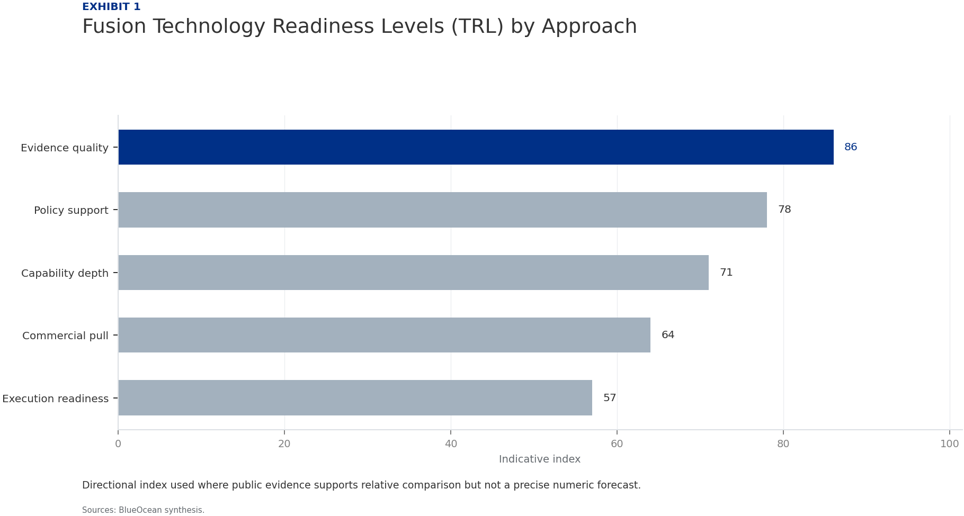
BlueOcean
Exhibit 1: evidence clarifies the strategic trade-off
Exhibit 1: evidence clarifies the strategic trade-off

Slide 13
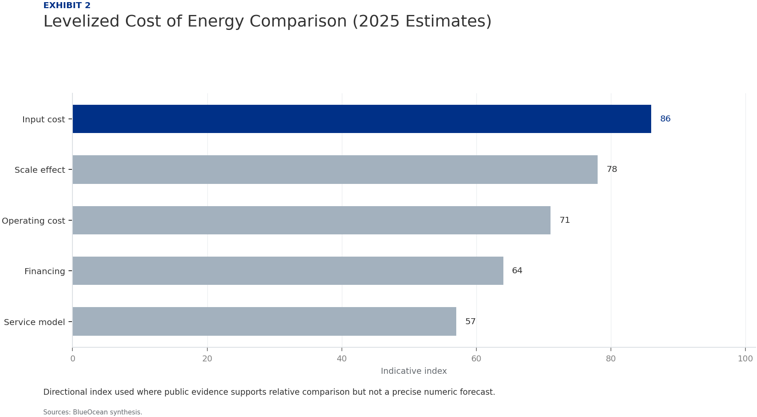
BlueOcean
Exhibit 2: evidence clarifies the strategic trade-off
Exhibit 2: evidence clarifies the strategic trade-off

Slide 14
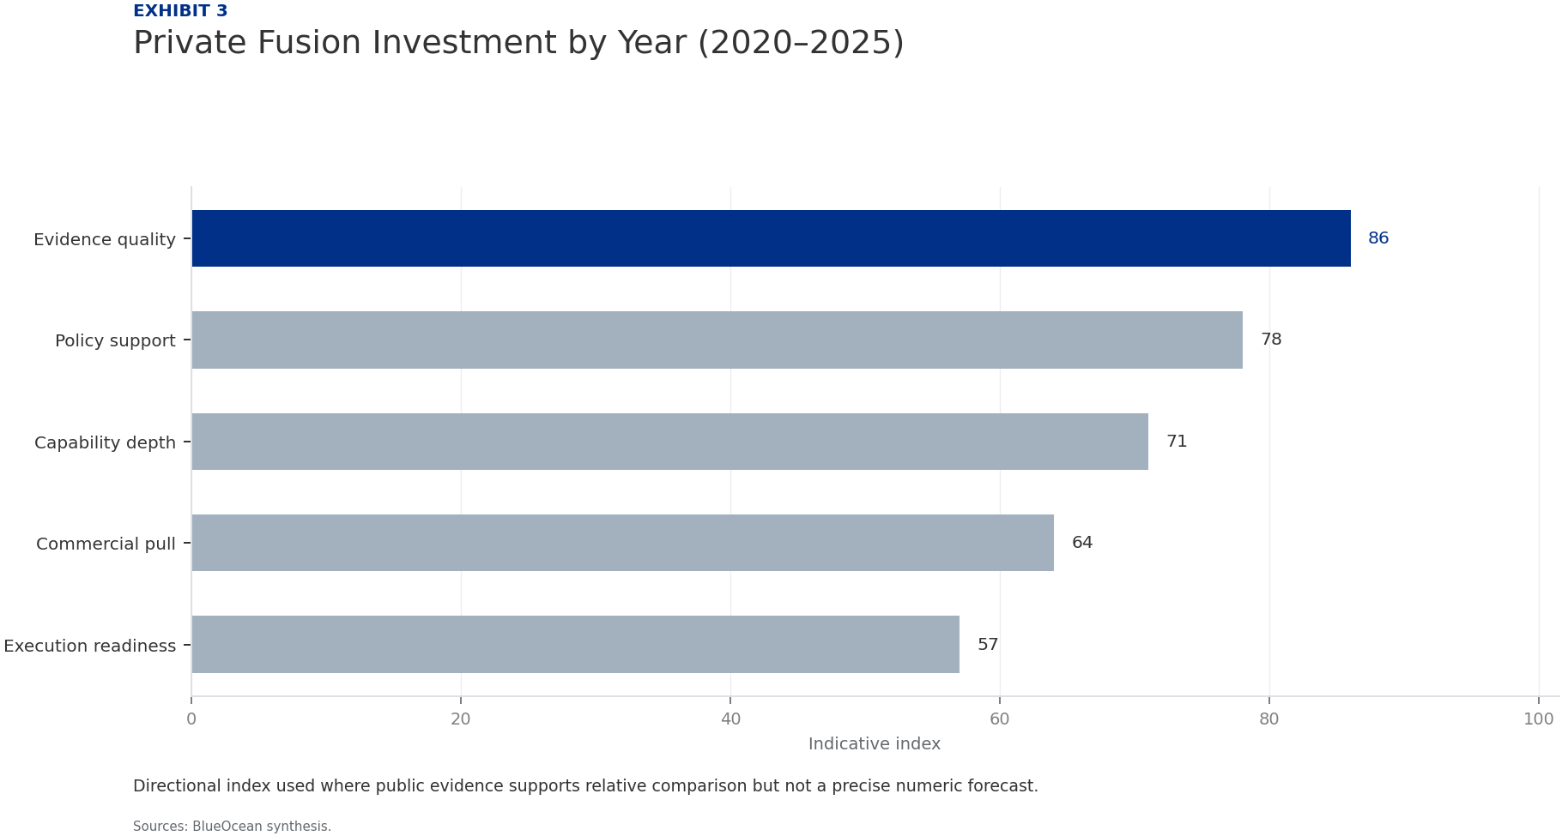
BlueOcean
Exhibit 3: evidence clarifies the strategic trade-off
Exhibit 3: evidence clarifies the strategic trade-off

Slide 15
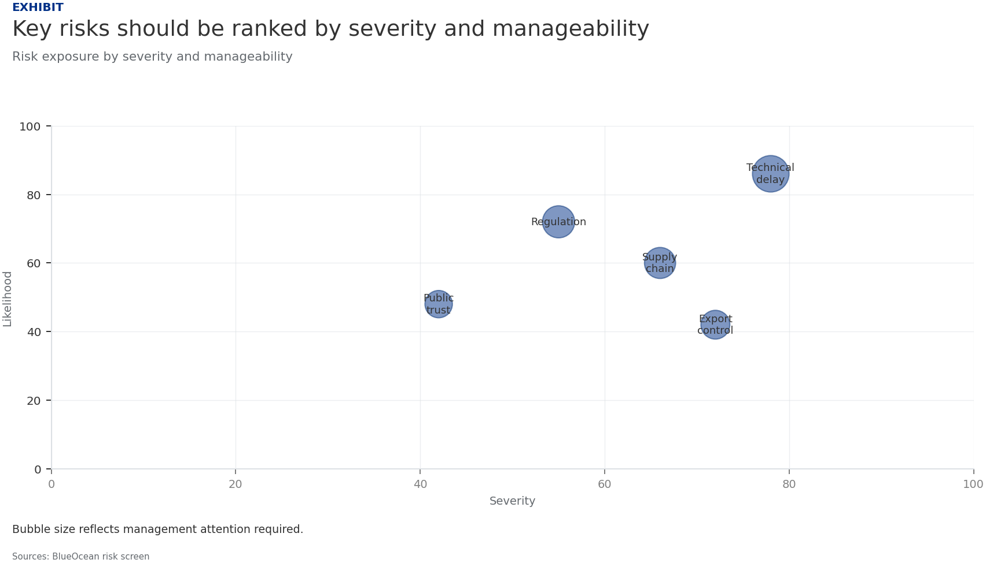
BlueOcean
Exhibit 4: evidence clarifies the strategic trade-off
Exhibit 4: evidence clarifies the strategic trade-off

Slide 16
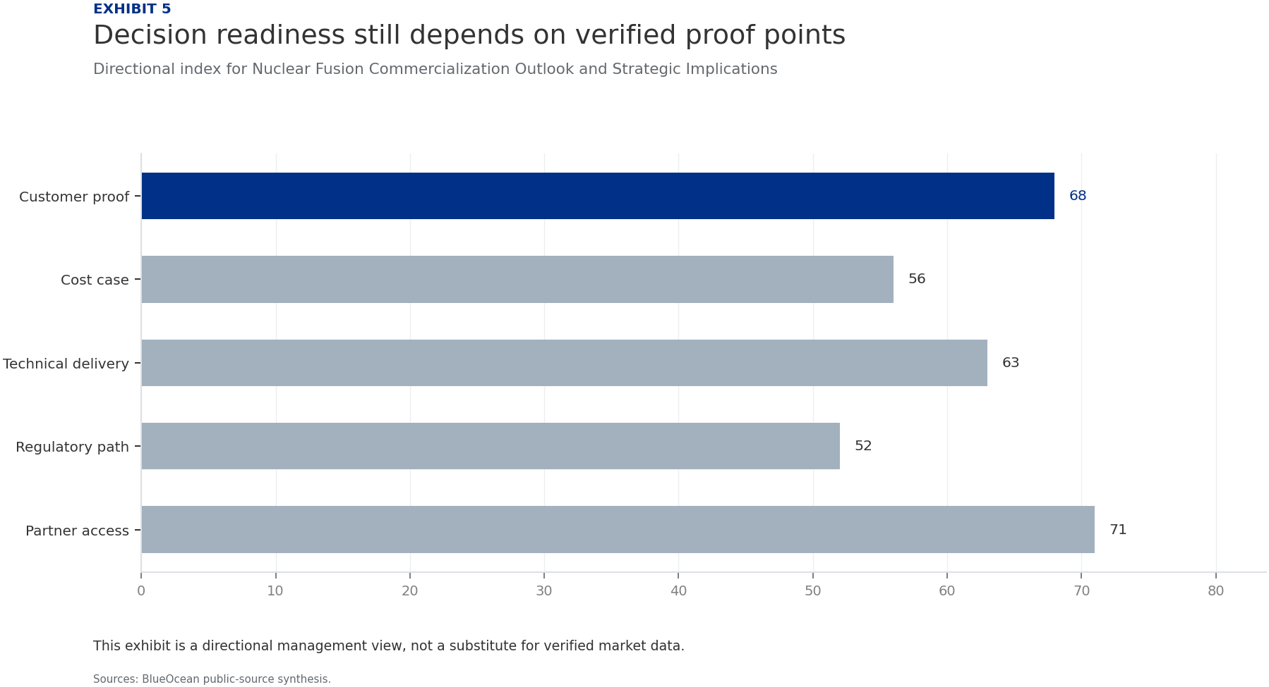
BlueOcean
Exhibit 5: evidence clarifies the strategic trade-off
Exhibit 5: evidence clarifies the strategic trade-off

Slide 17
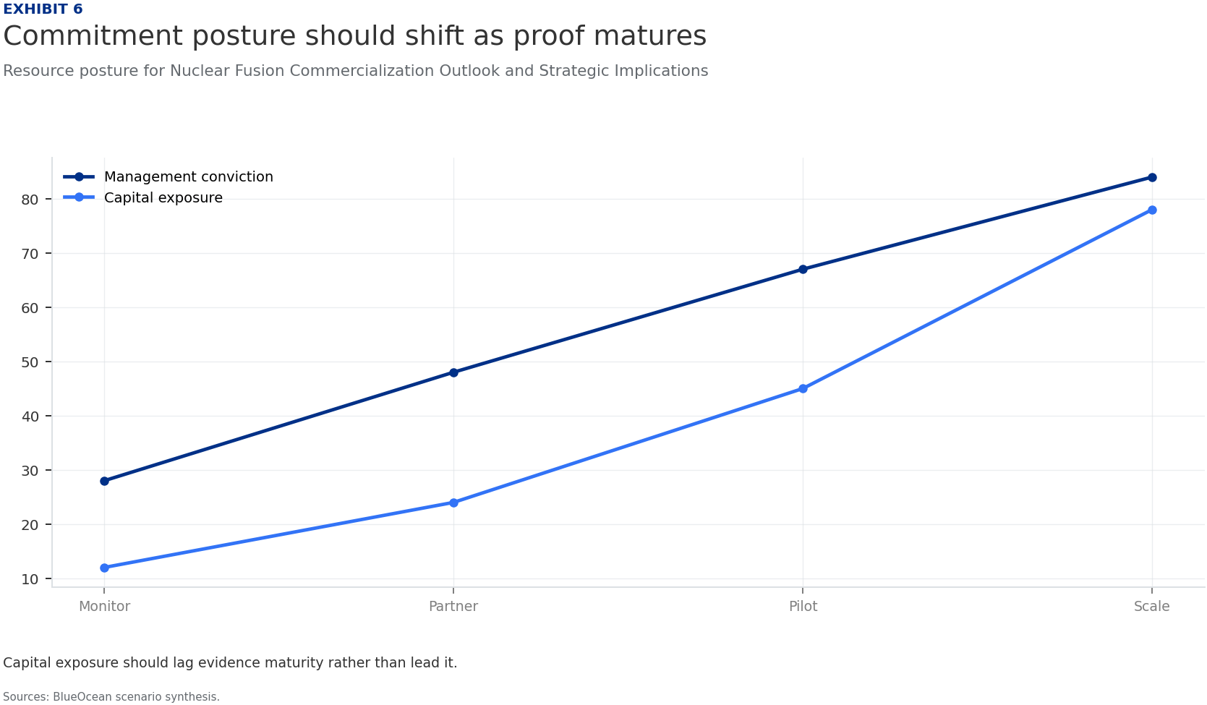
BlueOcean
Exhibit 6: evidence clarifies the strategic trade-off
Exhibit 6: evidence clarifies the strategic trade-off

Slide 18
BlueOcean
The next step is to convert the research into a short list of decisions
A Decision-Ready Analysis for Senior Executives and Strategic Investors
Closing

