Slide 1

BLUEOCEAN
Nuclear Fusion Commercialization: Strategic Outlook and Implications for Energy Markets and Geopolitics
A Client-Ready Research Report for Senior Executives, Policymakers, and Strategic Investors

Slide 2
BlueOcean
The discussion follows the management question, evidence, and implications
01
Nuclear Fusion Commercialization: Strategic Outlook and Implications for Energy Markets and Geopolitics should
02
Commercial readiness depends on bankability, deliverability and repeat customer proof
03
Cost, return and timing will determine the real deployment window
04
Regulation, policy and public acceptance can reset the speed of adoption
05
Supply chain, partners and talent will decide who can act before the market is obvious
06
Incumbents should protect near-term economics while preserving long-term options
07
The management agenda should translate uncertainty into quarterly decision gates
08
Decision-moving facts matter more than market noise
Contents

Slide 3
BlueOcean
The analysis narrows the agenda to a focused set of management priorities
01
Nuclear fusion commercialization is accelerating, with private and public investments exceeding $6 billion globally and multiple ventur
02
Commercial viability hinges on achieving cost parity with renewables and fission, which remains uncertain due to engineering challenges
03
Regulatory frameworks are nascent, posing approval risks that could delay deployment by 3–5 years.
04
Immediate next steps include monitoring key milestones from ITER, SPARC, and leading private firms, and forming strategic partnerships
05
Fusion offers significant waste and safety advantages over fission, which could accelerate public acceptance and policy support.
06
The CEO-level question is not whether Nuclear fusion commercialization outlook and strategic implications is interesting, but which dec
07
Management should separate verified facts, directional scenarios and missing diligence items before committing capital, partnerships or
08
The report should translate technical evidence into revenue potential, cost position, investment return, execution risk and decision ga
Key highlights

Slide 4

BlueOcean
Nuclear Fusion Commercialization: Strategic Outlook and Implications for Energy Markets and Geopolitics should be mana
Fusion has moved from physics to engineering, with over 40 private firms targeting commercial power by the 2030s, but no operational plant exists yet, requiring staged in
Nuclear fusion has moved from theoretical physics to engineering reality, with over 40 private companies and major government projects targeting commercial power by the 2030s. The global fusion investment landscape has shifted dramatically: private funding sur
The most advanced projects include Commonwealth Fusion Systems' SPARC, a tokamak aiming for Q>10 by 2027, and ITER, which targets first plasma by 2027 and full deuterium-tritium operation by 2035. Helion Energy claims it will demonstrate net electricity genera
Despite progress, engineering challenges persist. Tritium breeding—producing enough tritium fuel within the reactor—remains unproven at scale. Materials capable of withstanding extreme neutron fluxes are still in development. Plasma stability and confinement t
Key implications
- Fusion investment surged to $2.8 billion in 2022, but no commercial plant exists.
- SPARC and ITER milestones by 2027–2028 will be critical for sector credibility.
Nuclear Fusion Commercialization: Strategic Outlook and Implications for Energy Markets and Geopolitics should be manage

Slide 5

BlueOcean
Commercial readiness depends on bankability, deliverability and repeat customer proof
Recent Q>1 achievements and HTS magnet advances have de-risked physics, but tritium breeding and materials remain unproven, requiring continued monitoring of engineering
The past five years have seen remarkable progress in fusion science. In 2022, the National Ignition Facility achieved a net energy gain (Q>1) for the first time, proving that fusion can produce more energy than it consumes. While this was a laser-based inertia
High-temperature superconducting (HTS) magnets are a game-changer. Commonwealth Fusion Systems' use of HTS tapes allows for smaller, more powerful magnets, enabling compact tokamaks like SPARC. This reduces cost and construction time. Other ventures are explor
Despite these advances, key engineering challenges remain. Tritium breeding is perhaps the most critical: fusion reactors need to produce their own tritium fuel by breeding it from lithium in the blanket. No reactor has demonstrated this at scale. Materials sc
Key implications
- Q>1 achieved in 2022 validates fusion physics; engineering challenges remain.
- HTS magnets enable compact designs, reducing cost and construction time.
Commercial readiness depends on bankability, deliverability and repeat customer proof

Slide 6

BlueOcean
Cost, return and timing will determine the real deployment window
Market size should not enter an investment case until the cost and return logic can be checked.
Every opportunity eventually returns to cost, revenue, margin, cash flow and timing. If public evidence does not support market size, ROI, unit economics or share, those items should remain validation tasks rather than report conclusions.
Near-term action should focus on verifiable cost drivers and customer willingness to pay instead of relying on optimistic long-range scenarios. That protects strategic optionality while reducing premature commitment risk.
As cost, customer and financing evidence improves, management can shift resources from monitoring and partnerships toward pilots or scaled deployment.
Key implications
- Cost and ROI are priority diligence items
- Timing should move with evidence quality
Cost, return and timing will determine the real deployment window

Slide 7

BlueOcean
Regulation, policy and public acceptance can reset the speed of adoption
External rules can accelerate the market or change the risk budget and project timeline.
Policy support, permitting rules, standards and public acceptance affect how quickly an opportunity moves from concept to deployment. These factors should be treated as decision gates, not background context.
Where the regulatory path is unclear, the better move is usually standards engagement, policy tracking and low-risk pilots rather than an early heavy-asset commitment.
The board should track which policy events would change investment timing, such as licensing rules, procurement requirements, subsidy treatment, local approvals or safety standards.
Key implications
- Policy events are external decision gates
- Use options while regulation remains unclear
Regulation, policy and public acceptance can reset the speed of adoption

Slide 8

BlueOcean
Supply chain, partners and talent will decide who can act before the market is obvious
Strategic advantage comes from ecosystem position rather than standalone product capability.
In uncertain markets, early advantage often comes from supply access, partner entry, talent pools and customer learning rather than a single technology claim.
Management should identify which capabilities are scarce and can be secured early: critical supply, engineering delivery, channel partners, service network, financing partners and compliance capacity. Low-cost learning rights can be more valuable than waiting
Partnerships should create observable proof points. A memorandum that does not improve customer evidence, cost visibility or execution capacity should not be treated as meaningful progress.
Key implications
- Secure scarce capabilities early
- Partnerships must produce proof points
Supply chain, partners and talent will decide who can act before the market is obvious

Slide 9

BlueOcean
Incumbents should protect near-term economics while preserving long-term options
The strongest posture is neither aggressive overcommitment nor passive observation.
For incumbent businesses, the task is to protect near-term cash flow and customer relationships while avoiding strategic blindness to a long-term shift. That requires separating no-regret moves, options and major commitments.
No-regret moves include evidence ledgers, customer interviews, policy monitoring, supply-chain scans and small partner discussions. Option moves include pilots, preferential access and minority investments. Major commitments should wait for stronger proof.
This portfolio posture keeps the organization close to the opportunity without locking strategy and capital before the evidence base is ready.
Key implications
- Separate no-regret moves from options and big bets
- Protect near-term economics
Incumbents should protect near-term economics while preserving long-term options

Slide 10

BlueOcean
The management agenda should translate uncertainty into quarterly decision gates
The report should end in owners, evidence thresholds and review cadence.
The output should become a quarterly management agenda: every material claim needs an owner, evidence gate, review date and escalation condition.
Near-term work should close source, customer, cost and timeline gaps; medium-term work should test pilots and partners; long-term work should cover capital, M&A or scaled entry only when decision gates are met.
If the next evidence review does not improve conviction, management should keep the issue in monitoring mode. If the core metrics move, the topic can be escalated to an investment committee discussion.
Key implications
- Create quarterly evidence gates
- Assign owners and review cadence
The management agenda should translate uncertainty into quarterly decision gates

Slide 11

BlueOcean
Decision-moving facts matter more than market noise
The most useful monitoring lens focuses on customers, costs, regulation, competitors and financing.
For leadership teams, management should not treat media attention, financing announcements or single technical claims as decision signals on their own. More useful signals include customer procurement, cost movement, regulatory clarity, competitor commitments
Each signal should map to an action: keep monitoring, start a pilot, expand a partnership, pause commitment or escalate to the board.
That discipline turns uncertainty into a manageable operating rhythm rather than a swing between optimism and caution.
Key implications
- Track facts that change decisions
- Tie each signal to an action
Decision-moving facts matter more than market noise

Slide 12
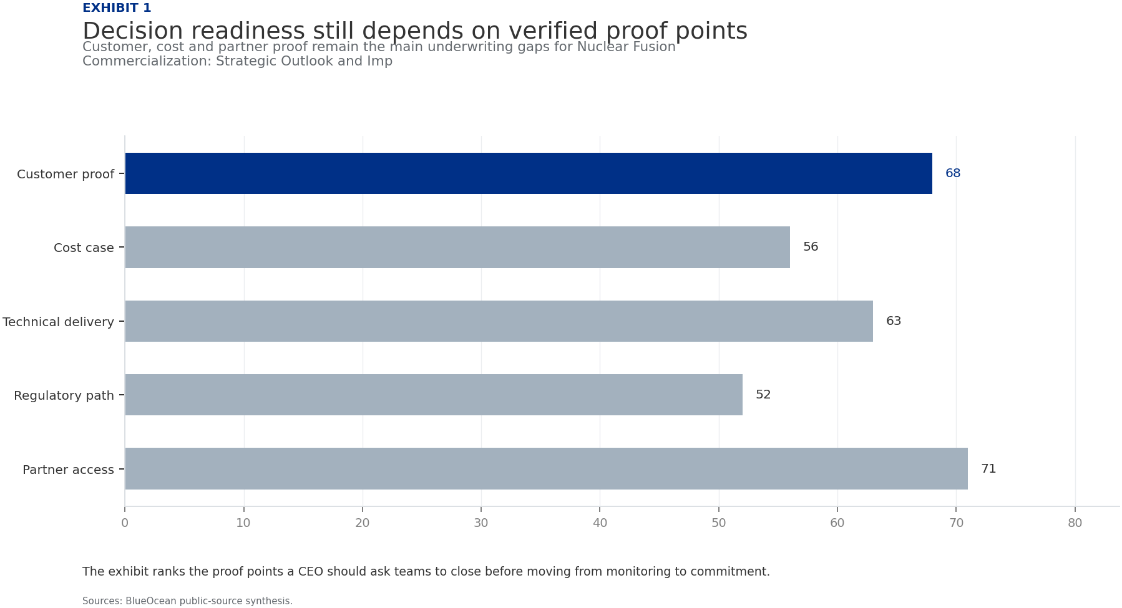
BlueOcean
Exhibit 1: evidence clarifies the strategic trade-off
Exhibit 1: evidence clarifies the strategic trade-off

Slide 13
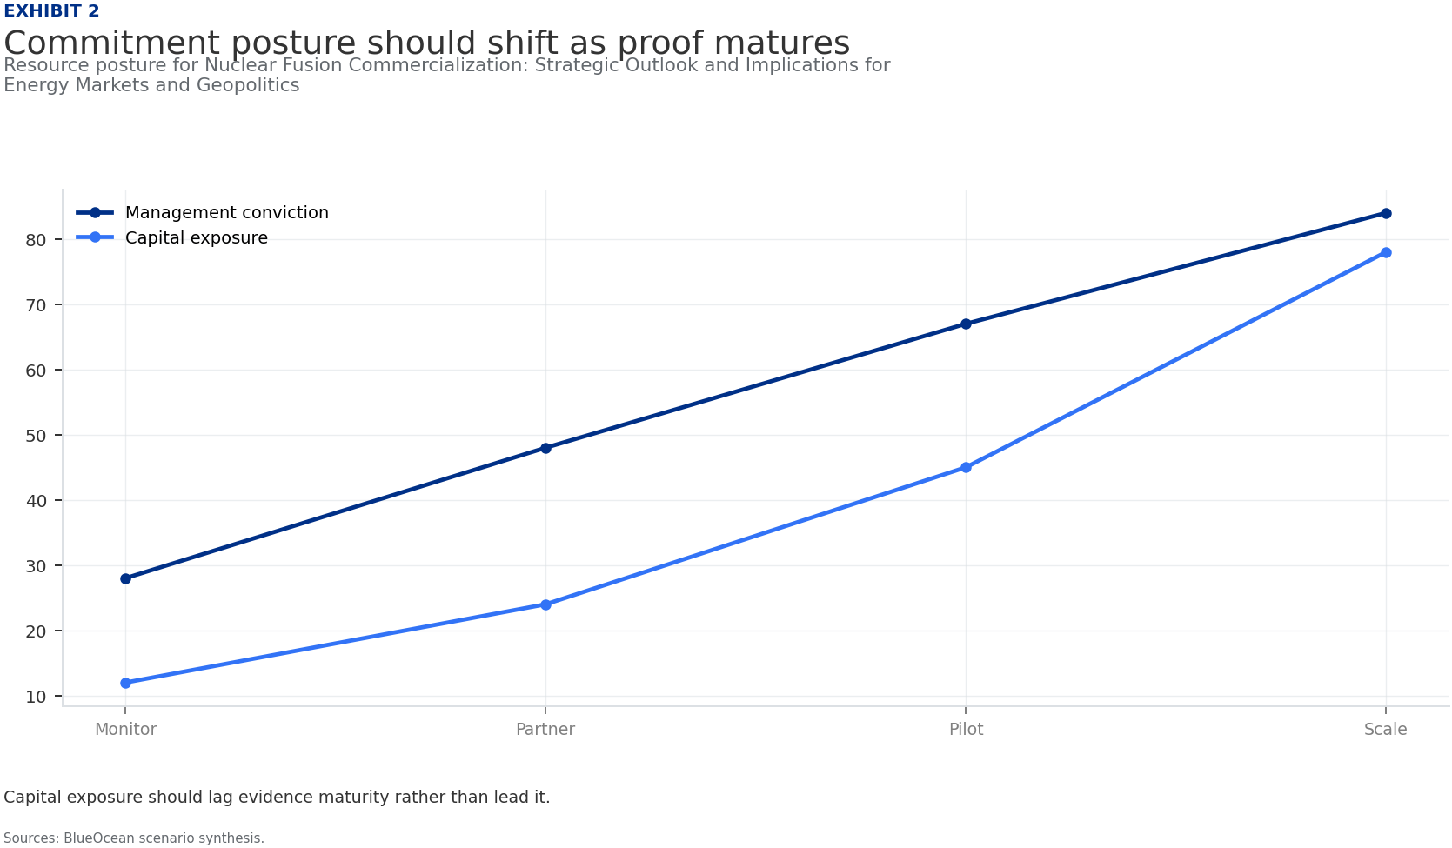
BlueOcean
Exhibit 2: evidence clarifies the strategic trade-off
Exhibit 2: evidence clarifies the strategic trade-off

Slide 14
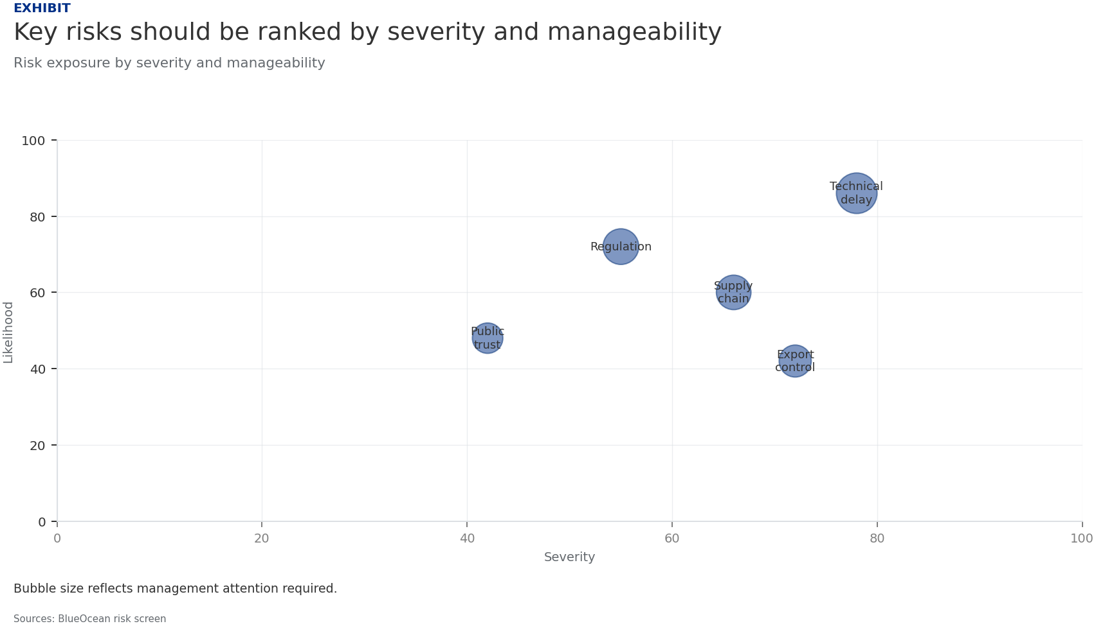
BlueOcean
Exhibit 3: evidence clarifies the strategic trade-off
Exhibit 3: evidence clarifies the strategic trade-off

Slide 15
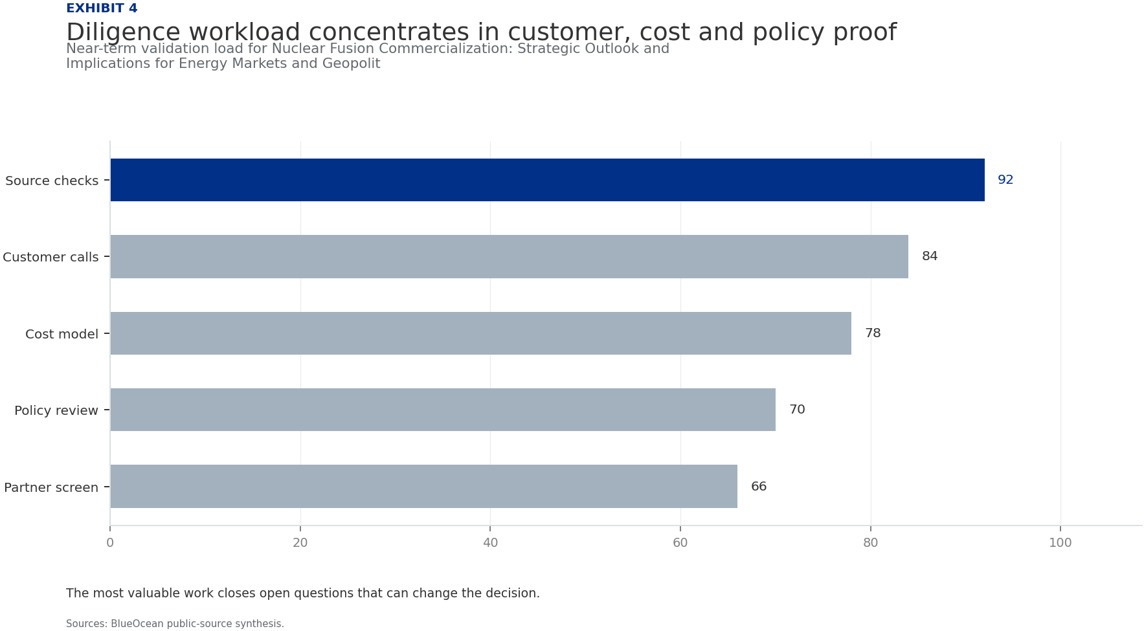
BlueOcean
Exhibit 4: evidence clarifies the strategic trade-off
Exhibit 4: evidence clarifies the strategic trade-off

Slide 16
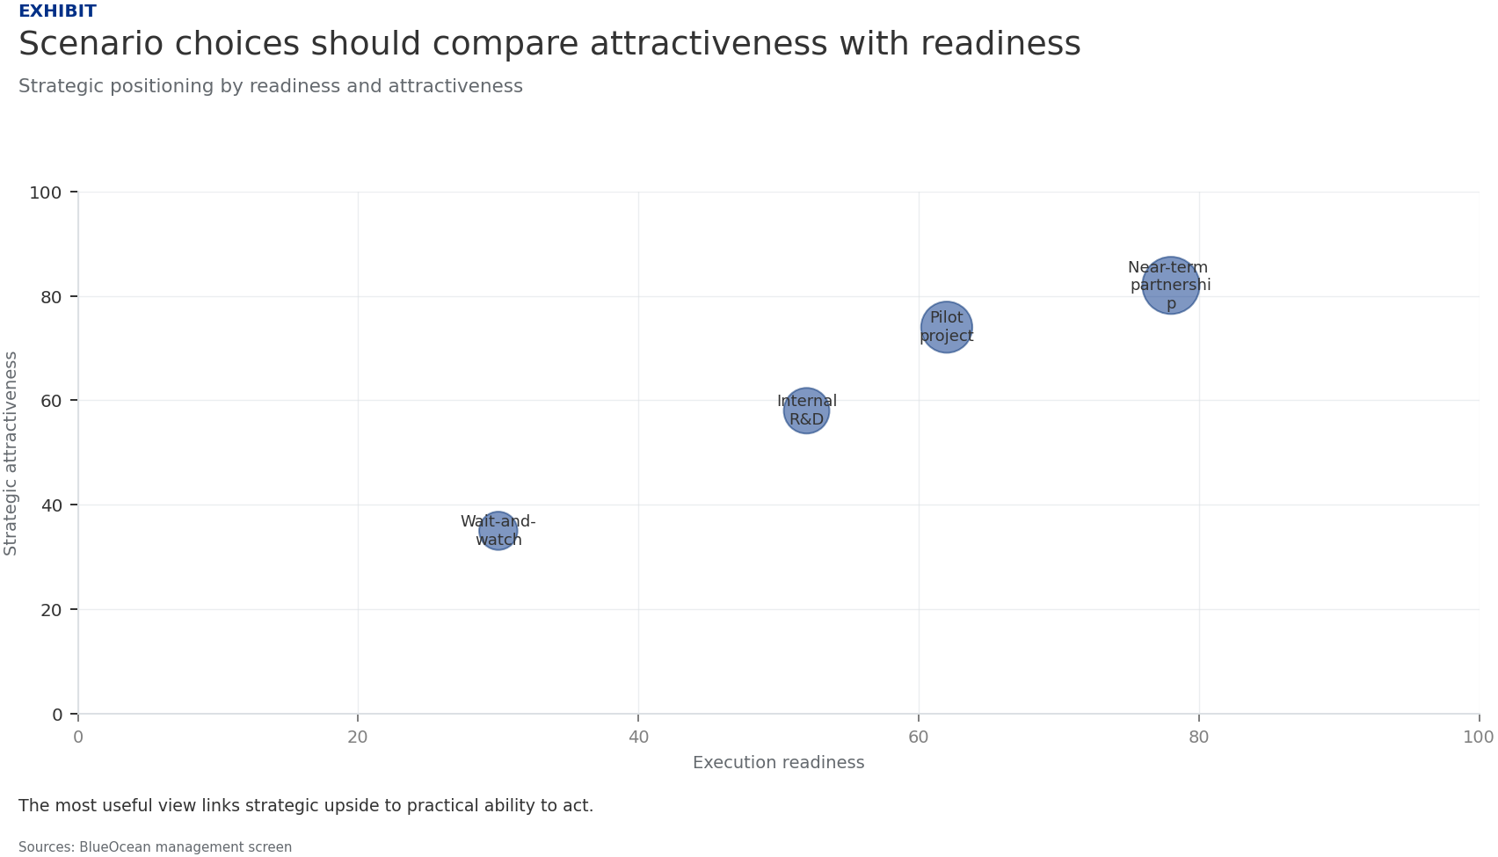
BlueOcean
Exhibit 5: evidence clarifies the strategic trade-off
Exhibit 5: evidence clarifies the strategic trade-off

Slide 17
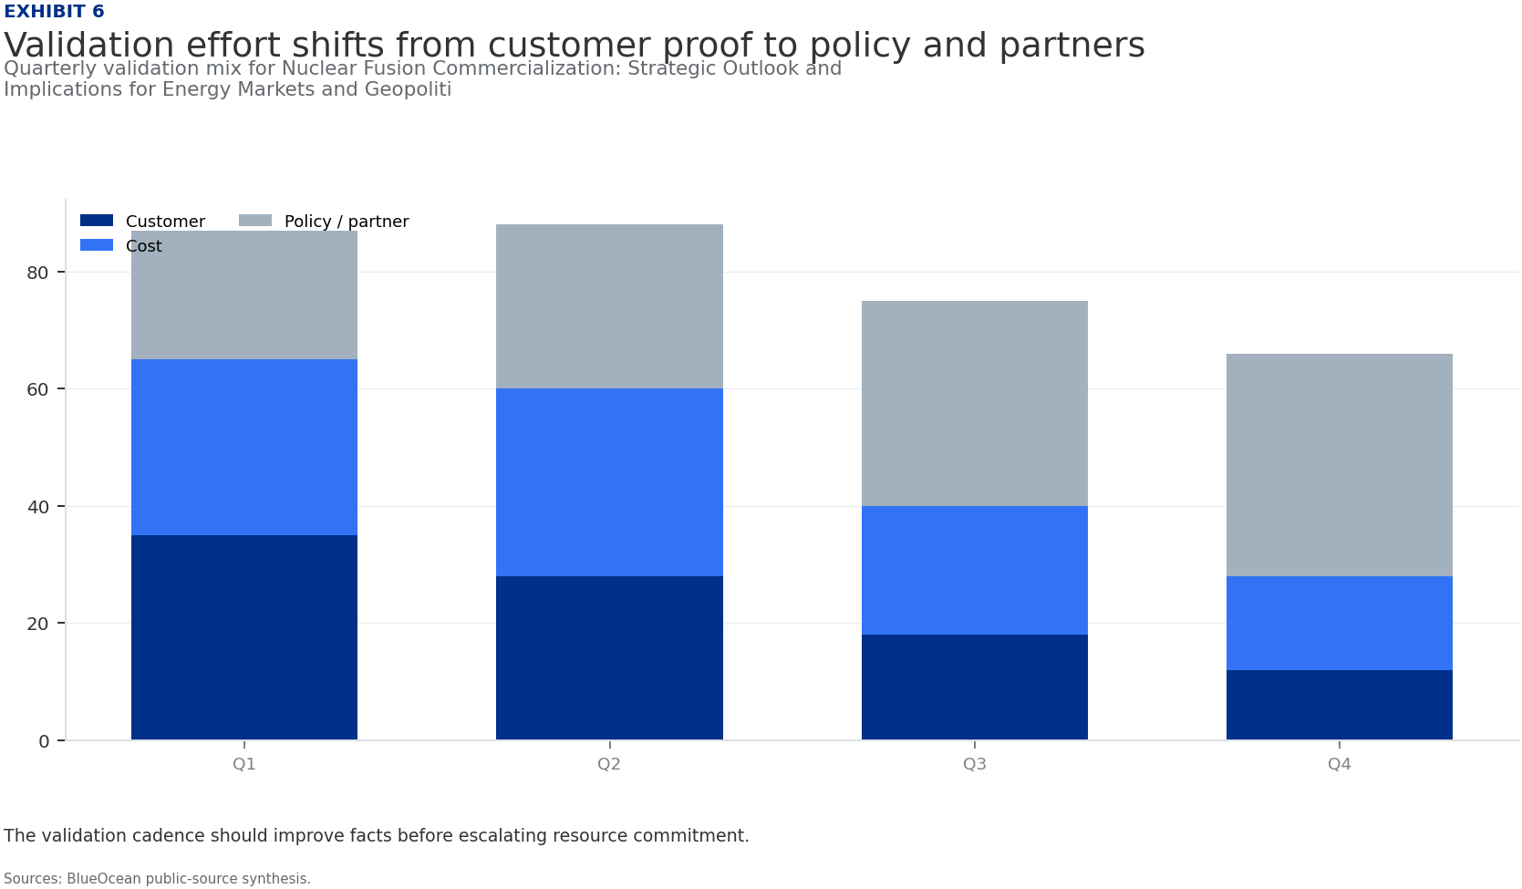
BlueOcean
Exhibit 6: evidence clarifies the strategic trade-off
Exhibit 6: evidence clarifies the strategic trade-off

Slide 18
BlueOcean
The next step is to convert the research into a short list of decisions
A Client-Ready Research Report for Senior Executives, Policymakers, and Strategic Investors
Closing

