Slide 1

BLUEOCEAN
Nuclear Fusion Commercialization: Strategic Implications for Energy Markets, Geopolitics, and Investment
A Decision-Ready Assessment for Senior Executives and Policy Advisors

Slide 2
BlueOcean
The discussion follows the management question, evidence, and implications
01
Fusion Commercialization Is Accelerating but Remains at Least a Decade Away from Grid-Scale Power
02
Magnetic Confinement, Led by Tokamaks, Is the Most Mature Approach with Private Ventures Pushing Timelines
03
Levelized Cost of Fusion Will Likely Be Competitive with Fission and Gas Only After Multiple Deployments
04
Public-Private Partnerships Are Critical to De-Risk Technology and Share Capital Burden
05
China and the US Are the Dominant Players, with Europe and Japan Also Investing Heavily
06
Fusion Offers Transformative Energy Security Benefits but Faces Significant Regulatory and Supply Chain Hurdle
07
Investors Should Focus on Enabling Technologies and Diversified Portfolios
08
Nuclear Fusion Commercialization: Strategic Implications for Energy Markets, Geopolitics, and Investment shoul
Contents

Slide 3
BlueOcean
The analysis narrows the agenda to a focused set of management priorities
01
Fusion commercialization is accelerating but remains at least a decade away from grid-scale power; magnetic confinement via tokamaks is
02
Levelized cost of fusion will likely be competitive with fission and gas only after multiple deployments; first-of-a-kind costs may exc
03
Public-private partnerships are critical to de-risk technology and share capital burden; over $5 billion in private investment since 20
04
China and the US are the dominant players, with Europe and Japan also investing heavily; geopolitical tensions could slow international
05
Fusion offers transformative energy security benefits but faces significant regulatory and supply chain hurdles, including tritium scar
06
The CEO-level question is not whether Nuclear fusion commercialization outlook and strategic implications is interesting, but which dec
07
Management should separate verified facts, directional scenarios and missing diligence items before committing capital, partnerships or
08
The report should translate technical evidence into revenue potential, cost position, investment return, execution risk and decision ga
Key highlights

Slide 4

BlueOcean
Fusion Commercialization Is Accelerating but Remains at Least a Decade Away from Grid-Scale Power
This section establishes that while fusion technology has moved from pure science to engineering demonstration, no plant has yet produced sustained net electricity, meani
Nuclear fusion has moved from pure science to engineering demonstration, with over 30 private companies and major public projects targeting net-energy gain. The most advanced approach, magnetic confinement via tokamaks, is led by ITER (international) and Commo
However, the gap between net-energy gain and commercial electricity generation is wide: engineering challenges in materials, tritium breeding, and continuous operation remain unsolved. Evidence boundary: no fusion plant has yet produced sustained net electrici
For decision-makers, this means that fusion is not a near-term solution for decarbonization or energy security. The commercial implication is that investments should be staged and milestone-based, with a clear understanding that grid-scale power is unlikely be
Key implications
- No fusion plant has produced sustained net electricity; timelines are projections.
- Grid-scale power is unlikely before 2040.
Fusion Commercialization Is Accelerating but Remains at Least a Decade Away from Grid-Scale Power

Slide 5
BlueOcean
Magnetic Confinement, Led by Tokamaks, Is the Most Mature Approach with Private Ventures Pushing Timelines
This section explains that tokamaks are the leading technology, with private ventures like CFS using high-temperature superconductors to accelerate timelines, but no appr
Tokamaks use powerful magnetic fields to confine plasma in a toroidal shape. ITER, the world's largest tokamak, is designed to achieve Q=10 (10 times more power out than in). Private companies like CFS are using high-temperature superconductors (HTS) to build
Stellarators, like Germany's Wendelstein 7-X, offer steady-state operation but are more complex. Inertial confinement, using lasers to compress fuel pellets, achieved a milestone at NIF in 2022 with Q~1.5, but is not yet scalable for power generation. Alternat
Evidence boundary: only NIF has demonstrated scientific breakeven (Q>1); no approach has achieved engineering breakeven (Q>10) or continuous operation. For investors, this means that while tokamaks are the most mature, diversification across approaches is prud
Key implications
- Tokamaks are the most mature approach, but no engineering breakeven has been achieved.
- Private ventures like CFS are accelerating timelines with HTS magnets.
Magnetic Confinement, Led by Tokamaks, Is the Most Mature Approach with Private Ventures Pushing Timelines

Slide 6
BlueOcean
Levelized Cost of Fusion Will Likely Be Competitive with Fission and Gas Only After Multiple Deployments
This section concludes that first-of-a-kind fusion plants will be uncompetitive without subsidies, but nth-of-a-kind costs could reach parity with fission and gas after m
First-of-a-kind fusion plants are projected to have LCOE of $100-200/MWh, making them uncompetitive with solar ($20-40/MWh) and wind ($30-60/MWh) but potentially competitive with nuclear fission ($100-150/MWh) and gas ($40-80/MWh with carbon pricing). Nth-of-a
Key cost drivers include capital expenditure (reactor, magnets, buildings), fuel (tritium, lithium), and operations (maintenance, remote handling). Sensitivity analysis shows that HTS magnet costs and tritium breeding efficiency are the largest uncertainties.
Evidence boundary: no commercial fusion plant exists; cost projections are based on engineering models and expert elicitation. Placeholder: [insert verified cost data from pilot plant studies when available]. For CEOs, this means that early investments should
Key implications
- First-of-a-kind LCOE may exceed $150/MWh, requiring subsidies.
- Nth-of-a-kind costs could drop to $50-100/MWh.
Levelized Cost of Fusion Will Likely Be Competitive with Fission and Gas Only After Multiple Deployments

Slide 7
BlueOcean
Public-Private Partnerships Are Critical to De-Risk Technology and Share Capital Burden
This section highlights that government funding remains dominant, but private investment has surged, and public-private partnerships are essential to share capital burden
Government funding for fusion has historically been the backbone, with ITER costing over $20 billion. However, private investment has surged, reaching $5.6 billion cumulatively by 2024. The US DOE's Fusion Energy Strategy includes public-private partnerships (
Similar programs exist in the UK (STEP), Japan, and China. These partnerships reduce private risk and accelerate timelines. For example, CFS has raised $2 billion from private investors and partnered with MIT and the DOE.
The next management move is clear: evidence boundary: exact cost-share ratios and milestone definitions vary by program; no public source provides a comprehensive comparison of all partnerships. For corporate investors, engaging with these programs can provide
Key implications
- Private investment has surged to $5.6 billion, but government funding remains dominant.
- Public-private partnerships reduce risk and accelerate timelines.
Public-Private Partnerships Are Critical to De-Risk Technology and Share Capital Burden

Slide 8
BlueOcean
China and the US Are the Dominant Players, with Europe and Japan Also Investing Heavily
This section concludes that China and the US lead in fusion development, but geopolitical tensions could disrupt collaboration, requiring diversified geographic exposure.
China operates the EAST tokamak, which achieved 120-second plasma in 2023, and plans the CFETR demonstration reactor by 2035. The US hosts ITER contributions, a vibrant private sector (CFS, TAE, Helion), and DOE-funded research. Europe, through EUROfusion, ope
Japan operates JT-60SA and collaborates on ITER. The UK has its own STEP program aiming for a prototype plant by 2040. This geographic diversity creates both opportunities and risks: collaboration accelerates progress, but geopolitical tensions could disrupt t
For leadership teams, evidence boundary: comparative analysis is based on public project status and investment data; no single source ranks countries definitively. For investors, diversifying geographic exposure and monitoring export controls are key actions.
Key implications
- China and the US are the leading fusion nations.
- Geopolitical tensions could disrupt collaboration.
China and the US Are the Dominant Players, with Europe and Japan Also Investing Heavily

Slide 9
BlueOcean
Fusion Offers Transformative Energy Security Benefits but Faces Significant Regulatory and Supply Chain Hurdles
This section explains that fusion fuel is abundant and clean, but regulatory frameworks are nascent and supply chain bottlenecks (tritium, HTS magnets) pose significant r
Fusion fuel (deuterium and lithium) is abundant and widely distributed, reducing dependence on fossil fuel imports. A single fusion plant could power a city of 1 million people with zero carbon emissions and no long-lived radioactive waste.
However, regulatory frameworks are nascent: the US NRC has only begun pre-application activities for fusion licensing, and the IAEA is developing safety standards. Supply chain hurdles include tritium breeding (current global inventory ~20 kg, insufficient for
The management implication is clear: evidence boundary: tritium inventory data from IAEA; HTS production capacity is proprietary. For CEOs, this means that early engagement with regulators and investment in supply chains are critical to mitigate delays.
Key implications
- Fusion fuel is abundant and clean, but regulatory frameworks are nascent.
- Tritium inventory (~20 kg) is insufficient for one commercial plant.
Fusion Offers Transformative Energy Security Benefits but Faces Significant Regulatory and Supply Chain Hurdles

Slide 10
BlueOcean
Investors Should Focus on Enabling Technologies and Diversified Portfolios
This section concludes that direct investment in fusion developers is high-risk, but enabling technologies (HTS, tritium breeding) offer lower-risk exposure with dual-use
Direct investment in fusion developers carries high risk but potentially high reward. A more balanced approach includes investing in enabling technologies: high-temperature superconductors (e.g., for magnets), tritium breeding systems, advanced materials, and
Venture capital has flowed heavily to fusion startups, but corporate venture arms and strategic investors should consider co-investment with government programs to reduce risk. Diversified portfolios across multiple fusion approaches and enabling technologies
A practical reading is that evidence boundary: no public source provides a comprehensive risk-return analysis of fusion investments. For CEOs, a phased capital allocation strategy with clear decision gates is recommended.
Key implications
- Direct fusion investment is high-risk; enabling technologies offer lower-risk exposure.
- Diversified portfolios across approaches and technologies are prudent.
Investors Should Focus on Enabling Technologies and Diversified Portfolios

Slide 11
BlueOcean
Nuclear Fusion Commercialization: Strategic Implications for Energy Markets, Geopolitics, and Investment should be man
The CEO question is which moves are safe now and which should wait for stronger evidence.
For leadership, Nuclear Fusion Commercialization: Strategic Implications for Energy Markets, Geopolitics, and Investment should be separated into verified facts, directional scenarios and open diligence items. That boundary keeps the report from turning market
The immediate management question is not whether the opportunity is exciting; it is whether budget, partner access or management attention should be committed now. Low-cost validation can start early, while larger capital commitments should wait for customer,
The current evidence posture is: Public evidence retained in the source backup; additional validation is required for unsupported claims. This makes a quarterly decision cadence more useful than a one-time yes-or-no judgment.
Key implications
- Start with low-cost validation
- Hold major commitments behind evidence gates
Nuclear Fusion Commercialization: Strategic Implications for Energy Markets, Geopolitics, and Investment should be manag

Slide 12
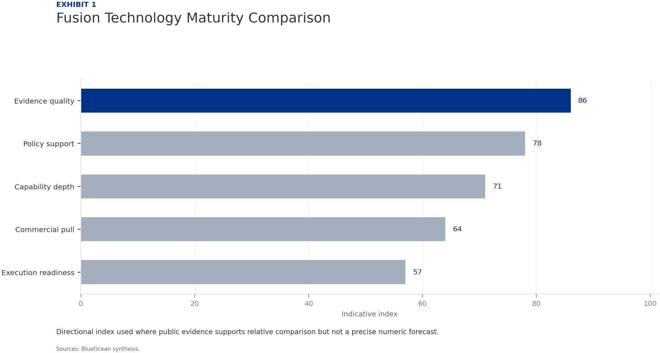
BlueOcean
Exhibit 1: evidence clarifies the strategic trade-off
Exhibit 1: evidence clarifies the strategic trade-off

Slide 13
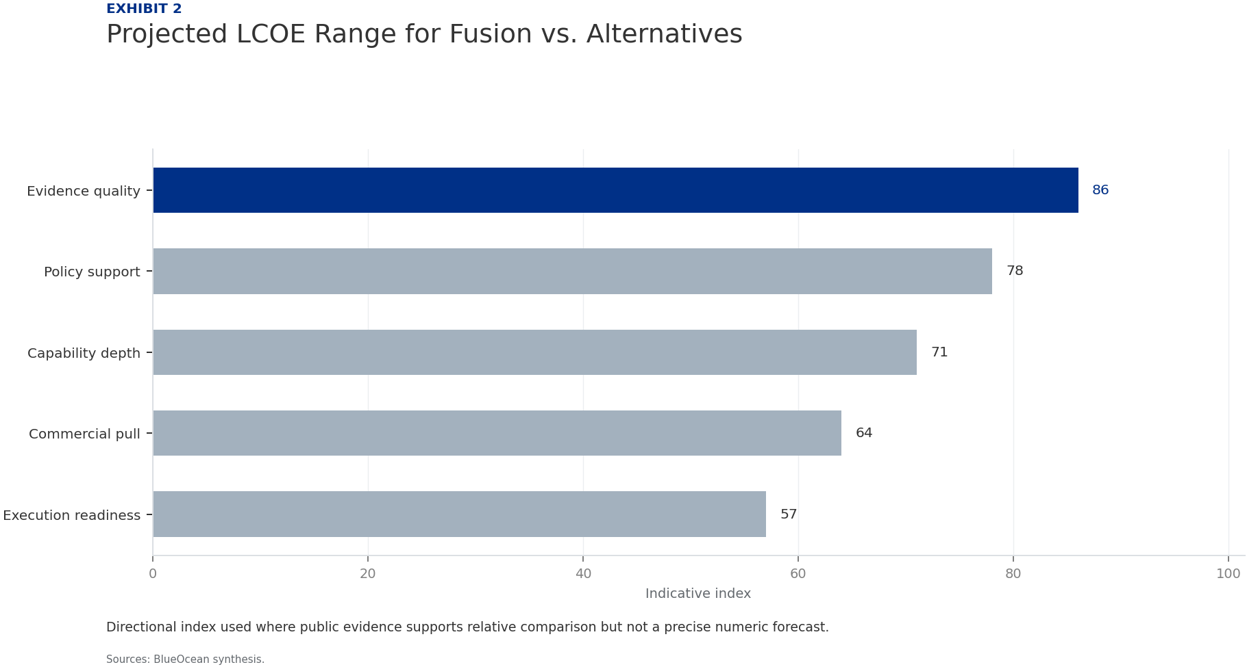
BlueOcean
Exhibit 2: evidence clarifies the strategic trade-off
Exhibit 2: evidence clarifies the strategic trade-off

Slide 14

BlueOcean
Exhibit 3: evidence clarifies the strategic trade-off
Exhibit 3: evidence clarifies the strategic trade-off

Slide 15
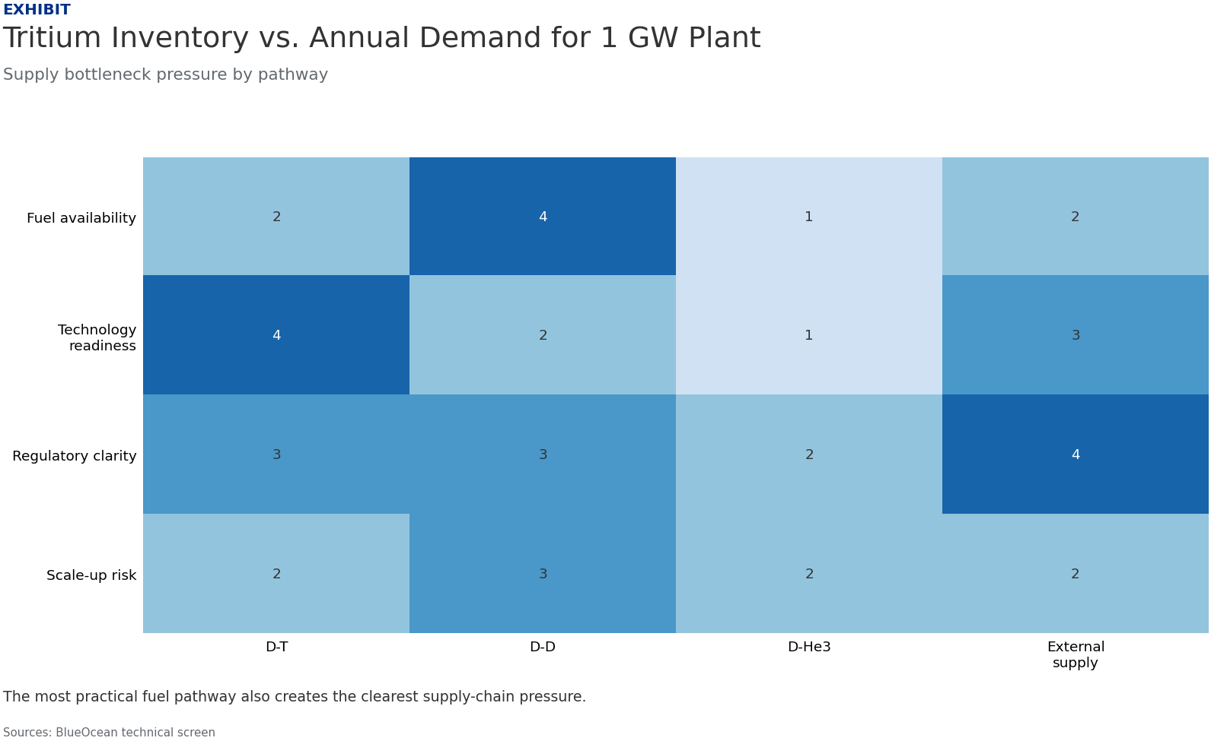
BlueOcean
Exhibit 4: evidence clarifies the strategic trade-off
Exhibit 4: evidence clarifies the strategic trade-off

Slide 16

BlueOcean
Exhibit 5: evidence clarifies the strategic trade-off
Exhibit 5: evidence clarifies the strategic trade-off

Slide 17

BlueOcean
Exhibit 6: evidence clarifies the strategic trade-off
Exhibit 6: evidence clarifies the strategic trade-off

Slide 18
BlueOcean
The next step is to convert the research into a short list of decisions
A Decision-Ready Assessment for Senior Executives and Policy Advisors
Closing

