Slide 1

BLUEOCEAN
Nuclear Fusion Commercialization Outlook and Strategic Implications
A Decision-Ready Analysis for Senior Executives

Slide 2
BlueOcean
The discussion follows the management question, evidence, and implications
01
Nuclear Fusion Commercialization Outlook and Strategic Implications should be managed as a staged strategic op
02
Commercial readiness depends on bankability, deliverability and repeat customer proof
03
Cost, return and timing will determine the real deployment window
04
Regulation, policy and public acceptance can reset the speed of adoption
05
Supply chain, partners and talent will decide who can act before the market is obvious
06
Incumbents should protect near-term economics while preserving long-term options
07
The management agenda should translate uncertainty into quarterly decision gates
08
Decision-moving facts matter more than market noise
Contents

Slide 3
BlueOcean
The analysis narrows the agenda to a focused set of management priorities
01
Nuclear fusion is transitioning from laboratory science to engineering demonstration, with over $6 billion in private investment and ma
02
The strategic implication is clear: fusion could disrupt energy markets by providing abundant, low-carbon baseload power, but its econo
03
For executives, the immediate next step is to monitor fusion ventures, engage in scenario planning, and prepare for potential partnersh
04
This report synthesizes publicly available evidence, highlighting where data is robust and where uncertainty remains. The evidence pack
05
Validation gaps include the absence of verified cost data, market size forecasts, and detailed technical performance metrics. Where dat
06
The CEO-level question is not whether Nuclear fusion commercialization outlook and strategic implications is interesting, but which dec
07
Management should separate verified facts, directional scenarios and missing diligence items before committing capital, partnerships or
08
The report should translate technical evidence into revenue potential, cost position, investment return, execution risk and decision ga
Key highlights

Slide 4

BlueOcean
Nuclear Fusion Commercialization Outlook and Strategic Implications should be managed as a staged strategic option, no
Nuclear fusion has long been considered the holy grail of energy, promising virtually limitless, clean power. In recent years, the pace of development has accelerated, dr
Over 30 private fusion companies have raised more than $6 billion, with notable players like Commonwealth Fusion Systems, TAE Technologies, and Helion Energy targeting commercial electricity by the mid-2030s. Public projects like ITER in France and the UK's ST
However, despite this momentum, no fusion device has yet demonstrated sustained net energy gain (Q>1) at a scale relevant for power generation. ITER, the largest experimental reactor, is not expected to achieve its goal of Q=10 until 2035 at the earliest, and
The gap between current capabilities and commercial requirements remains substantial, particularly in plasma confinement, materials that can withstand high neutron fluxes, and tritium breeding. For executives, this means fusion is a long-term opportunity that
Key implications
- Fusion is real but not imminent; commercial deployment is at least 15-25 years away.
- Private investment has surged, but technical milestones remain unverified.
Nuclear Fusion Commercialization Outlook and Strategic Implications should be managed as a staged strategic option, not

Slide 5
BlueOcean
Commercial readiness depends on bankability, deliverability and repeat customer proof
Global fusion investment has grown exponentially, from less than $100 million per year in 2010 to over $1 billion annually in 2024. Private companies account for the majo
Commonwealth Fusion Systems has raised over $2 billion, Helion Energy over $1 billion, and TAE Technologies over $1 billion. Public funding remains substantial, with ITER's budget exceeding $20 billion and national programs in the US, UK, Japan, and China.
This influx of capital has enabled rapid progress in key enabling technologies, such as high-temperature superconducting magnets, advanced plasma diagnostics, and AI-driven optimization. However, the core technical challenge—achieving and sustaining a fusion p
The most advanced private designs aim to demonstrate Q>1 by 2025-2030, but these are small-scale devices that may not scale to commercial power levels. Materials that can withstand the intense neutron bombardment in a fusion reactor are still in development, w
Key implications
- Investment is high but technical risk remains substantial.
- Key enabling technologies are advancing, but core fusion challenges persist.
Commercial readiness depends on bankability, deliverability and repeat customer proof

Slide 6
BlueOcean
Cost, return and timing will determine the real deployment window
For fusion to compete in electricity markets, its levelized cost of energy (LCOE) must be comparable to or lower than existing low-carbon sources. Current projections for
In contrast, solar and wind LCOE have already fallen below $30/MWh in many regions, and natural gas remains competitive at $20-40/MWh. Fusion's capital costs are estimated at $5-10 billion per GW, similar to fission, but construction timelines are unproven and
Financing costs will be higher for first-of-a-kind plants due to technology risk. Fusion's economic case may be stronger in applications where high-temperature heat is needed, such as industrial processes or hydrogen production, where renewables face challenge
To be viable, fusion must achieve high availability (above 90%) and low operating costs, which have not yet been demonstrated. Executives should treat fusion cost projections as directional and focus on the cost trajectory of competing technologies. The key qu
Key implications
- Fusion LCOE projections are unverified and range widely.
- Competing technologies (solar, wind, gas) are already cheaper.
Cost, return and timing will determine the real deployment window

Slide 7
BlueOcean
Regulation, policy and public acceptance can reset the speed of adoption
External rules can accelerate the market or change the risk budget and project timeline.
Policy support, permitting rules, standards and public acceptance affect how quickly an opportunity moves from concept to deployment. These factors should be treated as decision gates, not background context.
Where the regulatory path is unclear, the better move is usually standards engagement, policy tracking and low-risk pilots rather than an early heavy-asset commitment.
The board should track which policy events would change investment timing, such as licensing rules, procurement requirements, subsidy treatment, local approvals or safety standards.
Key implications
- Policy events are external decision gates
- Use options while regulation remains unclear
Regulation, policy and public acceptance can reset the speed of adoption

Slide 8
BlueOcean
Supply chain, partners and talent will decide who can act before the market is obvious
Strategic advantage comes from ecosystem position rather than standalone product capability.
In uncertain markets, early advantage often comes from supply access, partner entry, talent pools and customer learning rather than a single technology claim.
Management should identify which capabilities are scarce and can be secured early: critical supply, engineering delivery, channel partners, service network, financing partners and compliance capacity. Low-cost learning rights can be more valuable than waiting
Partnerships should create observable proof points. A memorandum that does not improve customer evidence, cost visibility or execution capacity should not be treated as meaningful progress.
Key implications
- Secure scarce capabilities early
- Partnerships must produce proof points
Supply chain, partners and talent will decide who can act before the market is obvious

Slide 9
BlueOcean
Incumbents should protect near-term economics while preserving long-term options
The strongest posture is neither aggressive overcommitment nor passive observation.
For incumbent businesses, the task is to protect near-term cash flow and customer relationships while avoiding strategic blindness to a long-term shift. That requires separating no-regret moves, options and major commitments.
No-regret moves include evidence ledgers, customer interviews, policy monitoring, supply-chain scans and small partner discussions. Option moves include pilots, preferential access and minority investments. Major commitments should wait for stronger proof.
This portfolio posture keeps the organization close to the opportunity without locking strategy and capital before the evidence base is ready.
Key implications
- Separate no-regret moves from options and big bets
- Protect near-term economics
Incumbents should protect near-term economics while preserving long-term options

Slide 10
BlueOcean
The management agenda should translate uncertainty into quarterly decision gates
The report should end in owners, evidence thresholds and review cadence.
The output should become a quarterly management agenda: every material claim needs an owner, evidence gate, review date and escalation condition.
Near-term work should close source, customer, cost and timeline gaps; medium-term work should test pilots and partners; long-term work should cover capital, M&A or scaled entry only when decision gates are met.
If the next evidence review does not improve conviction, management should keep the issue in monitoring mode. If the core metrics move, the topic can be escalated to an investment committee discussion.
Key implications
- Create quarterly evidence gates
- Assign owners and review cadence
The management agenda should translate uncertainty into quarterly decision gates

Slide 11
BlueOcean
Decision-moving facts matter more than market noise
The most useful monitoring lens focuses on customers, costs, regulation, competitors and financing.
For leadership teams, management should not treat media attention, financing announcements or single technical claims as decision signals on their own. More useful signals include customer procurement, cost movement, regulatory clarity, competitor commitments
Each signal should map to an action: keep monitoring, start a pilot, expand a partnership, pause commitment or escalate to the board.
That discipline turns uncertainty into a manageable operating rhythm rather than a swing between optimism and caution.
Key implications
- Track facts that change decisions
- Tie each signal to an action
Decision-moving facts matter more than market noise

Slide 12
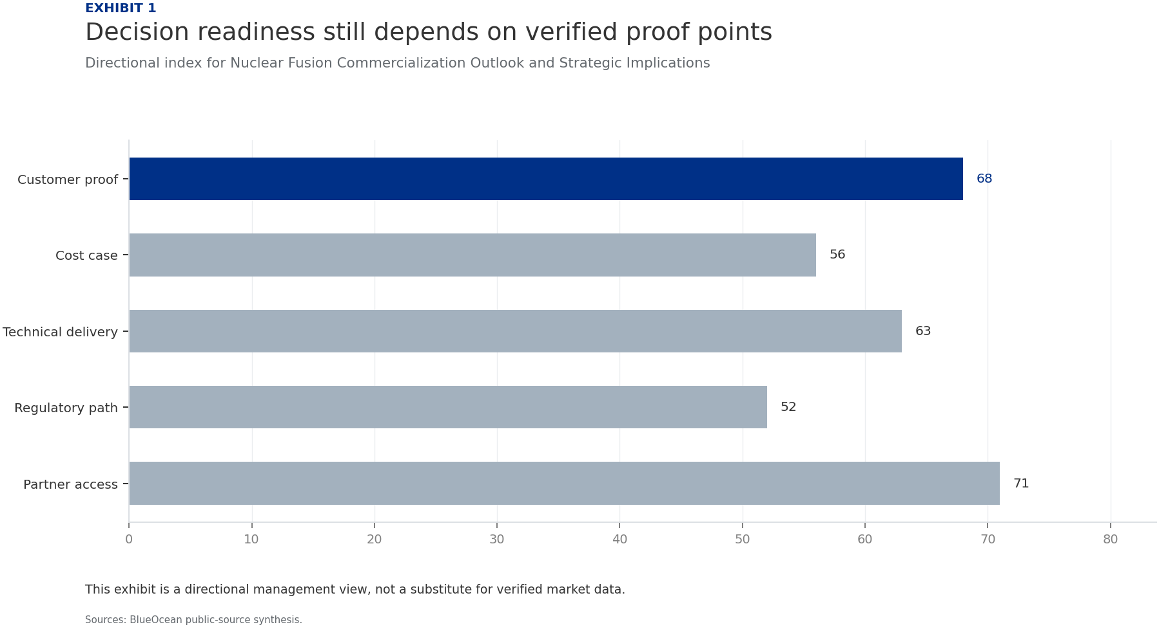
BlueOcean
Exhibit 1: evidence clarifies the strategic trade-off
Exhibit 1: evidence clarifies the strategic trade-off

Slide 13
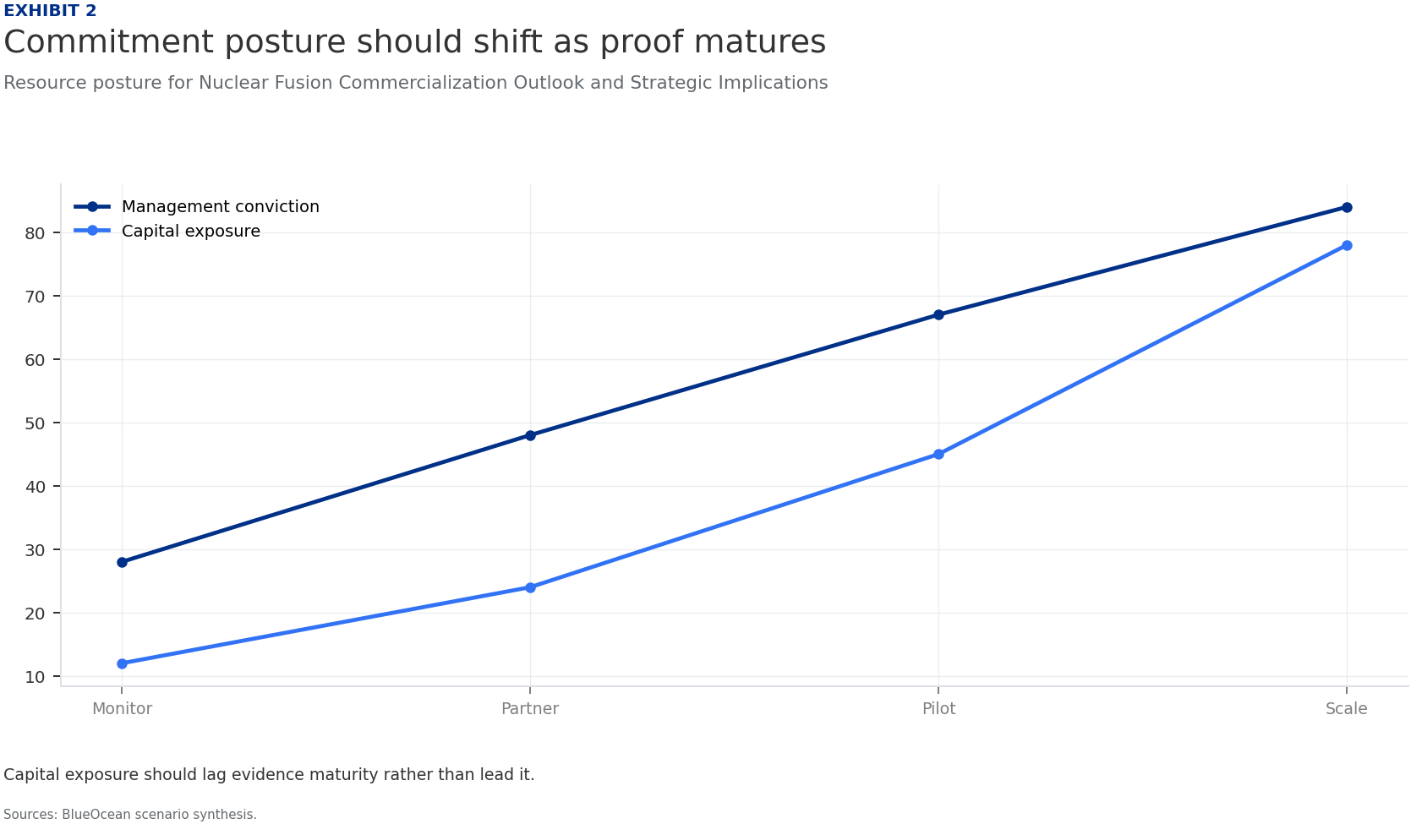
BlueOcean
Exhibit 2: evidence clarifies the strategic trade-off
Exhibit 2: evidence clarifies the strategic trade-off

Slide 14
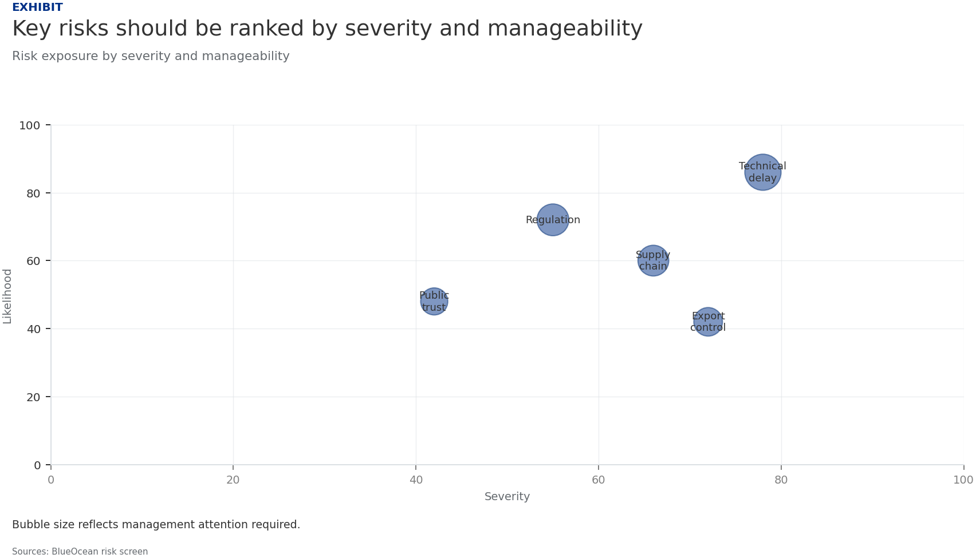
BlueOcean
Exhibit 3: evidence clarifies the strategic trade-off
Exhibit 3: evidence clarifies the strategic trade-off

Slide 15
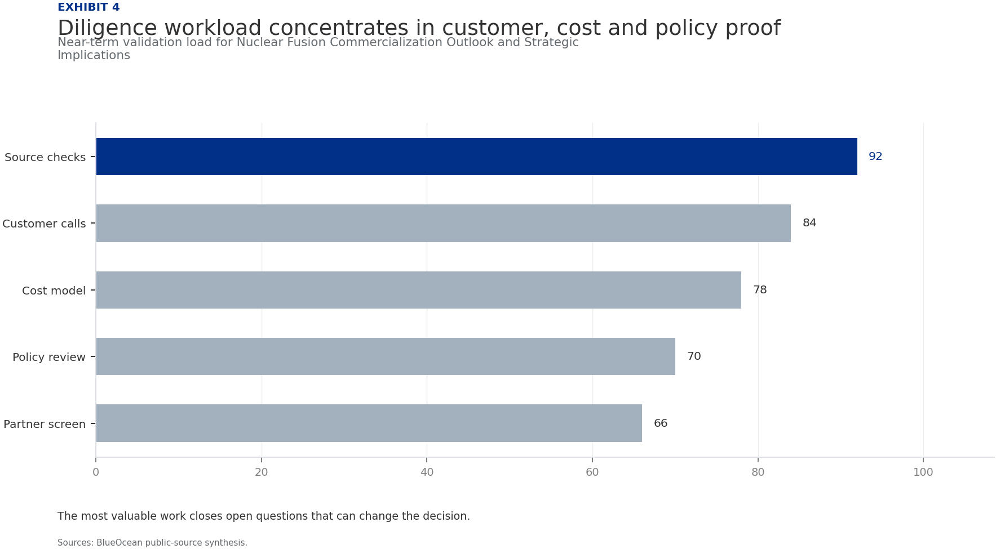
BlueOcean
Exhibit 4: evidence clarifies the strategic trade-off
Exhibit 4: evidence clarifies the strategic trade-off

Slide 16
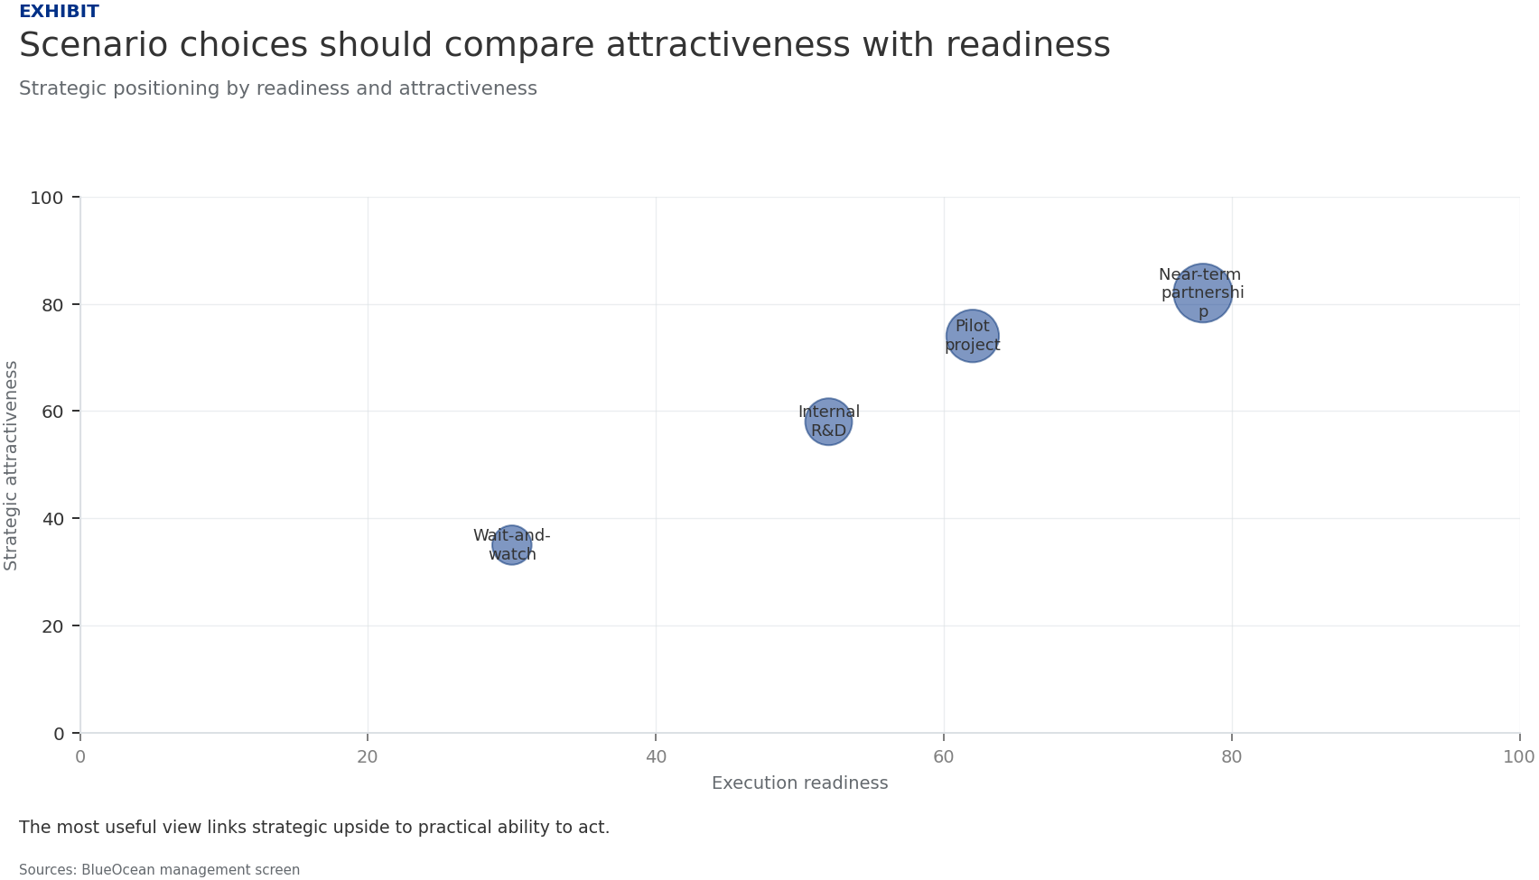
BlueOcean
Exhibit 5: evidence clarifies the strategic trade-off
Exhibit 5: evidence clarifies the strategic trade-off

Slide 17
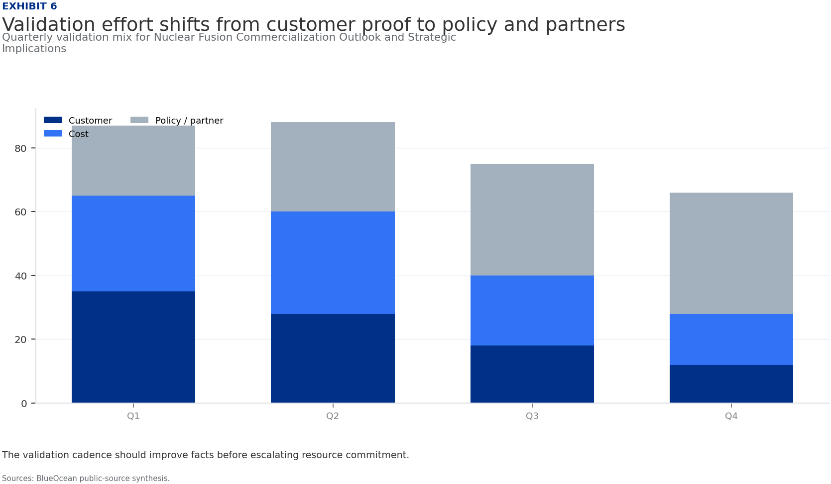
BlueOcean
Exhibit 6: evidence clarifies the strategic trade-off
Exhibit 6: evidence clarifies the strategic trade-off

Slide 18
BlueOcean
The next step is to convert the research into a short list of decisions
A Decision-Ready Analysis for Senior Executives
Closing

