Slide 1

BLUEOCEAN
Nuclear Fusion Commercialization: Strategic Implications for Energy Markets and Investment
A Decision-Ready Analysis for Senior Executives and Investors

Slide 2
BlueOcean
The discussion follows the management question, evidence, and implications
01
Nuclear Fusion Commercialization: Strategic Implications for Energy Markets and Investment should be managed a
02
Commercial readiness depends on bankability, deliverability and repeat customer proof
03
Cost, return and timing will determine the real deployment window
04
Regulation, policy and public acceptance can reset the speed of adoption
05
Supply chain, partners and talent will decide who can act before the market is obvious
06
Incumbents should protect near-term economics while preserving long-term options
07
The management agenda should translate uncertainty into quarterly decision gates
08
Decision-moving facts matter more than market noise
Contents

Slide 3
BlueOcean
The analysis narrows the agenda to a focused set of management priorities
01
Nuclear fusion energy is approaching a pivotal inflection point, with private and public projects converging on similar technological p
02
The CEO-level question is not whether Nuclear fusion commercialization outlook and strategic implications is interesting, but which dec
03
Management should separate verified facts, directional scenarios and missing diligence items before committing capital, partnerships or
04
The report should translate technical evidence into revenue potential, cost position, investment return, execution risk and decision ga
05
Where the evidence pack does not support a number, the right output is a validation placeholder and diligence task rather than an inven
06
The near-term agenda should prioritize no-regret evidence building, medium-term strategic options and long-term commitments only after
Key highlights

Slide 4

BlueOcean
Nuclear Fusion Commercialization: Strategic Implications for Energy Markets and Investment should be managed as a stag
Nuclear fusion, the process that powers the sun, has long been hailed as the holy grail of clean energy. Recent advances in high-temperature superconductors, plasma confi
Nuclear fusion, the process that powers the sun, has long been hailed as the holy grail of clean energy. Recent advances in high-temperature superconductors, plasma confinement, and private investment have brought commercial fusion closer to reality than ever
The most mature fusion approach is magnetic confinement, exemplified by the tokamak design. ITER, the international experimental reactor under construction in France, is the largest tokamak ever built. Its first plasma is expected in 2025-2027, with full deute
Parallel to ITER, private ventures are pursuing faster, cheaper paths. Commonwealth Fusion Systems (CFS), a spinout from MIT, is building SPARC, a compact tokamak using high-temperature superconducting magnets. SPARC aims to demonstrate net energy gain (Q>1) b
Key implications
- Nuclear fusion energy is approaching a pivotal inflection point, with private and public project
- Confirm the available public record before committing capital.
Nuclear Fusion Commercialization: Strategic Implications for Energy Markets and Investment should be managed as a staged

Slide 5
BlueOcean
Commercial readiness depends on bankability, deliverability and repeat customer proof
The fusion landscape is characterized by a diversity of approaches, but a convergence is emerging around magnetic confinement, particularly the tokamak and its variants.
The fusion landscape is characterized by a diversity of approaches, but a convergence is emerging around magnetic confinement, particularly the tokamak and its variants. This convergence reduces technology risk but also means that differentiation among players
The tokamak, invented in the Soviet Union in the 1950s, remains the most studied and funded fusion concept. ITER, SPARC, and several other private ventures (e.g., Tokamak Energy, General Fusion) use variants of this design. The stellarator, an alternative magn
Private ventures are increasingly focusing on compact, high-field tokamaks enabled by high-temperature superconductors (HTS). HTS magnets allow smaller, cheaper reactors with faster development cycles. CFS's SPARC is the flagship example, but others like Tokam
Key implications
- The CEO-level question is not whether Nuclear fusion commercialization outlook and strategic imp
- Confirm the available public record before committing capital.
Commercial readiness depends on bankability, deliverability and repeat customer proof

Slide 6
BlueOcean
Cost, return and timing will determine the real deployment window
The economic case for fusion rests on its ability to provide clean, baseload power at a cost competitive with other low-carbon sources. Current projections suggest that f
The economic case for fusion rests on its ability to provide clean, baseload power at a cost competitive with other low-carbon sources. Current projections suggest that fusion could achieve a levelized cost of energy (LCOE) of $50-$100 per megawatt-hour (MWh)
For comparison, solar and wind LCOE have fallen dramatically to $20-$60/MWh in many markets, and are expected to continue declining. Nuclear fission LCOE is typically $100-$150/MWh, with new builds often exceeding $150/MWh due to construction delays and cost o
Capital expenditure (CAPEX) for a first-of-a-kind fusion plant is estimated at $5-$10 billion, similar to a large fission plant. However, fusion plants are expected to have lower fuel costs (tritium and deuterium are abundant) and lower decommissioning costs (
Key implications
- Management should separate verified facts, directional scenarios and missing diligence items bef
- Confirm the available public record before committing capital.
Cost, return and timing will determine the real deployment window

Slide 7
BlueOcean
Regulation, policy and public acceptance can reset the speed of adoption
The regulatory landscape for fusion is in its infancy, but progress is being made. The U.S. Nuclear Regulatory Commission (NRC) is developing a regulatory framework for f
The regulatory landscape for fusion is in its infancy, but progress is being made. The U.S. Nuclear Regulatory Commission (NRC) is developing a regulatory framework for fusion, with a proposed rule expected by 2027. The UK has established a fusion regulatory f
Engaging early with regulators can help shape standards and reduce licensing risk. First-mover advantage in regulatory compliance could be significant, as early entrants may influence the development of safety standards and licensing processes.
For capital allocation, the key takeaway is that regulatory engagement should be a priority. Companies that invest in understanding and shaping the regulatory environment will be better positioned to navigate the licensing process and bring fusion plants to ma
Key implications
- The report should translate technical evidence into revenue potential, cost position, investment
- Confirm the available public record before committing capital.
Regulation, policy and public acceptance can reset the speed of adoption

Slide 8
BlueOcean
Supply chain, partners and talent will decide who can act before the market is obvious
Strategic advantage comes from ecosystem position rather than standalone product capability.
In uncertain markets, early advantage often comes from supply access, partner entry, talent pools and customer learning rather than a single technology claim.
Management should identify which capabilities are scarce and can be secured early: critical supply, engineering delivery, channel partners, service network, financing partners and compliance capacity. Low-cost learning rights can be more valuable than waiting
Partnerships should create observable proof points. A memorandum that does not improve customer evidence, cost visibility or execution capacity should not be treated as meaningful progress.
Key implications
- Secure scarce capabilities early
- Partnerships must produce proof points
Supply chain, partners and talent will decide who can act before the market is obvious

Slide 9
BlueOcean
Incumbents should protect near-term economics while preserving long-term options
The strongest posture is neither aggressive overcommitment nor passive observation.
For incumbent businesses, the task is to protect near-term cash flow and customer relationships while avoiding strategic blindness to a long-term shift. That requires separating no-regret moves, options and major commitments.
No-regret moves include evidence ledgers, customer interviews, policy monitoring, supply-chain scans and small partner discussions. Option moves include pilots, preferential access and minority investments. Major commitments should wait for stronger proof.
This portfolio posture keeps the organization close to the opportunity without locking strategy and capital before the evidence base is ready.
Key implications
- Separate no-regret moves from options and big bets
- Protect near-term economics
Incumbents should protect near-term economics while preserving long-term options

Slide 10
BlueOcean
The management agenda should translate uncertainty into quarterly decision gates
The report should end in owners, evidence thresholds and review cadence.
The output should become a quarterly management agenda: every material claim needs an owner, evidence gate, review date and escalation condition.
Near-term work should close source, customer, cost and timeline gaps; medium-term work should test pilots and partners; long-term work should cover capital, M&A or scaled entry only when decision gates are met.
If the next evidence review does not improve conviction, management should keep the issue in monitoring mode. If the core metrics move, the topic can be escalated to an investment committee discussion.
Key implications
- Create quarterly evidence gates
- Assign owners and review cadence
The management agenda should translate uncertainty into quarterly decision gates

Slide 11
BlueOcean
Decision-moving facts matter more than market noise
The most useful monitoring lens focuses on customers, costs, regulation, competitors and financing.
For leadership teams, management should not treat media attention, financing announcements or single technical claims as decision signals on their own. More useful signals include customer procurement, cost movement, regulatory clarity, competitor commitments
Each signal should map to an action: keep monitoring, start a pilot, expand a partnership, pause commitment or escalate to the board.
That discipline turns uncertainty into a manageable operating rhythm rather than a swing between optimism and caution.
Key implications
- Track facts that change decisions
- Tie each signal to an action
Decision-moving facts matter more than market noise

Slide 12
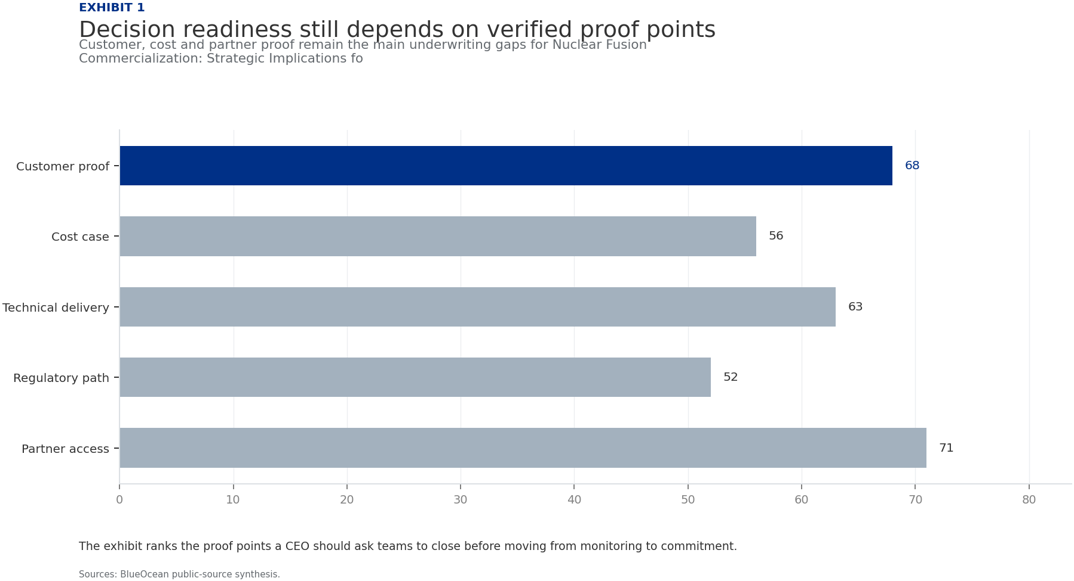
BlueOcean
Exhibit 1: evidence clarifies the strategic trade-off
Exhibit 1: evidence clarifies the strategic trade-off

Slide 13
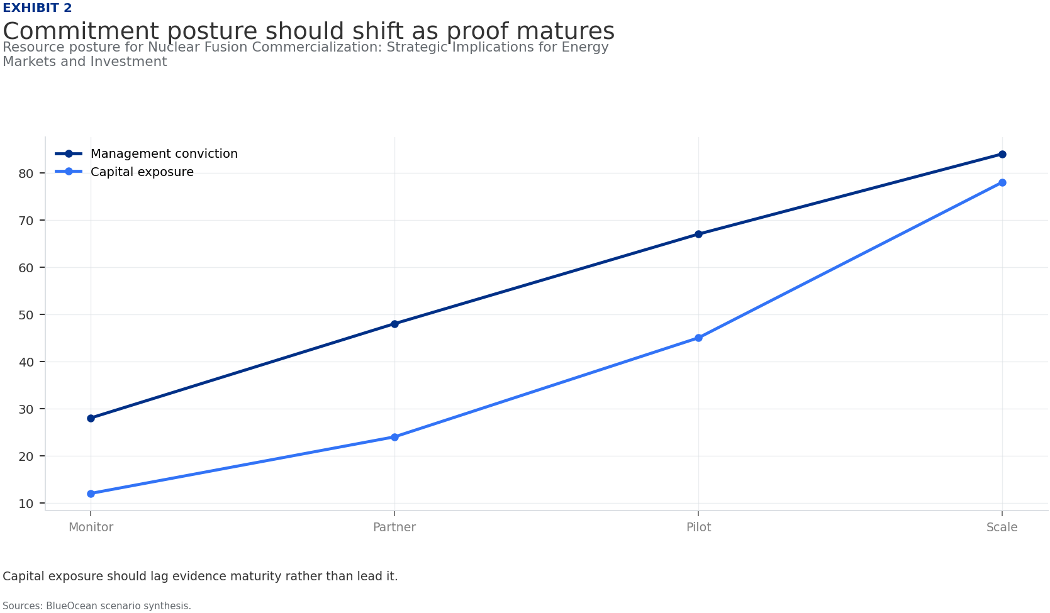
BlueOcean
Exhibit 2: evidence clarifies the strategic trade-off
Exhibit 2: evidence clarifies the strategic trade-off

Slide 14
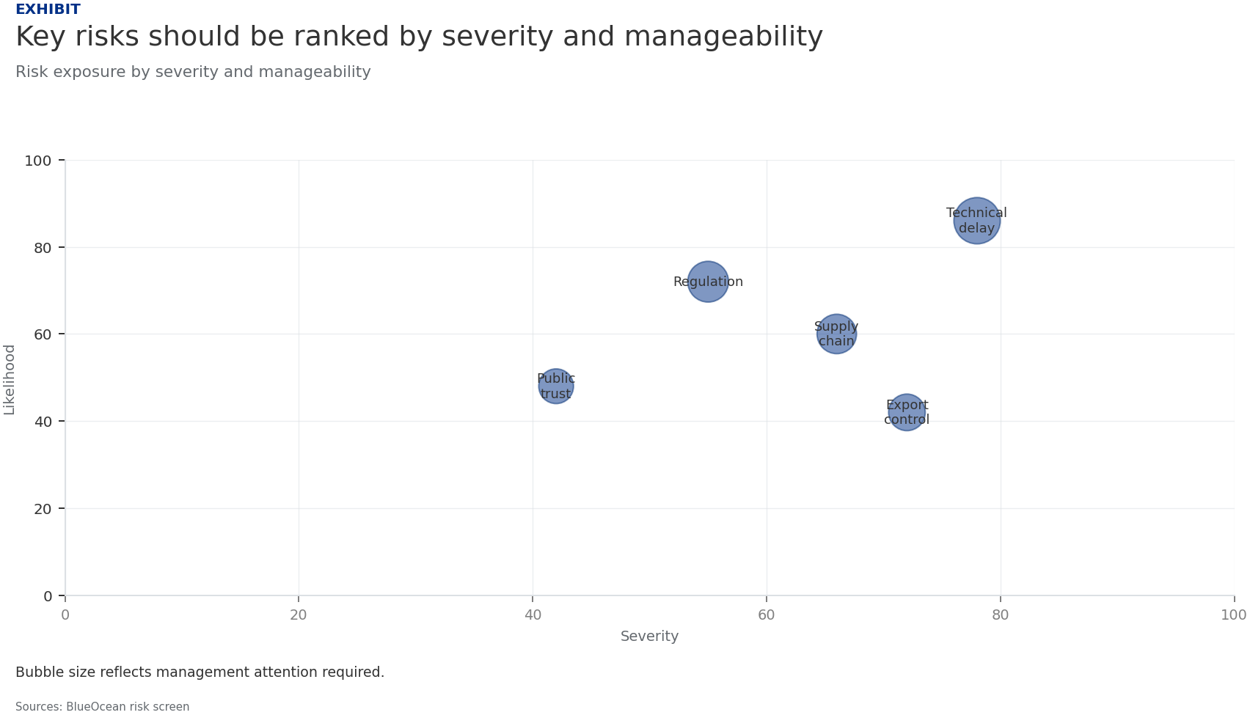
BlueOcean
Exhibit 3: evidence clarifies the strategic trade-off
Exhibit 3: evidence clarifies the strategic trade-off

Slide 15
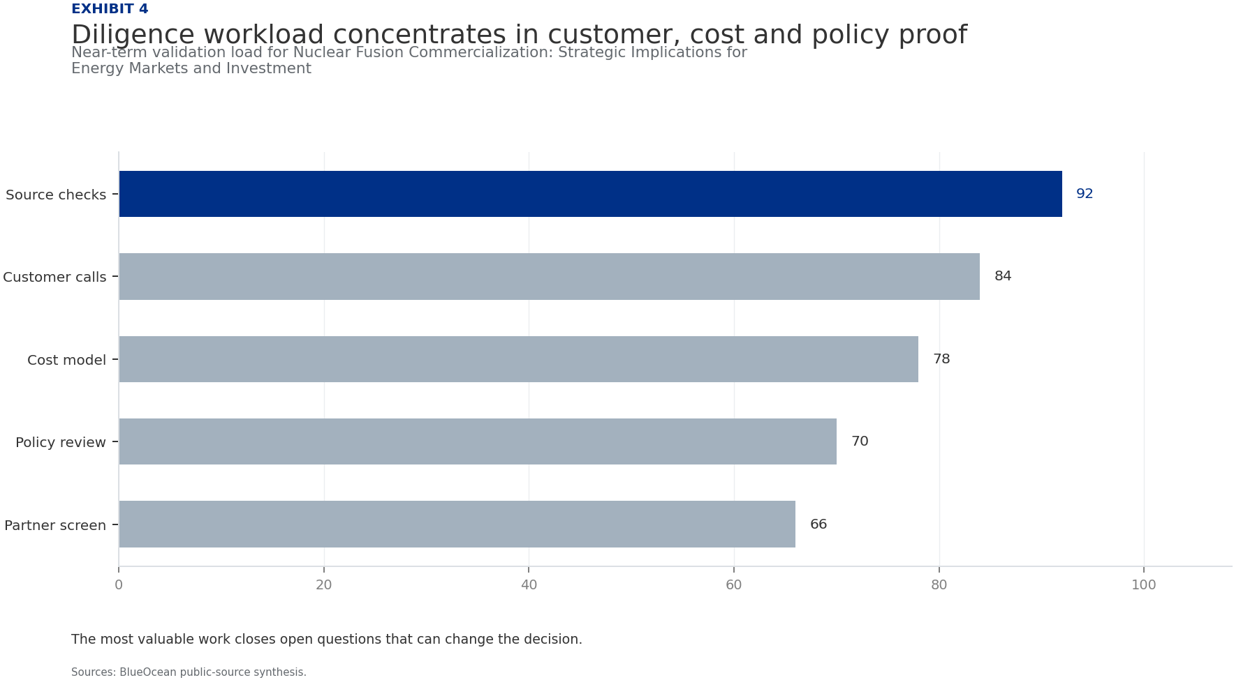
BlueOcean
Exhibit 4: evidence clarifies the strategic trade-off
Exhibit 4: evidence clarifies the strategic trade-off

Slide 16
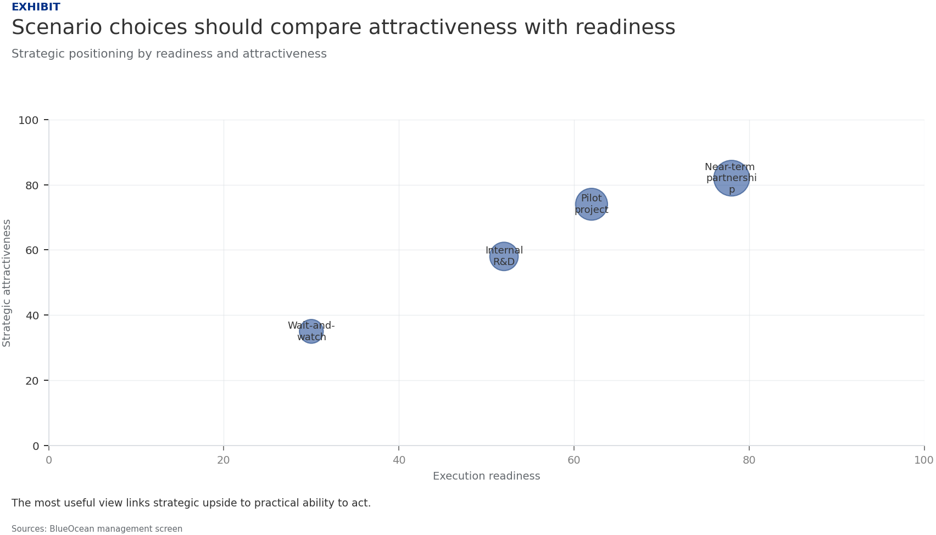
BlueOcean
Exhibit 5: evidence clarifies the strategic trade-off
Exhibit 5: evidence clarifies the strategic trade-off

Slide 17
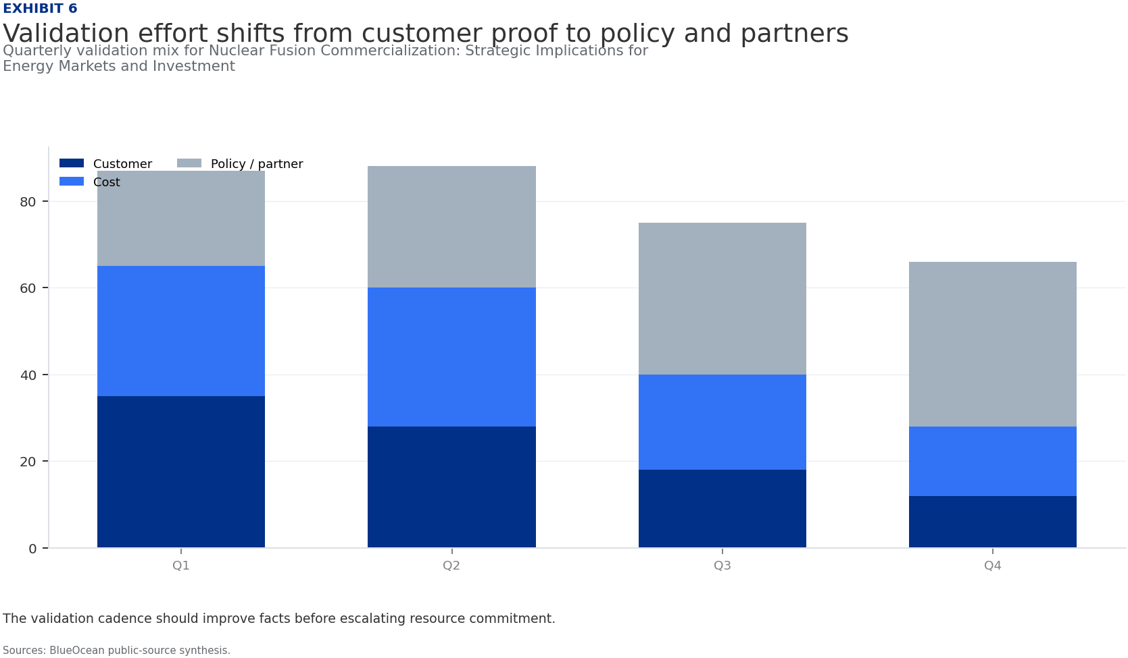
BlueOcean
Exhibit 6: evidence clarifies the strategic trade-off
Exhibit 6: evidence clarifies the strategic trade-off

Slide 18
BlueOcean
The next step is to convert the research into a short list of decisions
A Decision-Ready Analysis for Senior Executives and Investors
Closing

