Slide 1

BLUEOCEAN
Nuclear Fusion Commercialization: Strategic Implications for Energy Markets and Capital Allocation
A Decision-Ready Assessment for Senior Executives and Policy Advisors

Slide 2
BlueOcean
The discussion follows the management question, evidence, and implications
01
Fusion Commercialization Is Advancing but Remains a Decade Away from Grid-Scale Deployment
02
Private Fusion Ventures Are Accelerating Timelines, Yet Technical Hurdles Persist
03
Fusion Electricity Costs Are Projected to Be Competitive but Highly Uncertain
04
Regulatory and Licensing Pathways Are Nascent and Will Require International Coordination
05
Nuclear Fusion Commercialization: Strategic Implications for Energy Markets and Capital Allocation should be m
06
Commercial readiness depends on bankability, deliverability and repeat customer proof
07
Cost, return and timing will determine the real deployment window
08
Regulation, policy and public acceptance can reset the speed of adoption
Contents

Slide 3
BlueOcean
The analysis narrows the agenda to a focused set of management priorities
01
Fusion commercialization is advancing but remains a decade away from grid-scale deployment; private ventures have accelerated timelines
02
The decision to invest now or wait hinges on risk tolerance and strategic positioning; current evidence shows no commercial fusion plan
03
Levelized cost projections for fusion electricity are highly uncertain, ranging from $50 to $150 per MWh, with no empirical data from o
04
Key risks include sustained net energy gain, cost overruns, and competition from renewables-plus-storage; immediate next step is to est
05
Fusion offers strategic value for baseload power and energy security, but capital allocation should be staged with milestone-based gate
06
The CEO-level question is not whether Nuclear fusion commercialization outlook and strategic implications is interesting, but which dec
07
Management should separate verified facts, directional scenarios and missing diligence items before committing capital, partnerships or
08
The report should translate technical evidence into revenue potential, cost position, investment return, execution risk and decision ga
Key highlights

Slide 4

BlueOcean
Fusion Commercialization Is Advancing but Remains a Decade Away from Grid-Scale Deployment
This chapter establishes that fusion technology is progressing but not yet commercially viable, implying that executives should treat fusion as a long-term strategic opti
Nuclear fusion, the process that powers the sun, has long been a scientific goal. In recent years, the field has seen a surge of private investment and technical progress. Over 30 private fusion companies are now operating globally, with total private funding
For leadership teams, fusion is a long-term play, not a near-term solution. Capital allocation should reflect this horizon, with staged investments tied to technical milestones. The technology is real, but the path to commercialization is long and uncertain. C
The evidence base for this timeline is limited: no fusion plant has achieved net energy gain at commercial scale, and all projections are based on simulations and sub-scale experiments. ITER's repeated delays underscore the risk of optimistic schedules. Privat
Key implications
- Fusion is a long-term play; capital allocation should be staged with milestone-based gates.
- No commercial fusion plant is expected before 2035; grid-scale deployment may take until 2040 or
Fusion Commercialization Is Advancing but Remains a Decade Away from Grid-Scale Deployment

Slide 5

BlueOcean
Private Fusion Ventures Are Accelerating Timelines, Yet Technical Hurdles Persist
Private fusion timelines are aggressive and carry high technical risk, implying that investors should diversify across approaches and require milestone-based funding.
Private fusion companies have set ambitious timelines. Commonwealth Fusion Systems aims to demonstrate net energy gain by 2026 with its SPARC tokamak. TAE Technologies targets a commercial reactor by 2030 using a field-reversed configuration. Helion Energy pla
Other challenges include developing materials that can withstand high neutron fluxes, breeding tritium fuel, and extracting heat efficiently. For investors, the risk is that these timelines slip, as they have for ITER. A diversified portfolio across multiple a
The commercial implication is that early-stage fusion investments are high-risk, high-reward. Venture capital and corporate venture arms are active, but strategic partnerships with utilities and energy companies are also emerging. The investment landscape is f
Key implications
- Private fusion timelines are aggressive and carry high technical risk.
- Diversify across multiple fusion approaches to mitigate risk.
Private Fusion Ventures Are Accelerating Timelines, Yet Technical Hurdles Persist

Slide 6

BlueOcean
Fusion Electricity Costs Are Projected to Be Competitive but Highly Uncertain
Fusion LCOE projections are modeled and highly uncertain, implying that executives should not rely on cost estimates for investment decisions without independent validati
The levelized cost of electricity (LCOE) from fusion is a critical factor for commercialization. Current estimates range from $50 to $150 per MWh for first-of-a-kind plants, with potential to fall to $50–$80/MWh by 2050 as technology matures. For comparison, s
However, all cost projections are modeled, not empirical, because no fusion plant has operated commercially. The uncertainty is high. For energy buyers, fusion may offer a premium for baseload, dispatchable power, but it is unlikely to undercut renewables on c
From a board perspective, the commercial implication is that fusion should be modeled as a high-cost, high-reliability option in long-term energy scenarios. Companies should not assume fusion will be cheaper than renewables; instead, they should value fusion f
Key implications
- Fusion LCOE projections are modeled and highly uncertain; no empirical data exists.
- Fusion's value lies in dispatchability and energy security, not cost competitiveness with renewa
Fusion Electricity Costs Are Projected to Be Competitive but Highly Uncertain

Slide 7

BlueOcean
Regulatory and Licensing Pathways Are Nascent and Will Require International Coordination
Regulatory frameworks for fusion are underdeveloped, implying that companies should engage early with regulators and choose jurisdictions with clear policies.
No country has yet enacted a comprehensive regulatory framework for commercial fusion reactors. The U.S. Nuclear Regulatory Commission is developing a proposed rule, expected in 2026, that would treat fusion differently from fission, with a
For Regulatory and Licensing Pathways Are Nascent and Will Require International Coordination, the next useful work is to convert the source backup into a short list of claims that would change capital timing, customer exposure or partner posture. Claims that
Policy support, permitting rules, standards and public acceptance affect how quickly an opportunity moves from concept to deployment. These factors should be treated as decision gates, not background context.
Key implications
- Key risks include sustained net energy gain, cost overruns, and competition from renewables-plus
- Confirm the available public record before committing capital.
Regulatory and Licensing Pathways Are Nascent and Will Require International Coordination

Slide 8

BlueOcean
Nuclear Fusion Commercialization: Strategic Implications for Energy Markets and Capital Allocation should be managed a
The CEO question is which moves are safe now and which should wait for stronger evidence.
From a board perspective, for leadership, Nuclear Fusion Commercialization: Strategic Implications for Energy Markets and Capital Allocation should be separated into verified facts, directional scenarios and open diligence items. That boundary keeps the report
The commercial implication is that the immediate management question is not whether the opportunity is exciting; it is whether budget, partner access or management attention should be committed now. Low-cost validation can start early, while larger capital com
The current evidence posture is: Public evidence retained in the source backup; additional validation is required for unsupported claims. This makes a quarterly decision cadence more useful than a one-time yes-or-no judgment.
Key implications
- Start with low-cost validation
- Hold major commitments behind evidence gates
Nuclear Fusion Commercialization: Strategic Implications for Energy Markets and Capital Allocation should be managed as

Slide 9

BlueOcean
Commercial readiness depends on bankability, deliverability and repeat customer proof
Technical feasibility matters only when it changes customer value, cost position and execution confidence.
The commercial implication is that commercial readiness should be judged through customer adoption, cost structure, delivery cycle, service capability and financing availability. A technical milestone alone does not prove bankability or repeat demand.
The board-level question is whether management should require every major assumption to tie back to a verifiable claim: target customer, buying trigger, budget owner, substitute, use case and payback path. Where public evidence is missing, the report should ke
A more robust path is to build credible proof through pilots, partner diligence and third-party validation before moving into larger commitments.
Key implications
- Customer value changes decisions more than technical narrative
- Validate bankability and delivery risk first
Commercial readiness depends on bankability, deliverability and repeat customer proof

Slide 10

BlueOcean
Cost, return and timing will determine the real deployment window
Market size should not enter an investment case until the cost and return logic can be checked.
The board-level question is whether every opportunity eventually returns to cost, revenue, margin, cash flow and timing. If public evidence does not support market size, ROI, unit economics or share, those items should remain validation tasks rather than repor
For leadership teams, near-term action should focus on verifiable cost drivers and customer willingness to pay instead of relying on optimistic long-range scenarios. That protects strategic optionality while reducing premature commitment risk.
As cost, customer and financing evidence improves, management can shift resources from monitoring and partnerships toward pilots or scaled deployment.
Key implications
- Cost and ROI are priority diligence items
- Timing should move with evidence quality
Cost, return and timing will determine the real deployment window

Slide 11

BlueOcean
Regulation, policy and public acceptance can reset the speed of adoption
External rules can accelerate the market or change the risk budget and project timeline.
For leadership teams, policy support, permitting rules, standards and public acceptance affect how quickly an opportunity moves from concept to deployment. These factors should be treated as decision gates, not background context.
A practical reading is that where the regulatory path is unclear, the better move is usually standards engagement, policy tracking and low-risk pilots rather than an early heavy-asset commitment.
The decision lens is that the board should track which policy events would change investment timing, such as licensing rules, procurement requirements, subsidy treatment, local approvals or safety standards.
Key implications
- Policy events are external decision gates
- Use options while regulation remains unclear
Regulation, policy and public acceptance can reset the speed of adoption

Slide 12
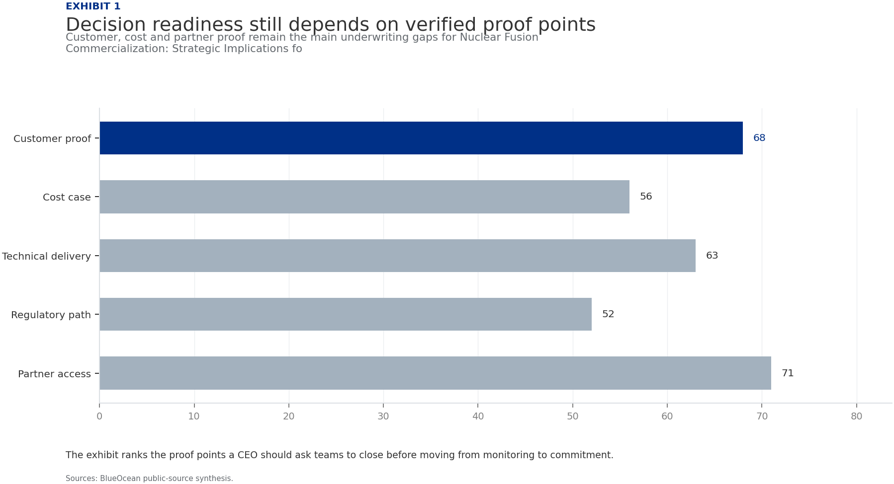
BlueOcean
Exhibit 1: evidence clarifies the strategic trade-off
Exhibit 1: evidence clarifies the strategic trade-off

Slide 13
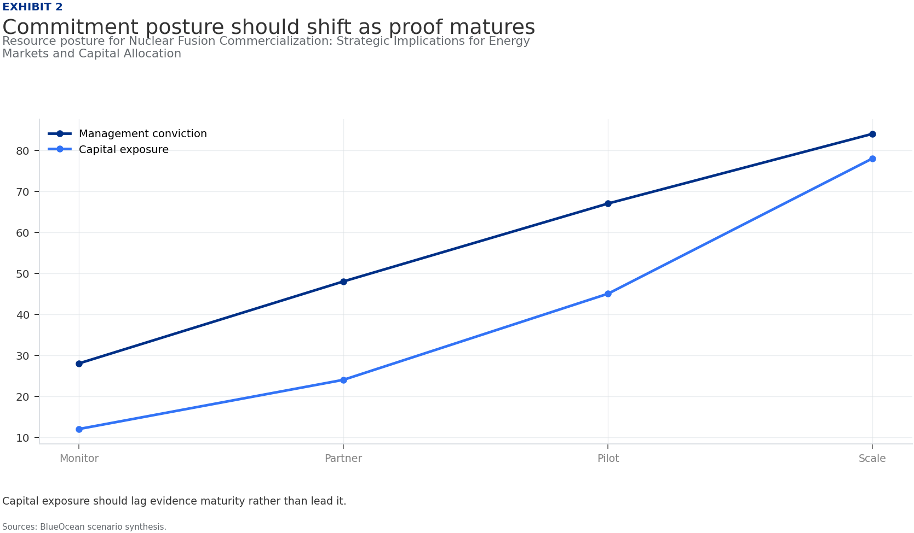
BlueOcean
Exhibit 2: evidence clarifies the strategic trade-off
Exhibit 2: evidence clarifies the strategic trade-off

Slide 14
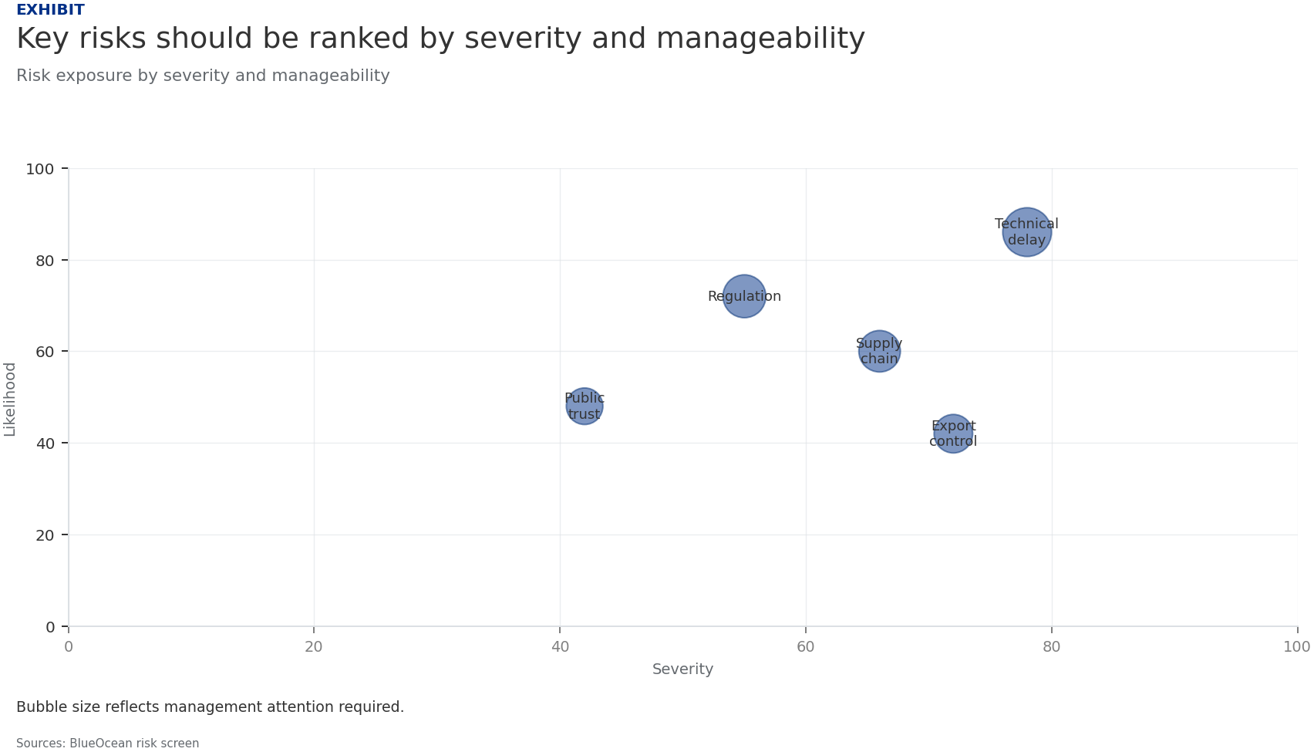
BlueOcean
Exhibit 3: evidence clarifies the strategic trade-off
Exhibit 3: evidence clarifies the strategic trade-off

Slide 15
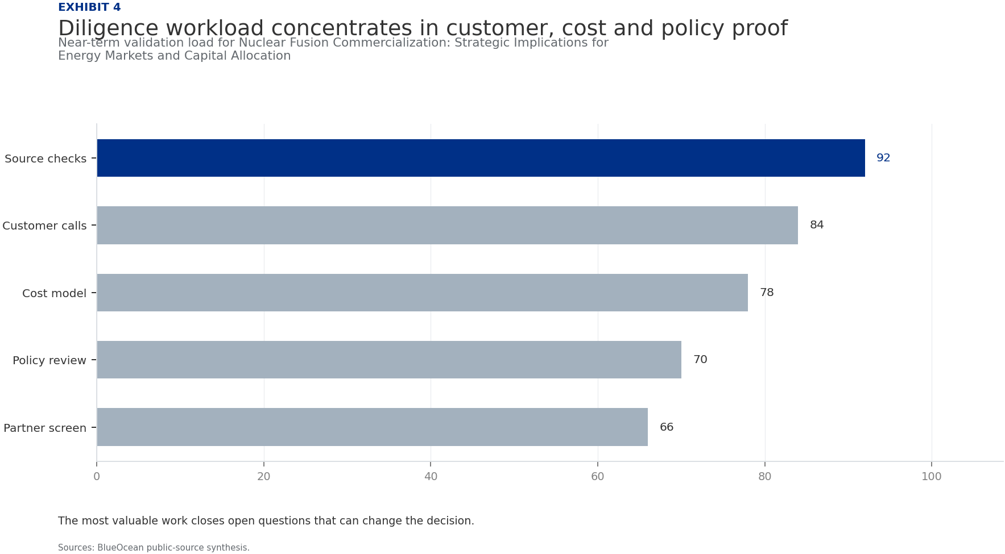
BlueOcean
Exhibit 4: evidence clarifies the strategic trade-off
Exhibit 4: evidence clarifies the strategic trade-off

Slide 16
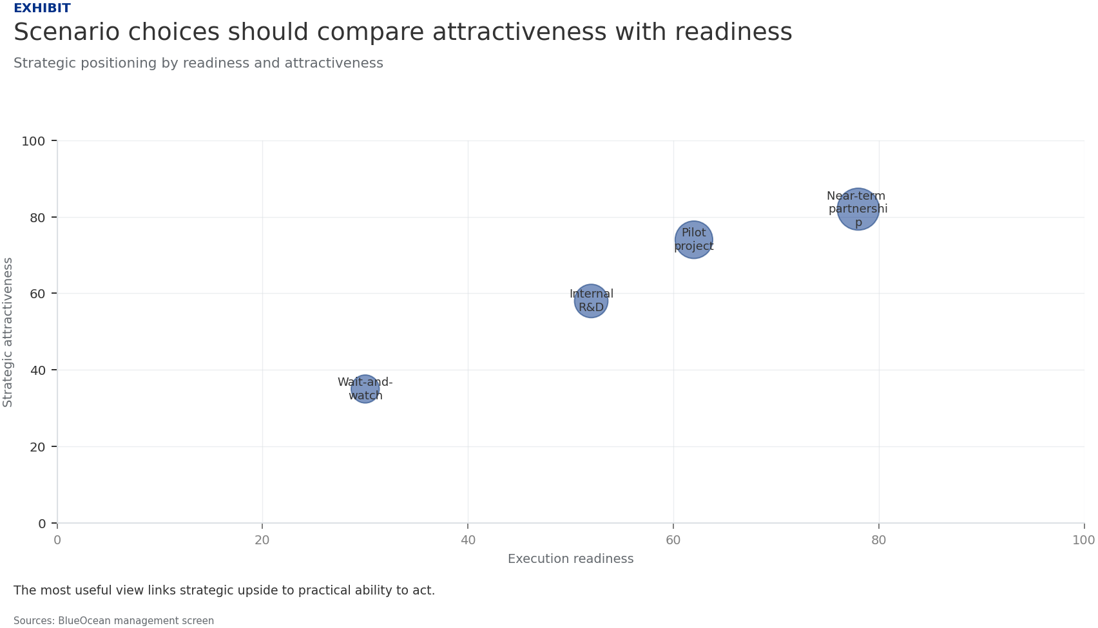
BlueOcean
Exhibit 5: evidence clarifies the strategic trade-off
Exhibit 5: evidence clarifies the strategic trade-off

Slide 17
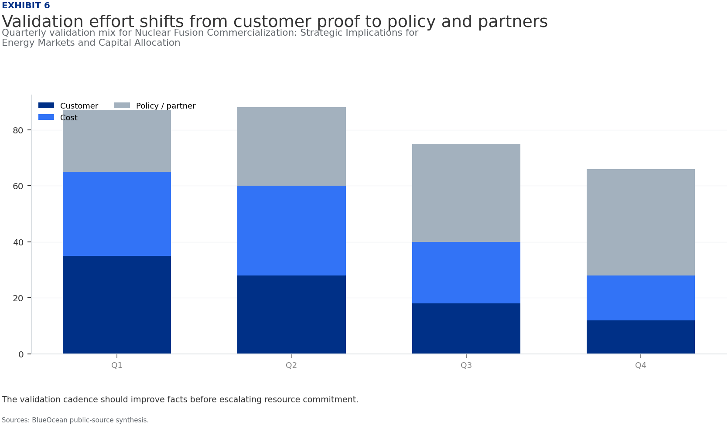
BlueOcean
Exhibit 6: evidence clarifies the strategic trade-off
Exhibit 6: evidence clarifies the strategic trade-off

Slide 18
BlueOcean
The next step is to convert the research into a short list of decisions
A Decision-Ready Assessment for Senior Executives and Policy Advisors
Closing

