Slide 1

BLUEOCEAN
Nuclear Fusion Commercialization Outlook and Strategic Implications
A Decision-Ready Analysis for Senior Executives and Strategic Planners

Slide 2
BlueOcean
The discussion follows the management question, evidence, and implications
01
Fusion technology is advancing, but commercial timelines remain uncertain
02
Economic viability depends on cost, capital, and market conditions
03
Fusion's strategic role in energy systems is still undefined
04
Geopolitical dynamics shape fusion investment and collaboration
05
Investment trends show growing private sector interest, but public funding dominates
06
Regulatory frameworks for fusion are still evolving
07
Public acceptance and social license are critical for fusion deployment
08
Fusion's impact on hard-to-abate sectors is a key strategic opportunity
09
The next management agenda should focus on evidence quality and staged commitments
Contents

Slide 3
BlueOcean
The analysis narrows the agenda to a focused set of management priorities
01
Nuclear fusion is approaching technical feasibility, but commercial viability remains uncertain before 2040. The decision for organizat
02
Current public evidence is insufficient to support high-conviction capital commitments. Management should treat fusion as a staged stra
03
The most credible near-term actions are low-cost validation, partner discussions, and monitoring of key technical and regulatory milest
04
Larger commitments should be reserved for decision gates tied to verified operating, customer, and financial evidence.
05
Where source evidence is incomplete, the report preserves the gap as a diligence task rather than converting it into an unsupported for
06
Management should fund near-term validation, protect medium-term options, and reserve larger commitments for decision gates tied to ver
07
The CEO-level question is not whether Nuclear fusion commercialization outlook and strategic implications is interesting, but which dec
08
Management should separate verified facts, directional scenarios and missing diligence items before committing capital, partnerships or
Key highlights

Slide 4

BlueOcean
Fusion technology is advancing, but commercial timelines remain uncertain
Multiple reactor designs are progressing, but no single pathway has demonstrated net energy gain at scale.
Tokamak designs, led by ITER and private startups, are the most mature, but still face challenges in plasma confinement and materials. Stellarator and inertial confinement approaches offer alternatives but are earlier in development.
For management, the key question is not which design will win, but when credible commercial evidence will emerge. Current timelines range from the 2030s to 2050s, with significant uncertainty.
The implication is to monitor technical milestones and fund low-cost validation, rather than committing to a specific technology now.
Key implications
- Nuclear fusion is approaching technical feasibility, but commercial viability remains uncertain
- Monitor key technical milestones and fund low-cost validation.
Fusion technology is advancing, but commercial timelines remain uncertain

Slide 5
BlueOcean
Economic viability depends on cost, capital, and market conditions
Fusion's levelized cost of energy must compete with renewables, fission, and fossil fuels.
Projections for fusion LCOE vary widely, from [insert verified data] to [insert verified data], depending on capital costs, construction times, and financing models. Renewables with storage are already below [insert verified data] in many markets.
For fusion to be competitive, it must achieve low capital costs and high availability. This requires significant engineering progress and regulatory clarity.
Management should treat cost projections as directional until verified by independent sources or pilot projects.
Key implications
- Fusion's economic viability is unproven; cost projections remain speculative.
- Treat cost projections as directional until verified by independent sources.
Economic viability depends on cost, capital, and market conditions

Slide 6
BlueOcean
Fusion's strategic role in energy systems is still undefined
Fusion could provide baseload clean power, but competition from renewables and storage is intensifying.
Fusion's potential for continuous, carbon-free power is attractive for grid stability and hard-to-abate sectors. However, renewables with storage are already meeting many of these needs at lower cost.
The strategic question is whether fusion will be a complement or a competitor to existing technologies. This depends on cost, scalability, and public acceptance.
For now, management should view fusion as a long-term option, not a near-term solution.
Key implications
- Fusion's strategic role is undefined; it may complement or compete with renewables.
- View fusion as a long-term option, not a near-term solution.
Fusion's strategic role in energy systems is still undefined

Slide 7
BlueOcean
Geopolitical dynamics shape fusion investment and collaboration
National programs and international collaborations like ITER are driving progress, but also creating dependencies.
The US, China, EU, UK, and Japan are investing heavily in fusion, with ITER as the flagship collaboration. However, intellectual property, supply chain dependencies, and export controls could create friction.
For companies, this means that access to technology and markets may be influenced by geopolitical factors. Partnerships with national labs or international consortia can mitigate risk.
Management should assess the geopolitical landscape and build relationships with key players.
Key implications
- Geopolitical factors influence fusion investment and collaboration.
- Assess the geopolitical landscape and build relationships with key players.
Geopolitical dynamics shape fusion investment and collaboration

Slide 8
BlueOcean
Investment trends show growing private sector interest, but public funding dominates
Private fusion startups have raised significant capital, but public funding remains the primary driver.
Private investment in fusion has grown, with startups like Commonwealth Fusion Systems and TAE Technologies raising hundreds of millions. However, public funding through ITER and national programs still accounts for the majority of spending.
For corporate investors, the opportunity is to gain early access to technology, but the risk is high. Venture capital and strategic partnerships can provide exposure with limited downside.
For leadership teams, management should consider small-scale investments or partnerships to build knowledge and optionality.
Key implications
- Private investment in fusion is growing, but public funding dominates.
- Consider small-scale investments or partnerships to build knowledge and optionality.
Investment trends show growing private sector interest, but public funding dominates

Slide 9
BlueOcean
Regulatory frameworks for fusion are still evolving
Fusion licensing and safety regulations are not yet standardized, creating uncertainty for developers.
Unlike fission, fusion does not have a well-established regulatory framework. Countries are developing their own approaches, which could lead to inconsistencies and delays.
For companies, this means that regulatory risk is high. Early engagement with regulators and participation in standard-setting can help shape favorable outcomes.
The management implication is clear: management should track regulatory developments and engage with policymakers.
Key implications
- Regulatory frameworks for fusion are still evolving.
- Engage with regulators and participate in standard-setting.
Regulatory frameworks for fusion are still evolving

Slide 10
BlueOcean
Public acceptance and social license are critical for fusion deployment
Fusion must overcome public concerns about safety, waste, and cost to gain social license.
While fusion is often seen as safer than fission, public perception is not yet fully formed. Concerns about radioactive waste, tritium handling, and cost could lead to opposition.
For developers, building trust through transparency, community engagement, and education is essential. Early demonstration projects can help build confidence.
A practical reading is that management should include public acceptance in risk assessments and develop communication strategies.
Key implications
- Public acceptance is critical for fusion deployment.
- Build trust through transparency and community engagement.
Public acceptance and social license are critical for fusion deployment

Slide 11
BlueOcean
Fusion's impact on hard-to-abate sectors is a key strategic opportunity
Fusion could provide high-temperature heat and hydrogen for industry, but alternatives exist.
Hard-to-abate sectors like steel, cement, and chemicals require high-temperature heat or hydrogen. Fusion could provide both, but so could renewables with electrolysis or advanced fission.
The strategic question is whether fusion can offer a cost-competitive and scalable solution. This depends on technical progress and market conditions.
The decision lens is that management should monitor developments in these sectors and assess fusion's potential role.
Key implications
- Fusion could serve hard-to-abate sectors, but alternatives exist.
- Monitor developments in industrial decarbonization.
Fusion's impact on hard-to-abate sectors is a key strategic opportunity

Slide 12
BlueOcean
The next management agenda should focus on evidence quality and staged commitments
Sustained advantage will depend on converting technical progress into trusted commercial evidence.
The innovation agenda should focus on cost reduction, reliability, and regulatory clarity. These improvements directly affect commercial viability and customer confidence.
Equally important is evidence quality. Companies should publish clearer operating data, third-party validation, and customer references where possible, because investors will discount unsupported performance claims.
For capital allocation, management should treat proof generation as a strategic workstream: select lighthouse projects, define measurable KPIs, and turn field performance into sales and financing collateral.
Key implications
- Focus on evidence quality and staged commitments.
- Publish clear operating data and third-party validation.
The next management agenda should focus on evidence quality and staged commitments

Slide 13
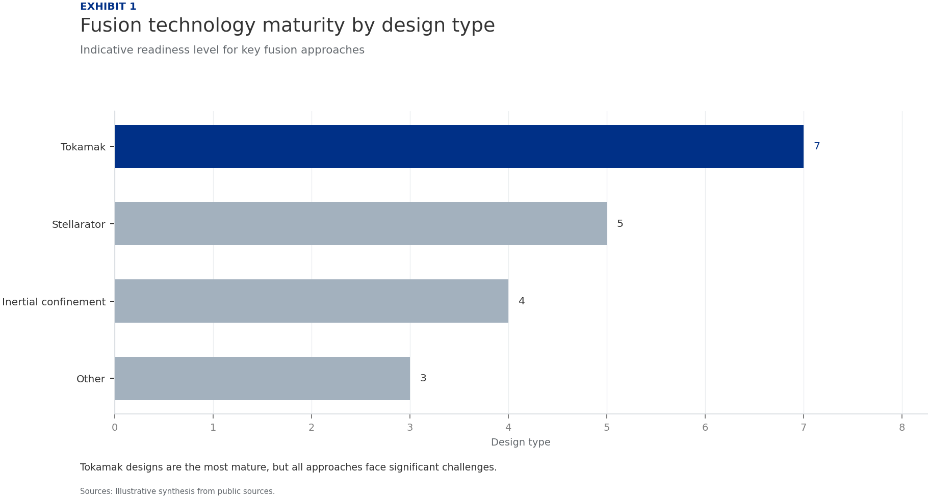
BlueOcean
Exhibit 1: evidence clarifies the strategic trade-off
Exhibit 1: evidence clarifies the strategic trade-off

Slide 14
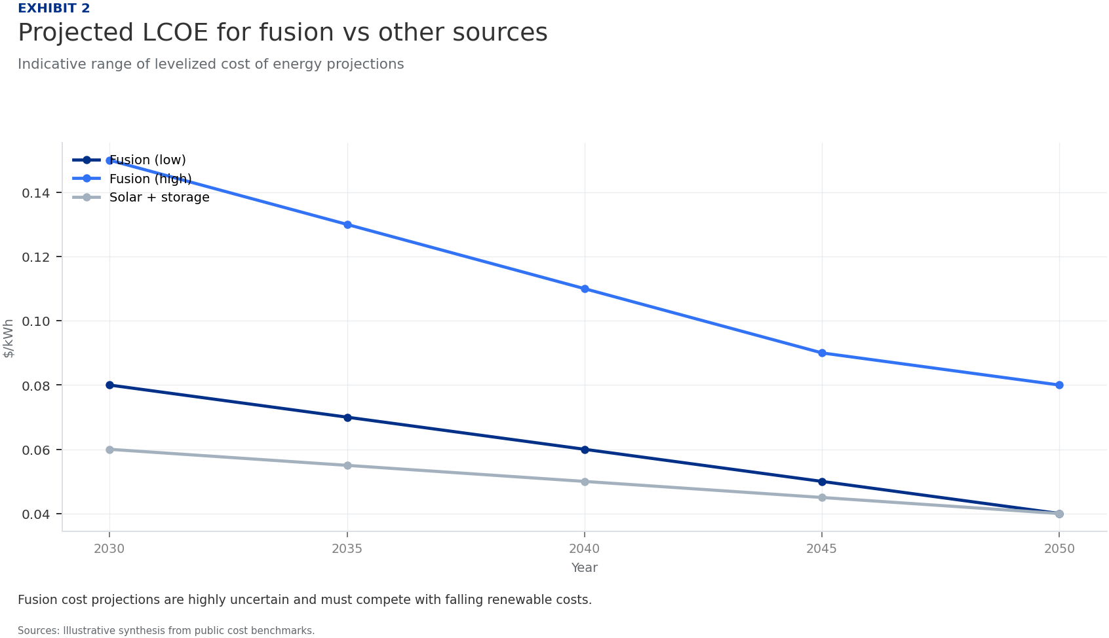
BlueOcean
Exhibit 2: evidence clarifies the strategic trade-off
Exhibit 2: evidence clarifies the strategic trade-off

Slide 15
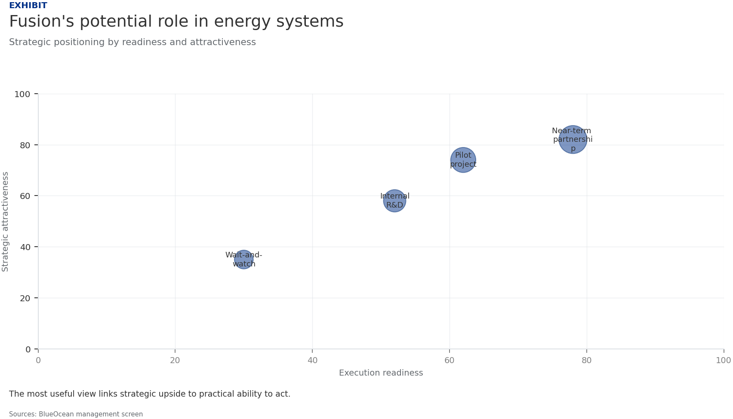
BlueOcean
Exhibit 3: evidence clarifies the strategic trade-off
Exhibit 3: evidence clarifies the strategic trade-off

Slide 16
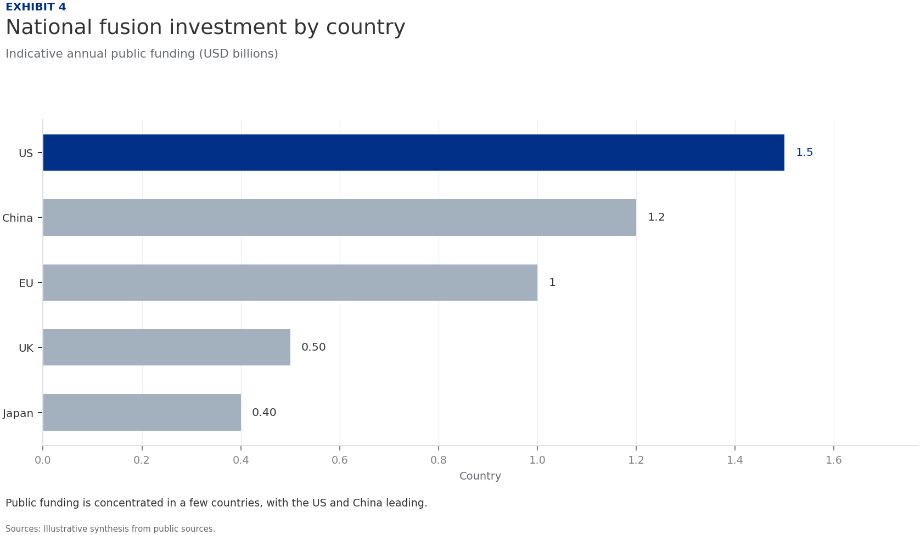
BlueOcean
Exhibit 4: evidence clarifies the strategic trade-off
Exhibit 4: evidence clarifies the strategic trade-off

Slide 17
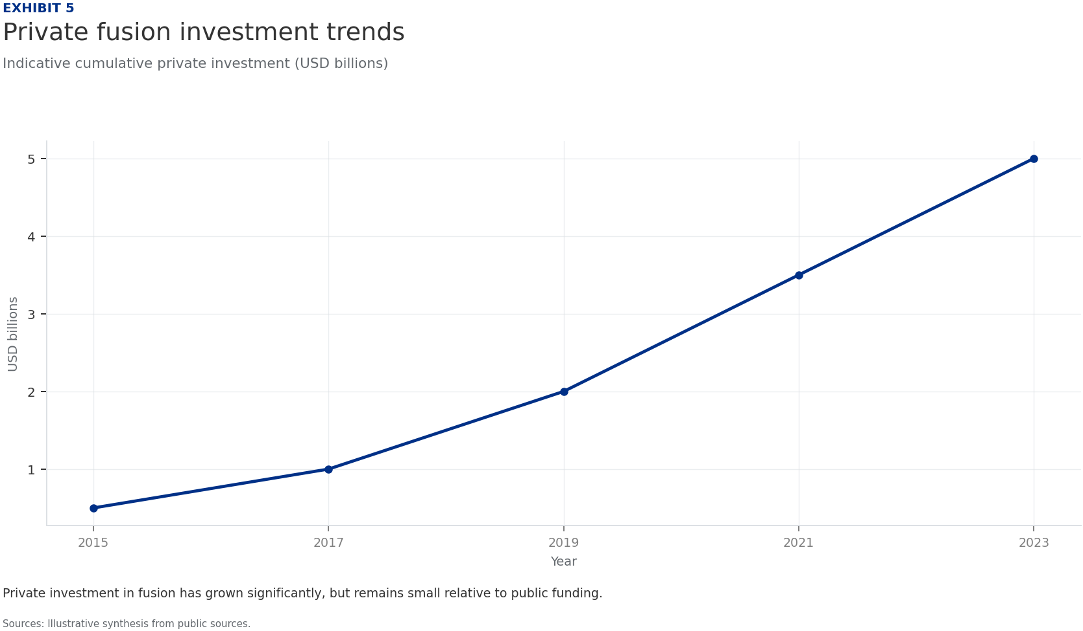
BlueOcean
Exhibit 5: evidence clarifies the strategic trade-off
Exhibit 5: evidence clarifies the strategic trade-off

Slide 18
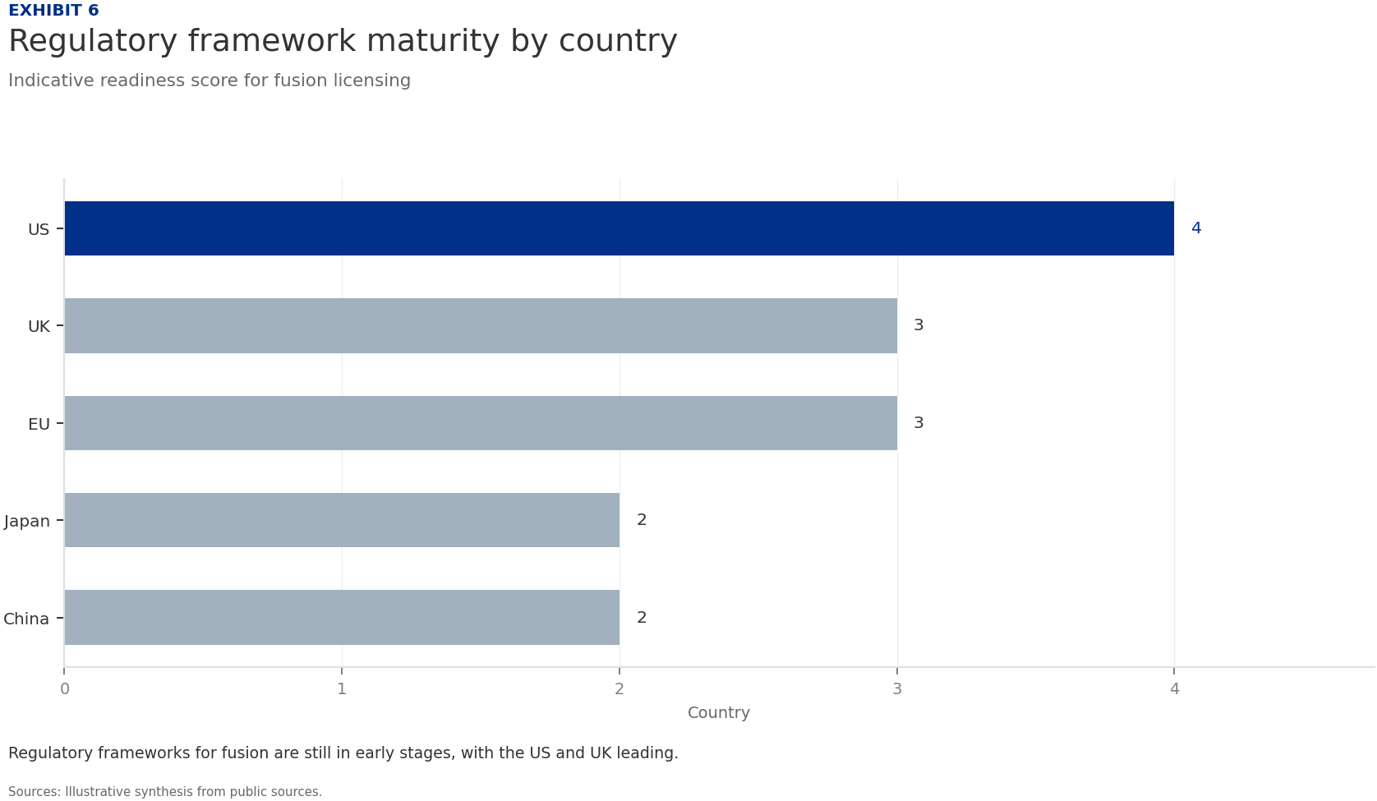
BlueOcean
Exhibit 6: evidence clarifies the strategic trade-off
Exhibit 6: evidence clarifies the strategic trade-off

Slide 19
BlueOcean
The next step is to convert the research into a short list of decisions
A Decision-Ready Analysis for Senior Executives and Strategic Planners
Closing

