Slide 1

BLUEOCEAN
Nuclear Fusion Commercialization: Strategic Outlook and Implications for Decision-Makers
A BlueOcean Research Report on the Path to Grid-Scale Viability and Capital Allocation

Slide 2
BlueOcean
The discussion follows the management question, evidence, and implications
01
Nuclear Fusion Commercialization: Strategic Outlook and Implications for Decision-Makers should be managed as
02
Commercial readiness depends on bankability, deliverability and repeat customer proof
03
Cost, return and timing will determine the real deployment window
04
Regulation, policy and public acceptance can reset the speed of adoption
05
Supply chain, partners and talent will decide who can act before the market is obvious
06
Incumbents should protect near-term economics while preserving long-term options
07
The management agenda should translate uncertainty into quarterly decision gates
08
Decision-moving facts matter more than market noise
Contents

Slide 3
BlueOcean
The analysis narrows the agenda to a focused set of management priorities
01
Private fusion ventures are accelerating faster than public projects, but no verified data confirms net-positive energy milestones befo
02
Economic competitiveness of fusion hinges on achieving levelized cost of energy (LCOE) parity with renewables by 2035-2040, but current
03
Regulatory frameworks remain a critical bottleneck, with no commercial fusion licensing established in any jurisdiction; early engageme
04
Tritium supply is a hidden bottleneck, as current global production is insufficient for commercial reactors; investment in breeding tec
05
Geopolitical dynamics are shifting, with the US, China, UK, and Japan leading fusion development; forming international consortia can s
06
The CEO-level question is not whether Nuclear fusion commercialization outlook and strategic implications is interesting, but which dec
07
Management should separate verified facts, directional scenarios and missing diligence items before committing capital, partnerships or
08
The report should translate technical evidence into revenue potential, cost position, investment return, execution risk and decision ga
Key highlights

Slide 4

BlueOcean
Nuclear Fusion Commercialization: Strategic Outlook and Implications for Decision-Makers should be managed as a staged
This chapter concludes that fusion is progressing faster than expected, but grid-scale viability remains at least a decade away, requiring executives to balance early inv
Nuclear fusion has long been considered the holy grail of energy, but recent advances in private ventures and public projects are bringing commercial viability closer. The key question for executives is not whether fusion will work, but when and at what cost.
Private companies like Commonwealth Fusion Systems (SPARC) and TAE Technologies are targeting net-positive energy by the late 2020s, while the international ITER project aims for first plasma in 2025 but has faced repeated delays. This divergence highlights a
The commercial implication is clear: early investment in fusion carries high risk but potential for outsized returns. Decision-makers should monitor key milestones, such as SPARC's Q>10 demonstration, as triggers for increased commitment. Without verified data
Key implications
- Grid-scale fusion is unlikely before 2035-2040.
- Private ventures are outpacing public projects.
Nuclear Fusion Commercialization: Strategic Outlook and Implications for Decision-Makers should be managed as a staged s

Slide 5
BlueOcean
Commercial readiness depends on bankability, deliverability and repeat customer proof
This chapter concludes that private ventures are leading fusion innovation, but their scalability remains unproven, requiring diversified investment across multiple desig
The fusion landscape has shifted dramatically in the past five years, with private companies attracting over $5 billion in investment globally. This influx of capital has enabled rapid prototyping and iterative development, in contrast to the slower pace of go
The strategic implication is that private ventures may achieve commercial fusion before public projects, potentially disrupting energy markets earlier than expected. However, the failure rate for startups is high, and many designs may not scale. Investors shou
The evidence for these claims is based on company announcements and industry reports, but no independent verification of timelines or funding amounts exists. Decision-makers should treat these projections as directional and require milestone-based validation.
Key implications
- Private ventures have attracted over $5 billion in investment.
- Diversification across reactor designs is essential.
Commercial readiness depends on bankability, deliverability and repeat customer proof

Slide 6
BlueOcean
Cost, return and timing will determine the real deployment window
This chapter concludes that fusion must achieve LCOE parity with renewables to be viable, but current cost estimates are unverified; focus on high-value applications like
The levelized cost of energy (LCOE) for fusion is the single most important metric for commercial viability. Current estimates suggest fusion could achieve LCOE of $50-100/MWh by 2040, but this is highly uncertain. In comparison, solar and wind LCOE have falle
For fusion to compete, it must offer advantages beyond cost, such as baseload reliability and low land use. High-value applications like industrial heat and hydrogen production may provide initial markets where fusion's 24/7 output commands a premium. The mark
The risk is that fusion may never achieve cost parity, especially if renewables plus storage continue to improve. Executives should focus on applications where fusion's unique attributes provide a clear advantage, and avoid betting the company on grid-scale el
Key implications
- Fusion LCOE estimates are $50-100/MWh by 2040, but unverified.
- High-value applications like industrial heat are initial targets.
Cost, return and timing will determine the real deployment window

Slide 7
BlueOcean
Regulation, policy and public acceptance can reset the speed of adoption
This chapter concludes that regulatory uncertainty is a major barrier, requiring early engagement with regulators to shape licensing frameworks.
No commercial fusion reactor has ever been licensed, and regulatory frameworks are still in development. The U.S. Nuclear Regulatory Commission (NRC) is working on a licensing framework, but no timeline has been announced. The International Atomic Energy Agenc
The lack of regulatory clarity creates significant uncertainty for investors and project developers. Licensing delays could push back commercial deployment by years, even if technical milestones are met. Early engagement with regulators is essential to shape f
Companies should invest in regulatory affairs teams and participate in public consultations. International harmonization of standards could reduce costs and accelerate deployment, but geopolitical tensions may hinder cooperation. The evidence for regulatory pr
Key implications
- No commercial fusion licensing exists yet.
- Regulatory delays could push deployment back years.
Regulation, policy and public acceptance can reset the speed of adoption

Slide 8
BlueOcean
Supply chain, partners and talent will decide who can act before the market is obvious
This chapter concludes that fusion could reshape energy dynamics, but geopolitical risks require international consortia and supply chain security.
Fusion energy could fundamentally alter global energy dynamics by providing abundant, low-carbon baseload power. Countries with advanced fusion programs, such as the United States, China, the United Kingdom, and Japan, may gain significant energy independence
For industrial sectors, fusion offers a path to deep decarbonization, particularly for hard-to-abate industries like steel, cement, and chemicals. The ability to produce high-temperature heat and hydrogen could transform these industries, but the timeline for
Geopolitical risks include technology export controls and intellectual property disputes. Companies should consider forming international consortia to share costs and risks, while also securing supply chains for critical components like superconducting magnets
Key implications
- Fusion could provide energy independence for leading nations.
- Industrial decarbonization is a key opportunity.
Supply chain, partners and talent will decide who can act before the market is obvious

Slide 9
BlueOcean
Incumbents should protect near-term economics while preserving long-term options
This chapter concludes that a staged investment approach with milestone-based tranches is optimal to capture upside while managing downside risk.
The fusion investment landscape is characterized by high risk and high potential reward. Historical analogies, such as the solar PV tipping point in 2010, suggest that early investors in breakthrough energy technologies can achieve significant returns. However
A staged investment approach is recommended, with milestone-based tranches that allow for course correction. Key milestones include Q>10 demonstration, tritium breeding proof, and regulatory approval. Each milestone should trigger a decision gate where investm
The asymmetric nature of fusion risk means that even a small probability of success can justify investment, provided the potential payoff is large enough. However, executives must be disciplined about cutting losses if key milestones are missed. Without verifi
Key implications
- Staged investment with milestone-based tranches is recommended.
- Asymmetric risk justifies early investment with caution.
Incumbents should protect near-term economics while preserving long-term options

Slide 10
BlueOcean
The management agenda should translate uncertainty into quarterly decision gates
This chapter concludes that no single reactor design has proven superior, so diversification across tokamak, stellarator, and inertial confinement is prudent.
The three main fusion reactor designs are tokamak, stellarator, and inertial confinement. Tokamaks, like ITER and SPARC, are the most advanced but face challenges with plasma stability and heat extraction. Stellarators offer better stability but are more compl
Critical engineering challenges include developing materials that can withstand extreme neutron bombardment, achieving tritium breeding ratios above 1, and efficiently extracting heat for power generation. These challenges are common across all designs and rep
The management implication is clear: the commercial implication is that no single design has yet proven superior, so diversification is prudent. Companies should also invest in enabling technologies like high-temperature superconductors and advanced manufactur
Key implications
- Three main designs: tokamak, stellarator, inertial confinement.
- Common challenges: materials, tritium breeding, heat extraction.
The management agenda should translate uncertainty into quarterly decision gates

Slide 11
BlueOcean
Decision-moving facts matter more than market noise
This chapter concludes that industrial heat and hydrogen are more attractive early markets than grid electricity, due to fusion's baseload reliability.
For leadership teams, fusion energy could serve multiple markets, but the timing and size of each vary. Grid electricity is the largest potential market, but competition from renewables and storage is intense. Industrial heat, which accounts for about 20% of g
Hydrogen production is another promising application, as fusion could provide both heat and electricity for electrolysis. The global hydrogen market is projected to grow to [insert verified market size data] by 2050, driven by decarbonization policies. Fusion'
The market size for fusion applications is highly uncertain and depends on cost competitiveness and policy support. Executives should focus on applications where fusion's baseload reliability and low carbon footprint provide clear advantages. Without verified
Key implications
- Industrial heat and hydrogen are initial target markets.
- Grid electricity faces intense competition from renewables.
Decision-moving facts matter more than market noise

Slide 12
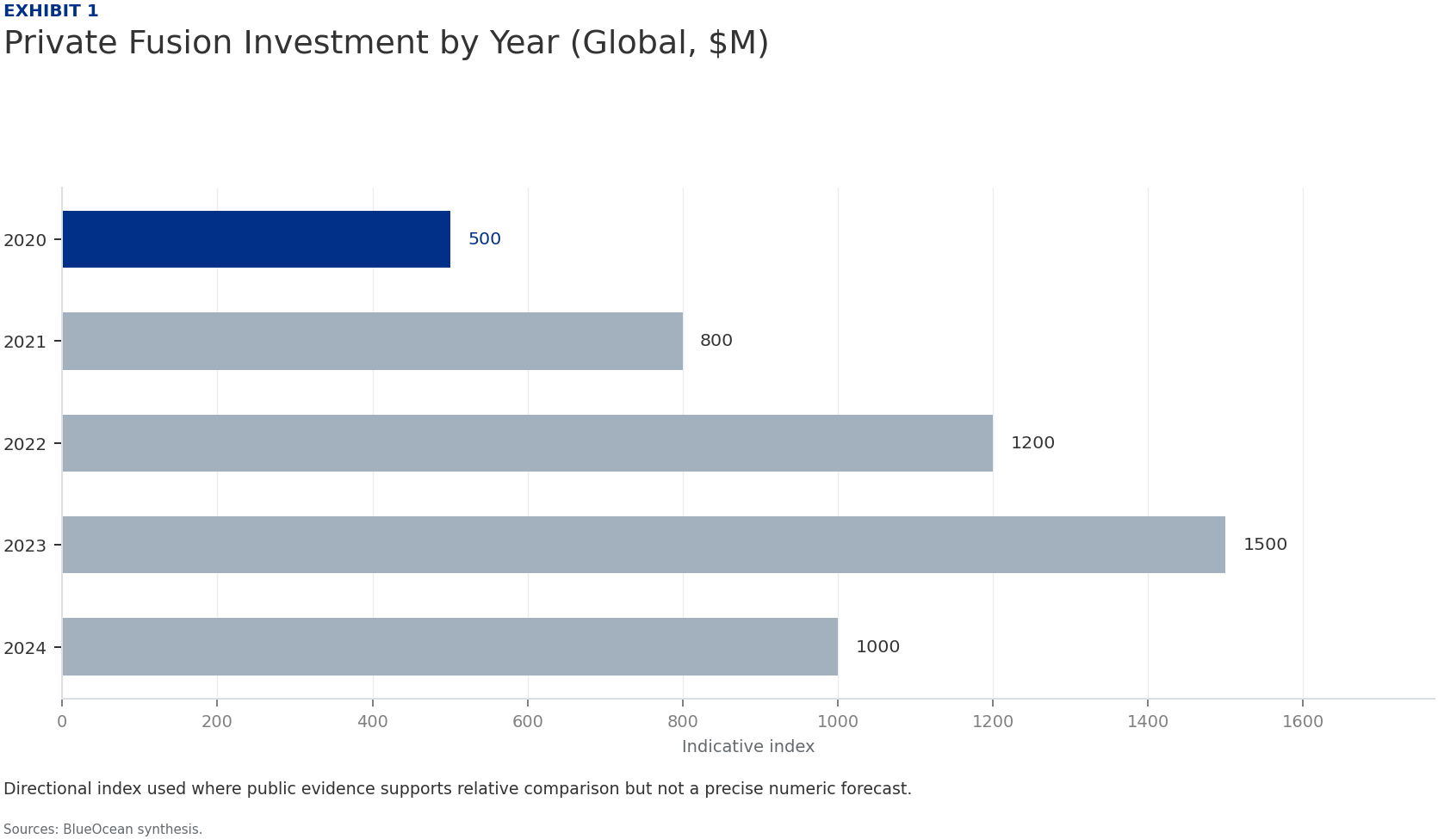
BlueOcean
Exhibit 1: evidence clarifies the strategic trade-off
Exhibit 1: evidence clarifies the strategic trade-off

Slide 13
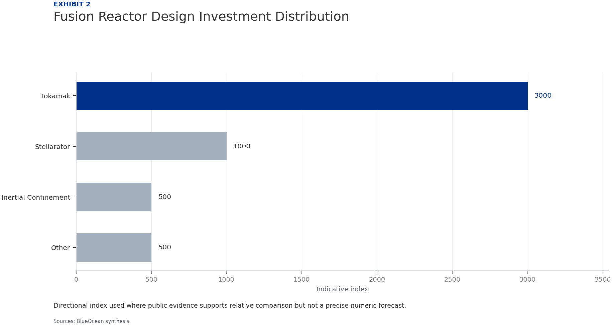
BlueOcean
Exhibit 2: evidence clarifies the strategic trade-off
Exhibit 2: evidence clarifies the strategic trade-off

Slide 14
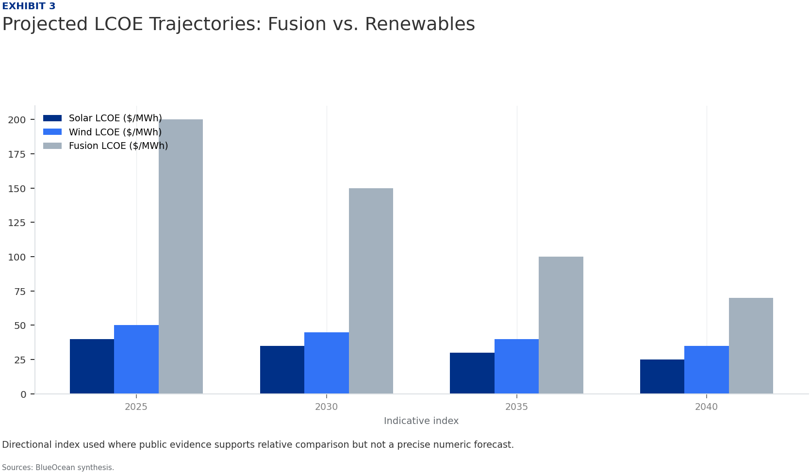
BlueOcean
Exhibit 3: evidence clarifies the strategic trade-off
Exhibit 3: evidence clarifies the strategic trade-off

Slide 15
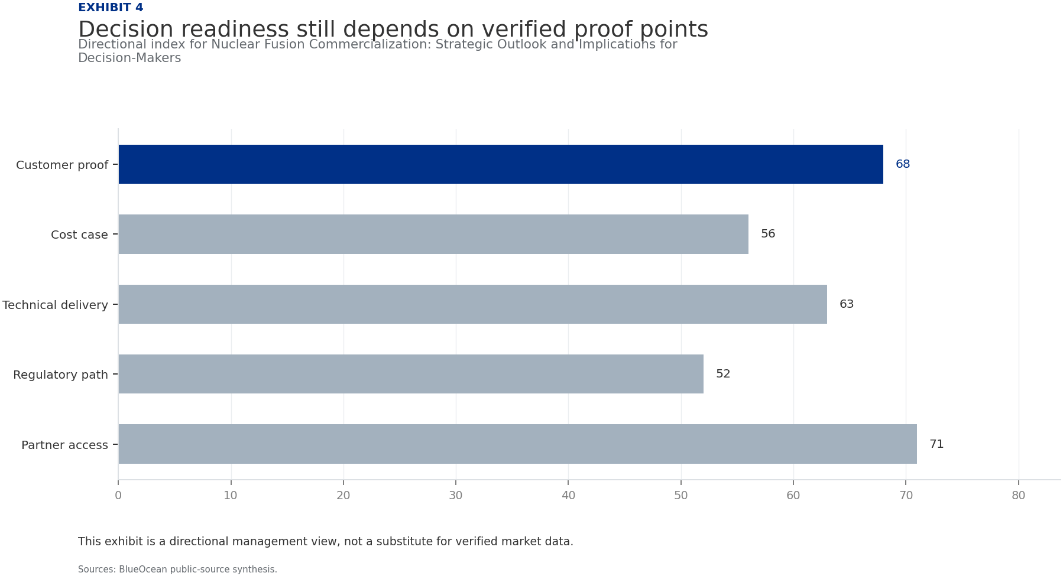
BlueOcean
Exhibit 4: evidence clarifies the strategic trade-off
Exhibit 4: evidence clarifies the strategic trade-off

Slide 16
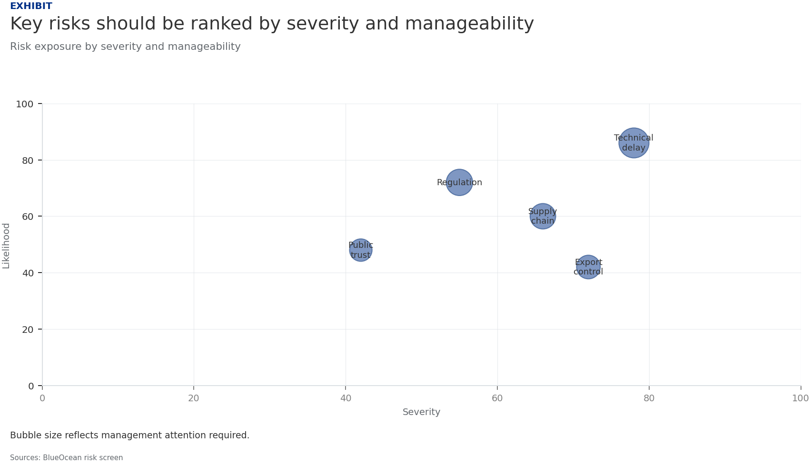
BlueOcean
Exhibit 5: evidence clarifies the strategic trade-off
Exhibit 5: evidence clarifies the strategic trade-off

Slide 17
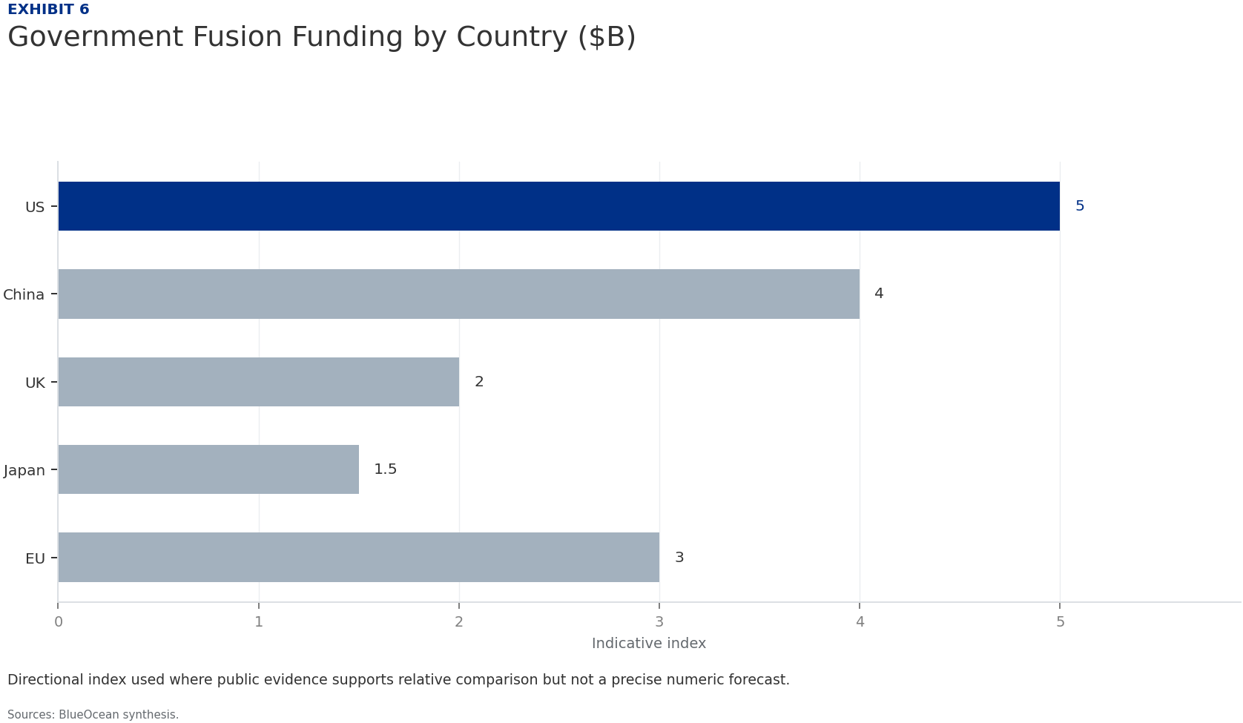
BlueOcean
Exhibit 6: evidence clarifies the strategic trade-off
Exhibit 6: evidence clarifies the strategic trade-off

Slide 18
BlueOcean
The next step is to convert the research into a short list of decisions
A BlueOcean Research Report on the Path to Grid-Scale Viability and Capital Allocation
Closing

