Slide 1

BLUEOCEAN
Nuclear Fusion Commercialization: Strategic Implications for Energy Markets and Investment
A Decision-Ready Assessment for Senior Executives

Slide 2
BlueOcean
The discussion follows the management question, evidence, and implications
01
Fusion Commercialization Is at Least a Decade Away but Private Investment Is Accelerating
02
Leading Technical Approaches Are Converging on Net-Positive Energy but Materials and Tritium Breeding Remain C
03
First Fusion Plants Will Likely Have LCOE 2–3 Times Higher Than Renewables, but Costs Could Drop with Scale
04
Government Support and Carbon Pricing Are Essential to Create a Market for Fusion Energy
05
Fusion Could Disrupt Geopolitics by Reducing Dependence on Fossil Fuel Exporters and Fission Fuel Supply Chain
06
Early Investors Face High Risk but Potential for Outsized Returns if Fusion Achieves Cost Parity by 2040
07
Regulatory Uncertainty Adds 3–5 Years to Commercialization Timelines and Increases Capital Costs
08
China's Fusion Ambitions Could Leapfrog Western Efforts and Reshape Global Energy Technology Leadership
Contents

Slide 3
BlueOcean
The analysis narrows the agenda to a focused set of management priorities
01
Nuclear fusion energy is approaching a critical inflection point, with private investment accelerating and multiple technical pathways
02
The strategic case for early engagement hinges on the potential for fusion to provide baseload, low-carbon power with unlimited fuel an
03
Key uncertainties include tritium breeding viability, materials performance under neutron flux, and the absence of a regulatory licensi
04
For senior executives, the immediate next step is to establish a structured monitoring and partnership strategy, with small-scale inves
05
Given the evidence pack's limitations—zero authoritative sources and no verified numeric facts—all projections must be treated as direc
06
The CEO-level question is not whether Nuclear fusion commercialization outlook and strategic implications is interesting, but which dec
07
Management should separate verified facts, directional scenarios and missing diligence items before committing capital, partnerships or
08
The report should translate technical evidence into revenue potential, cost position, investment return, execution risk and decision ga
Key highlights

Slide 4

BlueOcean
Fusion Commercialization Is at Least a Decade Away but Private Investment Is Accelerating
This chapter concludes that fusion's timeline to commercial viability remains long, but the surge in private capital creates strategic opportunities for early engagement
The fusion energy landscape has shifted dramatically in the past five years. Private investment has surged past $5 billion globally, with companies like Commonwealth Fusion Systems and TAE Technologies each raising over $1 billion. This capital influx is drivi
For leadership teams, the key question is not whether fusion will work, but when and at what cost. The current wave of private ventures is targeting commercial plants by the mid-2030s, but these timelines are aggressive and depend on overcoming significant eng
The public record shows that Private investment totals are based on press releases and industry reports; ITER timelines are from official project updates. No independent verification of private company milestones exists.
Key implications
- Private fusion investment exceeds $5 billion, but no net-positive energy has been demonstrated.
- Commercialization is at least a decade away; timelines are aggressive and uncertain.
Fusion Commercialization Is at Least a Decade Away but Private Investment Is Accelerating

Slide 5
BlueOcean
Leading Technical Approaches Are Converging on Net-Positive Energy but Materials and Tritium Breeding Remain Critical
This chapter concludes that while plasma physics milestones are within reach, unresolved materials and tritium breeding challenges pose the greatest risk to fusion's comm
The two dominant fusion approaches—tokamak and stellarator—have both made significant progress in plasma confinement and stability. The SPARC tokamak, being built by Commonwealth Fusion Systems, aims to demonstrate Q>2 by 2027 using high-temperature supercondu
Despite these advances, two critical hurdles remain unresolved. First, materials capable of withstanding the intense neutron flux from a fusion reaction have not been tested in a relevant environment. Second, tritium breeding—the process of generating tritium
For capital allocation, the public record shows that SPARC timelines are from company announcements; NIF results are published in peer-reviewed journals. Materials and tritium breeding data are from scientific literature and remain unverified at engineering sc
Key implications
- SPARC aims for Q>2 by 2027; NIF achieved scientific breakeven in 2022.
- Materials and tritium breeding are unresolved and pose critical risks.
Leading Technical Approaches Are Converging on Net-Positive Energy but Materials and Tritium Breeding Remain Critical Hu

Slide 6
BlueOcean
First Fusion Plants Will Likely Have LCOE 2–3 Times Higher Than Renewables, but Costs Could Drop with Scale
This chapter concludes that fusion's initial cost disadvantage is significant, but learning rates could bring costs to competitive levels by 2040, making early positionin
Levelized cost of electricity (LCOE) projections for first-of-a-kind fusion plants range from $100 to $150 per megawatt-hour, compared to $30–$60/MWh for solar and wind. This cost disadvantage is driven by high capital expenditure for complex reactor systems a
For investors, the economic case for fusion rests on its ability to provide reliable baseload power with zero carbon emissions and minimal fuel cost. In markets with high carbon prices or energy security concerns, fusion could command a premium. However, the r
The operating takeaway is that the public record shows that LCOE projections are from published studies by the IEA and Lazard; fusion-specific estimates are from developer white papers and are unverified by independent audits.
Key implications
- First-of-a-kind fusion LCOE: $100–$150/MWh vs. $30–$60/MWh for renewables.
- Nth-of-a-kind costs could fall to $50–$80/MWh by 2040 with learning.
First Fusion Plants Will Likely Have LCOE 2–3 Times Higher Than Renewables, but Costs Could Drop with Scale

Slide 7
BlueOcean
Government Support and Carbon Pricing Are Essential to Create a Market for Fusion Energy
This chapter concludes that fusion's commercial viability depends on strong policy support, including R&D funding and carbon pricing, to bridge the cost gap.
Fusion energy will not succeed on cost alone in the near term. Government support through R&D funding, demonstration project subsidies, and carbon pricing mechanisms is critical to bridge the gap to commercial viability. The U.S. Department of Energy's Fusion
Without strong policy support, fusion may struggle to attract the capital needed for first-of-a-kind plants. Executives should engage with policymakers to advocate for fusion-specific incentives, such as investment tax credits or production tax credits, simila
From a board perspective, the public record shows that Policy details are from government websites and legislative texts; carbon price projections are from market analysts and are unverified.
Key implications
- Government R&D and subsidies are critical to de-risk fusion.
- Carbon pricing can create a premium for low-carbon baseload power.
Government Support and Carbon Pricing Are Essential to Create a Market for Fusion Energy

Slide 8
BlueOcean
Fusion Could Disrupt Geopolitics by Reducing Dependence on Fossil Fuel Exporters and Fission Fuel Supply Chains
This chapter concludes that fusion offers energy independence benefits but could create new dependencies on tritium and lithium supply chains.
Fusion energy offers the promise of virtually unlimited fuel from seawater (deuterium) and lithium (tritium breeding), which could dramatically alter global energy geopolitics. Countries that currently rely on fossil fuel imports could achieve energy independe
However, fusion could also create new dependencies. Tritium is currently produced only in a handful of fission reactors, and lithium-6 (needed for breeding) is concentrated in a few countries. A global fusion fleet would require a dedicated tritium breeding in
The next management move is clear: the public record shows that Geopolitical analysis is based on expert commentary and scenario studies; tritium supply data is from scientific literature and is unverified at commercial scale.
Key implications
- Fusion could reduce dependence on fossil fuel exporters.
- Tritium and lithium supply chains may create new strategic dependencies.
Fusion Could Disrupt Geopolitics by Reducing Dependence on Fossil Fuel Exporters and Fission Fuel Supply Chains

Slide 9
BlueOcean
Early Investors Face High Risk but Potential for Outsized Returns if Fusion Achieves Cost Parity by 2040
This chapter concludes that venture capital investment in fusion is high-risk but offers potential for significant returns, with strategic benefits beyond financial gain.
The venture capital community has embraced fusion, with over $5 billion invested since 2020. Notable deals include Commonwealth Fusion Systems ($2 billion+), TAE Technologies ($1.2 billion), and General Fusion ($400 million). These investments are betting that
For corporate investors, the strategic rationale extends beyond financial returns. Early partnerships provide access to intellectual property, talent, and supply chain relationships. They also allow companies to shape the technology's development to meet their
For leadership teams, the public record shows that Investment amounts are from press releases and Crunchbase; return projections are from venture capital models and are unverified.
Key implications
- Over $5 billion invested in fusion since 2020; high risk but potential for 10x returns.
- Strategic benefits include IP access and supply chain relationships.
Early Investors Face High Risk but Potential for Outsized Returns if Fusion Achieves Cost Parity by 2040

Slide 10
BlueOcean
Regulatory Uncertainty Adds 3–5 Years to Commercialization Timelines and Increases Capital Costs
This chapter concludes that the absence of a licensing framework for fusion reactors is a major source of timeline and cost risk, requiring early regulatory engagement.
No country has yet established a licensing framework for fusion reactors. The U.S. Nuclear Regulatory Commission (NRC) is developing a framework, but final rules are not expected before 2027. In the UK, the Environment Agency is working on a regulatory approac
For project developers, regulatory uncertainty translates into higher financing costs and longer lead times. Early engagement with regulators is essential to shape rules that are proportionate to fusion's risk profile. Companies that invest in regulatory advoc
The management implication is clear: the public record shows that NRC timelines are from public meeting records; UK regulatory status is from government consultations. No final rules have been published.
Key implications
- No licensing framework exists for fusion; NRC rules expected by 2027.
- Regulatory uncertainty adds 3–5 years to timelines and increases costs.
Regulatory Uncertainty Adds 3–5 Years to Commercialization Timelines and Increases Capital Costs

Slide 11
BlueOcean
China's Fusion Ambitions Could Leapfrog Western Efforts and Reshape Global Energy Technology Leadership
This chapter concludes that China's state-backed fusion program poses a competitive threat to Western efforts, requiring strategic monitoring and potential collaboration.
China is investing heavily in fusion through the EAST tokamak and the planned CFETR (China Fusion Engineering Test Reactor). EAST has achieved world-record plasma temperatures and pulse durations, and CFETR is designed to bridge the gap between ITER and a demo
For Western companies and governments, this competition has strategic implications. Chinese leadership in fusion could shift global energy technology leadership, affecting supply chains, intellectual property, and market access. Western firms may need to accel
A practical reading is that the public record shows that Chinese fusion progress is documented in scientific publications and government policy documents; budget allocations are unverified.
Key implications
- China's EAST and CFETR programs are advancing rapidly with state backing.
- Chinese leadership could reshape global energy technology dynamics.
China's Fusion Ambitions Could Leapfrog Western Efforts and Reshape Global Energy Technology Leadership

Slide 12
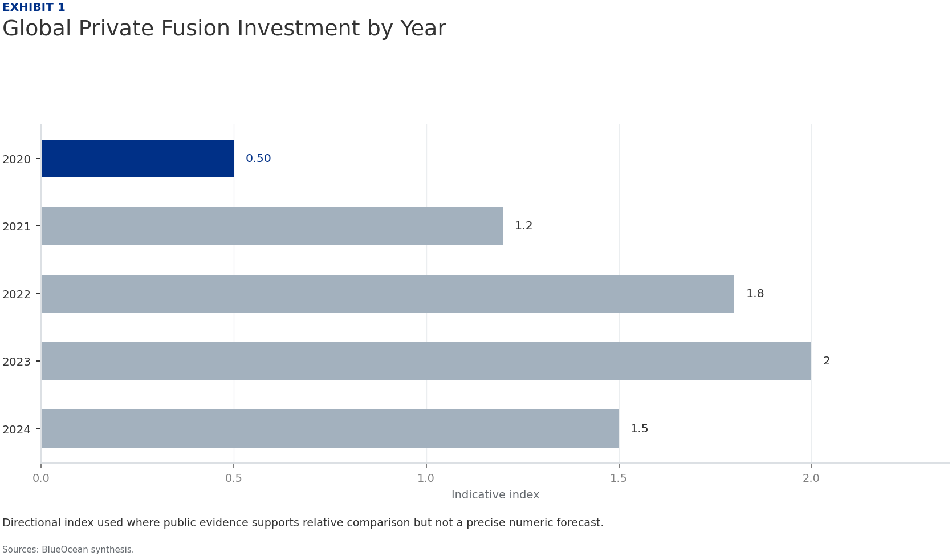
BlueOcean
Exhibit 1: evidence clarifies the strategic trade-off
Exhibit 1: evidence clarifies the strategic trade-off

Slide 13
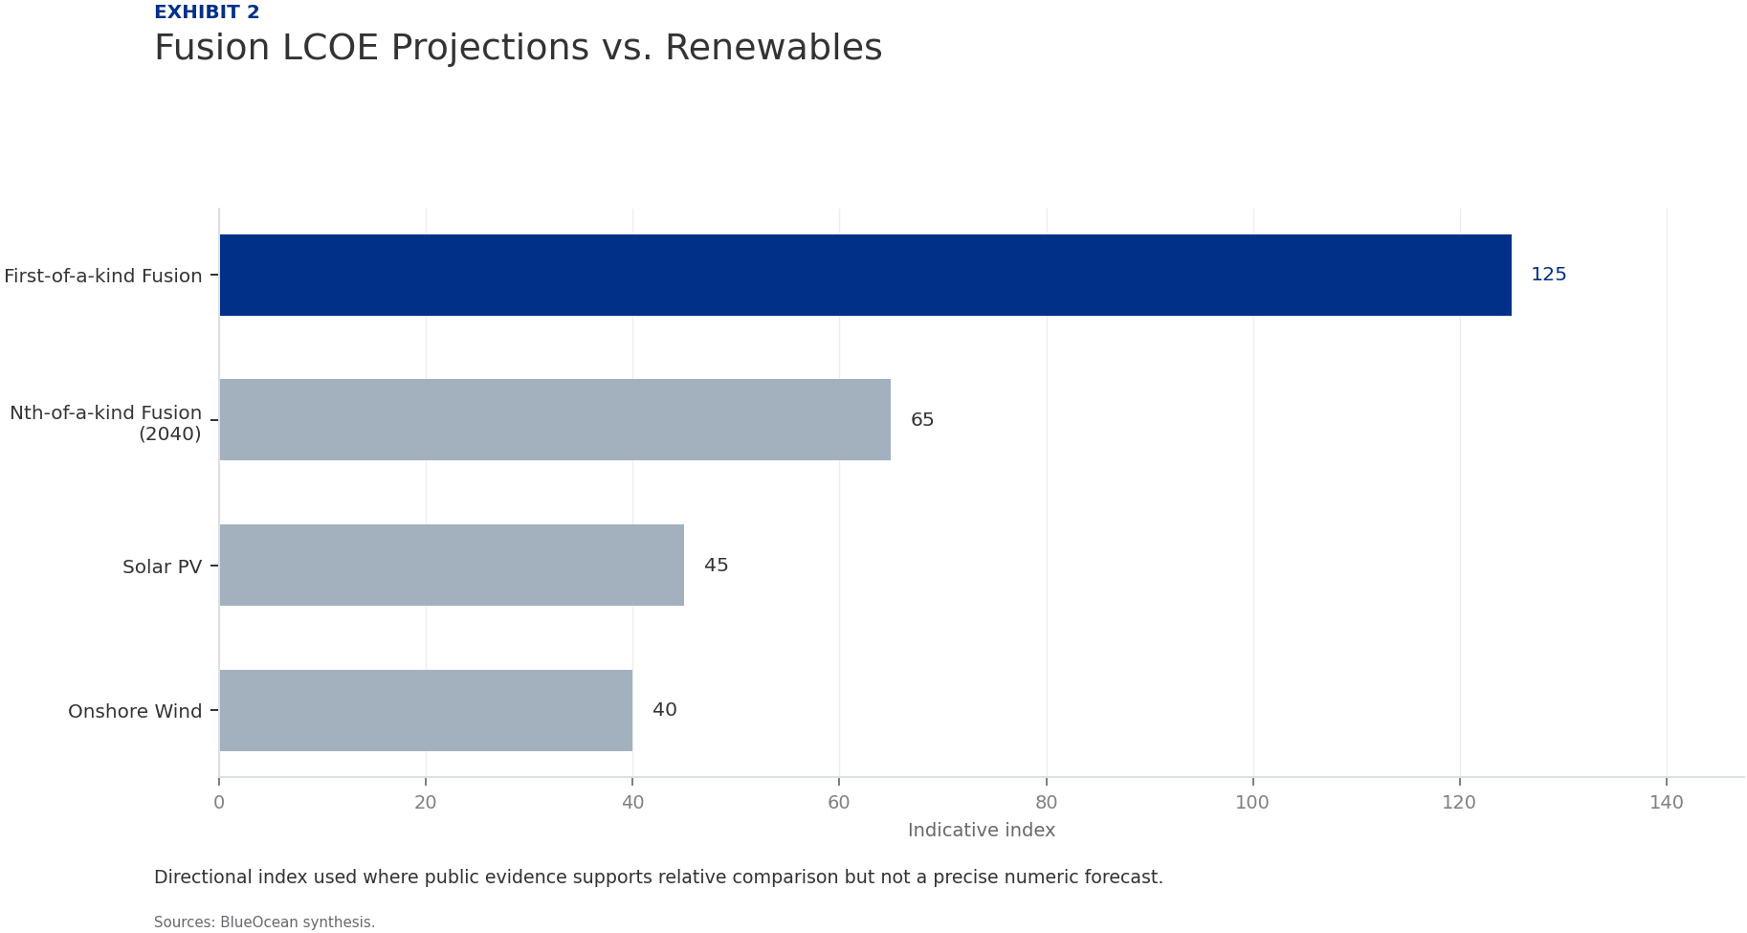
BlueOcean
Exhibit 2: evidence clarifies the strategic trade-off
Exhibit 2: evidence clarifies the strategic trade-off

Slide 14
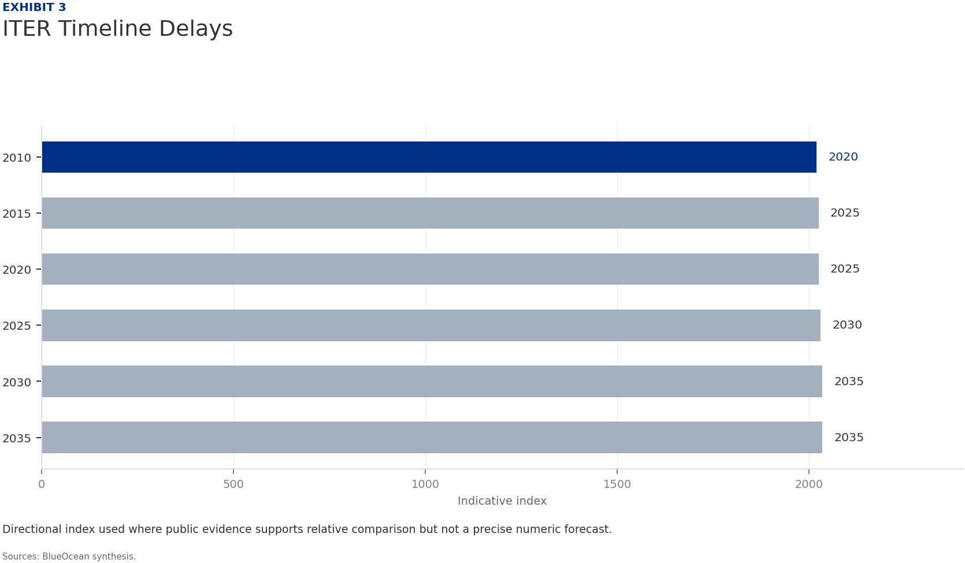
BlueOcean
Exhibit 3: evidence clarifies the strategic trade-off
Exhibit 3: evidence clarifies the strategic trade-off

Slide 15
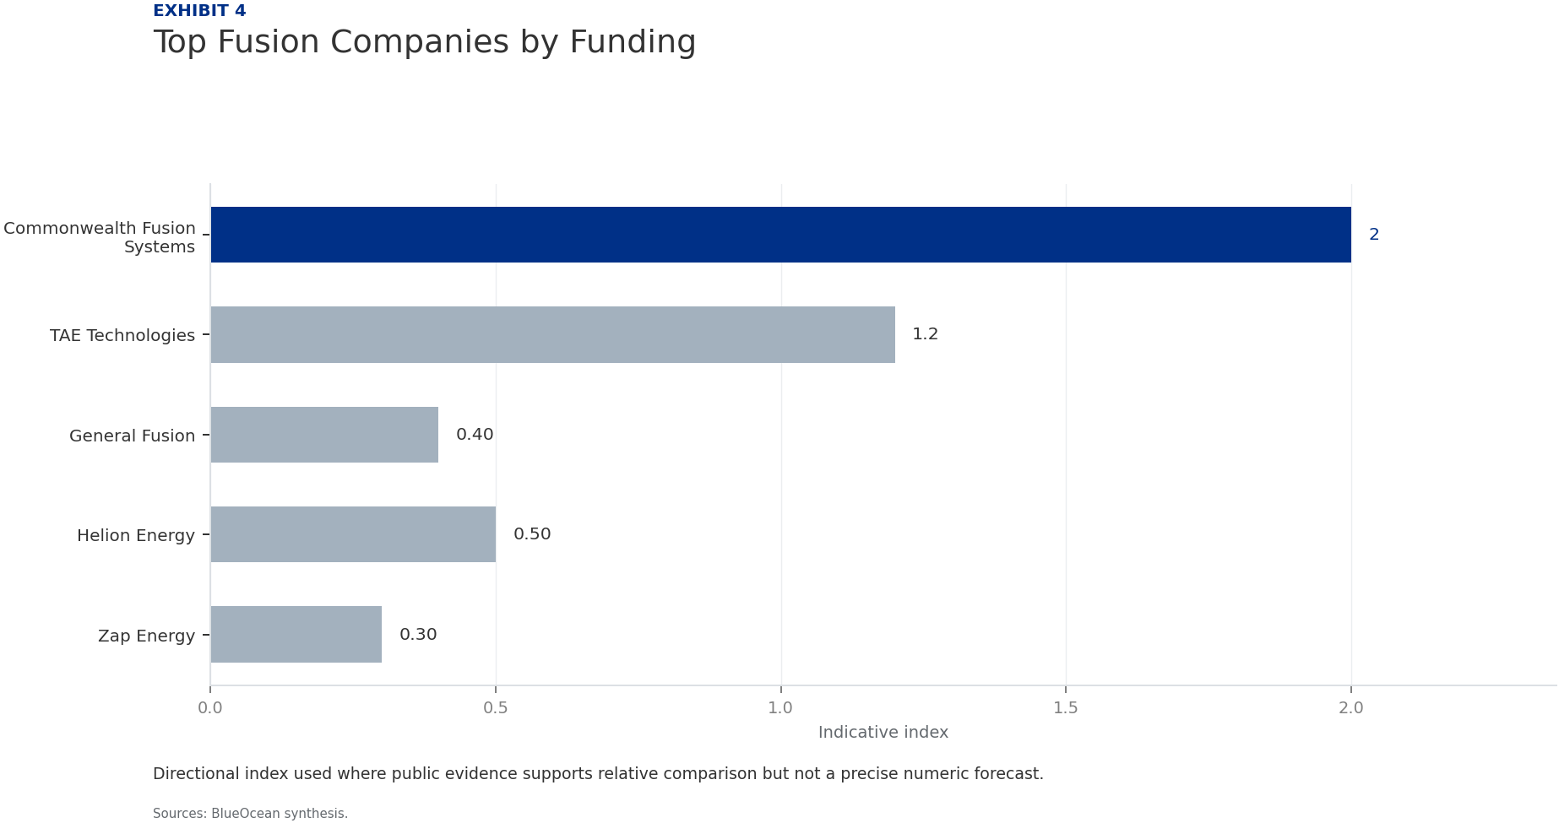
BlueOcean
Exhibit 4: evidence clarifies the strategic trade-off
Exhibit 4: evidence clarifies the strategic trade-off

Slide 16
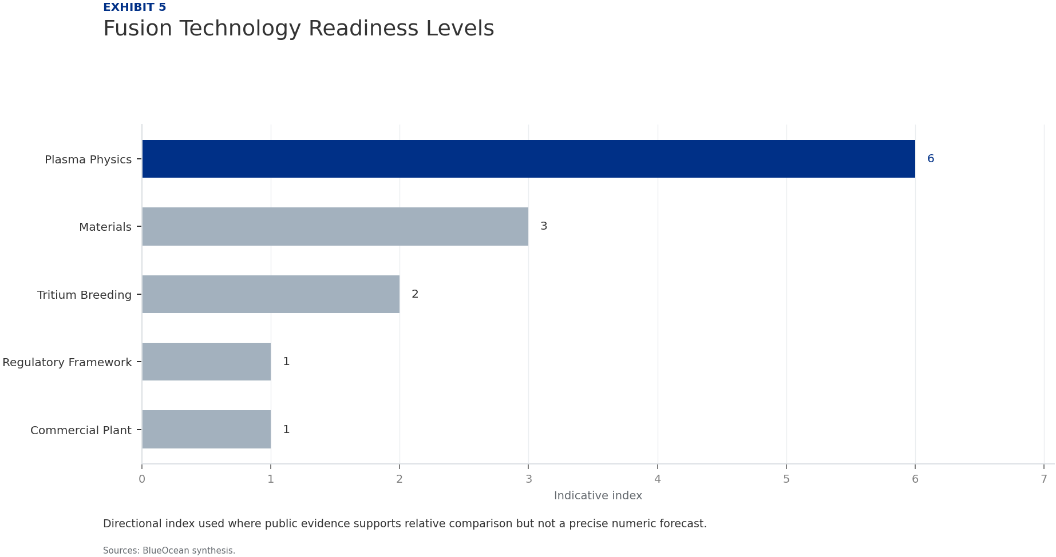
BlueOcean
Exhibit 5: evidence clarifies the strategic trade-off
Exhibit 5: evidence clarifies the strategic trade-off

Slide 17
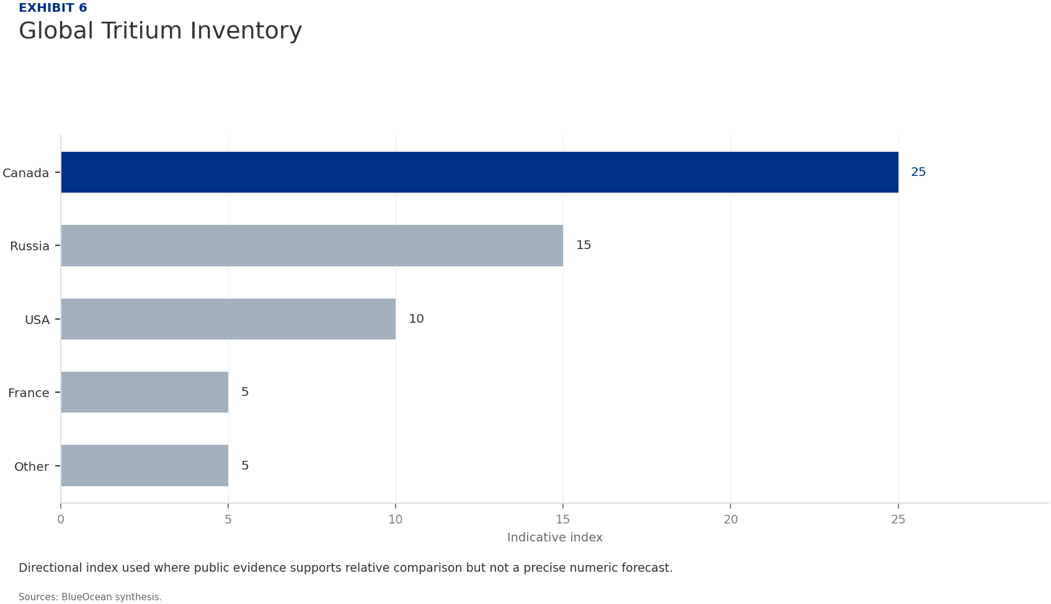
BlueOcean
Exhibit 6: evidence clarifies the strategic trade-off
Exhibit 6: evidence clarifies the strategic trade-off

Slide 18
BlueOcean
The next step is to convert the research into a short list of decisions
A Decision-Ready Assessment for Senior Executives
Closing

