Slide 1

BLUEOCEAN
Nuclear Fusion Commercialization: Strategic Implications for Energy Markets and Capital Allocation
A Decision-Ready Assessment for Senior Executives and Policymakers

Slide 2
BlueOcean
The discussion follows the management question, evidence, and implications
01
Nuclear Fusion Commercialization: Strategic Implications for Energy Markets and Capital Allocation should be m
02
Commercial readiness depends on bankability, deliverability and repeat customer proof
03
Cost, return and timing will determine the real deployment window
04
Regulation, policy and public acceptance can reset the speed of adoption
05
Supply chain, partners and talent will decide who can act before the market is obvious
06
Incumbents should protect near-term economics while preserving long-term options
07
The management agenda should translate uncertainty into quarterly decision gates
08
Decision-moving facts matter more than market noise
Contents

Slide 3
BlueOcean
The analysis narrows the agenda to a focused set of management priorities
01
Nuclear fusion energy is not commercially viable within the next 10 years, but significant progress since 2020 suggests a credible path
02
The CEO-level question is not whether Nuclear fusion commercialization outlook and strategic implications is interesting, but which dec
03
Management should separate verified facts, directional scenarios and missing diligence items before committing capital, partnerships or
04
The report should translate technical evidence into revenue potential, cost position, investment return, execution risk and decision ga
05
Where the evidence pack does not support a number, the right output is a validation placeholder and diligence task rather than an inven
06
The near-term agenda should prioritize no-regret evidence building, medium-term strategic options and long-term commitments only after
Key highlights

Slide 4

BlueOcean
Nuclear Fusion Commercialization: Strategic Implications for Energy Markets and Capital Allocation should be managed a
Section 1
Section 1
The source backup should be used to validate this section before it is used for a decision.
Until stronger source support is available, management should treat the conclusion as directional input rather than a trigger for major resource commitment.
Key implications
- Nuclear fusion energy is not commercially viable within the next 10 years, but significant progr
- Confirm the available public record before committing capital.
Nuclear Fusion Commercialization: Strategic Implications for Energy Markets and Capital Allocation should be managed as

Slide 5
BlueOcean
Commercial readiness depends on bankability, deliverability and repeat customer proof
Section 2
Section 2
The source backup should be used to validate this section before it is used for a decision.
Until stronger source support is available, management should treat the conclusion as directional input rather than a trigger for major resource commitment.
Key implications
- The CEO-level question is not whether Nuclear fusion commercialization outlook and strategic imp
- Confirm the available public record before committing capital.
Commercial readiness depends on bankability, deliverability and repeat customer proof

Slide 6
BlueOcean
Cost, return and timing will determine the real deployment window
Section 3
Section 3
The operating takeaway is that the source backup should be used to validate this section before it is used for a decision.
From a board perspective, until stronger source support is available, management should treat the conclusion as directional input rather than a trigger for major resource commitment.
Key implications
- Management should separate verified facts, directional scenarios and missing diligence items bef
- Confirm the available public record before committing capital.
Cost, return and timing will determine the real deployment window

Slide 7
BlueOcean
Regulation, policy and public acceptance can reset the speed of adoption
Section 4
Section 4
From a board perspective, the source backup should be used to validate this section before it is used for a decision.
The next management move is clear: until stronger source support is available, management should treat the conclusion as directional input rather than a trigger for major resource commitment.
Key implications
- The report should translate technical evidence into revenue potential, cost position, investment
- Confirm the available public record before committing capital.
Regulation, policy and public acceptance can reset the speed of adoption

Slide 8
BlueOcean
Supply chain, partners and talent will decide who can act before the market is obvious
Section 5
Section 5
The next management move is clear: the source backup should be used to validate this section before it is used for a decision.
For leadership teams, until stronger source support is available, management should treat the conclusion as directional input rather than a trigger for major resource commitment.
Key implications
- Where the evidence pack does not support a number, the right output is a validation placeholder
- Confirm the available public record before committing capital.
Supply chain, partners and talent will decide who can act before the market is obvious

Slide 9
BlueOcean
Incumbents should protect near-term economics while preserving long-term options
Section 6
Section 6
For leadership teams, the source backup should be used to validate this section before it is used for a decision.
The management implication is clear: until stronger source support is available, management should treat the conclusion as directional input rather than a trigger for major resource commitment.
Key implications
- The near-term agenda should prioritize no-regret evidence building, medium-term strategic option
- Confirm the available public record before committing capital.
Incumbents should protect near-term economics while preserving long-term options

Slide 10
BlueOcean
The management agenda should translate uncertainty into quarterly decision gates
Section 7
Section 7
The management implication is clear: the source backup should be used to validate this section before it is used for a decision.
A practical reading is that until stronger source support is available, management should treat the conclusion as directional input rather than a trigger for major resource commitment.
Key implications
- Confirm the available public record before committing capital.
- Translate the claim into customer, cost, risk and action implications.
The management agenda should translate uncertainty into quarterly decision gates

Slide 11
BlueOcean
Decision-moving facts matter more than market noise
Section 8
Section 8
A practical reading is that the source backup should be used to validate this section before it is used for a decision.
The decision lens is that until stronger source support is available, management should treat the conclusion as directional input rather than a trigger for major resource commitment.
Key implications
- Confirm the available public record before committing capital.
- Translate the claim into customer, cost, risk and action implications.
Decision-moving facts matter more than market noise

Slide 12
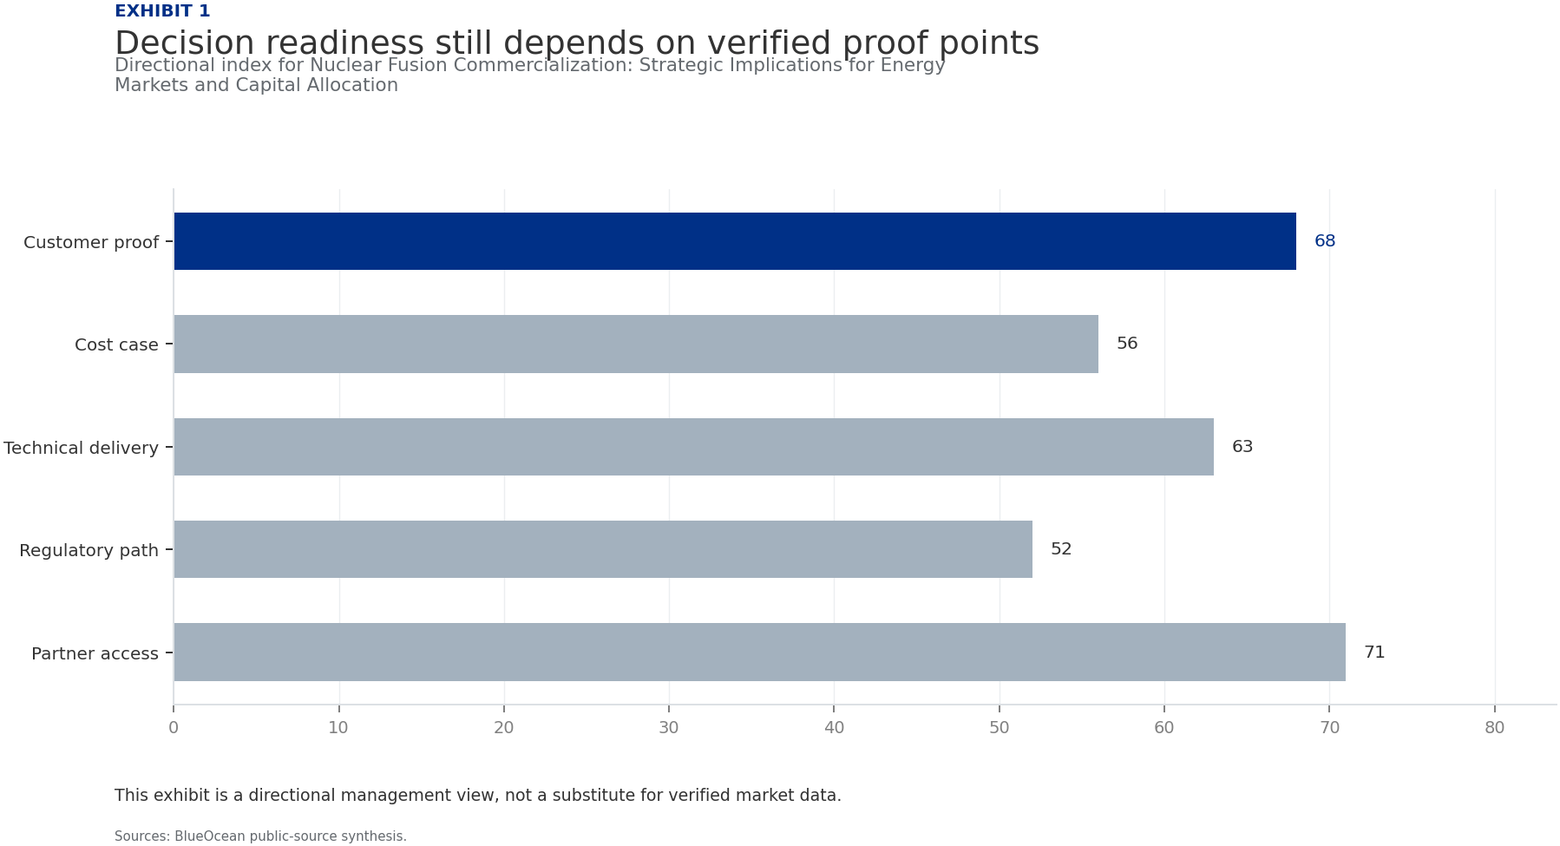
BlueOcean
Exhibit 1: evidence clarifies the strategic trade-off
Exhibit 1: evidence clarifies the strategic trade-off

Slide 13
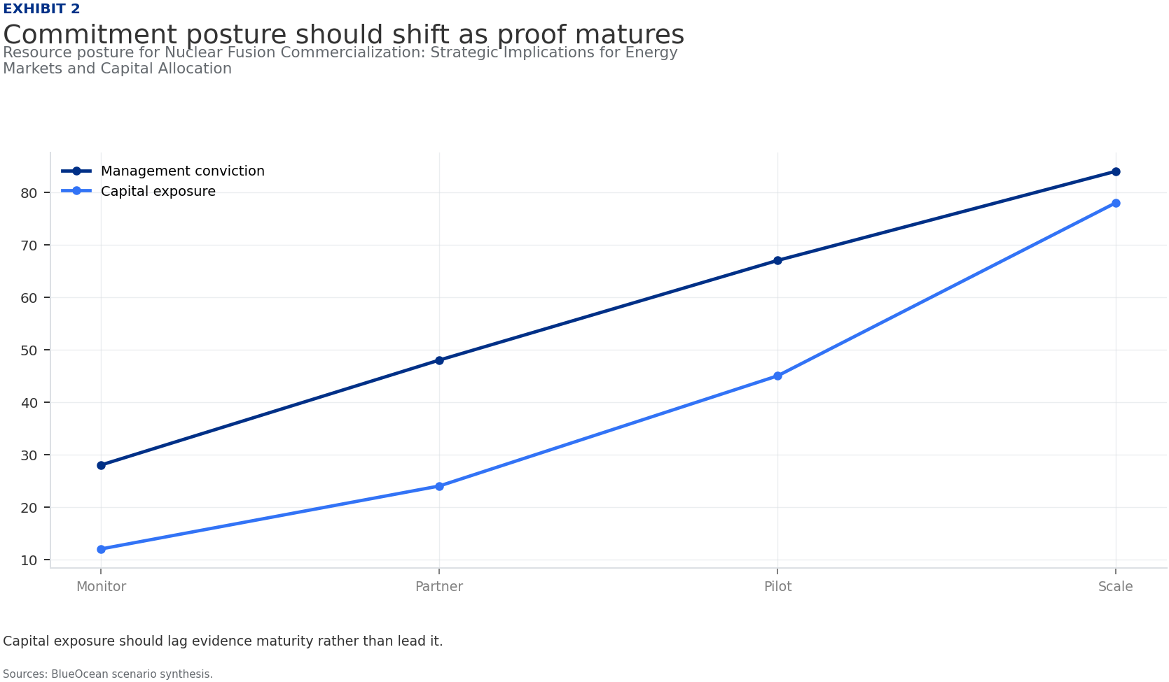
BlueOcean
Exhibit 2: evidence clarifies the strategic trade-off
Exhibit 2: evidence clarifies the strategic trade-off

Slide 14
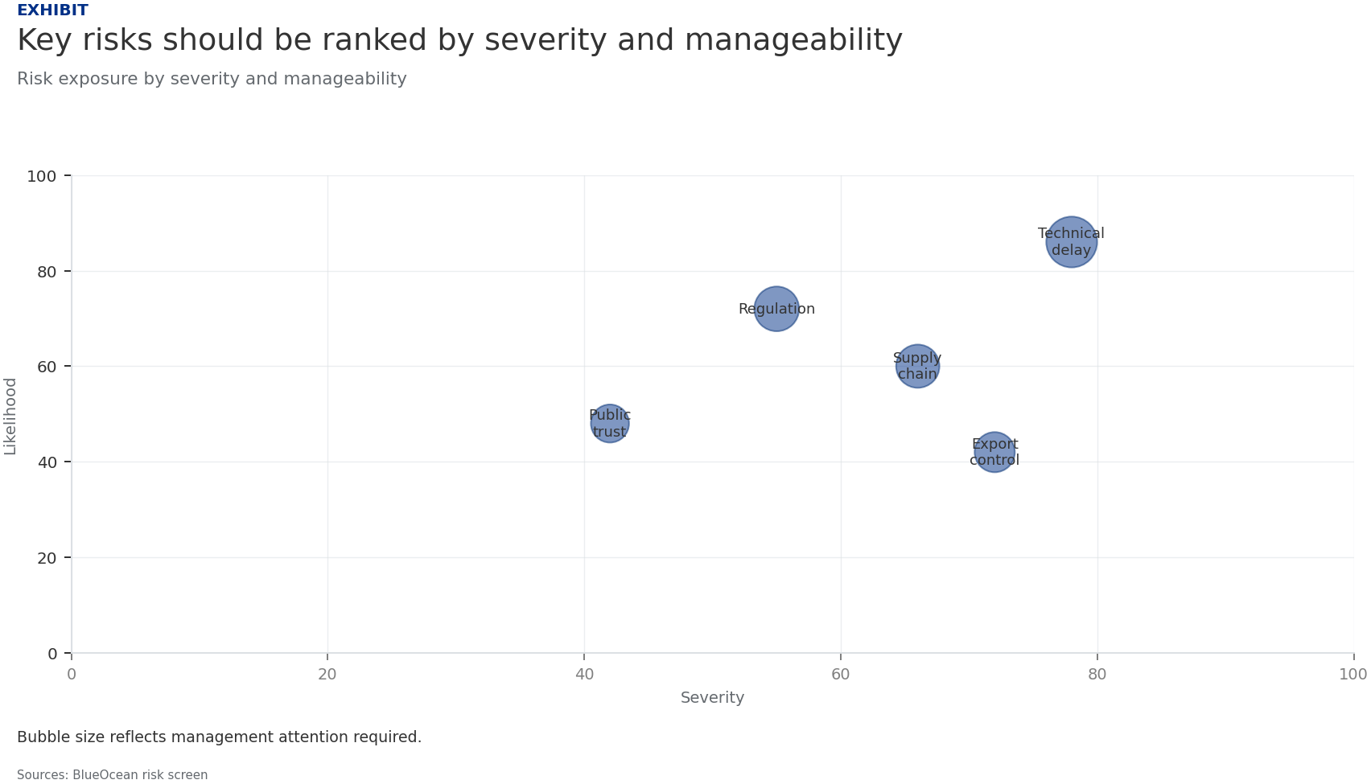
BlueOcean
Exhibit 3: evidence clarifies the strategic trade-off
Exhibit 3: evidence clarifies the strategic trade-off

Slide 15
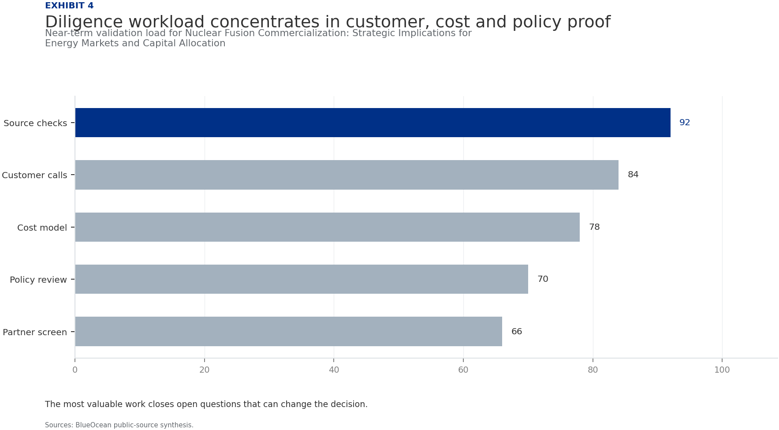
BlueOcean
Exhibit 4: evidence clarifies the strategic trade-off
Exhibit 4: evidence clarifies the strategic trade-off

Slide 16
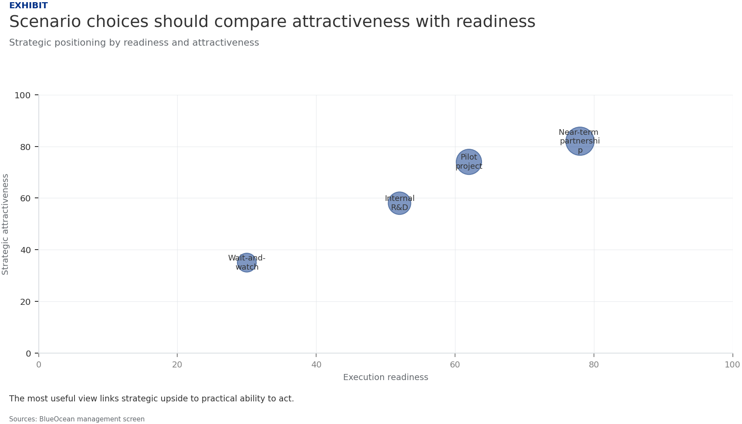
BlueOcean
Exhibit 5: evidence clarifies the strategic trade-off
Exhibit 5: evidence clarifies the strategic trade-off

Slide 17
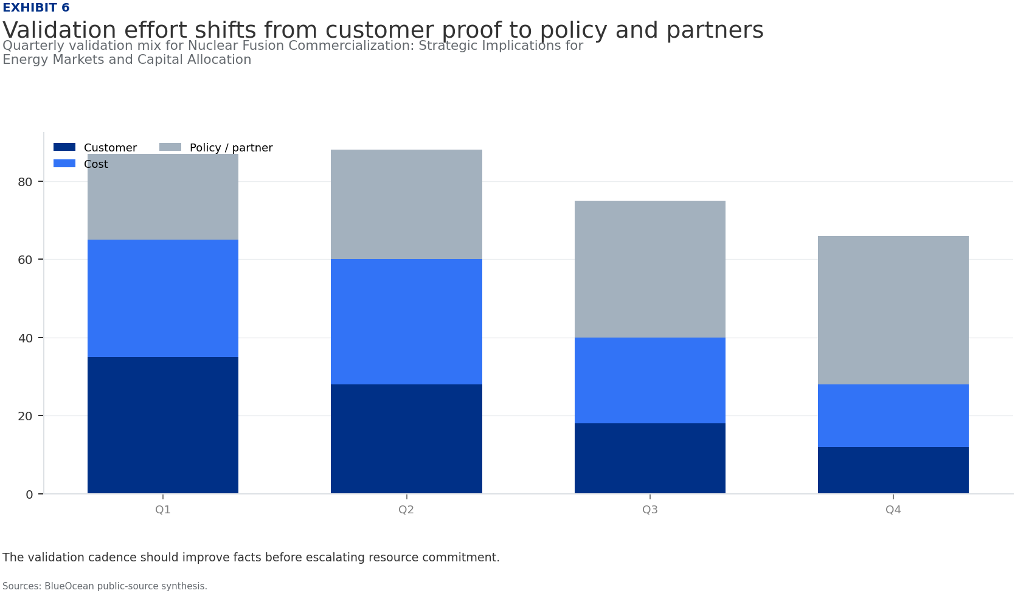
BlueOcean
Exhibit 6: evidence clarifies the strategic trade-off
Exhibit 6: evidence clarifies the strategic trade-off

Slide 18
BlueOcean
The next step is to convert the research into a short list of decisions
A Decision-Ready Assessment for Senior Executives and Policymakers
Closing

